Slide 1
Sediment – Organic Matter Decomposition

Slide 2
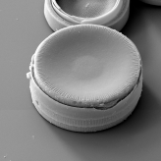
Commonly Observed Porewater Concentration Profiles
low
high
concentration
Non reactive (e.g., Chloride)
Surface Removal (e.g., O₂)
Subsurface consumption
e.g., Fe²⁺ _{(aq)} precipitating with
S²⁻ _{(aq)} to form FeS_{2(s)} (pyrite)
Reactive layer
Depth below sediment surface
Chemical released into pore waters from a subsurface layer and
then removed at another depth.
Chemical released at surface
Chemical released into
porewater from subsurface layer
Reactive layer 1
e.g., reduction of FeOOH_{(s)} to Fe²⁺ _{(aq)} (reactive layer 1)
and then Fe²⁺ _{(aq)} precipitating FeS_{2(s)} (pyrite; reactive layer 2)
e.g., Silica via dissolution
Reactive layer 2
Reactive layer
e.g., Mn²⁺ _{(aq)} release by reduction of MnO_{2(s)}
Notes:
MnO2 – manganese dioxide

Slide 3
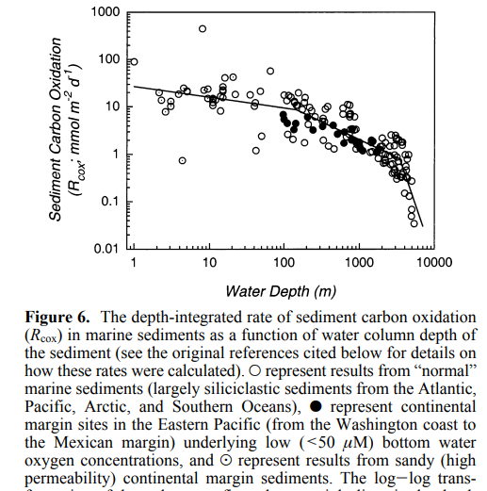
(Burdige 2007)

Slide 4
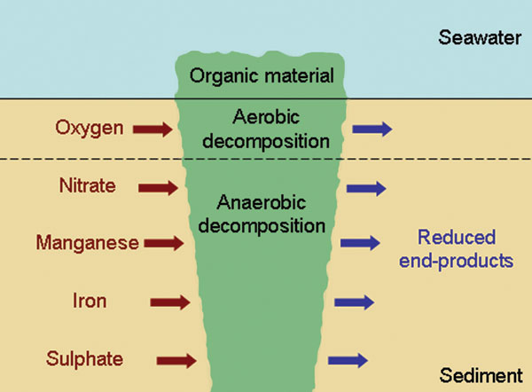
Notes:
Figure from: https://www.niwa.co.nz/publications/wa/vol16-no2-june-2008/towards-sustainable-aquaculture

Slide 5
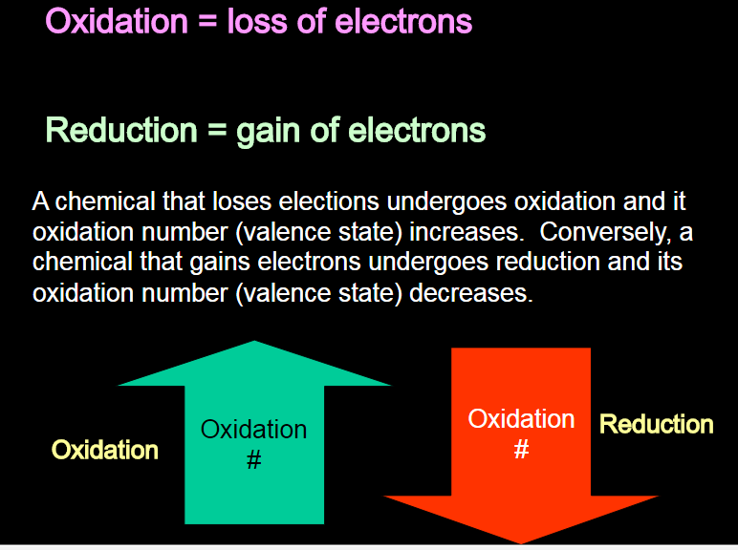

Slide 6
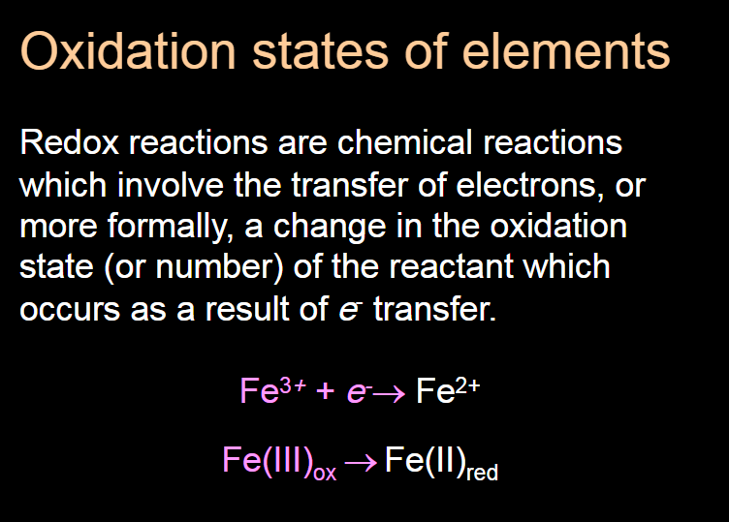

Slide 7
Thermodynamic equilibrium principles apply to the movement of electrons:
When chemicals have electron configurations out of equilibrium, relative to another chemical, they will spontaneously react together → transferring electrons to attain equilibrium….. i.e., the lowest possible state of free energy
Zn_{(s)} + Cu²⁺ + SO₄²⁻ ←→ Zn²⁺ + Cu_{(s)} + SO₄²⁻
Zinc metal (solid) lost 2 electrons and became the zinc ion – it became “oxidized”
For this to happen – something else had to become reduced… i.e., receive those e-.

Slide 8
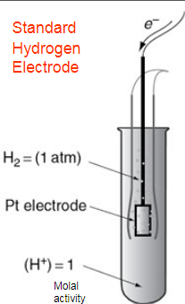
We measure these w/ Standard Hydrogen Electrodes
2H⁺ + 2e- ←→ H₂ (the reduction of H⁺ to hydrogen)
The half cell potential of this hydrogen reduction is set to Zero (by convention).
It is said to have an E_{h}º of zero.
Remember what “º” means??
(standard conditions – 1 molal concentrations, 1 atm pressure)
Notes:
“Molarity (M) is defined as the number of moles of solute per liter of solution. Molality (m) is defined as the number of moles of solute per kilogram of solvent. ... When water is the solvent and the concentration of the solution is low, these differences can be negligible (d = 1.00 g/mL).”

Slide 9
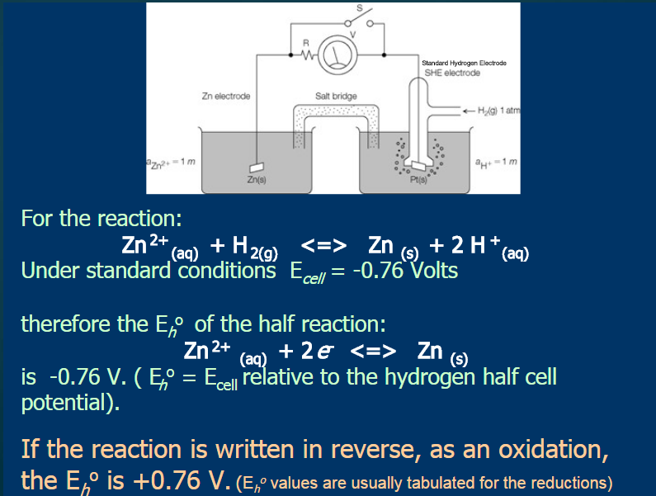

Slide 10
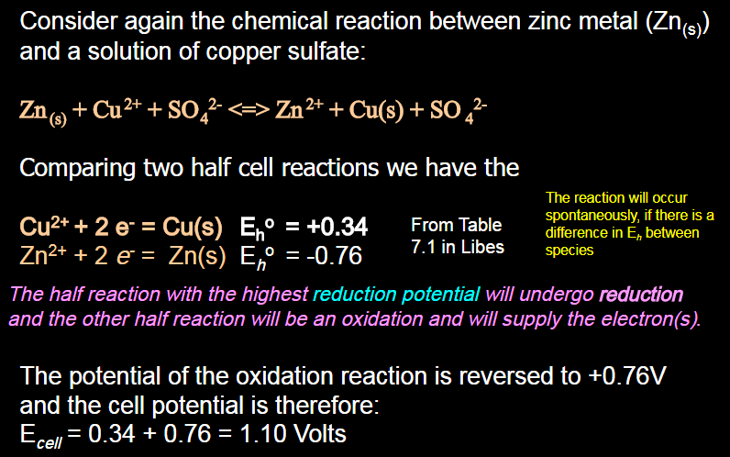

Slide 11
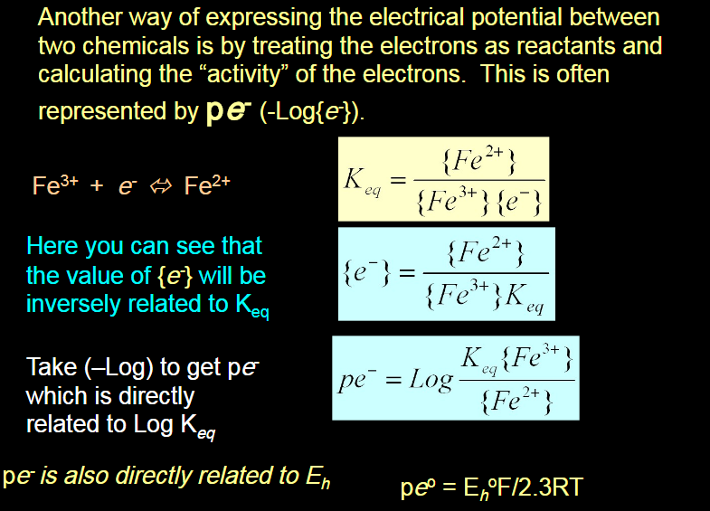

Slide 12
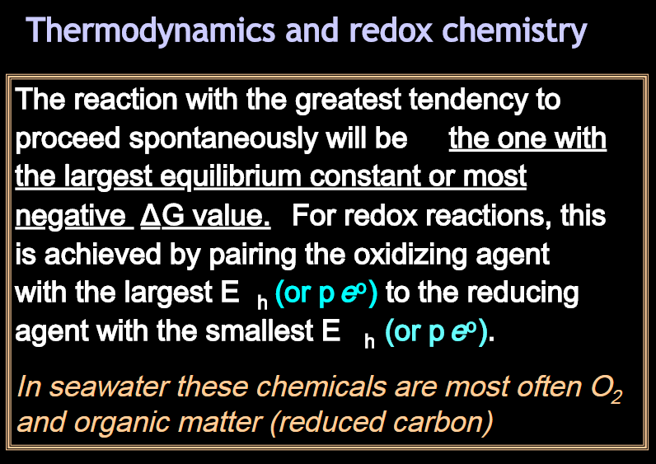

Slide 13
Oxidation / Reduction Reactions
Example:
CH₂O + O₂ → CO₂ + H₂O
“Reductant” or e- giver
“Oxidant” or e- acceptor
The Reductant loses electrons (is oxidized) ;
The Oxidant gains electrons (is reduced)
In this case, oxygen is the electron acceptor – the half-reaction is:
O₂ + 4H⁺ + 4e⁻ → 2H₂O

Slide 14
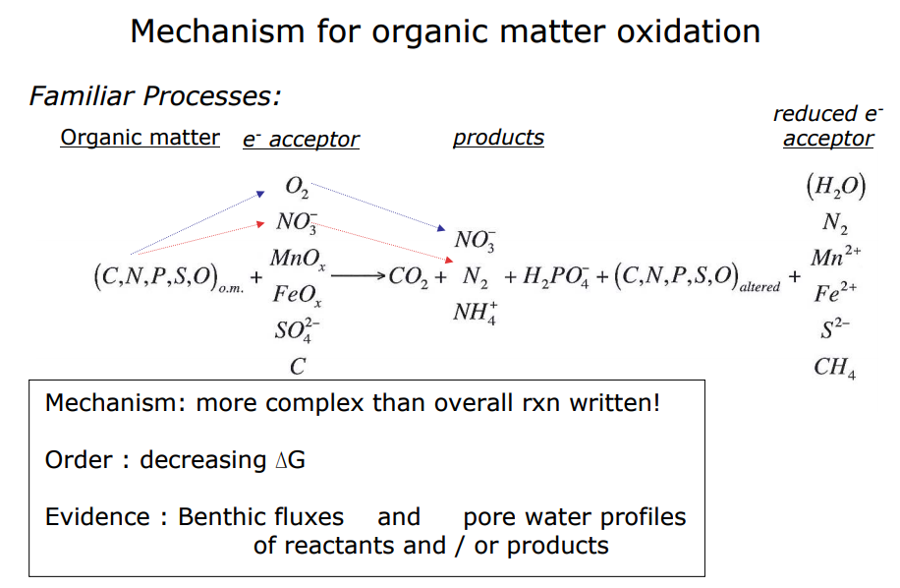

Slide 15
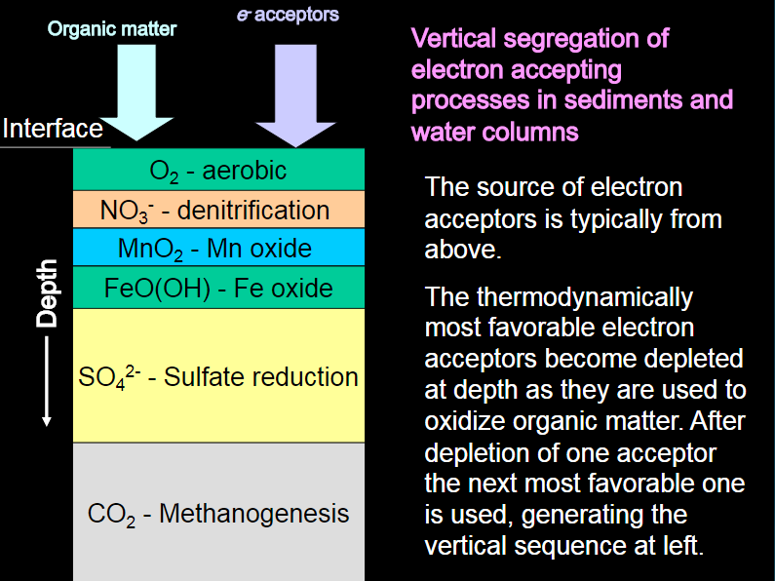
Organic matter

Slide 16
• Different organisms use different electron acceptors, depending on availability due to local redox potential
• The more oxidizing the environment, the higher the energy yield of the OM oxidation (the more negative is ΔG, the Gibbs free energy)
To calculate ∆G for a redox
Reaction, combine pe values:

Slide 17
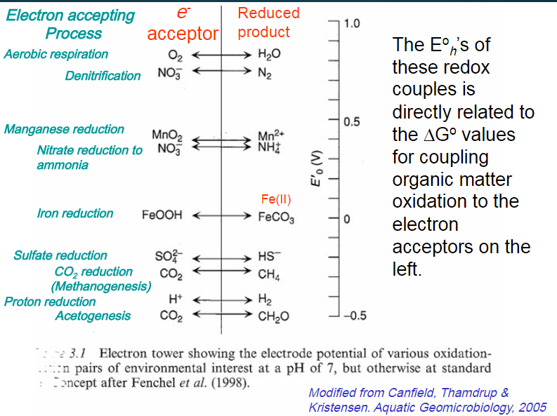

Slide 18
The free energy yield of the oxidation of organic matter by different e⁻ acceptors
Order of use:
O₂
NO₃⁻
Mn(IV)
Fe(III)
SO₄²⁻

Slide 19
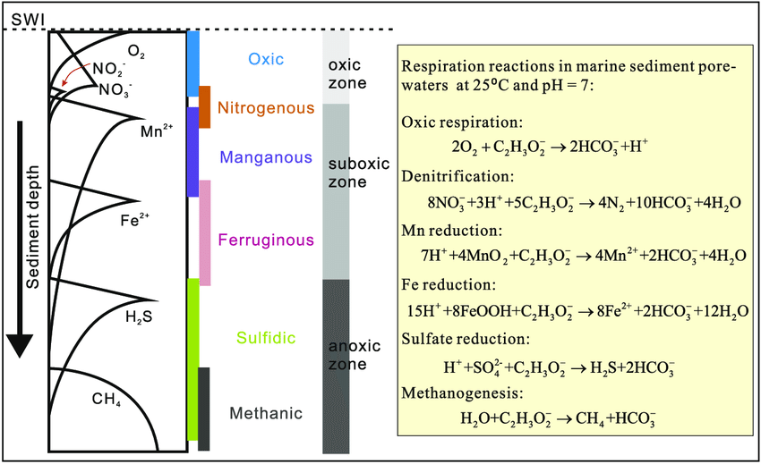
Canfield and Thamdrup (2009), Chen et al. (2015)

Slide 20
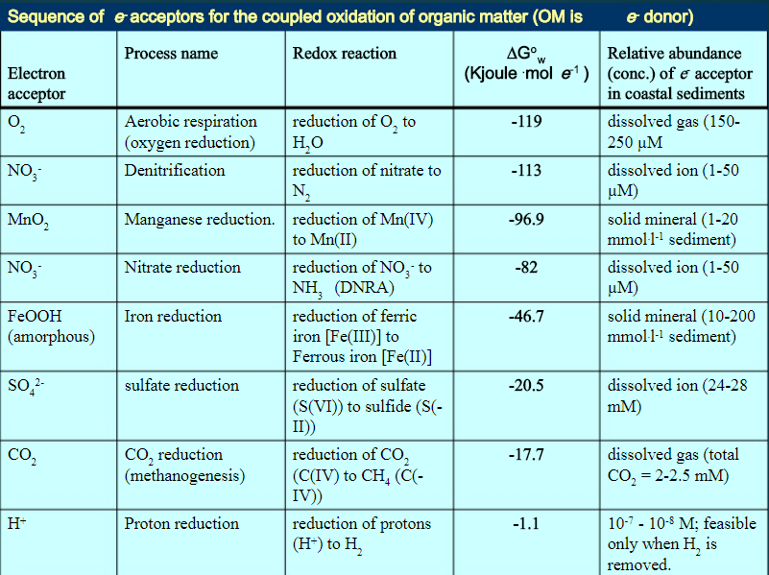

Slide 21
Electron acceptor use in marine sediments
The fraction of o.m. oxidized by each electron acceptor is determined by:
Order of use: can run out of reactive organic matter
Abundance: can run out of electron acceptor

Slide 22
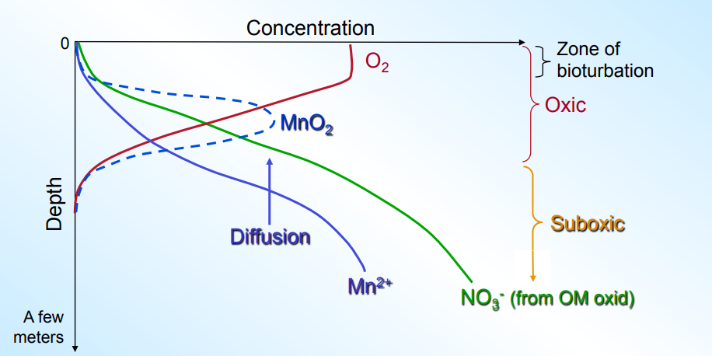
Deep Sea Sediment

Slide 23
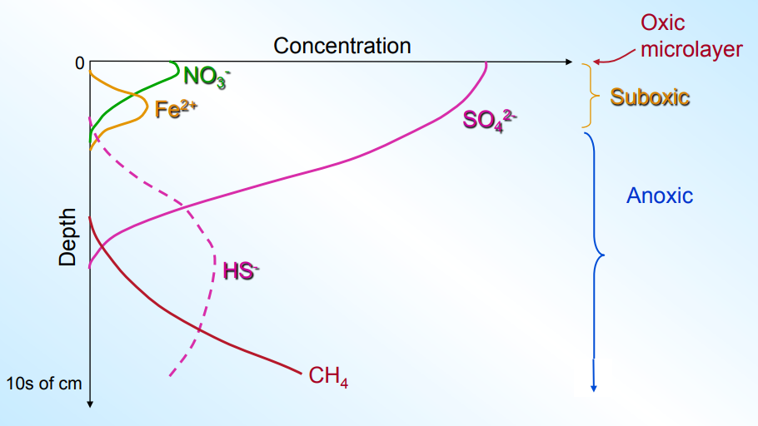
Nearshore Sediment

Slide 24
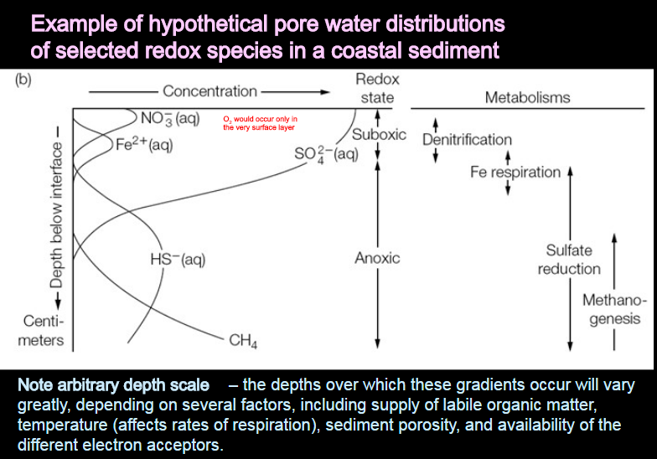

Slide 25
