Slide 1
Ocean Acidification
“The other CO₂ problem…”
Marine Biogeochemistry
April 23, 2019

Slide 2
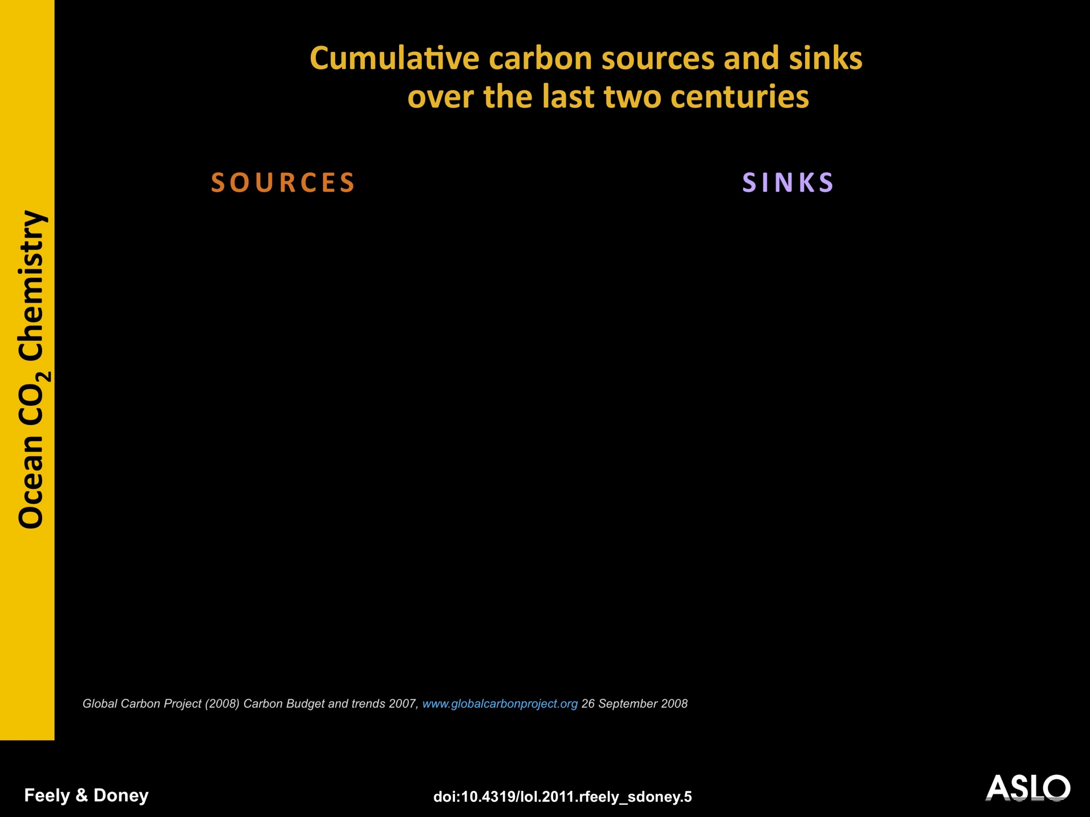
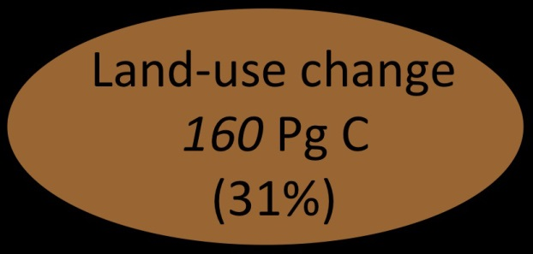
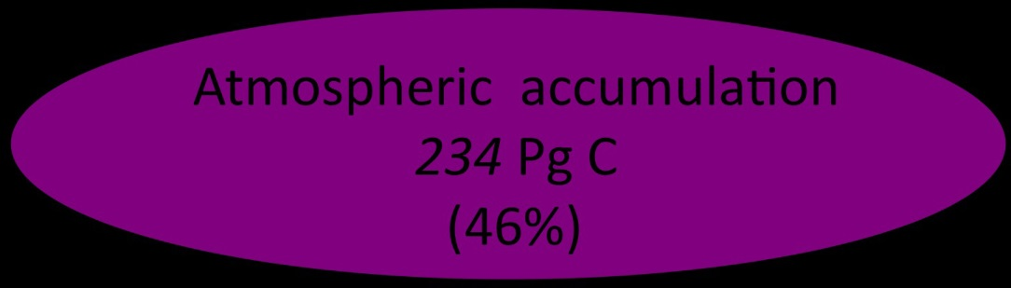
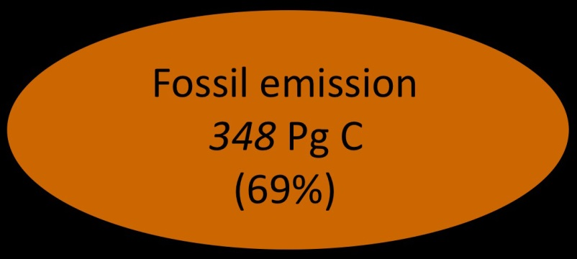
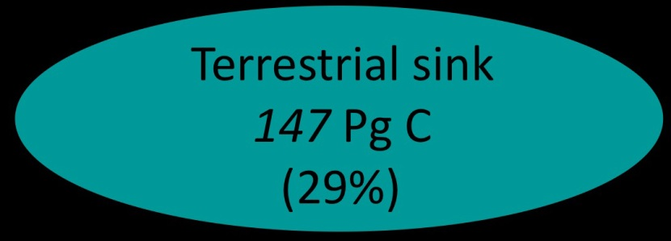
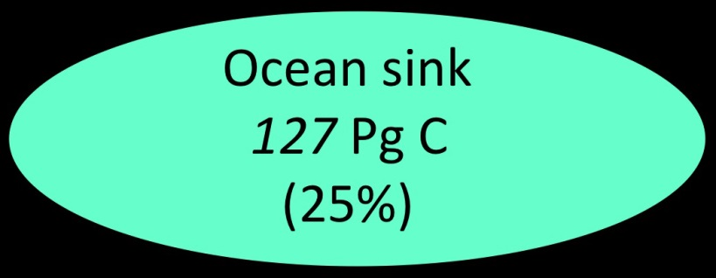
Notes:
SLIDE 5. Cumulative carbon sources and sinks over the last two centuries (Global Carbon Project (2008) Carbon Budget and trends 2007,www.globalcarbonproject.org, 26 September 2008). Similar carbon budget are previous slide but now for the entire industrial era. Note that the cumulative contribution of human land-use and deforestation to total carbon emissions is much larger than at present, reflecting the extensive spread of agriculture and forestry in the northern hemisphere in the 1900s and the more recent rapid rise in fossil-fuel emissions. The estimated cumulative airborne fraction and uptake fractions into the ocean and land are roughly similar to estimates for present day.

Slide 3
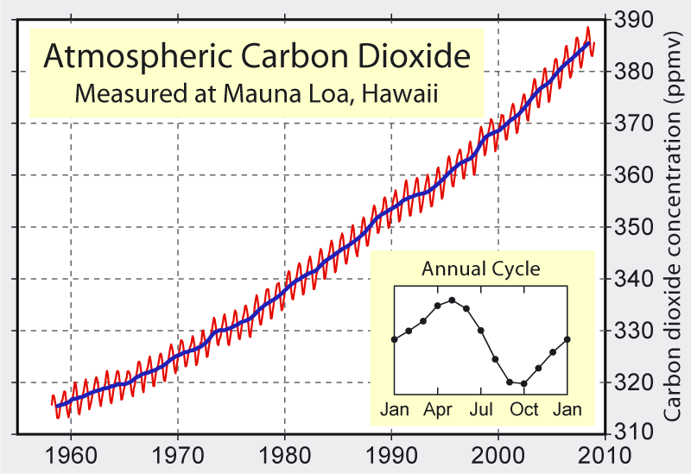
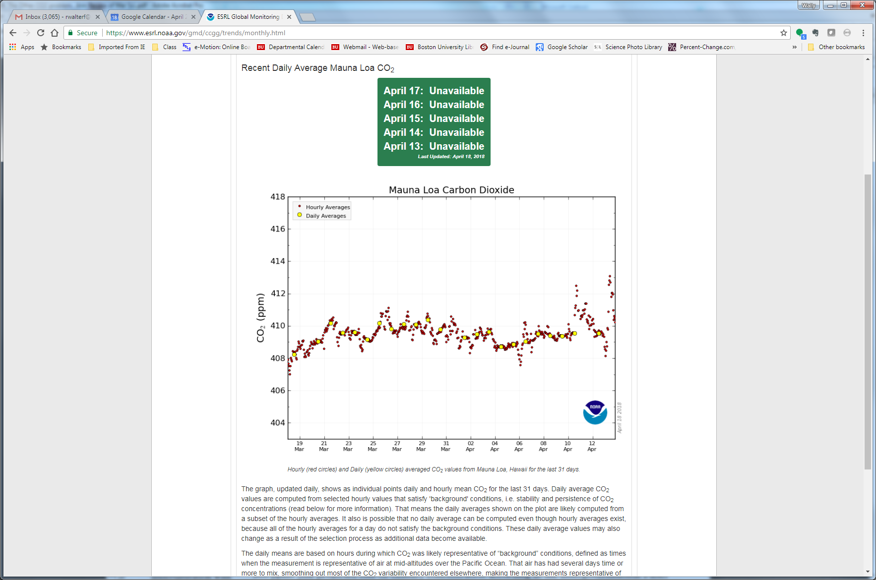
Notes:
https://www.esrl.noaa.gov/gmd/ccgg/trends/monthly.html

Slide 4
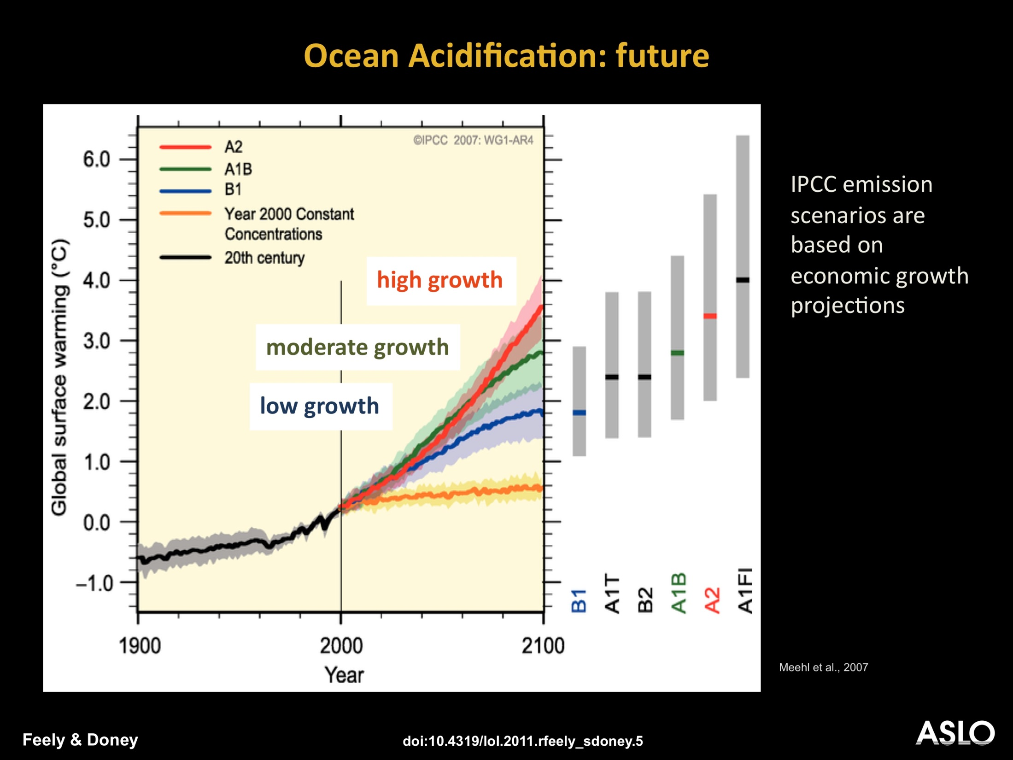
Notes:
SLIDE 6. 20th century historical trend (black line) and model projections (colored lines) of global surface temperature warming based on the IPCC CO₂ emission scenarios, which are based on population and economic growth projections (after Meehl et al., 2007, Global Climate Projections chapter, IPCC 4th Assessment, Working Group I). The pale color bands around each scenario and the grey bands to the right reflect different measures of uncertainty in climate sensitivity. The yellow line reflects a scenario where CO2 concentrations are fixed at 2000 levels for the 21st century. Even after CO2 levels are stabilized, the global climate continues to warm because of inertia in the climate system (National Research Council, 2011: Climate Stabilization Targets: Emissions, Concentrations and Impacts over Decades to Millennia, National Academies Press, Washington DC, ISBN 0-309-15176-7). Anthropogenic CO2 emissions drive both climate change and ocean acidification and are thus governed by the same underlying human and economic trends.

Slide 5
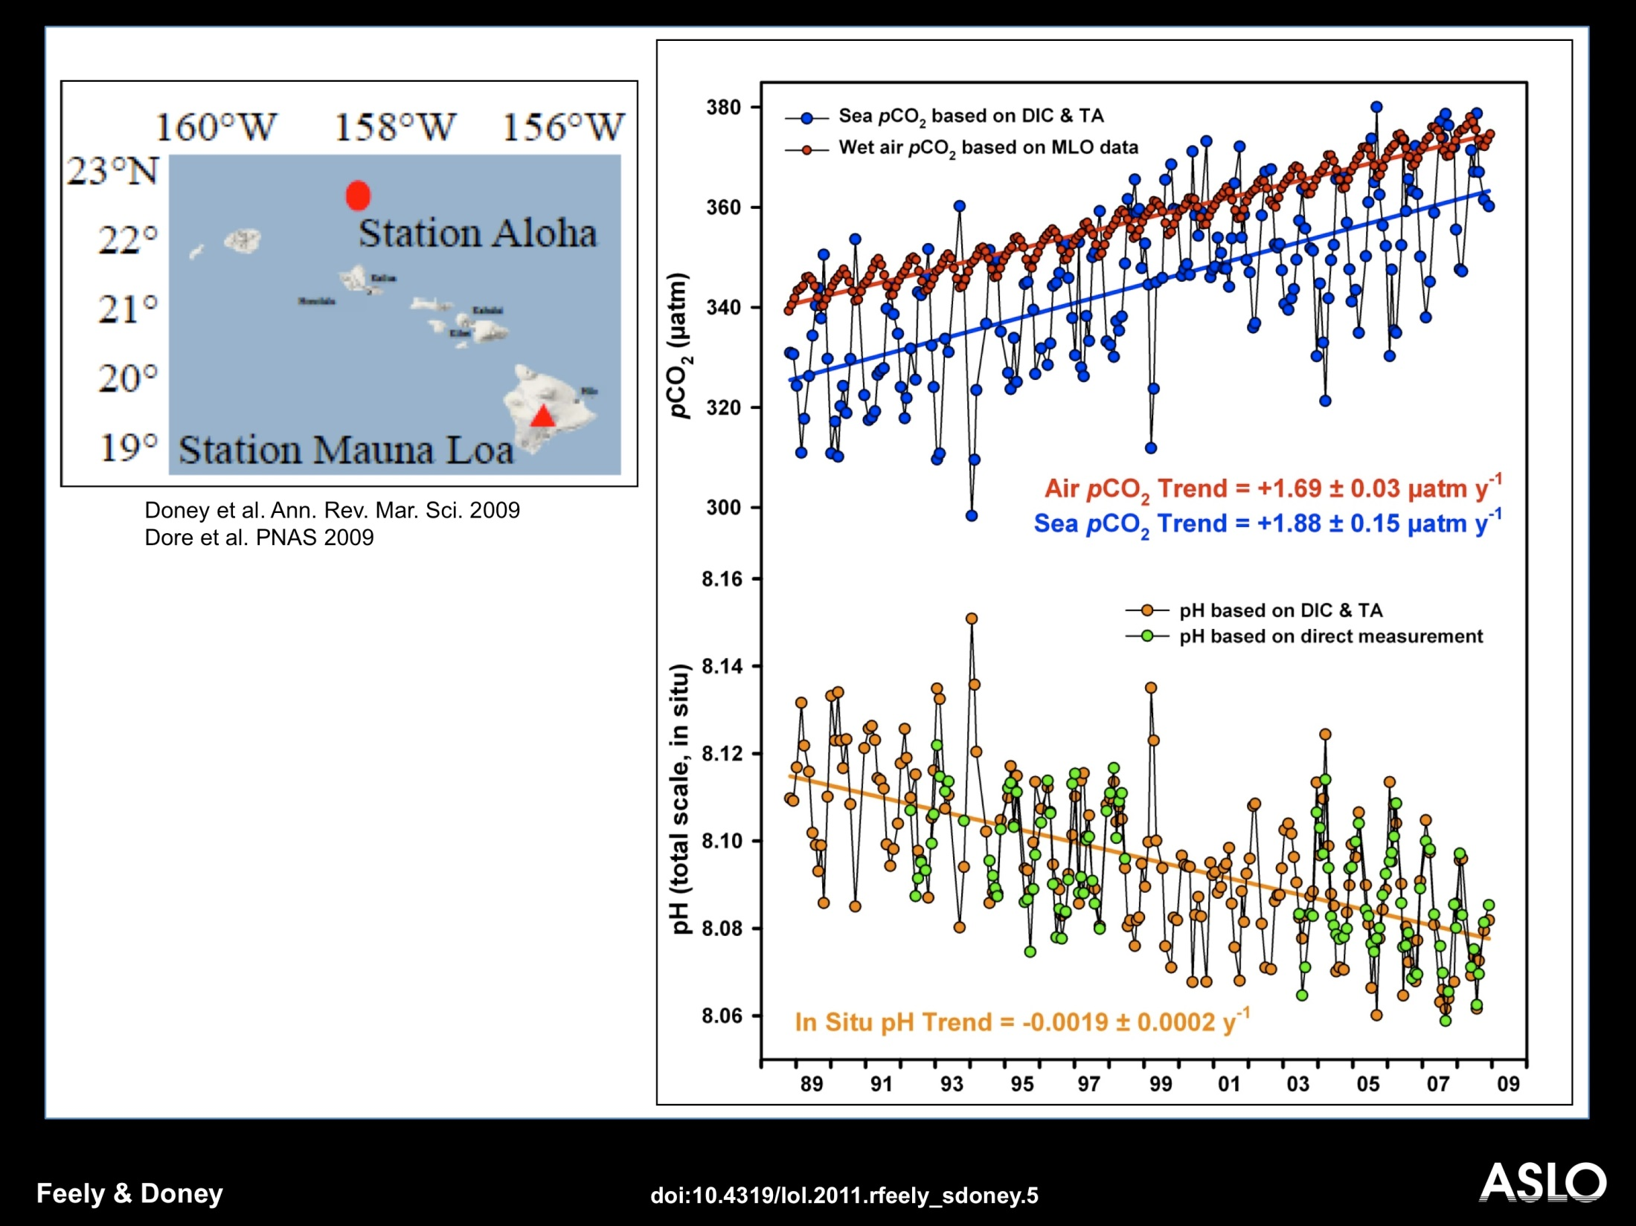
Notes:
SLIDE 3. Changes in atmospheric CO₂ concentrations (in red) at the Mauna Loa Observatory and ocean CO₂ (in blue) and pH (in green and light brown) at the Hawaii Ocean Time-series station Aloha off Hawaii. The decline in pH is approximately 0.02 pH units per decade. CO₂ is an acidic gas so the addition of 22 million tons of carbon dioxide to the ocean every day is acidifying the seawater…we call this process “ocean acidification.” (Dore et al. PNAS, 2009; Doney et al., Ann. Rev. Mar. Sci., 2009).

Slide 6
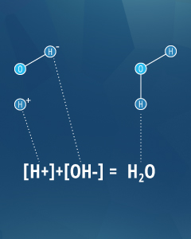
Operational definitions:
An Acid is a substance that will decrease pH when added to pure water.
A base is a substance that will increase the pH of water.
Or
An acid releases a hydrogen ion or proton (equivalent to H+)
A base accepts a hydrogen ion or proton
Notes:
From: https://www.fondriest.com/environmental-measurements/parameters/water-quality/ph/

Slide 7
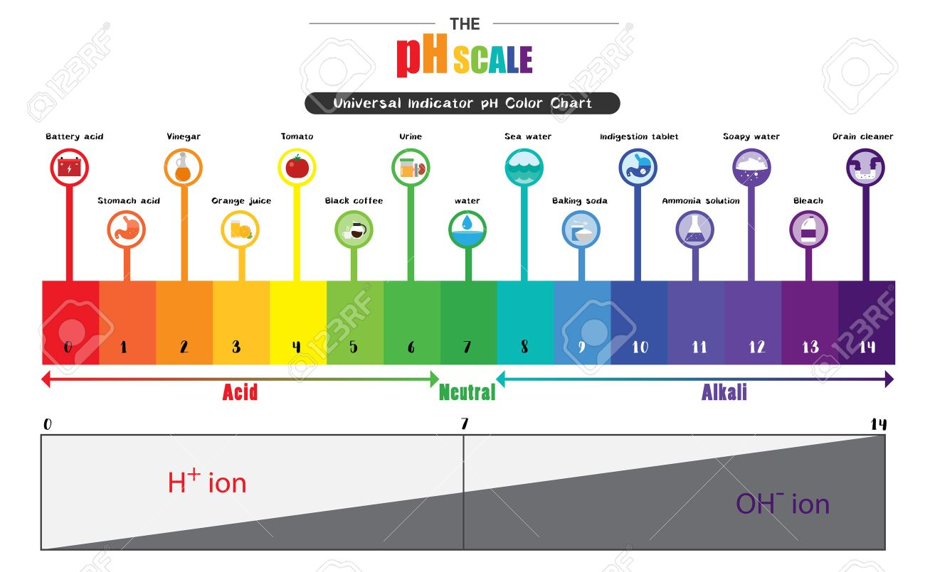
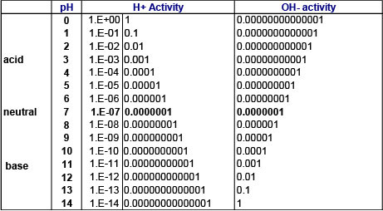
Notes:
https://previews.123rf.com/images/b44022101/b440221011707/b44022101170700021/81803308-the-ph-scale-universal-indicator-ph-color-chart-diagram-acidic-alkaline-values-common-substances-vec.jpg

Slide 8
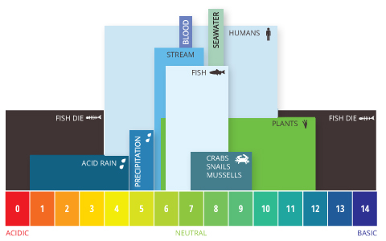
pH Range of Aquatic Systems - The optimum pH levels for fish are from 6.5 to 9.0.
Notes:
From: https://www.fondriest.com/environmental-measurements/parameters/water-quality/ph/

Slide 9
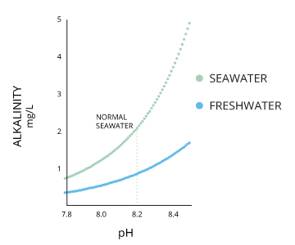
Alkalinity and the pH of Water
The alkalinity of water or a solution is the quantitative capacity of that solution to buffer or neutralize an acid (i.e., the ability to resist changes in pH).
If a body of water has a high alkalinity, it can limit pH changes due to acid rain, pollution or other factors
The alkalinity of a stream or other body of water is increased by carbonate-rich soils (carbonates and bicarbonates) such as limestone, and decreased by sewage outflow and aerobic respiration.
Notes:
From: https://www.fondriest.com/environmental-measurements/parameters/water-quality/ph/

Slide 10
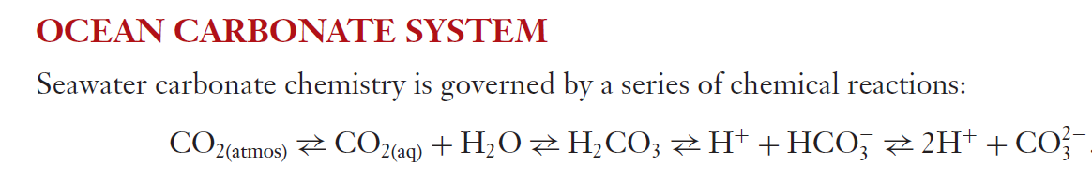

Slide 11
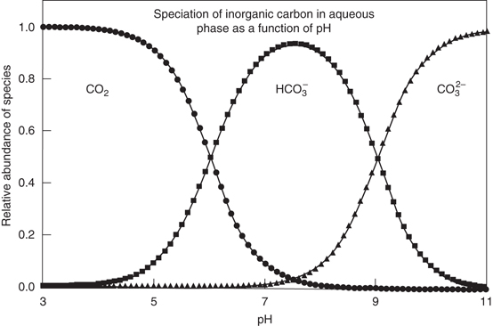
Inorganic C budget for seawater at pH ~8.1:
90% is bicarbonate (HCO₃⁻)
9% is carbonate (CO₃²⁻)
1% is dissolved CO₂
Notes:
https://wiley-vch.e-bookshelf.de/products/reading-epub/product-id/407704/title/Fundamentals%2Bof%2BGeobiology.html

Slide 12
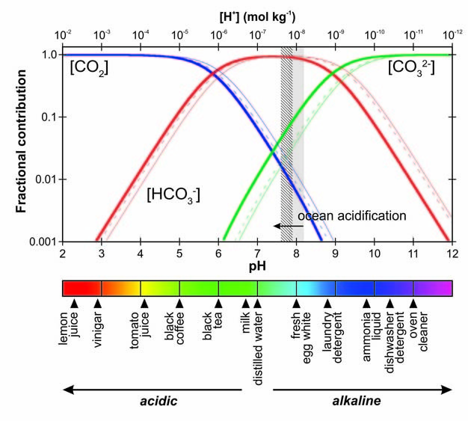

Slide 13
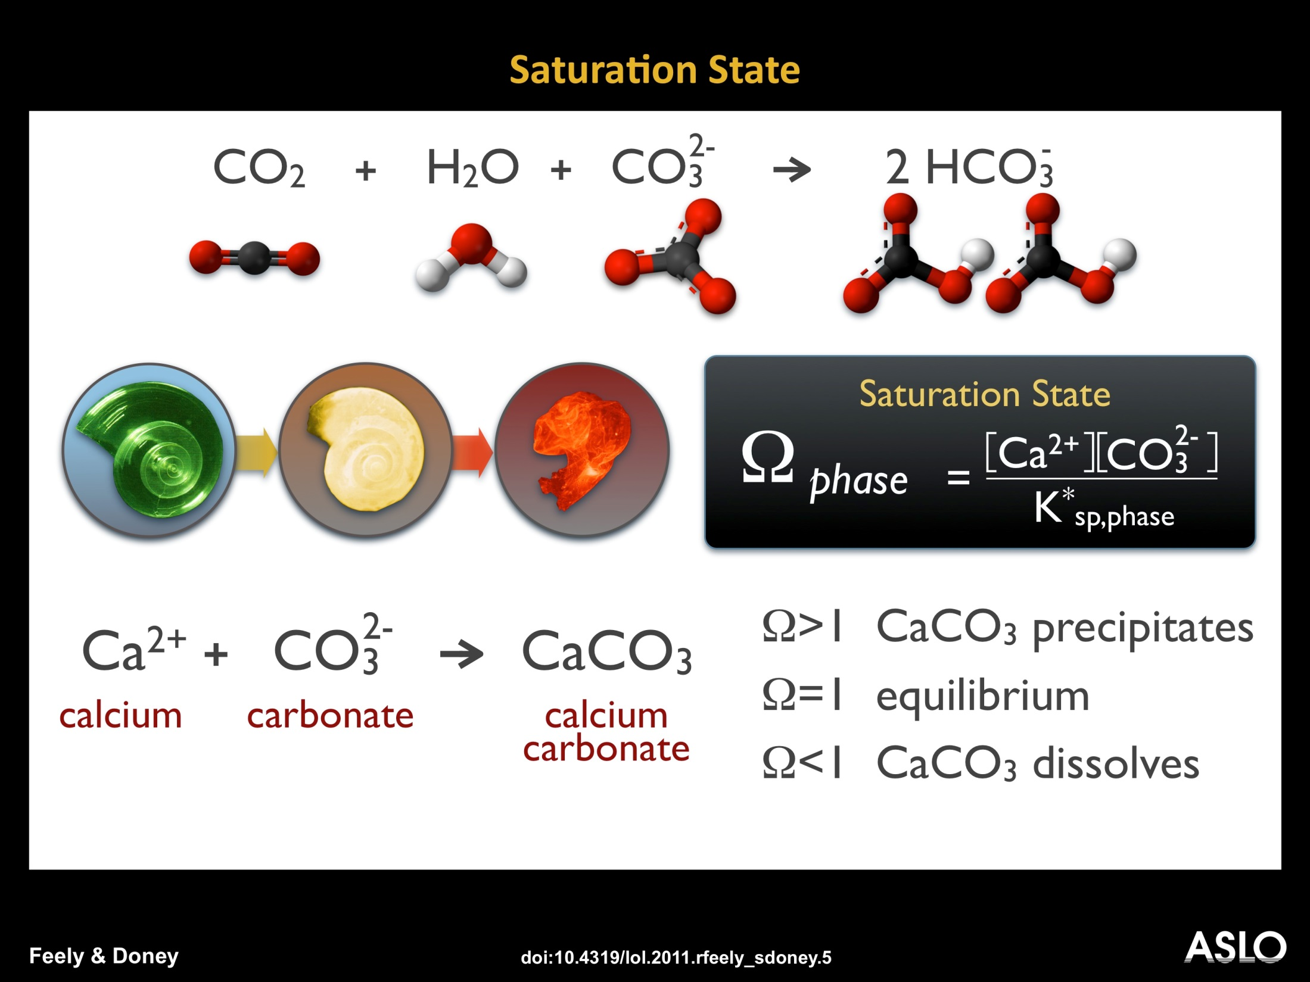
Notes:
SLIDE 10. Schematic diagram showing the effect of changing seawater chemistry and rising CO₂ on calcium carbonate (CaCO₃) saturation state (Ω) which is the calcium concentration times the carbonate ion divided by the solubility product for two of the more common mineral phases of CaCO₃, aragonite or calcite, used by organisms to construct shells and skeletons (from Feely et al., Science, 2004). Note that aragonite (pteropods, corals, some mollusks) is more soluble (has a lower saturation state) than calcite. The dissolving pteropod shows schematically what happens when the saturation state is less than 1.0 in seawater. The saturation state reflects chemical dynamics for unprotected CaCO₃, and while energetically unfavorable some organisms are able to survive in undersaturated conditions by protecting their shells with organic coatings.

Slide 14
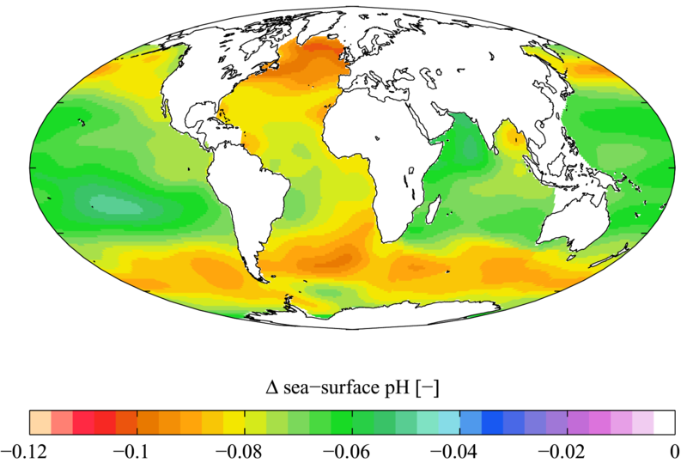
Ocean pH changes - Total change in annual oceanic pH levels from 1700s to 1990s
Notes:
data: World Ocean Atlas 2009; photo credit: Plumbago; Wikipedia Commons

Slide 15
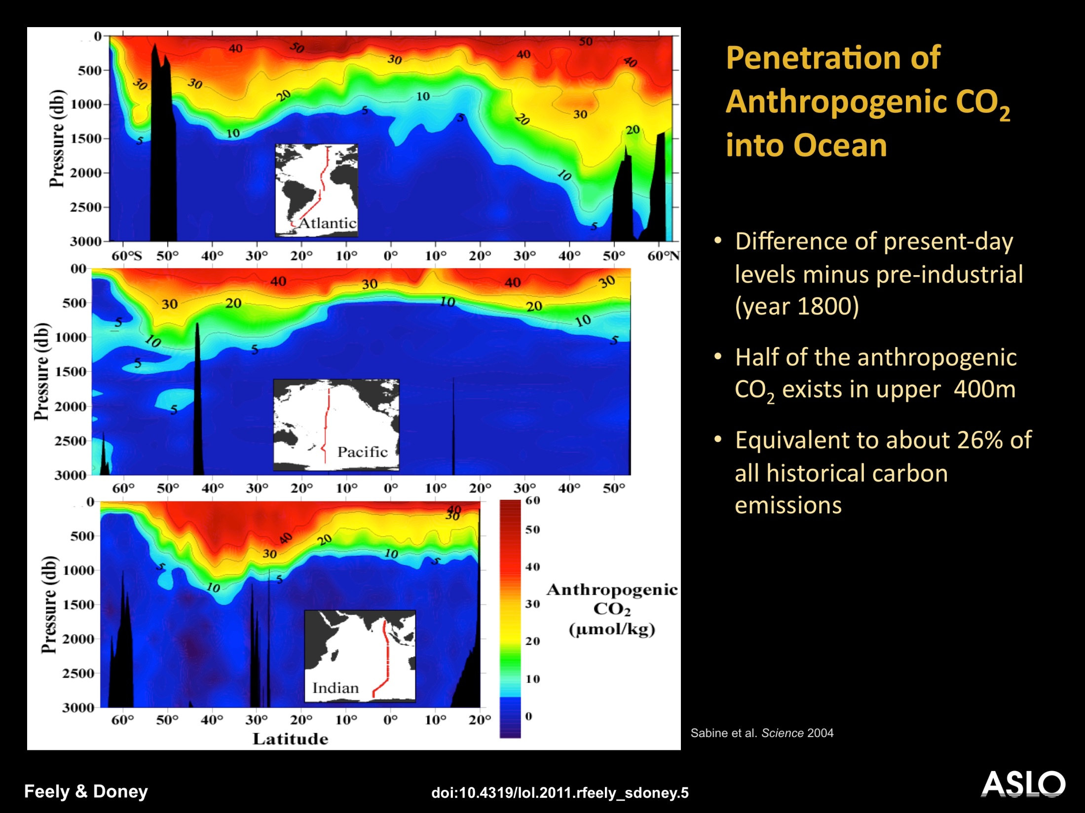
Notes:
SLIDE 15. Depth-latitude distributions of anthropogenic CO₂ for three north-south ocean transects estimated from synthesis of WOCE/JGOFS Global CO₂ survey (Sabine et al., 2004; Science). Anthropogenic CO₂ is estimated as the difference between present-day levels minus pre-industrial (year 1800) using empirical approaches and transient tracer data after correcting DIC data for respiration and CaCO₃ remineralization. The global anthropogenic ocean CO2 inventory amounts to approximately 118 Pg C through 1994 (Sabine et al., Science, 2004) and 148 Pg C through 2010 (Sabine et al., Ann. Rev. Mar. Res., 2011).

Slide 16
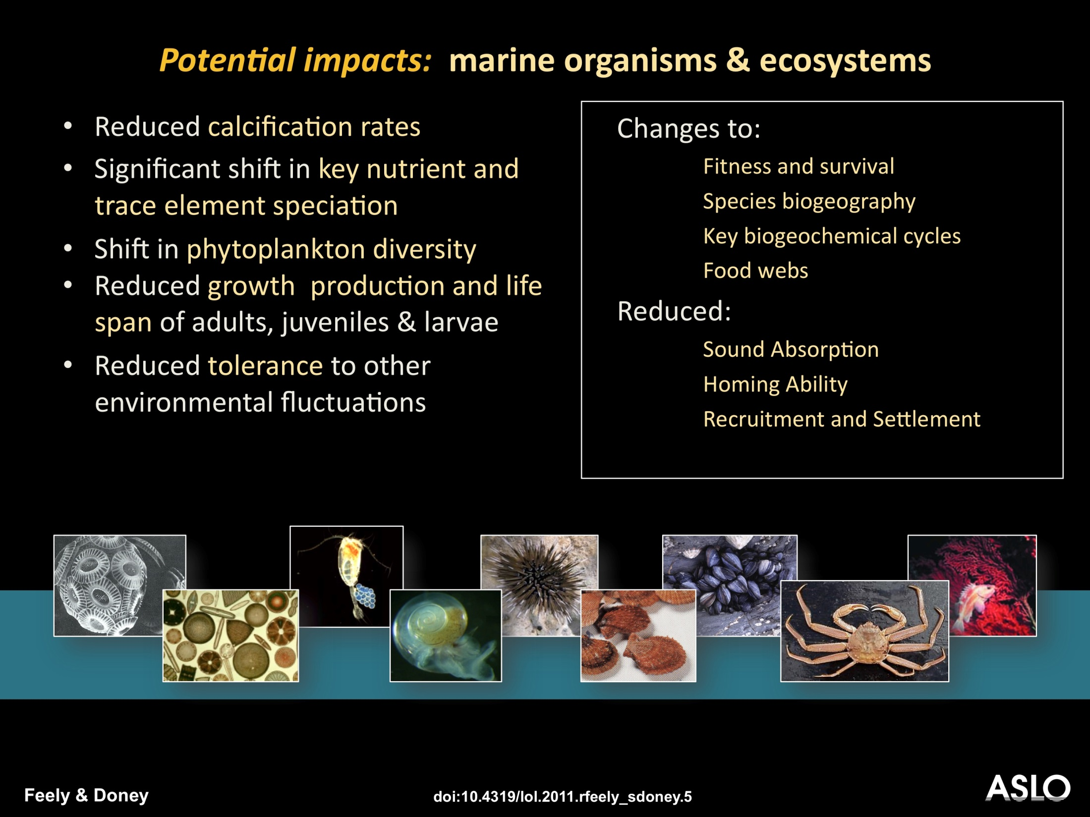
Notes:
SLIDE 23. A wide variety of potential impacts have been identified for ocean acidification on marine organisms & ecosystems. The emphasis of most studies to date has been on negative impacts on calcifying organisms. Recent work as expanded the range of organisms and physiological processes being examined. Positive impacts are also possible, for example elevated growth by some types of algae and seagrasses. Good review articles include Fabry et al. ICES J. Mar. Sci., 2008 and Doney et al., Ann. Rev. Mar. Res., 2009).

Slide 17
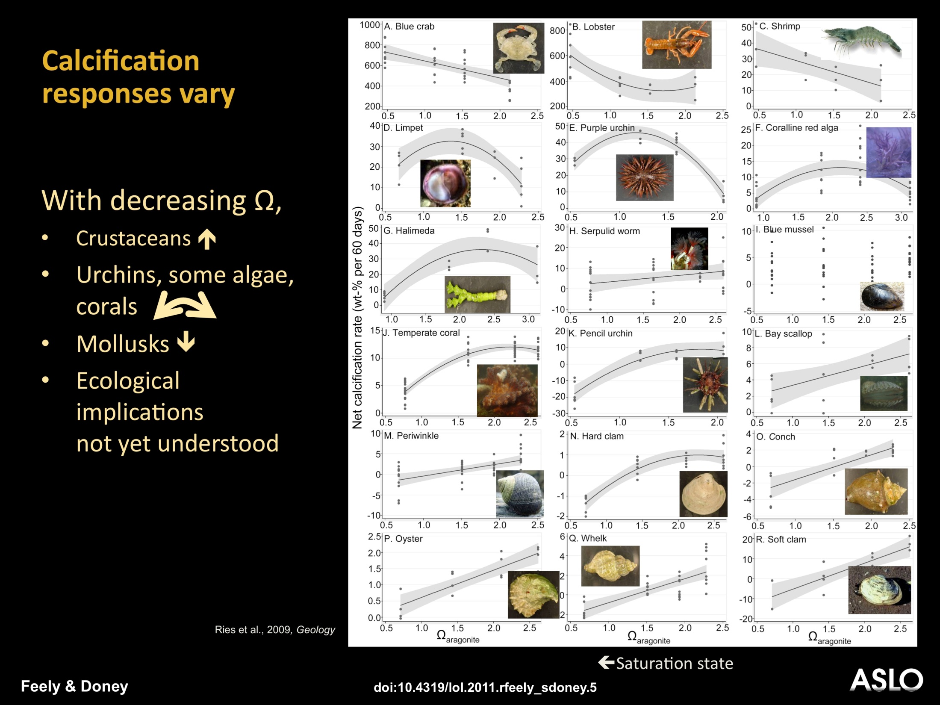
Notes:
SLIDE 24. Biological responses to acidification are just becoming known. Responses vary across major taxa groups, and impacts even differ for species and strains within a taxa. Ecological implications not well understood yet. The figure shows the change in calcification (shell-weight) due to increasing CO₂ and decreasing saturation (lower aragonite saturation state to the left in each subpanel) for temperate benthic calcifying organisms (Reis et al., Geology, 2009). Some increase in calcification rate while others decrease. It should be noted that these are results from a single study. Consequently, the details are likely to change with additional investigation, that is, the results shown are not likely to be universal. should be noted that these are results from a single study. Consequently, the details are likely to change with additional investigation, that is, the results shown are not likely to be universal.

Slide 18
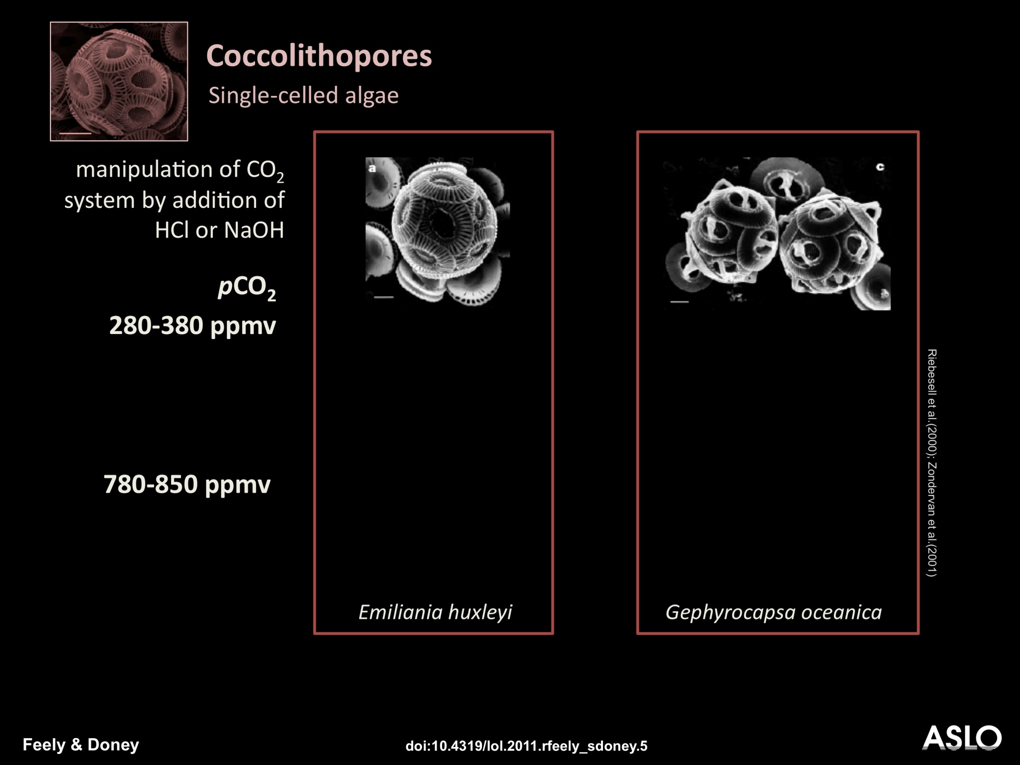
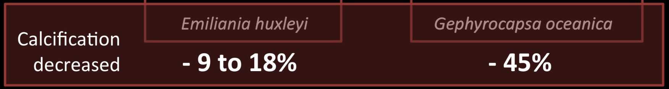
Notes:
SLIDE 28. A landmark study of Riebesell et al. (Nature, 2000) and related work by Zondervan et al. (Global Biogeochem. Cycles, 2001), measured the response of 2 coccolithophore species (E huxleyi, G. oceanica): These workers manipulated the CO₂ system by acid (HCl)/base (NaOH) addition
[Click] Measured a decrease in calcification – G. oceanica more sensitive to elevated pCO₂; they documented malformed coccoliths in both species.
Since these studies, numerous further experiments have been conducted on coccolithophores with most studies indicating decreased calcification but with considerable differences in response across species and strains and even some studies suggesting that calcification may increase for some strains under elevated CO₂.

Slide 19
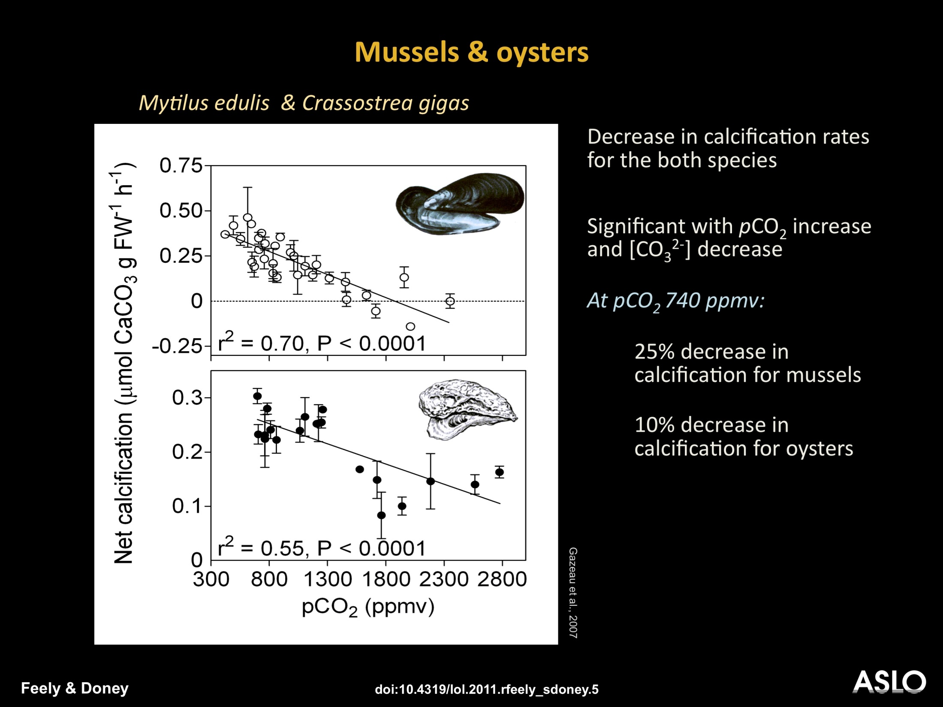
Notes:
SLIDE 33. Response of net calcification to increasing CO₂ for two commercially important shellfish species. Top: Mylitus edulis (common blue mussel); Bottom: oyster Crassostrea gigas is the most cultivated species in the world. Difference in calcification response - may be related to shell mineralogy – oyster shells are calcite but mussel shells are a mixture of calcite and aragonite – aragonite can be as high as 80% of the shell. (Gazeau et al., Geophys. Res. Lett., 2007).

Slide 20
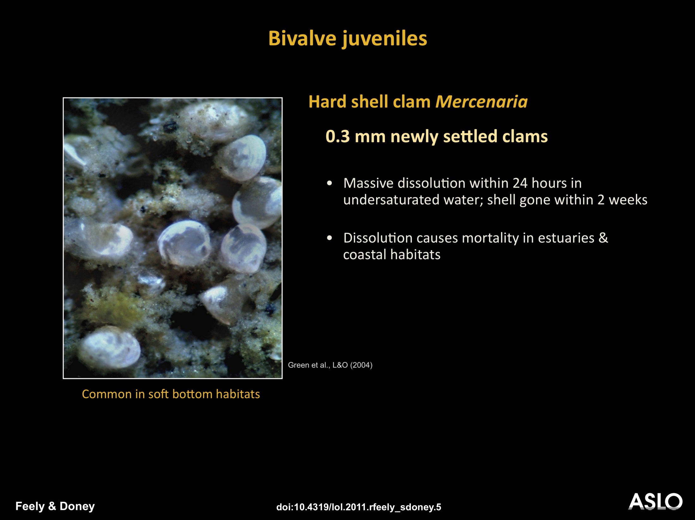
Notes:
SLIDE 34. What about the juvenile stages of molluscs? Strong evidence comes from the work of Mark Green (St. Joseph’s College). He looked at hard shell clam – Mercenaria mercenaria (aragonite shell). He introduced these juvenile clams to sediments that were undersaturated with respect to aragonite - at levels typical of estuarine surface sediments. Shells were gone within two weeks, leaving only the protein matrix. Dissolution is an important source of mortality for newly settled clams, and acidification of overlying waters could increase mortality (after Green et al., Limnology and Oceanography, 2009).

Slide 21
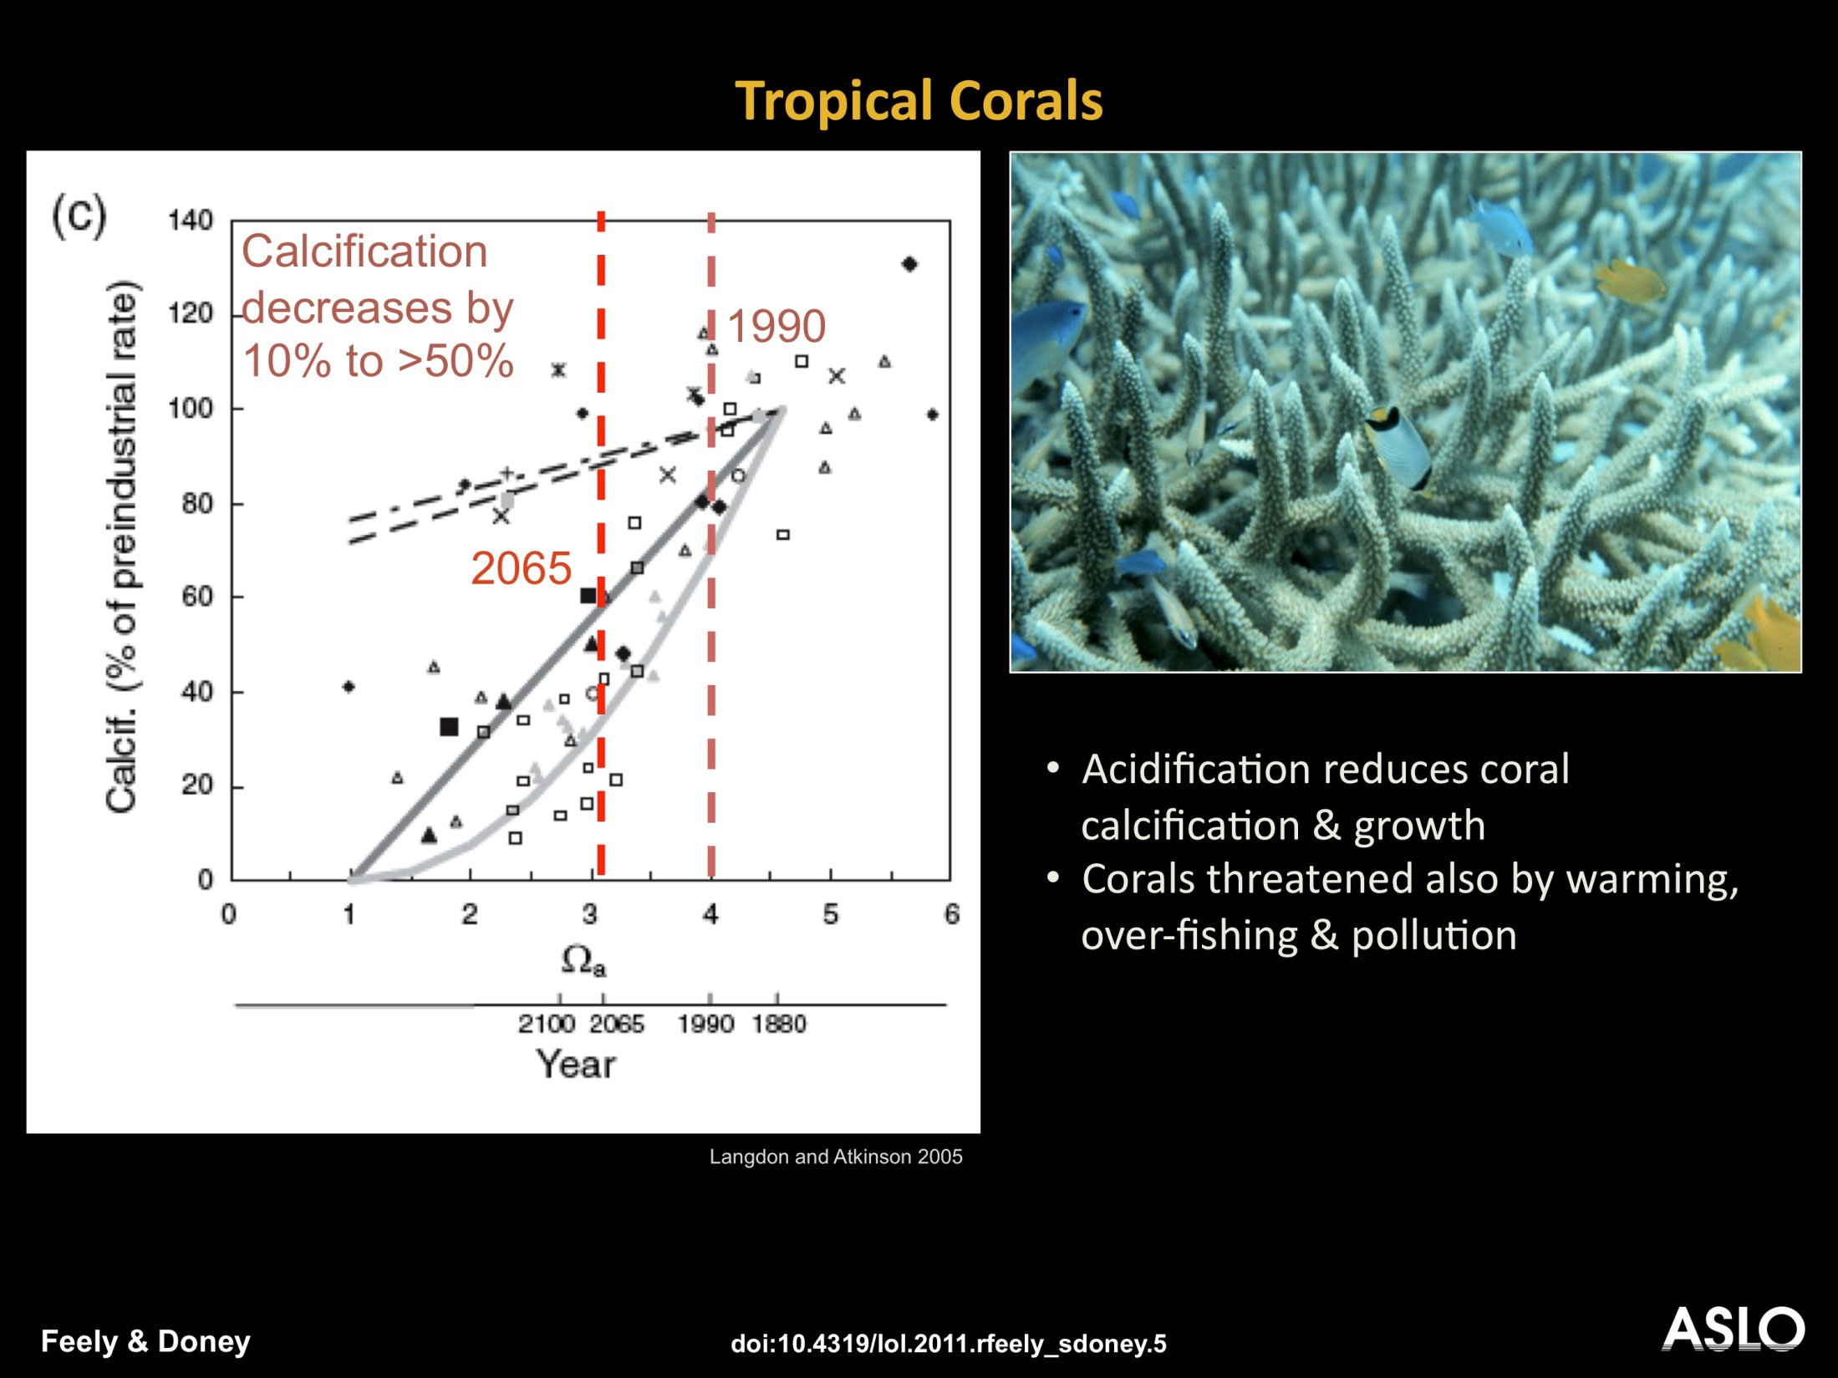
Notes:
SLIDE 25. Calcification in tropical corals decreases with increasing CO₂ levels and lower aragonite saturation state (saturation state declines to the left). The rate of decline is different for different species but calcification decreases with increasing CO2 for all tropical corals measured to date. Notice the negative biological effects occur for saturation state well above the geochemical threshold for undersaturation (Ω =1), and evidence suggests that tropical corals require waters to be substantially supersaturated (Ω_{arag}> ~3) for healthy growth. Based on Langdon et al. J. Geo Phys. Res. 2005 and other studies. Data from Chris Langdon, U. Miami.

Slide 22
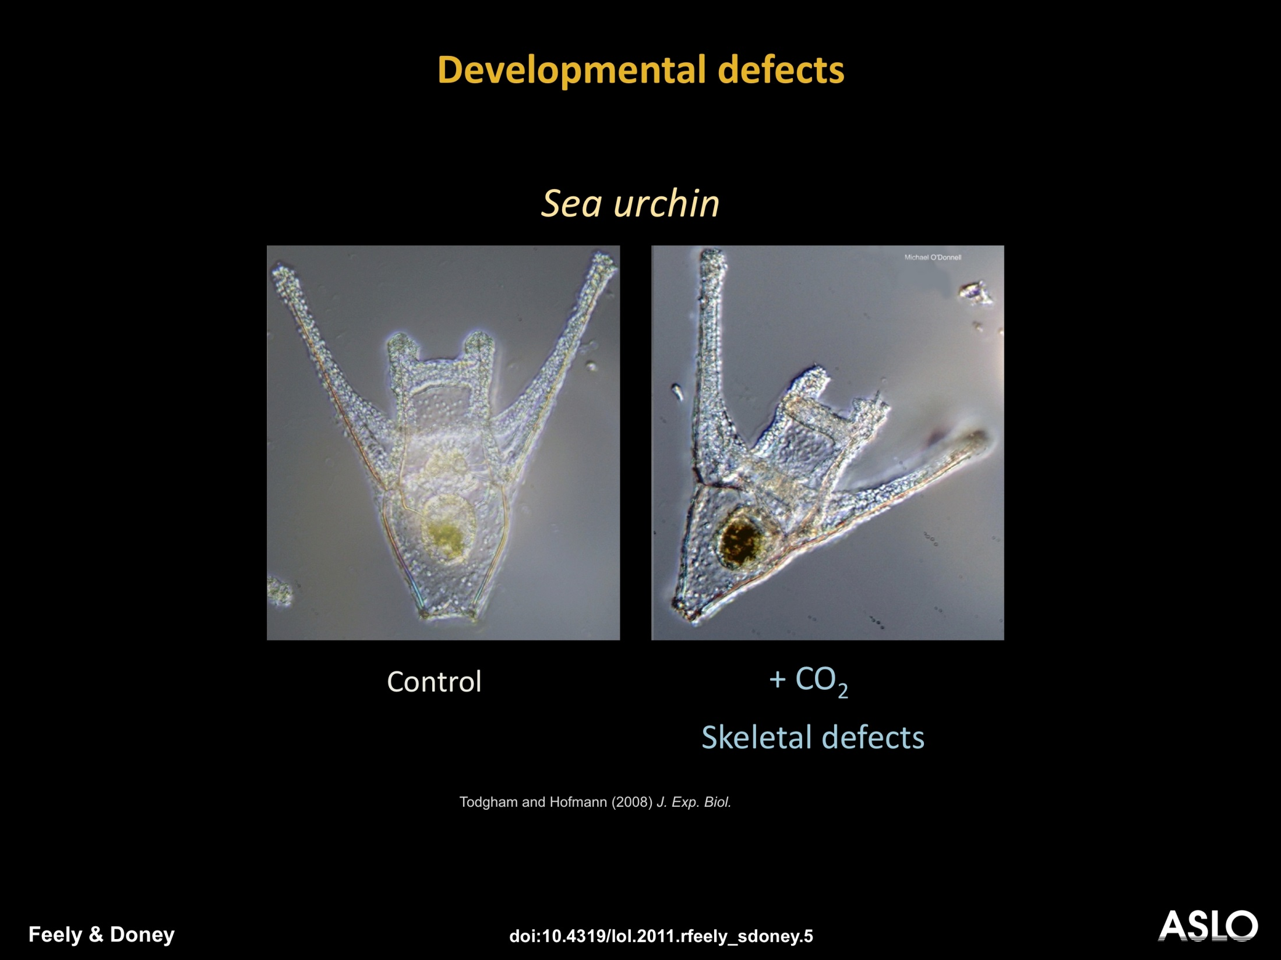
Notes:
SLIDE 35. When sea urchin larvae are raised at high CO₂/low pH culturing conditions, the larvae are smaller in the high-CO₂ groups and generally have a reduced calcium carbonate skeleton with the appearance of skeletal defects; here, various skeletal rods are significantly shorter, although it’s a bit tough to see with the naked eye (Todgham and Hofmann, J. Experimental Biology, 2009; O’Donnell et al., Mar. Ecol. Prog. Series, 2010).

Slide 23
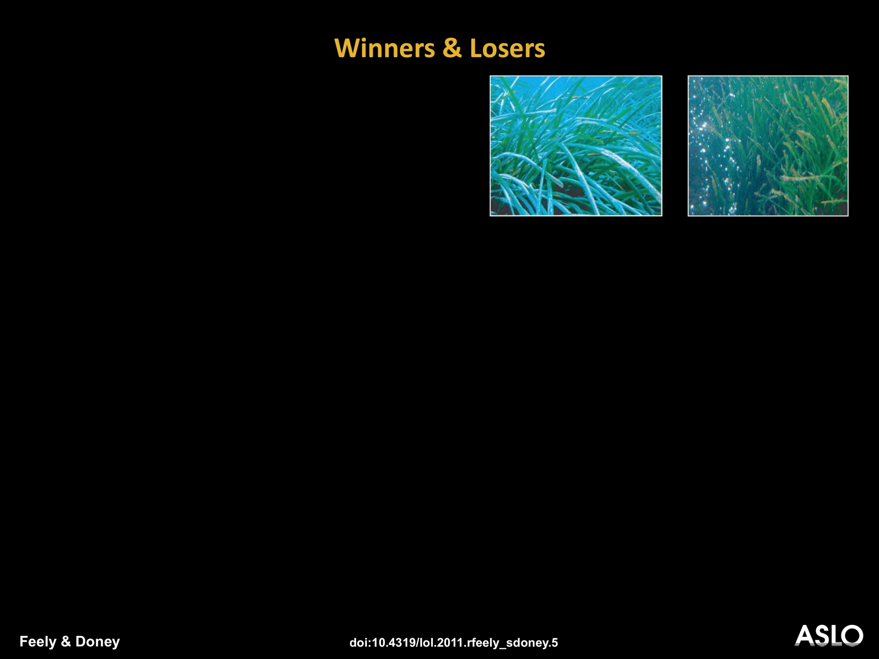
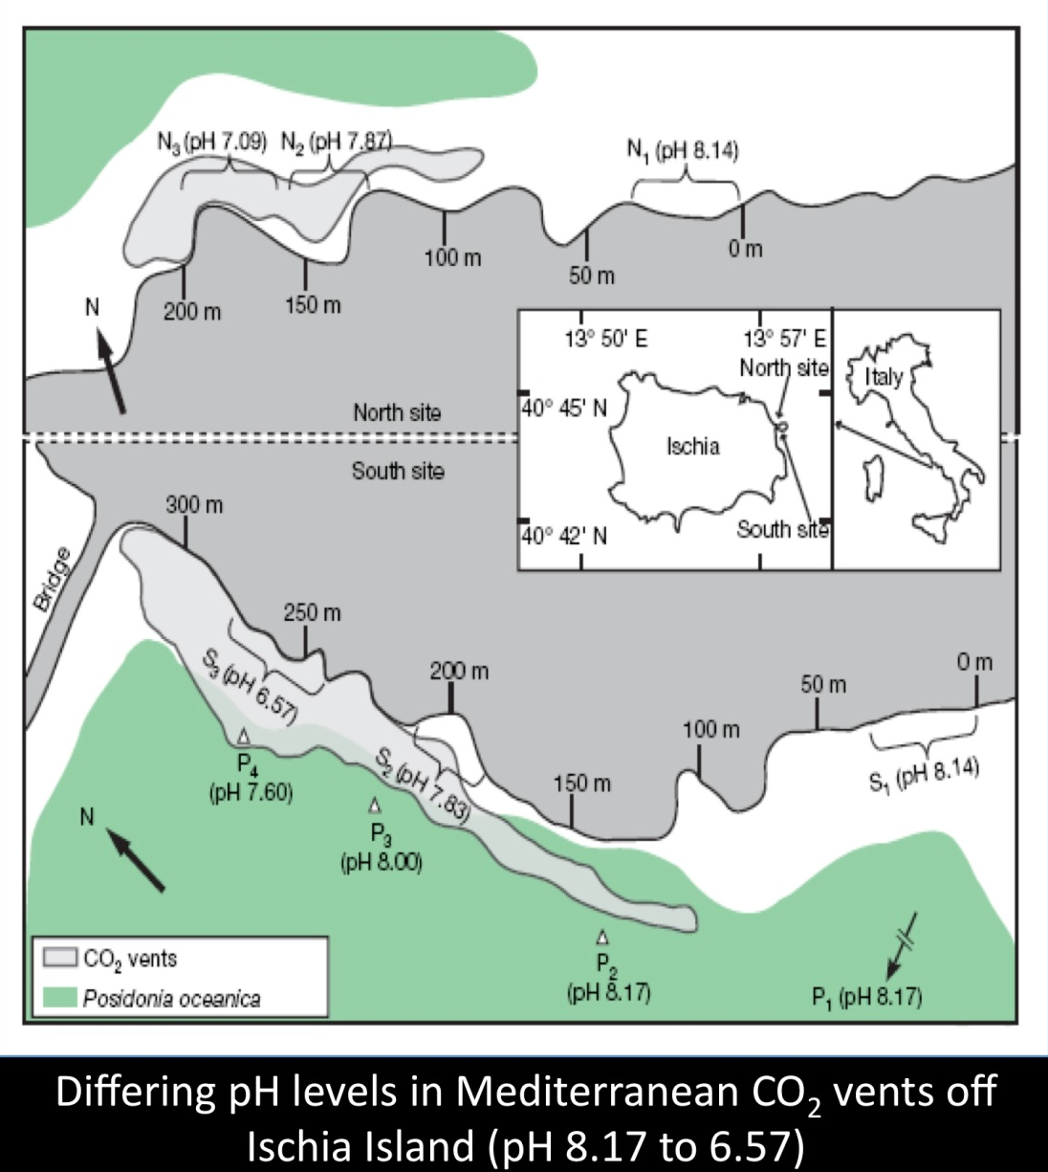
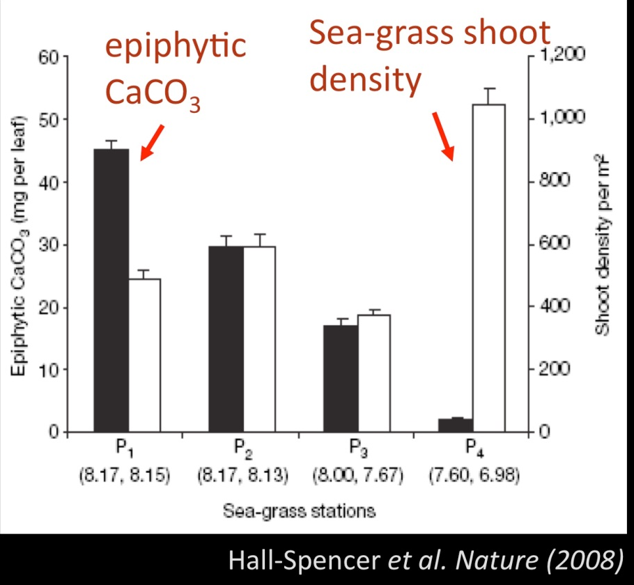
Notes:
SLIDE 41. Hall-Spencer et al. Nature (2008) - Differing pH levels in Mediterranean CO₂ vents off Ischia Island (pH 8.17 to 6.57) and impacts on calcifying organisms and sea-grass shoot density (Hall-Spencer et al., 2008). The panel on the left shows the location of the study site. The two panels in the upper right are images of the background benthic sea-grass community in the control outside of the CO₂ vent area (left) and in the vent fields with visible bubbles of CO₂ gas (right). The bottom panel on the right shows observed patterns with decreasing epiphytic CaCO₃ (black bars) with decreasing pH and an indication of increased sea-grass shoot density (white bars) at the lowest pH levels.

Slide 24
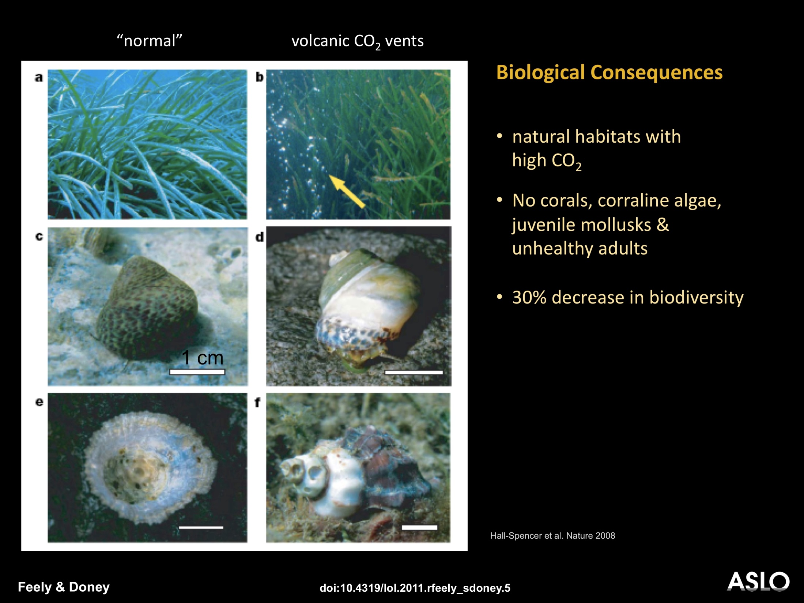
Notes:
SLIDE 42. Images from the background control (left column) and CO₂ vent fields (right column) from the Hall-Spencer et al. study (Nature, 2008). The study is consistent with many laboratory studies indicating a sharp reduction in calcifying organisms inside the CO₂ vent field. Observations indicate a 30% decrease of biodiversity in these high CO₂ regions and dissolving shells of living organisms. Typical examples of O. turbinata with the periostracum intact at pH 8.2 and with old parts of the periostracum removed at mean pH 7.3. Live P. caerulea (e) and H. trunculus (f) showing severely eroded, pitted shells in areas of minimum pH 7.4. Scale bars represent 1 cm.

Slide 25
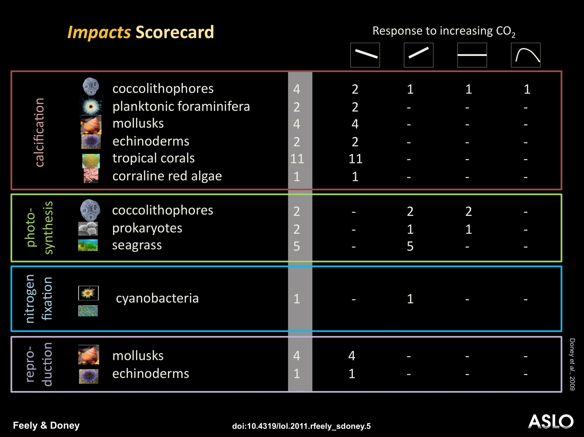
Notes:
SLIDE 40. Reported literature trends of ocean acidification impacts for various biogeochemical and physiological processes. The responses to rising CO₂ are grouped into 4 categories: “decreasing”, “increasing”, “constant”, and “non-linear”, respectively. The numbers in the table reflect the number of species (not studies) observed to display that particular response. In some cases multiple studies may report the same response for a particular species. Note that the literature is growing rapidly and that this table is therefore a selective overview (after Doney et al., 2009).
The calcification table entry shows responses from several groups of organisms that are diverse with respect to calcium carbonate mineralogy, trophic level and other attributes. For example, pteropods and forams are heterotrophs while coccolithophores are autotrophs. Pteropods secrete aragonite which is about 50% more soluble in seawater than the calcite formed by forams and coccolithophores. The relative abundance of different calcifiers varies regionally. Generation times are particularly important when considering the capacity of these groups to adapt to the future high CO₂ ocean. For example coccolithophores have generation times on the order of days, etc.

Slide 26
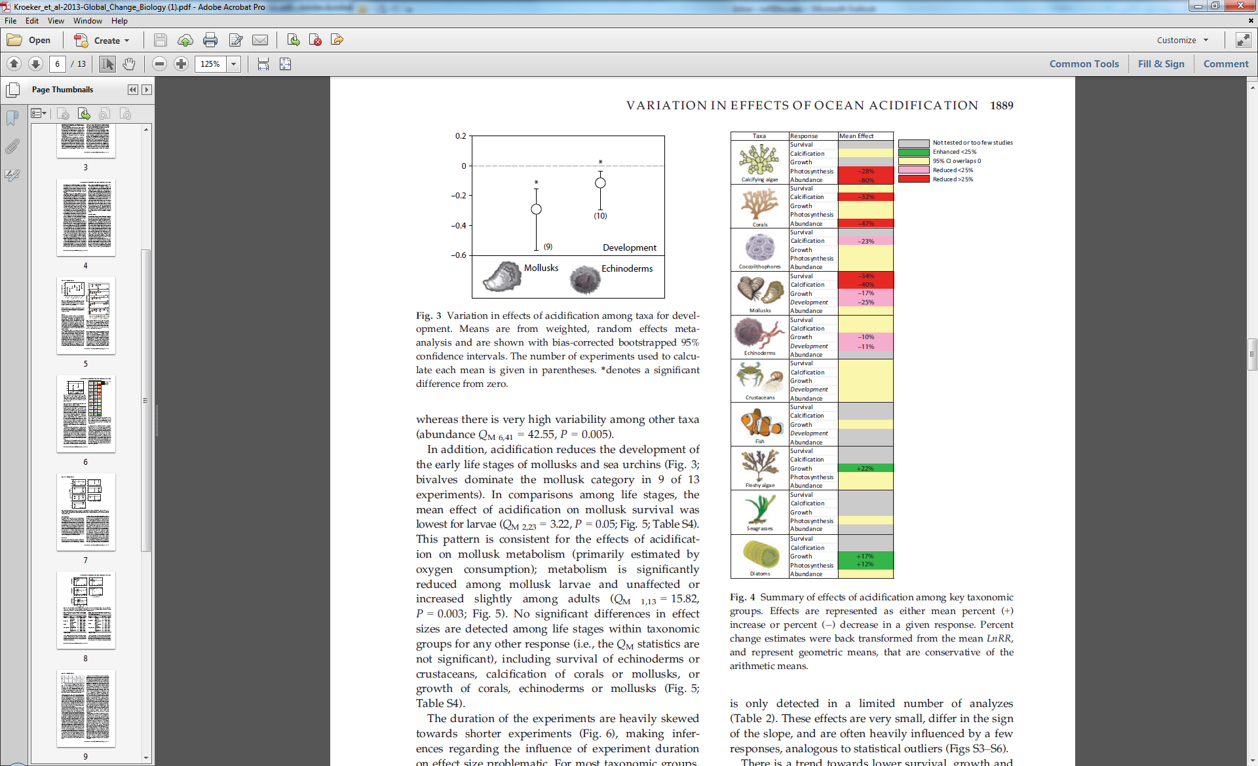

Slide 27
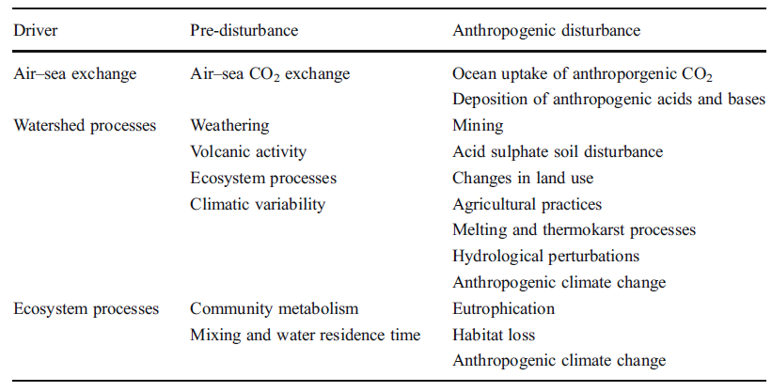

Slide 28
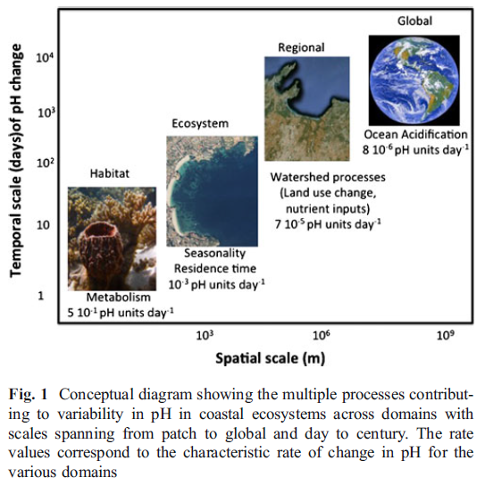
pH – Spatial Scales Matter

Slide 29
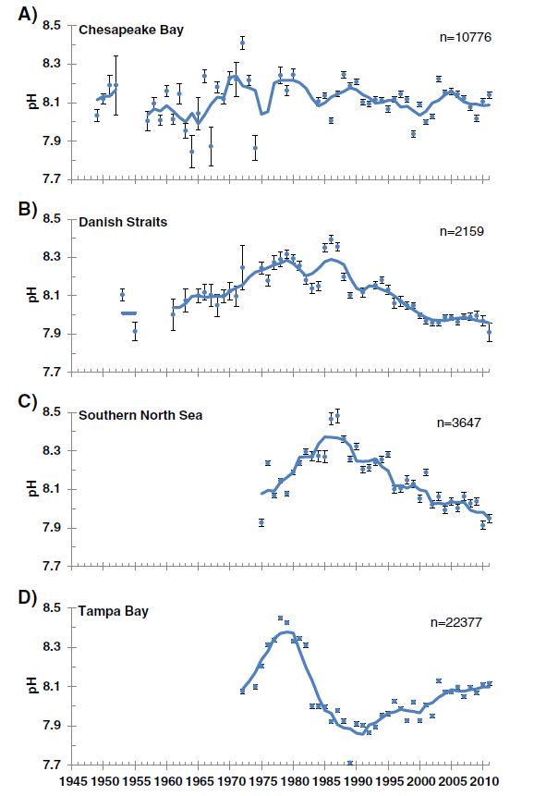
Long-term pH trends– Coastal Ecosystems

Slide 30
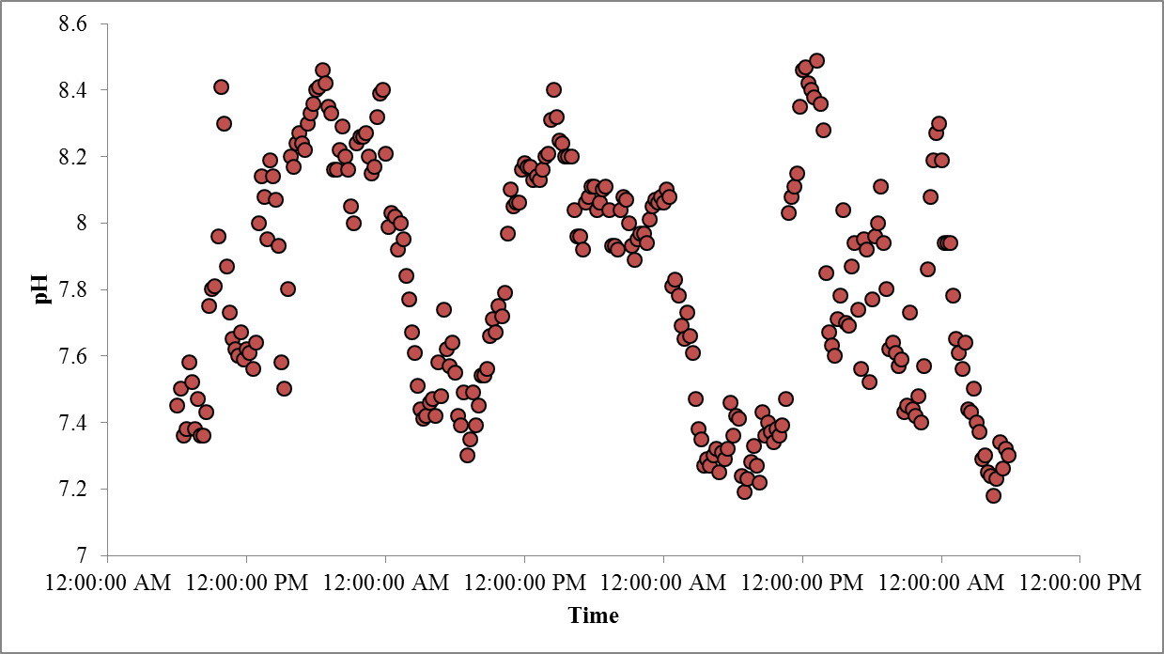
Diel pH – Narragansett Bay - June

