Slide 1
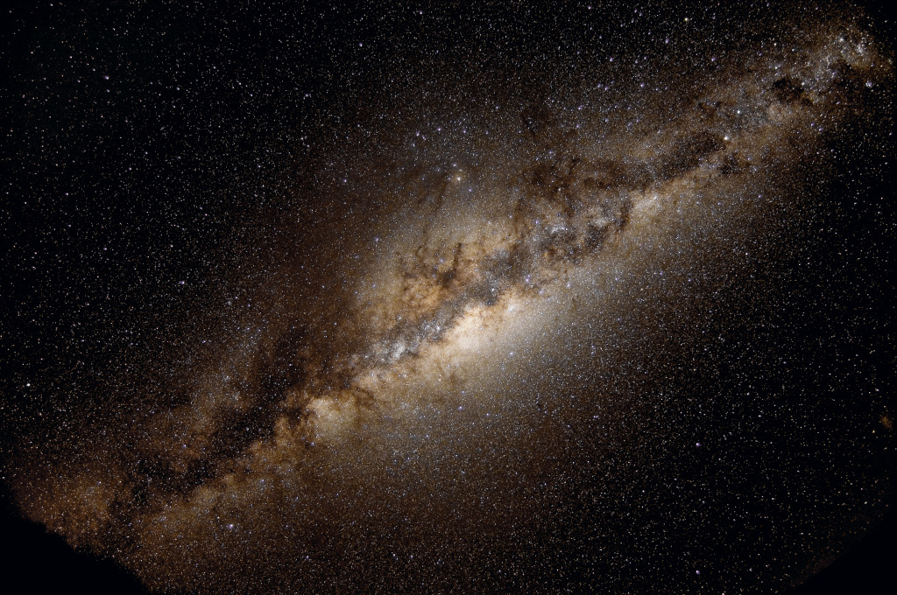
“You and I are flesh and blood, but we are also stardust.”
-Bio AP text book

Slide 2
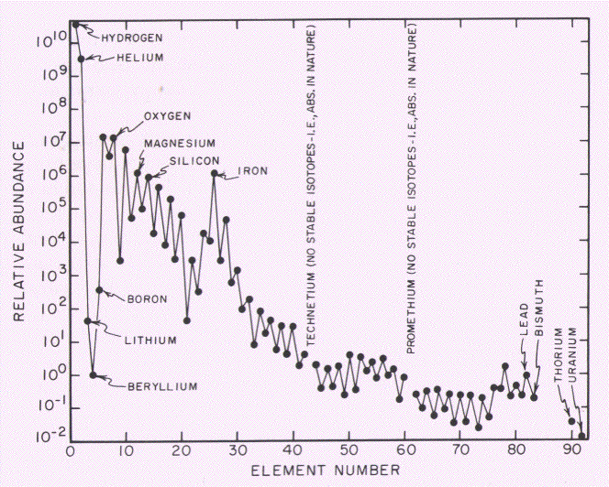
Relative Element Abundance in the Solar System
Figure from Broecker

Slide 3
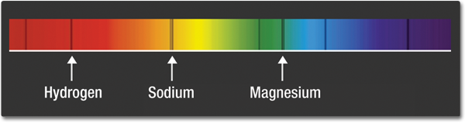
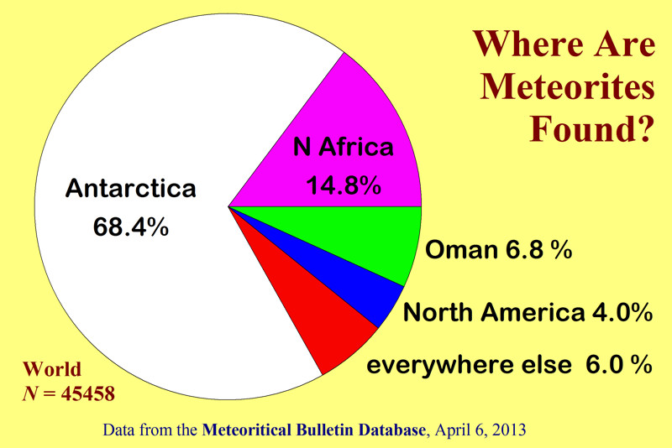
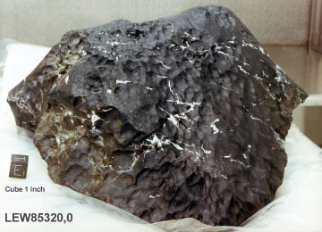
How Do Know the Elemental Abundance
of the Universe?
http://www.dailygalaxy.com
Notes:
Quote from page: SPECTRA AND SPECTRAL SIGNATURES
Close examination of the visible-light spectrum from our Sun and other stars reveals a pattern of dark lines—called absorption lines. These patterns can provide important scientific clues that reveal hidden properties of objects throughout the universe. Certain elements in the Sun's atmosphere absorb certain colors of light. These patterns of lines within spectra act like fingerprints for atoms and molecules. Looking at the Sun's spectrum, for example, the fingerprints for elements are clear to those knowledgeable about those patterns.
http://missionscience.nasa.gov/ems/09_visiblelight.html

Slide 4
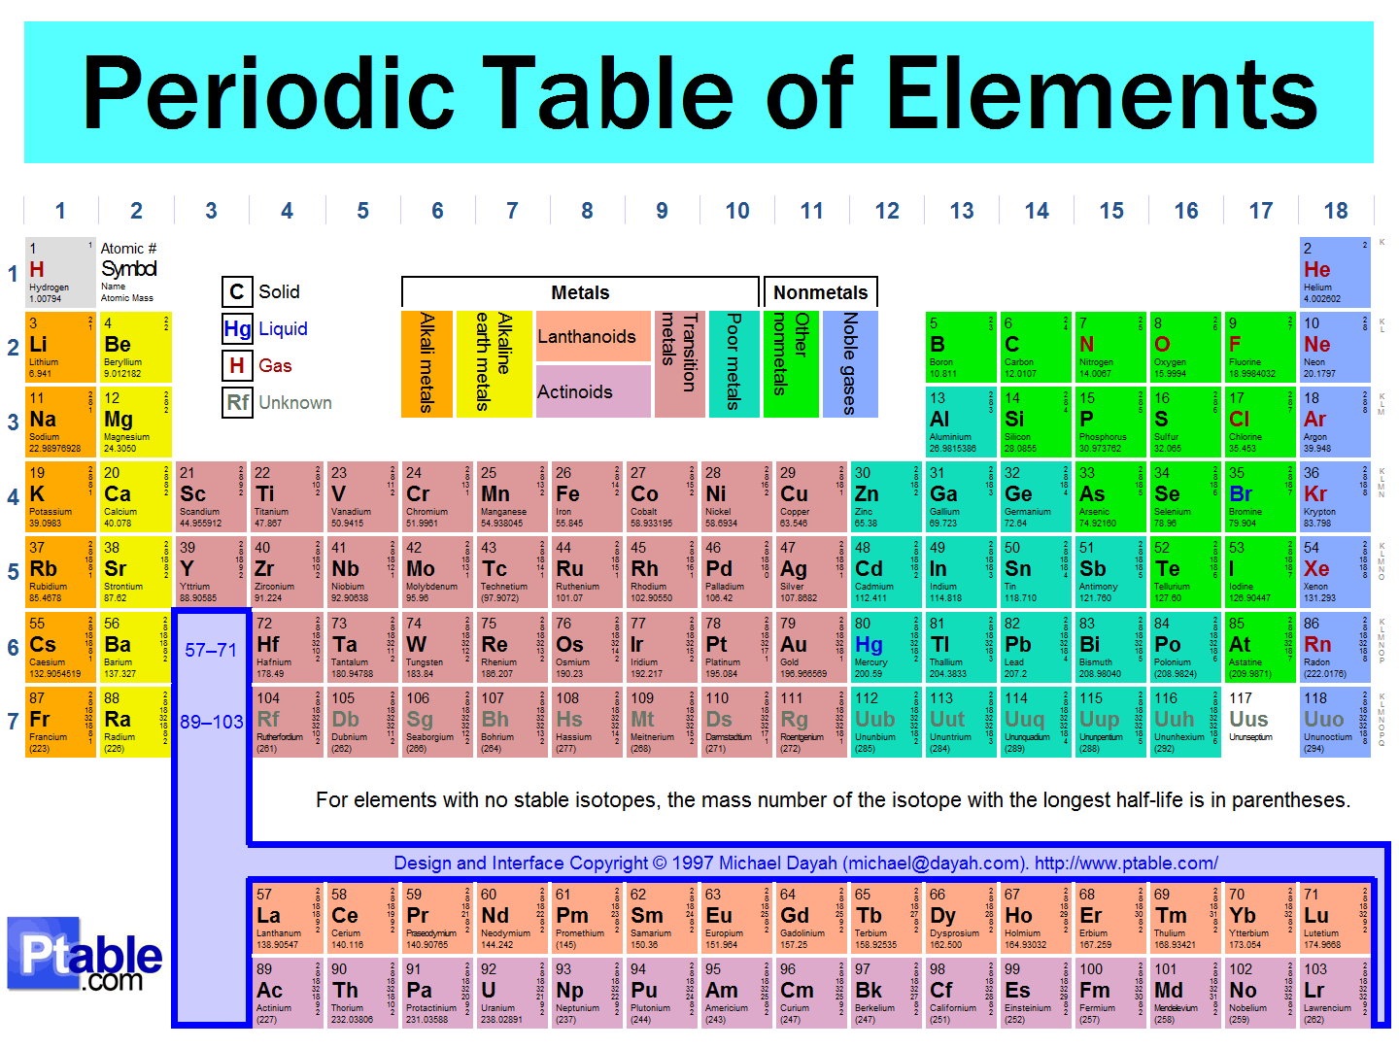

Slide 5
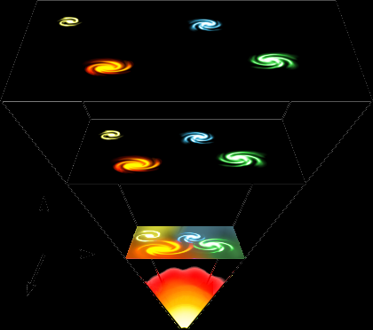
~ 13.7 billion years ago (bya)
Just seconds old
…began to form
H and He nuclei
Big Bang Nucleosynthesis…. 100-300 seconds…..

Slide 6
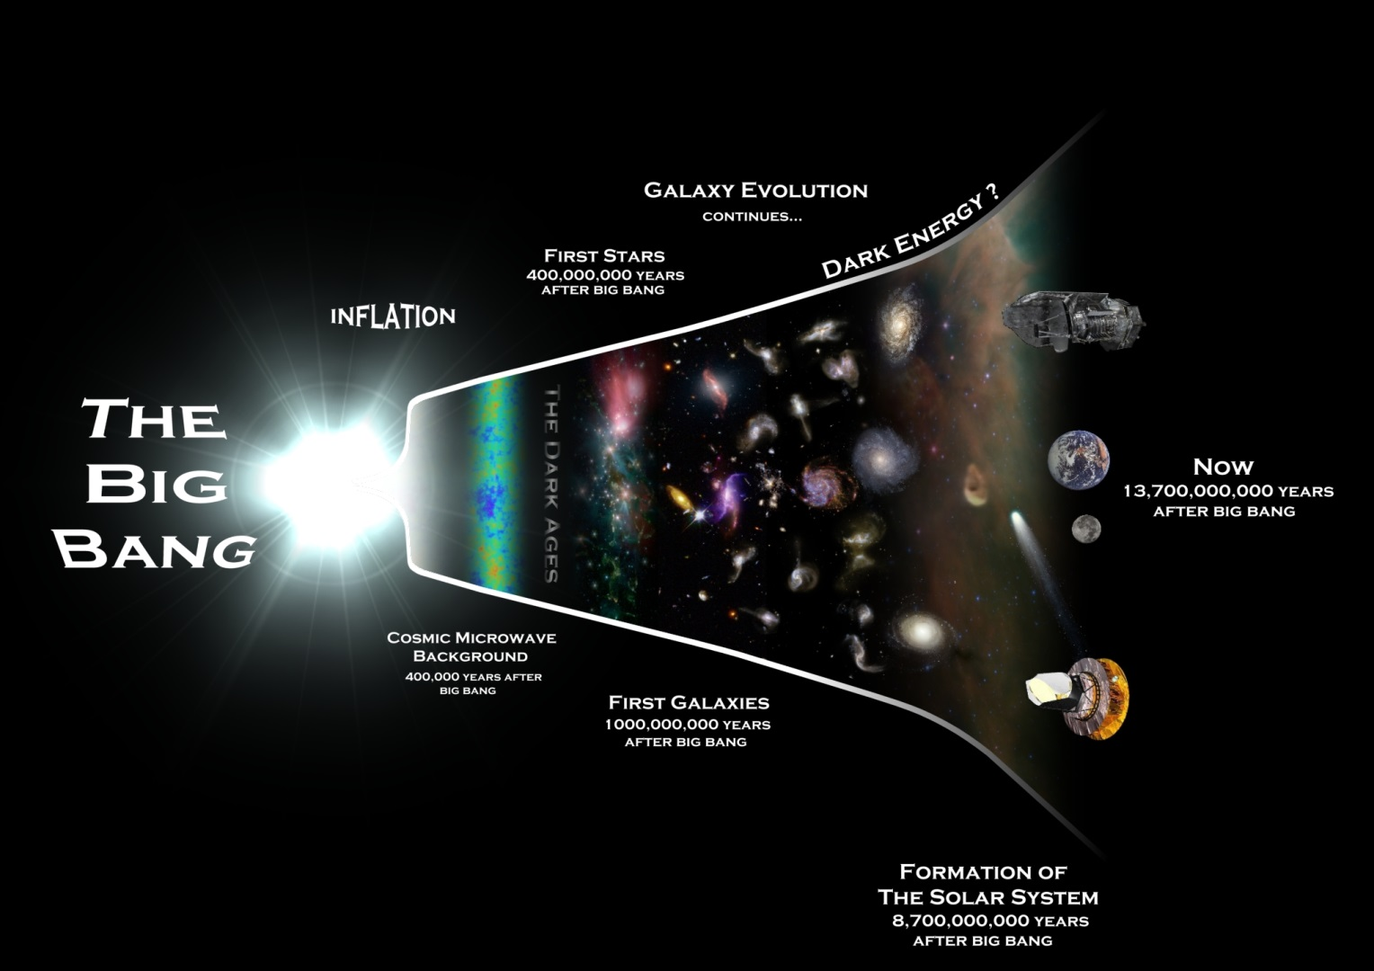
Stellar Nucleosynthesis
Big Bang Nucleosynthesis

Slide 7
One BILLION years later……..
Stars Formed…. And with them – other,
heavier elements……..
This is called Stellar Nucleosynthesis……

Slide 8
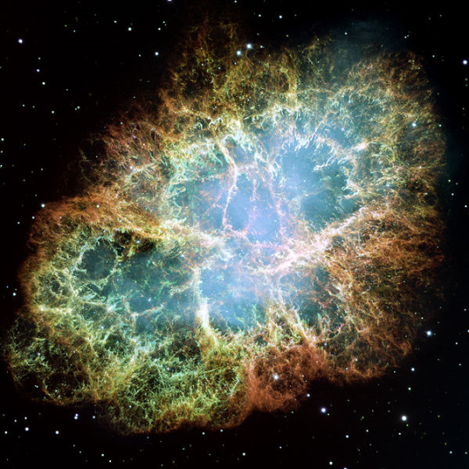
Temperature and Pressure
⁴He + ⁴He → ⁸Be
→ ⁸Be + ⁴He →
¹²C
¹²C + ⁴He → ¹⁶O

Slide 9
Temperature and Pressure
¹²C + He → ¹³N
+ He → ¹⁴N

Slide 10
What Are the Most Important Elements?
Six elements are the major constituents of living tissue…..
And they account for 95% of the biosphere……
Zone of Life on Earth
Global Sum of all ecosystems
C, H, O, N, P, S
Biotic/Abiotic (i.e. – the living/non living)
components of a system….

Slide 11
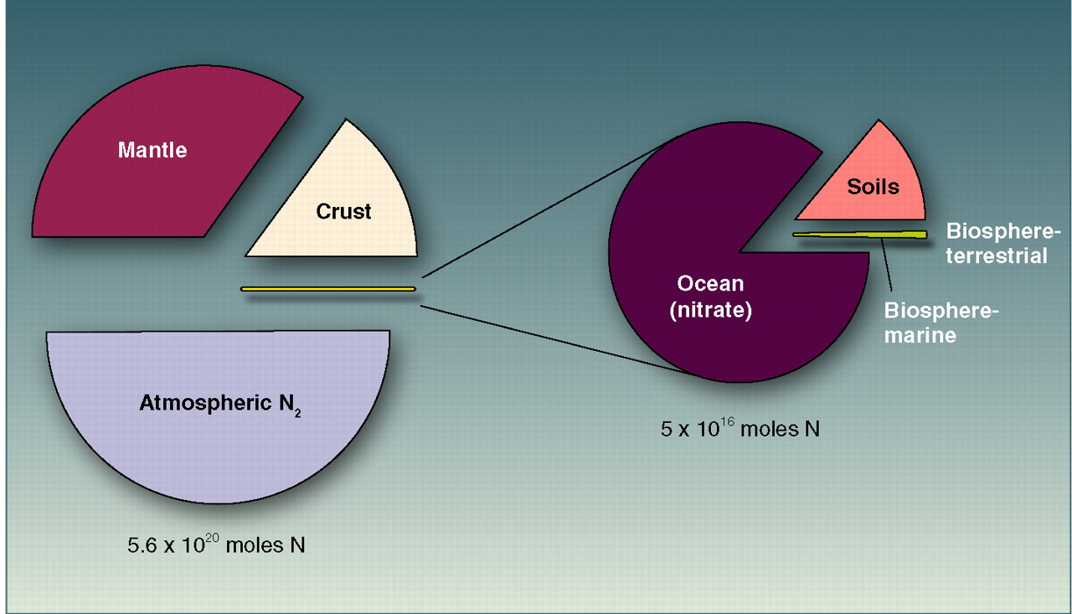
Reservoirs of N on Earth
Canfield et al. 2010

Slide 12
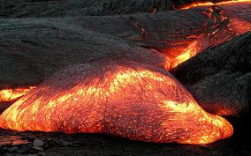
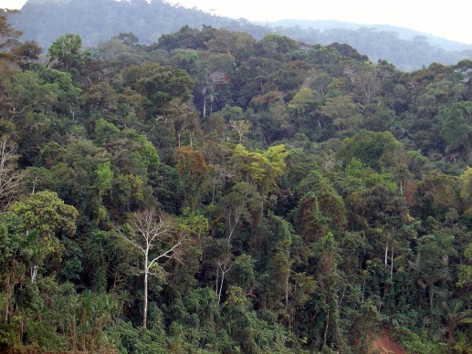
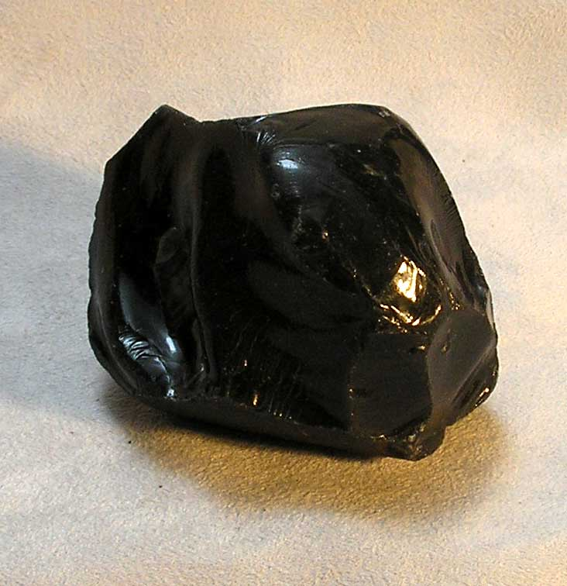
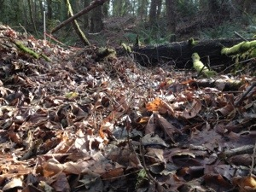
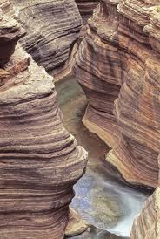

Reservoirs of N on Earth
Living and Dead Biomass
Igneous rocks
0.004%
~64%
~18%
~17%
Atmosphere
Sedimentary Rock

Slide 13
Biological Reactivity
Size of N Reservoir
Canfield et al. (2005) modified from Table 7.1 pg. 207

Slide 14
What did you find for common biomolecules?

Slide 15
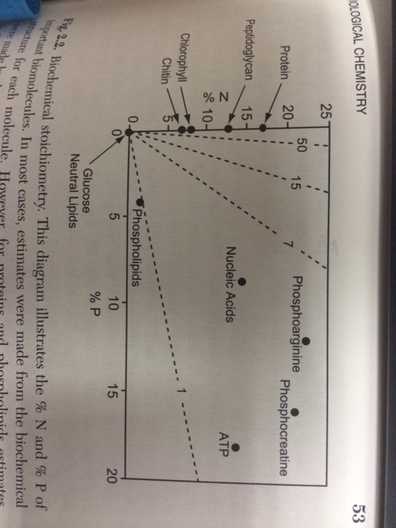
%N and %P in Important Biomolecules
Elser and Sterner (2002), fig. 2.2 pg. 53
Notes:
Phosphocreatine
From wiki (direct copy): “Phosphocreatine, also known as creatine phosphate or PCr, is a phosphorylated creatine molecule that serves as a rapidly mobilizable reserve of high-energy phosphates in skeletal muscle and the brain.”

Slide 16
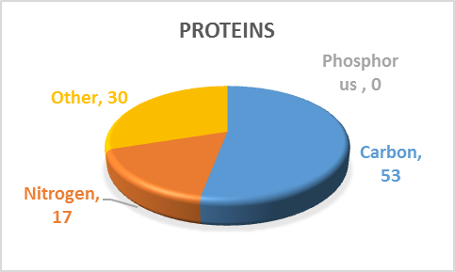
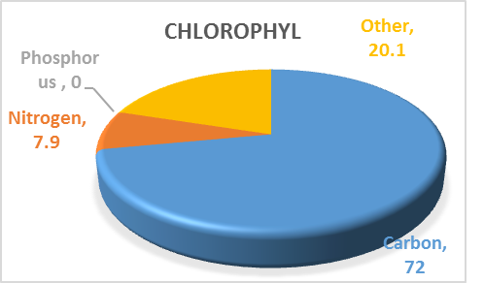
Data from Elser and Sterner (2002), figures from J. Morgan
Notes:
ATP: 28%C, 14%N, 18%P
Some proteins have P – like milk protein

Slide 17
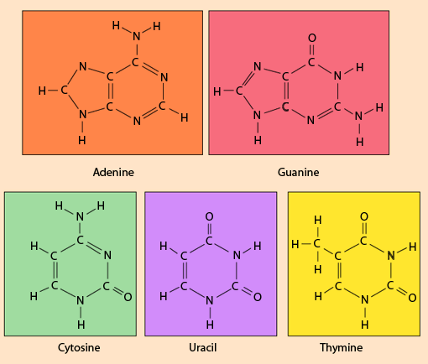
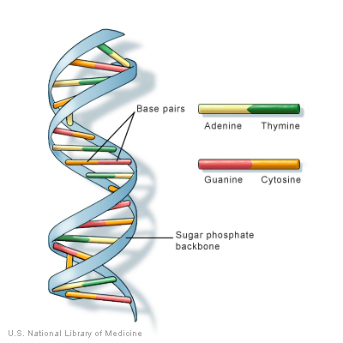
http://hyperphysics.phy-astr.gsu.edu/hbase/organic/base.html
http://ghr.nlm.nih.gov/handbook/basics/dna

Slide 18
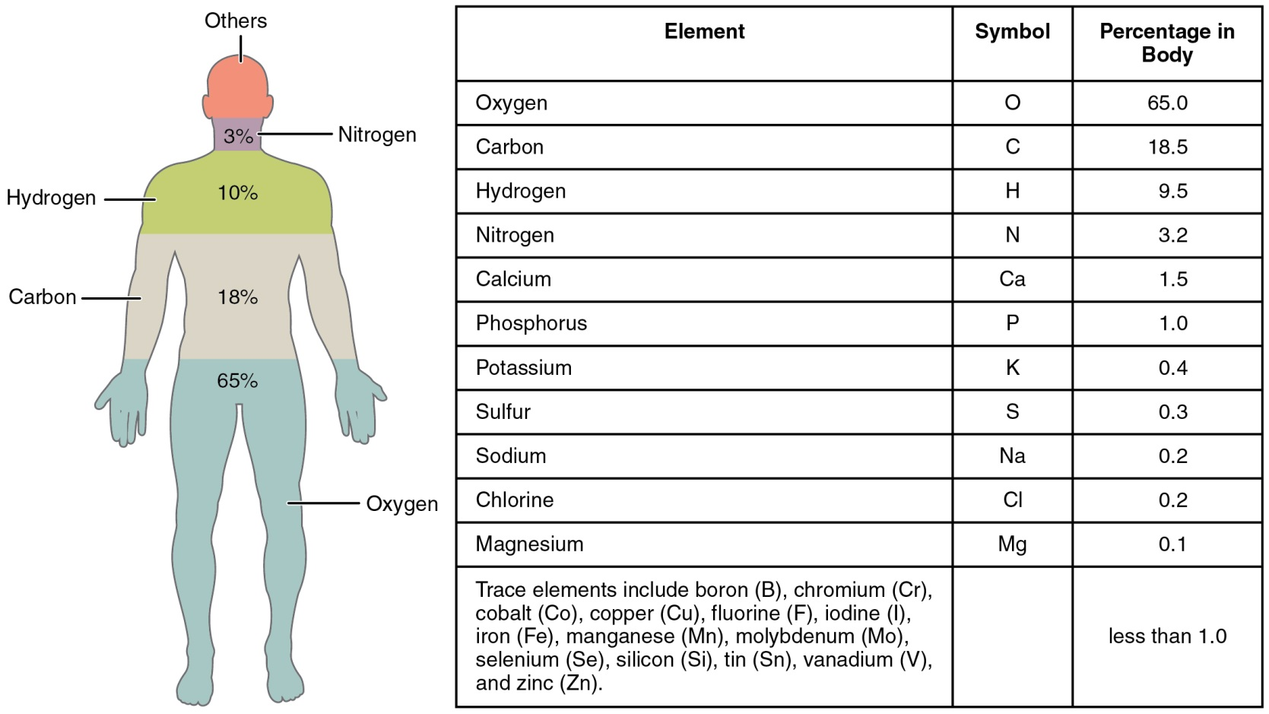
"201 Elements of the Human Body-01" by OpenStax College - Anatomy & Physiology, Connexions Web site. http://cnx.org/content/col11496/1.6/

Slide 19
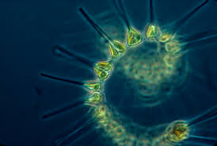
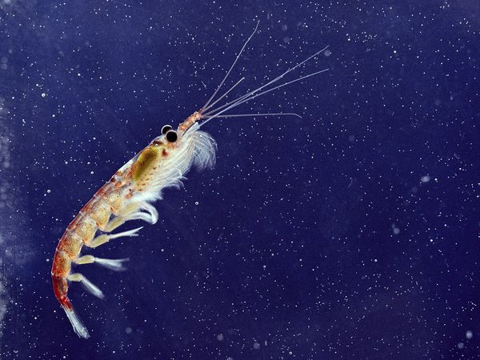
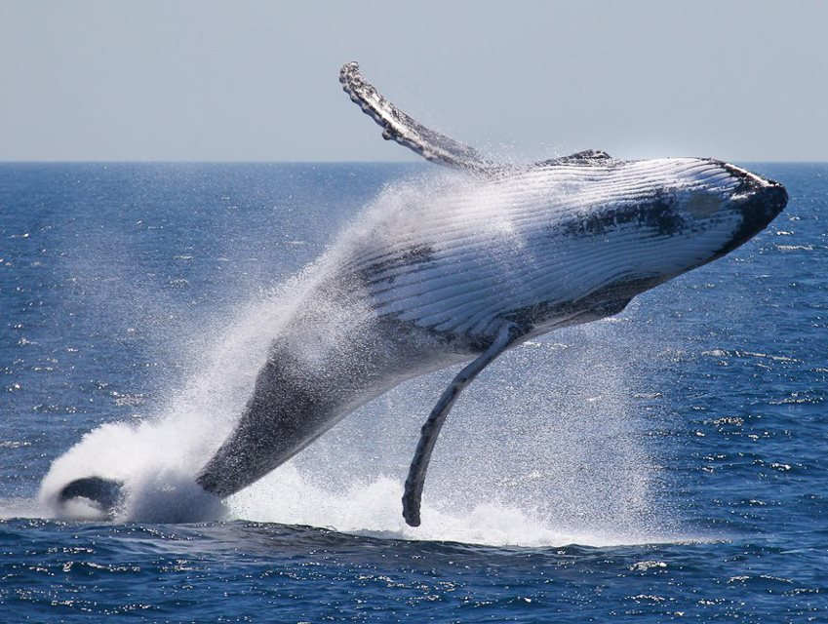

Nitrogen is essential for Life

Slide 20
“…depending on the life form, for every 100 atoms of C incorporated into cells, between 2 and 20
atoms of nitrogen follow…”
Canfield et al. (2011)

Slide 21
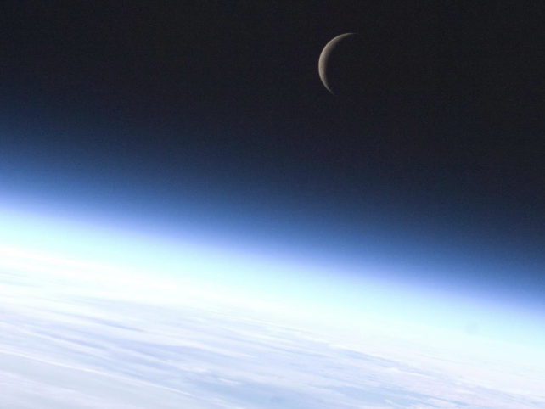

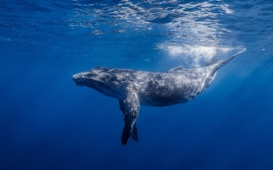

Two Broad Categories of Nitrogen
Biologically Usable
AKA:
Reactive Nitrogen (Nr)
2. **Biologically Un-usable
AKA:
Unreactive Nitrogen
NH₄⁺ = ammonium
NO₂⁻ = nitrite
NO₃⁻ = nitrate
  N₂ = Di-nitrogen gas

Slide 22
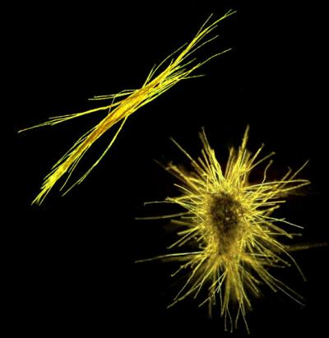
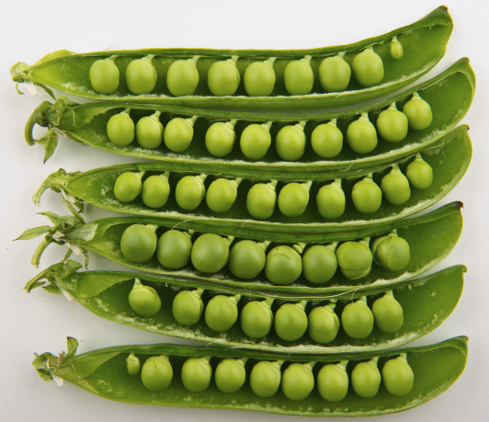
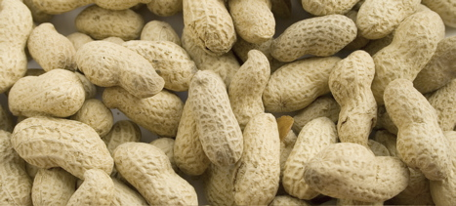
**Some organisms can use N₂!
Nitrogen Fixation
N₂ → NH₄⁺

Slide 23
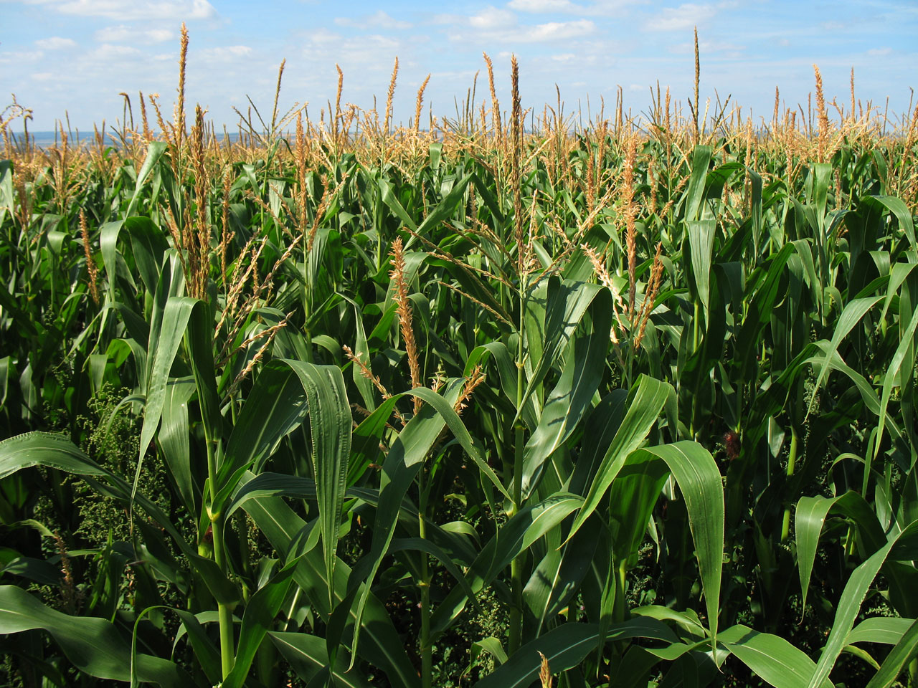

Slide 24
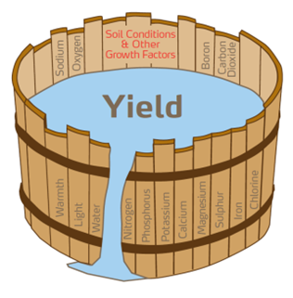
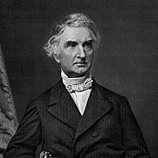
Justus von Liebig
“Father of Fertilizer Industry”
1855: Liebig’s Law of the Minimum
A limiting factor to biological activity is that material available in an amount most closely approaching the critical minimum required to sustain that activity (Odum 1971).

Slide 25
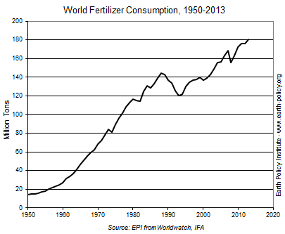

Slide 26
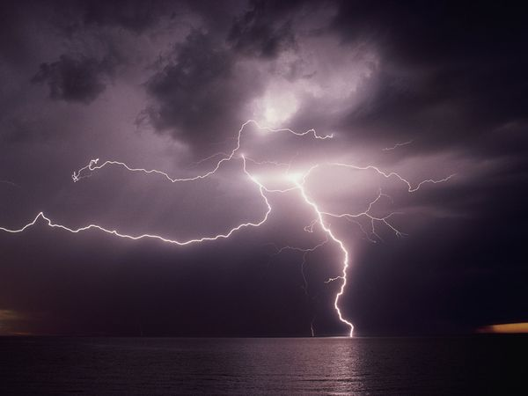

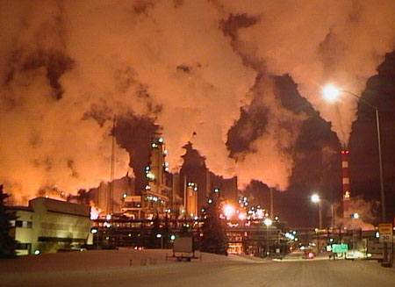
Human contribution:
1860
2000
Tg N y⁻¹
Tg N y⁻¹
Cultivation
15
33
Fossil Fuels
<1
25
Haber-Bosch
0
> 100
Total 1860: ~ 15 Tg N y⁻¹
Total 2000: ~ 165 Tg N y⁻¹
~1000%
Galloway et al. 2003 - The N Cascade
Notes:
22-26 million (if it’s 140)

Slide 27

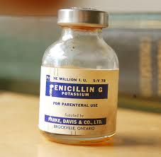


Greatest Invention of the last 150 or so years?

Slide 28
The Haber-Bosch process is often considered the most influential invention Of the 20th century because it
"detonated the population explosion...”
V. Smil, Nature, July 29 1999, p 415.
Notes:
Guesses on the % of the population that is alive today because of this process?

Slide 29
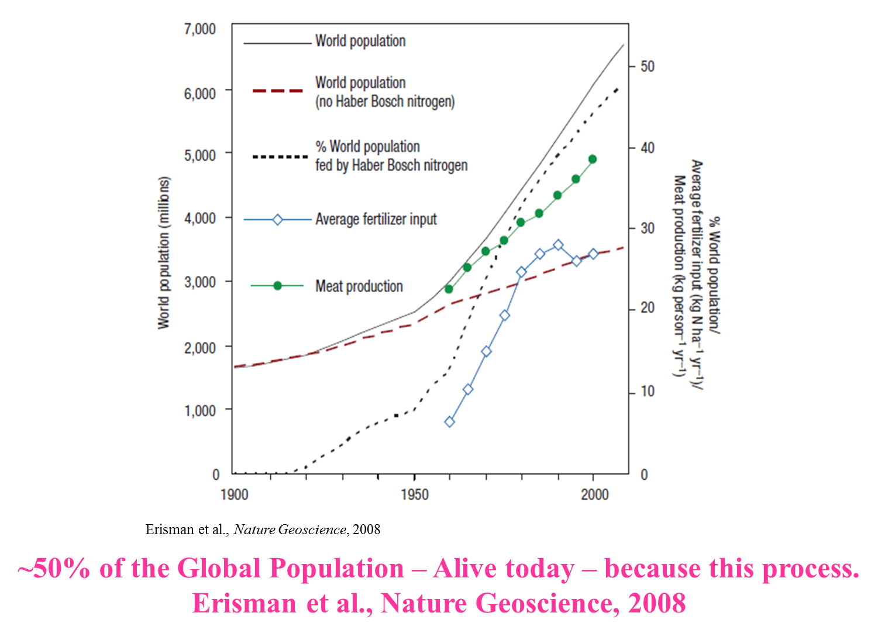

Slide 30
However….too much N - causes many
negative consequences…and, N gets
around…… that is - it doesn’t “stay put.”
“Cascades” through the
Environment….(from Galloway 2003)
Notes:
One nitrogen element can impact the ozone layer, land, freshwater, and marine waters….. It keeps going….

Slide 31
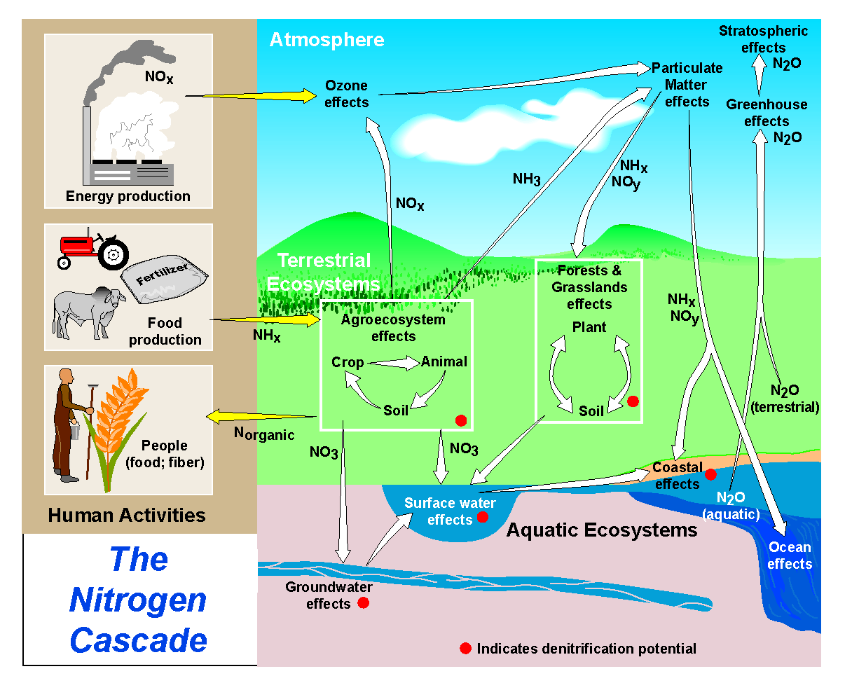
Nitrogen as a Shapeshifter
http://www.initrogen.net/94.0.html

Slide 32
The Fate of Haber-Bosch Nitrogen
N Fertilizer
Produced
N Fertilizer
Consumed
N
in Crop
N
Harvested
N
in Food
N
Consumed
100
94
47
31
26
14
-6
-47
-16
-5
-12
14% of the N produced in the Haber-Bosch process enters the
human mouth……….
if you are a vegetarian
Data from Galloway JN and Cowling EB. 2002; Slide modified from Galloway 2003

Slide 33
The Fate of Haber-Bosch Nitrogen
N Fertilizer
Produced
N Fertilizer
Applied
N
in Crop
N
In Feed
N
in Store
N
Consumed
100
94
47
31
7
4
-6
-47
-16
-24
-3
4% of the N produced in the Haber-Bosch process and used
for animal production enters the human mouth.
Data from Galloway JN and Cowling EB. 2002; Slide modified from Galloway 2003

Slide 34
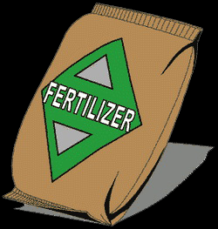

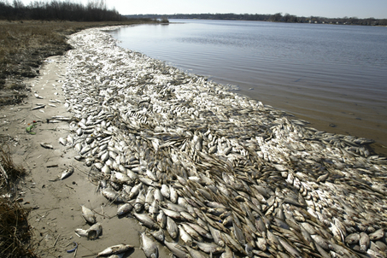

Too much of a good thing…
N
N

Slide 35
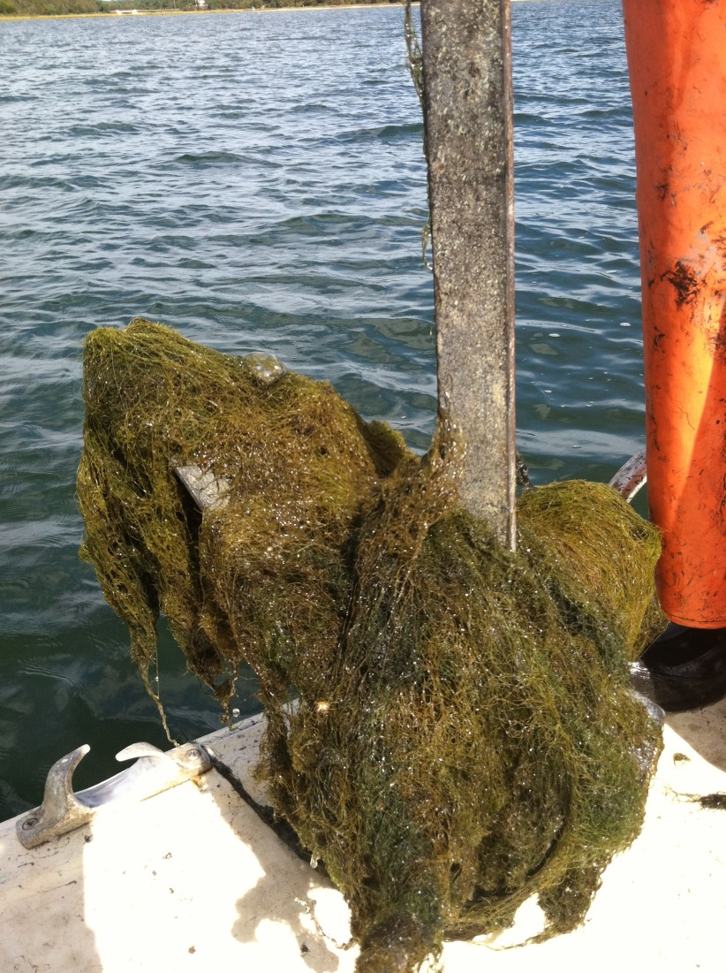
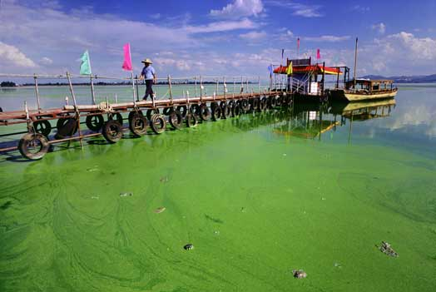
Eutrophication - an increase in the supply
of organic matter to a system. (Nixon 1995)

Slide 36

*
*
*
*
*
*
*
*
*
*
*
*
O₂
*
*
*
*
*
*
*
O₂
O₂
*
*
*
*
*
*
Septic tank
*
*
DIN_{r}
O₂
O₂
O₂
ANOXIA
Slide modified from S.Q. Foster

Slide 37
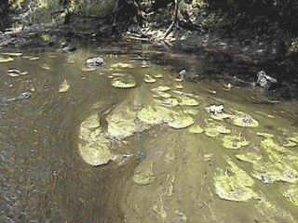
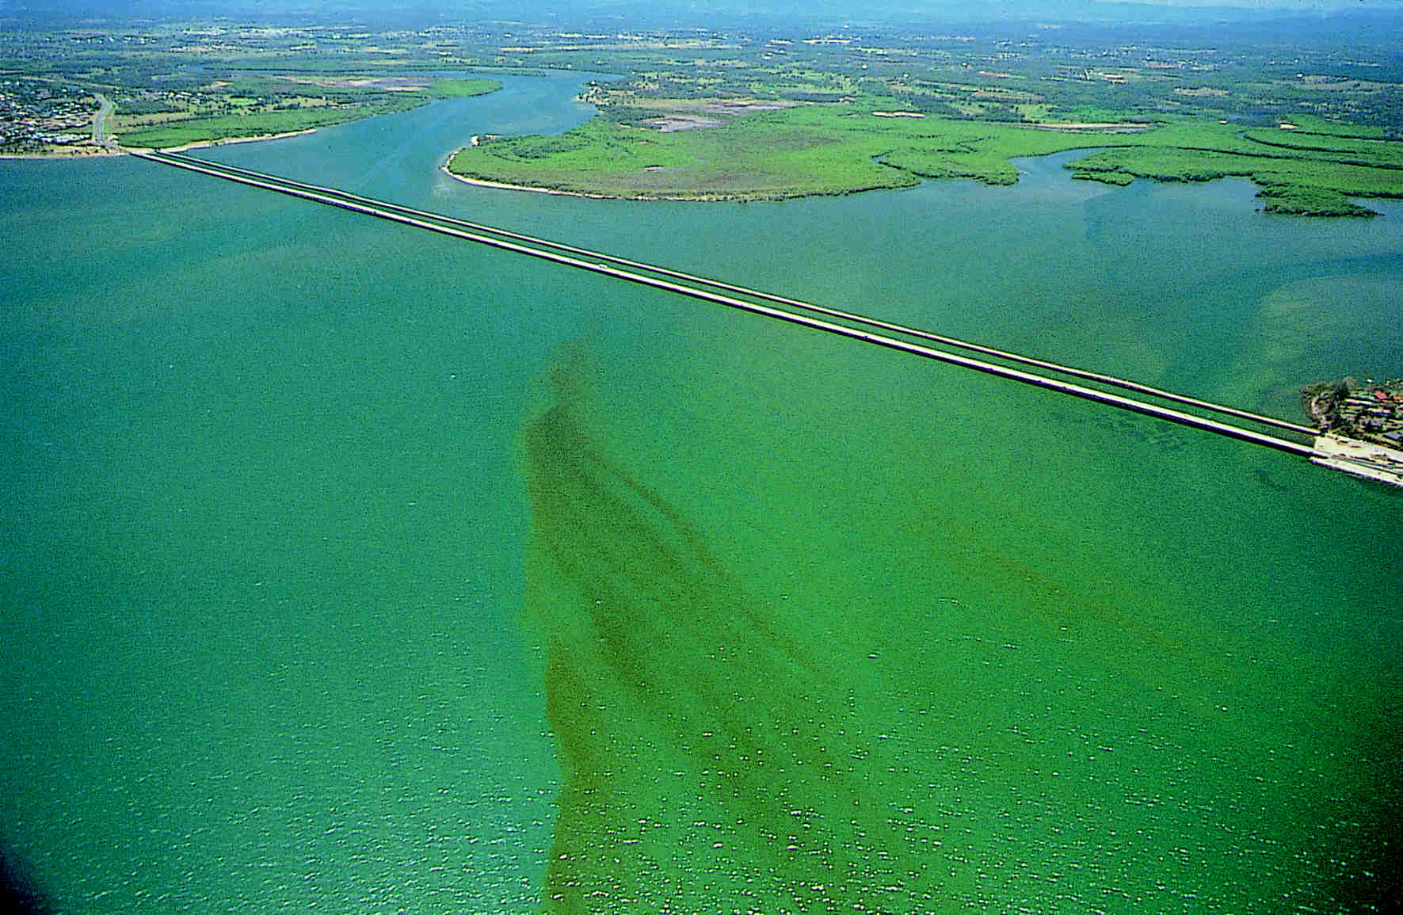
N Loading and Aquatic ecosystem response
• Increased algal productivity
• Harmful algal blooms
• Formation of nuisance algal mats
Low Oxygen Conditions
Fish kills - fin and shell
Loss of biodiversity
Loss of submerged aquatic vegetation
Sybil Seitzinger, 2003

Slide 38
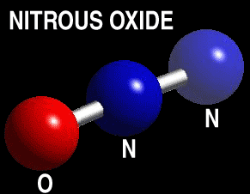
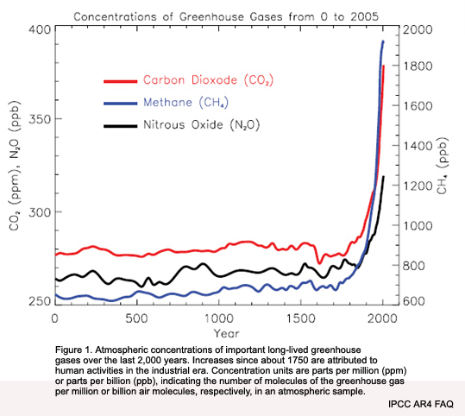
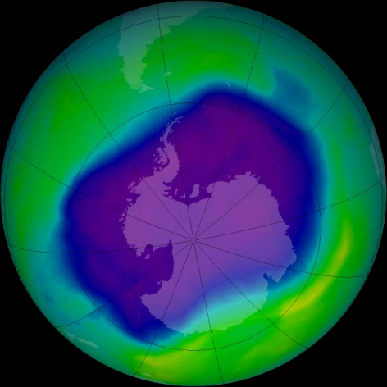
Excess N and Nitrous Oxide (N₂O)

Slide 39
We are currently faced with a grand challenge: how do we feed an increasing population while protecting and even restoring our environment?
The goal of this course is to take on this grand challenge.

Slide 40
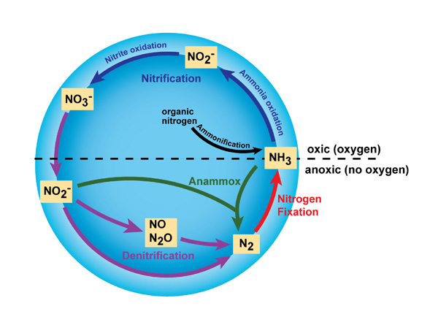
Bernhard 2008

Slide 41
Some Nitrogen Language
N₂ → NH₄⁺ N Fixation Very sensitive to oxygen
Auto or hetero-trophic
1. NH₄⁺ → NO₂⁻
2. NO₂⁻ → NO₃⁻ Nitrification aerobic, autotrophic
NO₃⁻ → N₂ Denitrification anaerobic, heterotrophic
Nr = reactive nitrogen

Slide 42
Extras

Slide 43
Chemistry 101
Atomic Number: number of protons
      Hydrogen has 1 proton; Carbon has 6 protons
Atomic Weight: average mass of atoms of
an element, calculated using the relative abundance of isotopes in a naturally occurring element.
Carbon = 12.001; Nitrogen = 14.007

Slide 44
Isotope: Atoms with the same number of protons but different number of neutrons.
Carbon-12 = 6 protons + 6 neutrons
Carbon-14 = 6 protons + 8 neutrons

