Slide 1
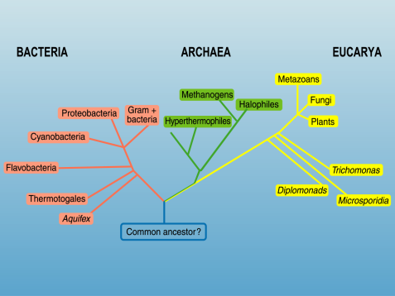
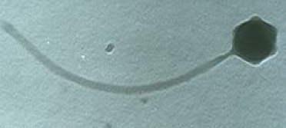
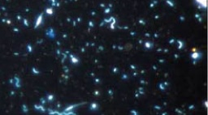
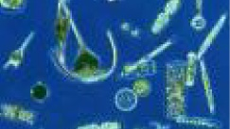
THE SEA MICROBES
bacterioplankton
phytoplankton
zooplankton
Eukaryotes
Prokaryotes (?)
algae
protozoa
micro-metazoa
Acellular
bacteria
archaea
viruses
<0.2 μm
0.2 – 2 μm
2 – 50 μm
Notes:
Virus-c.tif, microbes-1-c.tif, CAAFODG1-c.tif

Slide 2
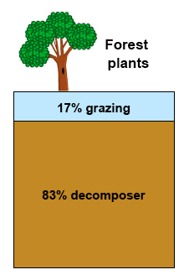
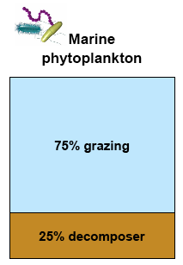
Microbial 1° production
Grazer community
Short food chains
Plant 1° production
Decomposer community
Long food chains
Microbes “unlock” C from plant polymers

Slide 3
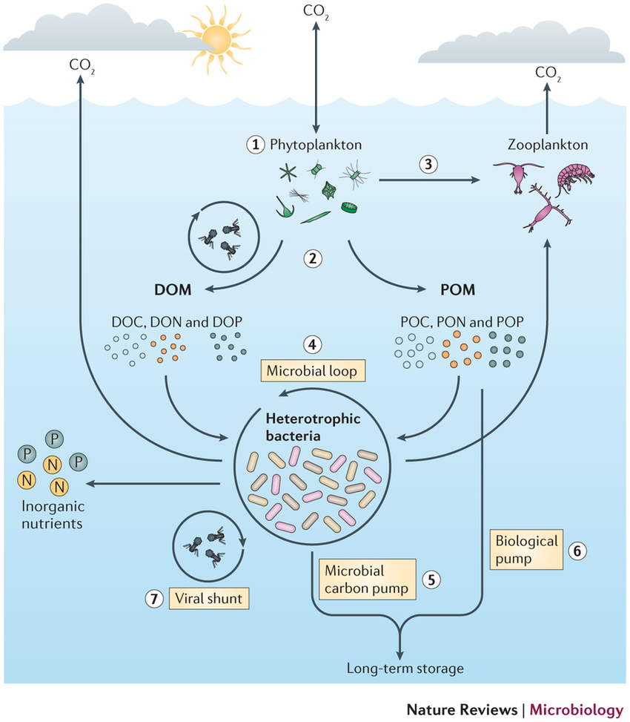
Buchan et al 2014 Nature Reviews Microbiology

Slide 4
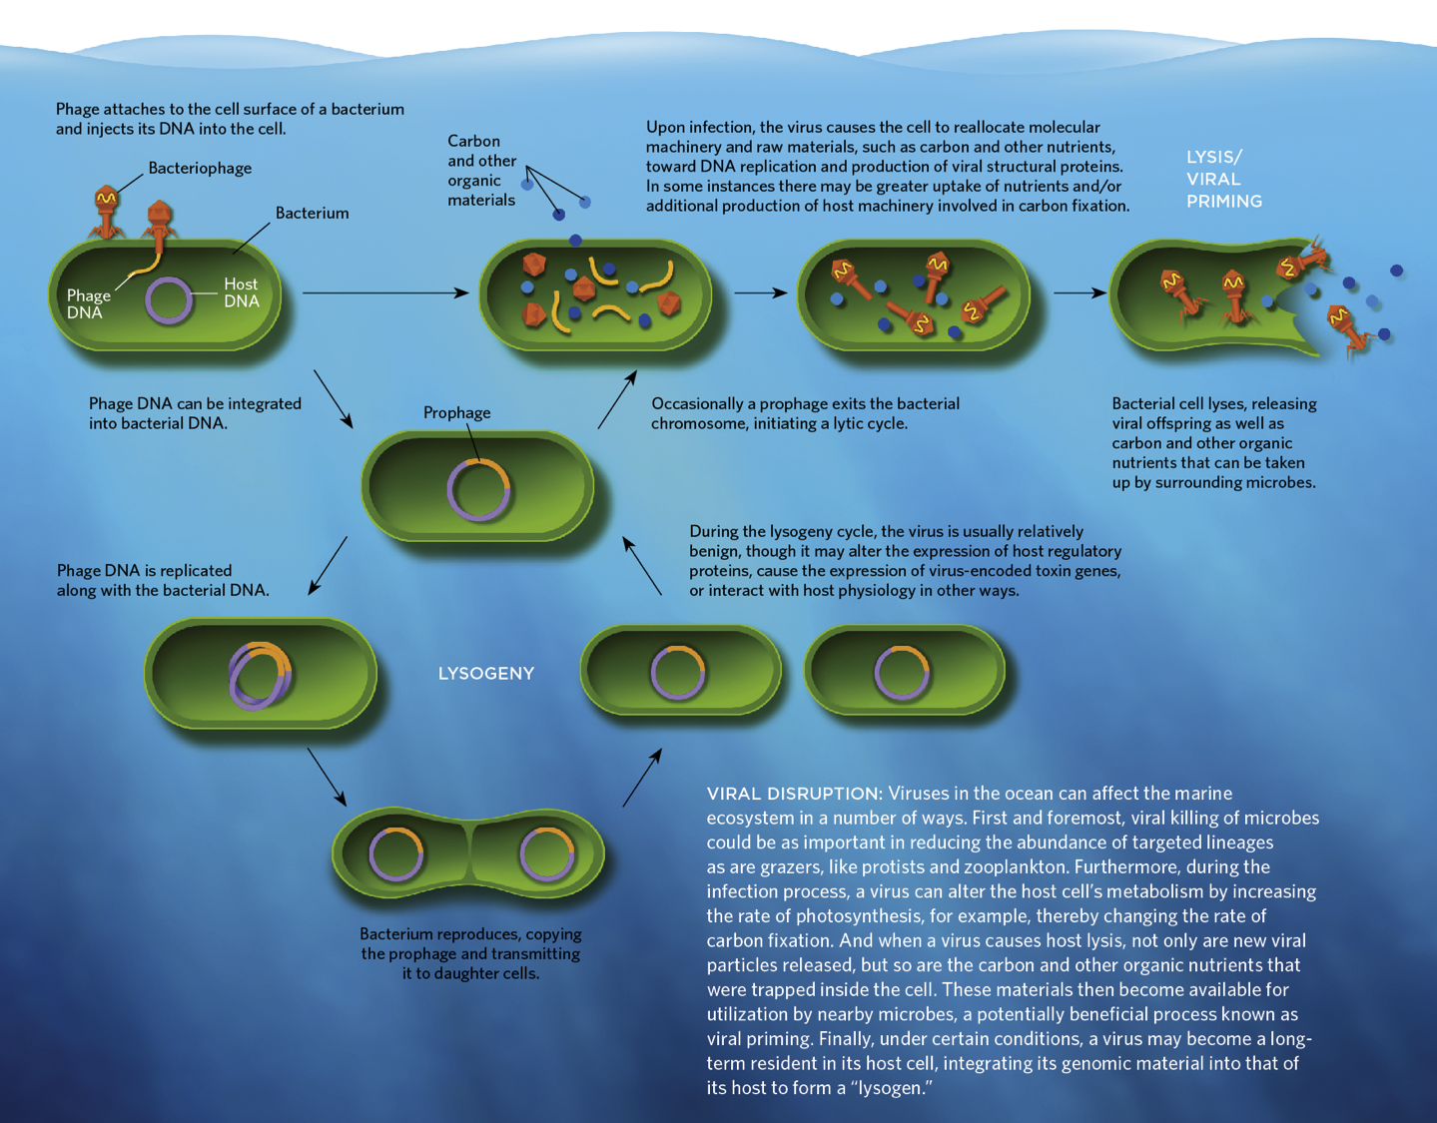
Are all viruses bad?
https://www.the-scientist.com/July2013/virus_infograph.pdf

Slide 5
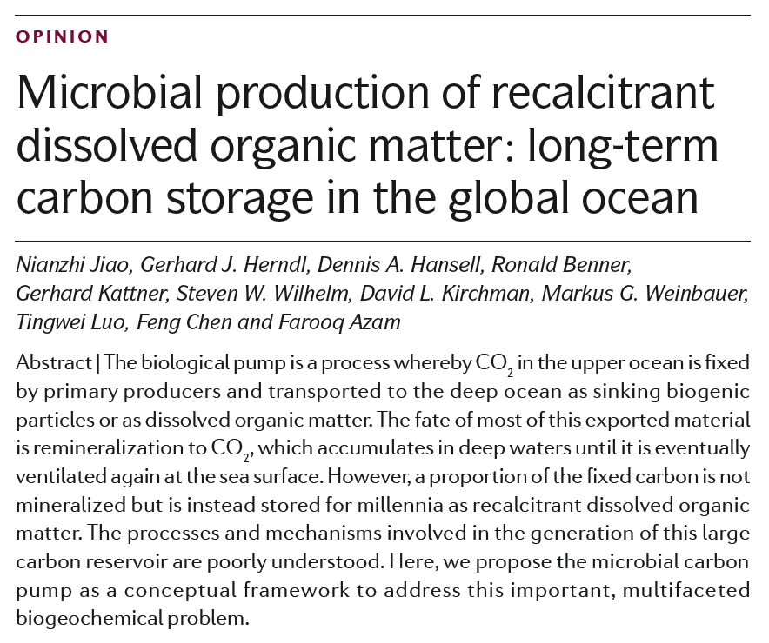
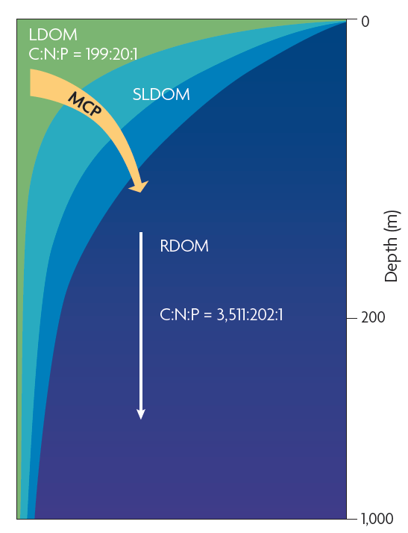
Nature reviews in microbiology v 8 (August 2010) p 593

