Slide 1
Methane Emissions from Vegetated Coastal Systems
Alia Al-Haj
Marine Biogeochemistry
April 24, 2018

Slide 2
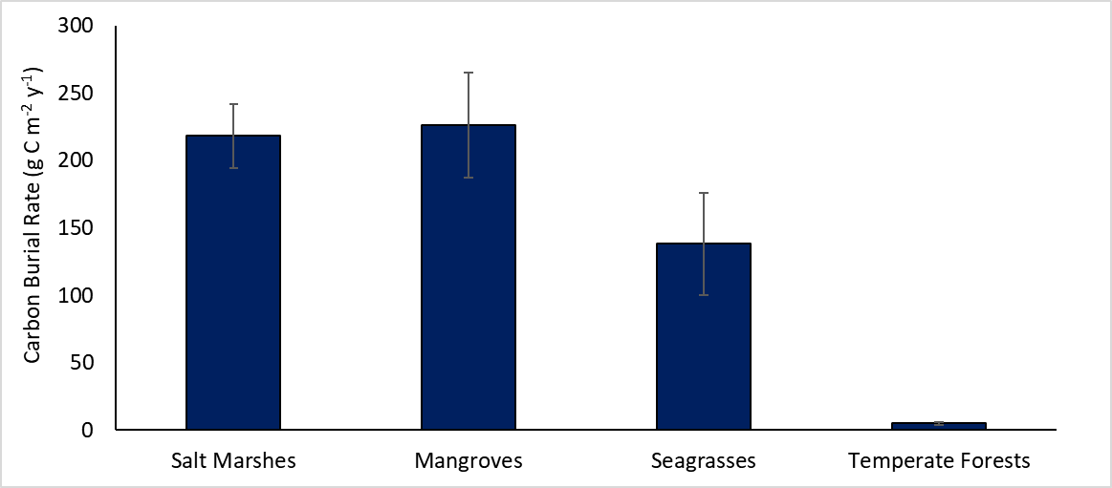
Coastal ecosystems bury 10x more carbon than terrestrial systems
Modified from: Mcleod et al., 2011
Notes:
Make all lines black

Slide 3
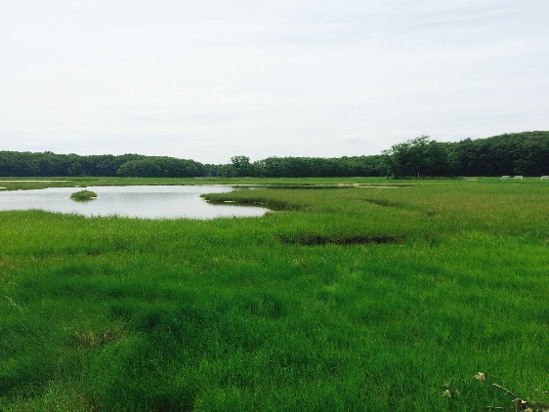
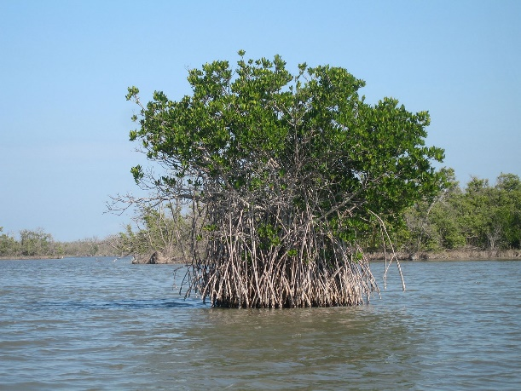
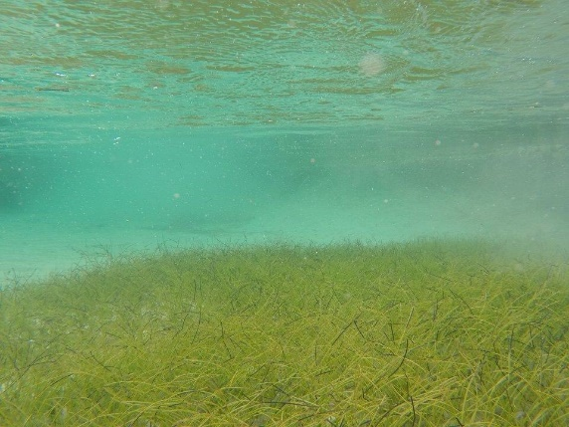
The carbon buried in coastal systems is called “Blue Carbon”
http://thebluecarboninitiative.org/
Notes:
Saturate the colors using photoshop add pictures outlined in same colors as the systems

Slide 4
Drivers of carbon storage: Photosynthesis
Howard et al., 2017

Slide 5
Most carbon in vegetated coastal systems is stored in the sediments
Murray et al. 2011

Slide 6
About 50% of the carbon stored in sediments is not vegetation
Soil OC from veg
Murray et al., 2011
Notes:
Seagrass: Kennedy et al., 2010
Salt Marsh: 4%-60% veg estimate based on Carey et al., 2017 (highly variable)
Mangroves: Up to 75% veg from Bouillon et al., 2003 (but highly variable, as little as 10%)
ANIMATE

Slide 7
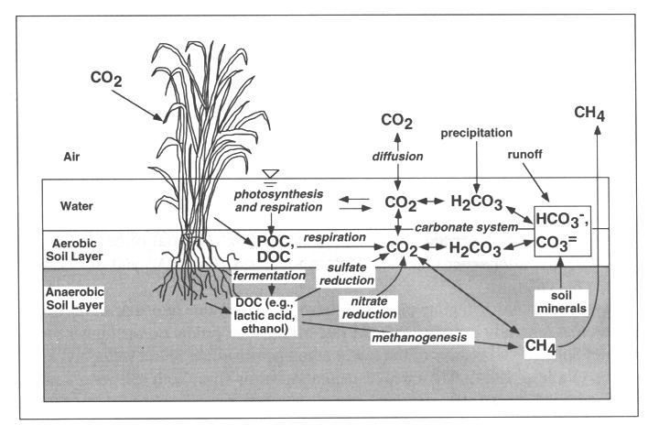
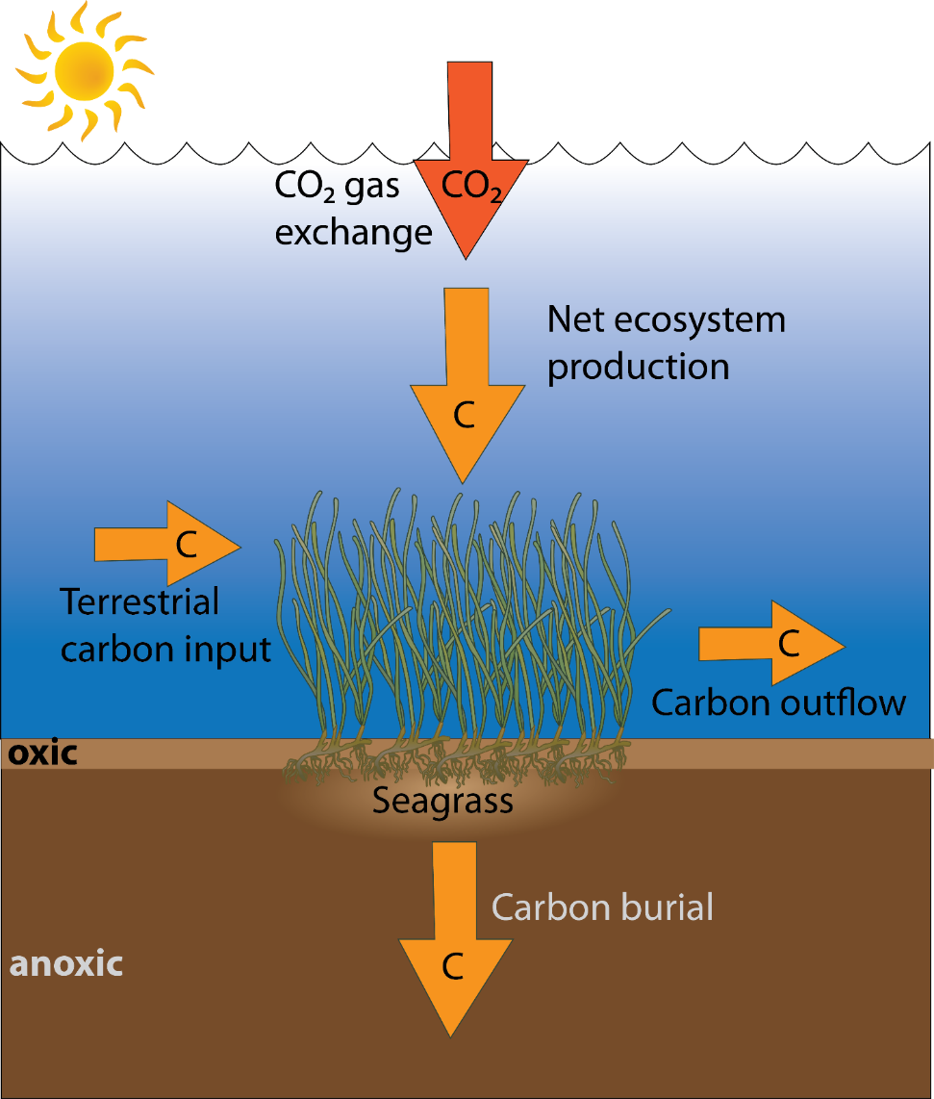
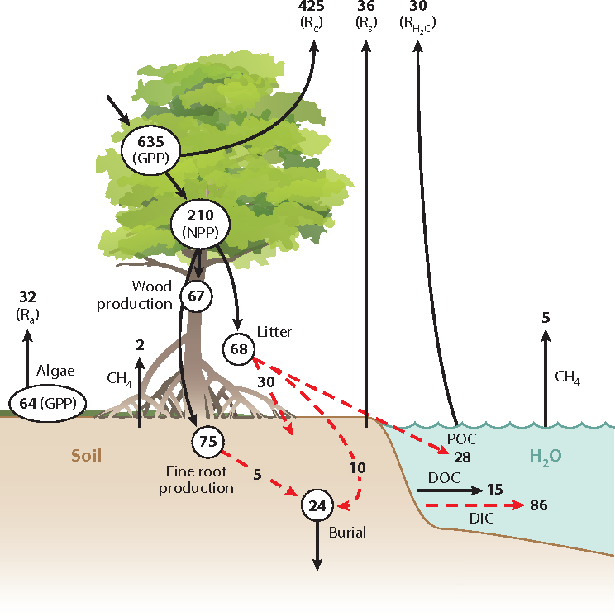
Drivers of carbon storage: Imported C, Sediment Anoxia
Mitsch and Gosselink, 1993
Adapted from Tokoro et al., 2014
Alongi, 2014
Notes:
M.E. Collins, R.J. KuehlOrganic matter accumulation in organic soils
J.L. Richardson, M.J. Vepraskas (Eds.), Wetland Soils. Genesis, Hydrology, Landscapes, and Classification, Lewis Publishers, CRC Press, Boca Raton, Florida (2001), pp. 137-162
Highlight each one as you are going through ANIMATE

Slide 8
How do gaseous carbon emissions impact carbon storage?
CH₄?
CH₄?
CH₄?
Adapted from Howard et al., 2017
Notes:
Want to balance the bank account for C but we don’t know how much we are spending on CH4 and CO2. We are spending money we don’t have in the form of CH4
Make the arrows and words bigger for fluxes

Slide 9
How much methane is emitted from vegetated coastal ecosystems?
What impact does methane emission have on blue carbon storage?

Slide 10
Methane has a global warming potential 25x that of carbon dioxide
IPCC, 2013
Notes:
Ch4 45 ppm CO2 equiv
N20 100 ppm CO2 equiv
VISUALIZE ONE METHANE =25 CO2

Slide 11
Methane has a global warming potential 25x that of carbon dioxide
IPCC, 2013
1 methane
25 carbon dioxide
Notes:
Ch4 45 ppm CO2 equiv
N20 100 ppm CO2 equiv
VISUALIZE ONE METHANE =25 CO2

Slide 12
Methanogenesis is at the bottom of the sediment redox ladder

Slide 13
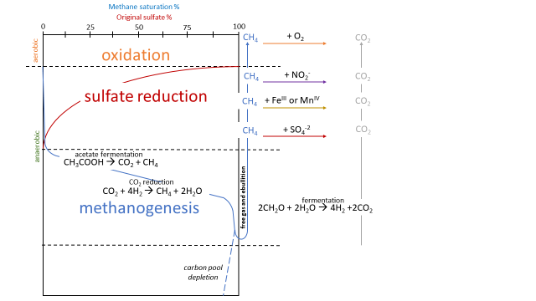
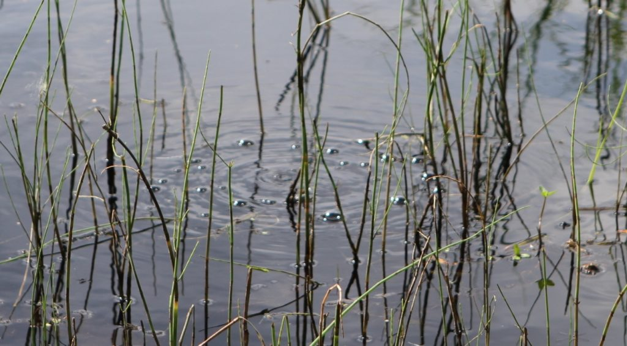
Methane oxidation can occur through many pathways
https://blogs.nasa.gov/earthexpeditions/2016/08/23/mapping-methane-in-a-bubbling-arctic-lake/
Notes:
Get A PICTURE OF BUBBLING METHANE
Move the hypothesis about salinity and sulfate to another slide add more pictures of seagrass and saltmarsh

Slide 14
How can we tell if sulfate is around?
Salinity is used as a proxy for sulfate presence in many studies
Current hypothesis: If sulfate concentrations are high, methane emission is low.
Therefore, if salinity is high, methane emission is low.
Is this hypothesis true?
Notes:
Get A PICTURE OF BUBBLING METHANE
Move the hypothesis about salinity and sulfate to another slide add more pictures of seagrass and saltmarsh

Slide 15
Methods
Literature Review
73 papers (94 data points)
7 seagrass
24 mangrove
42 Saltmarsh
26 field studies (data from these)
16 mesocosm studies
Notes:
Google Scholar search terms
Seagrass methane
Mangrove methane
Saltmarsh methane
Some papers found because cited in other papers

Slide 16
Methods
1. Literature Review
2. Meta-analysis
Basic statistics (mean, se)
Differences between veg types (ANOVA)
Change with salinity linear model

Slide 17
Average methane fluxes from vegetated coastal ecosystems do not vary by system
p>0.05
n = sample size
Notes:
Ran ANOVA, no differences between vegetation types
As I am talking do an animation to show what n is and as I am talking about each one. Conclusion box for take away of the figure (in red?)

Slide 18
What is the spatial coverage for this analysis?

Slide 19
What impact does methane emission have on blue carbon storage?
Modified from: Mcleod et al., 2011
Notes:
add a take home message box for end of figure CRAZY HIGHER FLUX THAN BEING BURIED. Put a red box that says is salinity driving this as a transition

Slide 20
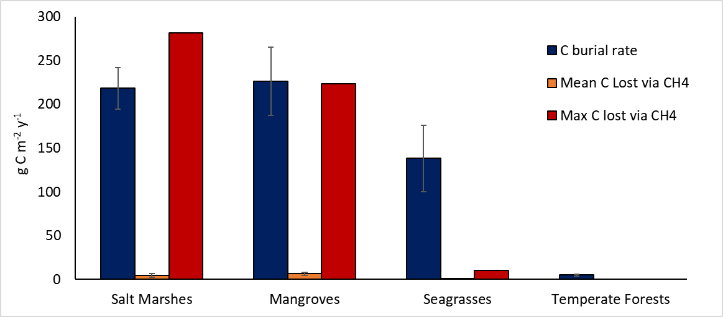
Losses of C by methane emission can be higher than burial
Is salinity driving this high methane emission?
Modified from: Mcleod et al., 2011

Slide 21
Does salinity predict methane emission?
Yes!
Mean methane flux (mg CH₄ m⁻² d⁻¹)
Salinity (ppt)
R² = 0.145, p = 0.0044
Notes:
Fill circles, make words clearer with text boxes, match colors on the map

Slide 22
What are potential drivers of methane emission from vegetated coastal systems?
Notes:
Screenshot the title of the lyimo 2017 paper -> disturbance matters!
Do a table comparing the systems of possible different drivers of fluxes
Temperature, Mechanical, Nitrogen

Slide 23
What are potential drivers of methane emission from vegetated coastal systems?
Methane emissions are higher in disturbed systems
Notes:
Screenshot the title of the lyimo 2017 paper -> disturbance matters!
Do a table comparing the systems of possible different drivers of fluxes
Temperature, Mechanical, Nitrogen

Slide 24
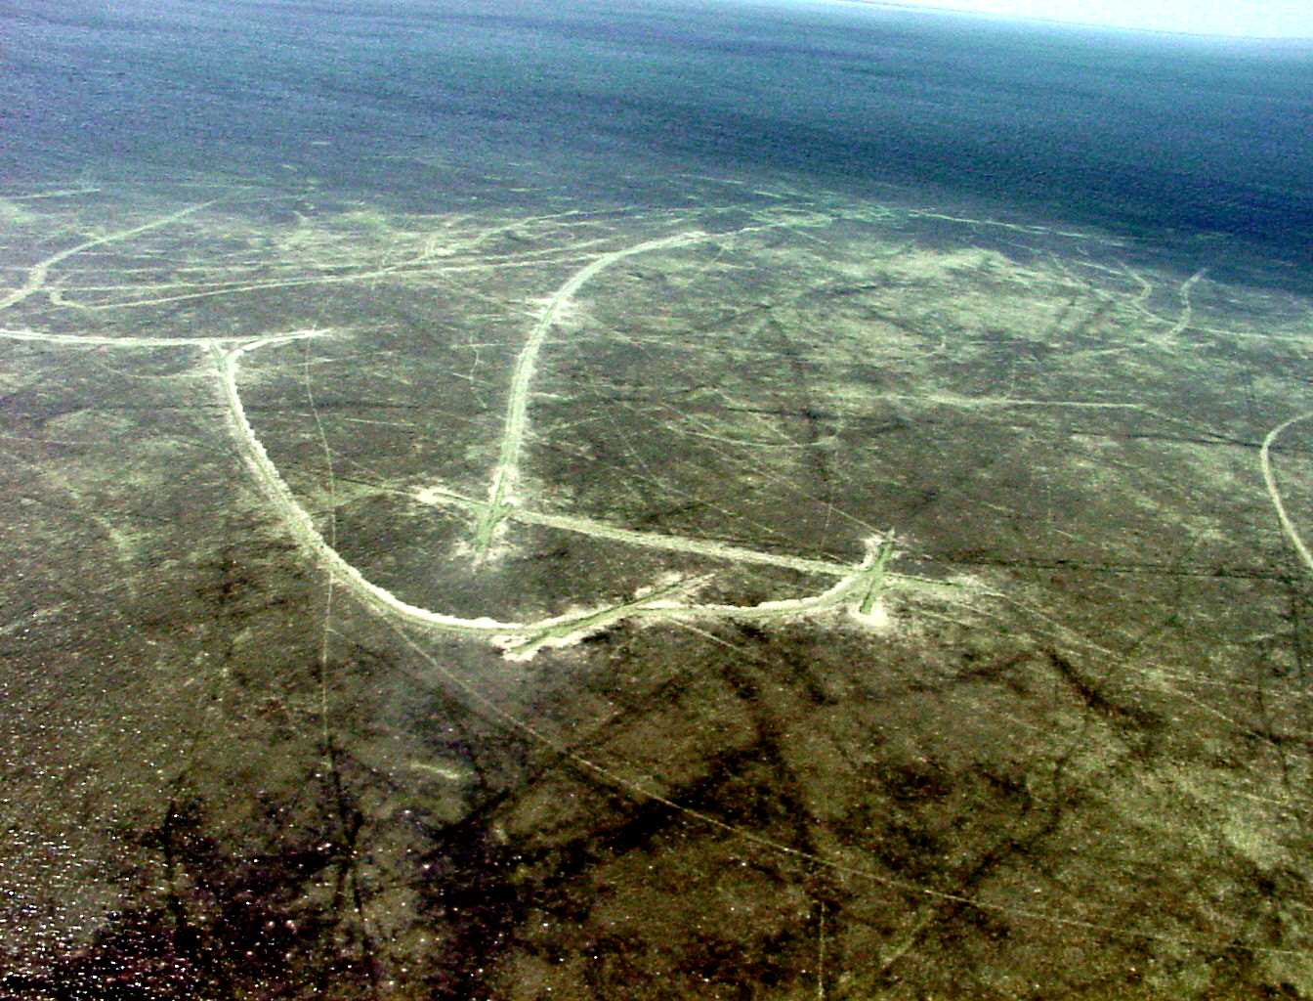
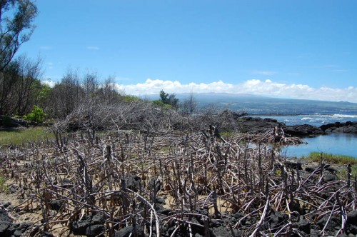
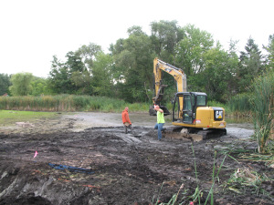
What are potential drivers of methane emission from vegetated coastal systems?
Mechanical Disturbance
https://www.oceanfdn.org/sites/default/files/MyJo_Air65a.jpg
https://damontucker.com/tag/mangrove-removal/
https://thurstonnaturecenter.wordpress.com/2015/08/
Notes:
Screenshot the title of the lyimo 2017 paper -> disturbance matters!
Do a table comparing the systems of possible different drivers of fluxes
Temperature, Mechanical, Nitrogen

Slide 25
What are potential drivers of methane emission from vegetated coastal systems?
Excess Nutrients
https://www.crcl.org/programs/science/land-loss-and-large-scale-disturbances/93-programs/science/land-loss-and-large-scale-disturbances/183-restoring-natural-hydrology-2.html

Slide 26
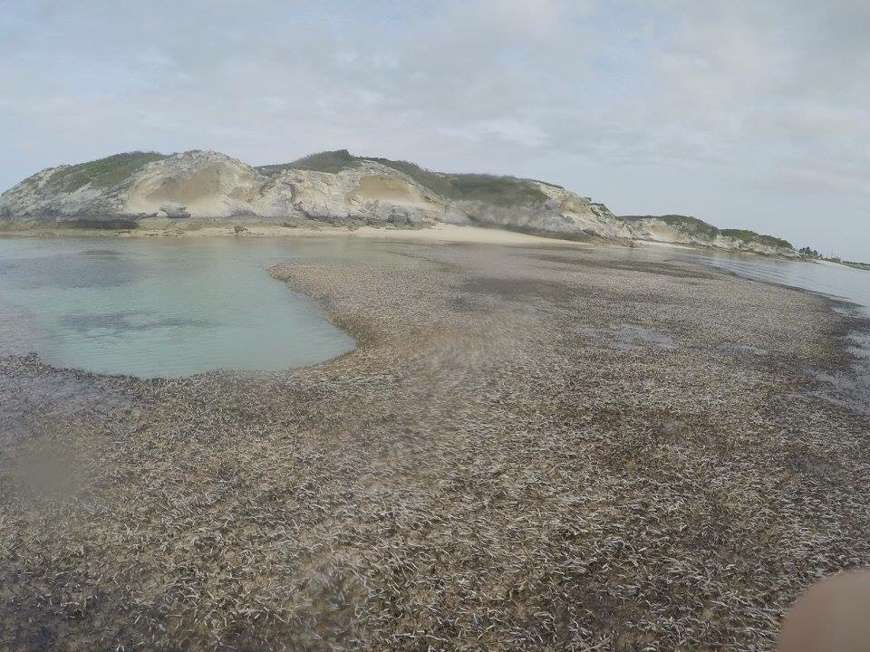
What are potential drivers of methane emission from vegetated coastal systems?
Increasing Temperatures

Slide 27
How might these drivers impact methane emissions?
Mechanical disturbance increases methane emissions
Notes:
Screenshot the title of the lyimo 2017 paper -> disturbance matters!
Do a table comparing the systems of possible different drivers of fluxes
Temperature, Mechanical, Nitrogen

Slide 28
How might these drivers impact methane emissions?
CH₄
CH₄
CH₄
CH₄
O₂
O₂
O₂
O₂
O₂
O₂
O₂
O₂
O₂
O₂
O₂
O₂
O₂
Notes:
Screenshot the title of the lyimo 2017 paper -> disturbance matters!
Do a table comparing the systems of possible different drivers of fluxes
Temperature, Mechanical, Nitrogen

Slide 29
How might these drivers impact methane emissions?
Mechanical disturbance
CH₄
CH₄
CH₄
CH₄
CH₄
CH₄
CH₄
Notes:
Screenshot the title of the lyimo 2017 paper -> disturbance matters!
Do a table comparing the systems of possible different drivers of fluxes
Temperature, Mechanical, Nitrogen

Slide 30
How might these drivers impact methane emissions?
Mechanical Disturbance
Nutrient Pollution
Temperature
Notes:
Screenshot the title of the lyimo 2017 paper -> disturbance matters!
Do a table comparing the systems of possible different drivers of fluxes
Temperature, Mechanical, Nitrogen

Slide 31
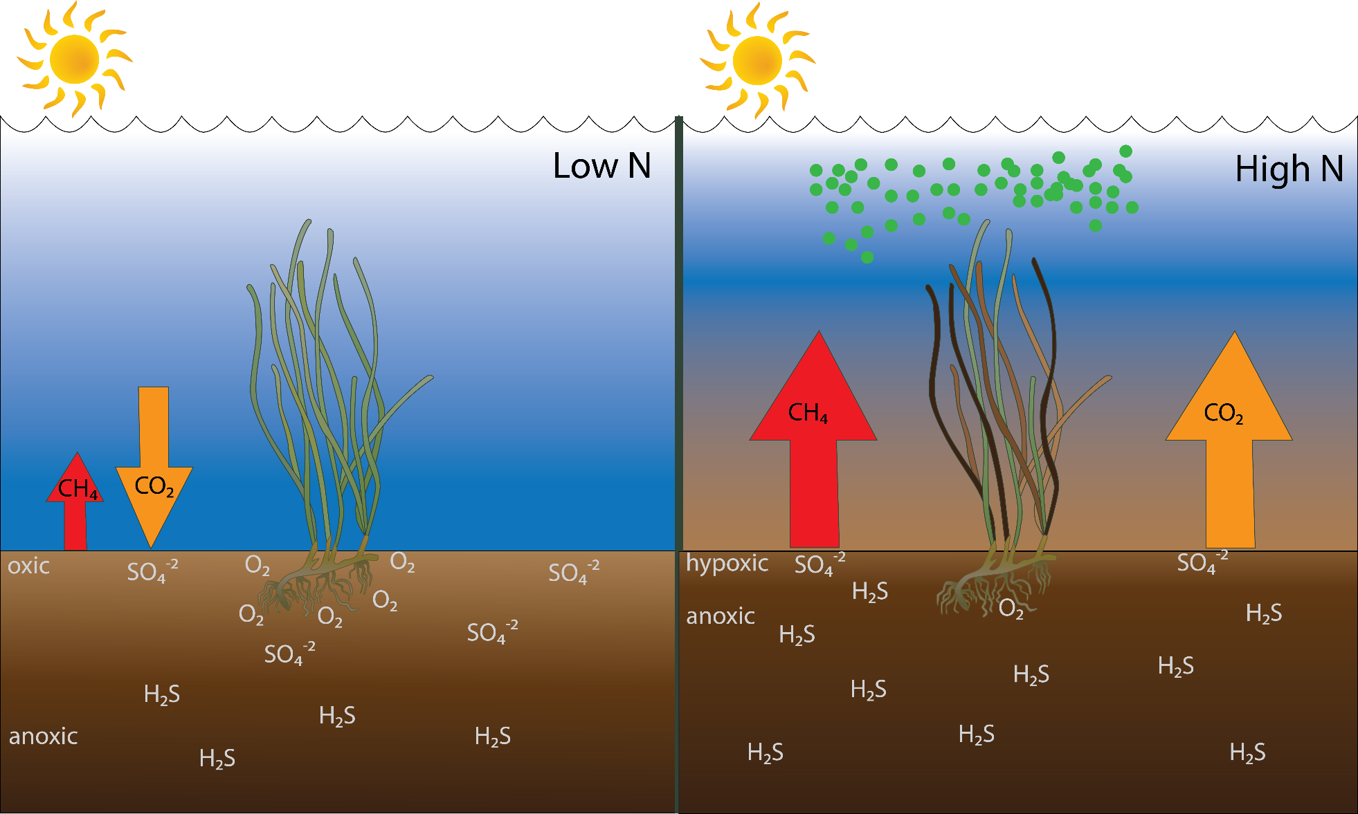
Nutrient loading can cause algal blooms that shade seagrass and limit oxygenation of rhizosphere
Notes:
Screenshot the title of the lyimo 2017 paper -> disturbance matters!
Do a table comparing the systems of possible different drivers of fluxes
Temperature, Mechanical, Nitrogen

Slide 32
How might these drivers impact methane emissions?
Mechanical Disturbance
Nutrient Pollution
Temperature
Notes:
Screenshot the title of the lyimo 2017 paper -> disturbance matters!
Do a table comparing the systems of possible different drivers of fluxes
Temperature, Mechanical, Nitrogen

Slide 33
How might these drivers impact methane emissions?
CH₄
CH₄
CH₄
CH₄
O₂
O₂
O₂
O₂
O₂
O₂
O₂
O₂
O₂
O₂
O₂
O₂
O₂
Notes:
Screenshot the title of the lyimo 2017 paper -> disturbance matters!
Do a table comparing the systems of possible different drivers of fluxes
Temperature, Mechanical, Nitrogen

Slide 34
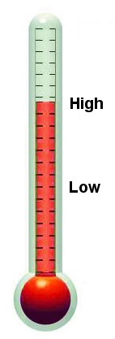
How might these drivers impact methane emissions?
Increased Temperatures
I am so hot, I am going to slow down photosynthesis!
I’m drooping!!
Me too!
CH₄
CH₄
CH₄
CH₄
₄
O₂
O₂
O₂
Notes:
Screenshot the title of the lyimo 2017 paper -> disturbance matters!
Do a table comparing the systems of possible different drivers of fluxes
Temperature, Mechanical, Nitrogen

Slide 35
How might these drivers impact methane emissions?
Mechanical Disturbance
Nutrient Pollution
Temperature

Slide 36
Can we manage systems to enhance carbon sequestration and lower greenhouse gas emissions?

Slide 37
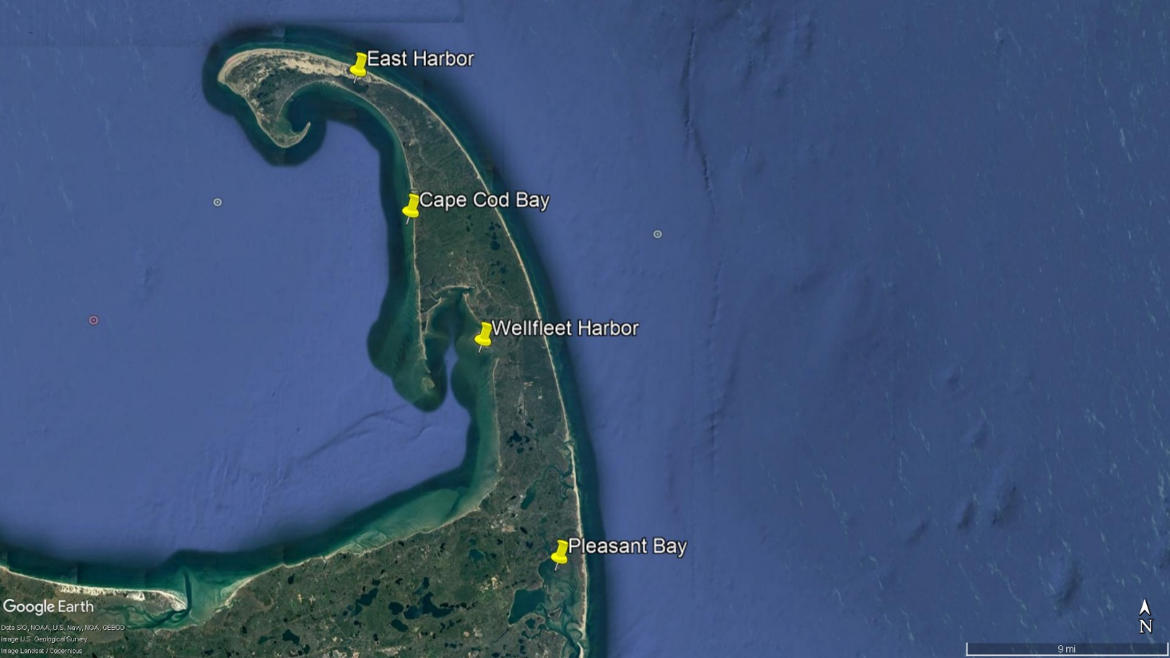
Future Work: Quantifying methane and carbon dioxide emissions from eelgrass meadows over a nutrient gradient in the Cape Cod National Seashore
nutrient loading

Slide 38
Acknowledgements
Wally Fulweiler
Alyssa Novak
Claudia Mazur
Fulweiler Lab Members
Follow me on Twitter: @aalhaj_CNP

Slide 39
Questions?

