Slide 1
Lignin’s
marine biogeochemical
journey
X. Zhu¹, and R. W. Fulweiler^{1, 2}
¹Departments of Earth and Environment, Boston University, Boston, MA, USA.
²Departments of Biology, Boston University, Boston, MA, USA.

Slide 2
1
Part one
What’s lignin?

Slide 3
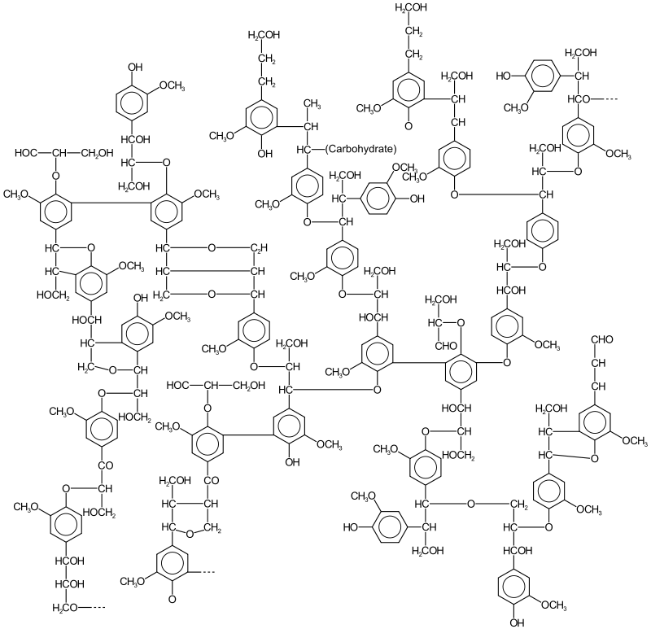
Lignin, a class of complex organic polymers
It is a class of material, not a specific compound.
It is organic, constituting 30% of non-fossil organic carbon.
It is complex polymers. Usually, it’s high weight and insoluble. Here， we will majorly talk about dissolved lignin’s cycle.

Slide 4
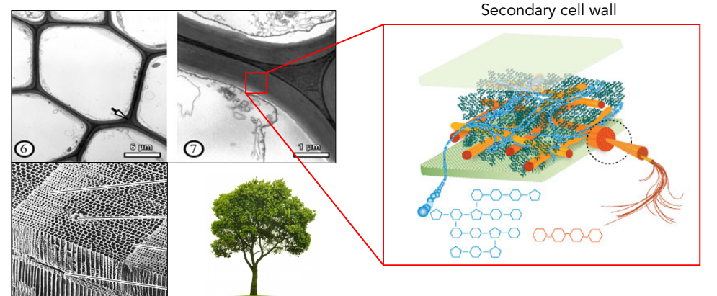
Lignin,
structural materials
Lignin and cellulose work together to provide a structural function in plants.
Lignin is a constituent of the secondary cell walls of vascular plants.
Lignin lends rigidity and does not rot easily.
Lignin constitutes 20-35% of the dry mass of wood and bark.

Slide 5
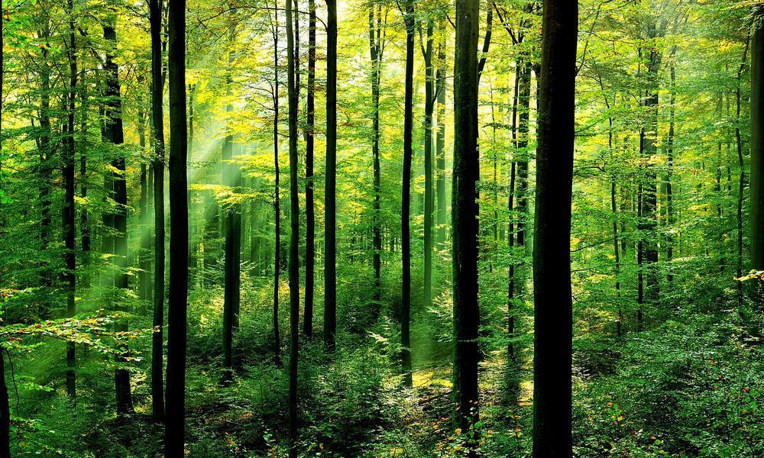
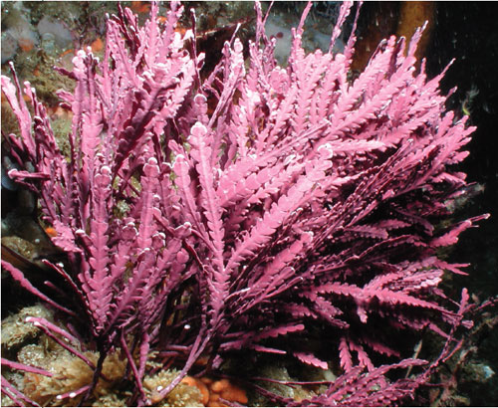
Lignin & vascular plants
Most lignin is in vascular plants, most of dry land plants.
There used to be some debates about the existence of lignin in algae and moss in history, and no reliable evidence support the existence in these debates.
Until recent year, strong evidence has shown there is lignin in one kind of red algae, Calliarthron cheilosporioides.

Slide 6
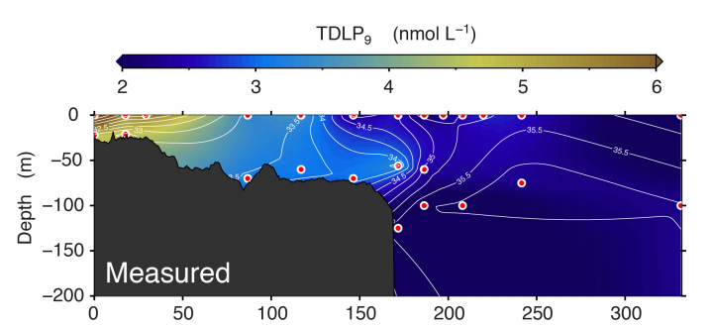
Lignin, terrestrial biomarker in seawater
The major source of lignin is from land.
The dissolved lignin is a biomarker for terrestrial dissolved organic matter (tDOM).
Lignin absorbs UV and blue light strongly.

Slide 7
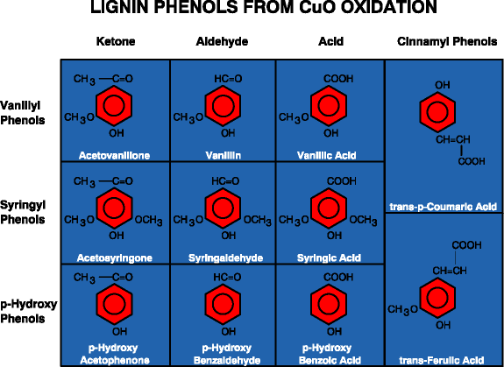
Lignin, source indicator
The molecular structure of lignin can indicate its source.
The gymnosperm (i.e., pine) majorly generates G-lignin (V phenol).
The dicotyledon (i.e., peanut) majorly generates S-lignin (S phenol).
The monocotyledon (i.e., corn) majorly generates H-lignin (P phenol).

Slide 8
2
Part two
Why we should care about lignin’s marine biogeochemical journey?

Slide 9
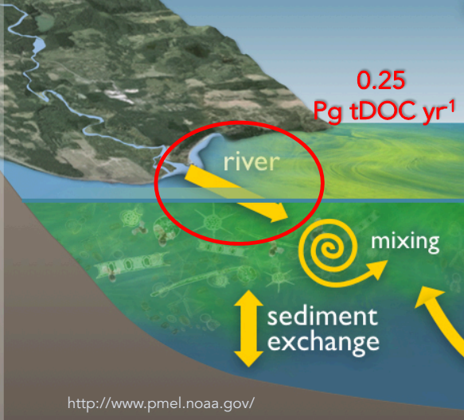
Carbon Cycle
tDOM
tDOM is important carbon input from land to the ocean.
The mineralization and tDOM will weaken the ability of ocean to be sink of CO₂.

Slide 10
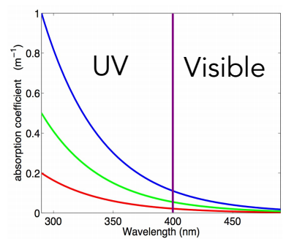
Light Regulation
Lignin’s strong absorption in UV protects marine life from the DNA damage leaded by UV.
Such absorption in visible bands limits the photon for photosynthesis.

Slide 11
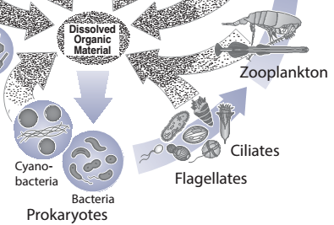
Nutrition Input
The lignin is low quality food.
It is used by food chain through the detrital pathway and DOM rather than grazers.
tDOM is essential in the iron transportation, as the organic ligands for iron in the ocean.

Slide 12
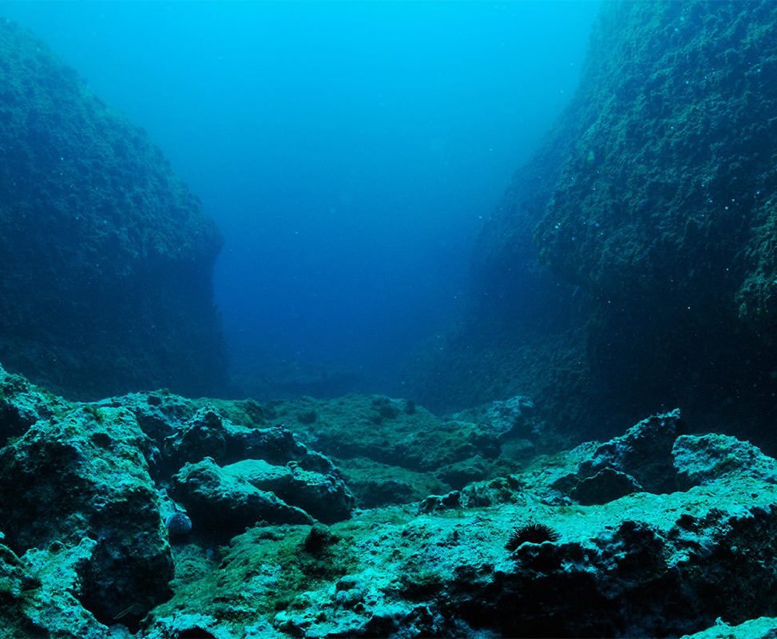
History Record
The lignin in ocean bottom sediment provides lots of information for researchers.
With the help of isotopic analysis, it displays the historical events on land (i.e., forest devastation) and in ocean (i.e., hypoxia zone).

Slide 13
3
Part three
The marine biogeochemical journey of lignin

Slide 14
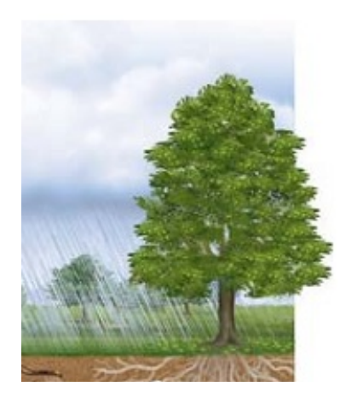
Generation
Pteridophyte
Gymnosperm: G-lignin
Angiosperm
Dicotyledon: S-lignin
Monocotyledon: H-lignin
The lignin generated by these plants could enter soil or river system.

Slide 15
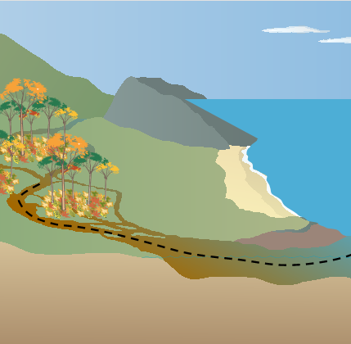
Transportation
The river system plays significant role in the dissolved lignin transportation.
The rain could bring the dissolved lignin in the soil into the river.
Ocean dynamic determines its mixture and transportation in the ocean.

Slide 16
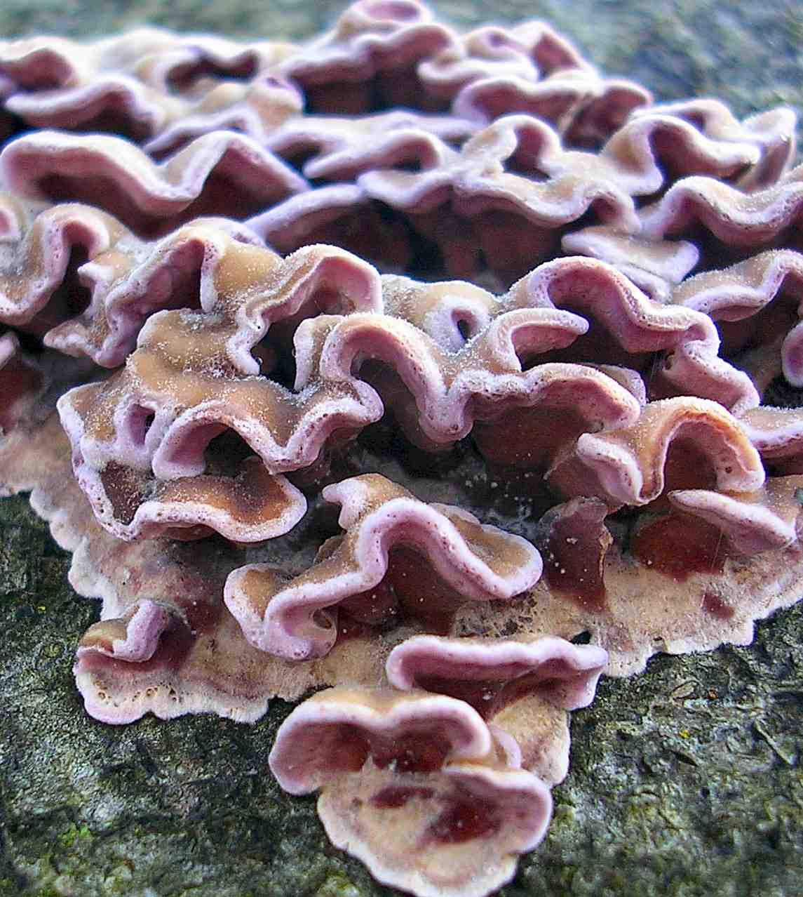
Biodegradation
Lignin is hard to be biodegraded.
Decomposer:
White-rot fungi
Certain bacteria
Certain archaea
Dominant removal process in coastal and shelf waters.

Slide 17
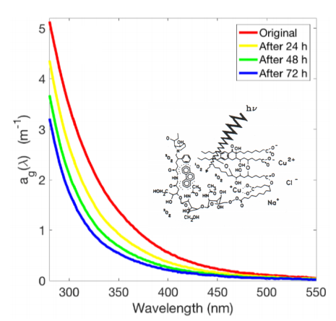
Photodegradation
When dissolved lignin absorb short wavelength photon, the strong energy in these photon will break down the chemical bond in lignin.
Low-weight dissolved organic matter is generated in this process.

Slide 18
Mineralization
Both biodegradation and photodegradation are process of lignin mineralization.
Mineralization is not the only destination of dissolved lignin. Some of them might be reserved by sediments.

Slide 19
4
Part four
Lignin’s application in marine environment research

Slide 20
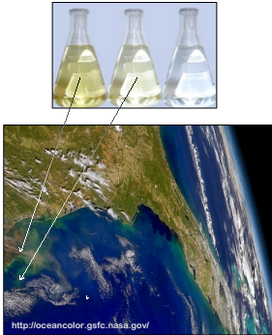
Biomarker for tDOM
Even though there is marine source of lignin, most of them is from land.
Lignin provides a tool to distinguish the tDOM and marine DOM.
This biomarker also could indicate ocean dynamic process and distinguish water mass.

Slide 21
Indicator of tDOM source and its degradation history
With CuO oxidation, the lignin phenols will be derived from lignin.
The ratio of V:S:P lignin phenols shows its source.
Because of the exist of selective phenol degradation, the ratio of phenols also display the degradation history.

Slide 22
THANKS
Questions
Comments

