Slide 1
Plate Tectonics II
Marine Discussions meetings start THIS week!!
MP – Monday 10 am, CAS B08B (or A stay tuned)
MR – Thursday, 3 pm, CAS B08B

Slide 2
Review:
Isostatic rebound
Continental Crust Thicker and less dense than oceanic crust
Wegener – Continental Drift: evidence – fossils, fit of continents, mountain chains, glacier deposits; (bad mechanisms of moon/sun dragging continents across the earth)

Slide 3
Harry Hess – US Navy Captain
During WWII left his depth recorder on all
the time….

Slide 4
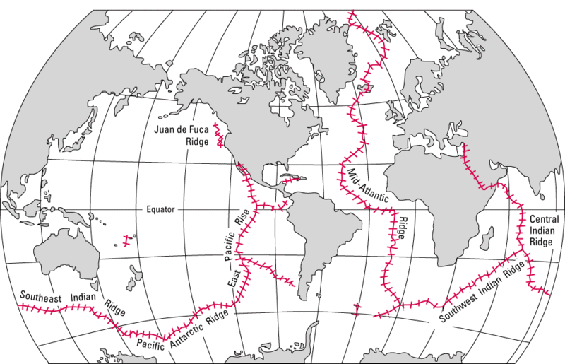
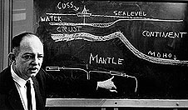
World Distribution of Mid-Oceanic Ridges
World’s longest mountain chain…..
Harry Hess
We didn’t “see” these until the 1950s…..

Slide 5
What did Hess notice?
mid-ocean ridges
Deep trenches at continental margins
But he also noticed…..
Undersea volcanoes had flattened tops…
Less sediment at mid ocean ridges…

Slide 6
Less sediment at mid-ocean ridges

Slide 7
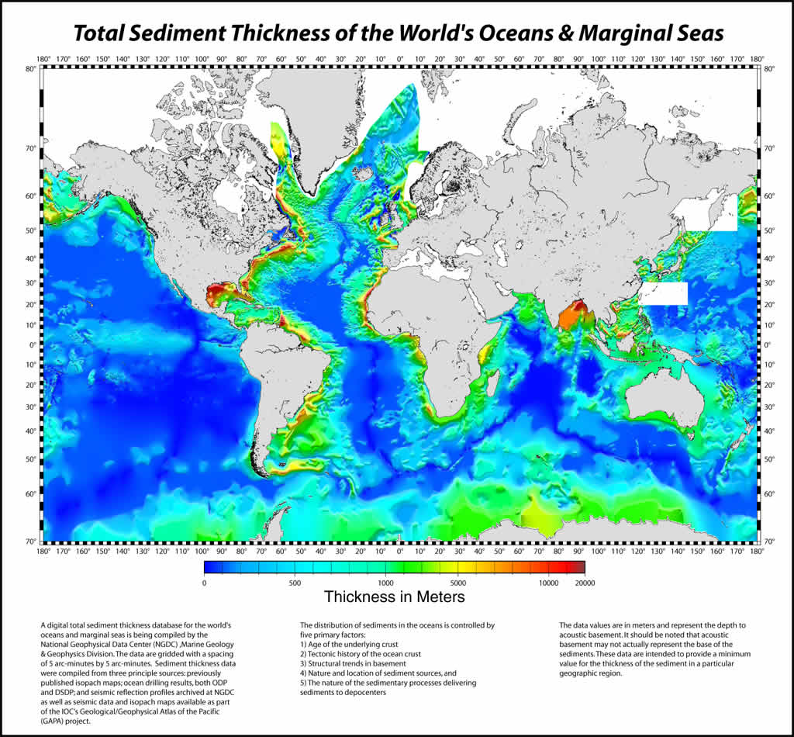
Lines of Evidence, 1930’s-1970’s
1960’s-1970’s: Very THIN amount of sediment in deep ocean.

Slide 8
As rocks age and cool, they become more dense, and due to isostasy, the ocean crust sinks deeper into upper mantle. Seafloor gets deeper with distance from mid-ocean ridge (MOR)….

Slide 9
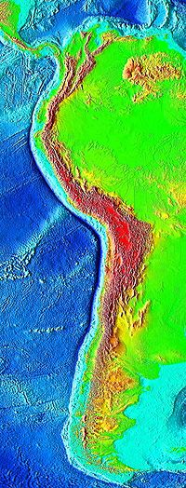
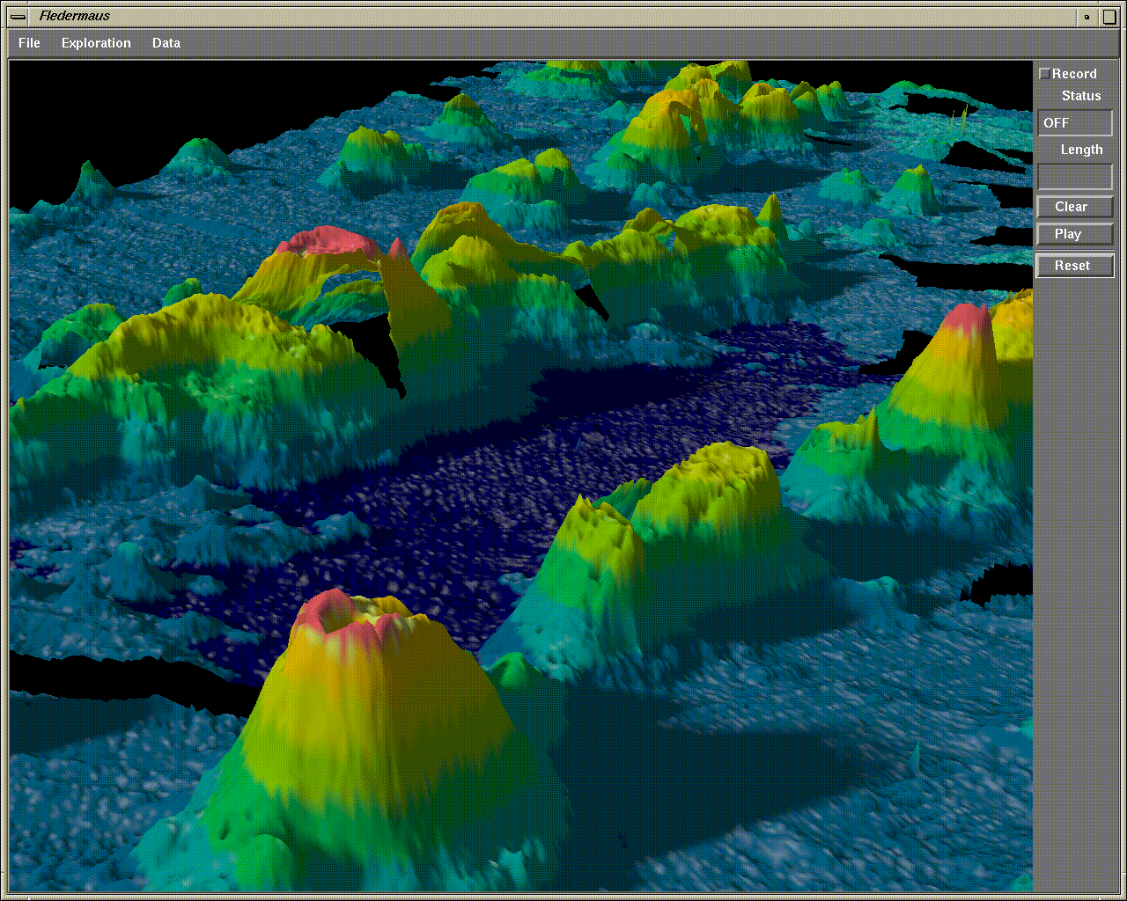
Deep trenches at continental margins
Undersea volcanoes had flattened tops…
Peru-Chili Trench

Slide 10
GEOPOETRY……
or Sea Floor Spreading
New ocean crust formed at ridges
Volcanoes that form along the ridge
are originally close to the surface of the
ocean where they can be eroded flat on top
Deep ocean trenches are where the seafloor
finally descends back into the mantle
Mud and sediments deposited on the ocean
floor thin toward the mid-ocean ridges is
because the age of the seafloor gets younger,
thus less and less time to accumulate
sediments
p.s. – I failed my first course in mineralogy at Yale… was told I had no
future in the field…..

Slide 11
Notes:
Where is the largest mountain chain on earth found? https://www.polleverywhere.com/multiple_choice_polls/xIKBE3FHPiC8UJP

Slide 13
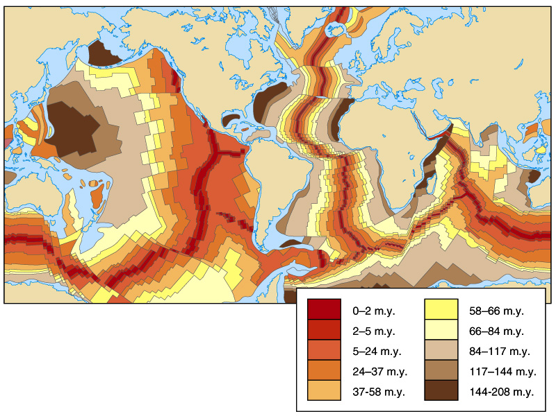
Oldest Sea floor rock: ~180 million
Oldest Continental Rock: ~ 4 billion

Slide 14
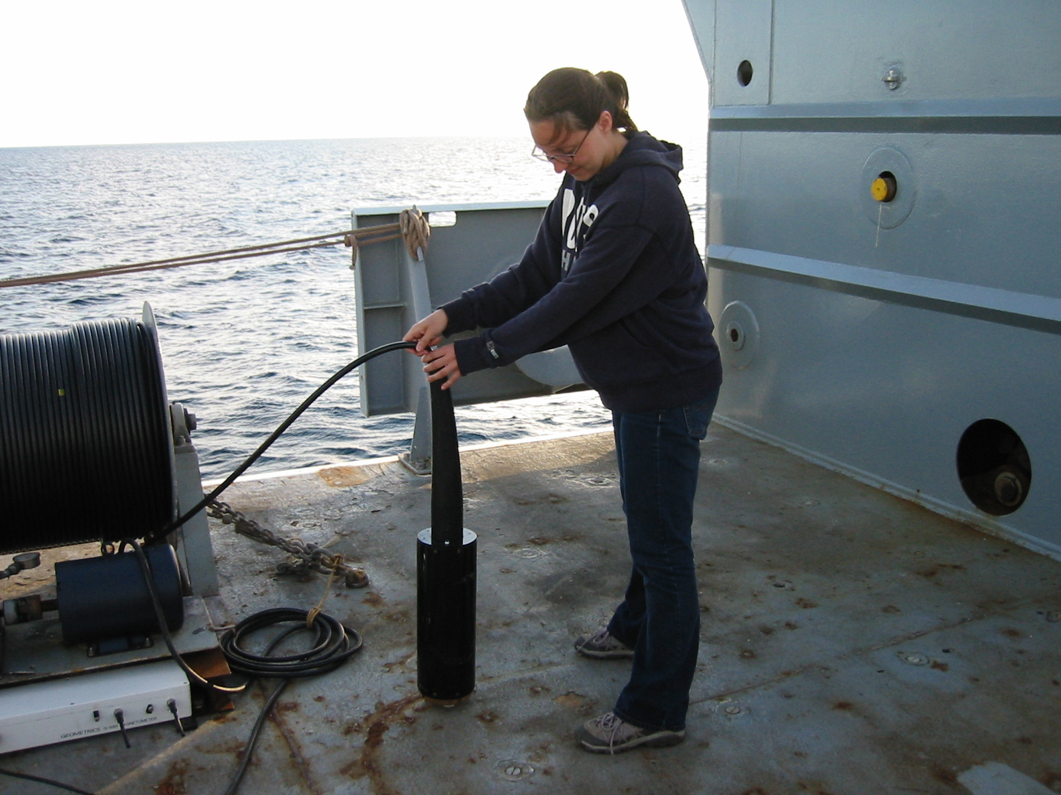
Magnetometer – instrument towed behind ocean vessel
Measures Earth’s magnetic field and how it was affected by sea floor rocks
http://deeptow.whoi.edu/restech.html

Slide 15
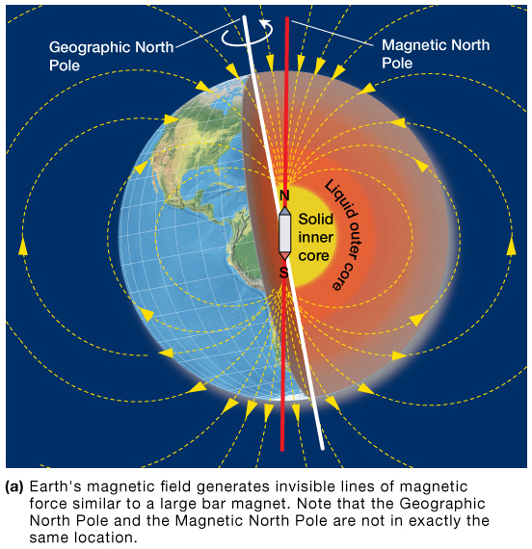
Earth’s magnetic field and paleomagnetism
Earth has magnetic polarity
North and South polarities
Magnetic polarity recorded in igneous rocks
Magnetite in basalt

Slide 16
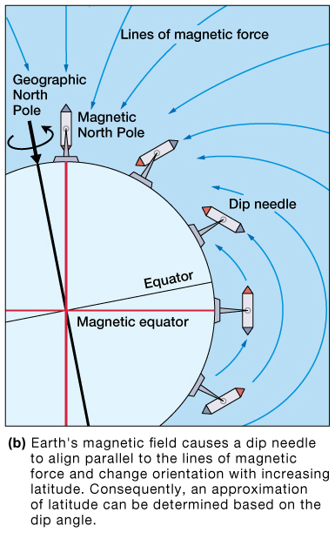
Paleomagnetism – study of Earth’s ancient magnetic field
Interprets where rocks first formed
Magnetic dip – magnetite particles in sedimentary rocks or igneous rocks such as basalt align with Earth’s magnetic field

Slide 17
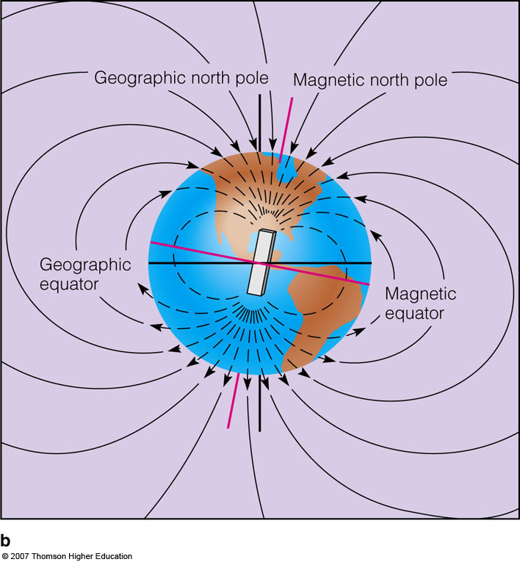
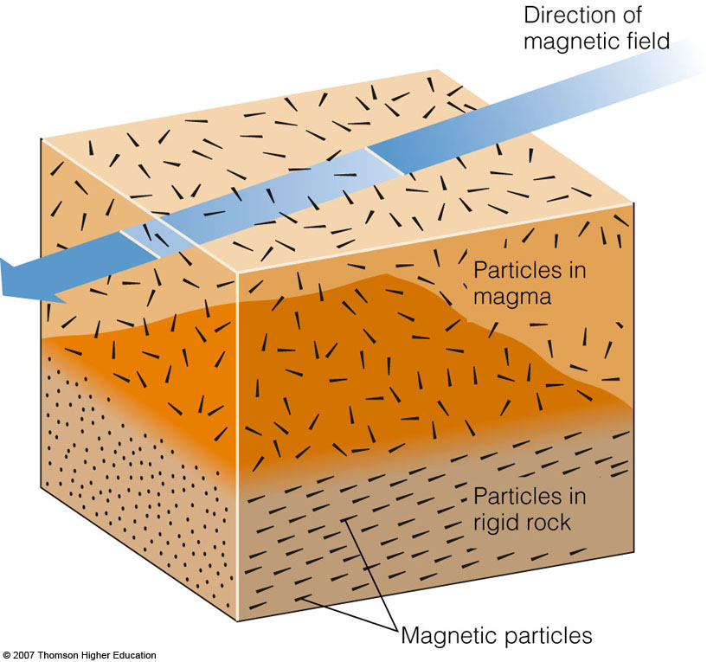
A History of Plate Movement Has Been Captured in Residual Magnetic Fields
Magnetite: formed from cooling magma that contains iron oxide
Notes:
Paleomagnetism: strips of alternating magnetic polarity at spreading regions.
The patterns of paleomagnetism support plate tectonic theory. The molten rocks at the spreading center take on the polarity of the planet while they are cooling. When Earth’s polarity reverses, the polarity of newly formed rock changes.
(a) When scientists conducted a magnetic survey of a spreading center, the Mid-Atlantic Ridge, they found bands of weaker and stronger magnetic fields frozen in the rocks.
(b) The molten rocks forming at the spreading center take on the polarity of the planet when they are cooling and then move slowly in both directions from the center. When Earth’s magnetic field reverses, the polarity of new-formed rocks changes, creating symmetrical bands of opposite polarity

Slide 18
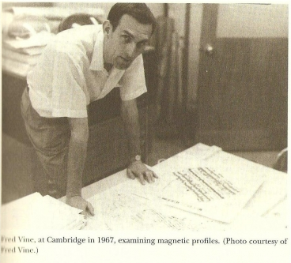
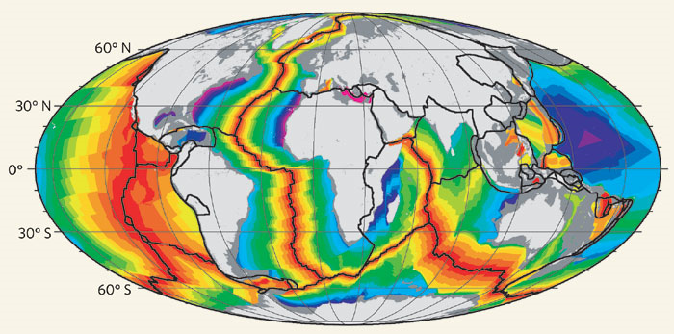
Drummond Matthews
Fred Vine….
Measured the first magnetic
Anomalies in the Indian Ocean.
Nature (2008)
Old, old, Ocean Crust
Young, new, Ocean Crust

Slide 19
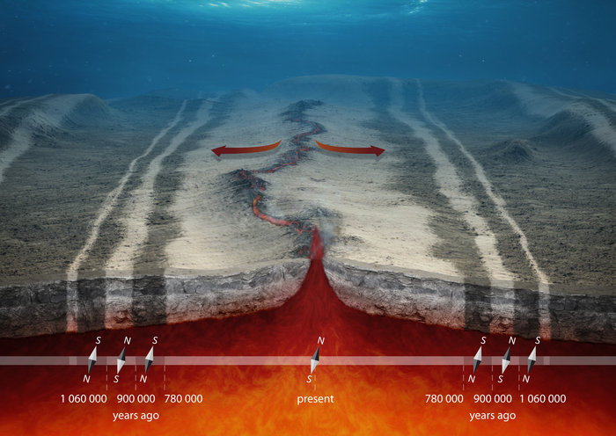
THE SEAFLOOR ACTS AS A GEOLOGICAL 'TAPE RECORDER'
http://www.esa.int/Our_Activities/Observing_the_Earth/The_Living_Planet_Programme/Earth_Explorers/Swarm/From_core_to_crust/(print)

Slide 20
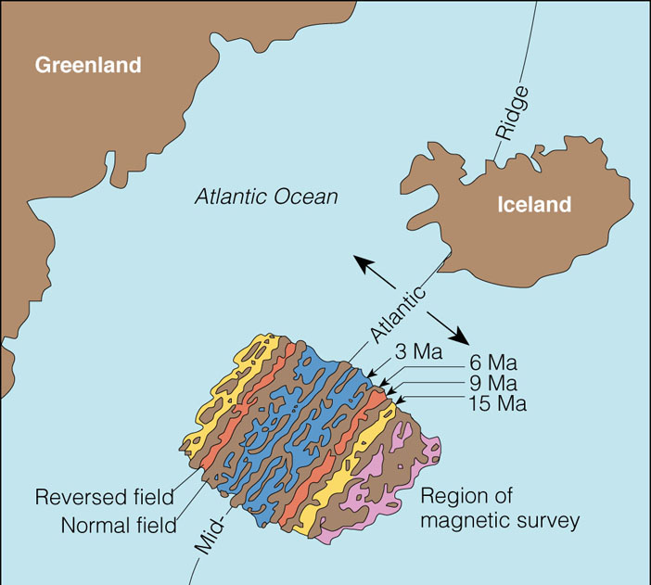
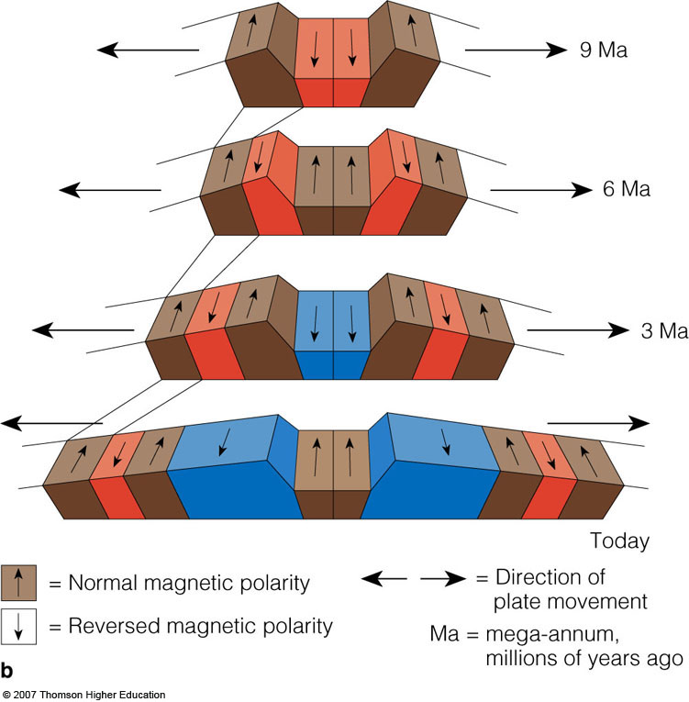
Magnetic Anomalies:
Stripes of magnetism were a historical record of new sea floor

Slide 21
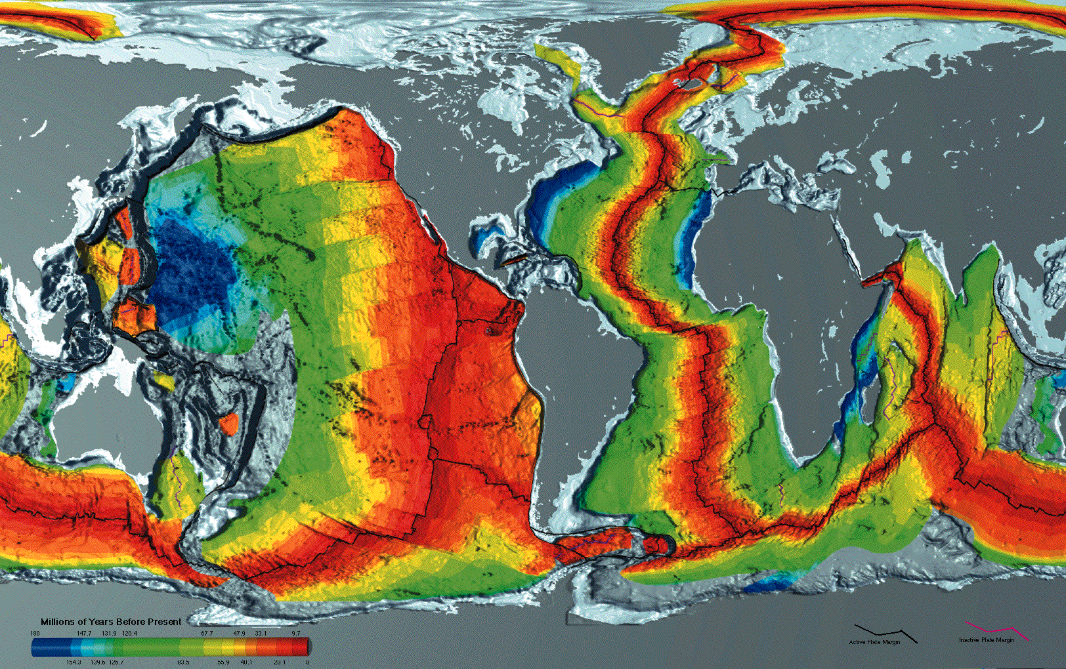
Seafloor Spreading

Slide 22
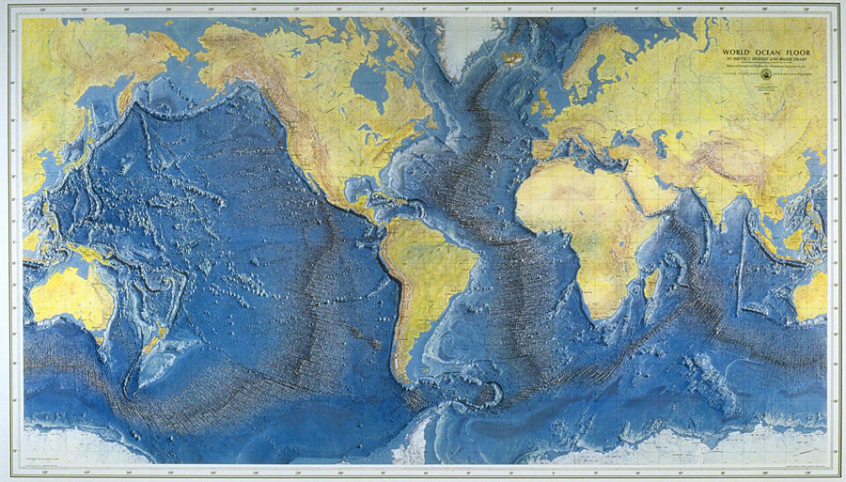
Marie Tharp’s Map

Slide 23
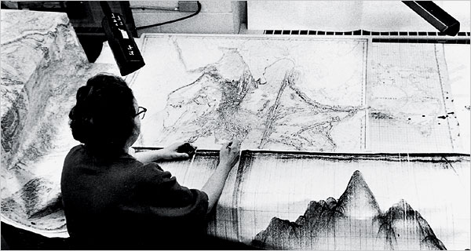
Marie Tharp, Pioneering Mapmaker of the Ocean Floor

Slide 24
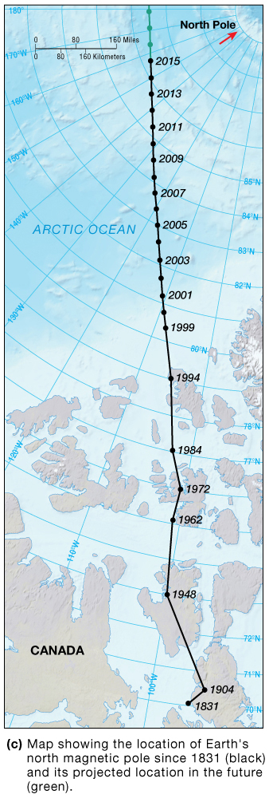
Magnetic polarity reversals
Earth’s magnetic poles switch
Switches occur at irregular intervals between 25,000 to 30 millions years.
The whole switch or flip takes ~ 5000 years
Recorded in rocks
Migrating north ~ 50 km (30 miles) per year

Slide 25
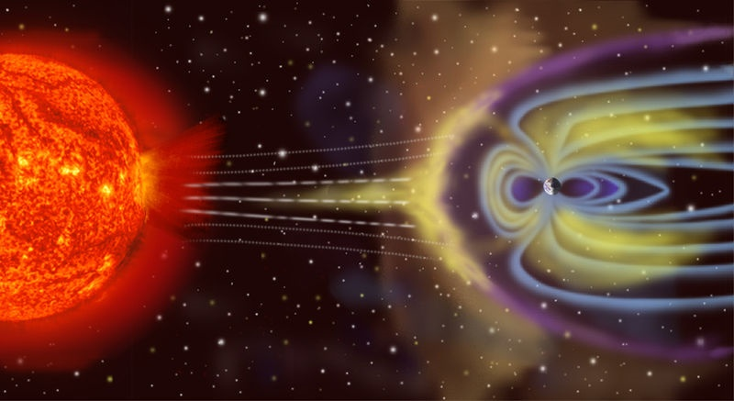
Earth’s Magnetic Field

Slide 26
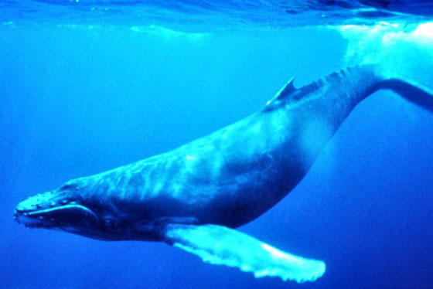
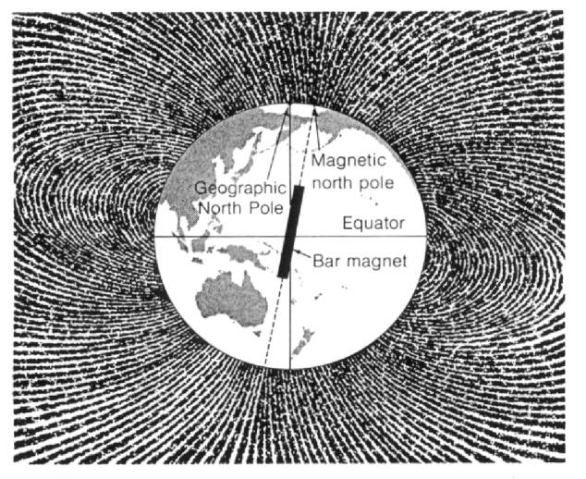
11 degree
angle

