Slide 1
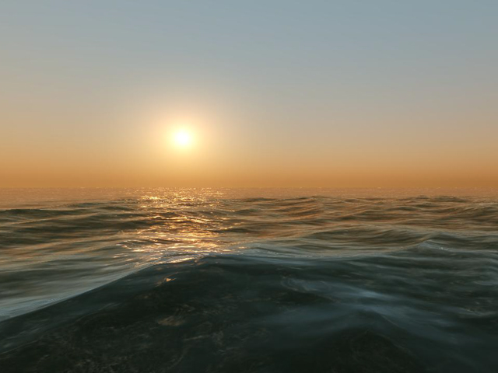
ES 144 – Introduction to Oceanography
History of Ocean Exploration
“Circumstances rule men; men do not rule circumstances.”—Herodotus, Histories
Notes:
Why would people leave land and explore the ocean?
Food, war, disease, trade and commerce, curiosity…

Slide 2
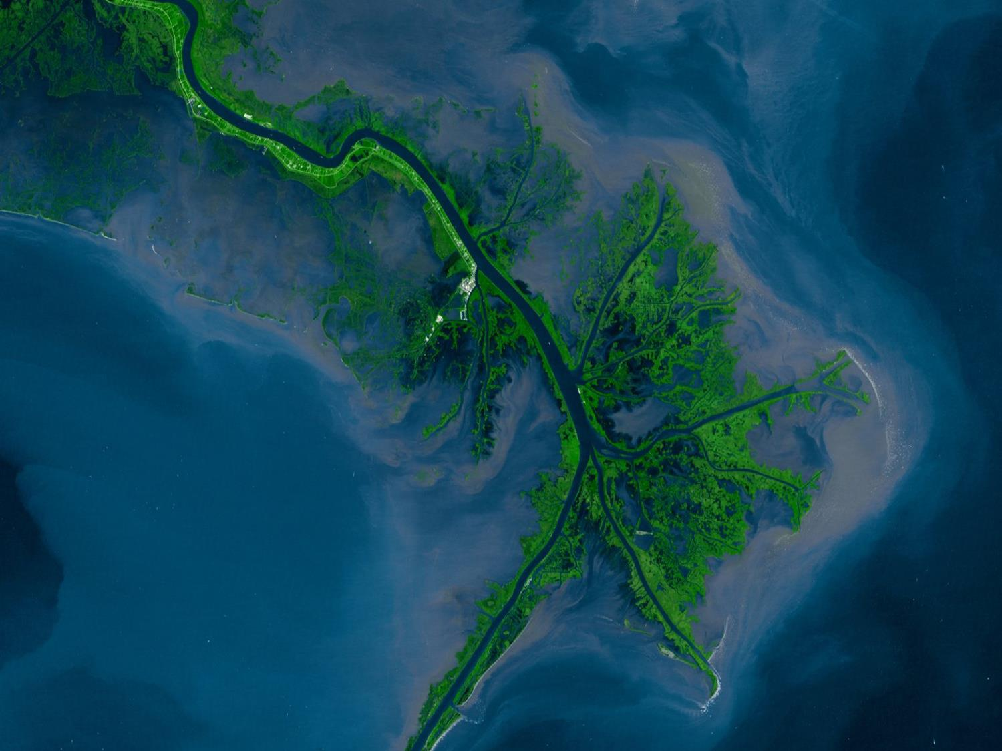
ES 144 A1 – Lecture Only (MWF 2-3 pm)
Two Discussion Groups for Marine Science Majors Only
ES 144 MP – Lecture, Discussion Group (M 10-11, CAS B08A, 1st mtg. 9/19)
ES 144 MR – Lecture, Discussion Group (Th 3-4, B08A, 1st mtg. 9/22)

Slide 3
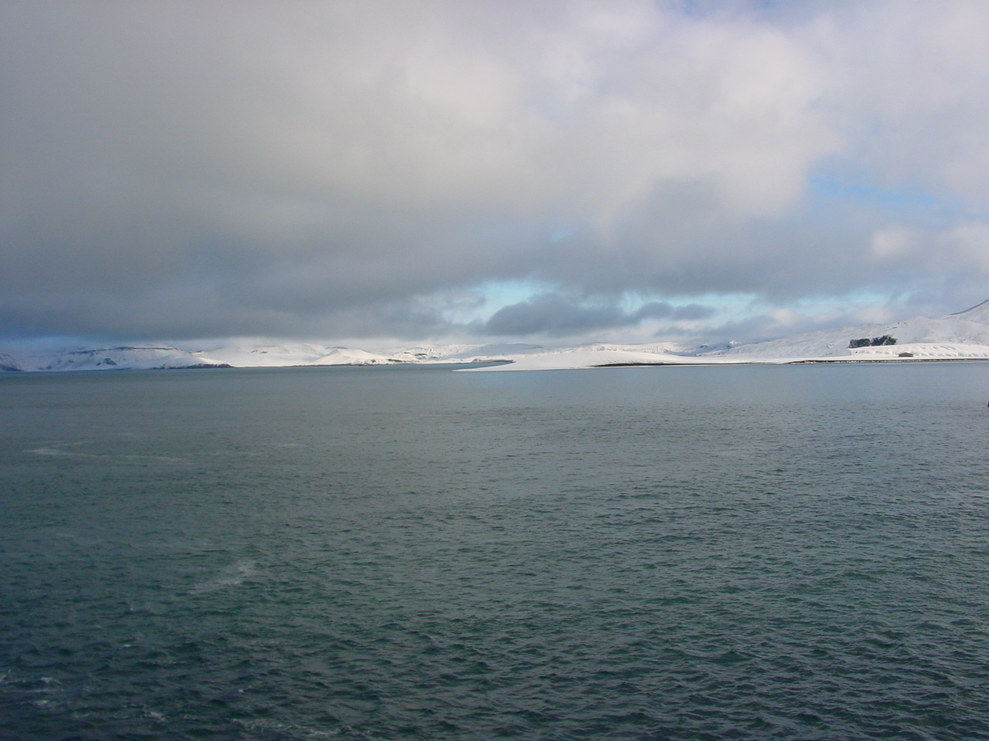
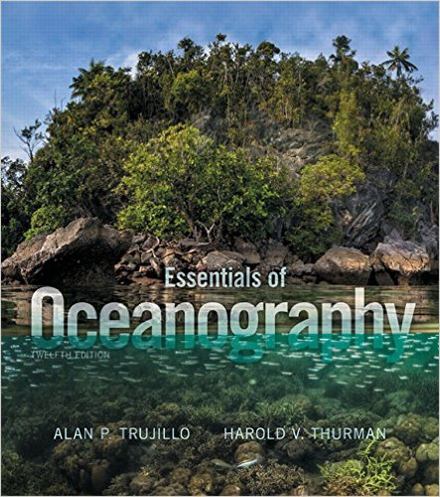
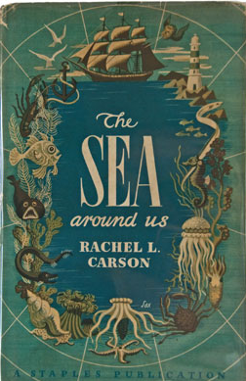
You can use another addition –
but you are responsible for what I teach

Slide 4
www.fulweiler.com
http://www.fulweilerlab.com/courses.html
Password:
#BUOceans2016

Slide 5
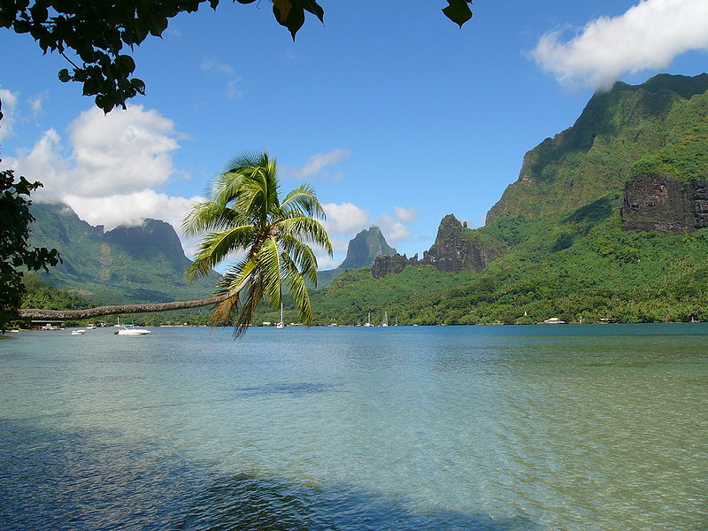

Slide 6

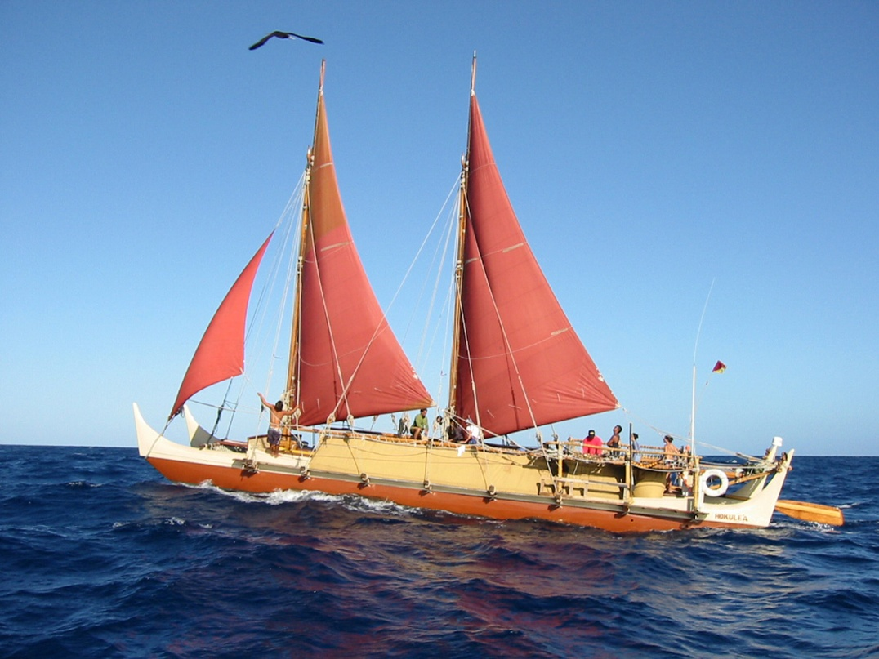
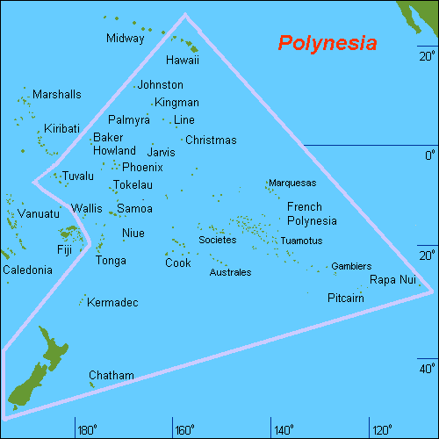
~30,000 years ago – started migrating across the Pacific.
Hokule’a -a traditional Polynesian canoe
http://www.hokulea.com/worldwide-voyage/
http://www.divediscover.whoi.edu/history-ocean/polynesian.html
Notes:
Over 25,000 years ago colonized southwest Pacific islands…New Guinea in the west to Figi and Somoa in the middle.
Ranged over an area wider than China and the Soviet Union combined.
~4000 B.C. to 800 A.D.
6

Slide 7
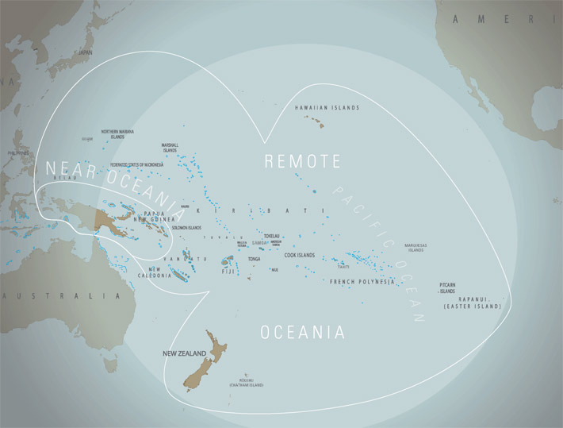
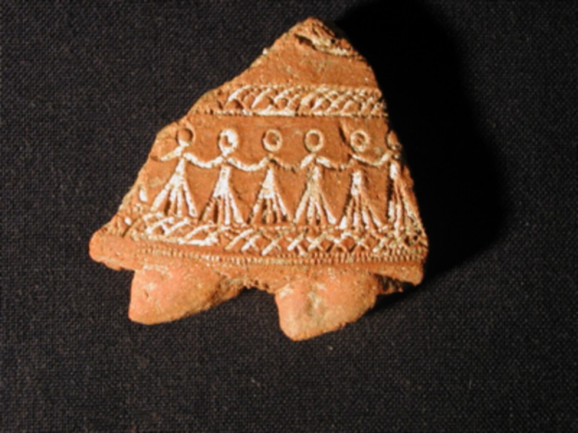
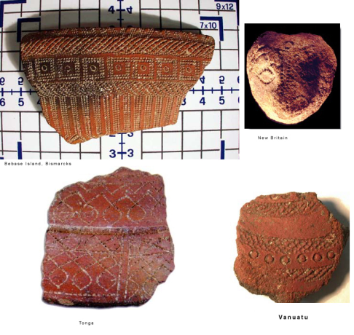
~10,000 islands in the western Pacific
Colonized New Guinea ~30,000 years ago
Colonized Phillipines ~ 20,000 years ago
Colonized Hawaii – the farthest away from any land masses ~ 1500 years ago
Easter islands…
Genetic evidence suggest Polynesians populated Easter island around 1200 A.D.
Notes:
~10,000 islands in the western Pacific
Colonized New Guinea ~30,000 years ago
Colonized Phillipines ~ 20,000 years ago
Colonized Hawaii – the farthest away from any land masses ~ 1500 years ago
Easter islands…
Traditional Lapita pottery… Lapita - a group of early people who were thought to have come from island Southeast Asia – produced this type of pottery – and traveled to Fiji, Tonga, and Somoa. From there – on the Marquesas islands – which was probably the starting point for longer voyages the islands of the Pacific and New Zealand.
Genetic evidence suggest Polynesians populated easter island around 1200 A.D.

Slide 8
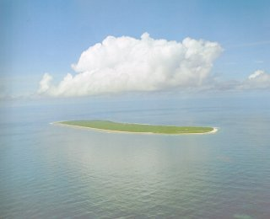
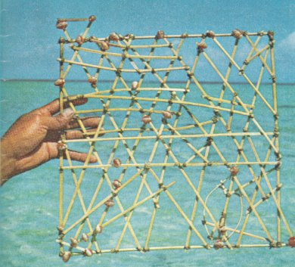
Early Navigation
Reflection of islands in the clouds.
Followed birds – eg. Frigate and terns – dawn/dusk patterns
Stars
Swells
Stick charts
Smell of the water
Notes:
Complex swell patterns around islands – last long beyond the island….follow those at sea.
Stick charts- made of wood and bamboo, shells marked the islands, curved wood marked pattern of sea swell.
8

Slide 9
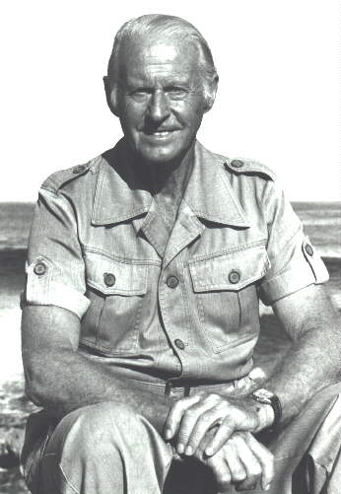
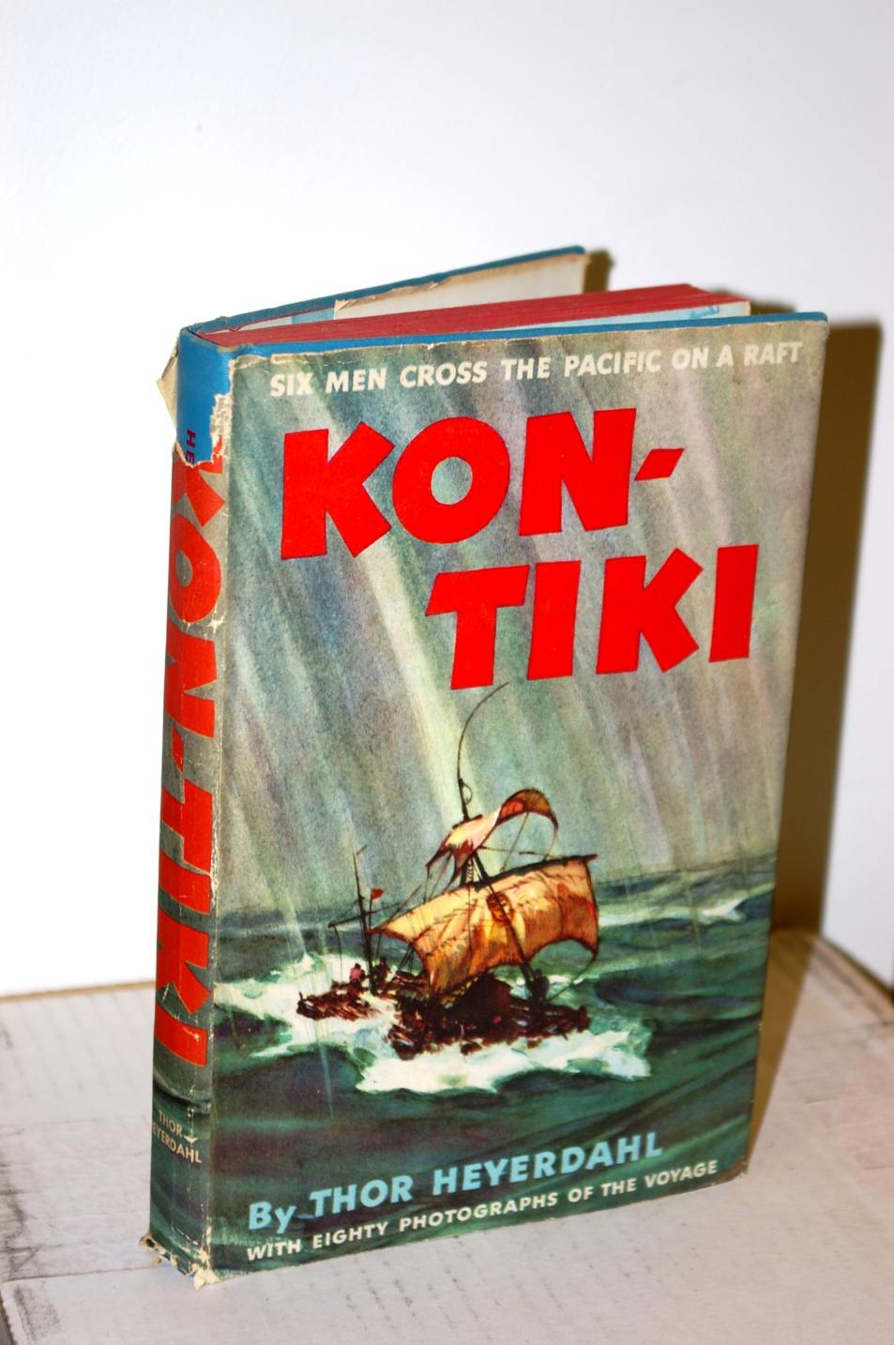
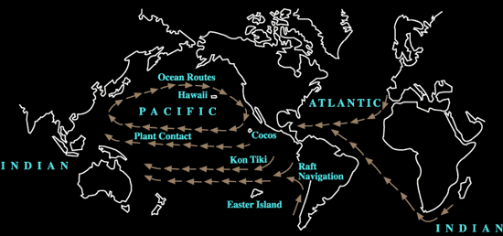
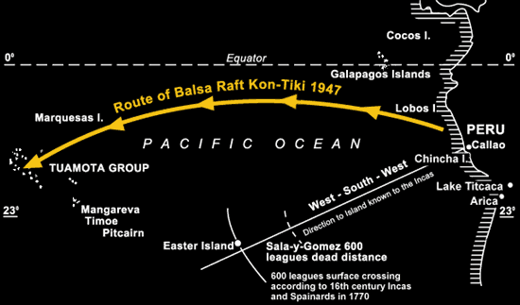
http://www.bradshawfoundation.com/thor/ocean-routes.php
Notes:
The great explorer and anthropologist Thor Heyerdahl used this southern current to sail the Kon Tiki raft on his 1947 epic voyage from Peru to the Tuamotu Islands. The dead distance between the point of departure and the point of arrival is approximately 4000 miles, and yet the raft only crossed 1000 miles of surface water. If another primitive craft had been able to travel with the same speed in an equally straight line, but in the opposite direction, it would have traversed about 7000 miles of surface water to reach Peru. The reason is that the ocean surface itself was displaced about 3000 miles, or about 50 degrees of the Earth's circumference, during the time needed for the Kon Tiki crossing. Put another way it means that the Islands are located only about 1000 miles from Peru, whereas Peru is located 7000 miles from the Islands. The current travels at about 40 miles per 24 hours, and if the craft is sailing at 60 miles per 24 hours, it means that it would have travelled a 100 miles in one day, and the duration of the voyage would be 40 days. Travelling the opposite way at the same speed against the current it will only travel 20 miles per 24 hours and thus need 200 days to make the voyage. If the craft was only travelling 40 miles per 24 hours it would sail from Peru to the islands in 50 days, but at that speed going in the opposite direction it would never leave the islands. (words directly from website)
9

Slide 10
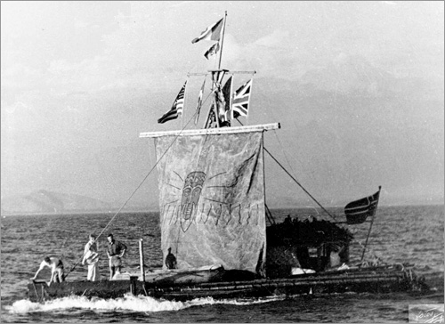
http://www.hulu.com/watch/438443
http://www.kontikidefilm.com/

Slide 11
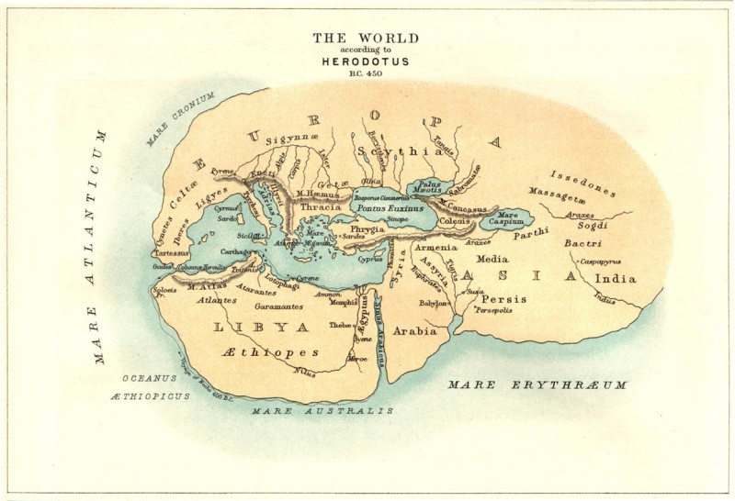
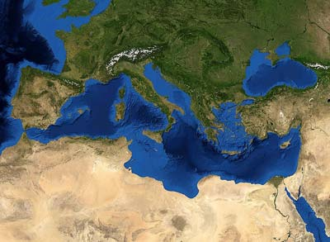
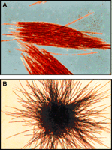
900-700 B.C. – Greeks had traveled the Med…but not outside of it…
Maybe named because of the phytoplankton that lives there-
Trichodesmium…

Slide 12
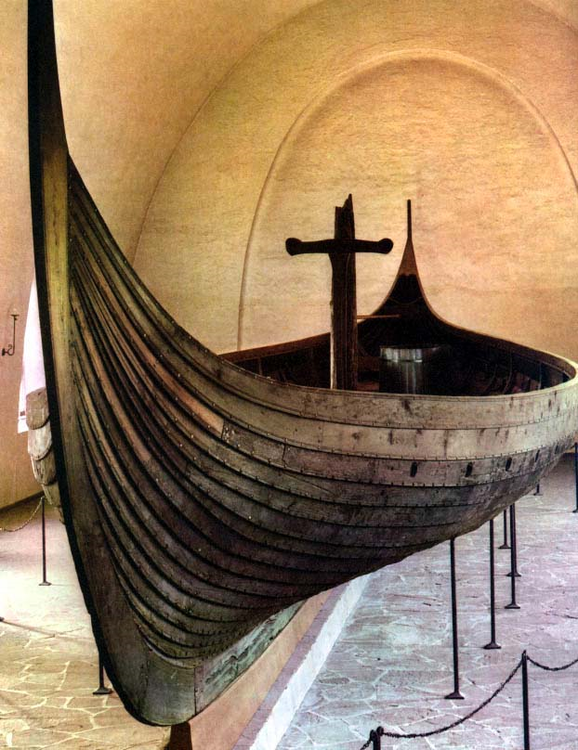
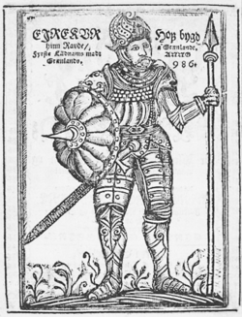
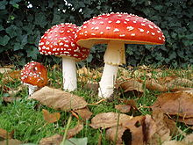
http://www.englishmonarchs.co.uk/images/viking_ship_gokstad.jpg
Notes:
They traveled far and wide- across the Atlantic Ocean to Iceland, Greenland, the Baffin Islands, and established a North American colony known as Vinland (present day Newfoundland).
12

Slide 13
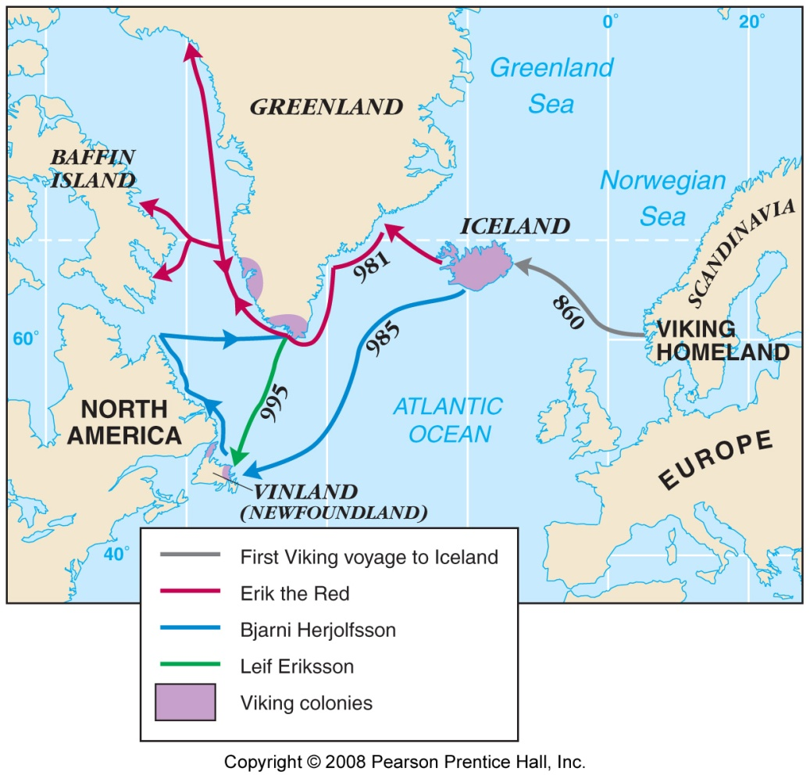
Farthest known extent of European exploration before Columbus.
Erik the Red… sailed west from Iceland and discovered Greenland.
Bjarni Herjolfsson – missed Greenland – is thought to be the first to see New Foundland.
-Leif Eriksson – son of Erik the red → set out to find New Foundland – and did - he named it Vinland because of the grapes…. But the Vikings left Greenland and Vinland – and were gone by around 1450.
Notes:
Farthest known extent of European exploration before Columbus. Erik the Red… sailed west from Iceland and discovered Greenland…He brought the first wave of vikings back to Greenland ~985 AD.
Bjarni Herjolfsson – missed Greenland – is thought to be the first to see New Foundland.
Leif Eriksson – son of Erik the red → set out to find New Foundland – and did - he named it Vinland because of the grapes…. But the Vikings left Greenland and Vinland – and were gone by around 1450.

Slide 14
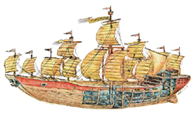
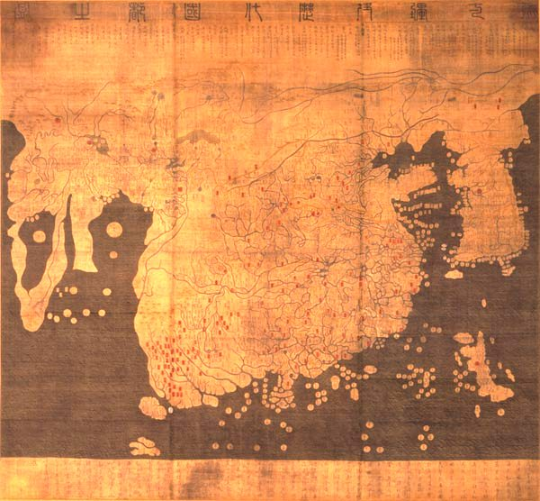
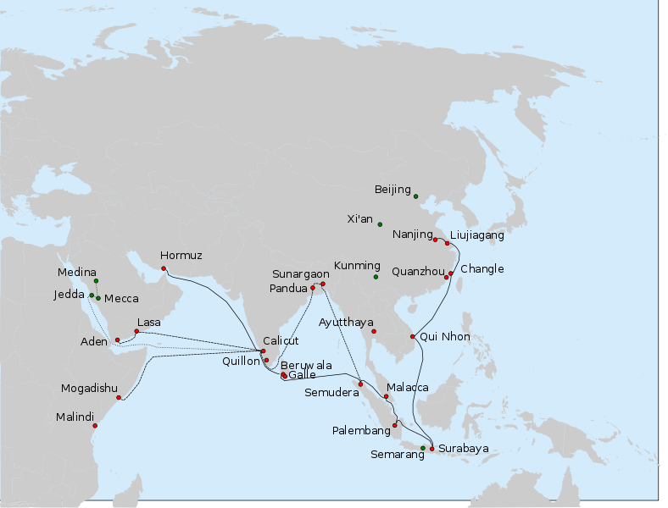

Zheng He (1371-1433)
Navigator | Number of Ships | Number of Crew
Zheng He (1405 - 1433) | 48 to 317 | 28,000
Columbus (1492) | 3 | 90
Da Gama (1498) | 4 | ca. 160
Magellan (1521) | 5 | 265

Slide 15
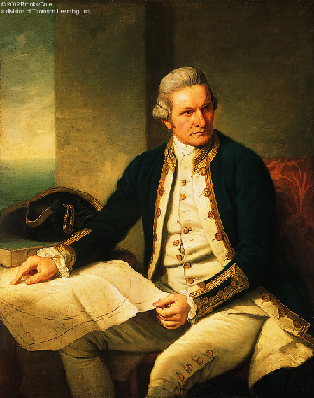
Captain James Cook – (1728-1779)
Three Expeditions btw.
(1768-1779):
Endeavour
Resolution
Adventure
Notes:
15

Slide 16
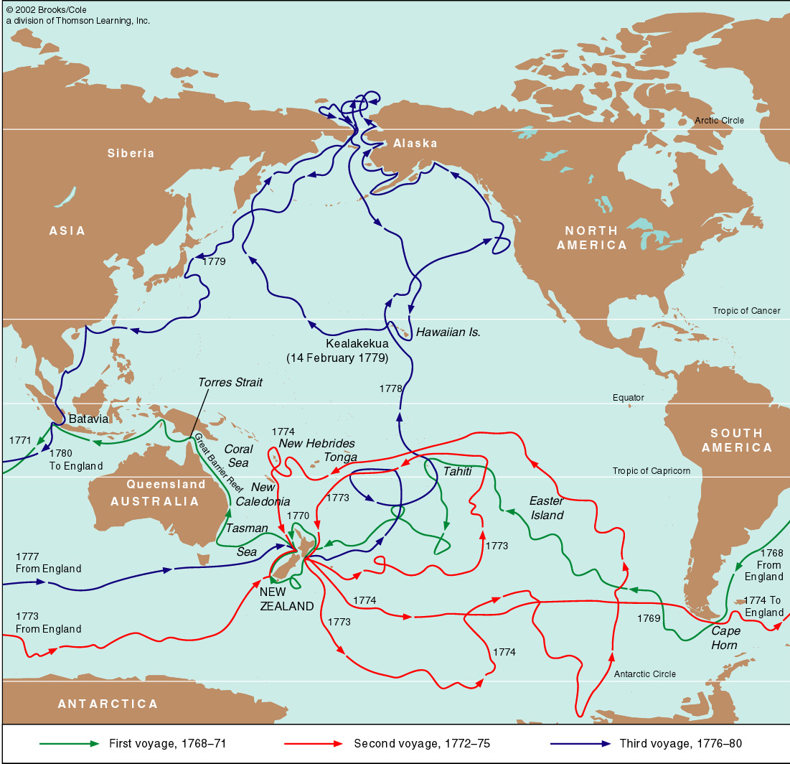
Notes:
16

Slide 17
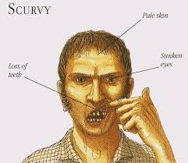
The Cook Expeditions
Extensive Scientific Investigations
Arctic to Antarctic
Mapping of the Pacific Ocean
Depth Soundings
Winds and Currents
Subsurface Temperatures
Biological Sampling
General Geography of the Pacific & Atlantic
Notes:
Thought Antarctica was below the ice fields in the Southern Ocean
Mapped the islands of southern Georgia, South Sandwich, and Hawaii… was killed on his third voyage – in Hawaii.
Determined the shape of the Pacific ocean, first person to cross the Antarctic circle,
Initatied systematic subsurface measurements of water temps, measured winds, and currents, depth measurements (with soundings..long rope, weight, to the sea floor.)
Learned that Scurvy was a vitamin C deficiency – prior to this – more people died from scurvy than any other death at sea….
17

Slide 18
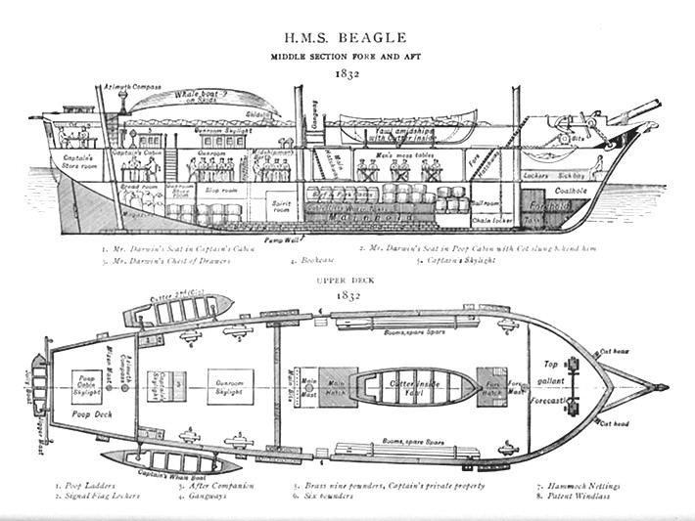
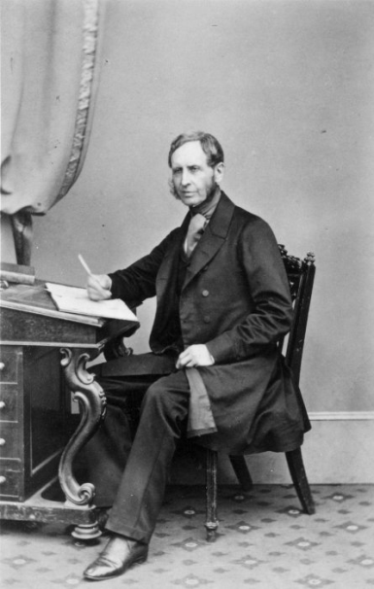
1831-1836

Slide 19
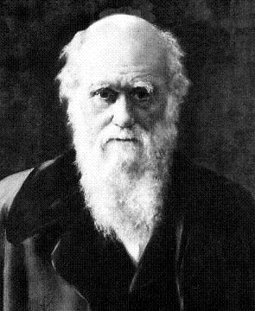
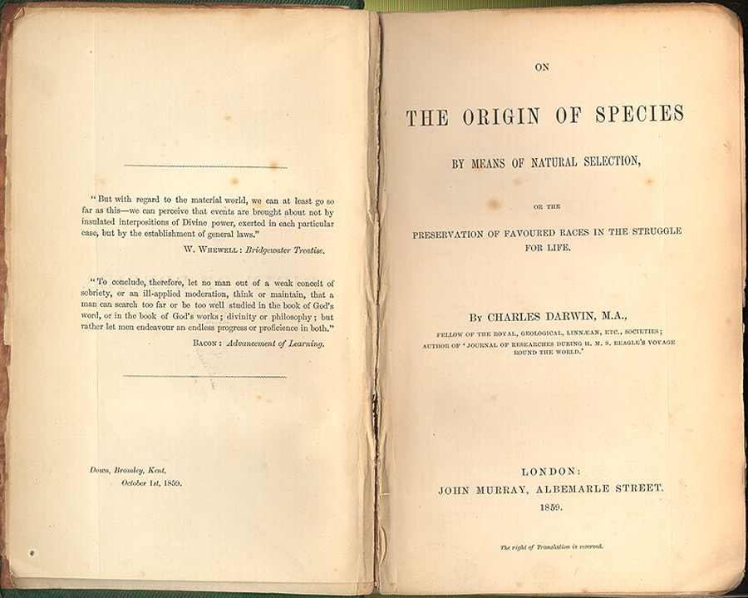

Slide 20
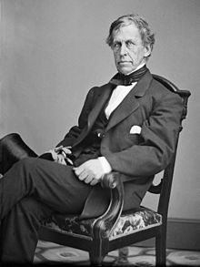
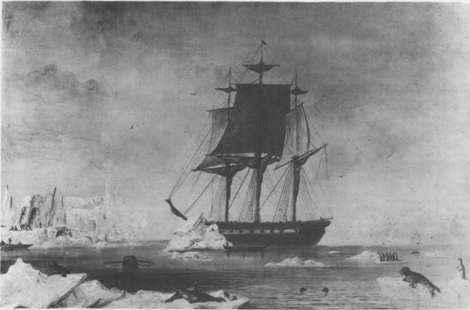
United States Exploring Expedition (US Ex EX)
1838 - 1842
Explored the coast of Antarctica
Mapped the Oregon Territory and San Francisco Bay
Thoroughly Explored Hawaii
Lt. Charles Wilkes
USS Vincennes in Disappointment Bay, Antarctica, during the Wilkes expedition.

Slide 21
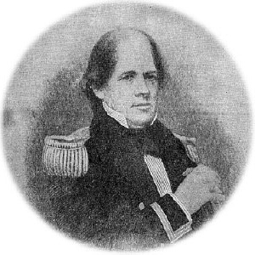
Lt. Matthew Maury
Head of the U.S. Navy's Depot of Charts and Instruments.
1847-assembled the observations archived there into charts of
winds, currents, and sea state throughout the trade routes.
1855-Author of the first oceanography textbook
The Physical Geography of the Sea.
Father of Physical Oceanography
Probably, the first person to devote full time to
the study of the ocean.

Slide 22

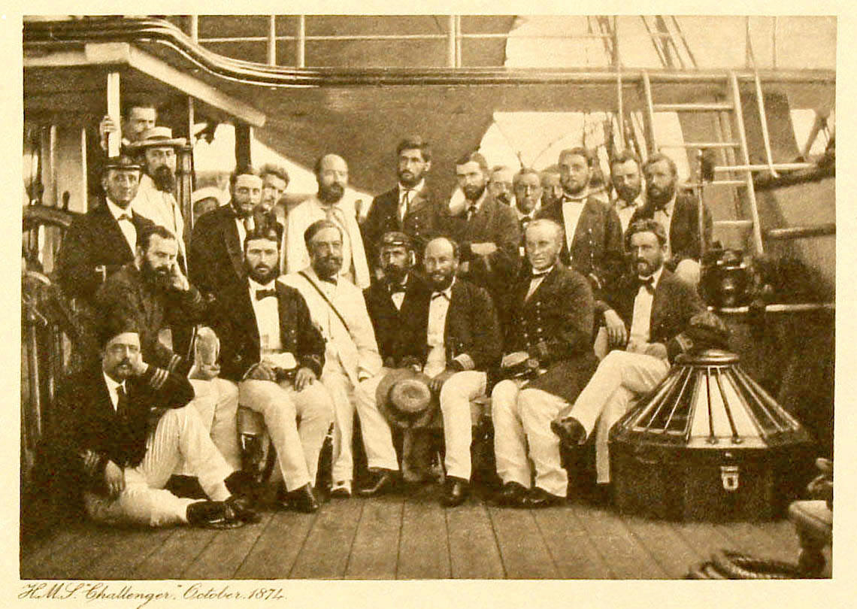
Lead by Charles Wyville Thompson – Departed on December 7, 1872
Notes:
December 1872 -24 May 1876, H.M.S. Challenger traversed 68,890 nautical miles.
Sampled in the North and South Atlantic and Pacific Oceans;
Travelled north of the limits of drift ice in the North Atlantic polar seas and south of the Antarctic Circle.
the Marianas Trench in the western Pacific, where the seafloor is 26,850 feet, or more than 4 miles deep (8,200 meters).
22

Slide 23
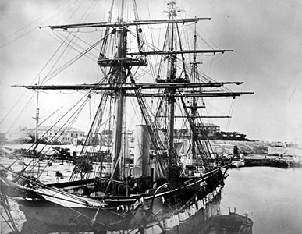
December 1872 -24 May 1876, H.M.S.
Challenger traversed 68,890 nautical miles.
Sampled in the North and South Atlantic and Pacific Oceans;
Travelled north of the limits of drift ice in the North Atlantic polar seas and south of the Antarctic Circle.
the Marianas Trench in the western Pacific, where the seafloor is 26,850 feet, or more than 4 miles deep (8,200 meters).

Slide 24
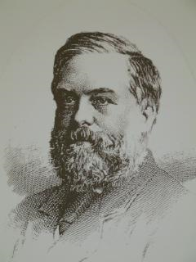
Wyville Thomson reported the Challenger to have made 362 sample/observation stations "at intervals as nearly uniform as possible".
1. Depth
2. sample of the bottom
3. A sample of bottom water for chemical/physical examination.
4. The bottom temperature was recorded
At most stations,
- a fair sample of the bottom fauna (dredge or trawl)
the fauna of the surface and of intermediate depths (tow nets).
-a series of temperature observations was made at different depths
At many stations,
samples of sea-water samples at different depths.
In all cases, atmospheric and other meteorological conditions were carefully observed and noted. The direction and rate of the surface current was determined.
http://www.geo.ed.ac.uk/scotgaz/people/famousfirst357.html
Major Motivation - is there life at depth?

Slide 25
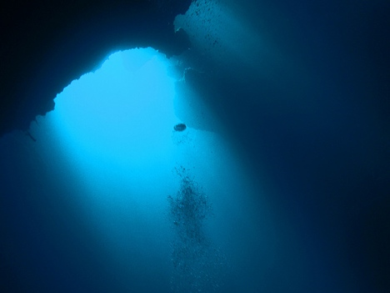
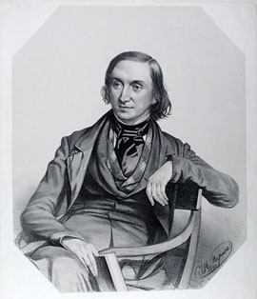
Edward Forbes
Azoics Theory – no life in the deep ocean (>550 m)
Notes:
Why? No light, great pressure, cold…..forbes got this idea from his work in the med on the HMS beacon
(Ross and his son had found life deeper than that…~1800 m)…

Slide 26
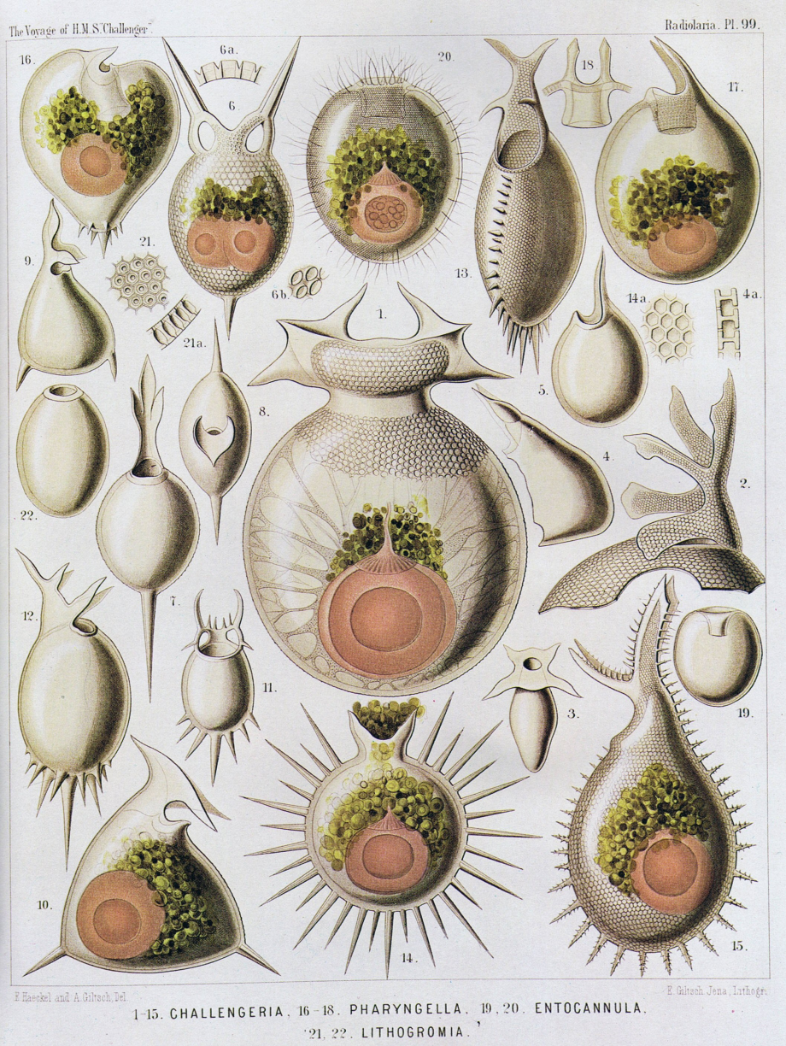
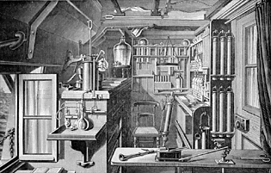
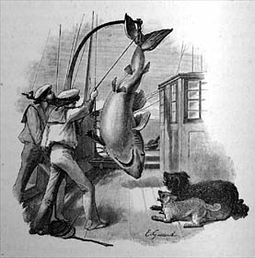
Dispelled the Azoics Theory
Number of dredges taken
133
Number of new species of animals and plants discovered
4,700
Notes:
Azoics theory – no life at depth…But they found lots of life at depth - >1500 species below 1500 m
Relatively constant salinity, mapped sediments….
Bathybius Haelcki – white goo – a primodorial ooze….
Turned out to be a reaction of water with ethanol….
Important because: 1. Dispelled the azoics theory, 2. model for future expeditions, 3. involved government
Number of dredges taken
133
Number of new species of animals and plants discovered
4,700
26

Slide 27

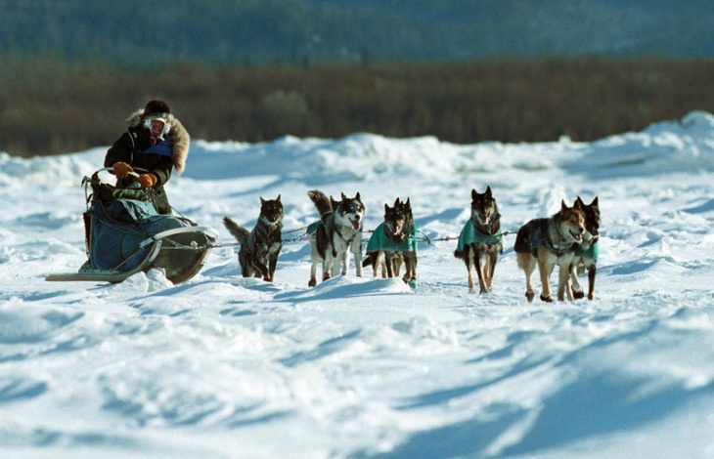
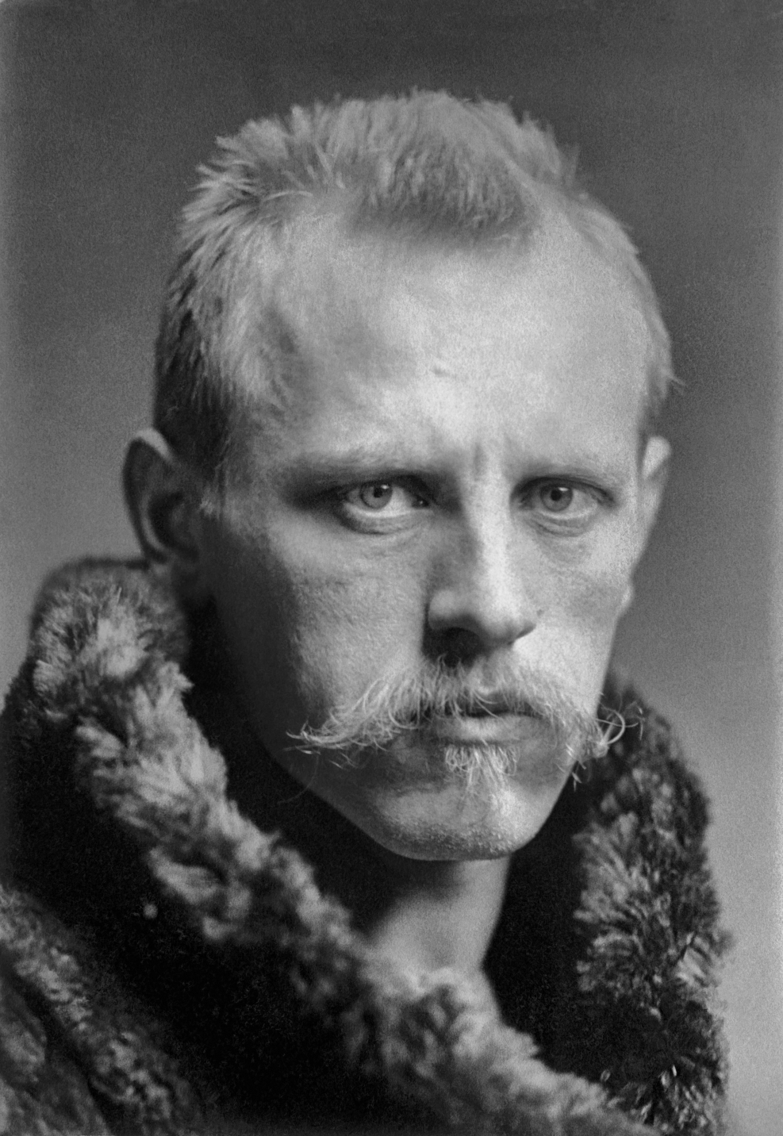
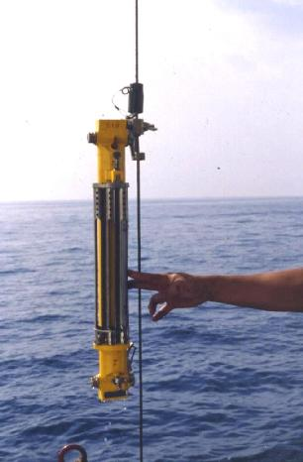
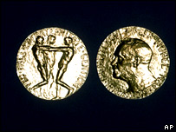

Fridtjof Nansen
Notes:
First professor of Oceanography
Not really relevant to know- but cool to know….he was an amazing athlete – modern alpine skiing – he did it first in cross country skis….
Neurobiologist – made his career doing that…. Won the Nobel peace prize for relocating WWI refugees……. And oh yes – he was an Arctic explorer.
First to cross Greenland ice sheet (by dogsled) –

Slide 28



38 m schooner – Fram
13 crew, provisions for five years, planned to get stuck in the ice for 3 years….were stuck for 4.
Frozen in ice – 750 miles from the Pole
Drifted 2 km per day…got to within 250 miles of the Pole
When he realized they weren’t going to make he and Frederick Johansen set out on dogsled to get there……
Notes:
They didn’t make it. They overwintered – in a snow cave, eating walrus meat….finally were rescued by a British sealing expedition – 14 months after leaving the Fram.
Robert Peary reached the pole in 1909 (disputed?).

Slide 29


Slide 30



Growth of Marine Research:
Woods Hole – US Fish Commission - 1871
Notes:
Act of Congress
“protection, study, management, and restroation of fish…”
Spencer Fullerton Baird – head of it…..

Slide 31


1934- 923 m
The Bathysphere
William Beebe
&
Otis Barton
Notes:
He was self proclaimed naturalist
-He (crawling out of bathysphere and to left of dual picture) and his partner, Otis Barton (to the right), designed the bathysphere.
-In 1930, he descended 183m (600 ft) off Nonsuch Island in Bermuda, where in 1934 he made a record descent of 923m (3,028 ft).
- Beebe made a total of 35 dives in the bathysphere between 1930 and 1934.

Slide 32


Figure 1.4
The Trieste – US Navy - 1960
Walsh and Piccard
Notes:
Swiss-designed deep-diving research bathyscaphe ("deep boat") with a crew of two (Piccard and Walsh).
-Reached a record-breaking depth of about 10,900 metres (35,761 ft), in the deepest part of any ocean on Earth, the Challenger Deep in the Mariana Trench, in January 1960.
-The descent to the ocean floor took 4 hours and 48 minutes at a descent rate of 0.914 m/s.
- After passing 9,000 m one of the outer Plexiglas window panes cracked, shaking the entire vessel.
-The two men spent ~20 min at the ocean floor (ate chocolate bars for strength).
-The temperature in the cabin was a mere 7°C (45°F) at the time.

Slide 33



35,756 feet, or roughly 7 miles beneath the ocean’s surface

Slide 34


Human Occupied Vehicle Alvin*
Alvin has safely transported over 2,500 researchers on more than 4,400 dives to depths of 14,764 feet (4,500m).
https://www.youtube.com/watch?v=a5aQ4W9GbpU
*Owned, Maintained, Operated by WHOI

Slide 35


Slide 36




Slide 37




Inside Alvin

Slide 38


Inside Alvin

Slide 39







http://4dgeo.whoi.edu/alvin

Slide 40




Slide 41



Johnson-Sea-Link's
Harbor Branch Oceanographic Institution
3000 ft, 4 people
The DeepWorker
2000 ft, one person
JASON (ROV)
Remotely Operated…over 21,000 ft.

