Slide 1
Deep Sea Life & Hydrothermal Vents
December 5, 2016
Any slide that says Oxford University courtesy of my colleague Anni Djurhuus

Slide 2
Today Vents etc.
Wednesday – Bigfoot: Nitrogen, the Ocean, & You
Friday – IPCC
Monday – Final Exam Review
***Pick up exams in 141 (upstairs)
All keys are posted → these are your study guides for the final.

Slide 3
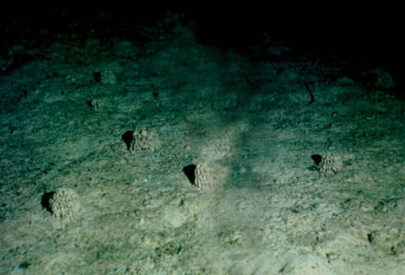
Deep Ocean - cold (0-3C) & Dark
No photosynthesis …
so where does the food come from?

Slide 4
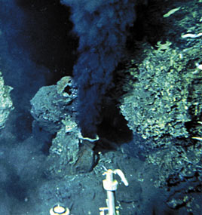
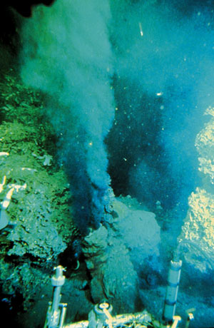
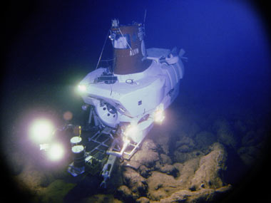
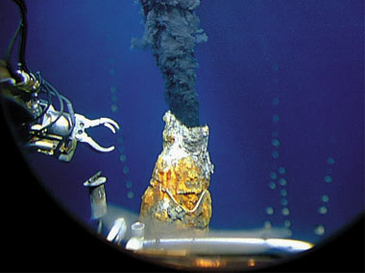
Hydrothermal Vents
https://vimeo.com/185380494
1977: The Galapagos Rift
Black smokers and 350 ºC water found.
The first black-smoker chimney—
whoi.edu

Slide 5
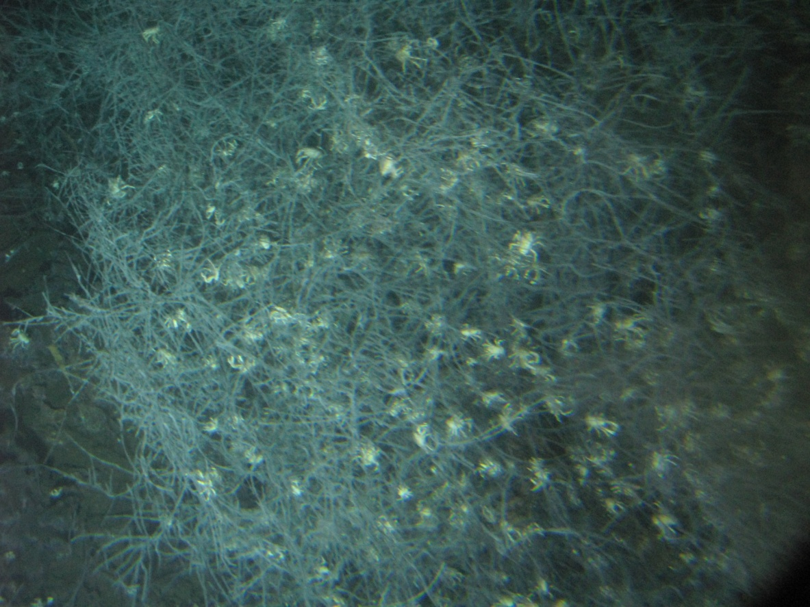
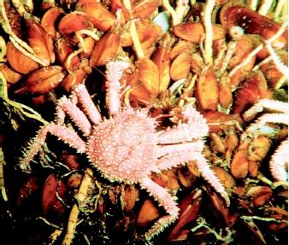
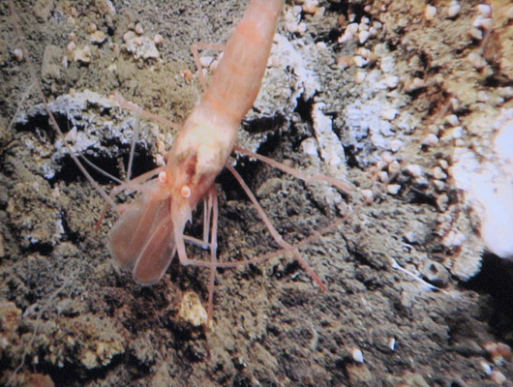
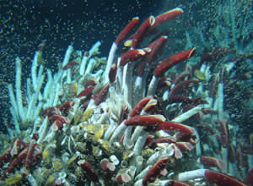

Slide 6
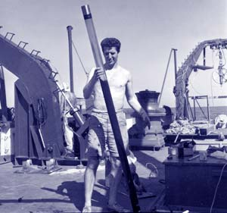
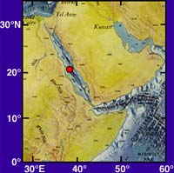
Early Clues - 1
Red Sea “Hot Brines”
1880s, Russian ship Vitaz,
Sampled 600m deep
found water to be hotter than expected.
1964, British Discovery
deep Red Sea waters 44°C (111°F)
1965 the R/V Atlantis II
Water temps of 56°C (133°F).
Dr. David A. Ross of Woods Hole Oceanographic Institution examines a sediment core collected in the Red Sea during a 1965 expedition on board R/V Chain. (Photo courtesy of WHOI Archives)
http://www.divediscover.whoi.edu/vents/index.html

Slide 7
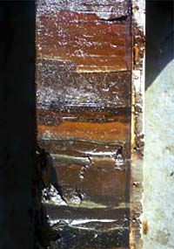
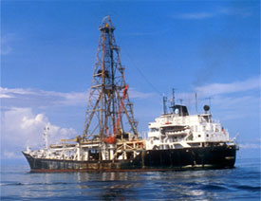
Early Clues - 2
Metal-Rich Sediments
1968 – 1983, Deep Sea Drilling Project, Golmar Challenger
Cores contained metal-rich sediments on top of volcanic ocean crust
Not just the Red Sea!
Atlantic, Pacific, Indian … wherever seafloor was spreading!
http://www.divediscover.whoi.edu/vents/index.html

Slide 8
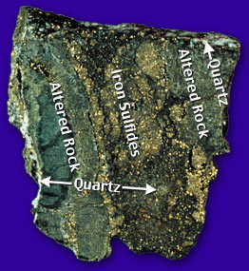
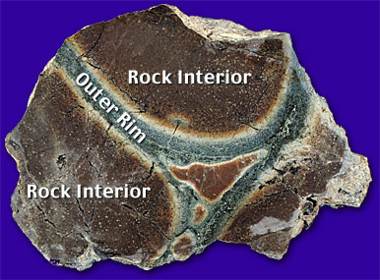
Early Clues - 3
Unusual Rocks
Most ocean-ridge rocks are black, white, pale green
Found mid-ocean ridge rocks of brown, orange, and dark green
Could only come from chemical reactions
involving hot water!
http://www.divediscover.whoi.edu/vents/index.html

Slide 9
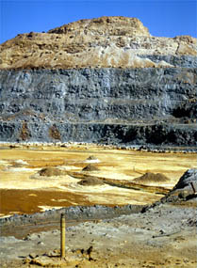
Early Clues - 4
Ophiolites
Ocean crust on land
Brought up onto continents during tectonic movement
Copper mine in Cyprus
http://www.divediscover.whoi.edu/vents/index.html

Slide 10
Early Clues - 5
“Missing Heat”

Slide 11
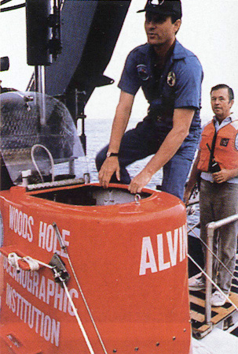
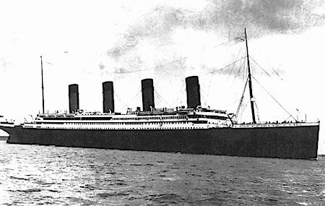
Discovery Cruises
In 1977 → a group of geologists
→ found one of the most exciting biological phenomena

Slide 12
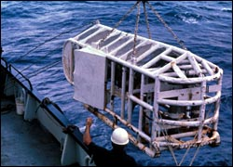
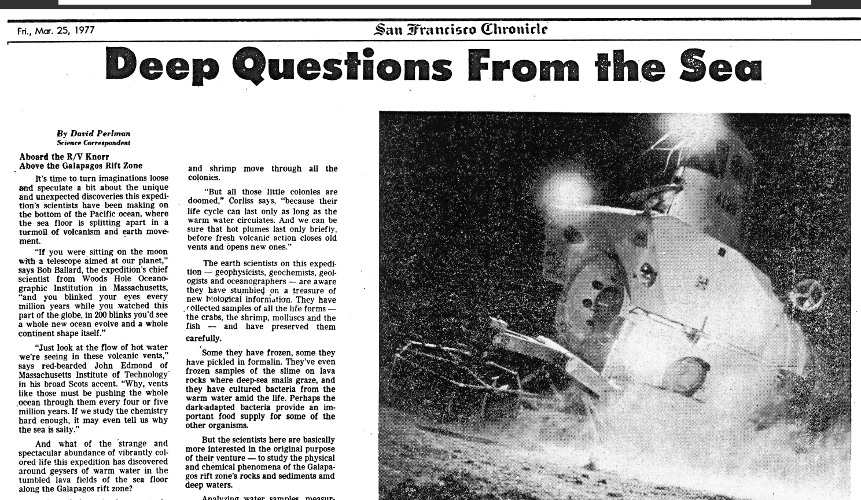
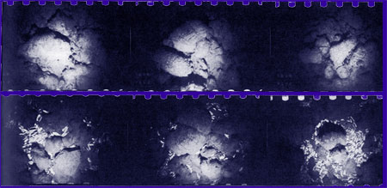
Discovery Cruises
ANGUS

Slide 13
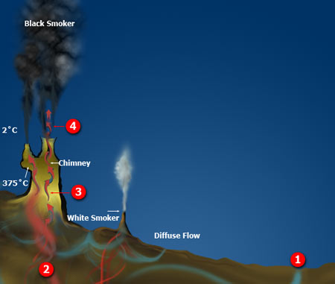
How do Hydrothermal Vents Work?
1. Cold seawater (2°C) seep into ocean floor cracks
2. 350 - 400°C, water reacts with crust
- oxygen removed
- becomes acidic
- picks up dissolved metals (Fe, Cu, Zn)
- Picks up hydrogen sulfide (H₂S)
3. Hot liquid rises carrying metals and H₂S
4. Exits, mix with cold, oxygen-rich water
- Black smoker: Metals and Sulfides mix
to form black minerals
- White smoker: Not as hot, silica and
anhydrite (white) precipitate

Slide 14
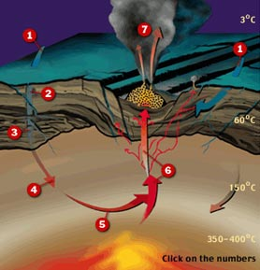
Vent Chemistry Affect Entire Ocean
7. Cold, oxygen precipitate
metals and sulfur
1. Cold seawater sinks into crust
2. Oxygen and
Potassium removed
3. Calcium, Sulfate,
Magnesium removed
6. Hot fluids carrying
dissolved metals
4. Sodium, Calcium, Potassium
from crust enter fluid
5. Copper, Zinc, Iron, Sulfur
from crust enter fluid
http://www.divediscover.whoi.edu/vents/index.html

Slide 15
Black Smokers vs. White Smokers
There are two main types of hydrothermal vents.
"Black smokers" are another name for the most common type. They are named for the black colored water that comes out of them, like the picture on the left. The black "smoke" is caused the presence of iron and sulfur, which combine to become iron monosulfide, which has a black color. When the iron monosulfide solidifies, it created the black chimneys. "White smokers" are the cooler cousins of black smokers. These vents release cooler water then "black smokers". These vents contain more barium, calcium and sillicon. These elements also have a white color, causing the white "smoke", as seen on the right. White smokers also create white chimneys, which are usually smaller.
Notes:
http://hydrothermalventszcrenshaw.weebly.com/black--white-smokers.html

Slide 16
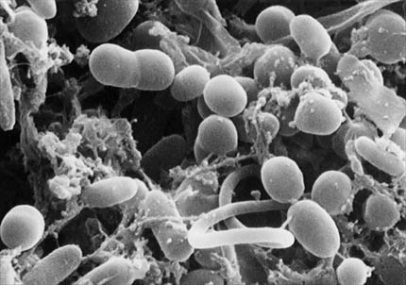
Life Without Sunlight
Chemosynthesis: Uses chemical energy instead of solar energy
Microscopic Archaea (bacteria-like organisms)
H₂O + CO₂ + H₂S + O₂ → CH₂O + H₂SO₄
Water Carbon dioxide Hydrogen sulfide Oxygen Carbohydrates Sulfuric acid
Chemosynthetic bacteria
whoi.edu

Slide 17
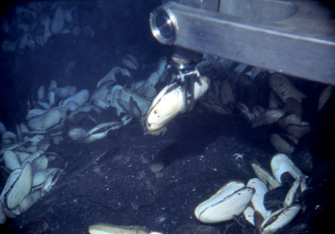
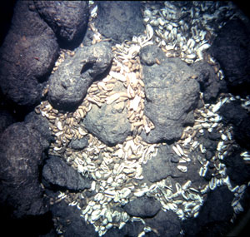
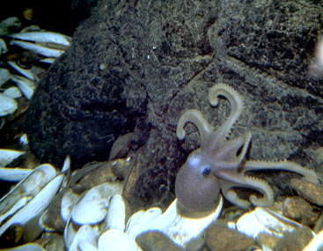
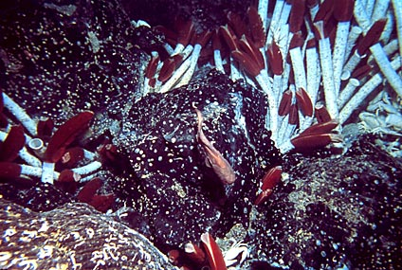
Life Without Lights
1977, The Galapagos Rift, thriving biological community
whoi.edu

Slide 18
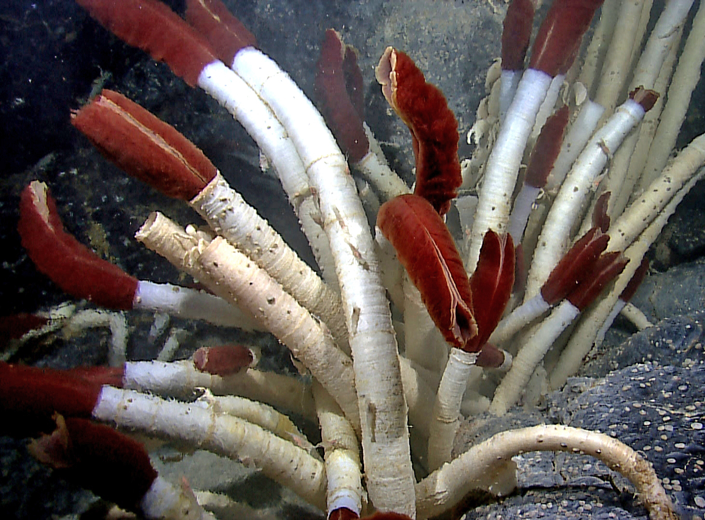
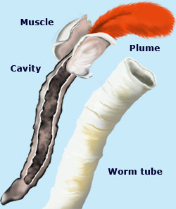
Life Without Lights
Tube Worms
Plume filters oxygen, hydrogen sulfide and CO₂ from seawater.
Plume contains hemoglobin (that’s why it’s red).
Blood transports chemicals to bacteria in the cavity.
Bacteria produces sugar and tube worms use some of it (symbiosis).
Worm tubes made of chitin

Slide 19
Life Span of Hydrothermal Vents
Short life span (~years)
Hydrothermal vents are dependant on
sporadic volcanic activity of Mid Ocean Ridges
How vent communities move from one to another vent?
Dead whale hypothesis (stepping stones).
Following deep currents.

Slide 20
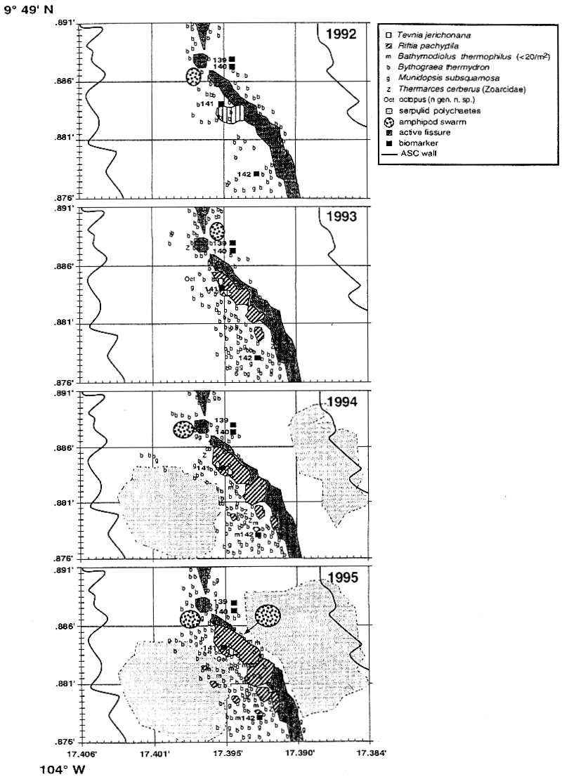
Temporal changes in community structure at 9ºN EPR
4/1991
3/1992
12/1993
10/1994
11/1995

Slide 21
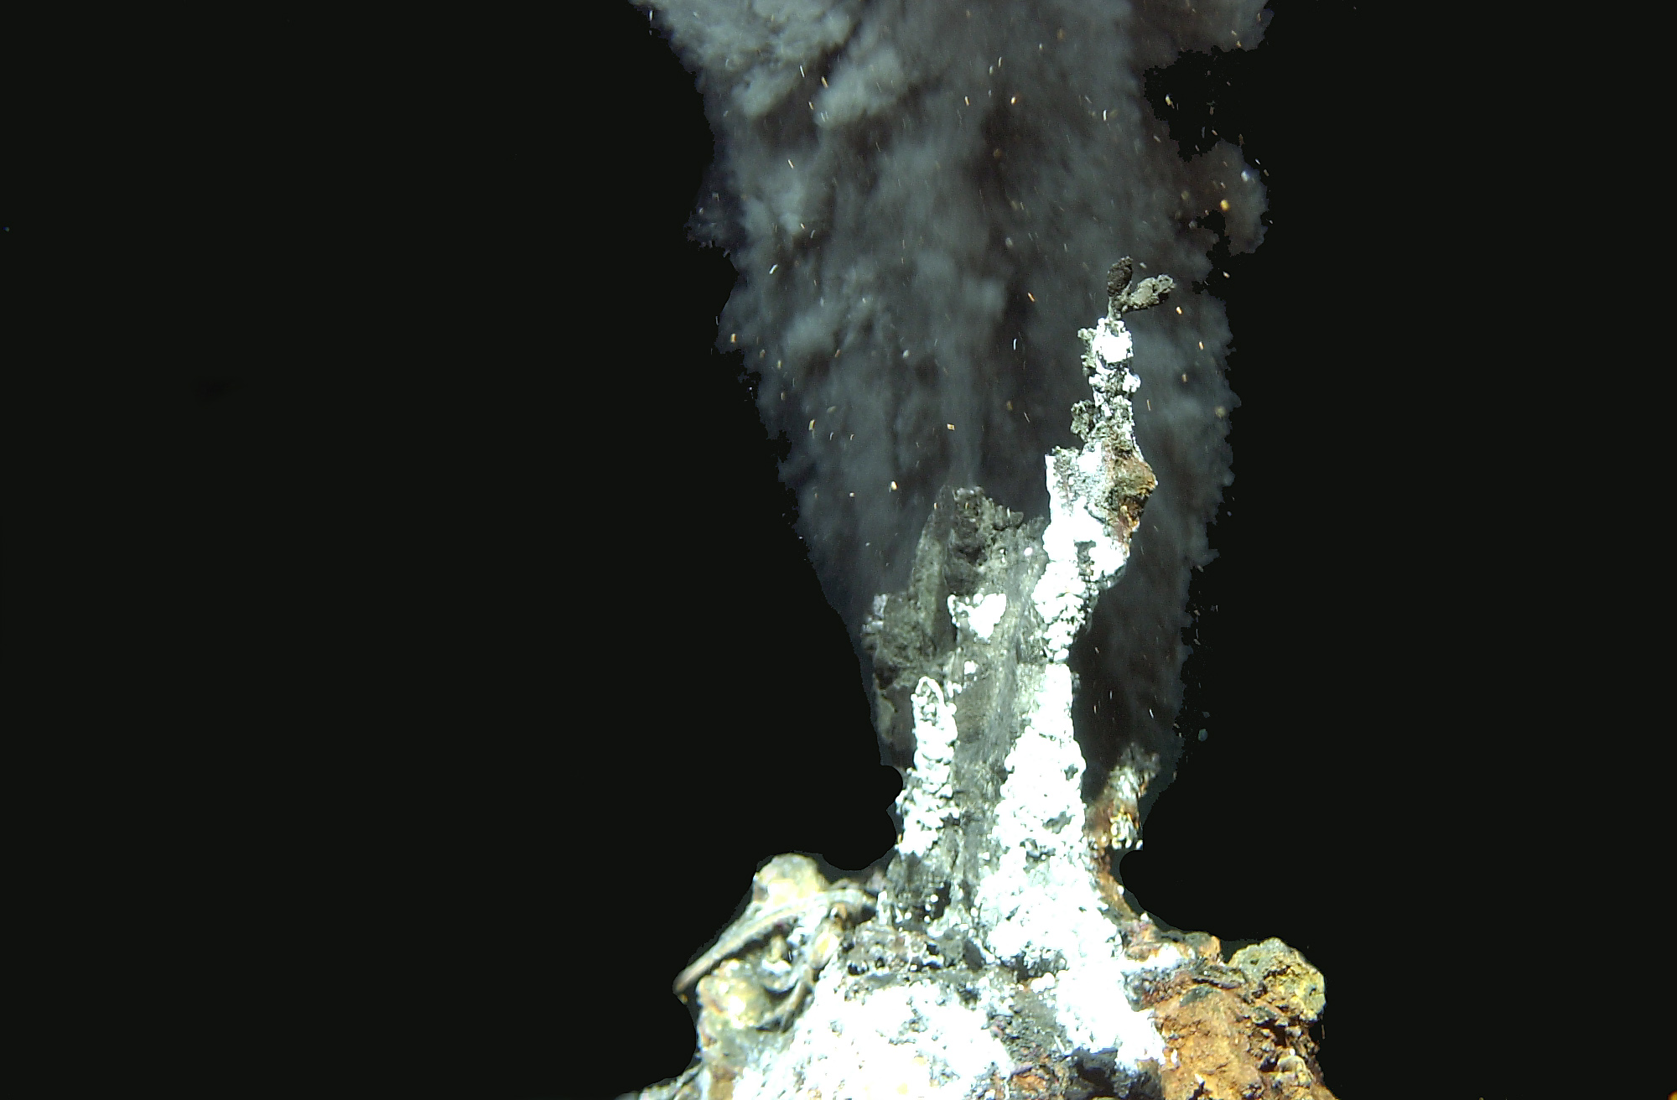
Longevity of vent fields
Estimated by:
Heat loss in rocks decades
(Macdonald et al., 1980)
Sulphide Radiochronology 15-60 years
(Stakes & Moore, 1989;
Lalou et al., 1984)
Clam ages 4-40 years
(Lutz et al, 1988;
Fisher et al., 1988)

Slide 22
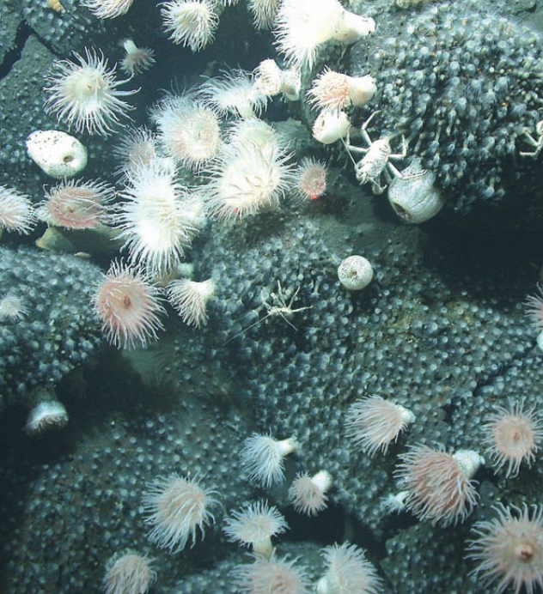
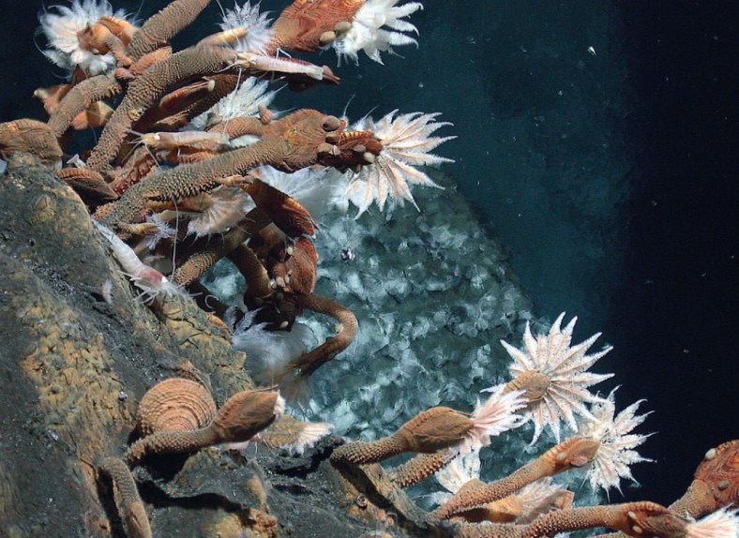
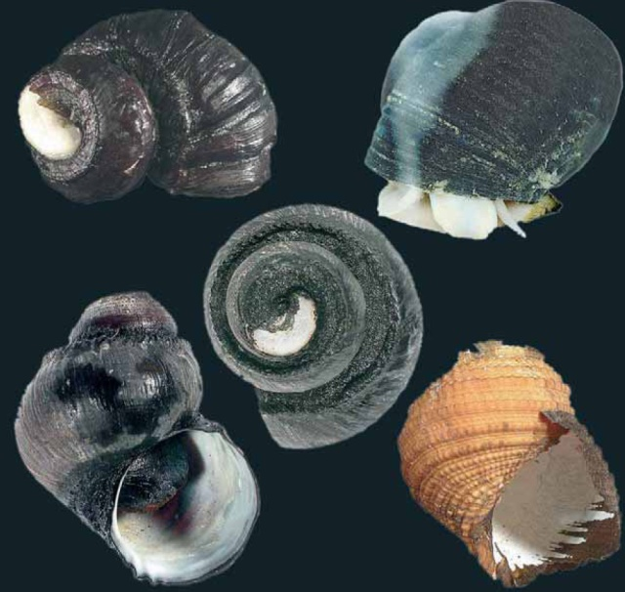
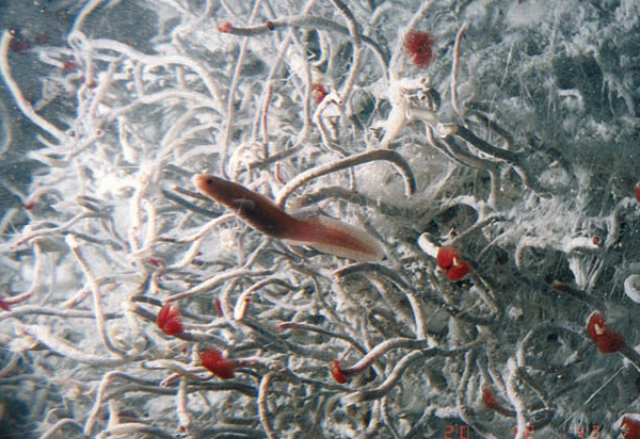
West Pacific back-arc basins
Vulcanolepas sp.
Lamellibrachia sp.
Vent gastropods (Ifremeria)
Anemones

Slide 23
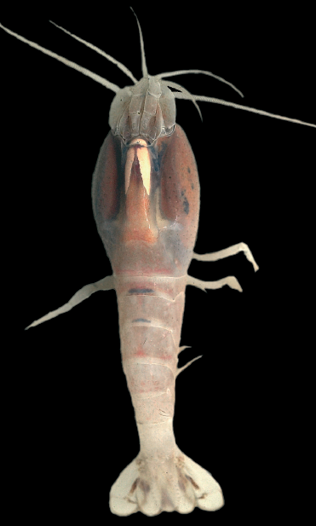
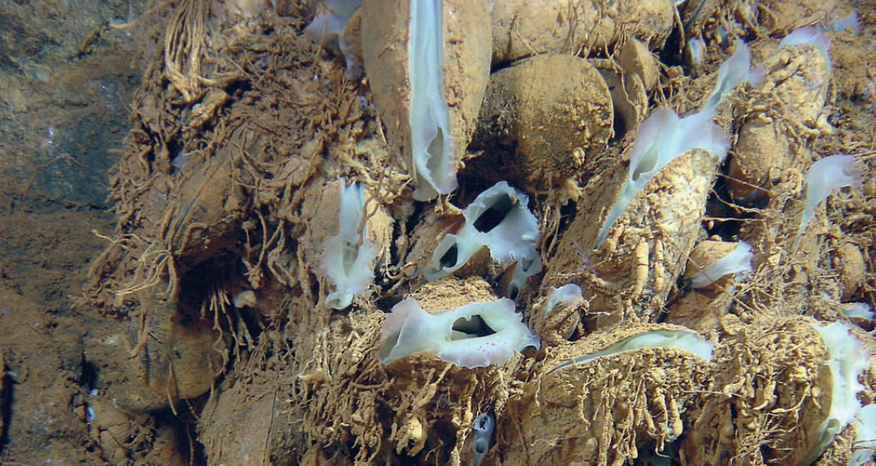
Mid-Atlantic Ridge
Rimicaris exoculata
Bathymodiolus spp

Slide 24
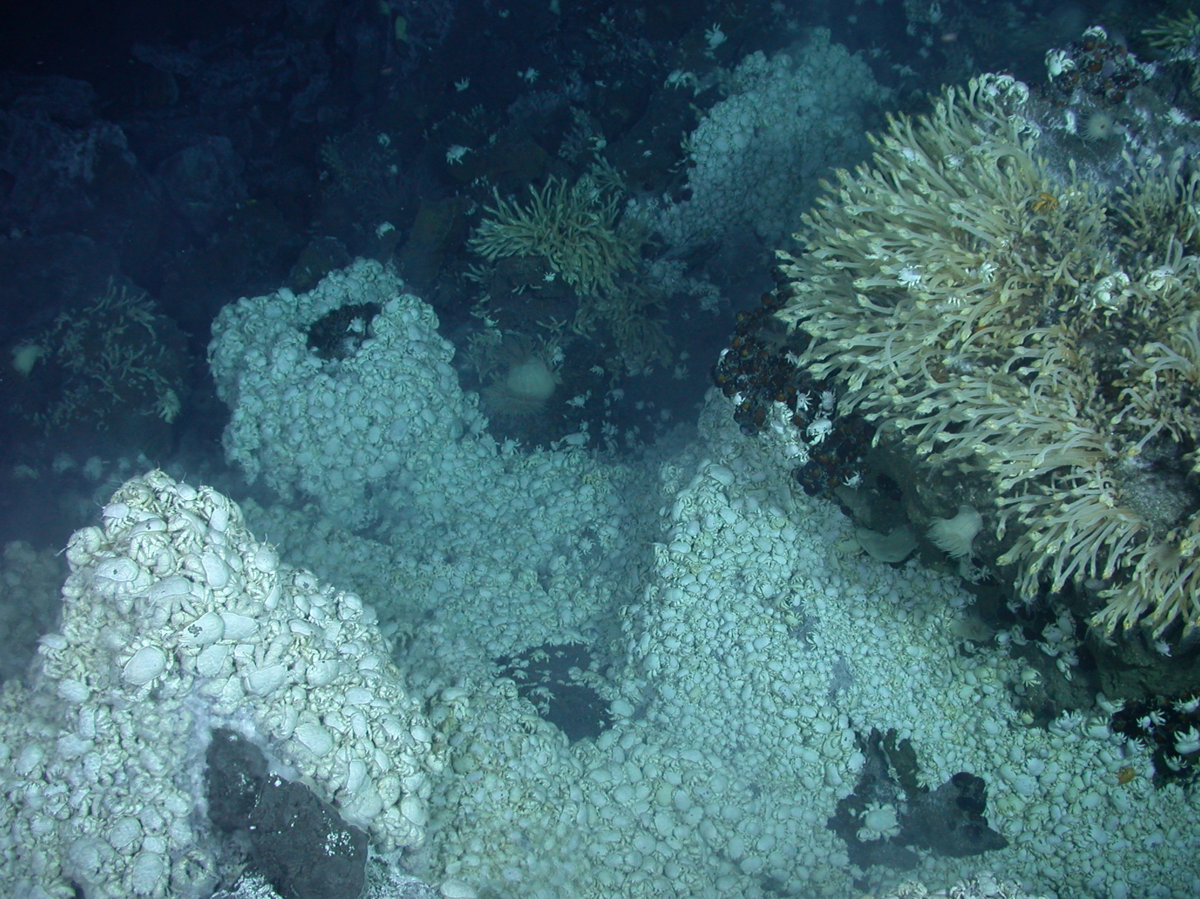
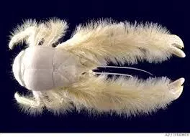

Slide 25
Global distribution of cold-seep communities

Slide 26
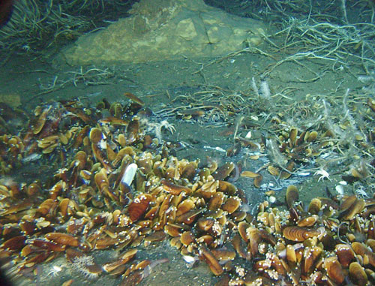
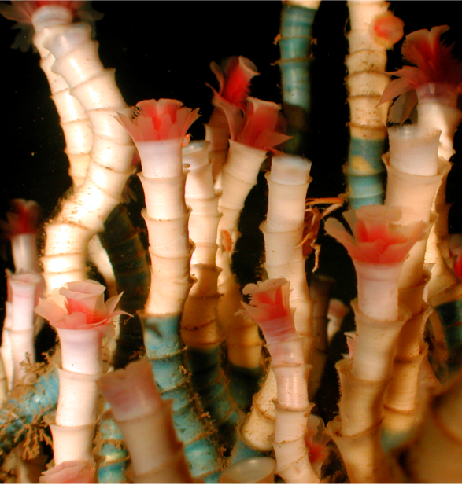
Other Deep Biocommunities –
Cold Seeps
Hypersaline seeps
Discovered in 1984
High salinity.
Normal temperature.
Hydrogen Sulfide-rich water seeps.
Hydrocarbon seeps
Observed in 1984
Hydrogen sulfide and
methane as energy sources.

Slide 27
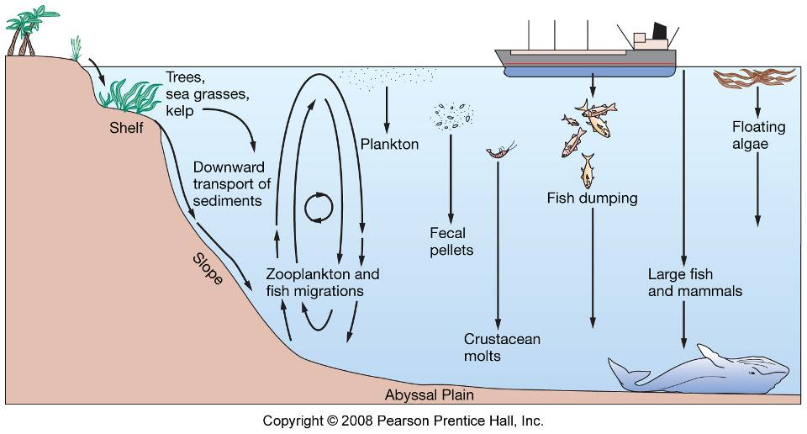
Deep Ocean Floor
Surface waters!
1 – 3% reaches ocean floor

Slide 28
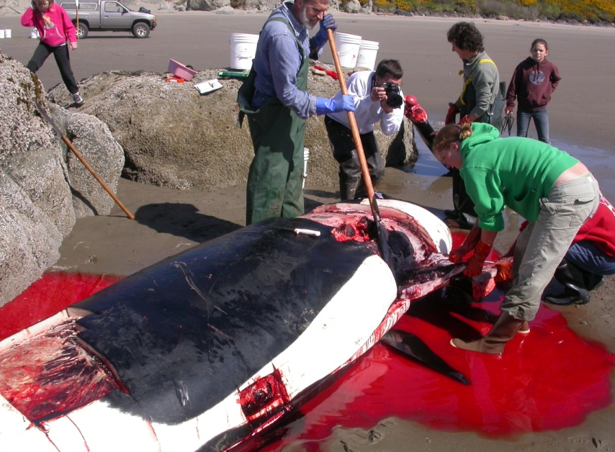
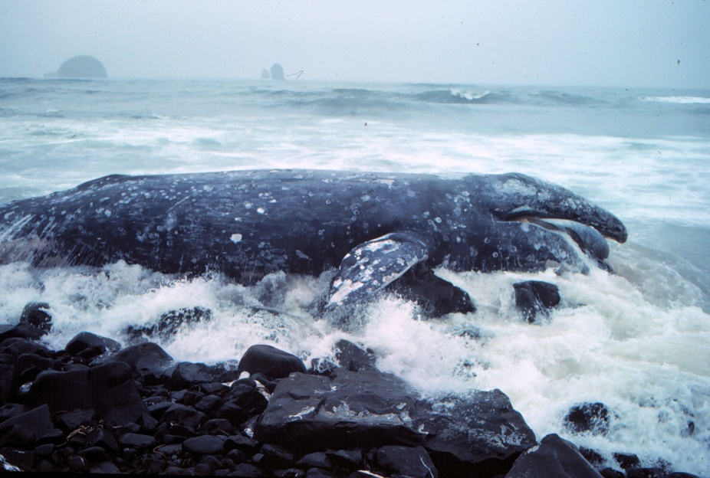
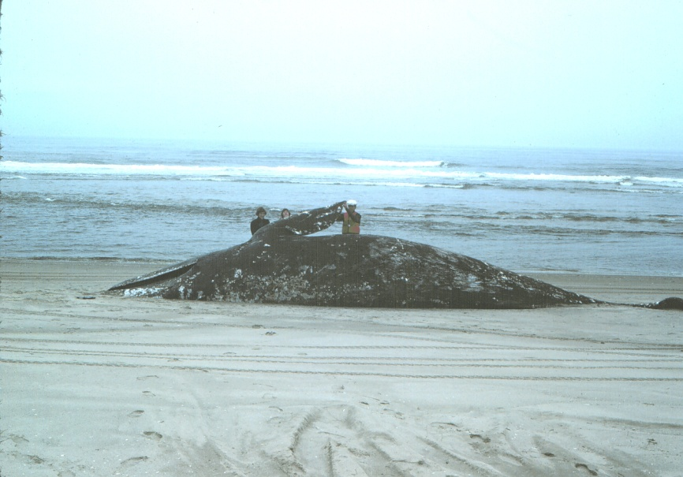
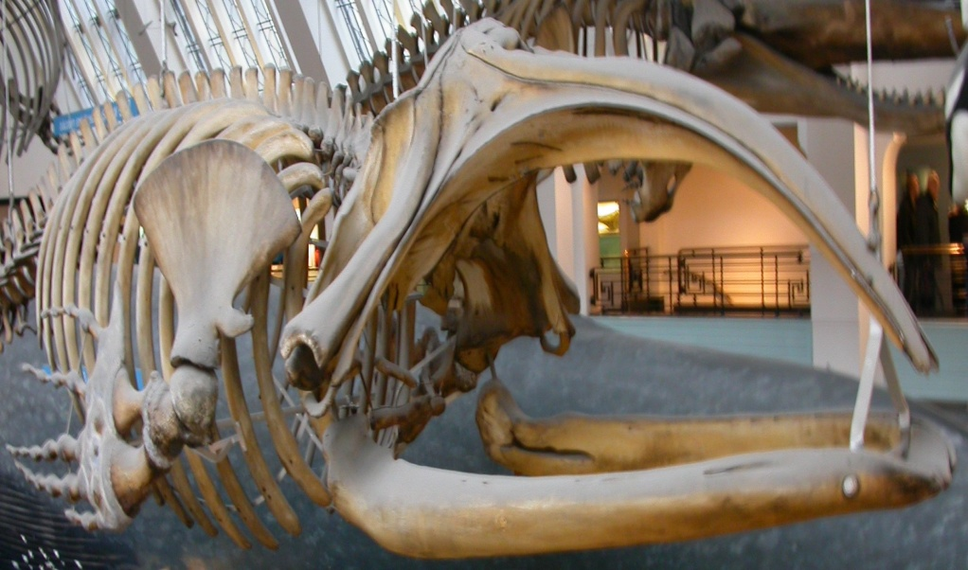
Whale falls

Slide 29
Successional stages of carcass decomposition
Mobile-scavenger stage lasting months to years, during which aggregations of sleeper sharks, hagfish, rat-tails and invertebrate scavengers remove whale soft
Tissue consumed at high rates (40–60 kg d1);
Enrichment opportunist stage (duration of months to years) during which organically enriched sediments and exposed bones are colonised by dense assemblages (up to 40,000 m-²) of opportunistic polychaetes and crustaceans;
Sulphophilic (“or sulphur-loving”) stage lasting for decades, during which a large, species-rich, trophically complex assemblage lives on the skeleton as it emits sulphide from anaerobic breakdown of bone lipids; this stage includes a chemoautotrophic component deriving nutrition from sulphur-oxidising bacteria.
Local species diversity on large whale skeletons during the sulphophilic stage (mean of 185 macrofaunal species) is high.

Slide 30
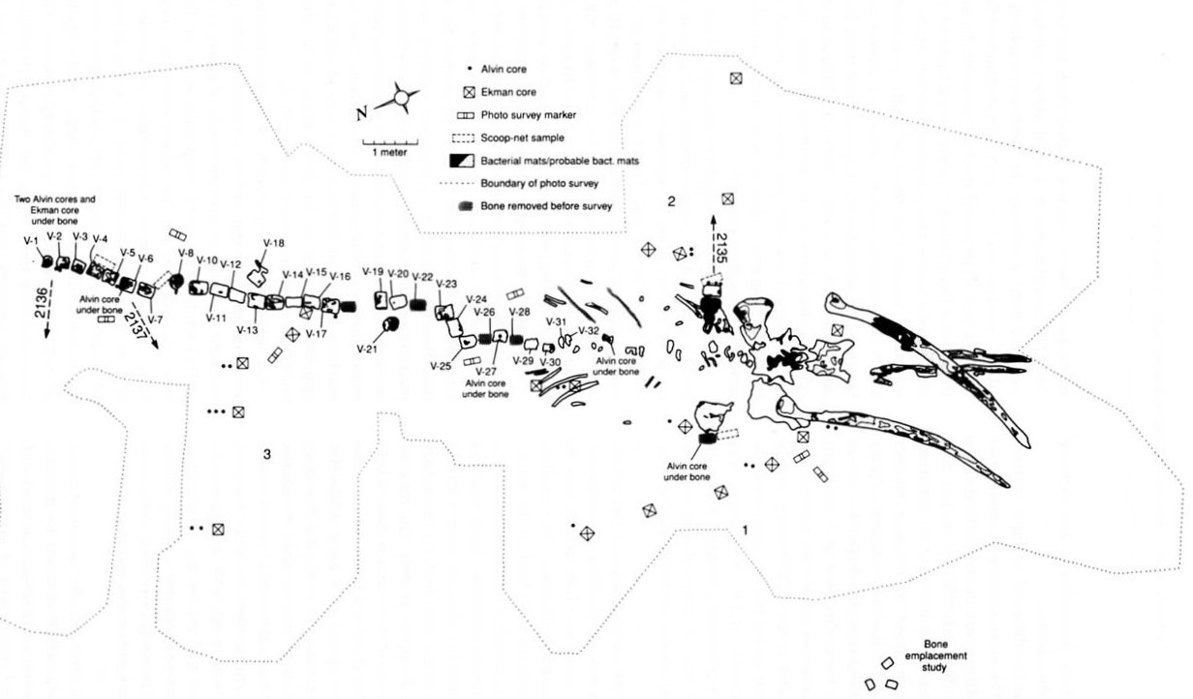
Santa Catalina whale carcass

Slide 31
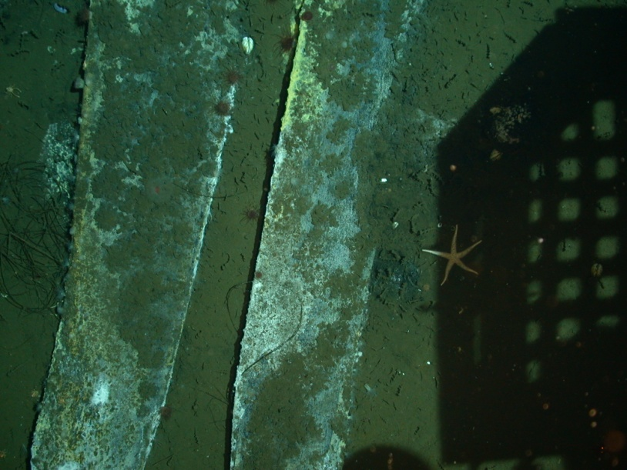
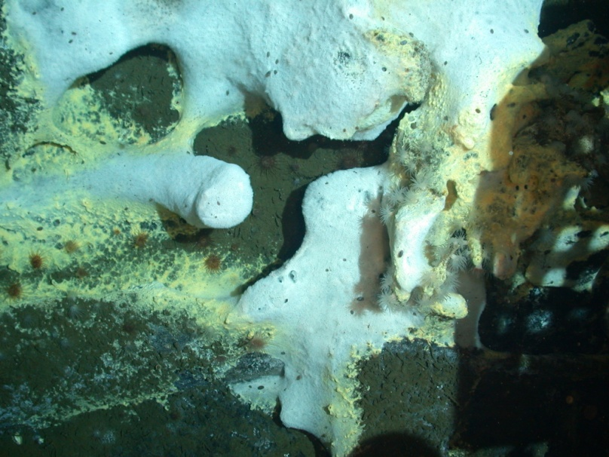
Decaying skeleton with bacterial mats

Slide 32
Wood implanted in Santa Cruz Basin

Slide 33
Chemosymbiosis has now been found across various marine ecosystems & taxa
Ciliophora Epibiotic Shallow Water,
Vents
Porifera Intracellular Seeps
Extracellular
Platyhelminthes Intracellular Shallow Water
Nematoda Epibiotic Shallow Water
Endosymbiotic
Mollusca Various Vents, Seeps, Whale
& Falls, Shallow Water
Annelida
Arthropoda Epibiotic Vents
Dubilier et al. (2008) Nature Revs Microbiol. 6: 725-740

Slide 34
Origin of life on Earth?
The “prebiotic soup” (Oparin, 1924;
Haldane, 1929)
Earth had a reducing (CO₂) atmosphere
Energy (UV light, lightning) drove the synthesis
of simple organic molecules
Molecules concentrated somewhere (shoreline,
clays)
Organic molecules formed more complex
polymers

Slide 35
Quiz –
Name one line of evidence
for hydrothermal vents

