Slide 1
Suggested reading:
https://labroides.org/2016/11/09/an-open-letter-to-my-class/
“So on a summer’s day waves collect, overbalance, and fall; collect and fall; and the whole world seems to be saying “that is all” more and more ponderously, until even the heart in the body which lies in the sun on the beach says too, That is all. Fear no more, says the heart. Fear no more, says the heart, committing its burden to some sea, which sighs collectively for all sorrows, and renews, begins, collects, lets fall.” -V. Woolf

Slide 2
Phytoplankton, Primary Production,
and Respiration Continued
November 9th, 2016

Slide 3
Primary production by phytoplankton
CO₂
Nutrients +
CO₂
phytoplankton
Surface Ocean

Slide 4
Respiration
Organic Matter + O₂ → CO₂ + NO₃ + PO₄ + H₂O
Respiration (remineralization, regeneration, degradation)
consumes oxygen.
produces carbon dioxide.
regenerates nutrients.

Slide 5
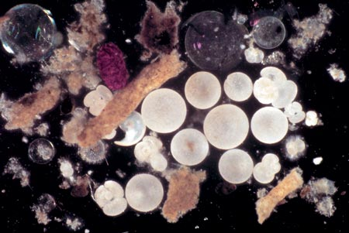
Marine Snow
Fecal pellets
Planktonic tests
www.whoi.edu/oceanus
Sinking particles collected in a sediment trap

Slide 6
Let’s draw…….
What would a profile of O₂ w/ depth look like?
How about dissolved inorganic nitrogen?
[O2]
Epi-pelagic zone
~1000
Depth, m

Slide 7
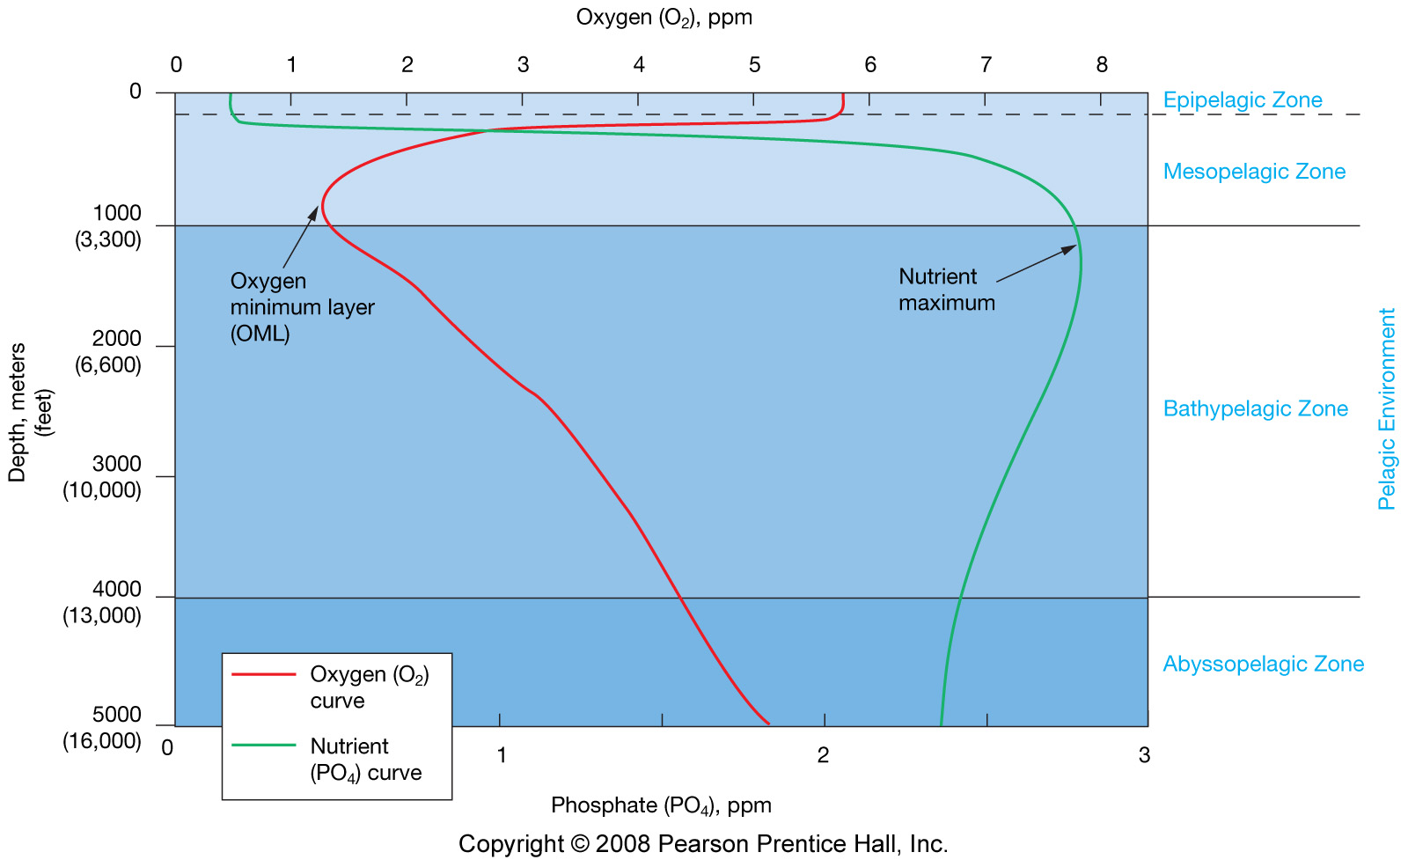
Depleted by
photosynthesis
Remineralization
75% of ocean
Nutrient remain high, O₂ high – because it’s replenished with
High oxygen cold water from polar regions….

Slide 8
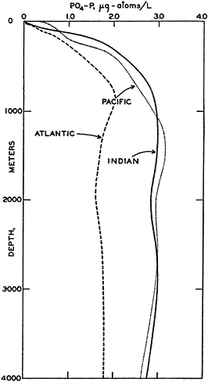
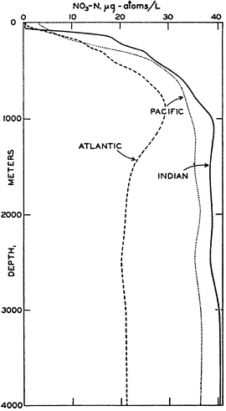
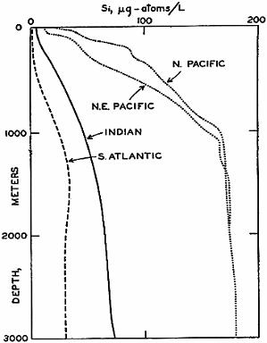
Vertical distribution of nutrients
Depleted in surface water, abundant in deep water
PO₄
NO₃
Si

Slide 9
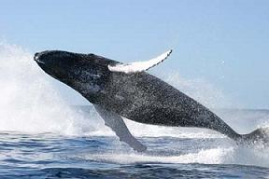
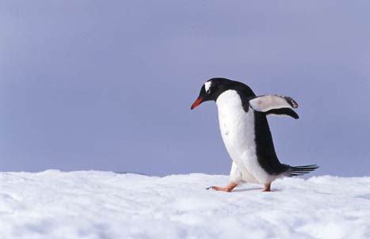
When do you get a phytoplankton
bloom???
Why do we care?

Slide 10
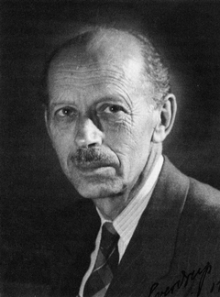
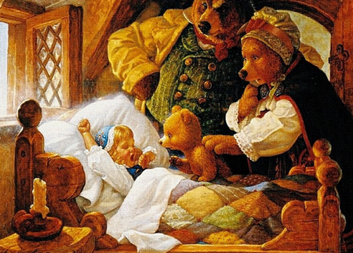
Sverdrup's Model of Critical Depth
Photosynthesis decreases exponentially with depth due to decrease in light availability
Respiration is unaffected by light and remains
constant with depth

Slide 11
Sverdrup's Model of Critical Depth
Too much light including harmful UV prohibits photosynthesis
Euphotic zone
Photosynthesis rate
~100m
Depth
Respiration rate

Slide 12
Sverdrup's Model of Critical Depth
Euphotic zone
Photosynthesis rate
Compensation Point:
Rate of Photosynthesis = Rate of Respiration
~100m
Depth
Respiration rate
Operationally defined as
The depth at which 1%
Of surface light occurs.

Slide 13
Sverdrup's Model of Critical Depth
Phytoplankton is mixed by turbulence and experiences different light intensities over time, sometimes above and sometimes below compensation point
Critical depth = depth at which photo-synthesis
of the TOTAL water column phytoplankton
population equals their TOTAL respiration

Slide 14
Sverdrup's Model of Critical Depth
Euphotic zone
Photosynthesis rate
~100m
Depth
Critical Depth:
TOTAL Photosynthesis =
TOTAL Respiration
Respiration rate
A phytoplankton bloom –can only occur if mixing is shallower than this depth…..shallower than the critical depth. Only then is the population net production >0

Slide 15
Low latitude: strong thermocline → stratified.
High latitude: vertically well mixed.
High latitude
Temperature
Low latitude
Mixing
Depth

Slide 16
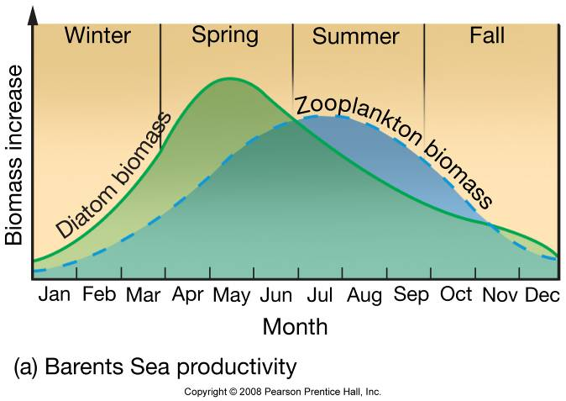
Primary productivity
Polar oceans:
Nutrients are abundant due to vertical mixing.
limited by sunlight: darkness for winter months.
(partly) covered by sea ice.

Slide 17
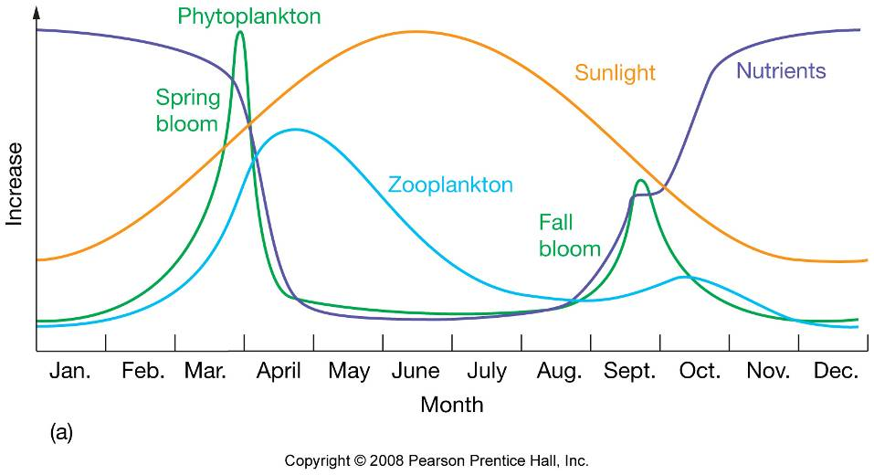
Primary productivity in temperate oceans

Slide 18
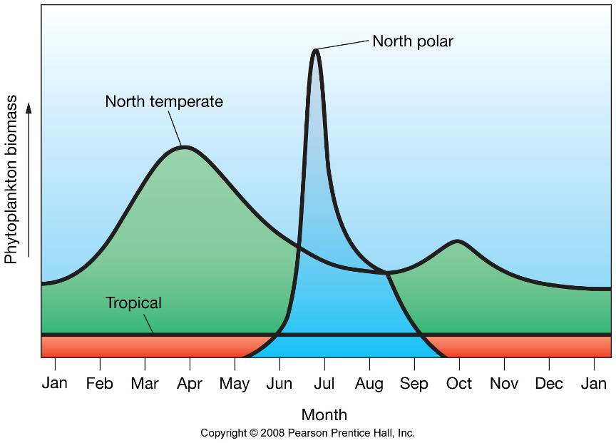
Primary productivity

Slide 19
Quiz
T/F Tropical Water column productivity peaks in the fall.

