Slide 1
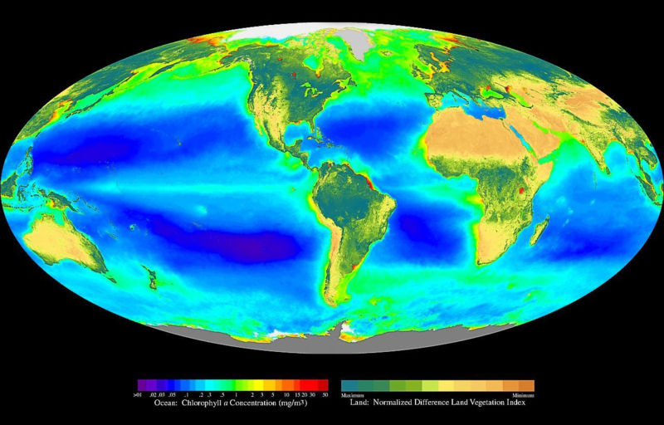
“Each day as the sun rises and retires the beautiful green bays like great Creatures breathe in and out. By day photosynthetic production of food and oxygen is Plentiful, but day and night there is also a furious feasting.”
– Odum and Hoskin 1958
SeaWiFS Global Biosphere September 1997 - August 1998
This composite image gives an indication of the magnitude and distribution of global primary production, both oceanic (mg/m³ chlorophyll a) and terrestrial (normalized difference land vegetation index).

Slide 2
Primary production
Primary Production: Organic matter synthesized from inorganic substances.
Photosynthesis: producing organic matter from carbon dioxide and water using Light energy.
Carbon dioxide + Water + Light → Organic matter + Oxygen
6CO₂ + 6H₂O + Light → C₆H₁₂O₆ + 6O₂
Photosynthesis consumes CO₂ and produces O₂

Slide 3
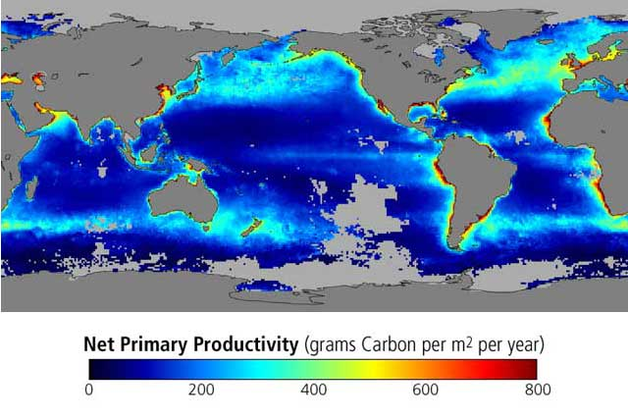
Key Terms:
Biomass – static measure
of how much,
e.g. – how many grams?
Primary Production – dynamic measure of how much is
(made) produced per unit time,
e.g. – how many grams per day?

Slide 4
Controls on primary productivity
Photosynthetic light.
Dissolved inorganic nutrients.
Grazing by zooplankton.

Slide 5
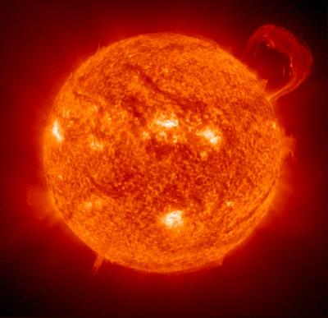
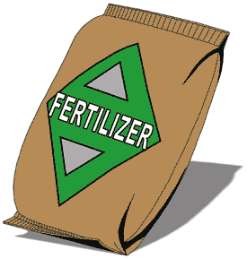
What limits primary production in the ocean?
Most common limiting factors:
Light
Nutrients

Slide 6
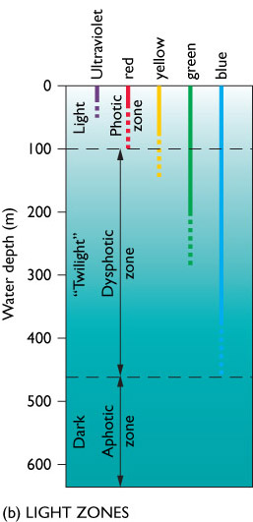
The photic zone is the depth where light is sufficient for photosynthesis.
The dysphotic zone is where illumination is too weak for photosynthesis.
The aphotic zone receives no light from the surface because it is all absorbed by the water above.

Slide 7
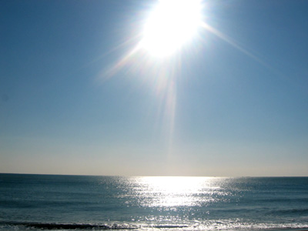
Define areas in the Ocean by Light
Photos = Light
Euphotic (eu= good) – Rarely deeper than 100 m (330 feet); photosynthesis takes place.
Disphotic (dis= apart from) – euphotic to 1000 m (3300 feet); small but measurable quantities of light.
Aphotic (a= without) – below 1000 m (3300 feet); zone has no light.

Slide 8
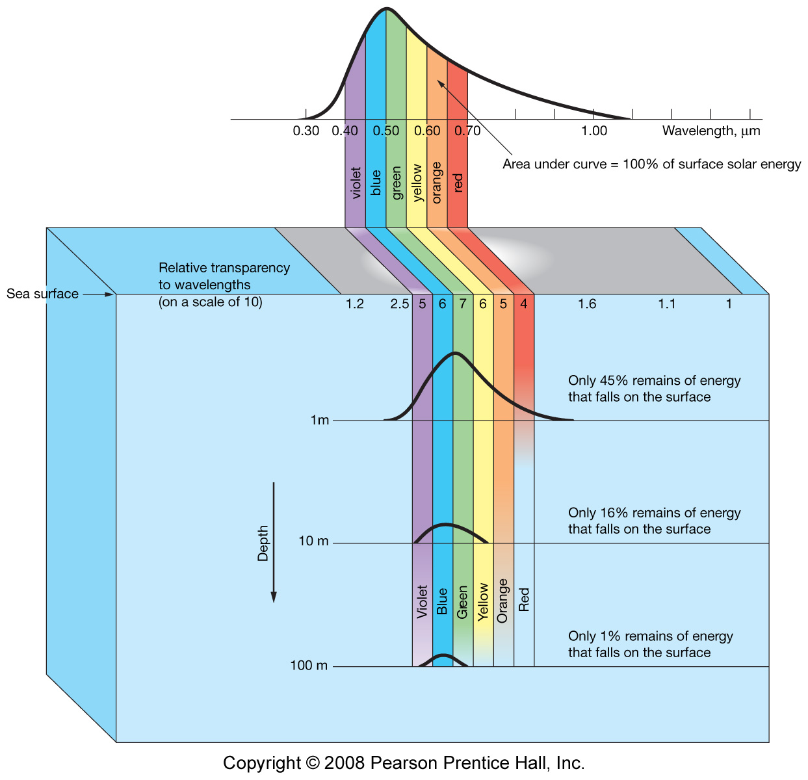
Ultraviolet
Infrared
PAR: photosynthetic active radiation
(400-700 nanometers)
Euphotic
Zone

Slide 9
1% light level

Slide 10
Major nutrients?
Carbon: important but abundant in seawater.
Nitrate (NO₃⁻), Nitrite (NO₂⁻), Ammonium (NH₄⁺)
Phosphate (PO₄³⁻)
Silicate (SiO₄)
106CO₂ + 16NO₃⁻ + PO₄³⁻ + 122H₂O + 19H⁺ + Light
→ (CH₂O)₁₀₆(NH₃)₁₆(H₃PO₄) + 138O₂
Redfield ratio C:N:P = 106:16:1 (in phytoplankton)
Diatoms?
C:N:P:Si → 106:16:1:16

Slide 11
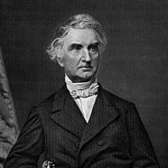
Justus von Liebig
“Father of Fertilizer Industry”
(May 12, 1803 - April 18, 1873)
1855: Liebig’s Law of the Minimum: By the deficiency or absence of one necessary constituent, all others being present, the soil is rendered barren for all crops to the life of which that one constituent is indispensable. With equal supplies of the atmospheric conditions for the growth of plants, the yields are directly proportional to the mineral nutrients supplied in the manure. In a soil rich in mineral nutrients, the yield of a field cannot be increased by adding more of the same substances"

Slide 12
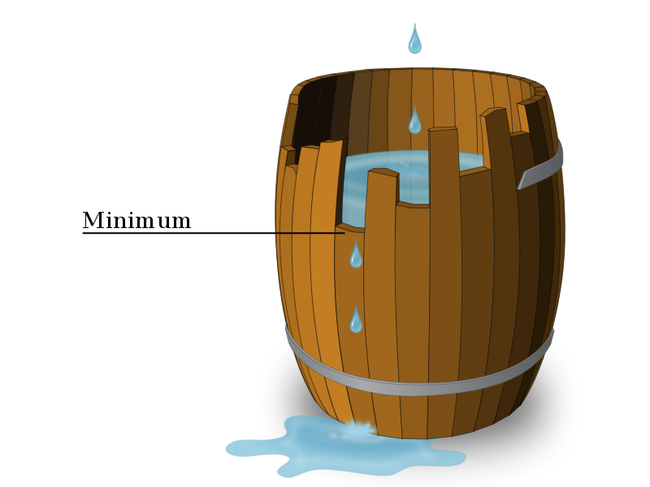
Leibig’s Law of the Minimum (for oceans):
Phytoplankton growth is determined by the response of
phytoplankton to the single factor that is most limiting.
These factors include N, P, Fe, Si, and other trace materials.

Slide 13
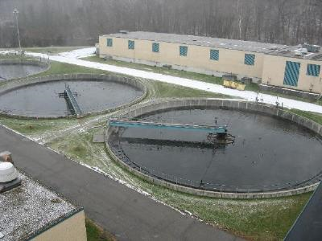
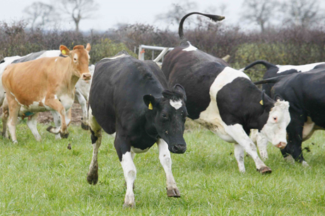
What are sources of nutrients to ocean?
Source of nutrients: Continents.
weathering, farm fertilizers → runoff
wastewater treatment plants….

Slide 14
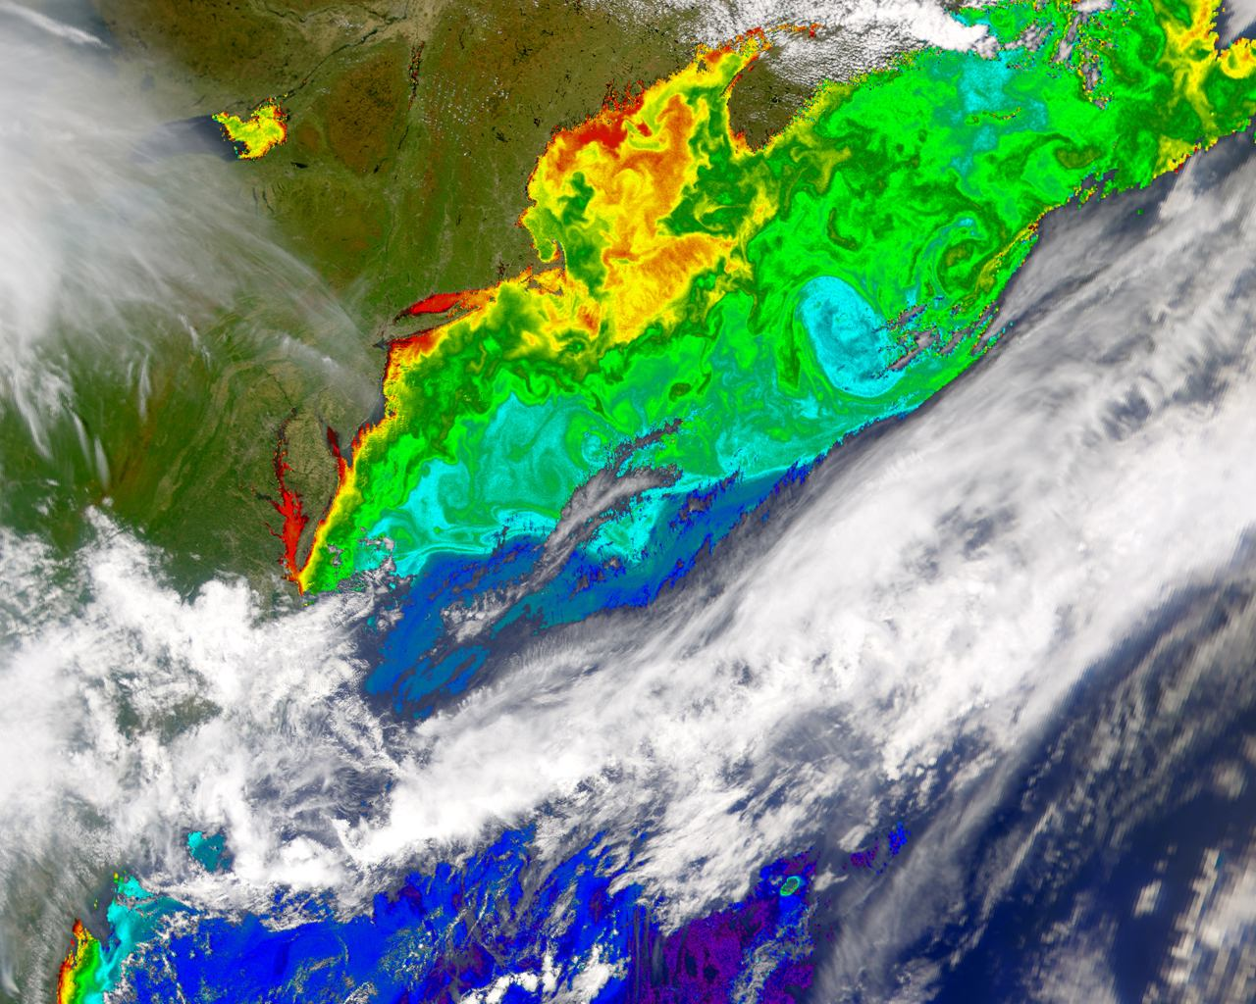

Slide 15
Primary production by phytoplankton
CO₂
Nutrients +
CO₂
phytoplankton
Surface Ocean

Slide 16
Respiration
Organic Matter + O₂ → CO₂ + NO₃ + PO₄ + H₂O
Respiration (remineralization, regeneration, degradation)
consumes oxygen.
produces carbon dioxide.
regenerates nutrients.

Slide 17
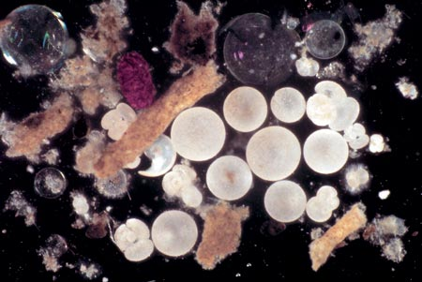
Marine Snow
Fecal pellets
Planktonic tests
www.whoi.edu/oceanus
Sinking particles collected in a sediment trap

Slide 18
Let’s draw…….
What would a profile of O₂ w/ depth look like?
How about dissolved inorganic nitrogen?
[O2]
Epi-pelagic zone
~1000
Depth, m

Slide 19
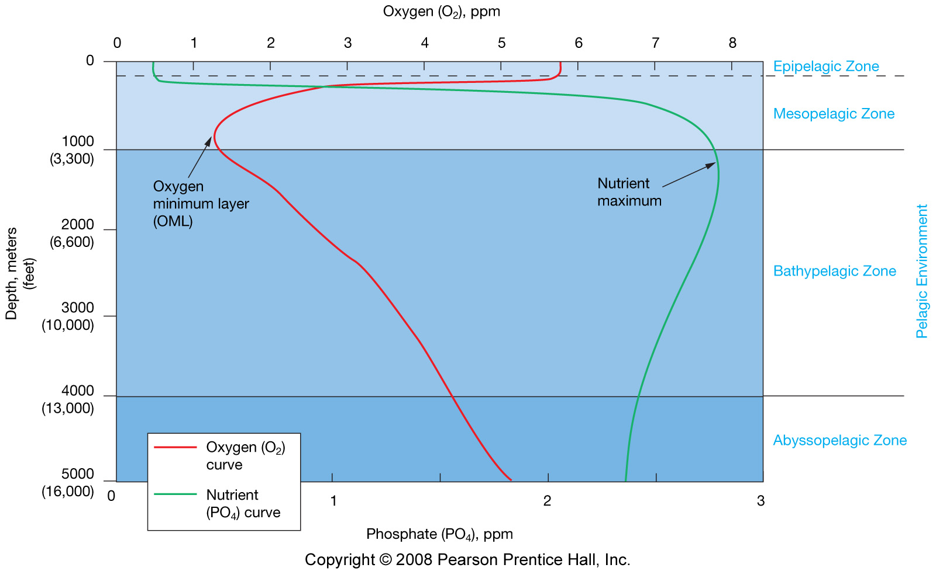
Depleted by
photosynthesis
Remineralization
75% of ocean
Nutrient remain high, O₂ high – because it’s replenished with
High oxygen cold water from polar regions….

Slide 20
Quiz
T/F Photosynthesis makes O2 below 100 m.

