Slide 1
Plankton
November 2, 2016

Slide 2
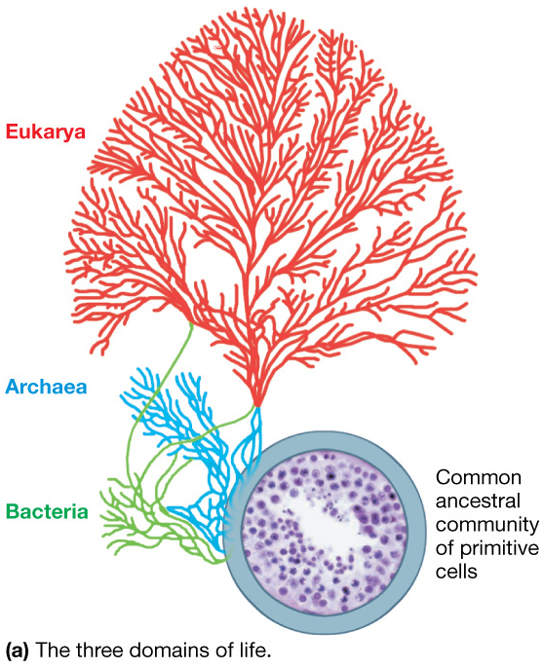
Recap last lecture:
Bacteria – simple life forms without nuclei
Archaea – simple, microscopic creatures
Eukarya – complex, multicellular organisms
Plants and animals
DNA in discrete nucleus

Slide 3
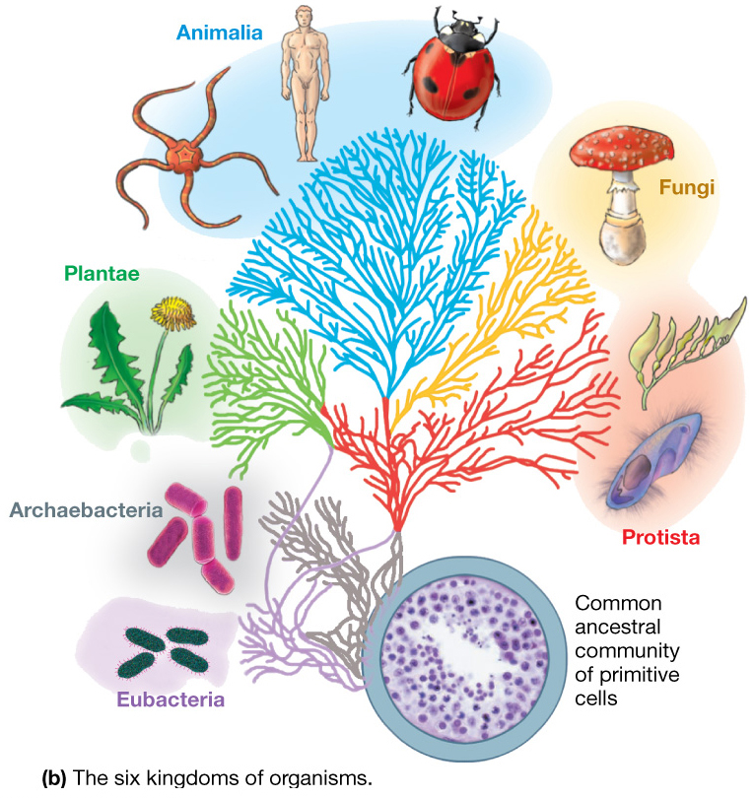
Six kingdoms
Archaebacteria
Eubacteria
Protista
Fungi
Plantae
Animalia
Used to be called – Monera….

Slide 4
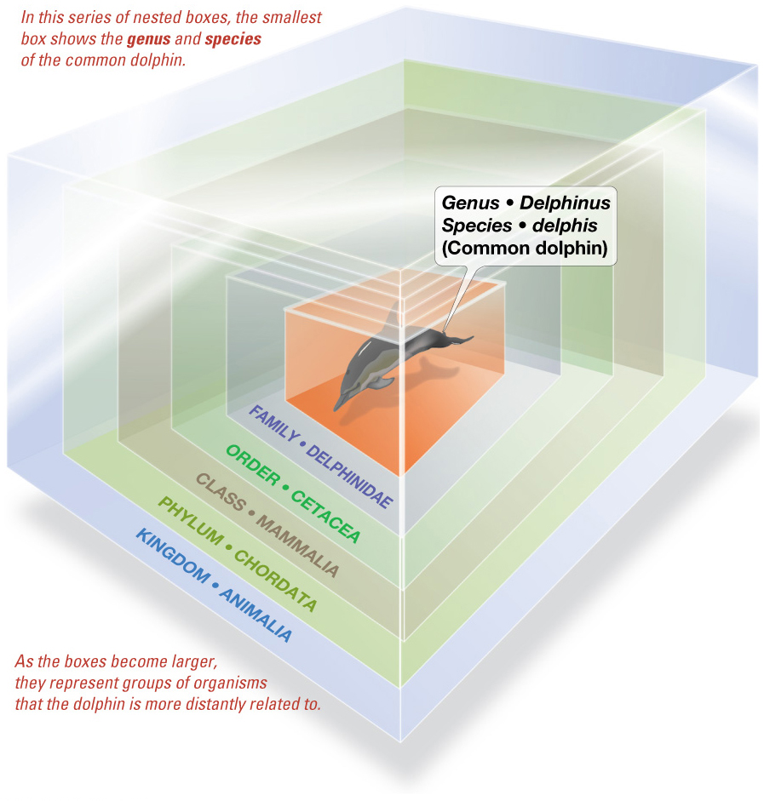
Taxonomy
Kingdom
Phylum
Class
Order
Family
Genus
Species
Fundamental unit
Population of genetically similar, interbreeding individuals

Slide 5
More classification examples…

Slide 6
Classification of Marine Organisms – by mobility
Plankton (floaters)
Nekton (swimmers)
Benthos (bottom dwellers)

Slide 7
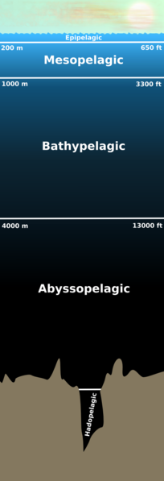
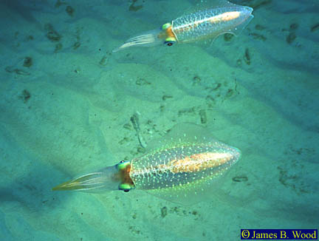
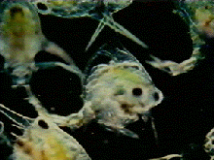
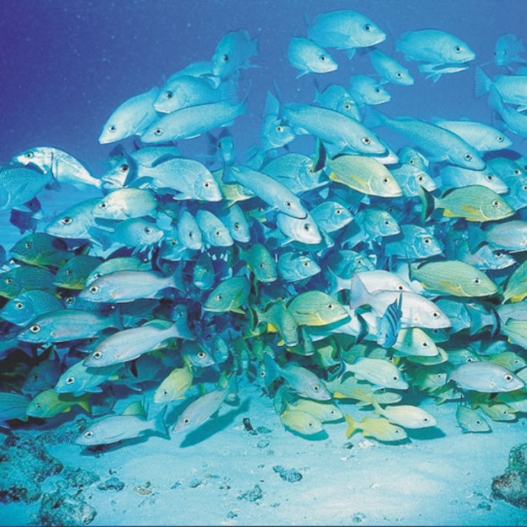
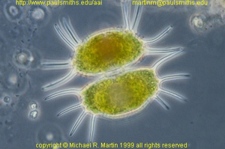
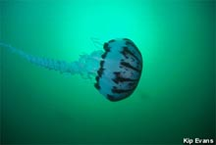
PELAGIC
PELAGIC
Plankton
Nekton
“wandering” or “drifting”
(incapable of sustained, directed horizontal movement)
Active swimmers
functional groups:
Viruses,
Bacteria,
Phytoplankton,
Zooplankton,

Slide 8
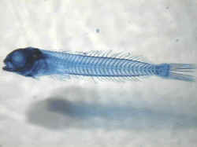
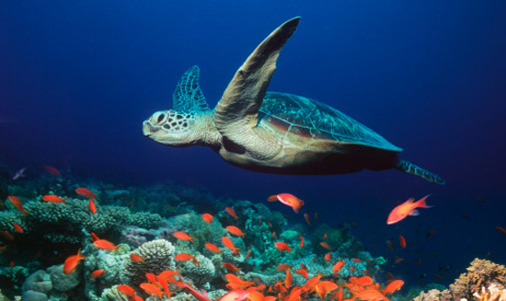
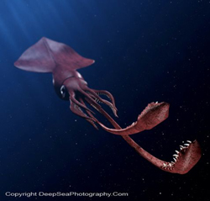
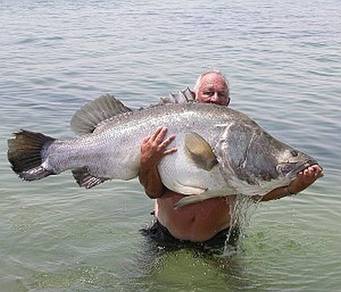
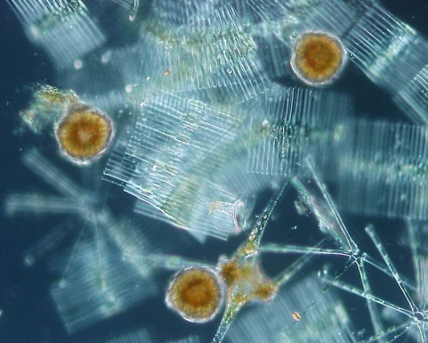
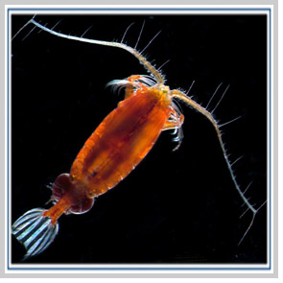
Types of Plankton
Nekton – active swimmers….
Ichthyoplankton
Autotrophs…. = phytoplankton
Animals…. = zooplankton

Slide 9
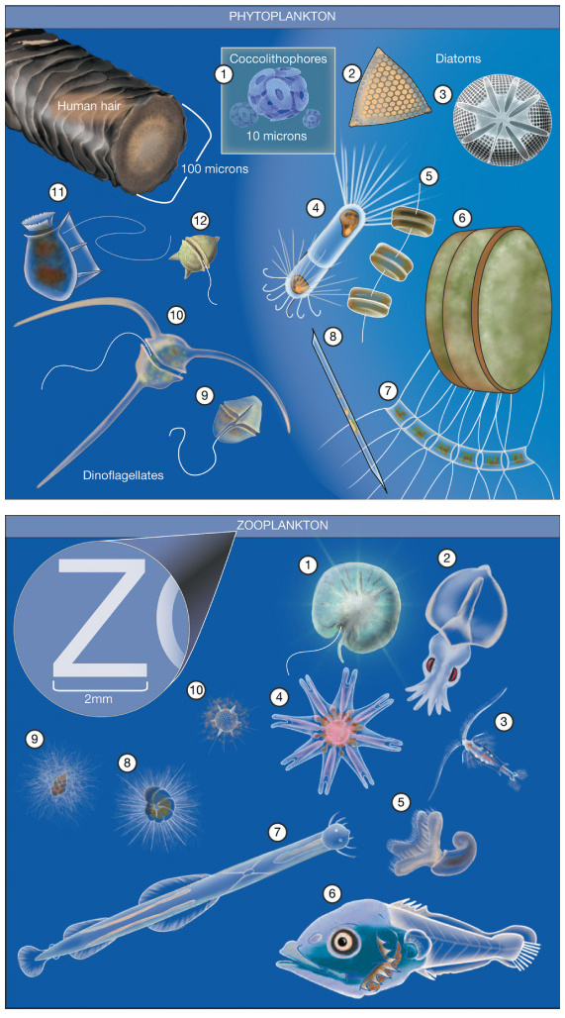
Types of Plankton
Most biomass on Earth consists of plankton
Phytoplankton
Autotrophic – can photosynthesize and produce own food
Zooplankton
Heterotrophic – relies on food produced by others

Slide 10
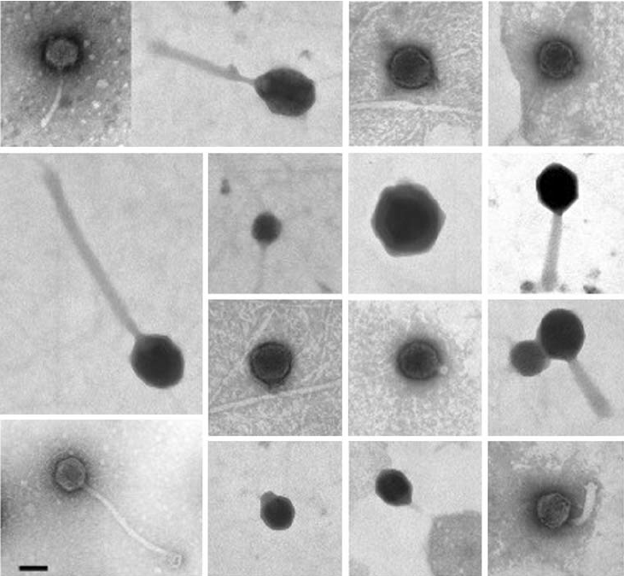
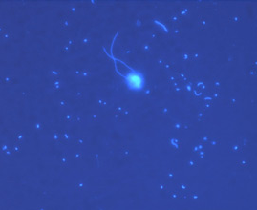
Other Types of Plankton
Bacterioplankton
Very small
At least half the ocean’s photosynthetic biomass
Likely most abundant photosynthetic organism
Virioplankton
Smaller than bacterioplankton
Not well understood, may limit abundance of other plankton through infection
Bacterioplankton
Virioplankton
Notes:
Virioplankton figure from: https://www.researchgate.net/publication/226735944_Helgoland_Roads_North_Sea_45_Years_of_Change/figures?lo=1
Bacterioplankton figure from: Craig Carlson, UCSB

Slide 11
More classifications of Plankton
Holoplankton
Entire lives as plankton
Meroplankton
Part of lives as plankton
Juvenile or larval stages
Macroplankton
Large floaters such as jellyfish or Sargassum
Picoplankton
Very small floaters such as bacterioplankton

Slide 12
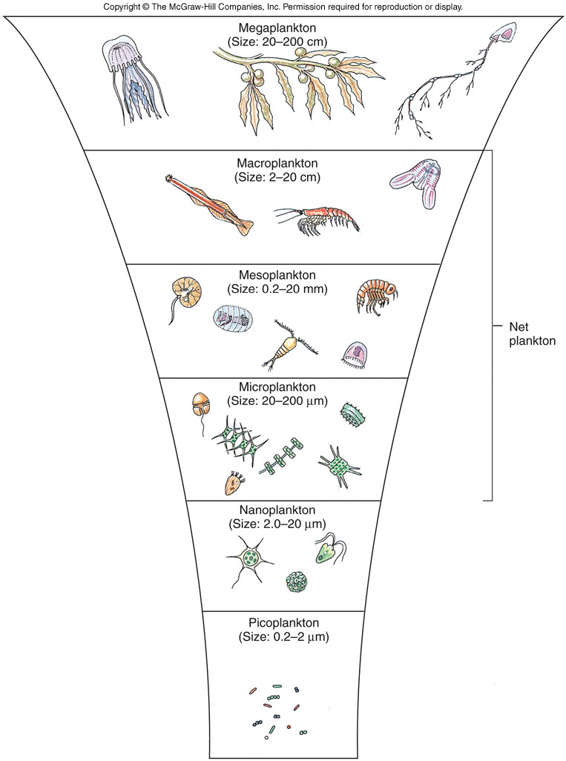
size classes:
femtoplankton | 0.02 - 0.2 µm
picoplankton | 0.2 - 2 µm
nanoplankton | 2 - 20 µm
microplankton | 20 - 200 µm
mesoplankton | 0.2 - 20 mm
macroplankton | 2 - 20 cm
megaplankton | 20 - 200 cm

Slide 13
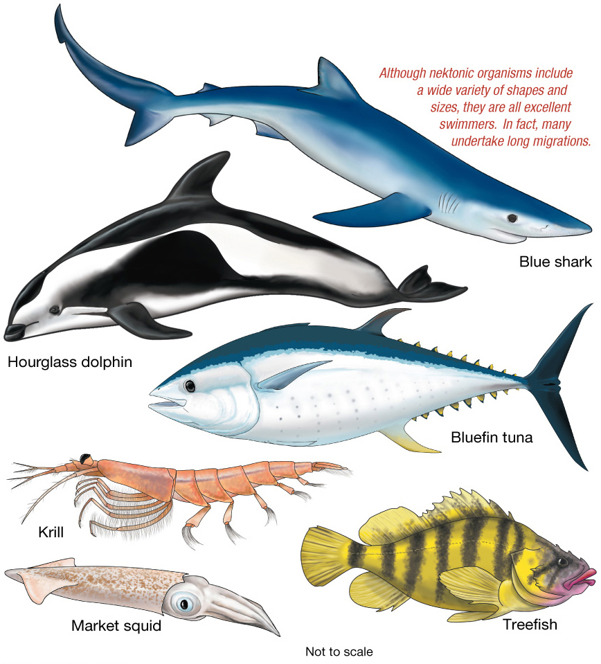
Nekton

Slide 14
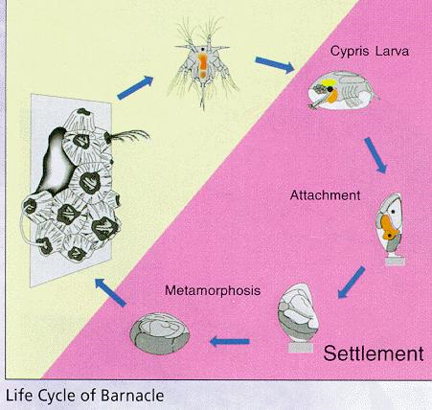
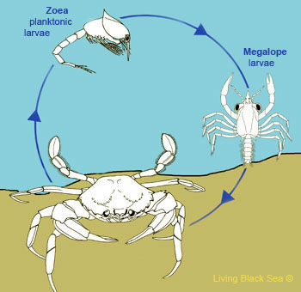
Some organisms cross from one lifestyle to another during their life, for example being planktonic early in life and benthic later.

Slide 15
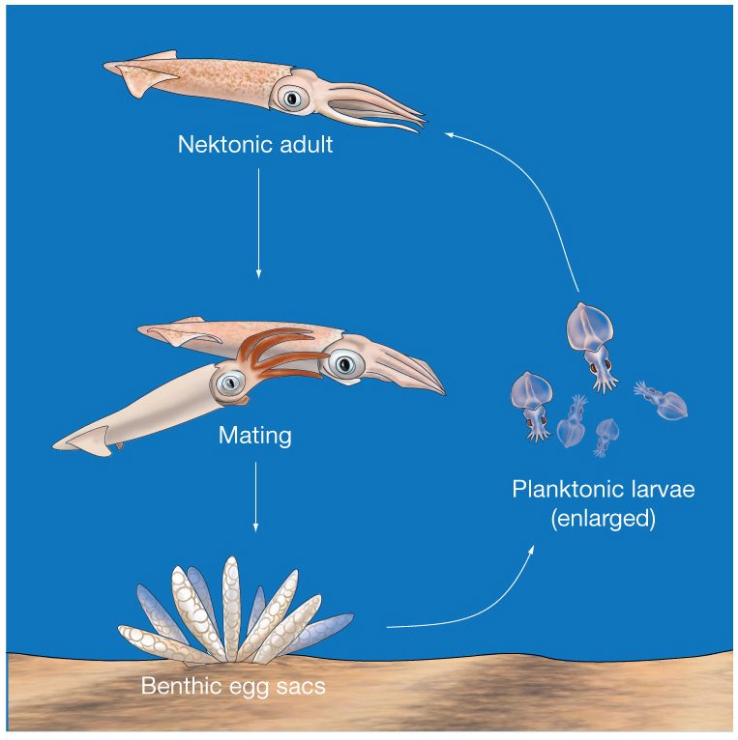
Life Cycle of a Squid

Slide 16
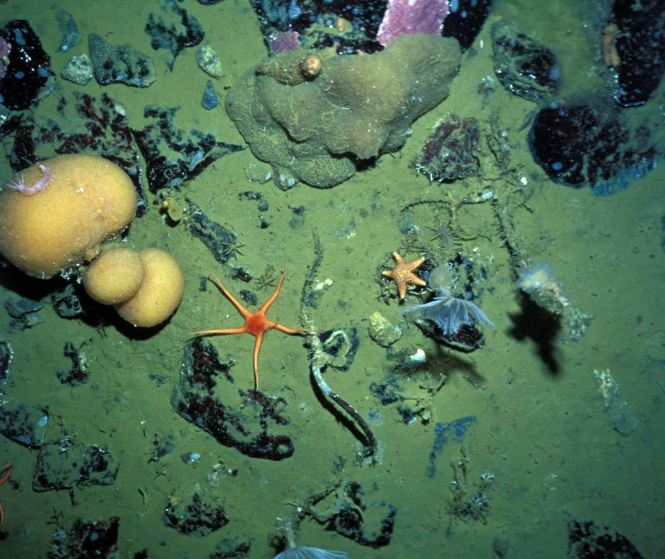
Benthos – Bottom Dwellers
Epifauna live on the surface of the sea floor.

Slide 17
Benthos – Bottom Dwellers
Infauna live buried in sediments.

Slide 18
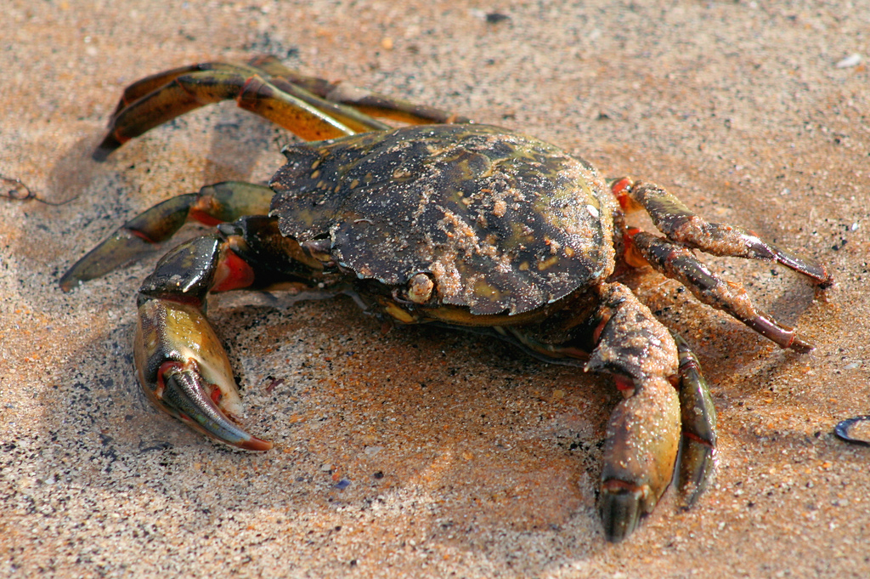
Benthos – Bottom Dwellers
Nektobenthos swim or crawl through water above the seafloor.

Slide 19
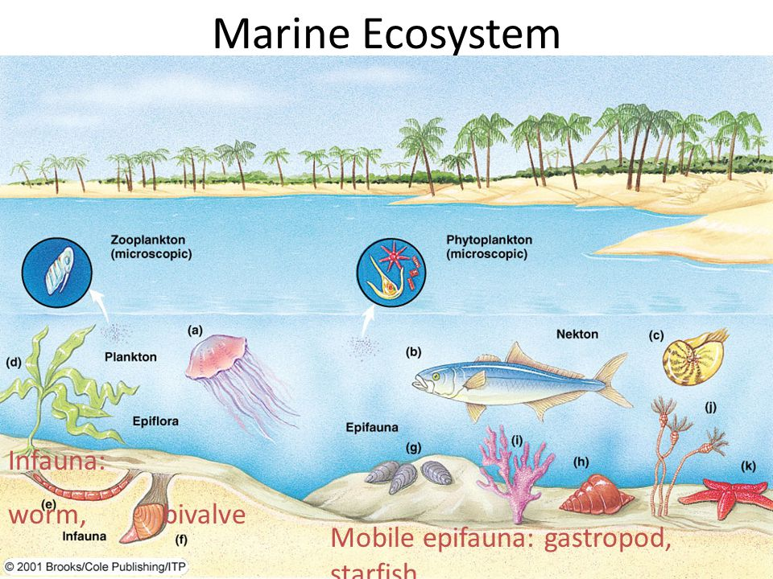
Benthos are most abundant in shallower water.
Many live in perpetual darkness, coldness, and stillness.

Slide 20
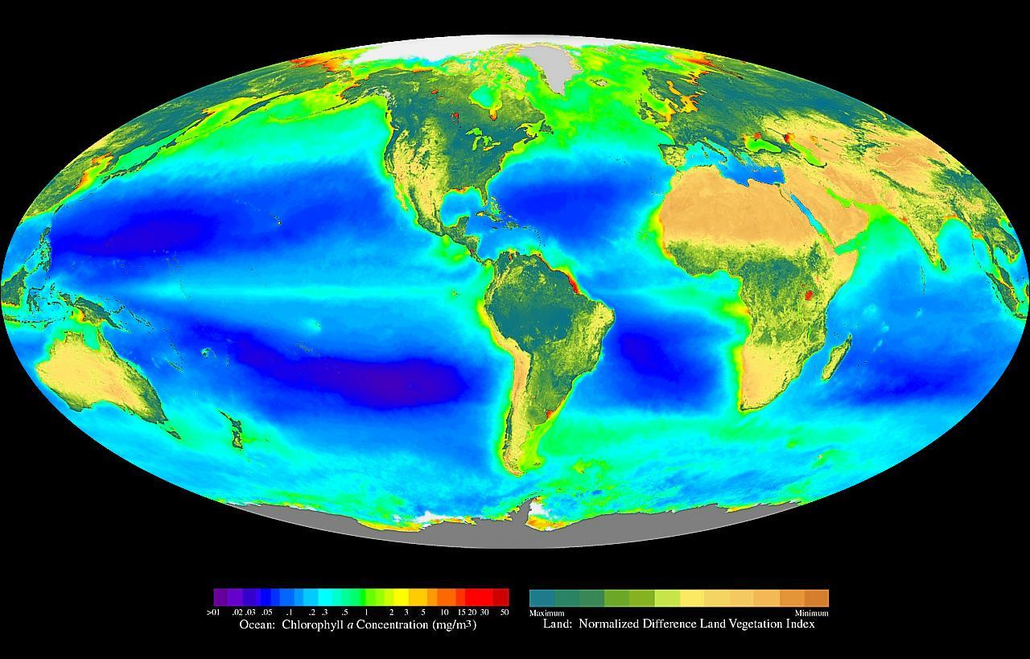
Ocean Primary Production

Slide 21
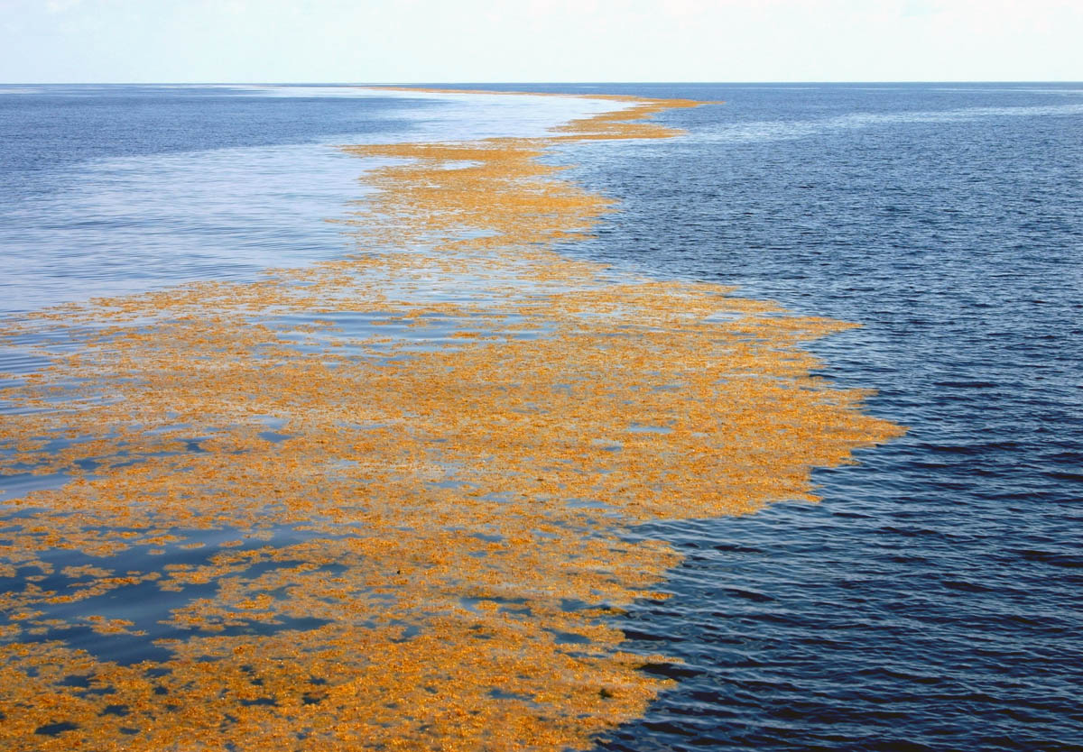
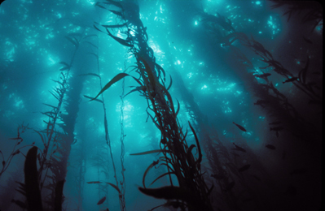
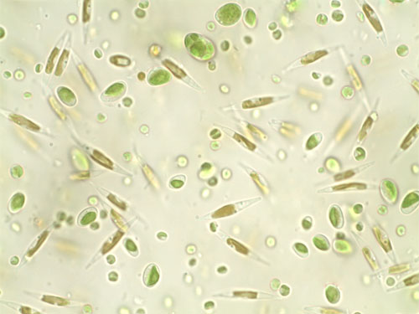
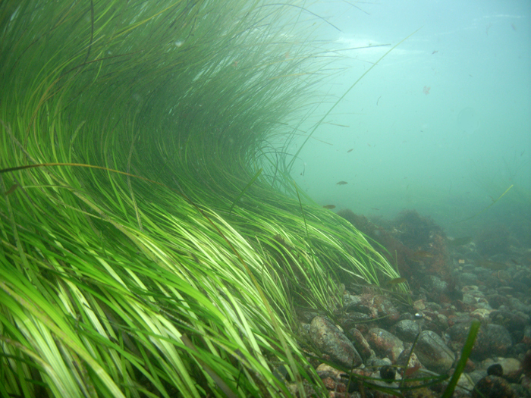
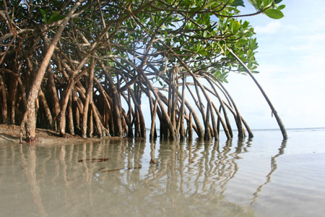

Slide 22
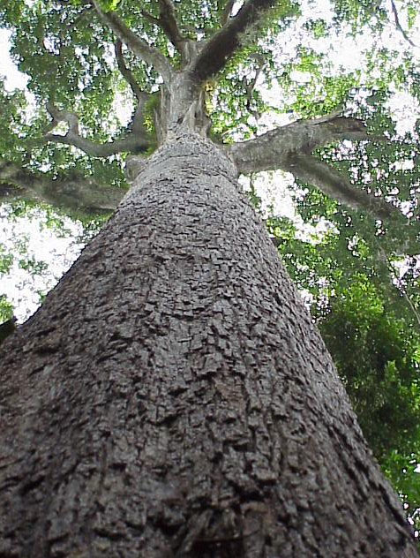
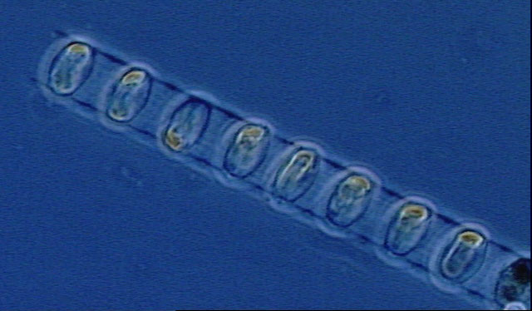
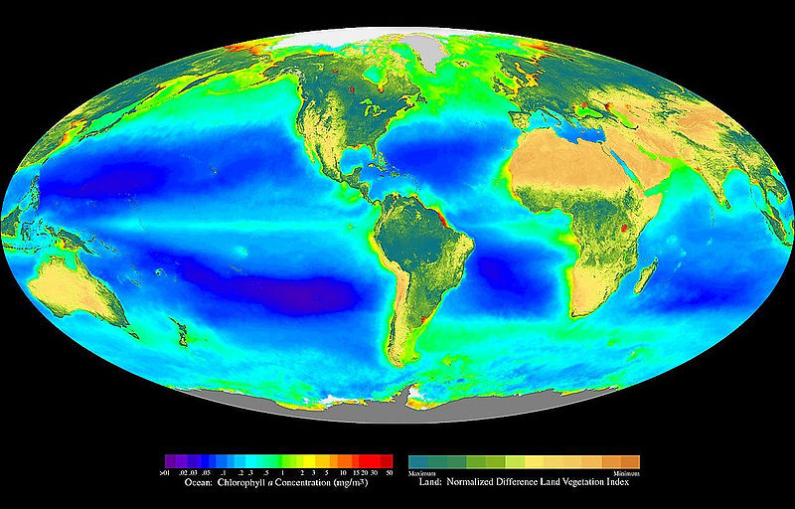
Sea Surface Chl a
(a proxy for phytoplankton biomass)
But…they only account for 0.2% of the earth’s biomass
~47% of Global Primary Production

Slide 23
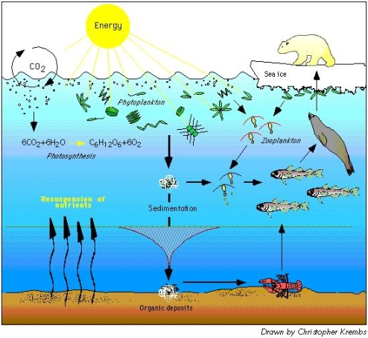
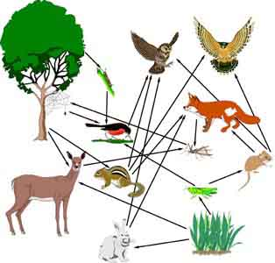
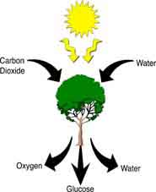
Phytoplankton = Grass of the Sea!
Primary Producers
Autotrophs…..
Carbon dioxide + Water + Light → Organic matter + Oxygen

Slide 24
Quiz – T/F Holoplankton spend their entire lives as plankton.

