Slide 1
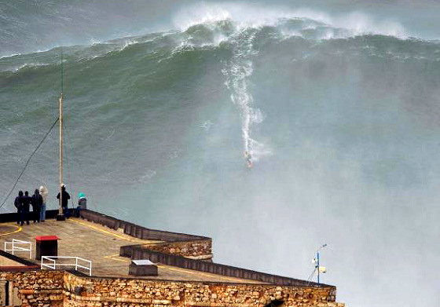
Waves Continued…
October 26th, 2016
Trigger Warning –
We’ll talk about tsunamis today

Slide 2
Wave Steepness
= wave height (H)/ wavelength (L)
If the wave steepness exceeds 1/7 – the wave breaks!
So….anytime a wave exceed the 1:7 ratio – it breaks! At shore or at sea….

Slide 3
Why do we care about the steepness???
It dictates maximum wave height!
Example:
A wave 7 meters long can only be 1 meter high…

Slide 4
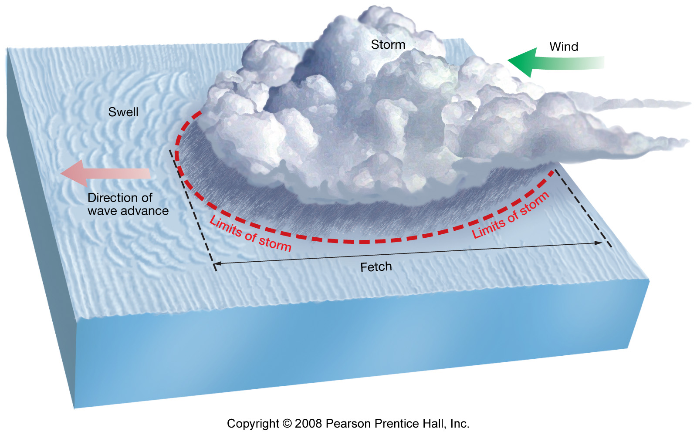
Most waves wind-driven
Wave development – speed, duration, fetch

Slide 5
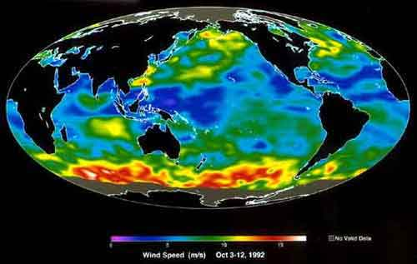
Roaring 40s
Furious Fifties
Screaming Sixties…

Slide 6
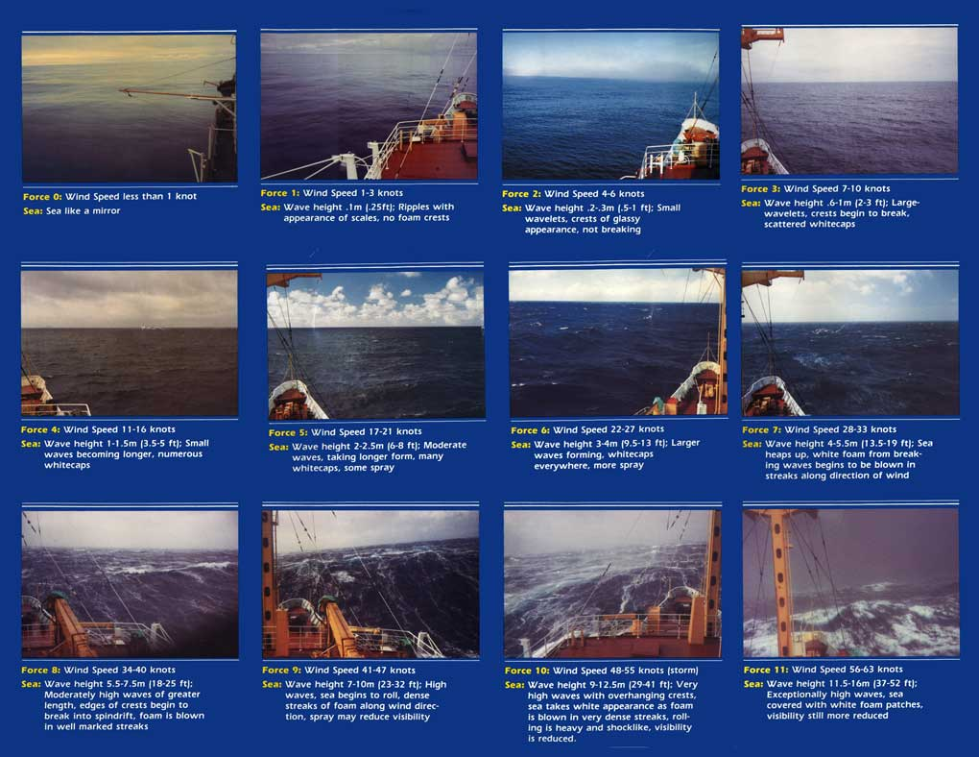
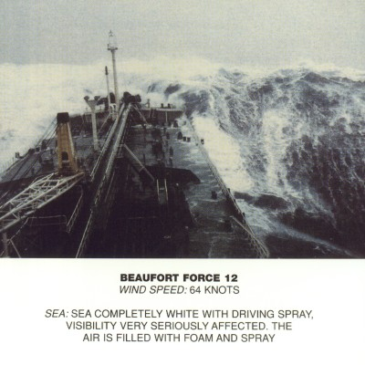
Beaufort Wind Scale and the State of the Sea

Slide 7
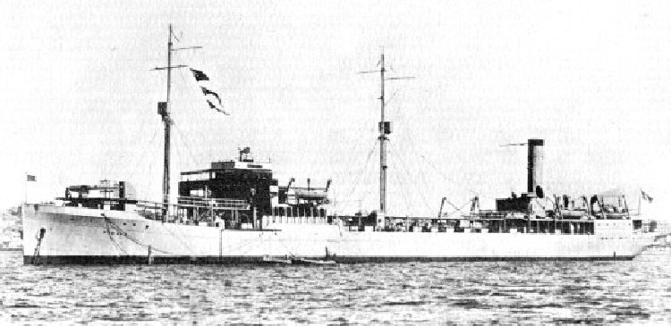
How big can a wind generated
wave be?
→ 60 ft. (18.3 m) rule…. US Navy
USS Ramapo → Typhoon in Pacific Ocean, 108 km winds (~70 mph)

Slide 8
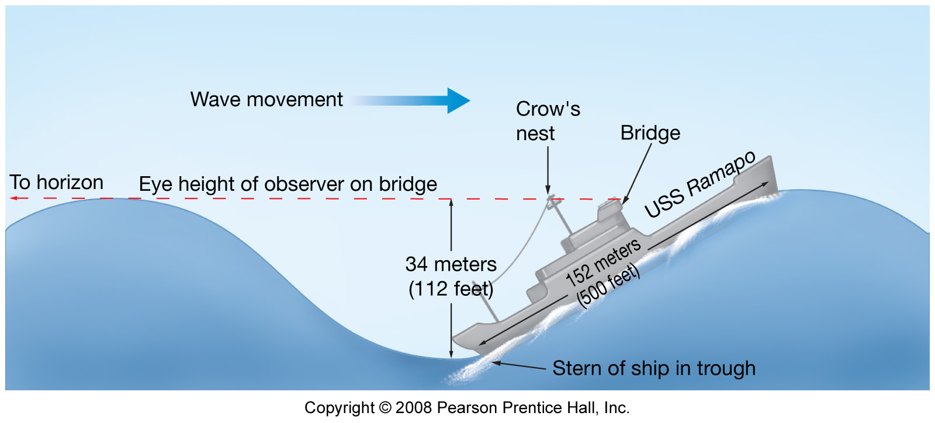
Maximum wave height
Reliable measurement
Wave height 34 m or 112 ft

Slide 9
Three categories of freak waves:
"Walls of water" travelling up to 10 km (6.2 mi) through the ocean
"Three Sisters", groups of three waves
3. Single, giant storm waves, building up to fourfold the storm's waves height and collapsing after some seconds

Slide 10
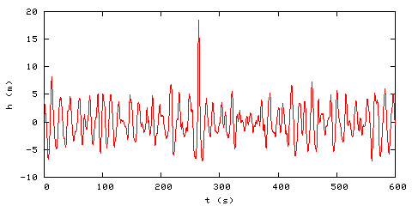
60 ft
The Draupner wave, a single giant wave measured on New Year's Day 1995, finally confirmed the existence of freak waves, which had previously been considered near-mythical
Notes:
The Draupner wave or New Year's wave was the first rogue wave to be detected by a measuring instrument, occurring at the Draupner platform in the North Sea off the coast of Norway on 1 January 1995. In an area with significant wave height of approximately 12 metres (39 ft), a freak wave with a maximum wave height of 25.6 metres (84 ft) occurred (peak elevation was 18.5 metres (61 ft)).

Slide 11
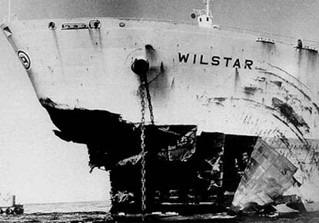
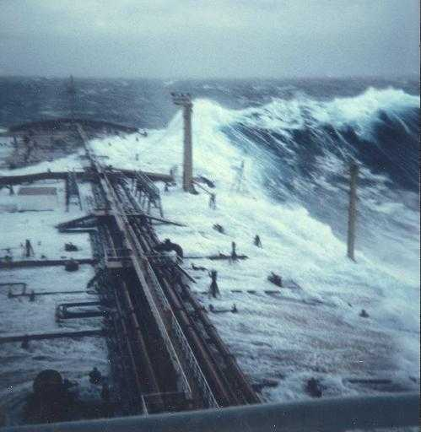
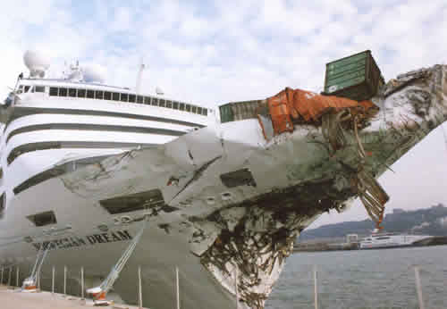
Freak waves, rogue waves, extreme waves
In the open ocean:
1 in 23 will 2X as high
1 in 1175 will be 3X as high
1 in 300,000 will be 4X as high
TRULY BIG – 1 in several billion

Slide 12
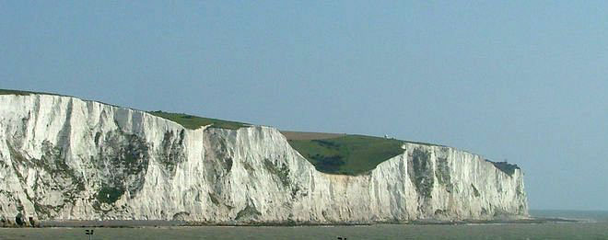
RMS Queen Elizabeth 2 – North Atlantic, September 1995, 29 meters (95 ft), during Hurricane Luis: The Master said it "came out of the darkness" and "looked like the White Cliffs of Dover." [25] Newspaper reports at the time described the cruise liner as attempting to "surf" the near-vertical wave in order not to be sunk.
U.S. Naval Research Laboratory ocean-floor pressure sensors detected a freak wave caused by Hurricane Ivan in the Gulf of Mexico, 2004. The wave was around 27.7 meters (91 ft) high from peak to trough, and around 200 meters (660 ft) long.[26]
Aleutian Ballad, (Bering Sea, 2005)
http://www.youtube.com/watch?v=l_8hOai9hGQ

Slide 13
Now one of the quotes you got from one scientist was mind boggling to me — "Two large ships disappear every week on average worldwide." How is that possible? Are there hundreds of people a year disappearing into the sea and we just don't hear about it? Well, it's not that nobody hears about it. It's that it's not going to be on page one of the New York Times if a Lithuanian crew in a Liberian flagship goes down in the Andaman Sea. I went to the insurance firm Lloyds of London and their notion was "We don't know how many ships are going down, because between when they go down and when they're missing we don't know what happened to them." So I did a lot of work in the archives. The figure that I felt confident with is two a month. But that's still a lot. Read more: http://www.time.com/time/health/article/0,8599,2022481,00.html#ixzz11834Xml1

Slide 14
Wave energy
Fully developed sea
Maximum wave height, wavelength for particular fetch, speed, and duration of winds at equilibrium conditions →they lose energy through breaking as fast as they gain energy from the wind
Swell
Uniform, symmetrical waves that travel outward from storm area
Long crests
Transport energy long distances

Slide 15
Ground Swell vs. Wind Swell
Ground – deep ocean swell , one that might be generated by a distant storm or earthquake. Originally –meant to describe waves that were so big their troughs bared “the ground” of the sea floor.
Generally – ground swell is larger and from farther away; wind swell is smaller locally-produced waves.

Slide 16
As Waves approach shore
Wave speed decreases
Wavelength decreases
Wave height increases
Wave steepness increases
Waves break

Slide 17
Breakers in surf zone
Top of wave topples over base because of decrease in wave speed due to friction with sea floor
Wave form not sustained
Different types of breakers associated with different slope of sea floor

Slide 18
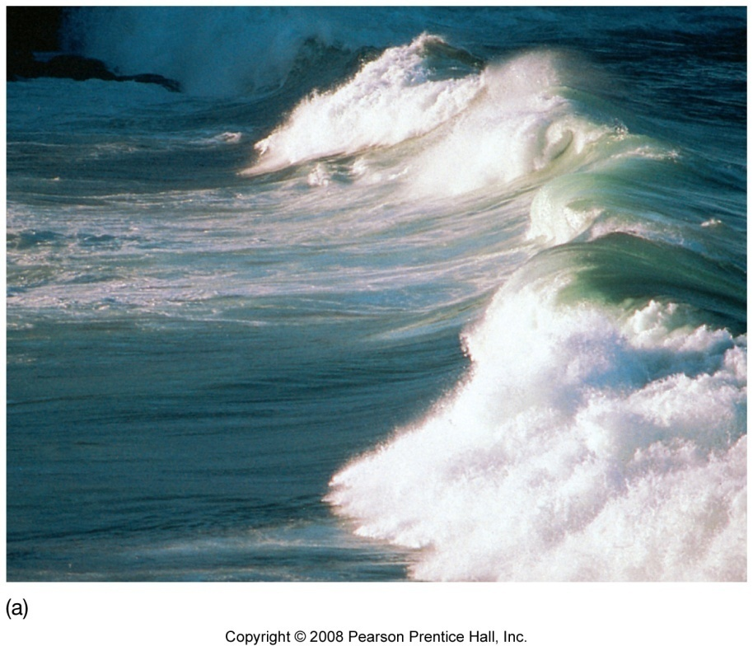
Spilling breaker
Water slides down front slope of wave
Gently sloping sea floor
Wave energy expended over longer distance

Slide 19
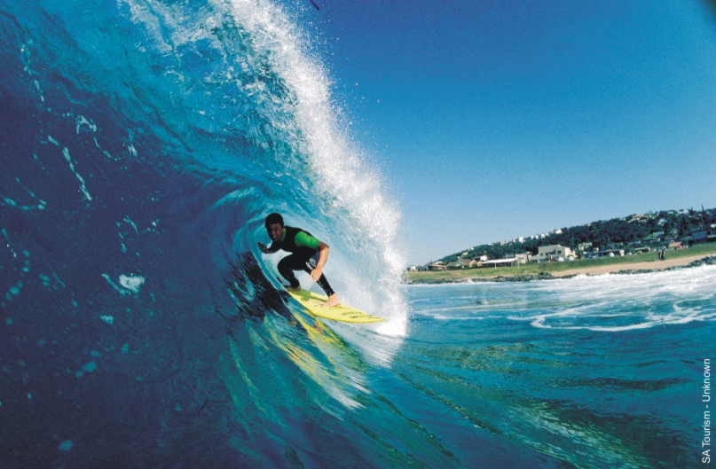
Plunging breaker
Curling crest
Moderately steep sea floor
Wave energy expended over shorter distance
Best for board surfers

Slide 20
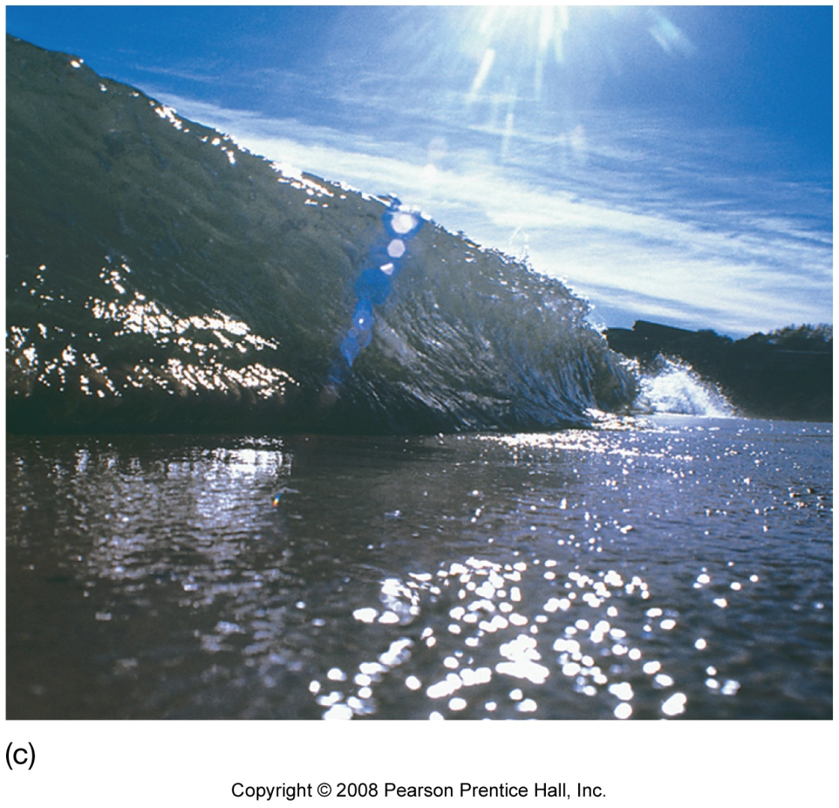
Surging breaker
Breakers on shore
Steepest sea floor
Energy spread over shortest distance
Best for body surfing

Slide 21
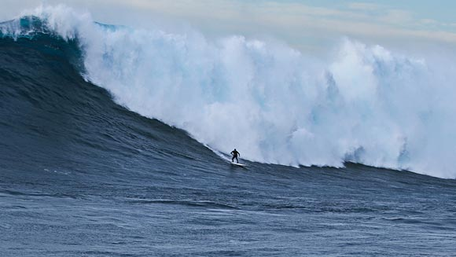
Shawn Dollar - 61 foot wave off of San Diego
** Paddle In

Slide 22
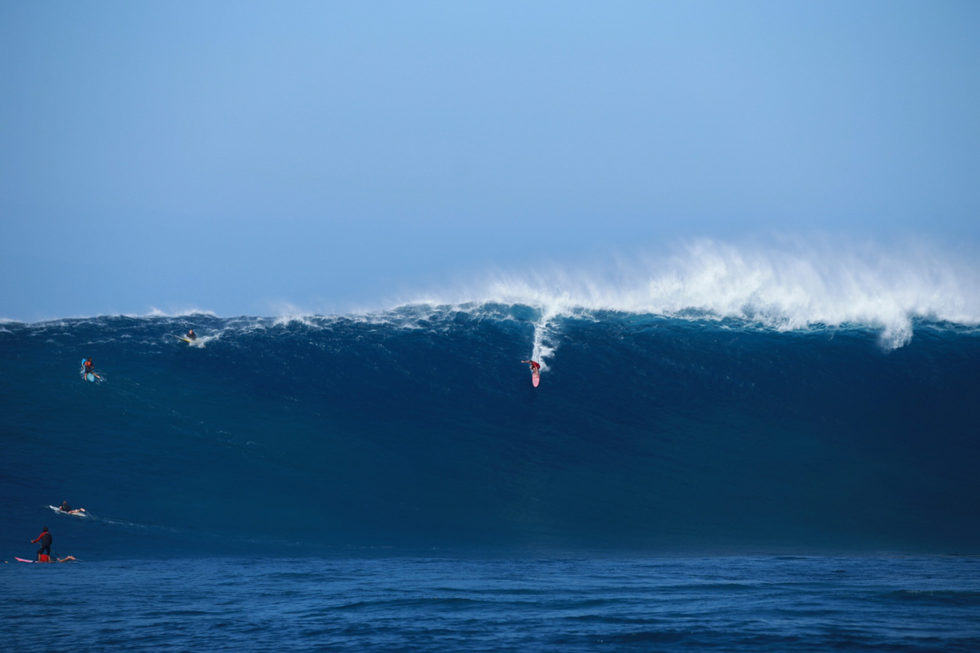
AARON GOLD- > 50 ft Pe’ahi (Jaws)
** Paddle In

Slide 23
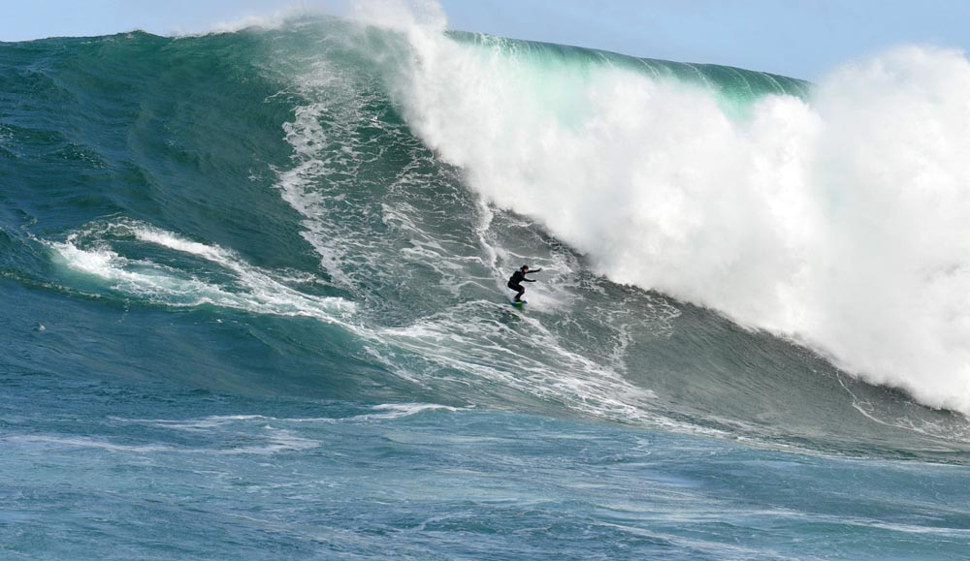
Maya Gabeira: 45-foot wave at Dungeons Beach, a big wave beach in South Africa
** Paddle In

Slide 24
Garret McNamara
https://www.youtube.com/watch?v=LM2u3NknU4Q
Notes:
100 ft wave
McNamara was born on August 10, 1967 in Pittsfield, Massachusetts

Slide 25
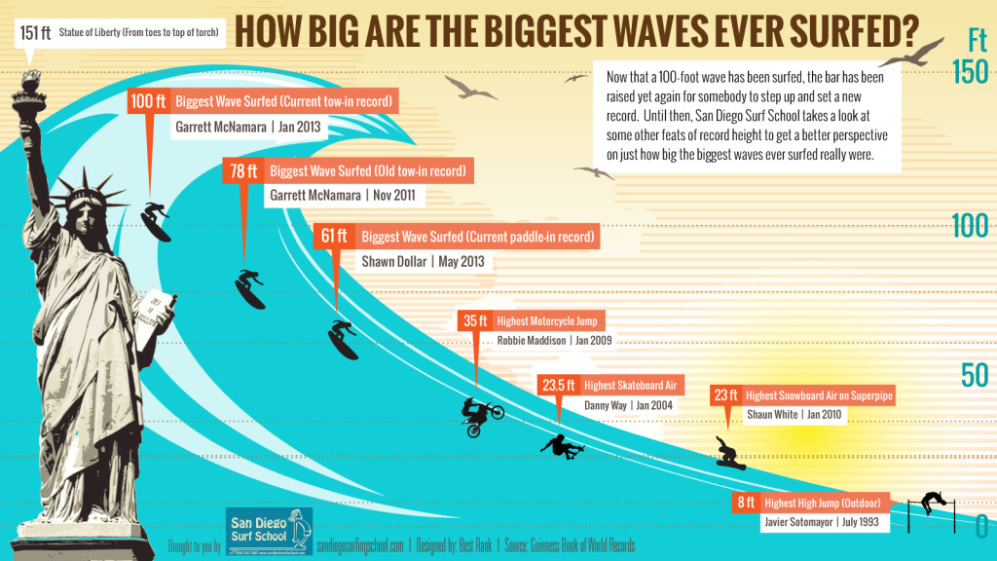

Slide 26
Why is it better surfing on the West Coast vs. the East?
Pacific waves are bigger
Steeper beach slopes → plunging breakers –
Wind blows toward shore
(east coast - wind typically blows away from shore)

Slide 27
Tsunami or seismic sea wave
Sudden changes in sea floor caused by
Earthquakes, submarine landslides, volcanic eruptions
Long wavelengths (> 200 km or 125 m)
Shallow-water wave
Speed proportional to water depth so very fast in open ocean
Sea level can rise up to 40 m (131 ft) when tsunami reaches shore

Slide 28
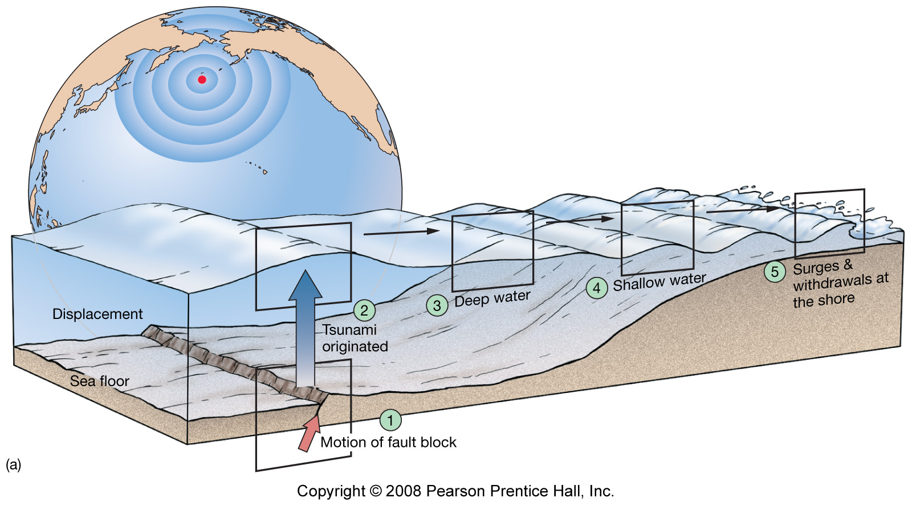
Tsunami or seismic sea wave
Fig. 8.20a

Slide 29
Tsunami or seismic sea wave
Most occur in Pacific Ocean (more earthquakes and volcanic eruptions)
Damaging to coastal areas
Loss of human lives
Example, Krakatau eruption (1883) in Indonesia created tsunami that killed more than 36,000 people
Example, Aura, Japan (1703) tsunami killed 100,000 people

Slide 30
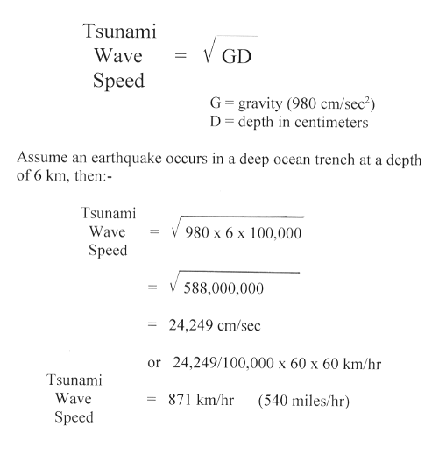
Typical wavelength for a tsunami -
Can be in excess of 300 miles (~500 km)
How fast do they travel?
Tsunami Wave Speed = square root of gravity x depth

Slide 31
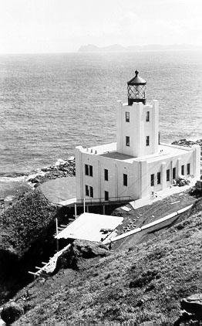
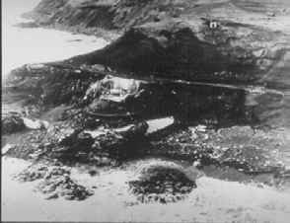
Scotch Cap lighthouse, Aleutian Islands was completely
destroyed by a tsunami following an earthquake in the
Aleutian islands in 1946.
The lighthouse was 40 ft above the water, but the tsunami
produced 100 ft waves!

Slide 32
Tsunamis may reach a maximum vertical height onshore above sea level, called a run-up height, of 30 meters (98 ft).

Slide 33
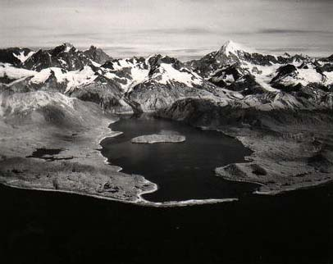
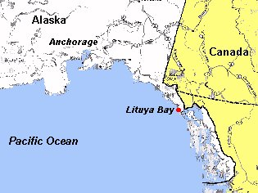
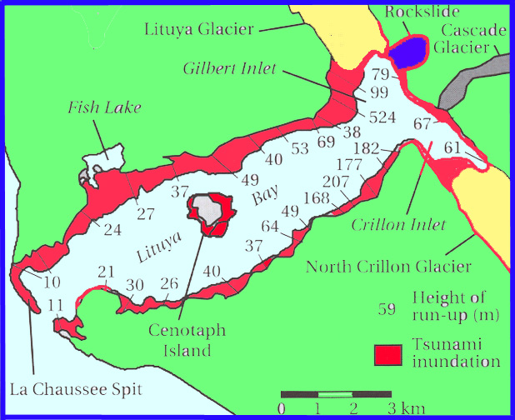
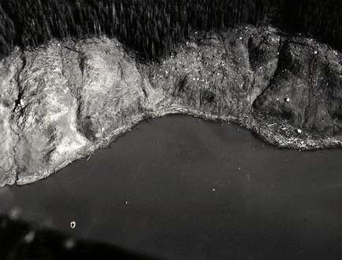
A notable exception is the landslide generated tsunami in Lituya Bay, Alaska in 1958 which produced a 525 meter (1722 ft) wave.

Slide 34
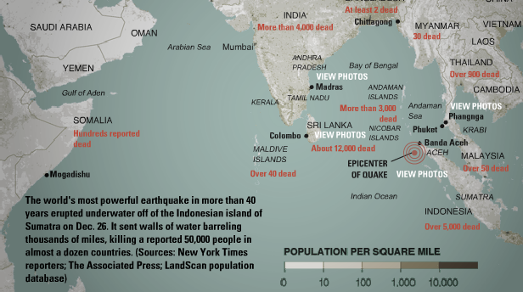
NOAA

Slide 35
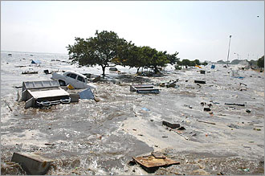
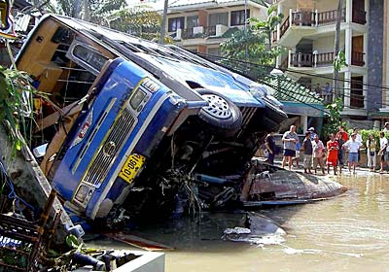
IN DEEP OCEAN tsunami has long wavelength, travels fast, small amplitude - doesn’t affect ships
AS IT APPROACHES SHORE, it slows. Since energy is conserved, amplitude builds up - very damaging

Slide 36
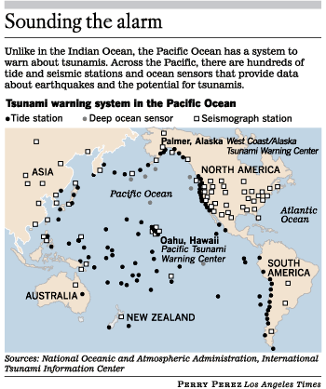
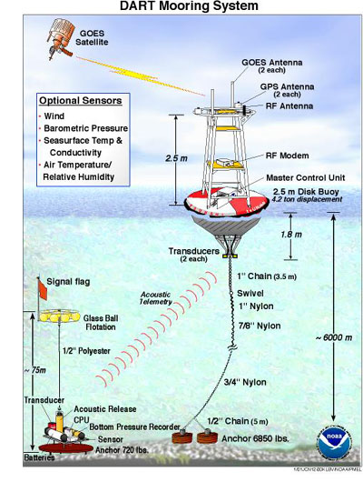
TSUNAMI WARNING
Because seismic waves travel much faster (km/s) than tsunamis, rapid analysis of seismograms can identify earthquakes likely to cause major tsunamis and predict when waves will arrive
Deep ocean buoys can measure wave heights, verify tsunami and reduce false alarms

Slide 37
Quiz
What’s the ratio that describes when waves break?

