Slide 1
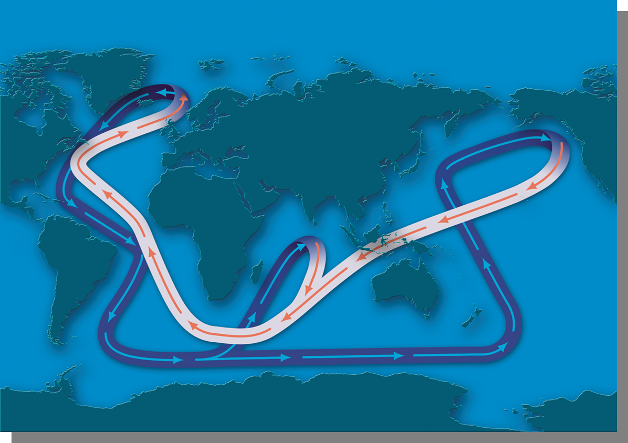
Deep Ocean Circulation
October 17th, 2016

Slide 3
Ocean Currents
Only 10% of ocean currents moved this way!
Wind driven
Density (gravity) Driven
AKA – Surface Currents
(down to ~ 1km)
→ Moves water horizontally
Moves water vertically!
→ Responsible for mixing water masses

Slide 4
Deep water Circulation
Also called:
Thermohaline circulation
Abyssal circulation
Meridional overturning circulation
Global conveyor belt
Is caused by Density difference.
Density is a function of
Temperature (“thermo”) &
Salinity (“haline”).

Slide 5
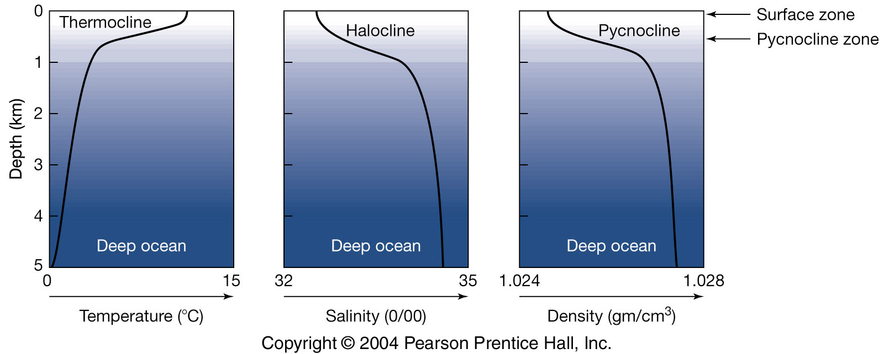
Circulation of the Deep Ocean (the other 90% of the ocean)
Thermohaline circulation- driven by temperature and salinity.
Vertical structure of the deep ocean

Slide 6
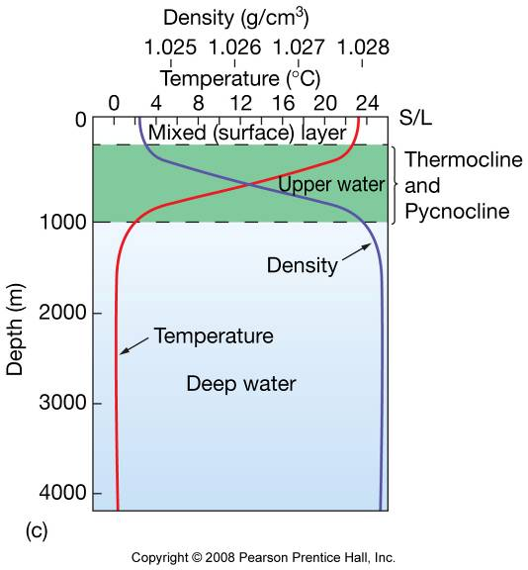
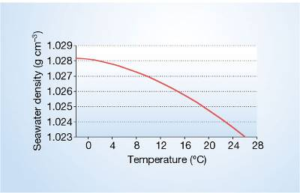
Temperature variation with depth
Sun heats only upper ~100m layer.
Deep water is cold.
Density & T = mirror image.
Temp. has a greater effect on density.

Slide 7
Sources of Deep Water
Low latitude: strong thermocline → stratified.
High latitude: vertically well mixed.
High latitude
Temperature
Low latitude
Mixing
Depth

Slide 8
Driving force:
Wind cools surface water (T↓), evaporates water vapor (S↑).
Importance of Deep water circulation
Vertical stratification – important in dynamics and biology.
Heat transport influences Earth’s heat budget and climate.
It provides dissolved oxygen to the deep ocean.
Deep ocean stores anthropogenic CO₂ (it takes 1000’s of years for one mixing).

Slide 9
Density = function of T&S
Increasing density

Slide 10
Water Masses
Water masses: Parcels of water exhibiting somewhat narrow range of T & S.

Slide 11
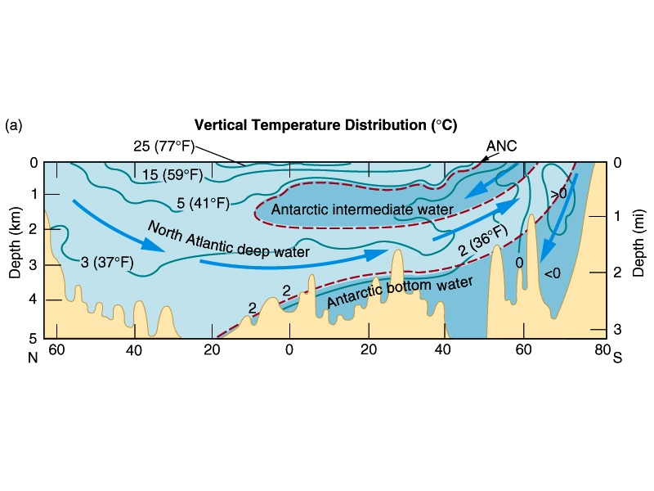
Deep water currents are SLOW – 10-20 km per year!
NADW = “Start” of thermohaline circulation
Joined by AABW
The Atlantic Ocean
Stratification by density difference !

Slide 12
Returning Flow
Mixing in the ocean brings deep water to the surface.
Indonesian Throughflow connects the Pacific and Indian Ocean.
The Antarctic Circumpolar Current mixes deep water from all oceans and redistributes it back to each ocean

Slide 13
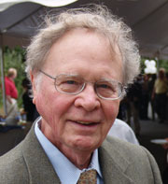
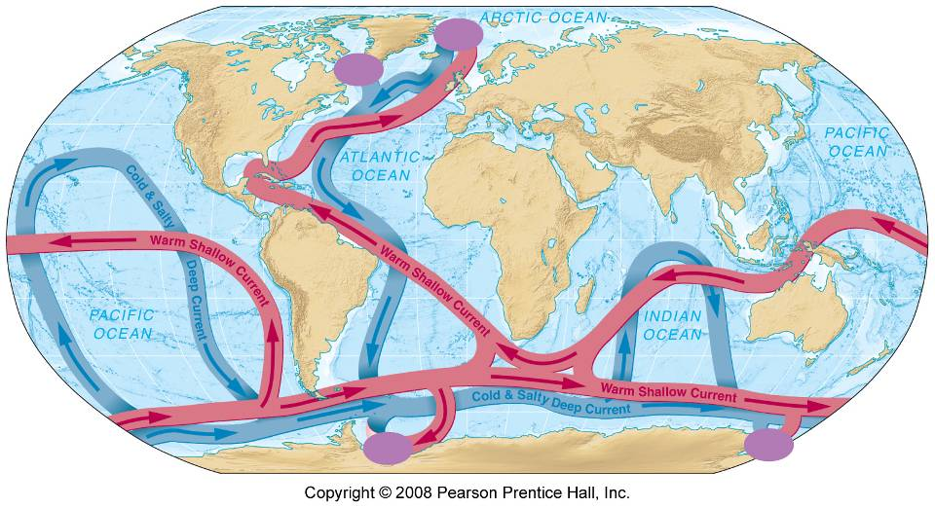
The Ocean Conveyor Belt
By Wally Broecker
(Meridional Overturning Circulation)

Slide 14
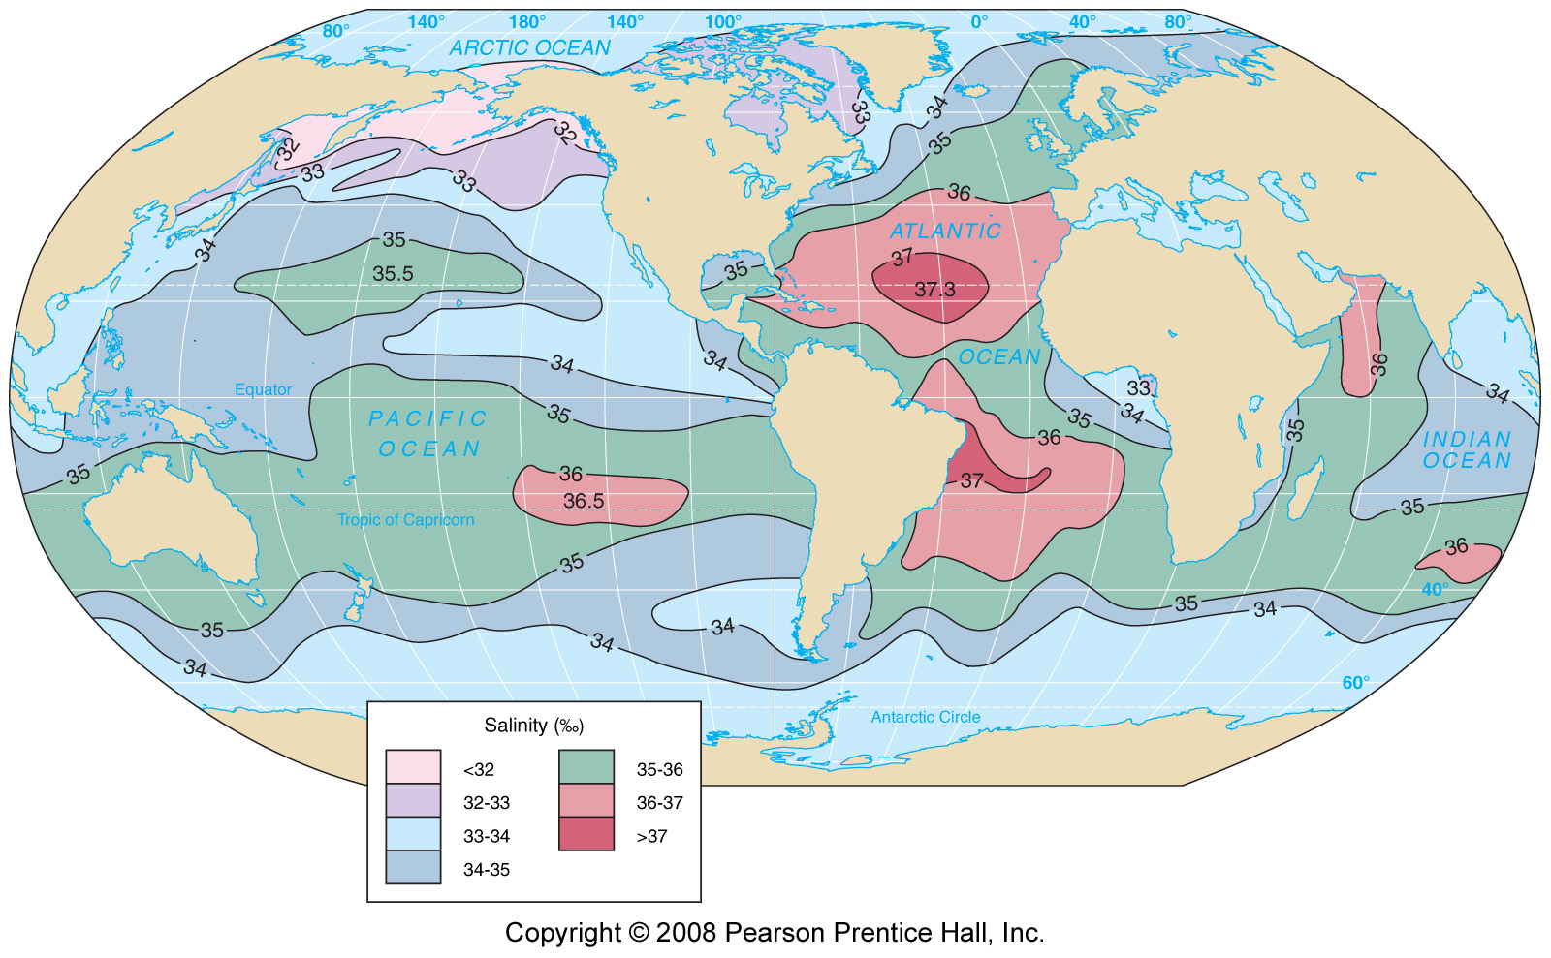
No deep water formation in the N. Pacific…Why?
Salinity

Slide 15
More complicated.. Schmitz 1995
The Indian
The Pacific
The Atlantic

Slide 16
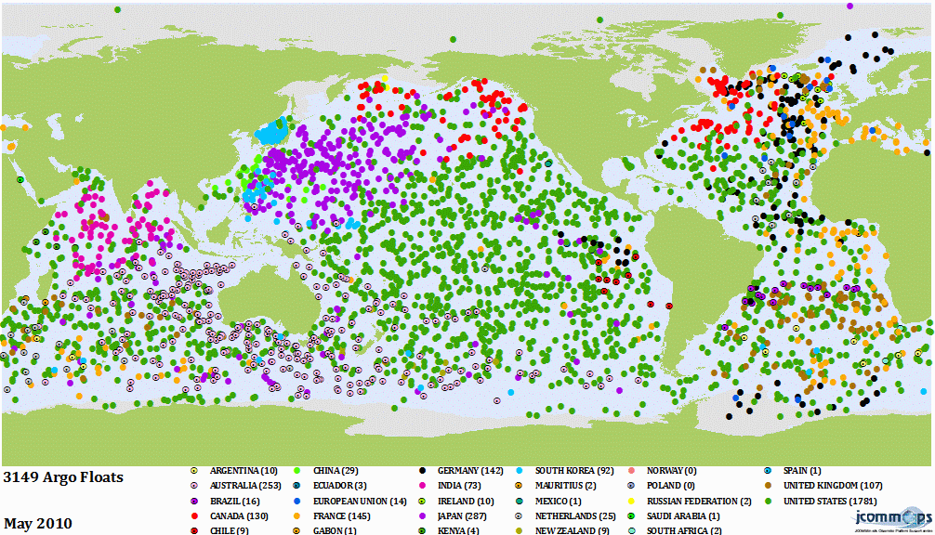
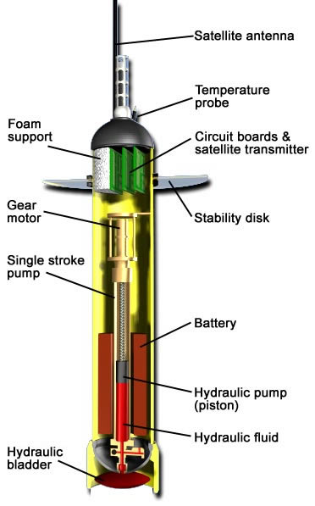
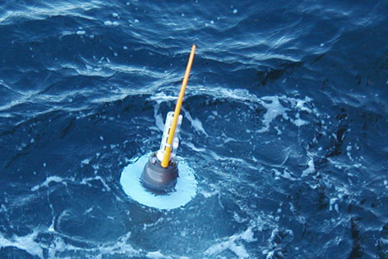
ARGO – For Deep Currents

Slide 17
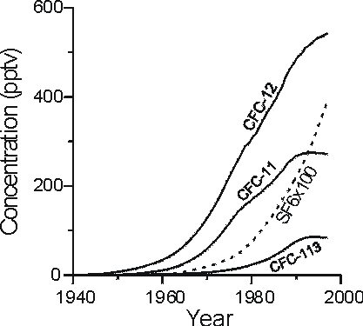
Examples of Tracers
Tritium (H-3): half-life ~12 years.
Radiocarbon (C-14): Half-life ~5700 years (especially C-14 from nuclear bomb test).
Oxygen: consumed by organisms in the deep water.
Nutrients: produced by organisms in the deep water.
CFCs (Chlorofluorocarbons-Freons) and SF₆ (sulfur hexafluoride): man-made; recently injected to atmosphere, and consequently, into the ocean.

Slide 18
Thermohaline Circulation and Climate Change
Salinity forcing is affected by excess precipitation, runoff, or ice melt.
Slowdown or shutdown of the ocean conveyor belt can disturb the climate by disturbing heat transport toward high latitude.

Slide 19
Extra Info in case you’re interested

Slide 20
So, what happens if this flow stops?

Slide 21
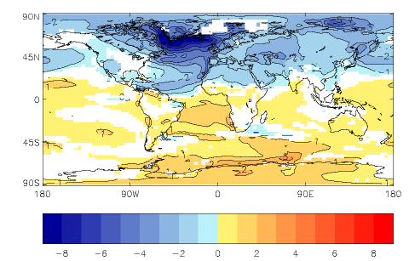
Predicted change in mean annual temperatures 30 years after shutdown of circulation. Brrrr……
Has it ever happened in the past?

Slide 22
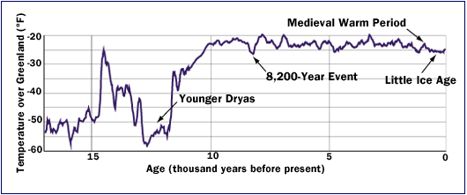
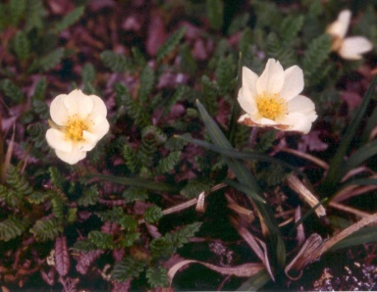
About 12,700 years ago, as Earth emerged from the most recent ice age and began to warm, the Conveyor was disrupted. Within a decade, average temperatures in the North Atlantic region plummeted nearly 5° Celsius. This cold period, known as the Younger Dryas, lasted 1,300 years. It is named after an Arctic wildflower.

Slide 23
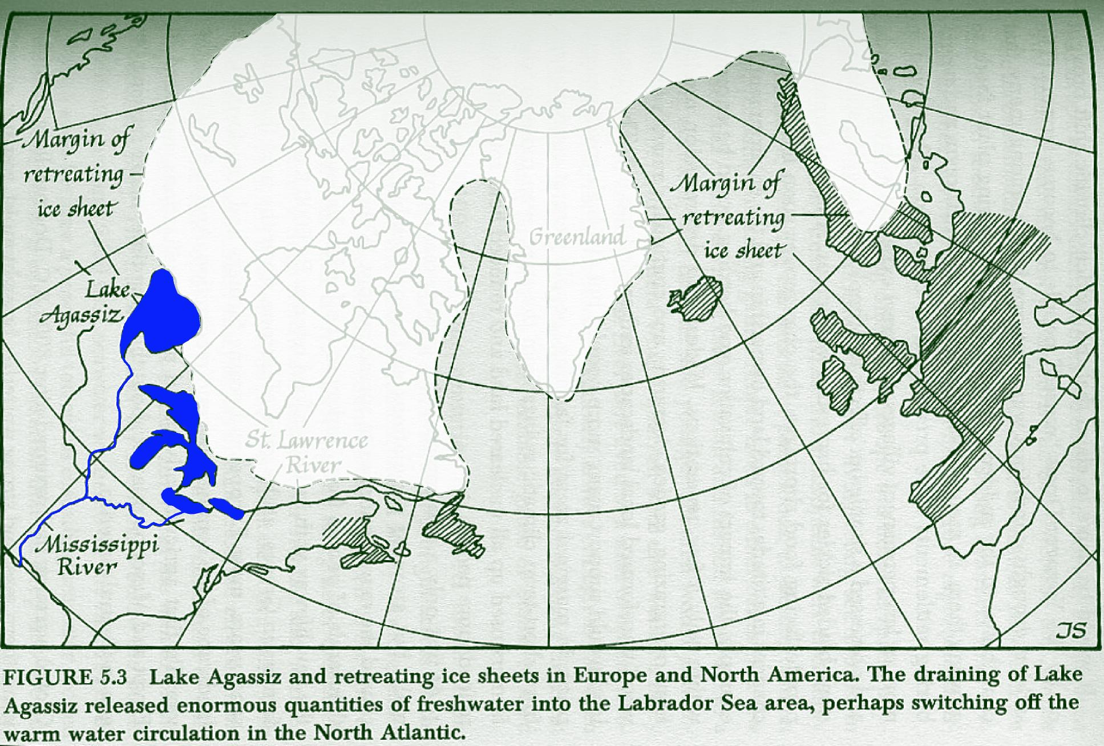
Laurentide Ice Sheet

Slide 24
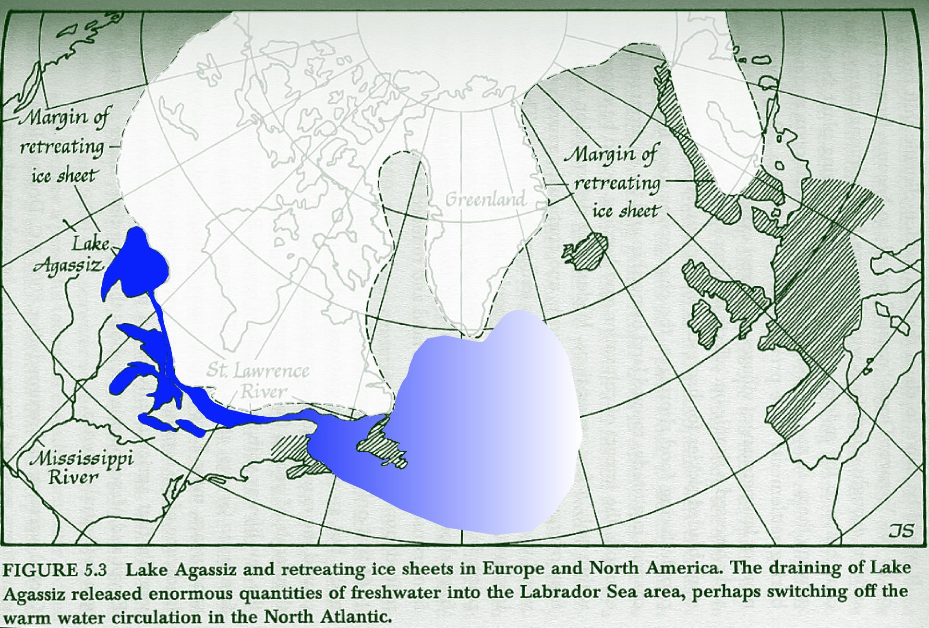
Lake Agassiz boots into the Atlantic

Slide 25
As this ice sheet melted, Lake Agassiz filled the Depression left by the retreating ice cap. At first, the melt water spilled into the Mississippi watershed and flowed into the Gulf of Mexico.
12,000 years ago, the shrinking of ice front opened up a new channel to the east.
Lake Agassiz dropped rapidly as the water shot across southern Canada into what is now the St. Lawrence valley.
An enormous surge of fresh water washed into the already dilute Labrador Sea.

Slide 26
Within a short time, the downwelling that carried salt into the deep ocean and and it's movement southward stopped altogether.
The warm conveyor belt that had nourished global warming for 3000 years had abruptly shut down. Far below the surface of the Labrador Sea, Salt ceased to flow away from the northern ocean. Global warming stopped perhaps within a few years. The northern and glaciers advanced again, plunging the world into a 600 year cold snap.
Then suddenly, Atlantic down welling suddenly resumed, and the conveyor belt switched on. 10,000 years of warmer conditions began and continue to this day.

Slide 27
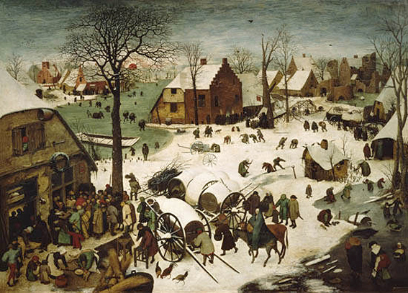
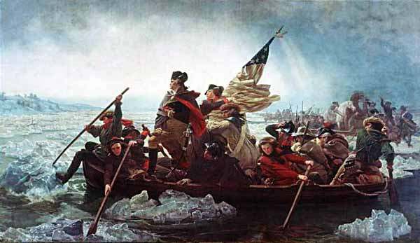
Emanuel Gottlieb Leutze (1851)
Peter Bruegel’s - Famous Frozen Landscapes…

