Slide 1
What can bath toys (and this man) tell us about
Ocean Currents?
ES 144 – October 12th, 2016

Slide 3
First ….a key concept to keep in mind:
Winds are named from the direction in which they are coming….
for example: A Southerly – is a wind coming from the south
but blowing north.
2. Currents are named for the direction in which they flow…..
for example: an eastward current - moving to the east (so
it’s coming from the west).

Slide 4
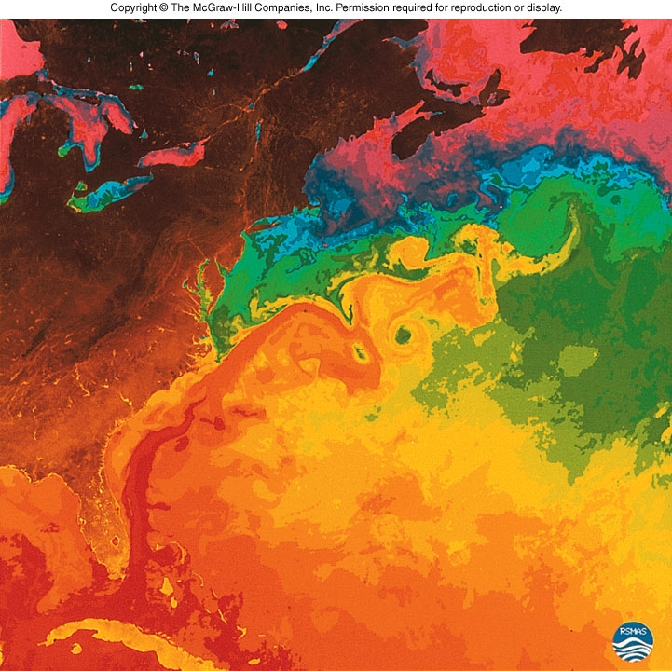
Why is Ocean Circulation Important?
Transport ~ 20% of latitudinal heat
Equator to poles
Transport nutrients and organisms
Influences weather and climate
Influences commerce
Ocean Currents –
Wind driven – mainly moves water horizontally……down to 1 km
Density or gravity driven - moves water vertically – mixes water masses!

Slide 5
Ocean Currents
Only 10% of ocean currents moved this way!
Wind driven
Density (gravity) Driven
AKA – Surface Currents
(down to ~ 1km)
→ Moves water horizontally
Moves water vertically!
→ Responsible for mixing water masses

Slide 6
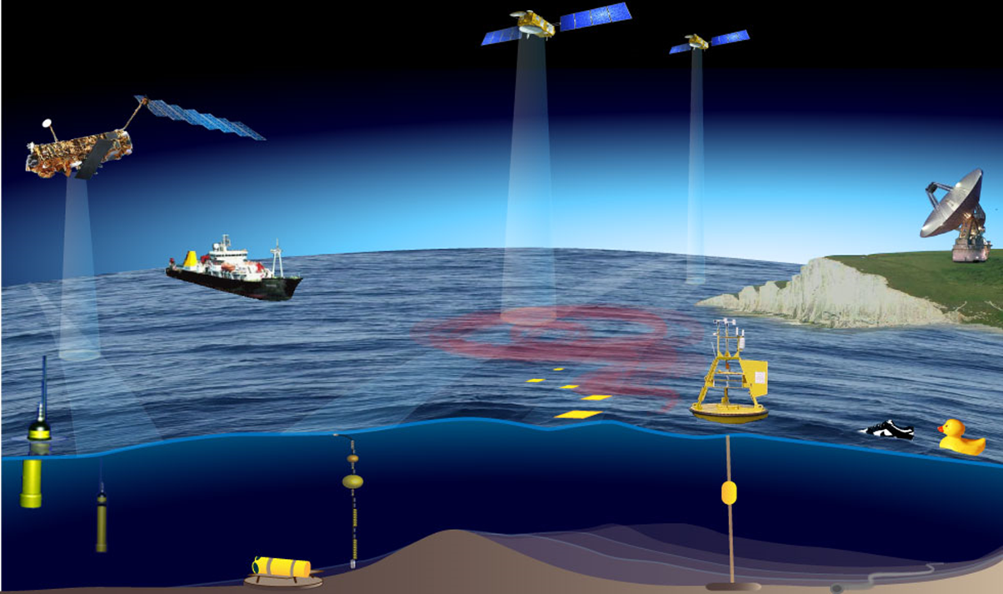
We can measure currents using:

Slide 7
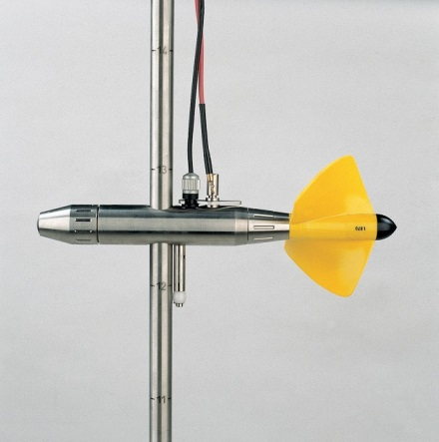
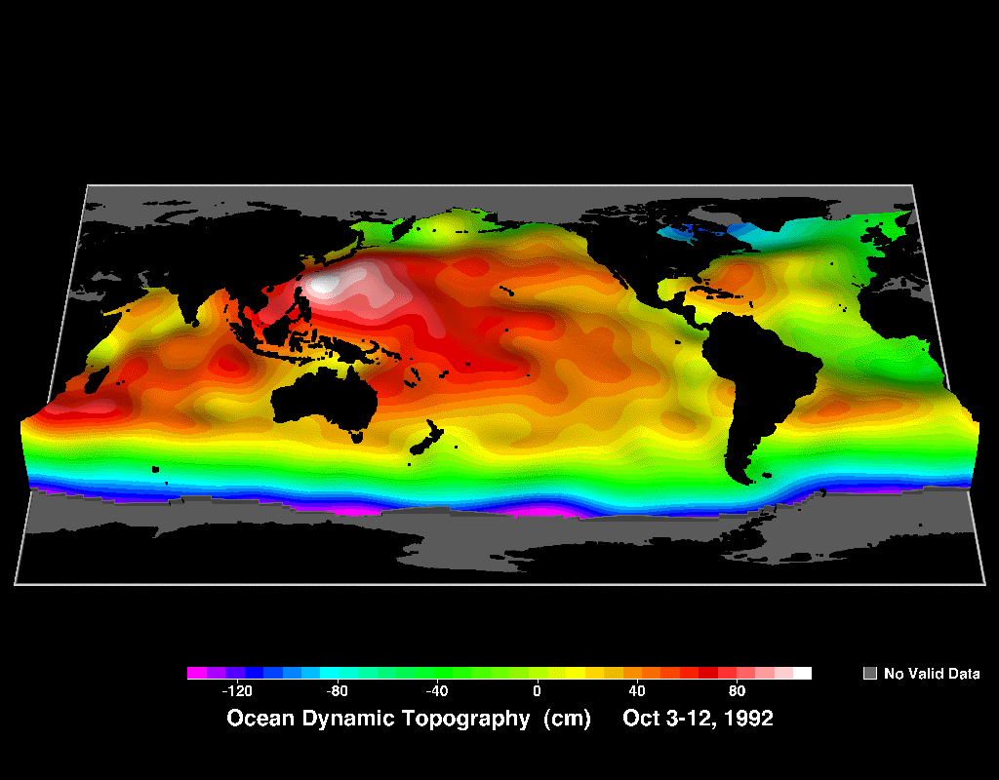
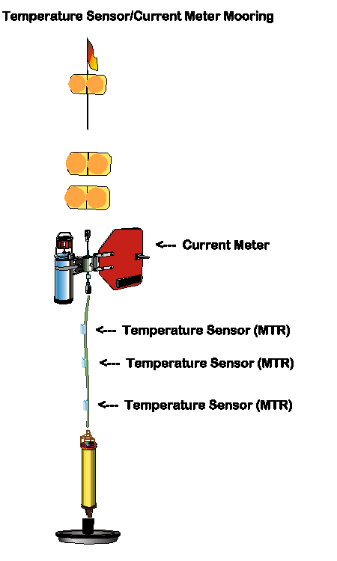
We can measure currents using:
Basic Current meters
Satellites – TOPEX/Poseidon radar….

Slide 8
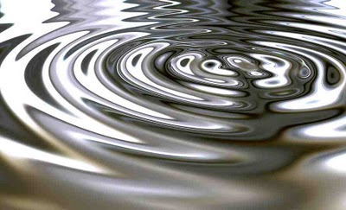
Surface currents develop because of the friction between wind and water….
Only 2% of the wind’s energy is transferred to the ocean surface.
So – 100 knot wind – will create a 2 knot current.
A knot is equal to 1 nautical mile or 1.15 land miles (1.85 km)

Slide 9
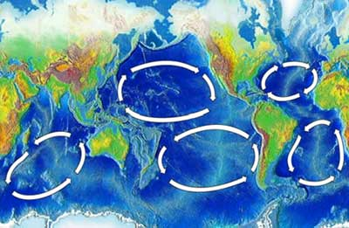
A gyre is any large system of rotating ocean currents, particularly those involved with large wind movements.
Five Subtropical Gyres:
1. North Atlantic
2. South Atlantic
3. Indian Ocean
4. North Pacific
5. South Pacific

Slide 10
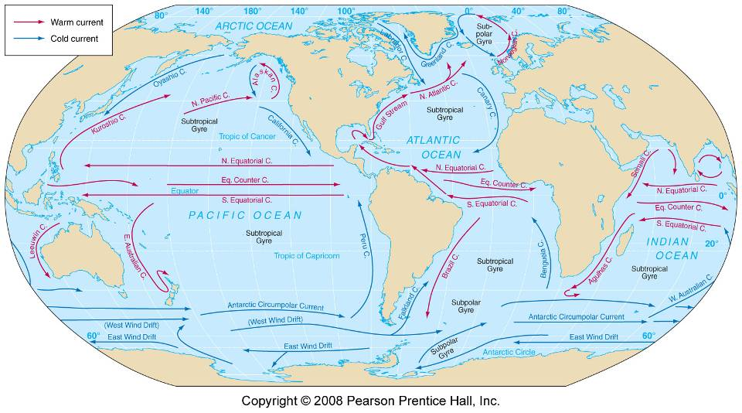
Western Boundary currents –narrow (<100 km), deep (up to 2km), fast (hundreds of km per day) – moving warm water to the poles
Eastern Boundary currents –wide ( >1000 km), shallow (0.5 km), slow (tens of km per day)
– moving cool water to the equator…

Slide 11
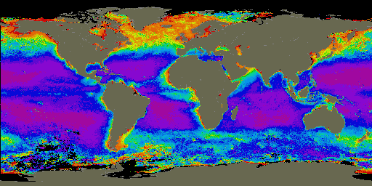
Major Upwelling Regions in the Ocean
California
Canary
Peru
Somalia
Equatorial
Benguela

Slide 12
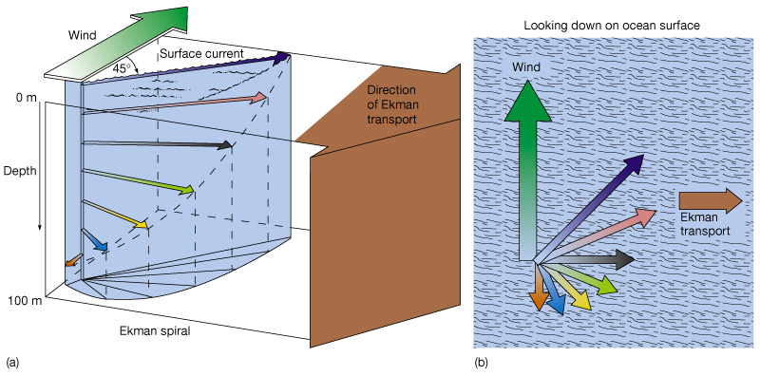
Ekman spiral
Ekman spiral describes the speed and direction of flow of surface waters at various depths
Factors:
Wind
Coriolis effect

Slide 13
Ekman transport
Ekman transport is the overall water movement due to Ekman spiral
Ideal transport is 90º from the wind
Transport direction depends on the hemisphere

Slide 14
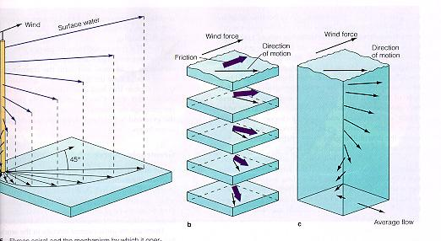
Ekman Transport
Water flow in the Northern hemisphere- 90º to the right of the wind direction
Depth is important

Slide 15
Upwelling and downwelling
Vertical movement of water
- Upwelling = movement of deep water to surface
Hoists cold, nutrient-rich water to surface
Produces high productivities and abundant marine life
Downwelling = movement of surface water down
Moves warm, nutrient-depleted surface water down
Not associated with high productivities or abundant marine life

Slide 16
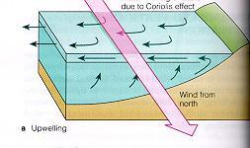
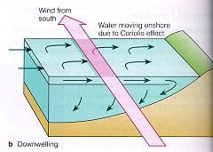
upwelling
downwelling

Slide 17
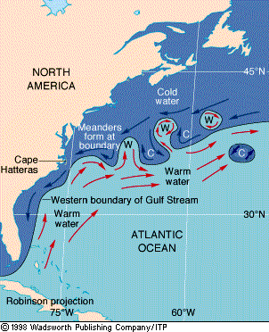
Eddy
A circular movement of water formed along the edge of a permanent current
In an average year, 10-15 rings are formed
150-300 km in diameter
Speed 1 m/sec
Warm core ring
Rotates clockwise
Found on the landward side of the current
Cold core ring (cyclonic eddy)
Rotates counterclockwise
Forms on the ocean side of the current

Slide 18
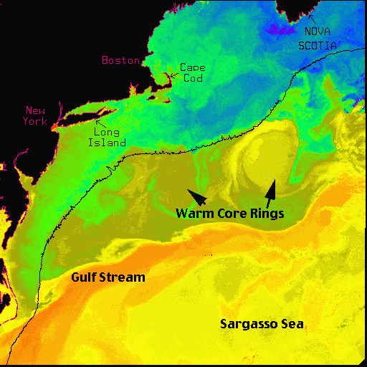

Slide 19
Hello, My name
is Curtis Ebbesmeyer

Slide 20
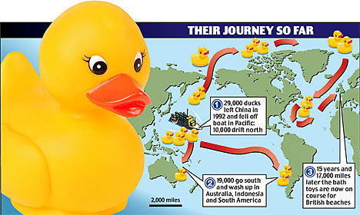
Notes:
It began Jan. 10, 1992, when a container ship, en route from Hong Kong to Tacoma, ran into a hurricane near the international dateline. The waves were so powerful that they broke some of the steel cables holding the huge containers, releasing 12 of them over the side. One that was lost held 28,800 Friendly Floatee bathtub toys, made in China for The First Years Inc. of Avon, Mass. They were red beavers, green frogs, blue turtles and, of course, yellow ducks.
We might expect that elaborate wrapping around the toys would have dragged them straight to the bottom. But they managed to escape five levels of packing, from the heavy steel containers (violent waves opened the door latches) to the plastic and paper boxes (water pulped the cardboard) before finally floating free.
It took 10 months for the first 10 Floatees to reach shore near Sitka, Alaska, having been swept along by the Subpolar Gyre, the ocean current in the Bering Sea. By then they had covered about 3,200 km and two oceanographers in Seattle, Ebbesmeyer and James Ingraham, were tracking their progress. (Ebbesmeyer and Ingraham were already studying 61,000 Nike running shoes that had fallen in the ocean two years earlier.)
A few months later another 20 toys reached Alaska. By August 1993, 400 more had been found along the shores of the Gulf of Alaska. Ingraham logged them in his OSCUR (Ocean Surface Currents Simulation), a program that calculates the course of wind and currents. Other toys, after following a circuitous route to Washington state, began arriving there in 1996.
The oceanographers predicted that some toys would drift north, get locked in Arctic ice, then eventually be released. In a few years they could move across the Pole to the Atlantic. Then where would they go? Eventually they arrived in Maine, Iceland, Newfoundland, the U.K. and Germany.
The last of the survivors continued to float, Ebbesmeyer says, “bleached and battered but still recognizable after 16 years.” Well, the manufacturer said they were designed to survive 52 dishwasher cycles.
Ebbesmeyer approaches this narrative with a cheerful buoyancy: “These high-seas drifters offer a new way of looking at the seas. Call it ‘flotsametrics.’ It’s led me to a world of beauty, order and peril I could not have imagined even after decades as a working oceanographer.” He loves his status as flotsam headquarters for data sent back by the world’s 1,000 or so dedicated beachcombers.
It’s a joyful story of discoveries he tells in his book. But he brings the reader back to Earth, and starts us thinking again about BP, when he describes the seabed slowly filling with bits of plastic that poison the fish and eventually the humans who eat them. Thousands of containers fall into the sea every year, creating an oceanic junkyard.
And the junk never disappears. These days beachcombers keep coming across flotsam antiques, like a plastic ball decorated with 40-year-old cartoon characters or Japanese glass buoys for fishing nets that haven’t been used in half a century. These relics are fascinating bits of the past, but when it comes to the fate of the oceans, perhaps beachcombers have stumbled upon the melancholy truth.
Read more: http://www.nationalpost.com/arts/Robert+Fulford+Plenty+rubber+ducks/3238158/story.html#ixzz13Y813VEs
January 1992 - shipwrecked in the Pacific Ocean, off the coast of China
November 1992 - half had drifted north to the Bering Sea and Alaska; the other half went south to Indonesia and Australia
1995 to 2000 - spent five years in the Arctic ice floes, slowly working their way through the glaciers
2001 - the duckies bobbed over the place where the Titanic had sunk
2003 - they were predicted to begin washing up onshore in New England, but only one was spotted in Maine
2007 - a couple duckies and frogs were found on the beaches of Scotland and southwest England.

Slide 21
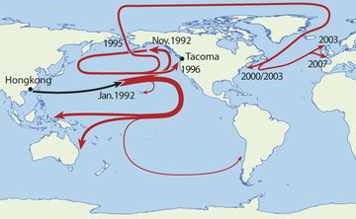
Duckie Progress
January 1992 - shipwrecked in the Pacific Ocean, off the coast of China
November 1992 - half had drifted north to the Bering Sea and Alaska; the other half went south to Indonesia and Australia
1995 to 2000 - spent five years in the Arctic ice floes, slowly working their way through the glacier
2001 - the duckies bobbed over the place where the Titanic had sunk
2003 - they were predicted to begin washing up
in New England, but only one was spotted in Maine
2007 - a couple duckies and frogs were found
on the beaches of Scotland and southwest England.

Slide 22
Quiz –
How many major upwelling sites are there?

