Slide 1
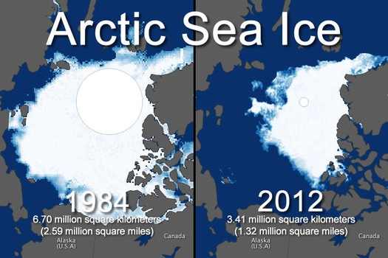
We Need To Talk about Climate Change
December 9, 2016

Slide 2
What’s the difference between
weather and climate?
Weather is the day-to-day state of the atmosphere, and its short-term (minutes to weeks) variation.
Climate is defined as statistical weather information that describes the variation of weather at a given place for a specified interval. (usually - locality averaged over some period (usually 30 years) plus statistics of weather extremes.

Slide 3
IPCC:
Intergovernmental Panel on Climate Change
“formed in 1988 by two United Nations organizations, the United Nations Environment Programme and the World Meteorological Organization, to assess the state of scientific knowledge about the human role in climate change.”
Notes:
2000 scientists, 154 countries represented… to analyze the data and come to “consensus”

Slide 4
http://www.ipcc.ch/pdf/supporting-material/uncertainty-guidance-note.pdf

Slide 5
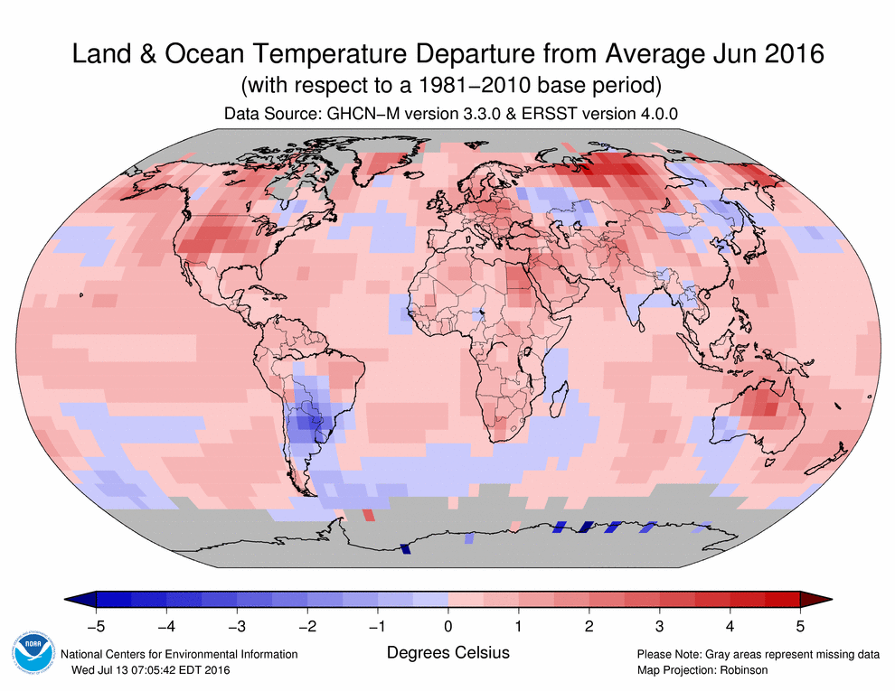

Slide 6
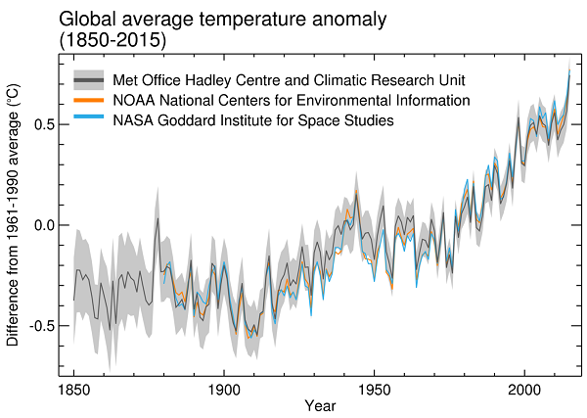
Notes:
http://www.metoffice.gov.uk/research/monitoring/climate/surface-temperature

Slide 7
“In the last decade, about 30% of the warming has occurred below 700 m, contributing significantly to an acceleration of the warming trend.”
Distinctive climate signals in reanalysis of global ocean heat content. M. A. Balmaseda, K. E. Trenberth, E.Källén,Geophys. Res. Lett.,Doi: 10.1002/grl.50382

Slide 8
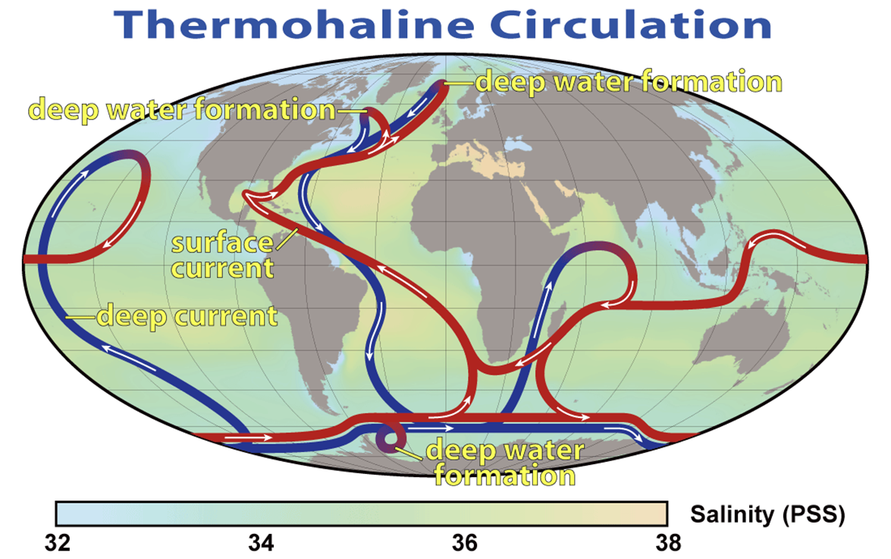

Slide 9
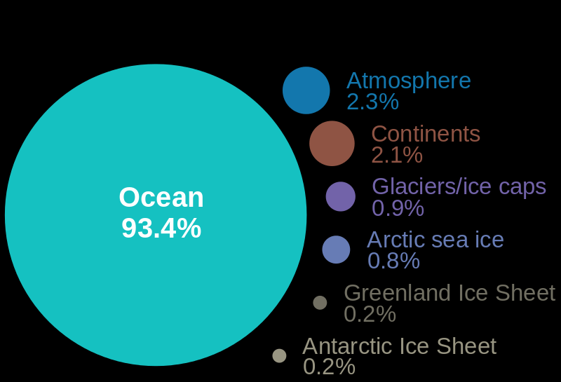
Where is the heat going?
Notes:
http://en.wikipedia.org/wiki/File:WhereIsTheHeatOfGlobalWarming.svg
Over the past 50 years, the oceans have absorbed
about 90% of the total heat added to the climate system
[Bindoff et al., 2007], while the rest goes to melting sea
and land ice, and warming the land surface and atmosphere. From Balmaseda et al. 2013

Slide 10
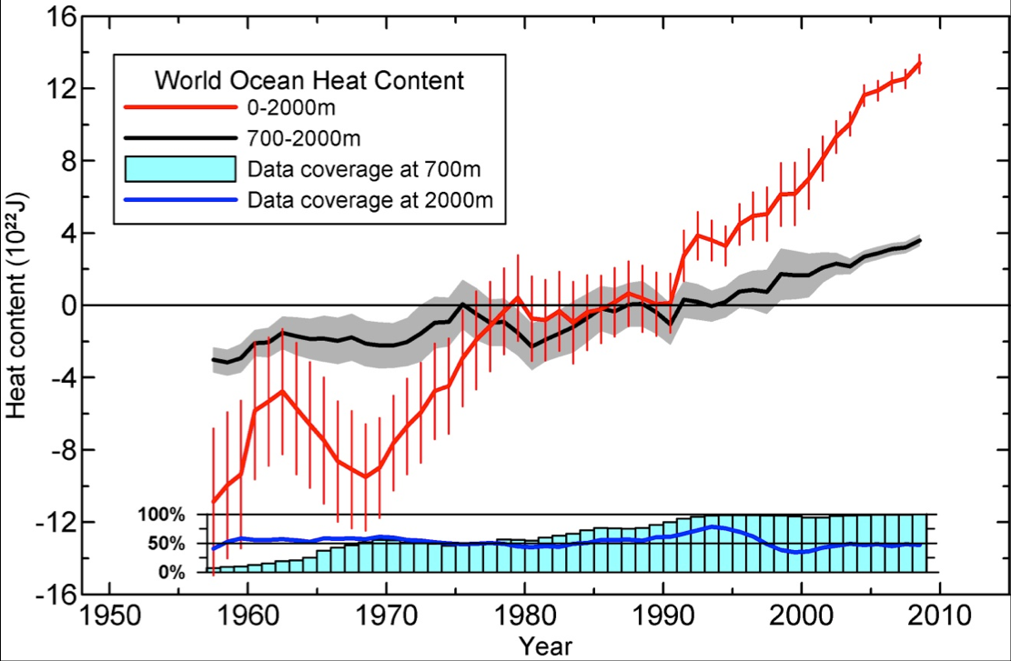
The increase in global ocean heat content from 1955-2010, from Levitus et al., Geophysical Research Letters, 2012. S. Levitus.

Slide 11
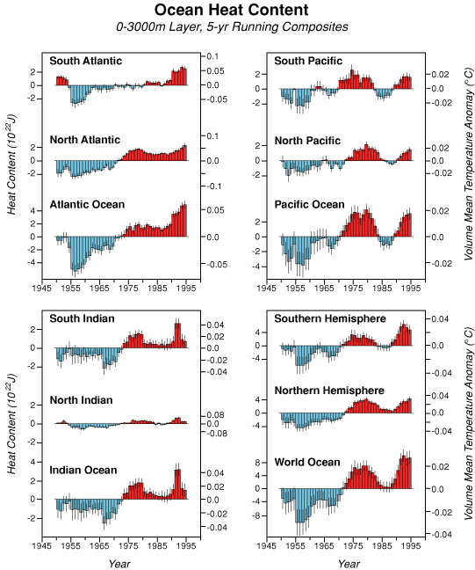
The oceans have been warming for the last 50 years
Levitus et al., 2000

Slide 12
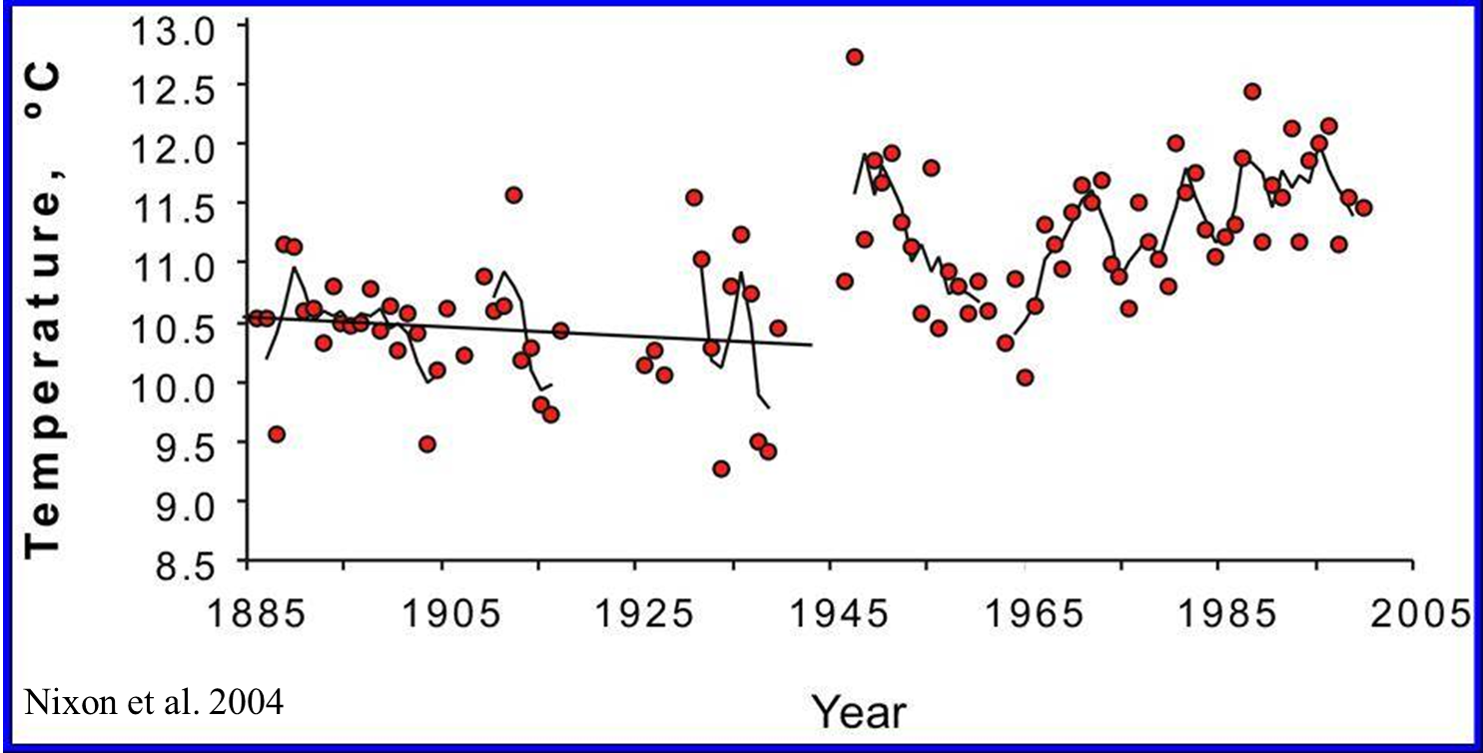
Fulweiler et al. (2015)

Slide 15
“Human influence has been detected in warming of the atmosphere and the ocean, in changes
in the global water cycle, in reductions in snow and ice, in global mean sea level rise, and
in changes in some climate extremes (see Figure SPM.6 and Table SPM.1). This evidence for
human influence has grown since AR4. It is extremely likely that human influence has been
the dominant cause of the observed warming since the mid-20th century.”

Slide 17
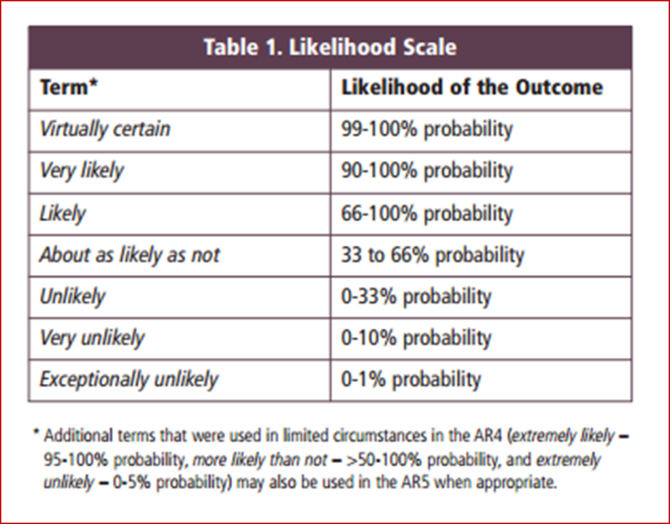
Things that scientists are less certain or just
As certain as that humans play a significant role
In current climate change:
that cigarettes kill
the age of the universe
that vitamins make you healthy
that dioxin in Superfund sites is dangerous
http://motherboard.vice.com/blog/things-scientists-are-less-sure-of-than-climate-change

Slide 18
Future?

Slide 21
Mean sea level refers to the height of the sea in relation to a surface reference point. Sea level goes through periodic cycles of change throughout geologic time.
Eustatic – global (climate driven)
Isostatic - local
Global mean sea level rise since the 1990s - ~3.5 mm per year
Notes:
Local – glaciers make land sink, glaciers move away – land rises… for ex.

Slide 22
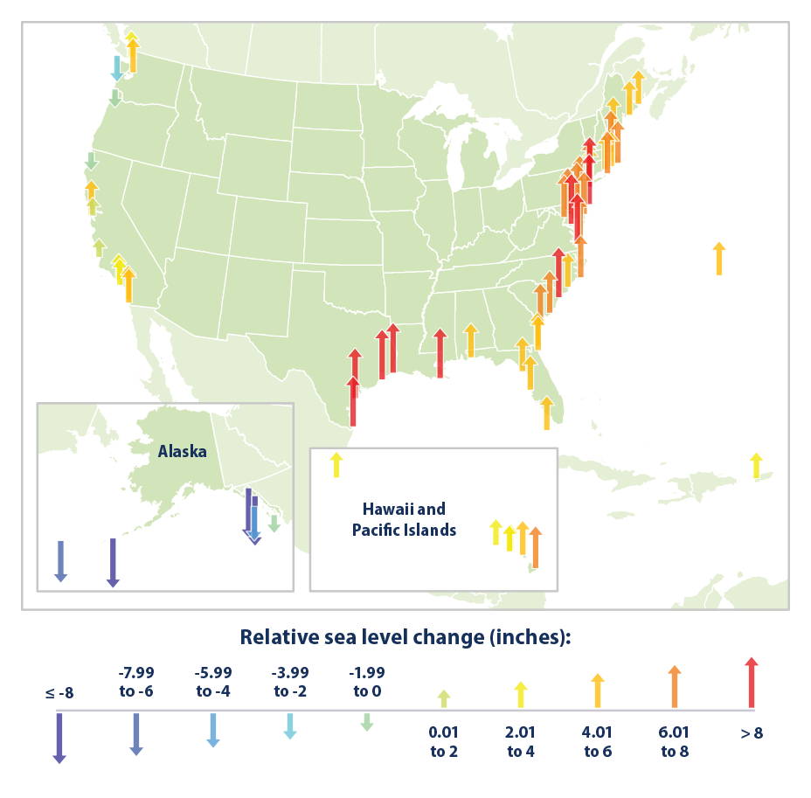
http://tidesandcurrents.noaa.gov/sltrends/sltrends.shtml
Notes:
https://www.epa.gov/climate-indicators/climate-change-indicators-sea-level

Slide 23
Why does sea level change?
Two dominant reasons….
1. Thermal Expansion
2. Melting of glaciers and ice caps
From IPCC: thermal expansion accounts for 30 to 55% of 21st century global mean sea level rise, and glaciers for 15 to 35%.
Notes:
Eustatic – global sea level rise

Slide 24
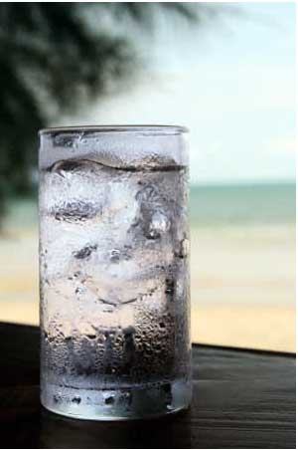
How about sea ice?
https://www.youtube.com/watch?v=lPgZfhnCAdI

Slide 25
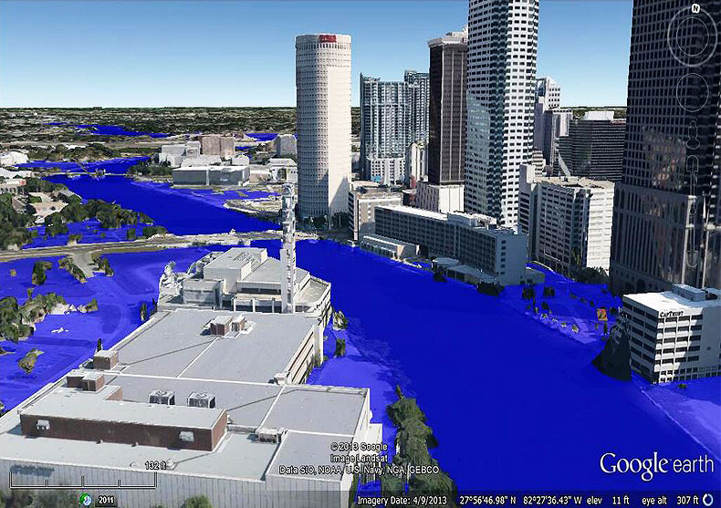
Tampa, Florida– under 1 m of sea level rise

Slide 26
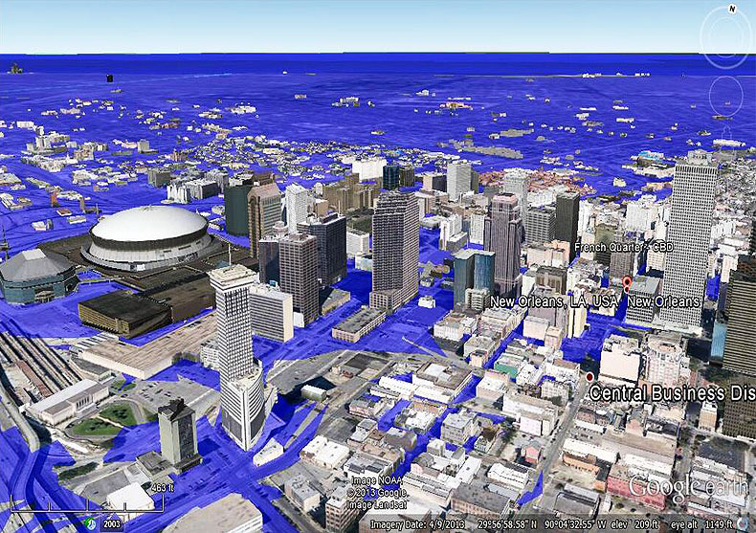
New Orleans, LA – under 1 m of sea level rise

Slide 27
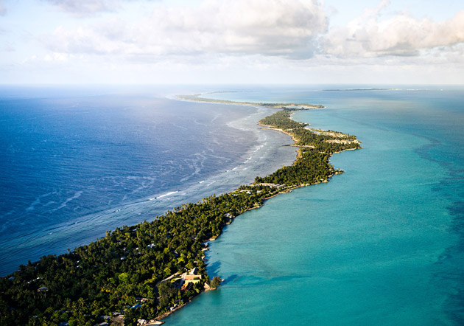
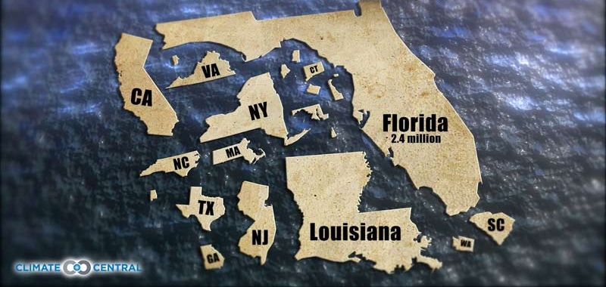
Very obvious impacts of sea-level rise
Islands, low-lying areas become uninhabitable
4.9 million in US live less than 4ft above sea level
Kiribati
Slide from Daniel J. Jacob, Harvard University

Slide 28
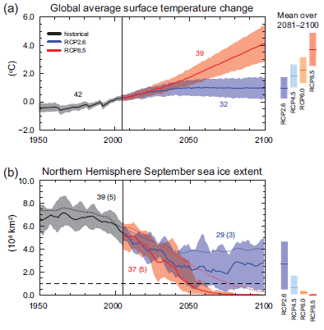
What does this mean for future climate change?
business-as-usual
scenario: 8ºF warming
by 2100
extremely aggressive
Intervention: climate
stabilization by 2040
IPCC [2014]
Slide from Daniel J. Jacob, Harvard University

Slide 29
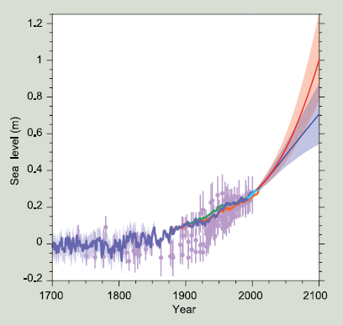
Projections of future sea-level rise
Limiting future rise to 1 foot will require
extremely aggressive intervention
IPCC [2014]
Slide from Daniel J. Jacob, Harvard University

Slide 30
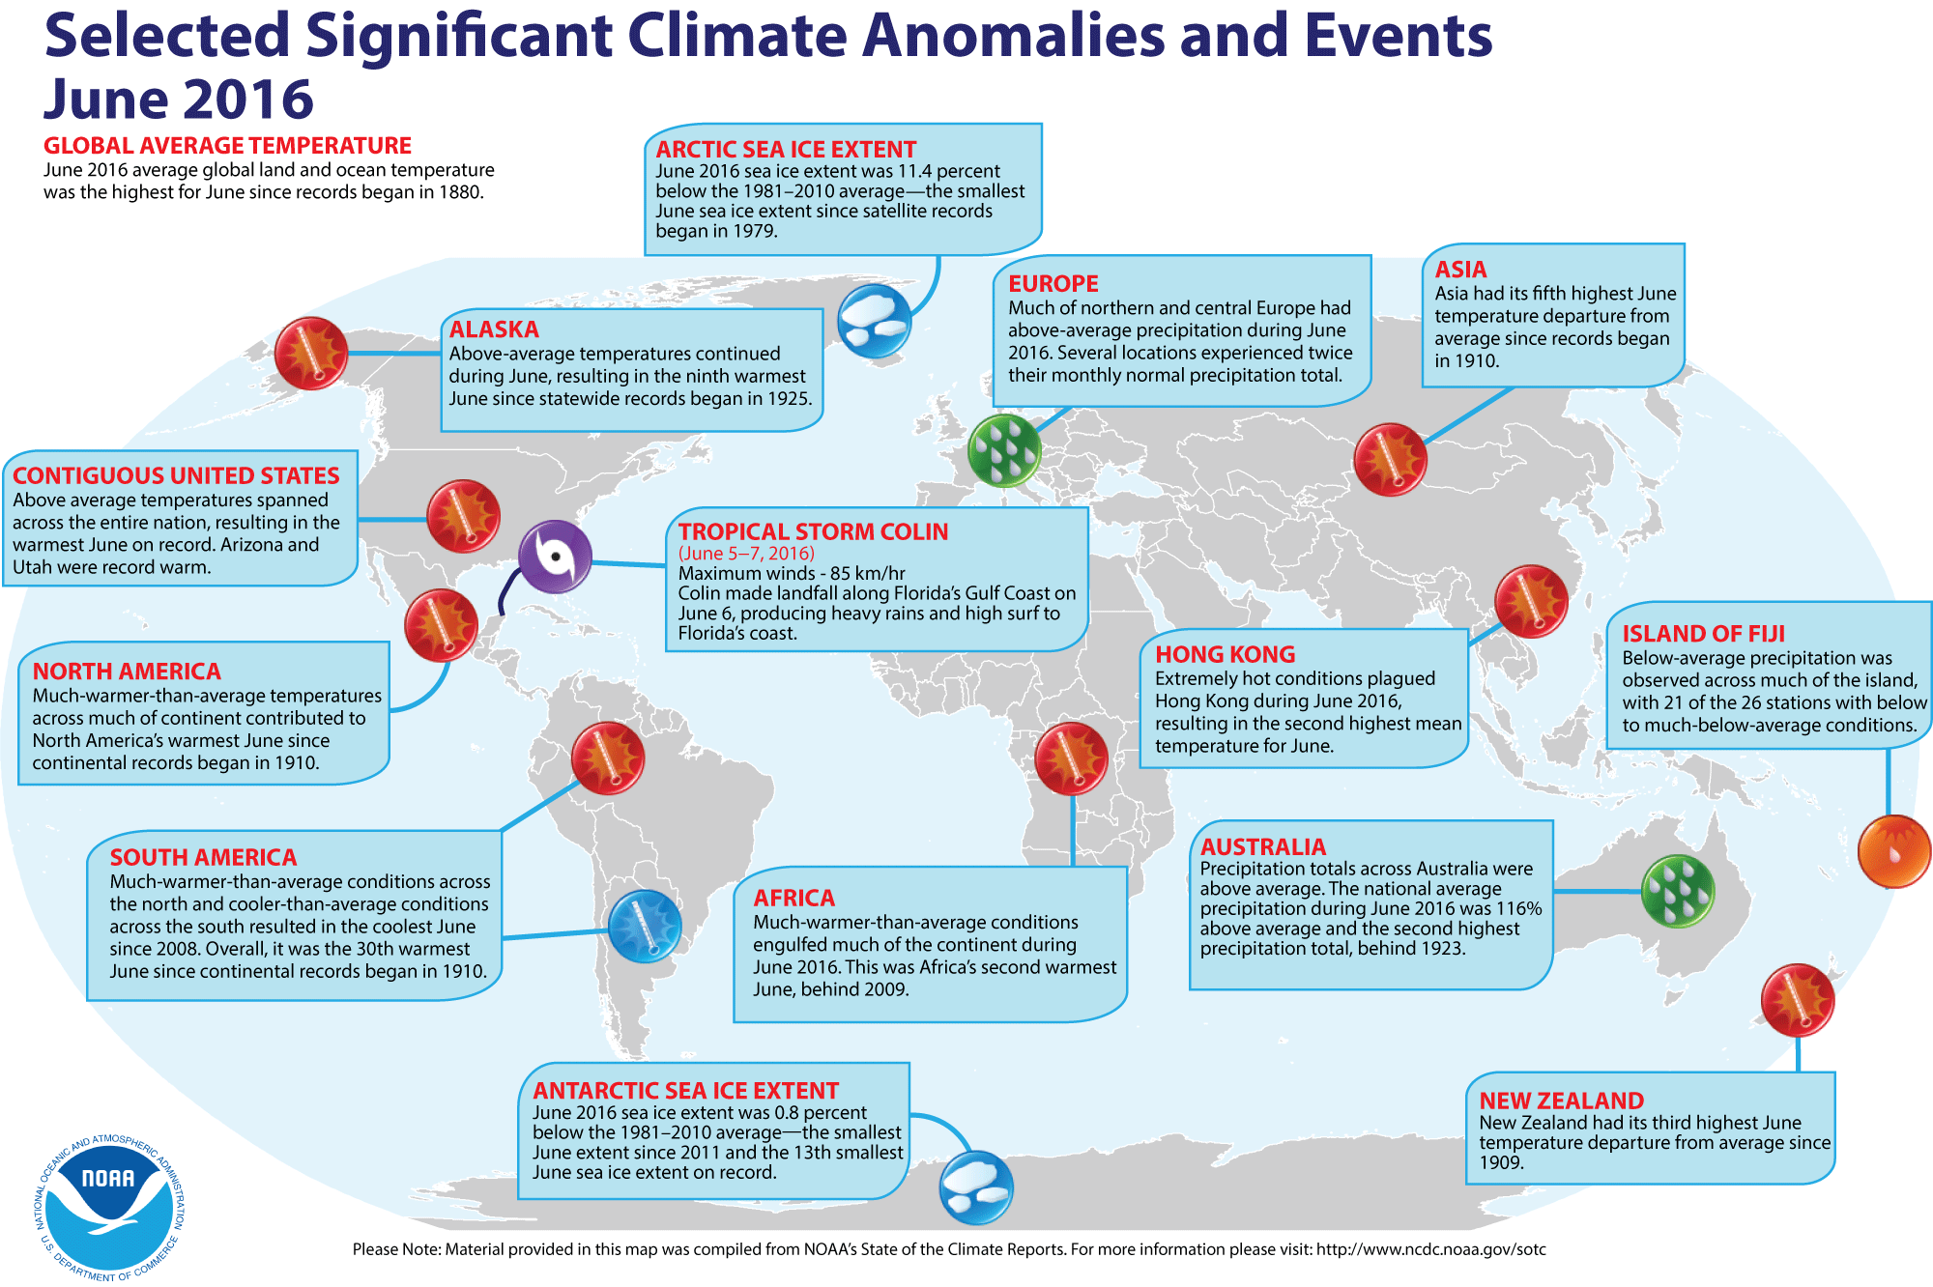

Slide 31
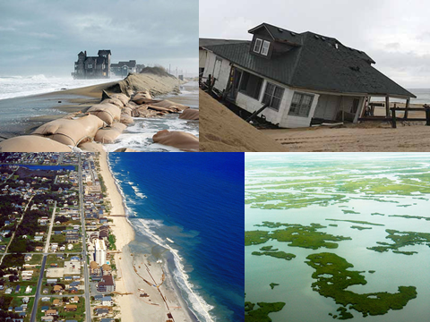

Slide 32
What can you do about climate change?
Lots…. And yes, one person can make a difference
Decrease use of personal vehicles
Decrease use of electricity
Eat Local (will help w/ Nitrogen too)
Recycle
Consume less
Compost
Use less water
Spread the word…….
Write Senators, write congress, write the president….
tell them we must take action on climate change
For more info: http://www.epa.gov/climatechange/wycd/

Slide 33
Quiz:
Name the two mechanisms
driving sea level rise.

