Slide 1
Questions about being a Marine Science Major or Minor at BU?
Please ask!
Email me: rwf@bu.edu

Slide 2
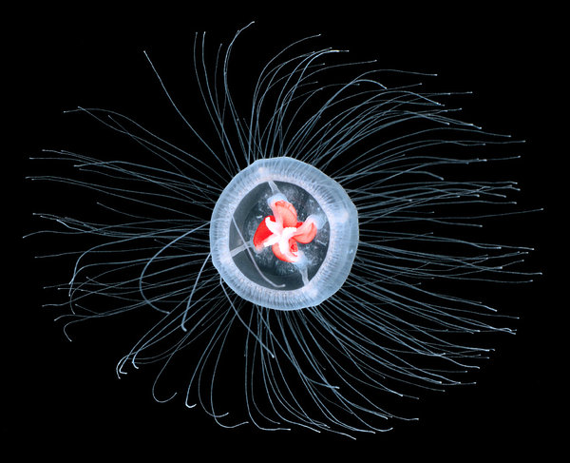
The Immortal Life of Jellyfish
November 16, 2016
Lecture inspired from Nathaniel Rich’s NY Times article (11/28/2012):
“Can a Jellyfish Unlock the Secret of Immortality?”

Slide 3
What’s the one certainty of life?
What if that’s wrong?

Slide 4
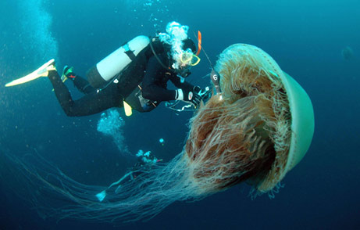
What are Jellyfish?
Radially symmetrical –
Their body plans are arranged around a central point
Radiata: include the Cnidaria and the Ctenophora
Notes:
This is different than bilateral symmetry – where are there are equal halves on each side of the organism – like cephalopods and humans.

Slide 5
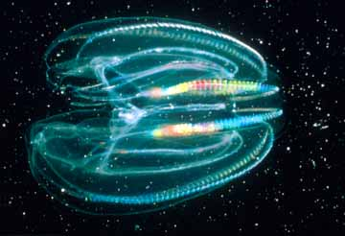
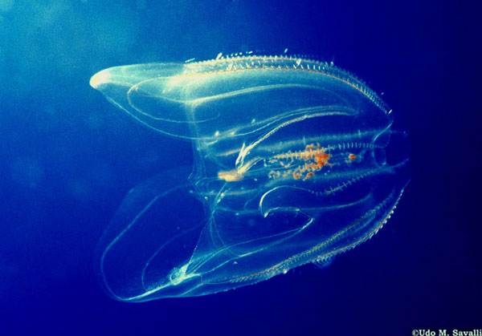
Ctenophora includes:
Comb Jellies
1 – 10 cm in length
Largest animal to use cilia for moving
NO stinging cells
Eat copepods and small fish, have a real gut

Slide 6
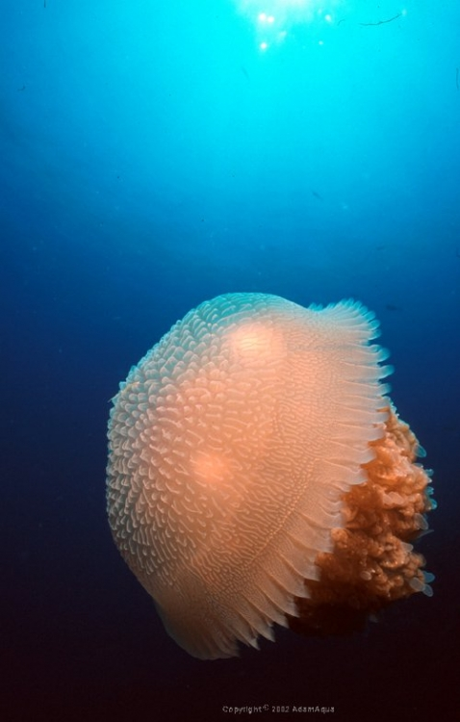
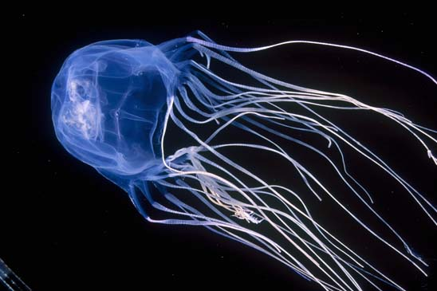
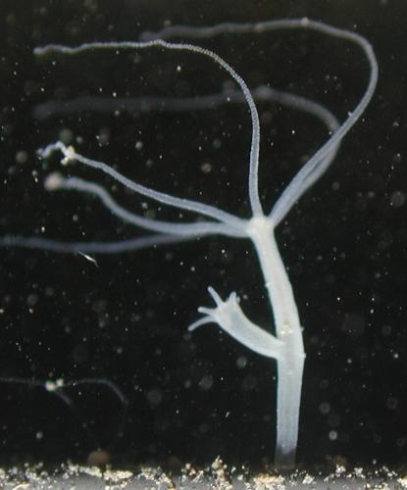
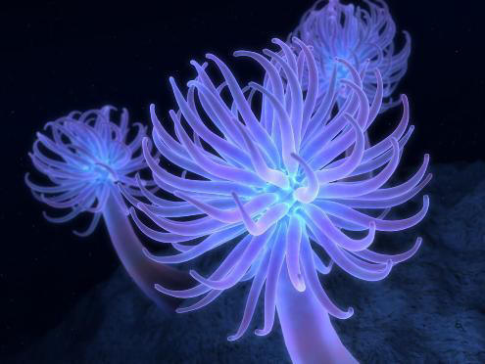
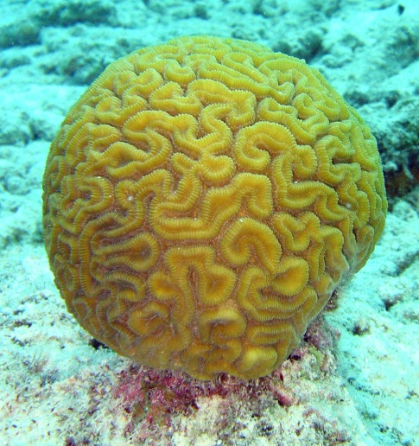
Cnidaria includes:
Box jellies
Hydra
Jellyfish
Sea anemones
Coral

Slide 7
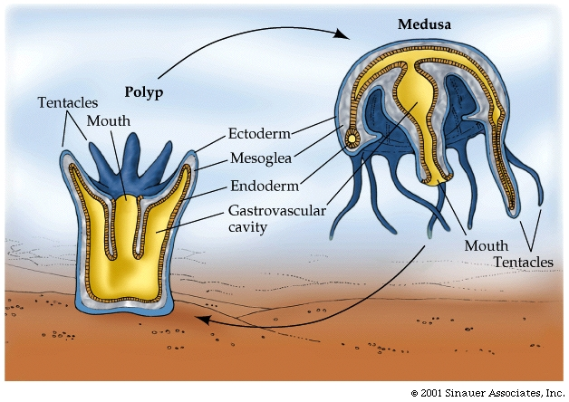
Cnidaria –
Most cnidarians have two different body forms
and associated life stages:
Sessile polyp
Mobile Medusa

Slide 8
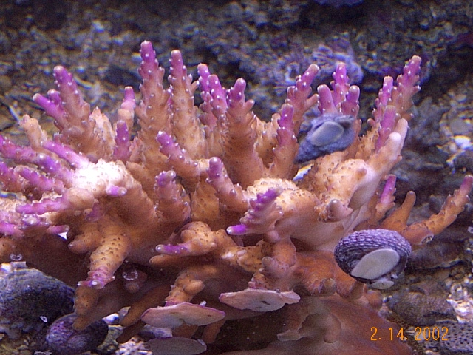
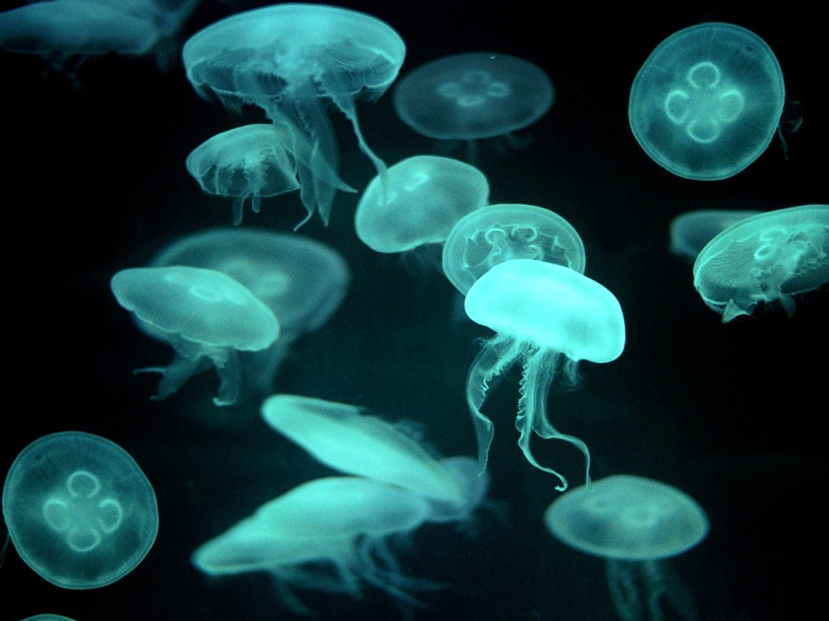
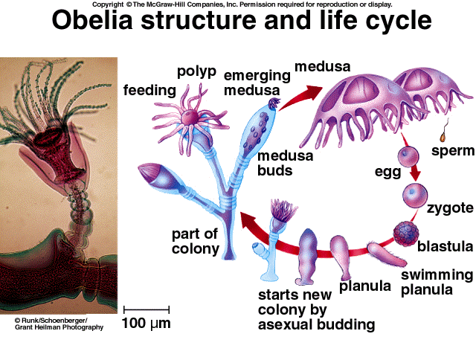
Many exist primarily as one form or the other….. For example:
Corals exist only as the polyp form
Jellyfish only as the medusa form
Others – have both stages….

Slide 9
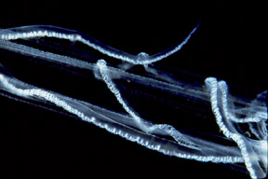
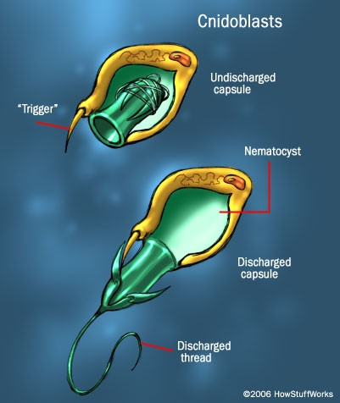
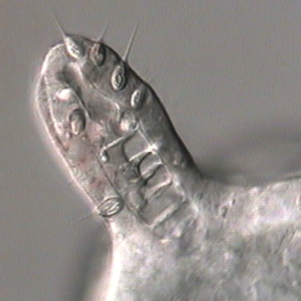
All Cnidarians have stinging cells known as Cnidoblasts….
These contain Nematocysts – capsules w/ coiled, bared thread…
filled w/ venom.

Slide 10
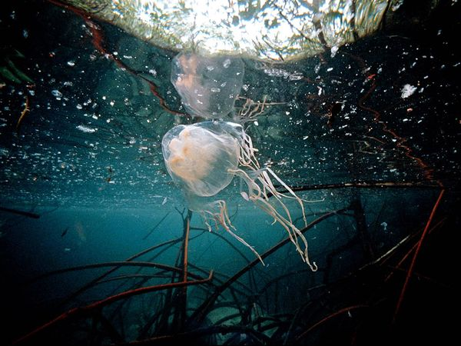
In fact – box jellyfish are one of the most deadly animals
on earth……

Slide 11
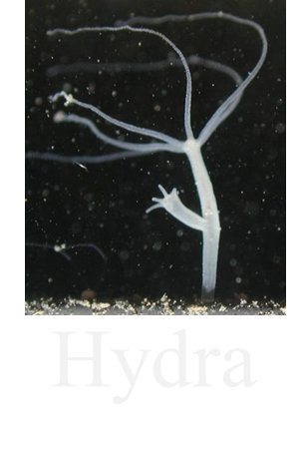
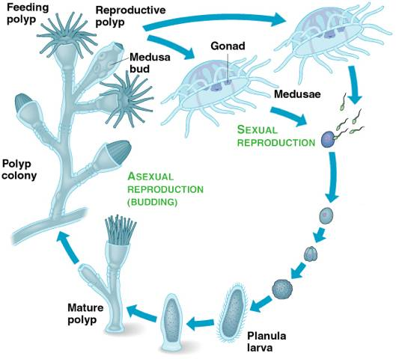
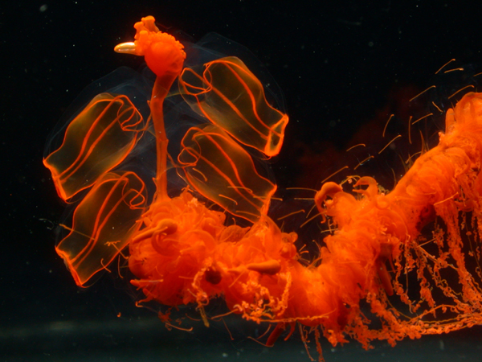
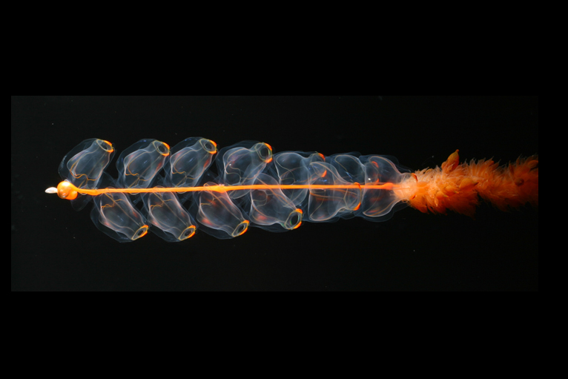
AKA Hydrozoans
Siphonophores
Notes:
Siphonophores - - in the phylum Cnidaria – actually a colony of animals…. Longest ‘animals’ ever – 40 m long!

Slide 12
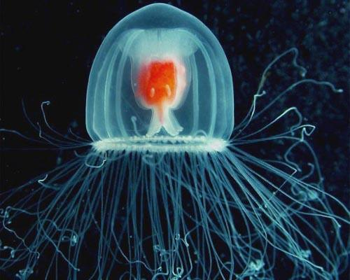
Turritopsis dohrnii - (Atlantic Sp. -Turritopsis nutricula)
“The Immortal Jellyfish”
~ Tiny - (think the size of your pinky nail)
It used to be found only in the Caribbean –
But because of ballast water transport –
It’s now found all over the globe.
Notes:
Most jellyfish live one year – w/ the oldest being 30 years old.

Slide 13
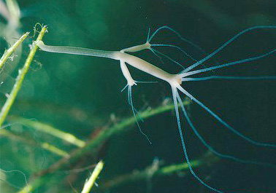
Notes:
Polyp phase is suspected to last for days to year depending on environmental conditions….
Adult jellyfish can be males or females… sometimes they are hermaphrodites

Slide 15
How do they do this?
Cellular Transdifferentiation
Two types of cells –
Somatic Cells – any cell that forms the body of an organism
Gametes – gametes are sex cells (e.g., eggs & sperm)
Change from one form to another….

Slide 16
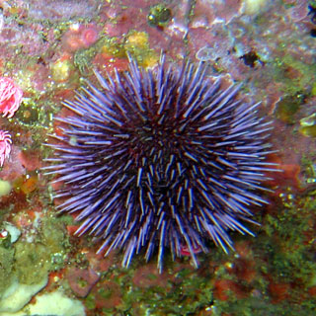
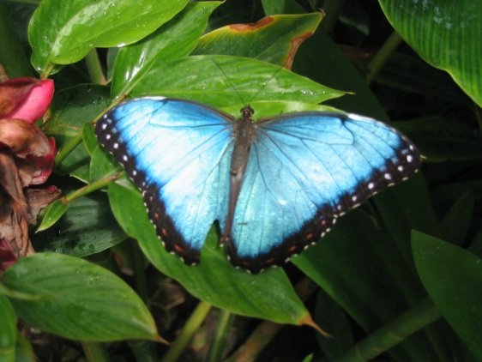
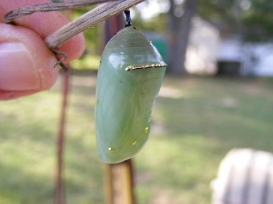
So is this immortality??
….well No, the cells are destroyed,
And new cells make a clone…..
But…. This is a VERY Strange thing.
Notes:
Some sea urchins can do this… (or a similar thing), there are other hydroids that can do this as well….

Slide 17
Why do we care?
After all, “It has no brains, for instance, nor a heart. It has a single orifice through which its food and waste pass — it eats, in other words, out of its own anus.”
Jellyfish are more than just blobs……

Slide 18
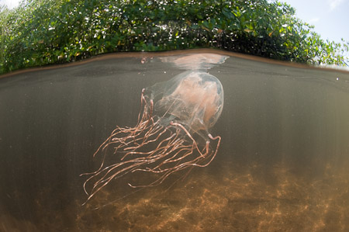
Box jellyfish… are active hunter and stalks its prey with the aid of 24 fully functioning eyes.
Eye clusters on each side of its “head” – four that see light
And dark and two eyes – w/ lenses, corneas, and retinas.
Notes:
Eyeballs allow full visual pictures – w/ very little distortion.

Slide 19
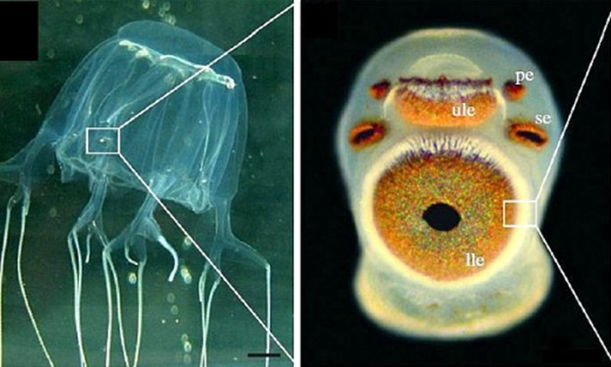
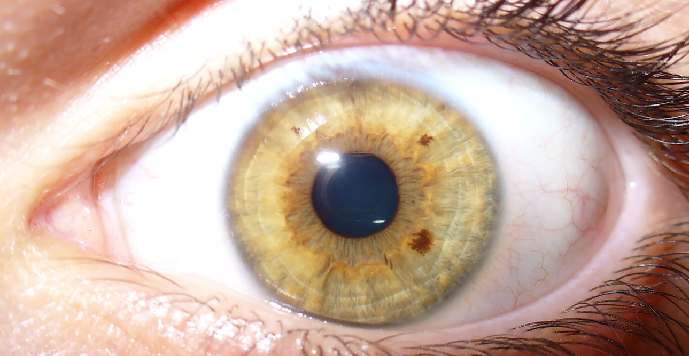
Notes:
And these are much like higher trophic level eyes…. Like ours….and the genetic building blocks that make our eyes – make their eyes too!

Slide 20
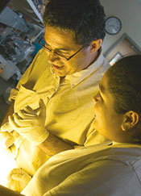
The National Institutes of Health has awarded Martínez a five-year, $1.26 million research grant to study the hydra — a species that resembles a polyp but never yields medusas. Its body is almost entirely composed of stem cells that allow it to regenerate itself continuously.
His research of the last 15 years has convinced him that hydra can, in fact, survive forever and are “truly immortal.”
“It’s important to keep in mind that we’re not dealing with something that’s completely different from us,” Martínez told me.
“Genetically hydra are the same as human beings. We’re variations of the same theme.”

Slide 21
Quiz:
What’s the difference between a Cnidarian and a Ctenaphore?

