Slide 1
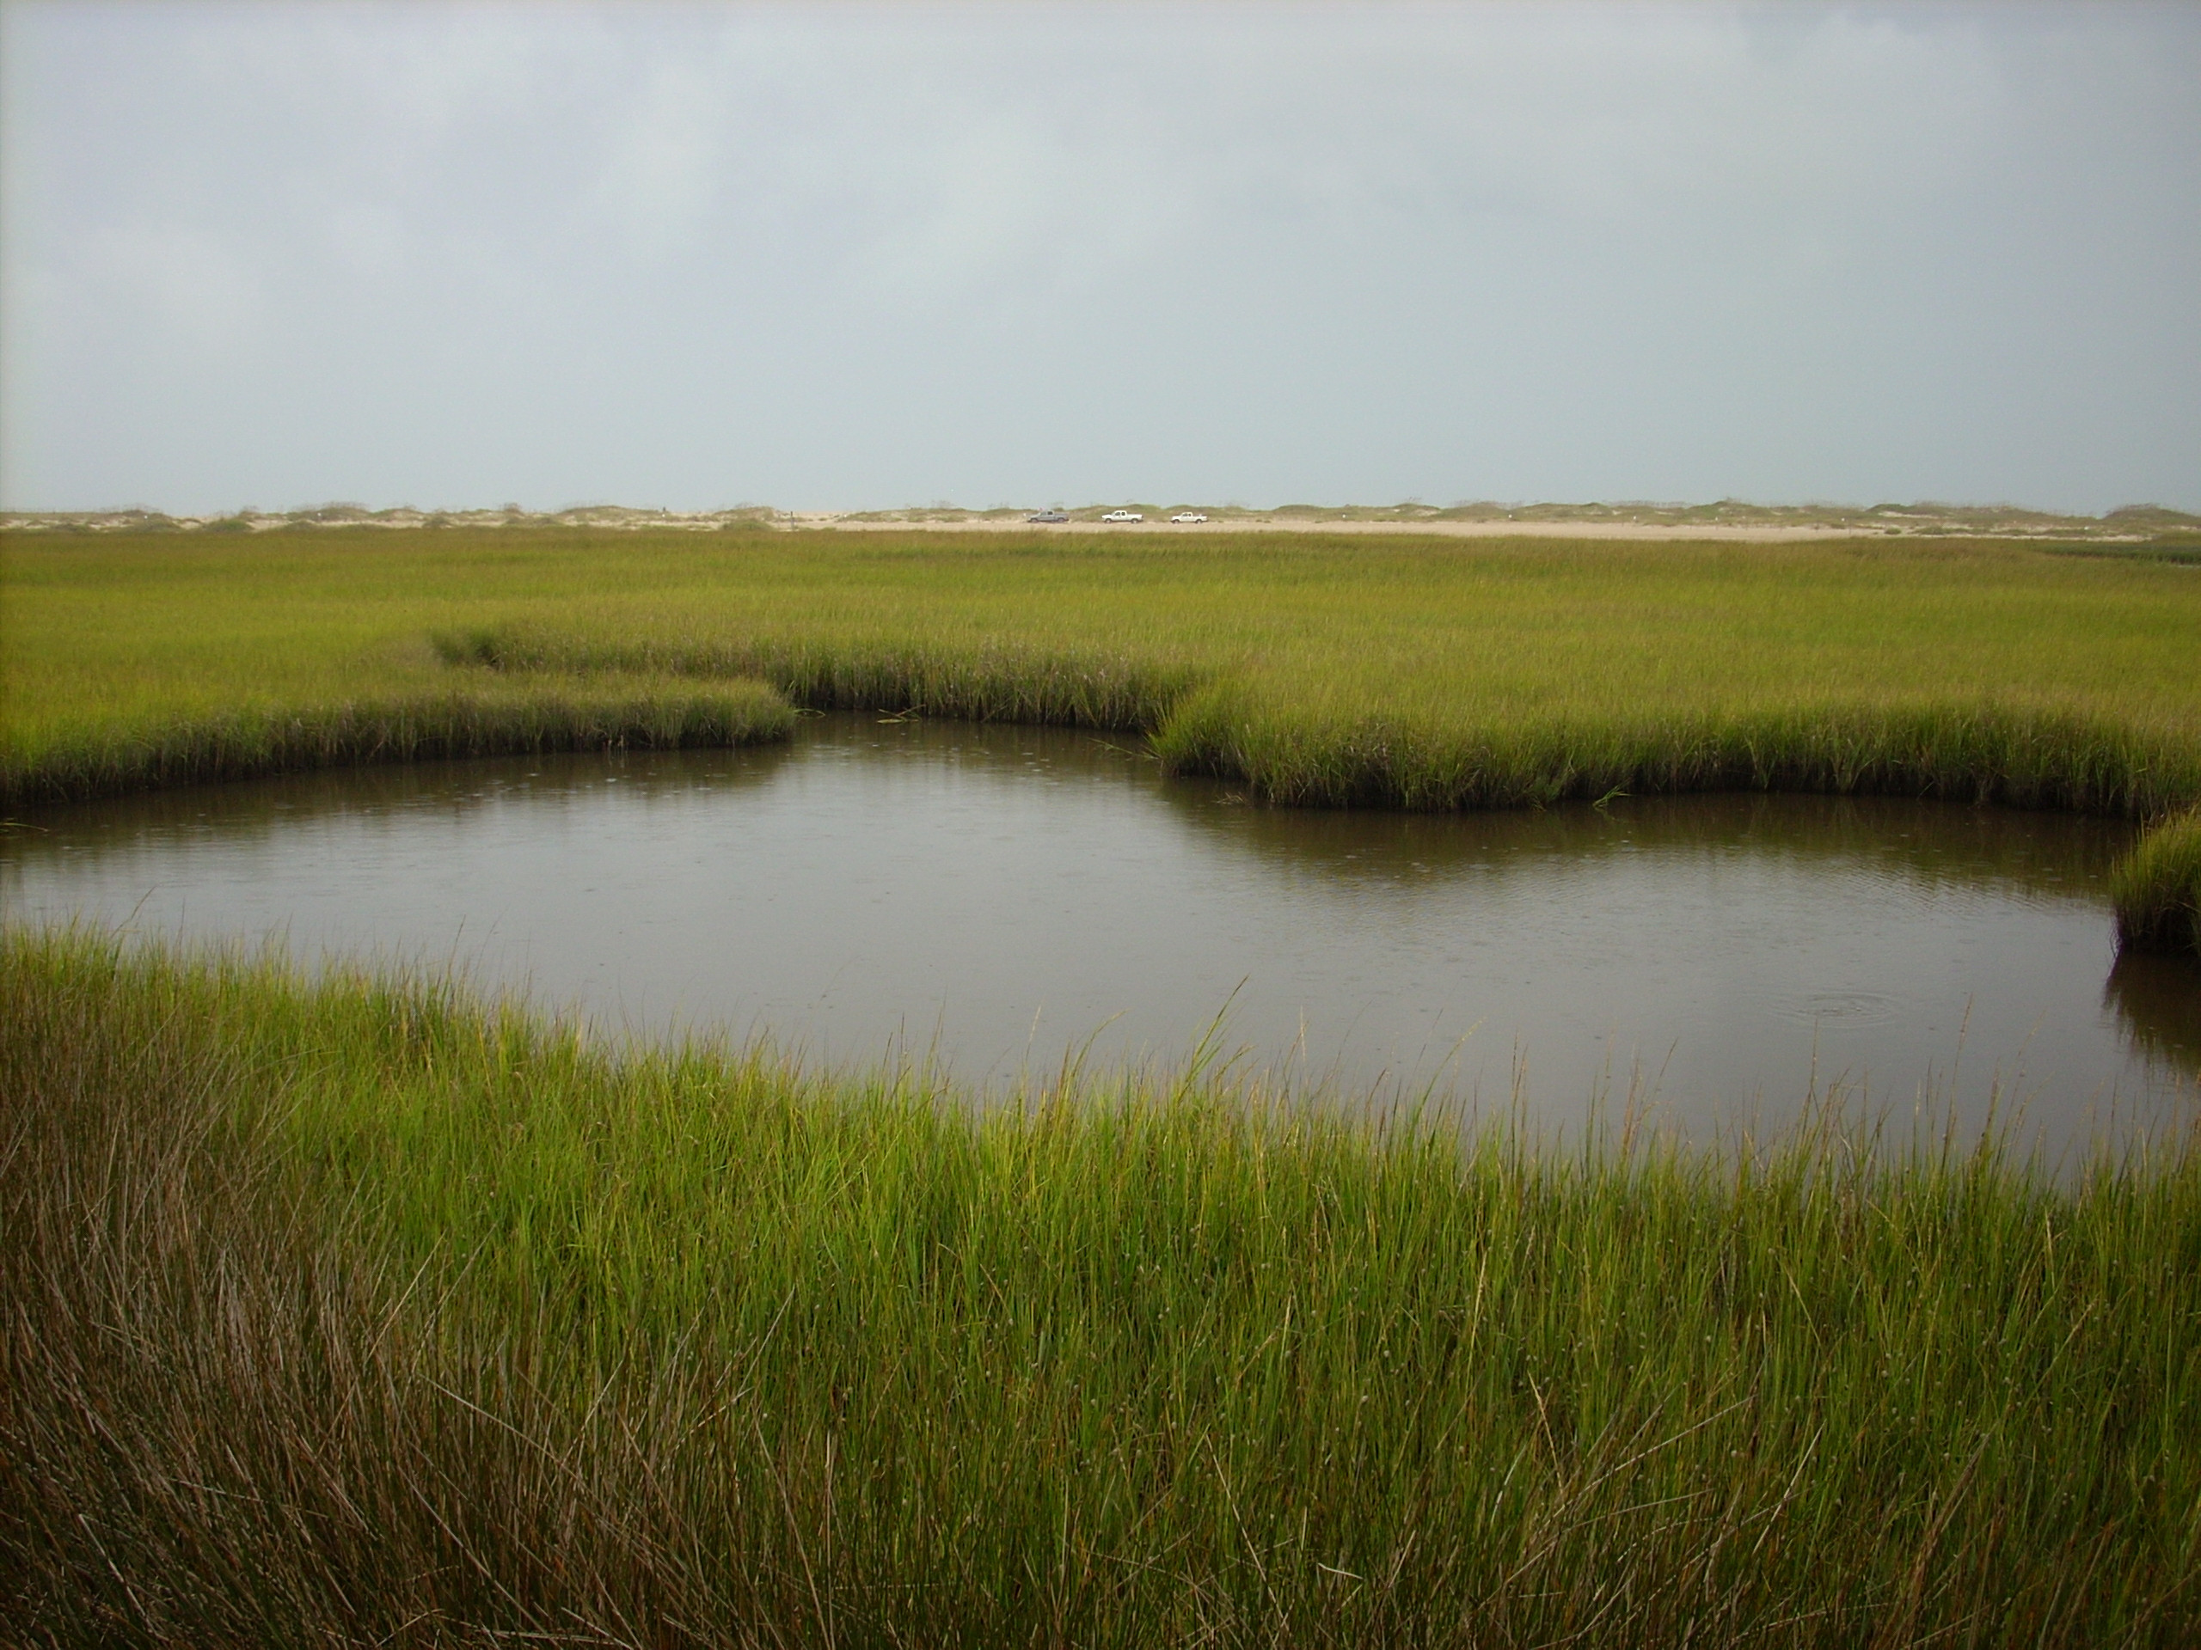
Salt Marsh Productivity
February 5, 2019

Slide 2
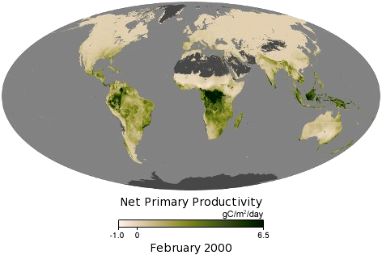
Global Net Primary Productivity

Slide 3
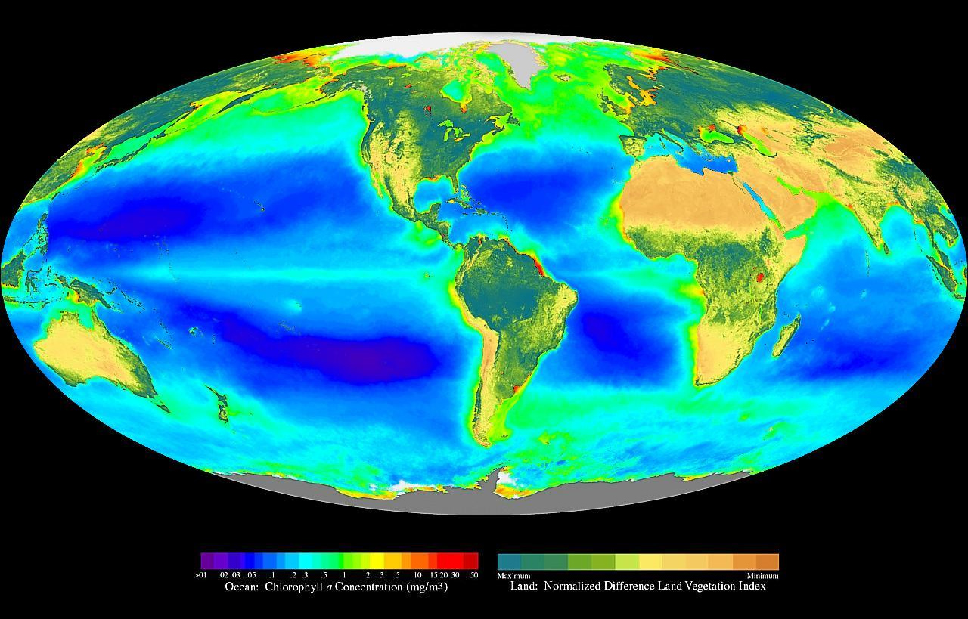
Global Primary Productivity

Slide 4
Definitions
Primary Productivity – the synthesis of organic compounds from atmospheric or aqueous carbon dioxide.
Gross Primary Productivity (GPP) – the total amount of CO₂ that is fixed by photosynthesis.

Slide 5

Respiration (R) – is the amount of CO₂ that is lost from an organism or system from metabolic activity.
Plant (Autotroph) respiration = Rp

Slide 6
Plant respiration is also called plant metabolism
Largely the result of mitochondrial activity in plant cells
Plants respire ~ 50% of the carbon they fix.
Rp generally increases with temperature.
Plant (Autotroph) respiration = Rp
Net Primary Productivity (NPP) – gross primary productivity - Rp

Slide 7

Net Primary Productivity – amount of primary production after plant respiration.
NPP units – most common: g m⁻² yr⁻¹
But also in units of energy, caloric content of plant tissue → efficiency of photosynthesis relative to receipt of sunlight energy.
NPP generally increases w/ more sunlight; typically, only captures ~1% of light energy.
Plant tissue typically contains 45-50%, so dividing by 2 is a quick/convenient way to get convert accumulation of organic matter of to carbon fixation.

Slide 8

Net Primary Productivity – how do we measure it?
Harvest
Annual growth increments – e.g., forests

Slide 9
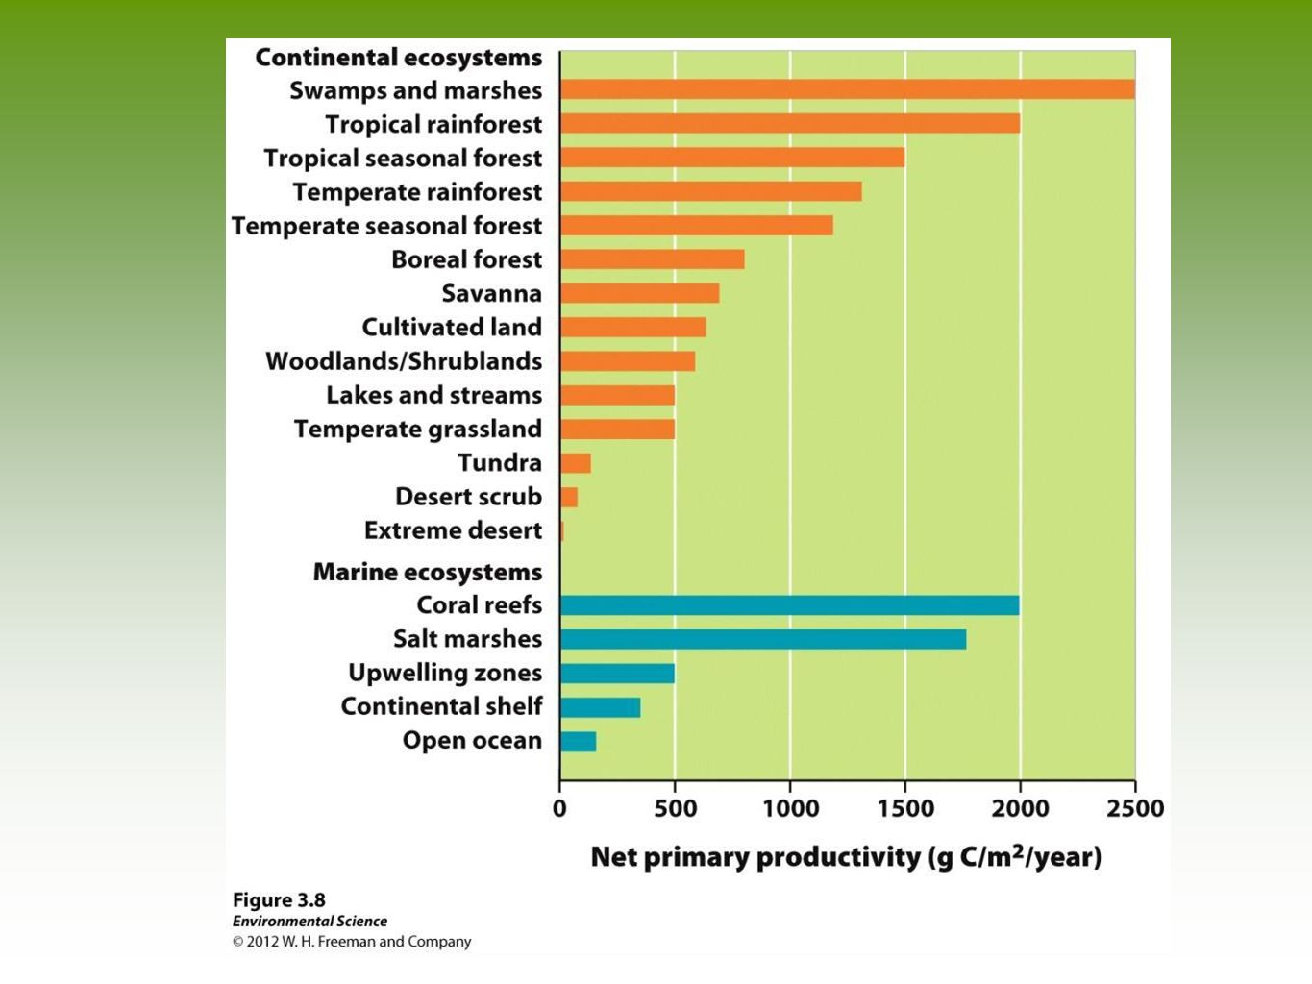
Net Primary Productivity – A comparison across ecosystems

Slide 10


Respiration (R) – is the amount of CO₂ that is lost from an organism or system from metabolic activity.
Plant (Autotroph) respiration = Rp
Heterotroph respiration = Rh
Decomposer respiration = Rd

Slide 11
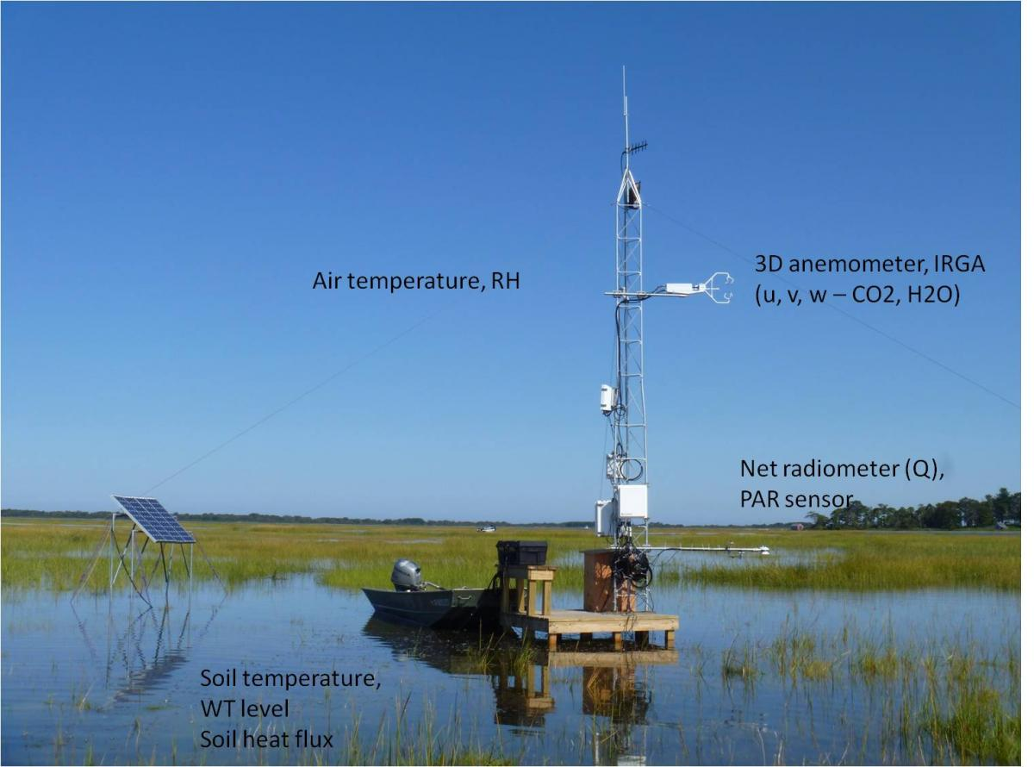
Net Ecosystem Production (NEP)– is the amount of CO₂ that is lost from an organism or system from metabolic activity.
Eddy covariance towers

Slide 12

Eddy covariance towers

Slide 13
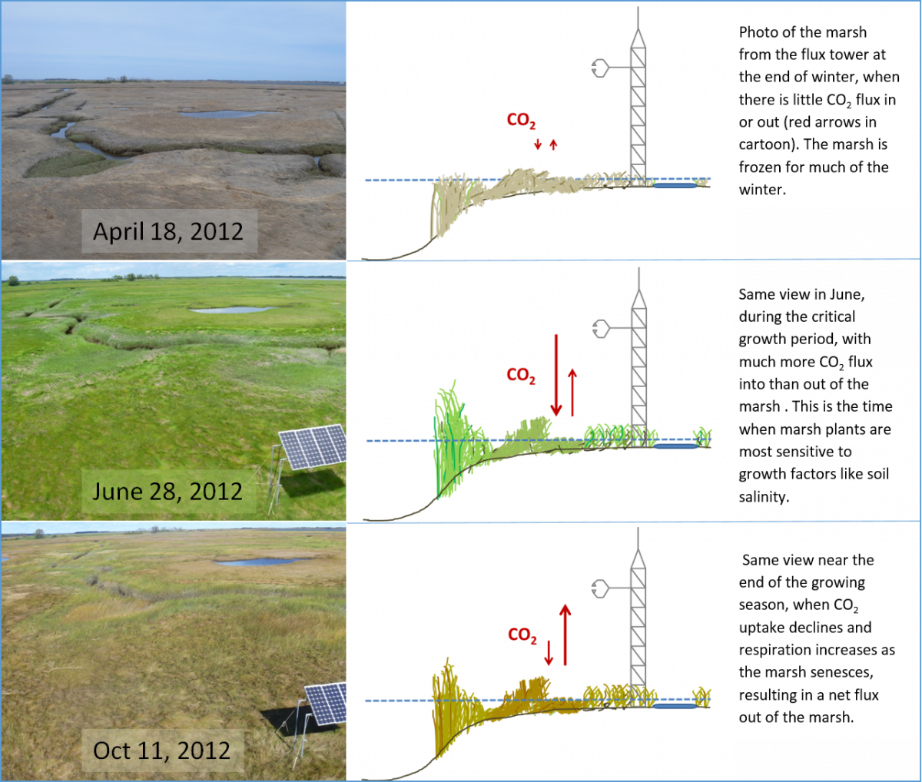
Plum Island Marsh

Slide 14
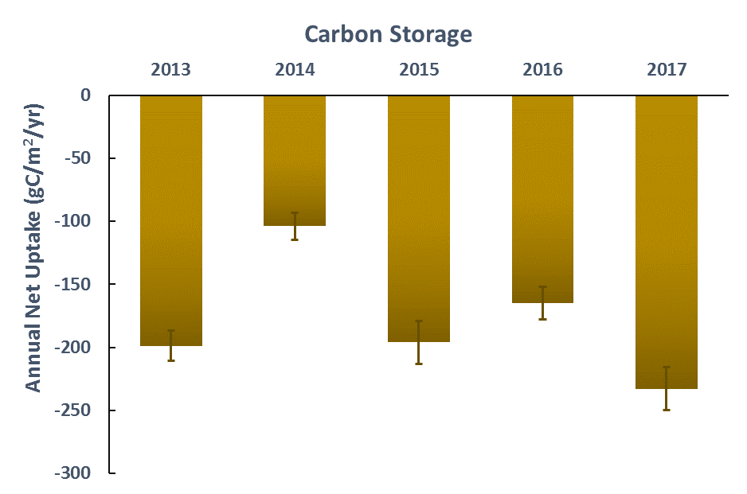
2013-2017 confirmed that the PIE marsh was a strong net carbon sink for all years.

Slide 15
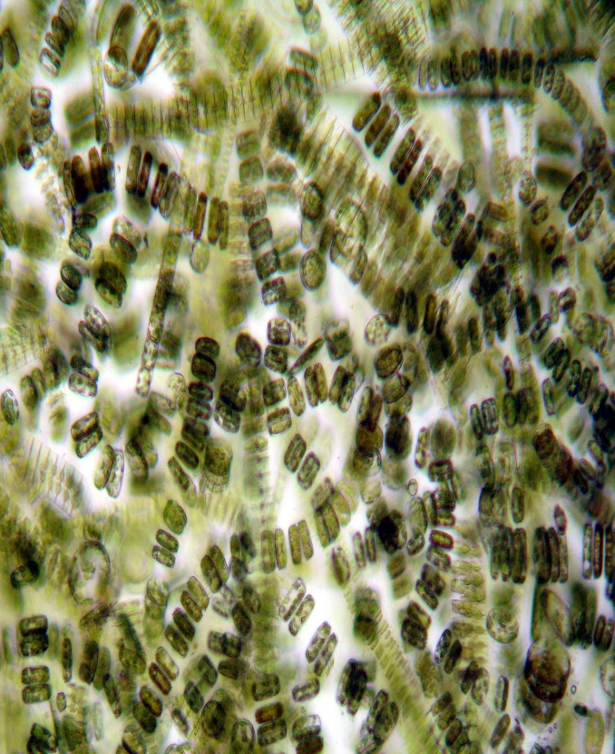
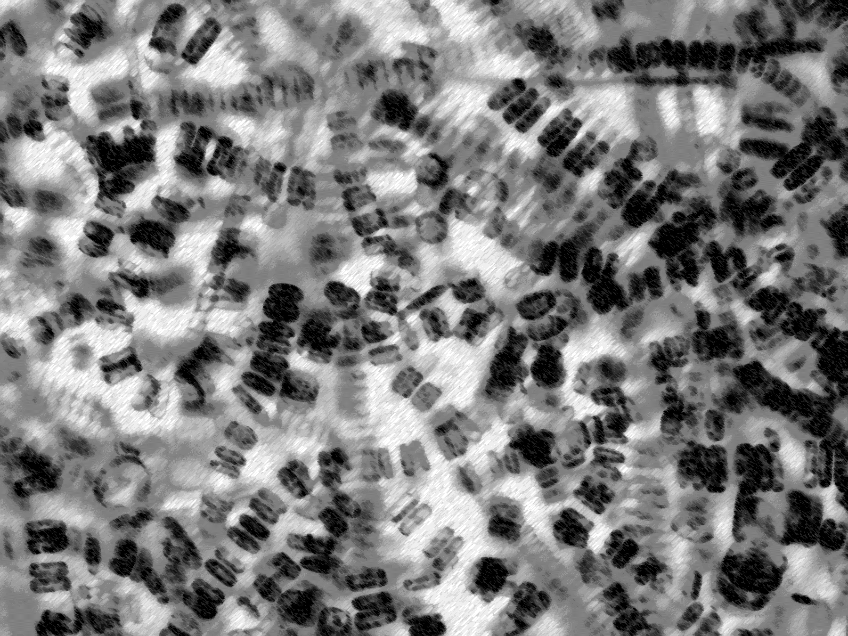
Quick detour: Measuring primary production in aquatic systems
Photosynthesis
Respiration
6 CO₂+ 6 H₂O → sunlight → C₆H₁₂O₆ + 6 O₂
C₆H₁₂O₂ → 6 CO₂ + 6 H₂O
Bottle of seawater exposed to light
Bottle of seawater exposed to no light
Notes:
Light bottle is equivalent to what? NPP (but probably some respiration from bacteria too)
Dark bottle is respiration

Slide 16
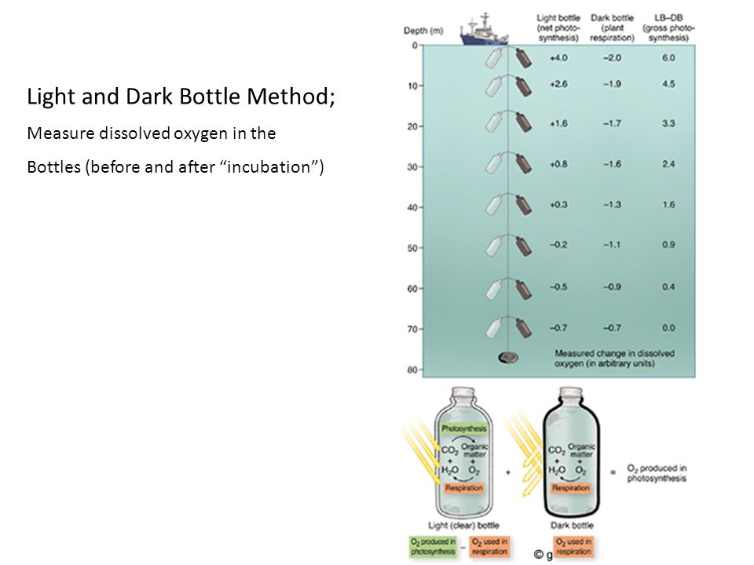

Slide 17
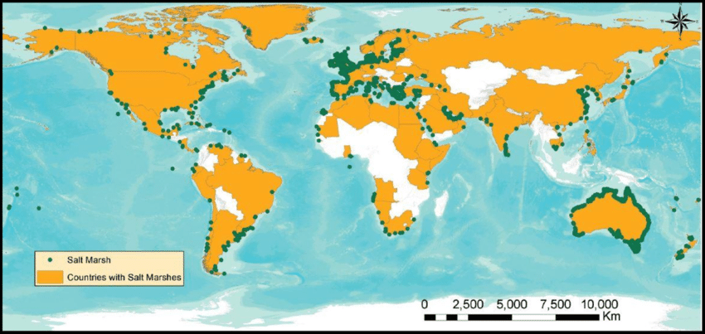
Salt Marsh
Also known as coastal salt marsh or a tidal marsh….located in the upper intertidal zone between land and open salt water. (Salinity ranges btw 5-35 on average….could be higher)

Slide 18
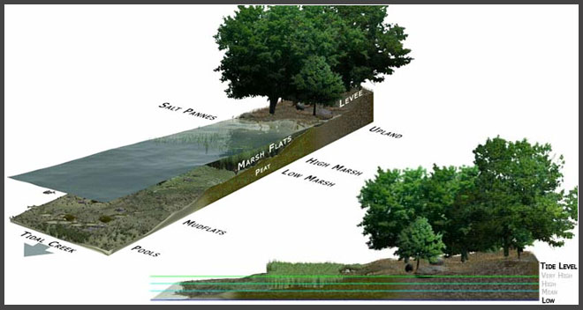
Regularly flooded by tides
Dominated by halophiles – or salt tolerant plants – such as herbs, grasses, and shrubs.
http://oceanservice.noaa.gov/facts/saltmarsh.html

Slide 19
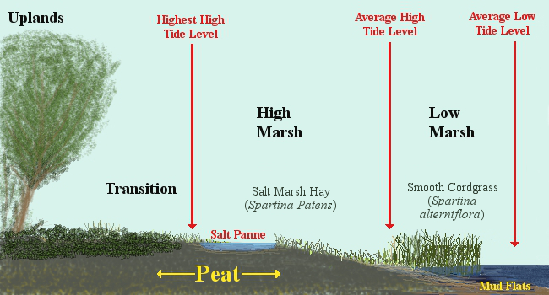

Slide 20
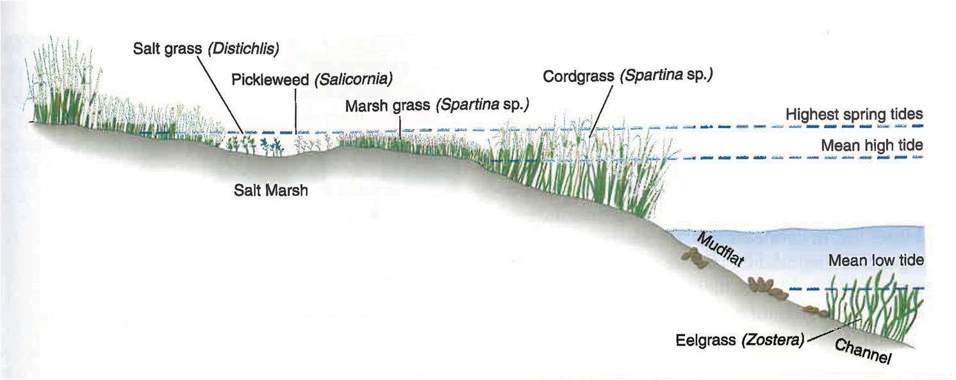
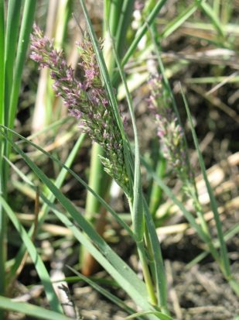
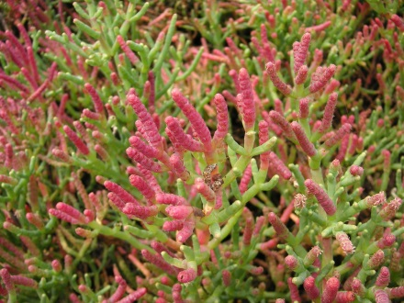
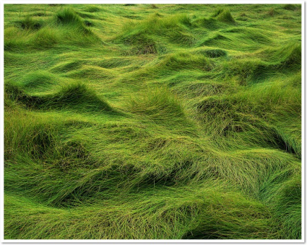
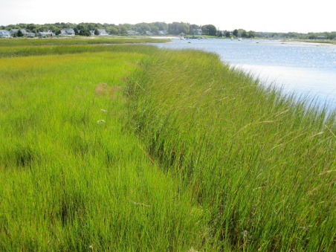
Plant Zonation is very important for all aspects of salt marshes – including Biogeochemistry
Spartina patens
Sp. alterniflora
In New England we have semidiurnal or semidaily tides ….which means we have two high
tides and two low tides each day….

Slide 21
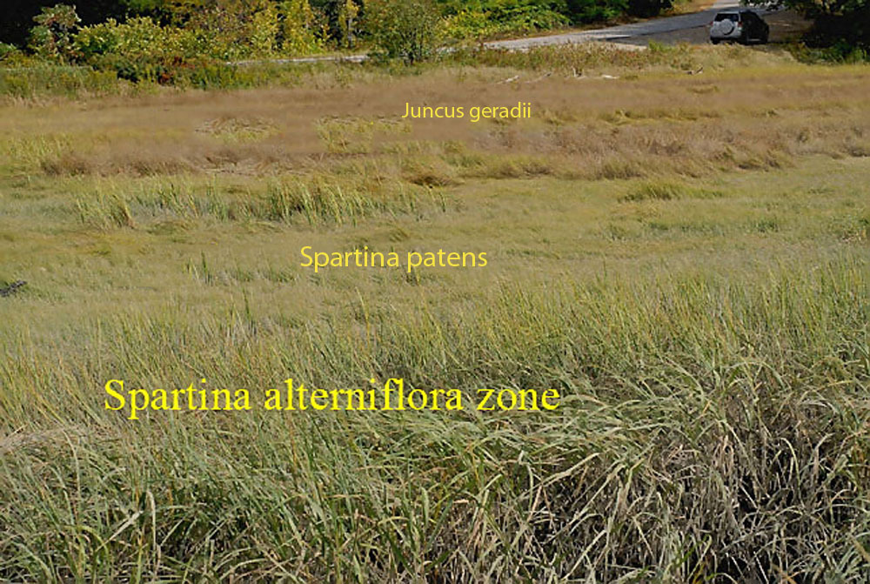

Slide 22

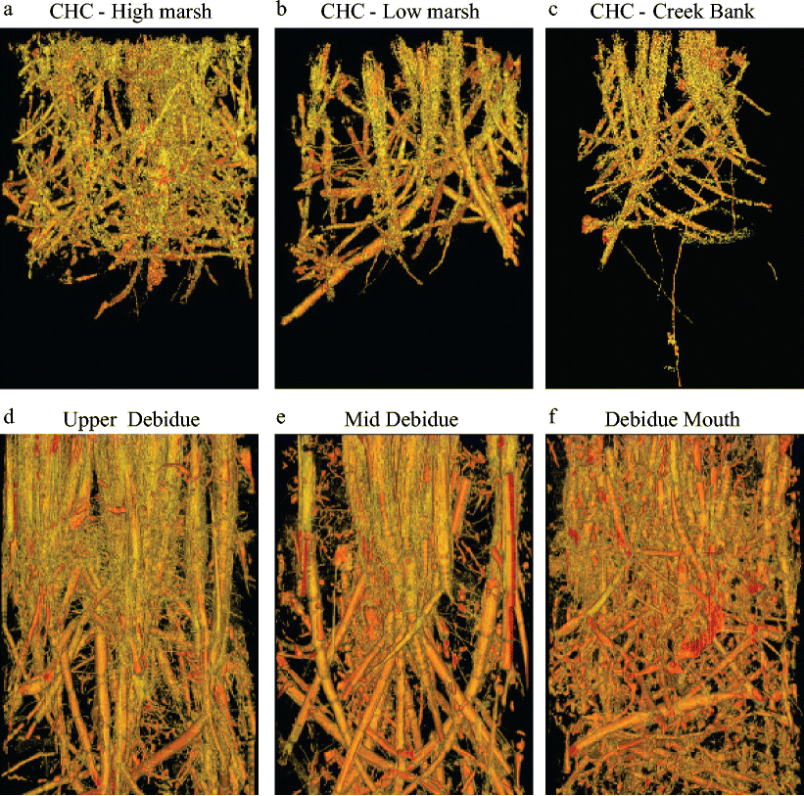

Slide 23
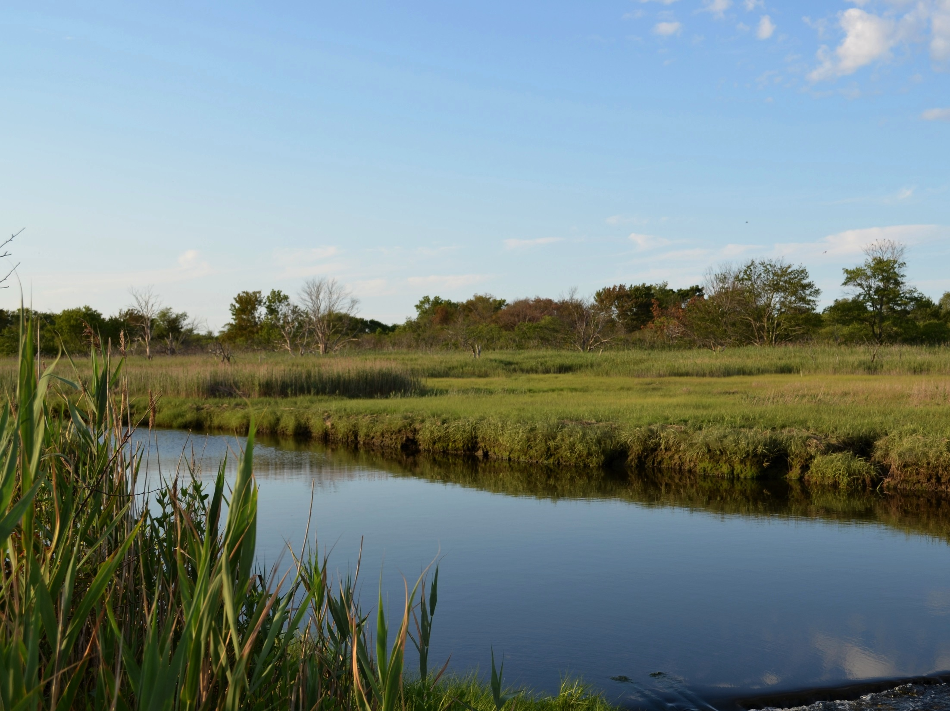
Ecosystem | Area (10³ km²) | C burial (Tg yr⁻¹)
Salt marsh | 22 - 400 | 5 - 87
Temperate forest | 10,400 | 53
Mcleod et al (2011) Front Ecol Environ 9 (10): 552-560
Slide from H. Emery, BU

Slide 24
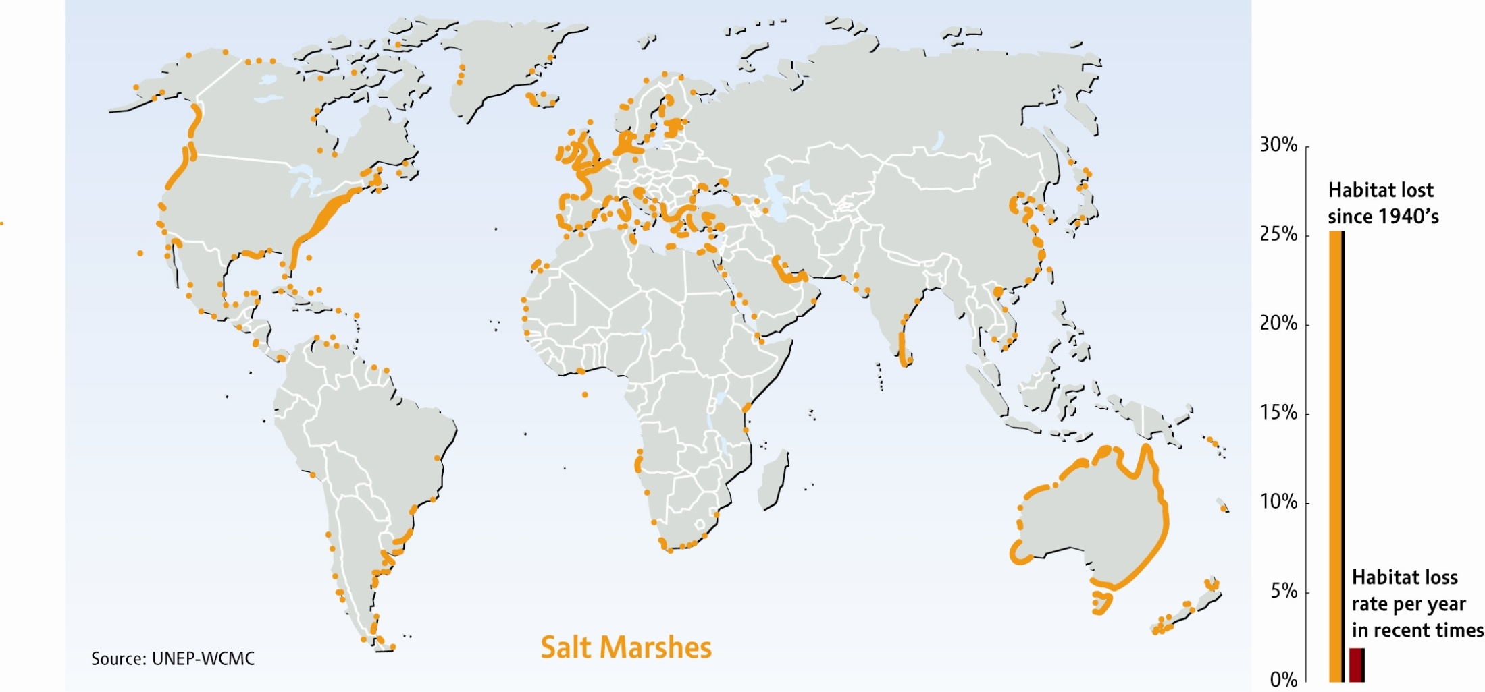
Global Salt Marsh Loss

Slide 25
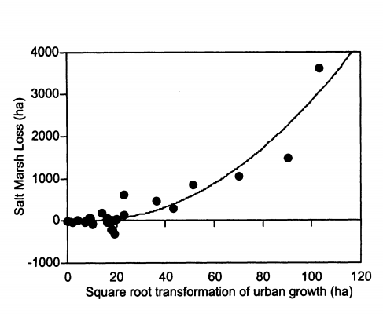
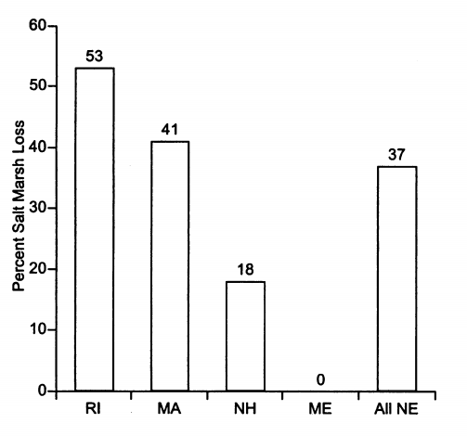
Salt Marsh Loss in New England over the last 200 years
R²=0.89
Figures from Bromberg and Bertness (2005) Estuaries 28 (6): 823-832.

Slide 26
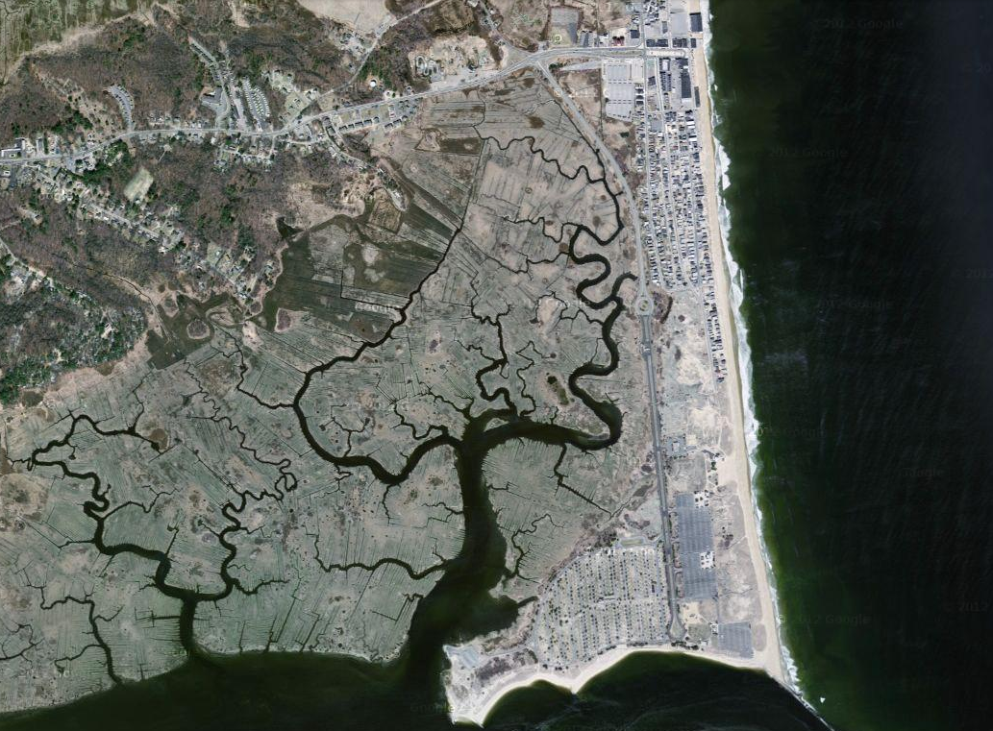
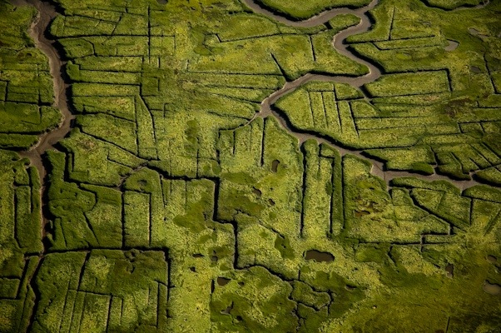

Slide 27
Mean sea level refers to the height of the sea in relation to a surface reference point. Sea level goes through periodic cycles of change throughout geologic time.
Eustatic – global (climate driven)
Isostatic - local
Notes:
Local – glaciers make land sink, glaciers move away – land rises… for ex.

Slide 28
Why does sea level change?
Two dominant reasons….
1. Thermal Expansion
2. Melting of glaciers and ice caps
Notes:
Eustatic – global sea level rise

Slide 29
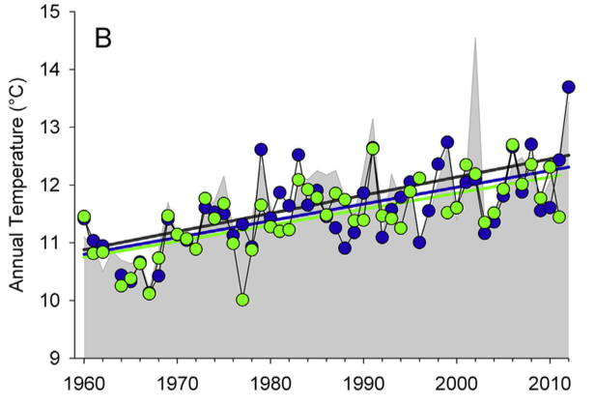
Narragansett Bay as an example:
Total surface water temperature increase – 1.5 to 1.6 ◦7
Fulweiler et al. (2015)
Notes:
1.4 C to 1.6 C total rise over the last fifty years. Winter warming has been especially high over this time period, increasing between 1.6 C to 2.0 C.
Fulweiler et al. 2015

Slide 30
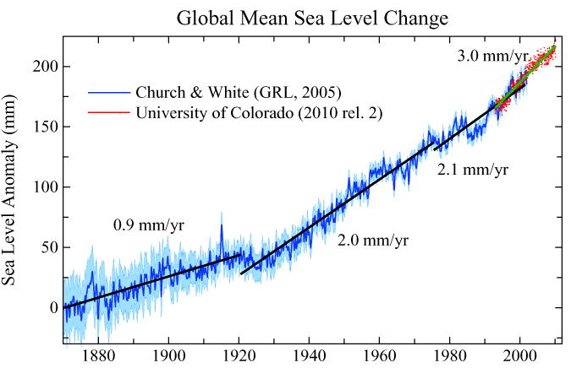
Global Sea Level Rise over the last 150 years
Notes:
1970 and 2009 was 0.98
± 0.4 mm year−1,

Slide 31
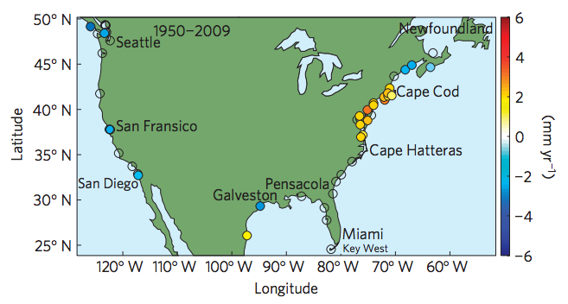
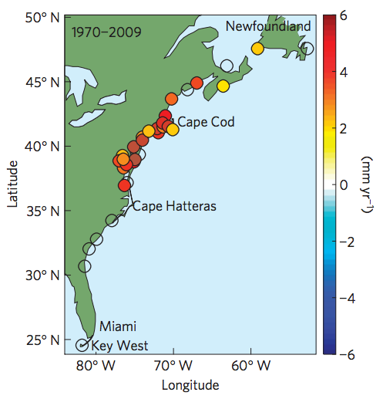
Sea Level Rise in the “Northeast Hotspot”
Northeast average: 2 and 3.7 mm per year since 1980
Global average: 0.6–1.0 mm per year since 1980
Sallenger et al. (2012) Nature Climate Change 2 (12): 884-888.
Notes:
3.8 mm yr-1

Slide 32
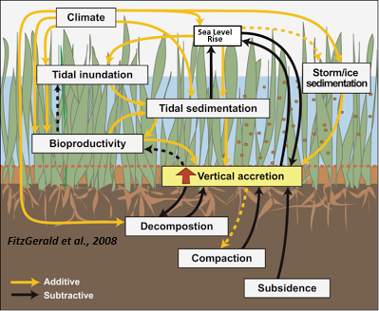
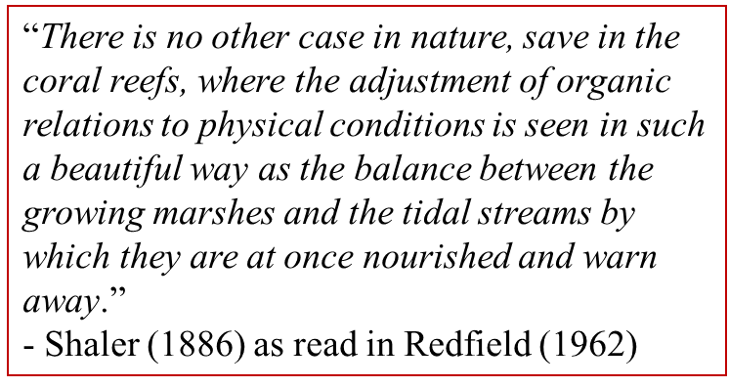

Slide 33

Accretion basics: driven by biotic and abiotic factors
Sediment Deposition
and
Primary Production
Erosion
and
Decomposition
Other Factors
Compaction, Subsidence
Which are abiotic and which are biotic?
Notes:
Primary Production and Sediment inputs contribute positively to accretion – why?

Slide 34
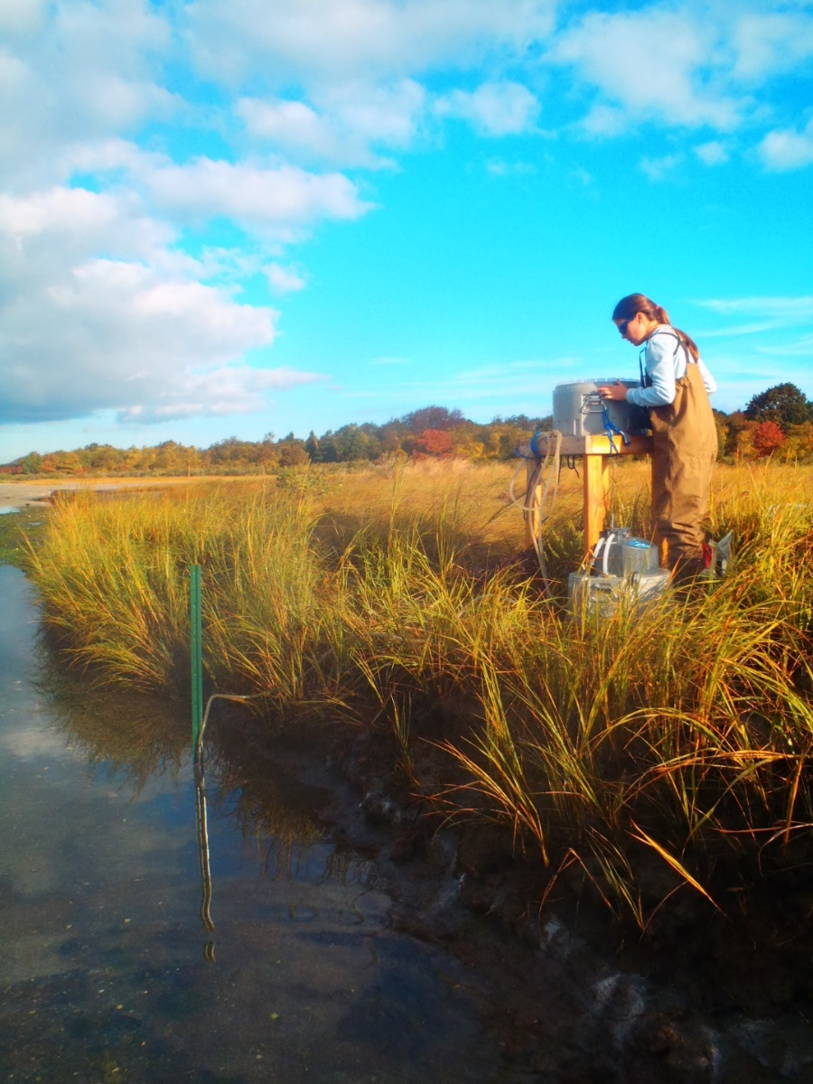
Major Controls on Primary Production in Salt Marsh
Nutrients
  Necessary for primary production
  Nitrogen limiting nutrient (mostly)
Oxygen Availability
  Influenced by tidal inundation- so changes a lot over space and over time
  More O₂ = plant happier

Slide 35
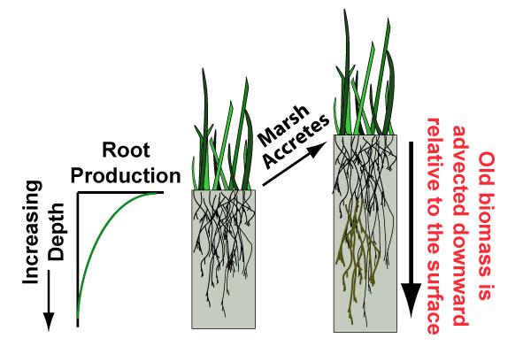
Primary Production doesn’t occur aboveground only!
Importance of Belowground Organic Matter
Majority of organic matter in marsh belowground!
Image: Simon Mudd

Slide 36
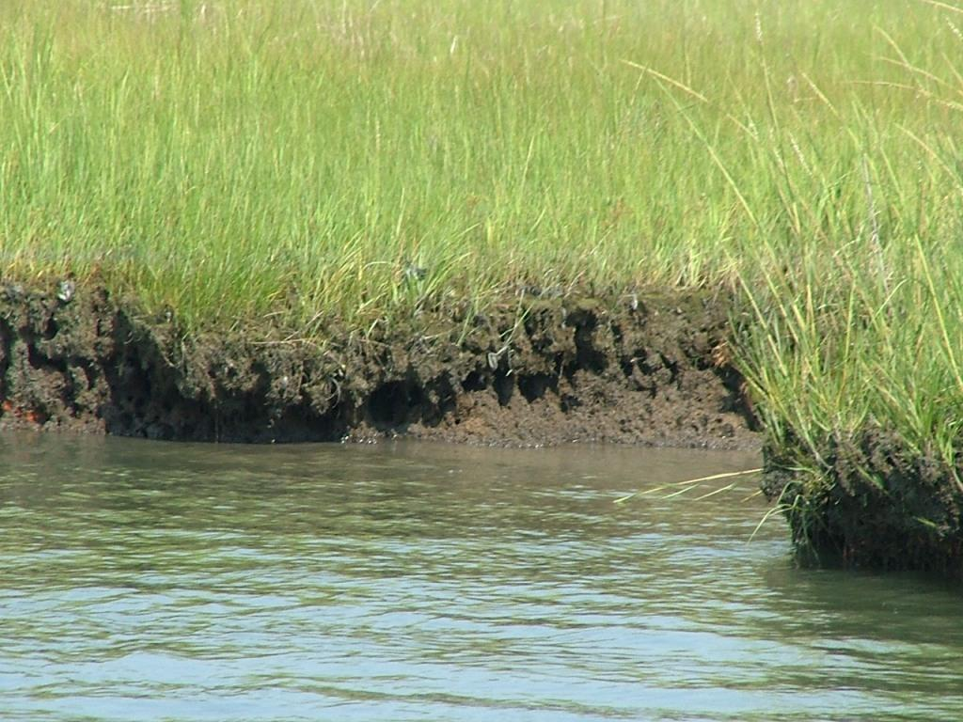
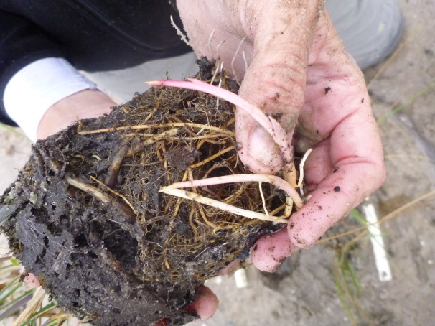
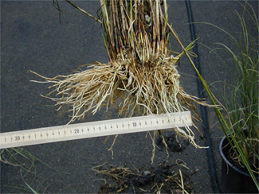

Slide 37
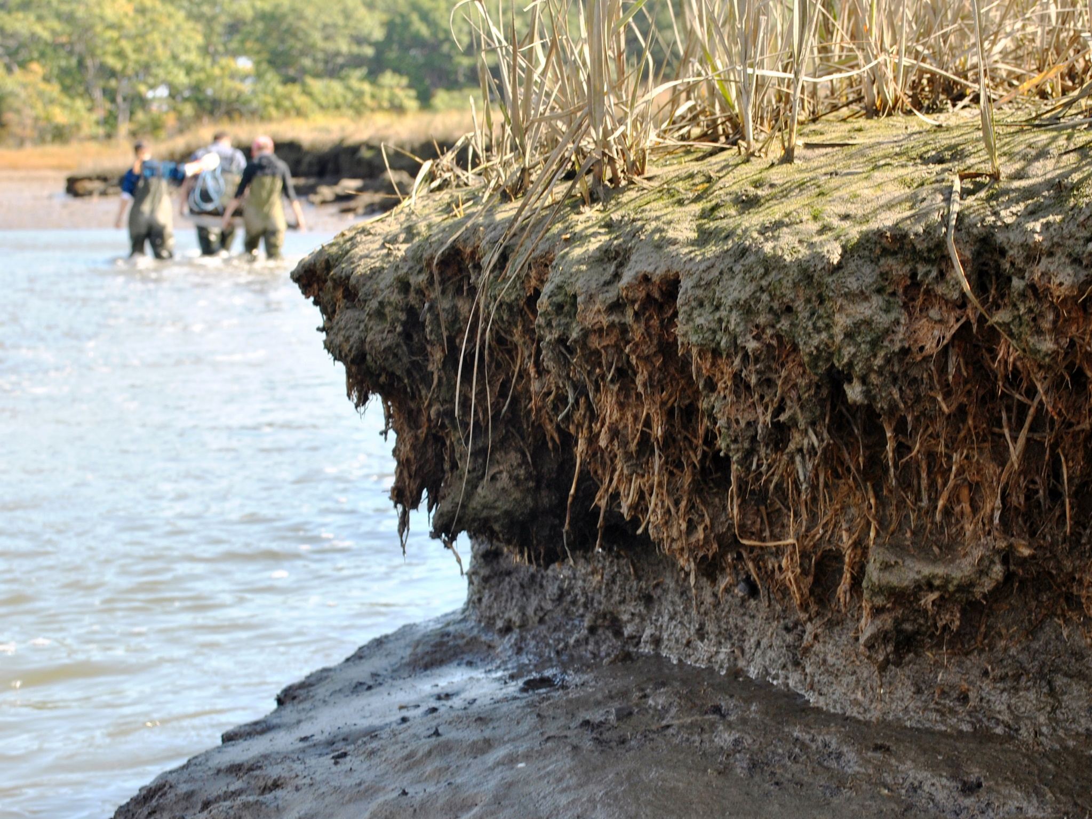

Slide 38
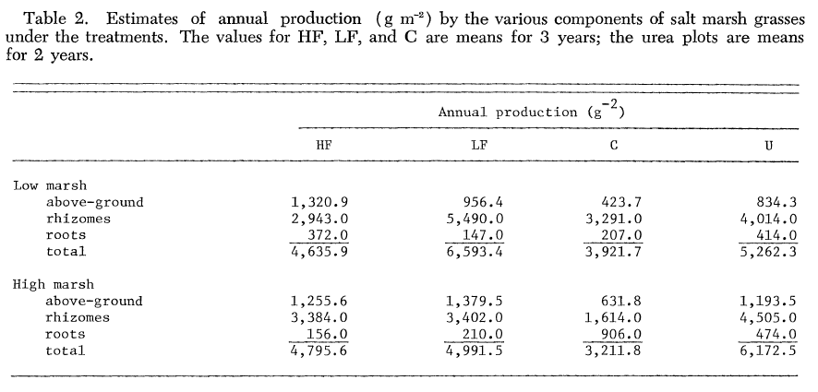
HF = High Fertilization
LF = Low Fertilization
C = control
U= urea (another fertilizer type)
Rhizomes and roots are below ground
Notice percentage of biomass aboveground vs. rhizomes!
Importance of nutrients
Majority of organic matter in marsh belowground
Valiela et al. 1974

Slide 39
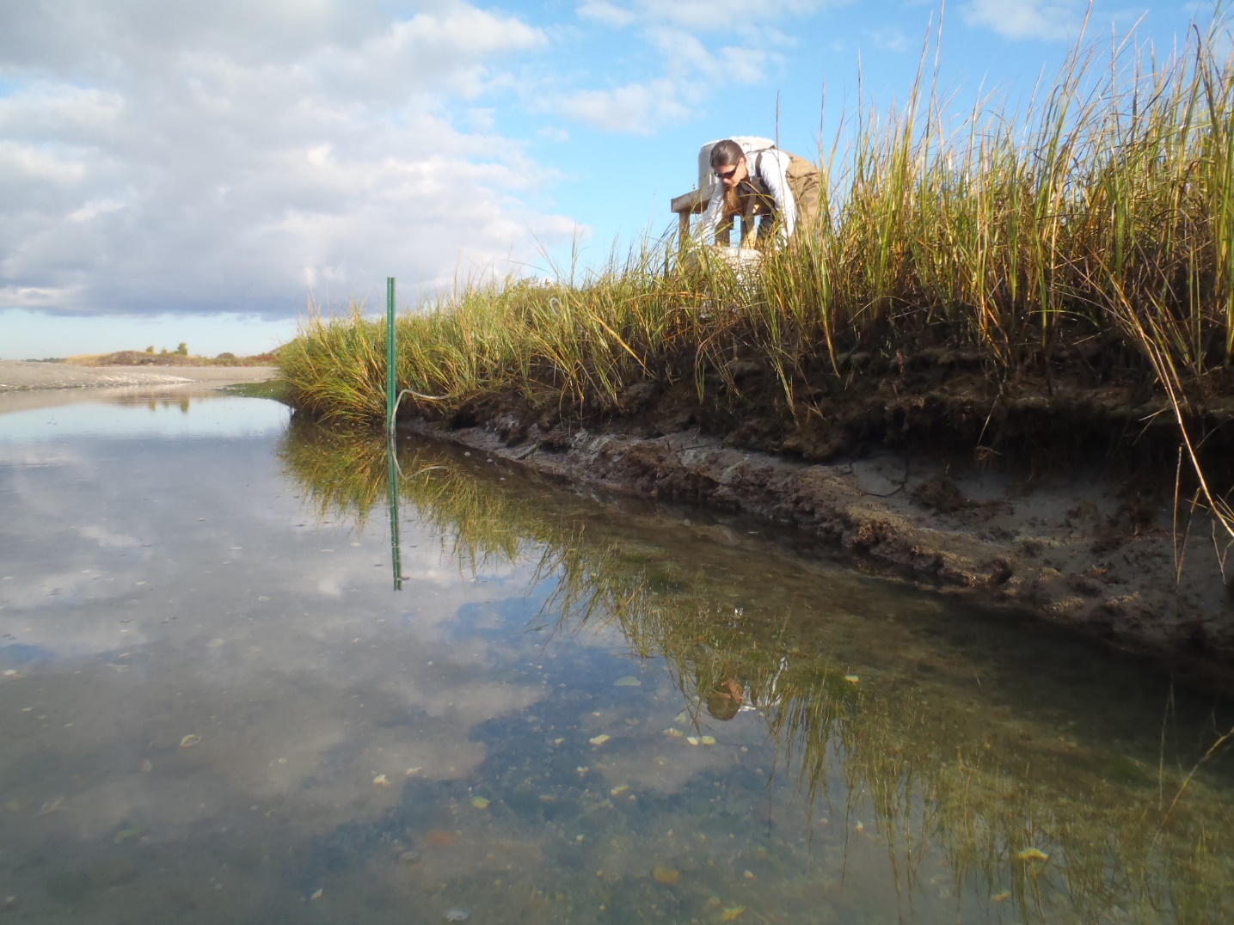
Sediment
You cannot have a marsh without sediment
Sediment brought into marsh via tides and rivers
Marsh grasses trap sediment
More sediment available allows for marsh stability at higher rates of SLR

Slide 40
Accretion basics: driven by biotic and abiotic factors
Sediment Deposition
and
Primary Production
Erosion
and
Decomposition
Other Factors
Compaction, Subsidence
Notes:
Decomposition of organic matter and erosion contribute to negatively to accretion – why?

Slide 41
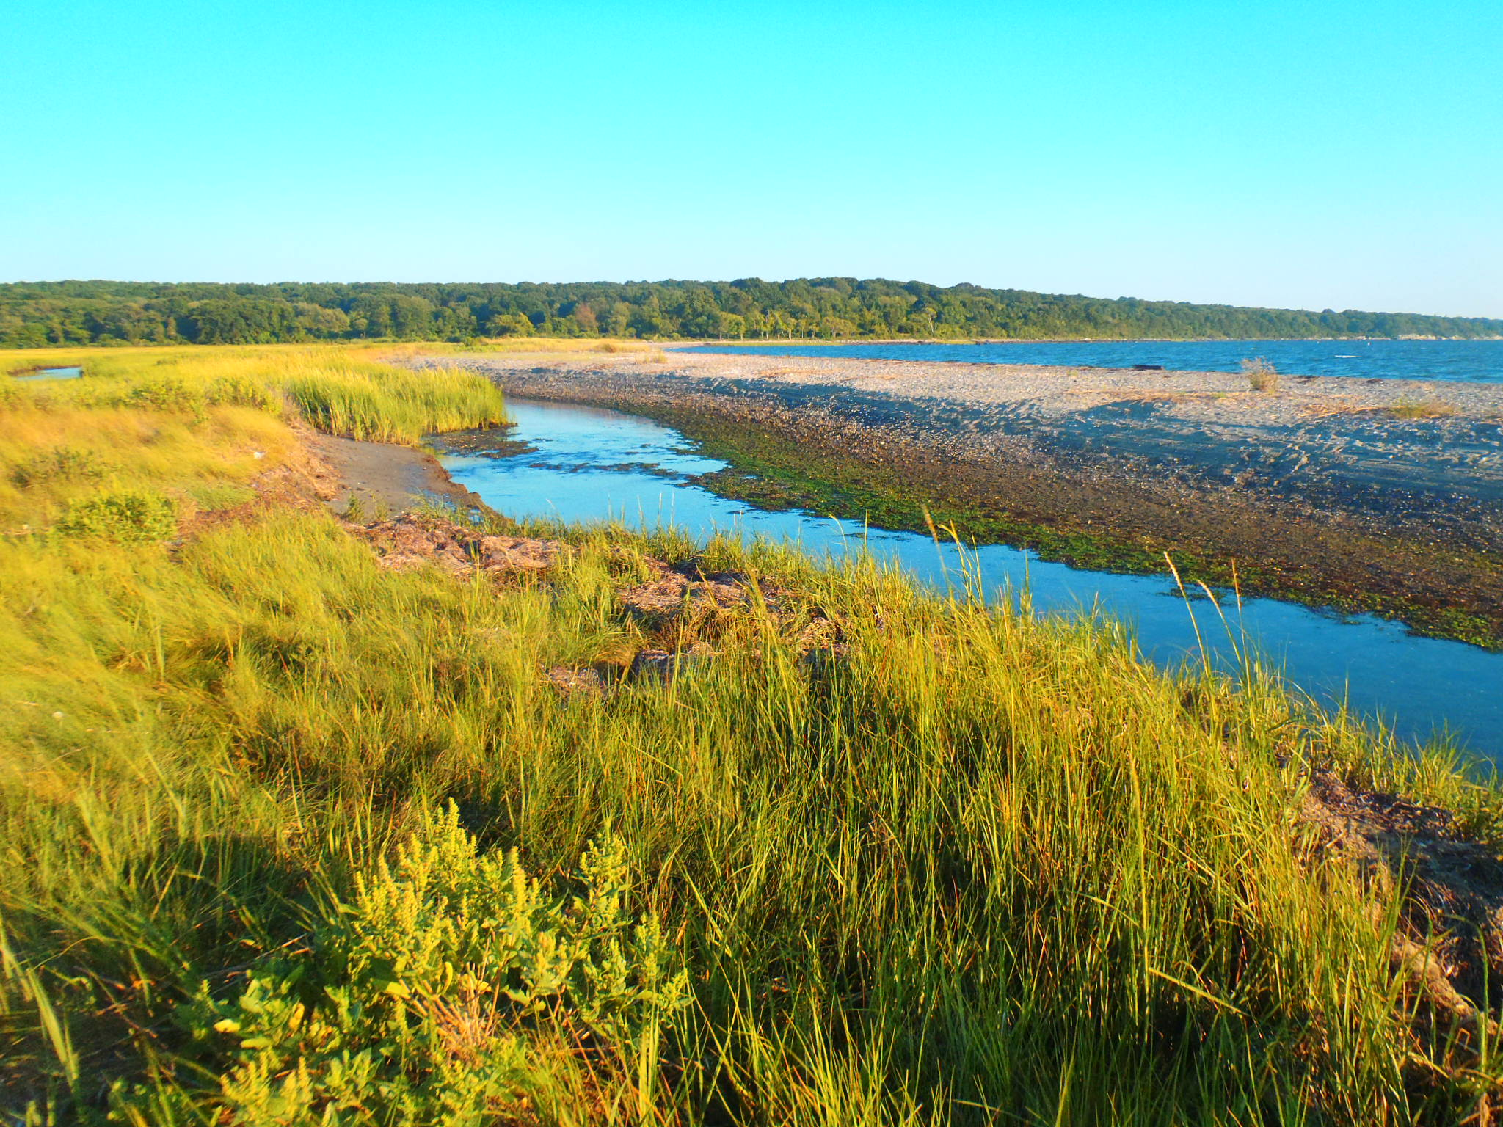
Controls on Decomposition Rates?
Oxygen availability (positive relationship, function of inundation)
Temperature (positive relationship)
Controls on Erosion Rates
Plant presence and condition
Wave action, storms, proximity to disturbances

Slide 42

Case Study 1: Narragansett Bay
Dr. Joanna Care, now Asst. Professor at Babson
Impact: Sea Level Rise

Slide 43
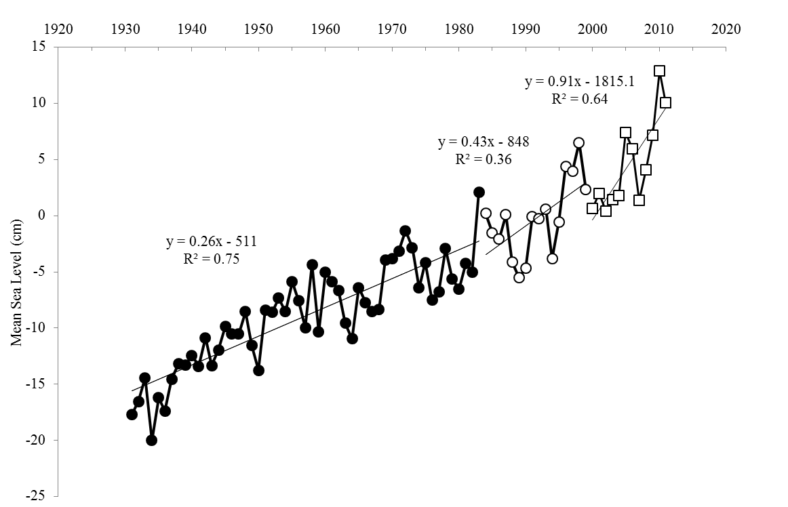
Local example - Newport, RI Sea Level Rise
Carey et al. (2015)

Slide 44
Relationship between OM and Salt Marsh Accretion
for Narragansett Bay, RI
Carey et al. (2015)

Slide 45

Case Study 2: Long Island Sound
Sarabeth Buckley, now Ph.D. student w/ Nathan Phillips
Impact: Sea Level Rise and Excess Nutrients

Slide 46
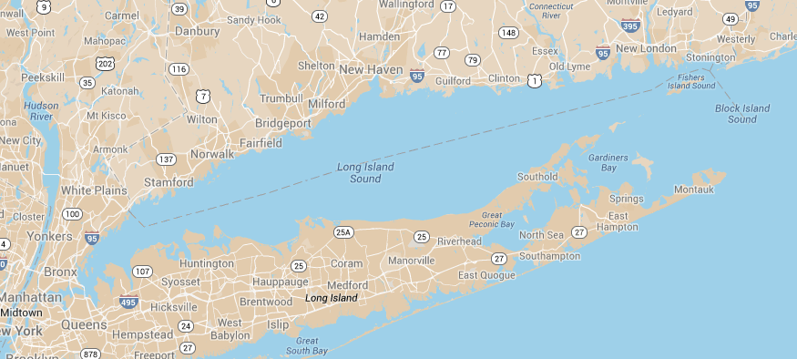
Map of Study Sites
Hunter Island Marine Sanctuary
Jarvis Creek Preserve
Barn Island Wildlife Management Area
N+P
Caumsett State Historic Park Preserve
Udalls Cove
Wading River Marsh

Slide 47
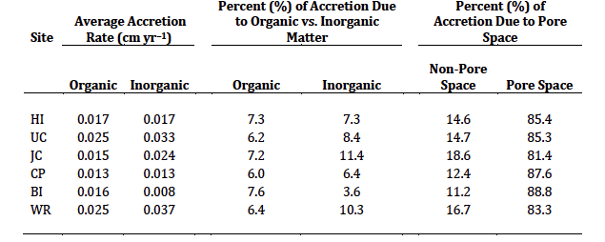
How is the Accretion Happening?
Notes:
St = total average sediment accumulation
LOI = loss on ignitions
Di = sediment density (2.6 g cm-3 for inorganic, 1.1 g cm-3 for organic)
Si = inorganic (or organic) accretion rate per year

Slide 48
LIS Litter Bag Decomposition Rates

Slide 49
Salt Marsh Organic Content vs.
Litter Bag Decomposition Rates

Slide 50
Inorganic Salt Marsh Accretion Rates vs.
Litter Bag Decomposition Rates

