Slide 1
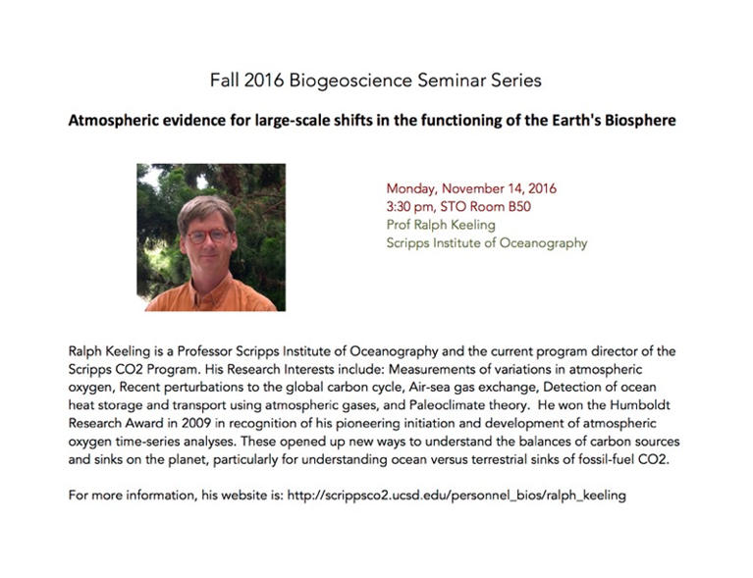

Questions about being a Marine Science Major or Minor at BU?
Please ask!
Email me: rwf@bu.edu

Slide 2
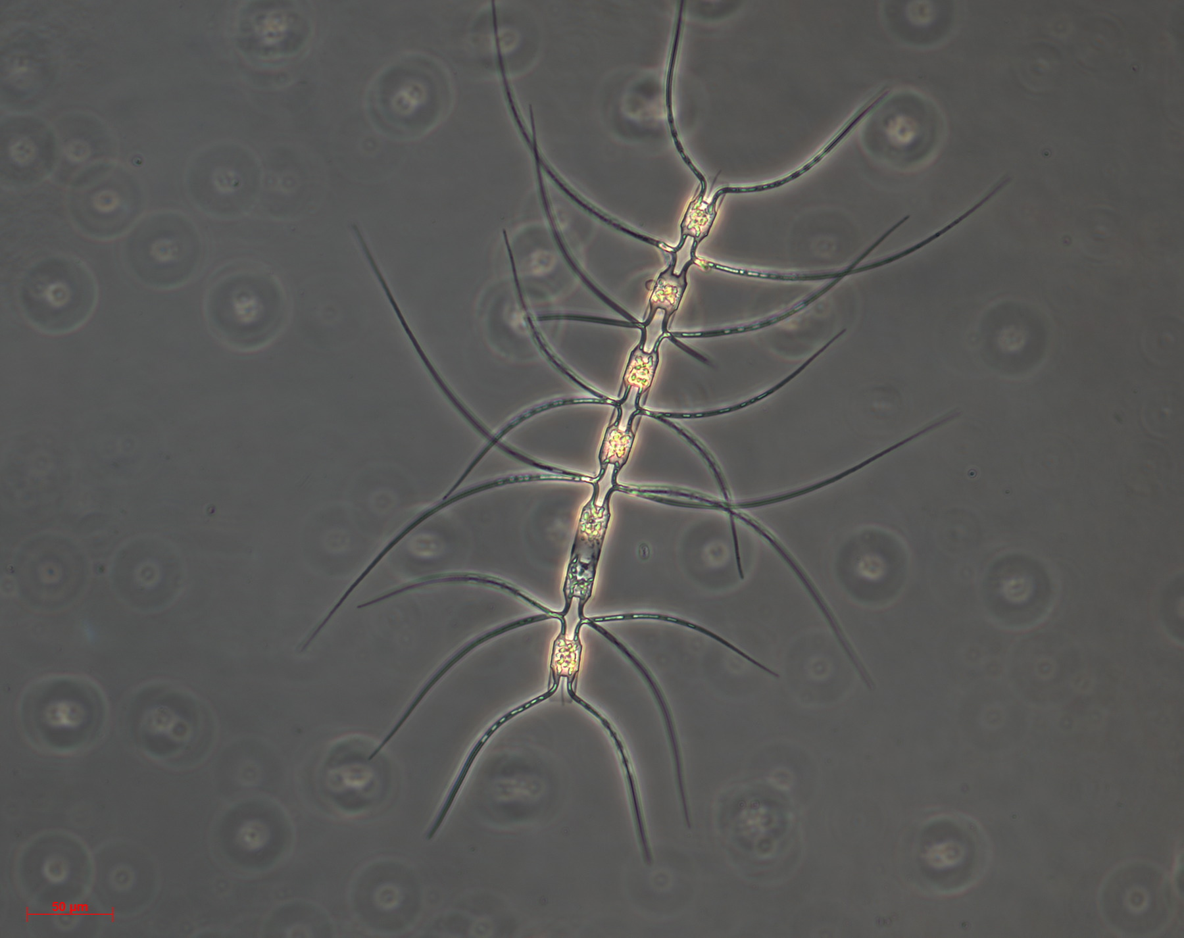
“It was the best of times, it was the worst of times, it was the age of wisdom, it was the age of foolishness, it was the epoch of belief, it was the epoch of incredulity, it was the season of Light, it was the season of Darkness, it was the spring of hope, it was the winter of despair, we had everything before us, we had nothing before us, we were all going direct to Heaven, we were all going direct the other way.”
C. Dickens
A Tale of Two Pumps…
November 14, 2016

Slide 3
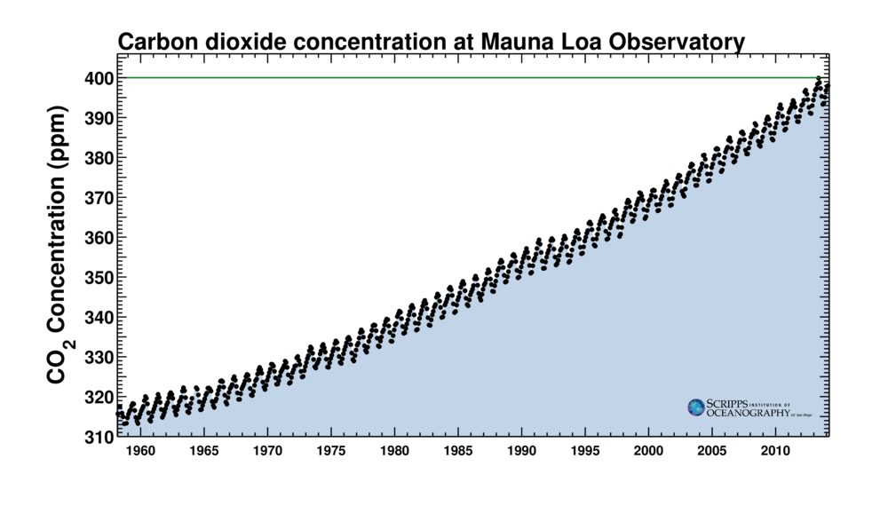

Slide 4
Primary production by phytoplankton
CO₂
Nutrients +
CO₂
phytoplankton
Surface Ocean
50 times more inorganic carbon in the global ocean than in the atmosphere.

Slide 5
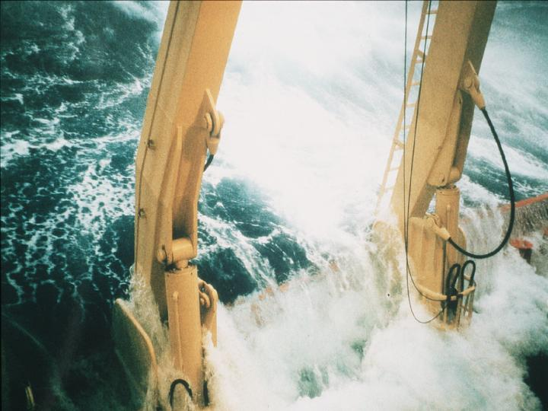
Factors that Influence the Ocean’s Carbon Cycle
The solubility pump; and
The biological pump.
Smith, W.O. VIMS

Slide 6
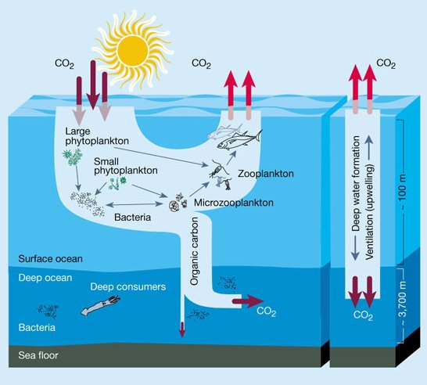
A Tale of Two Pumps

Slide 7
The “Solubility Pump”
Gas exchange allows CO₂ to enter ocean
  flux depends upon air-sea CO₂ difference
  Solubility increases in cold water (polar regions are sinks, equatorial sources)
Smith, W.O. VIMS

Slide 8
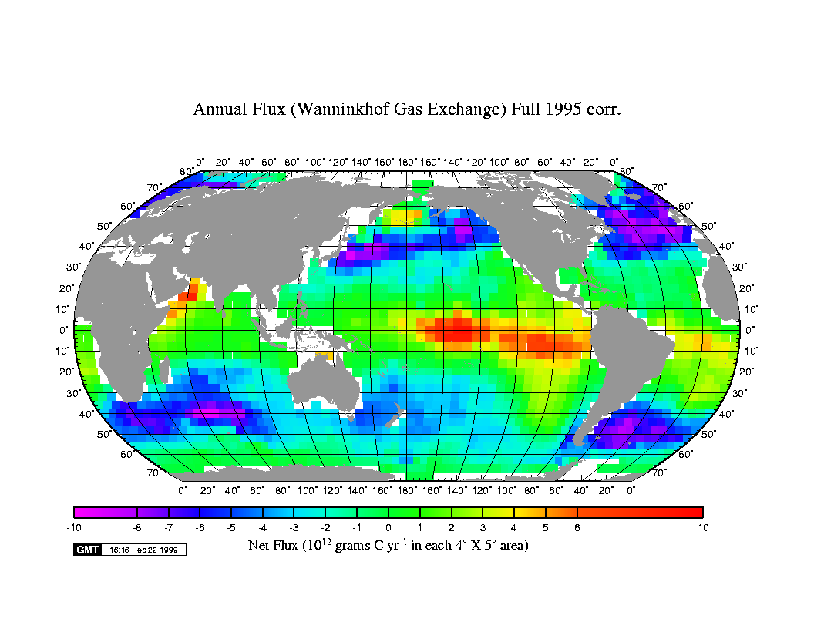
The ocean naturally acts as an overall sink for carbon dioxide, but the location of sinks and sources is not uniform
Smith, W.O. VIMS

Slide 9
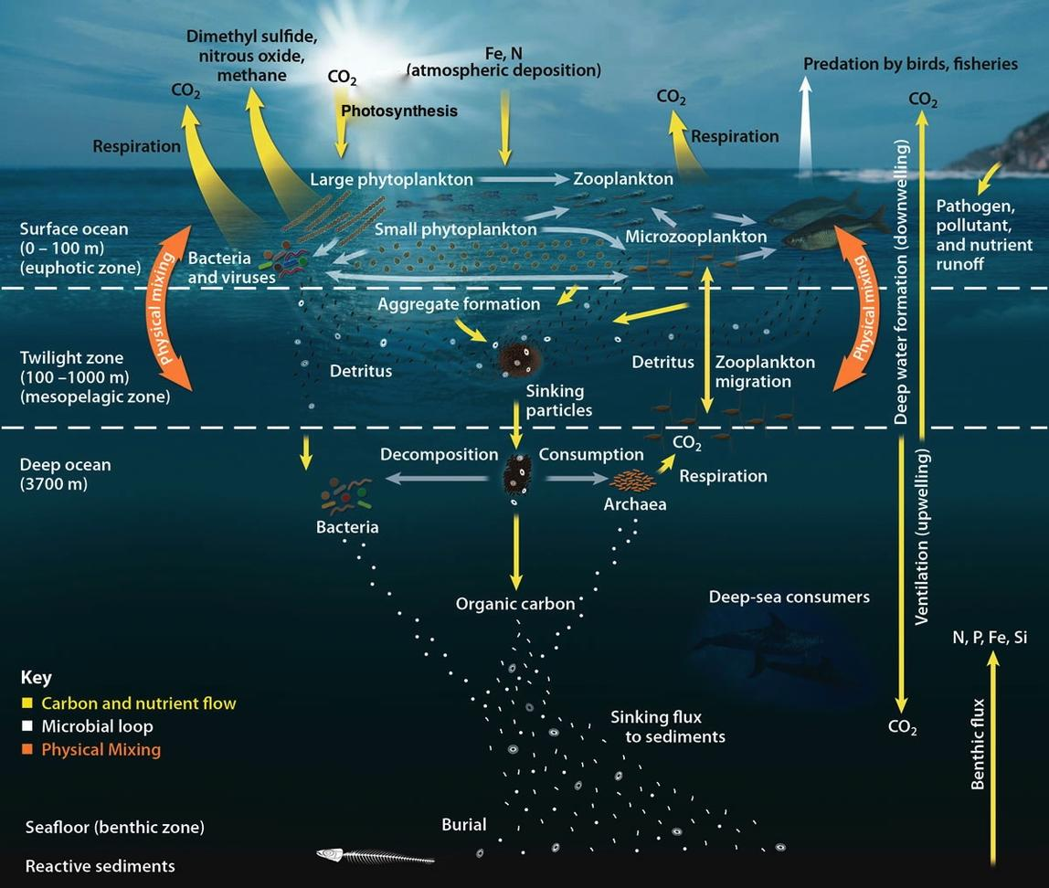
The “Biological Pump”
Combined biological processes which transfer organic matter and associated elements to depth
- pathway for rapid C sequestration
Quickly remove C from surface ocean & atm.
- turn off bio pump and 200 ppmv increase atm. CO₂

Slide 10
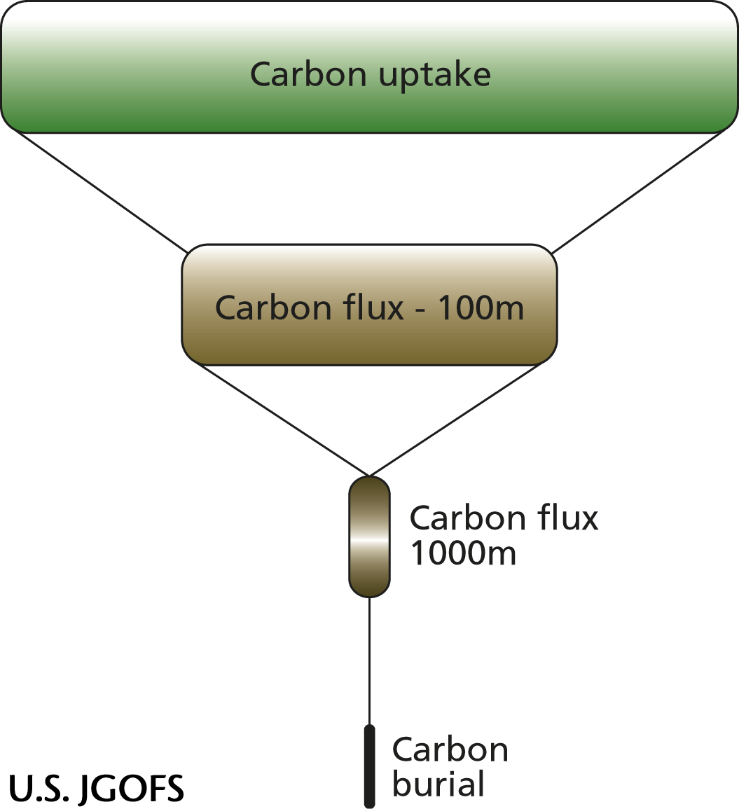
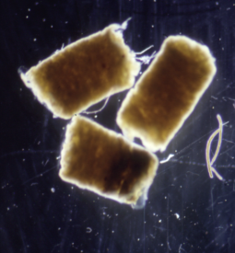
What controls carbon export?
(i.e. efficiency of biological pump)
Biological pump and the ocean C sink-
an inverted pyramid
Primary Production
Export flux on sinking particles
<5 to >15% (decades)
~1% (centuries)
~0.1% (millennium)
Smith, W.O. VIMS

Slide 11
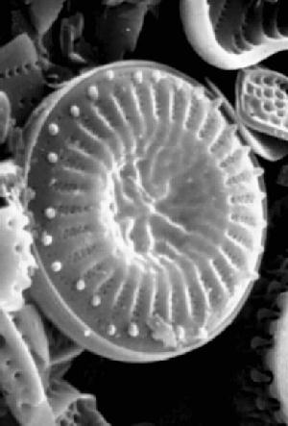
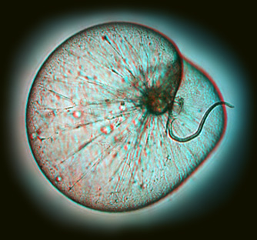
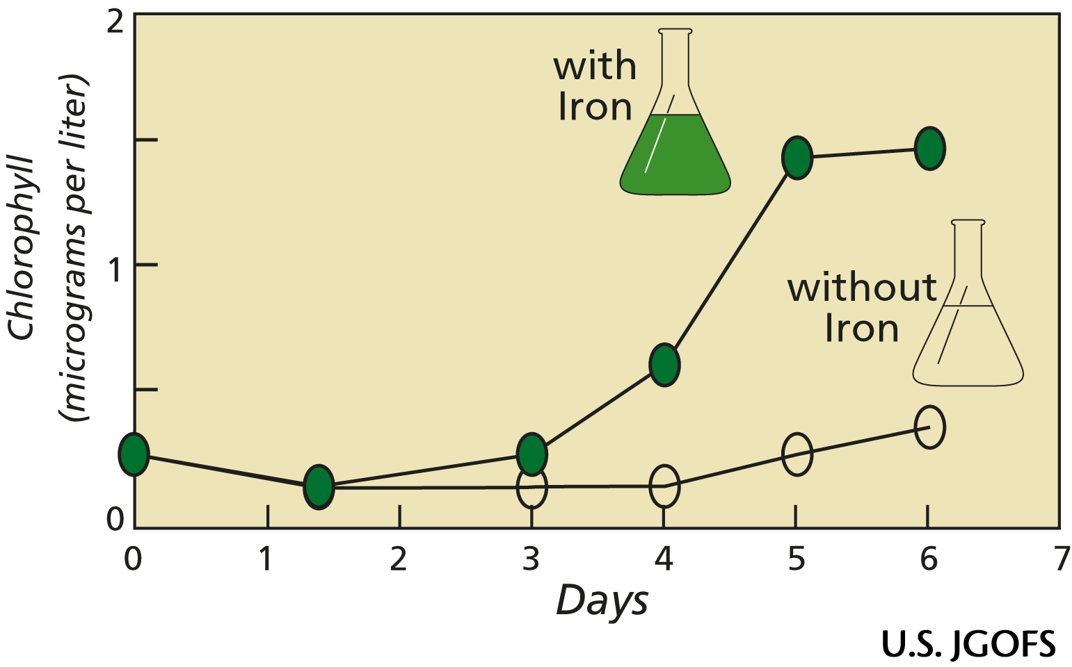
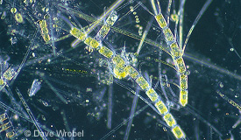
What controls phytoplankton primary productivity?
Temperature
Light (via solar angle and/or mixing)
Major nutrients (N, P, Silica)
Grazing
Micro-nutrients (Iron)
Smith, W.O. VIMS

Slide 12
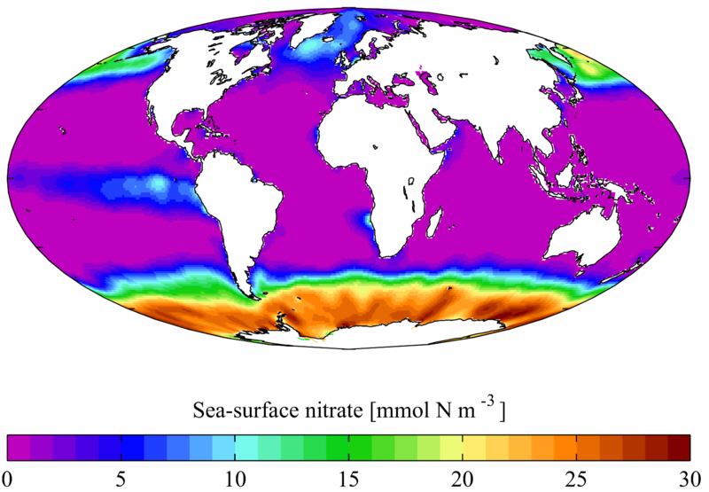
Annual mean sea surface nitrate from the World Ocean Atlas 2001
HNLC areas or High Nutrient Low Chlorophyll

Slide 13
What are minor nutrients?
Iron (Fe), Zinc (Zn), other metals.

Slide 14
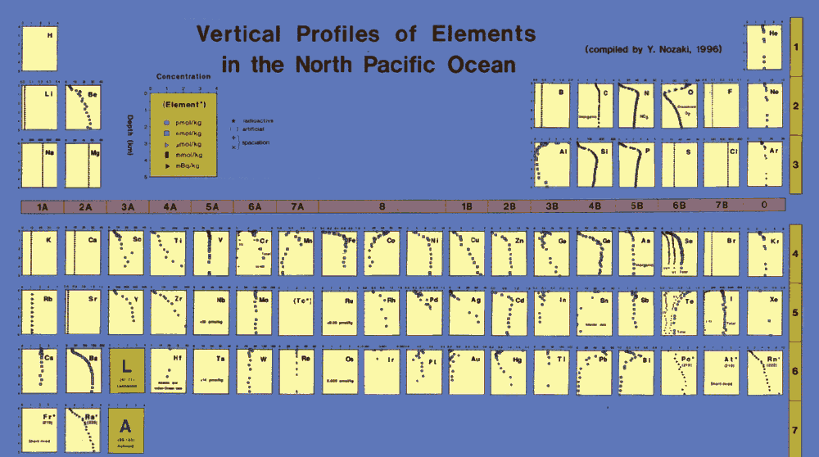
Iron (Fe), Zinc (Zn), other metals.
Na
Fe
Zn
Cl
http://www.agu.org/eos_elec/97025e-table.html
Fe and Zn profiles are similar to those of the major nutrients (depleted in the surface, abundant in the deep),
unlike Na & Cl.

Slide 15
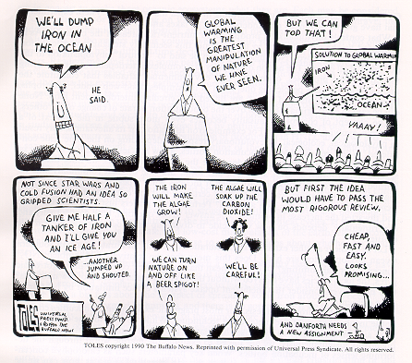

Since algal growth is limited by the resource that is in smallest supply relative to its needs, it was hypothesized by John Martin that iron was limiting phytoplankton growth in open-ocean environments
John Martin, 1935 - 1993
“Give me a half a tanker of iron, and I will give you an ice age.”
Smith, W.O. VIMS

Slide 16
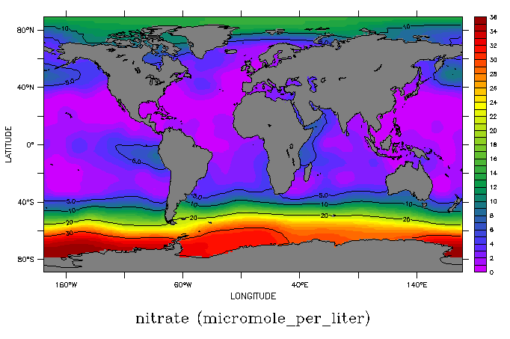
areas that show the lowest algal biomass and highest surface nutrients also have the lowest input of iron both from below (via upwelling and mixing) and from atmospheric dust
Nitrate Concentrations
Dust input (modeled)
Smith, W.O. VIMS

Slide 17
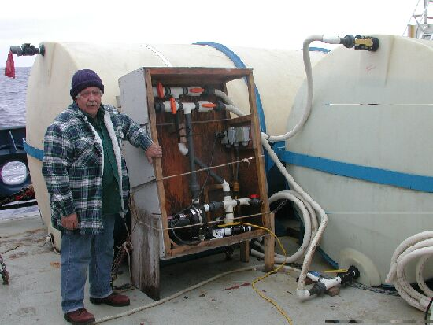
The Ultimate Test
Enrich a small area of the the ocean by adding iron along with an inert and sensitive tracer
Follow what happens through time by ship-board measurements and satellite observations
Smith, W.O. VIMS

Slide 18
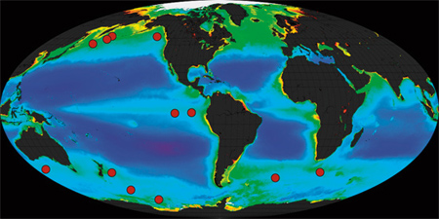
Experiments have been done around the Ocean:
http://www.whoi.edu/ocb-fert/page.do?pid=40716&tid=441&cid=104610&ct=61&article=70329

Slide 19
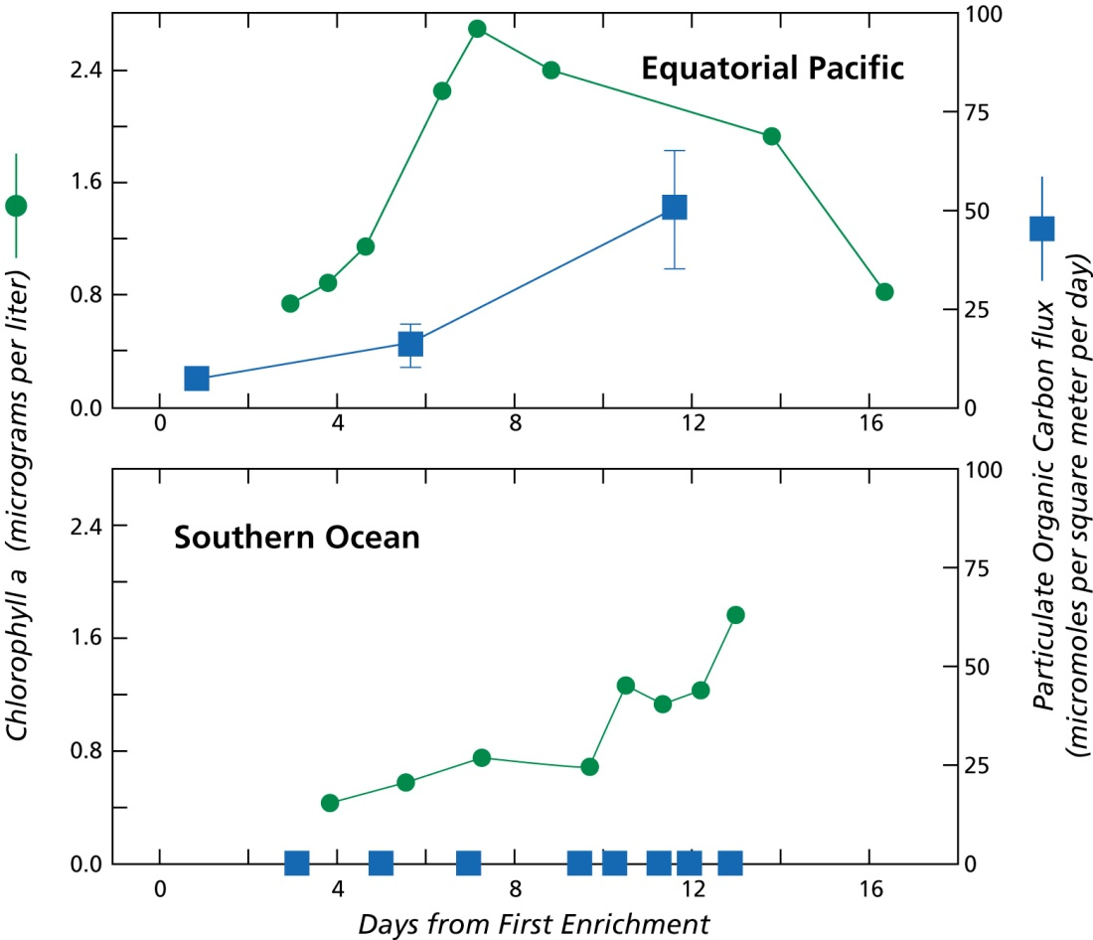
Phytoplankton grew rapidly in response to iron enrichment in all environments; diatoms grew most rapidly.
However, little or no increase in carbon export was observed.

Slide 20
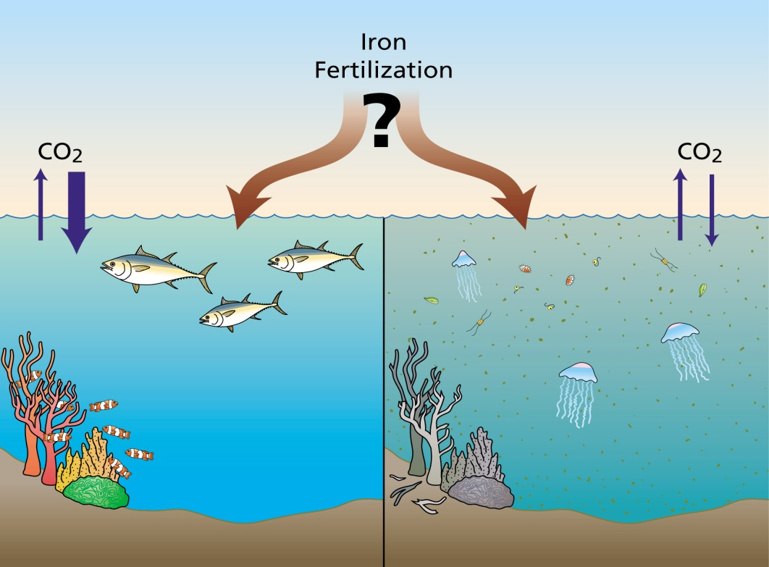
IronEx-1: no phytoplankton biomass increase, rapid increase in photosynthetic capacity
IronEx-2: increase in biomass, productivity
EisenEx: small increase, storm effects
SOIREE: clear increase, long-lived effects, unusual iron chemistry
SEEDS: massive bloom
SOFeX: small bloom
Smith, W.O. VIMS

Slide 21
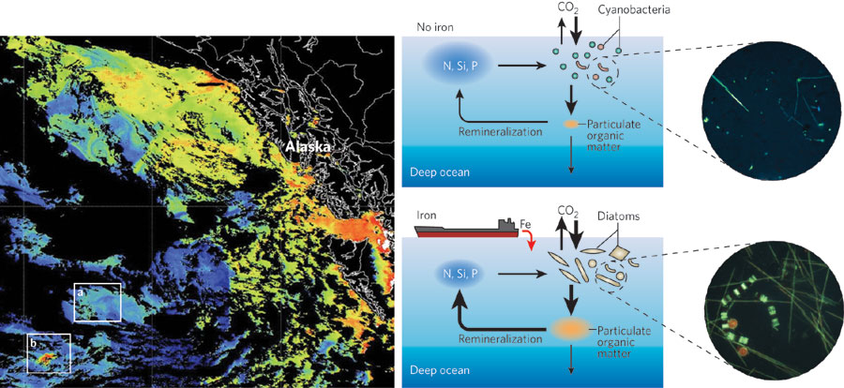

Slide 22
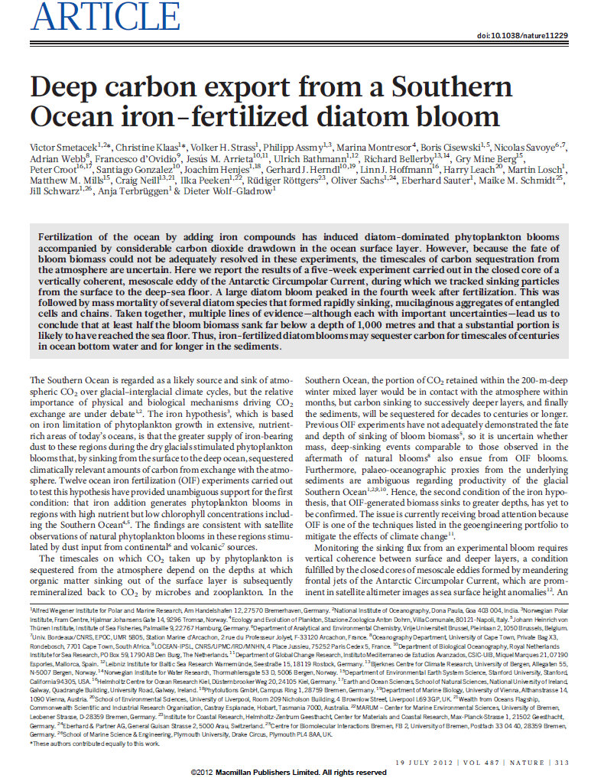

Slide 23
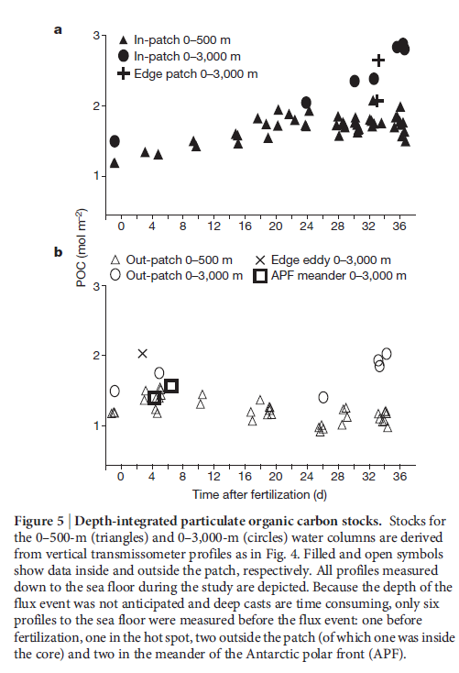
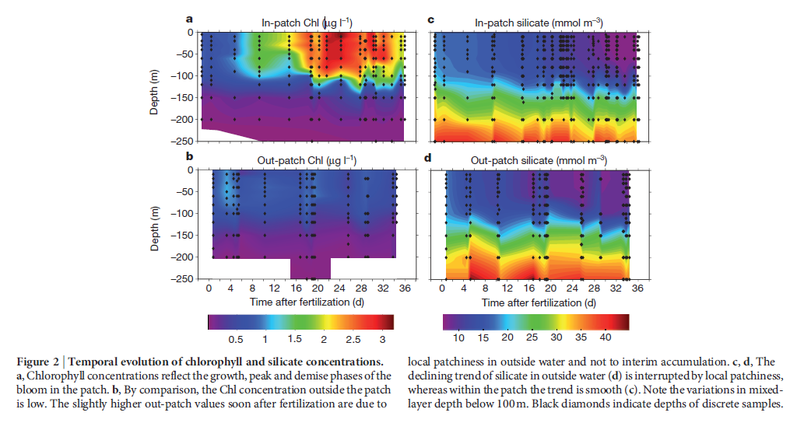

Slide 24
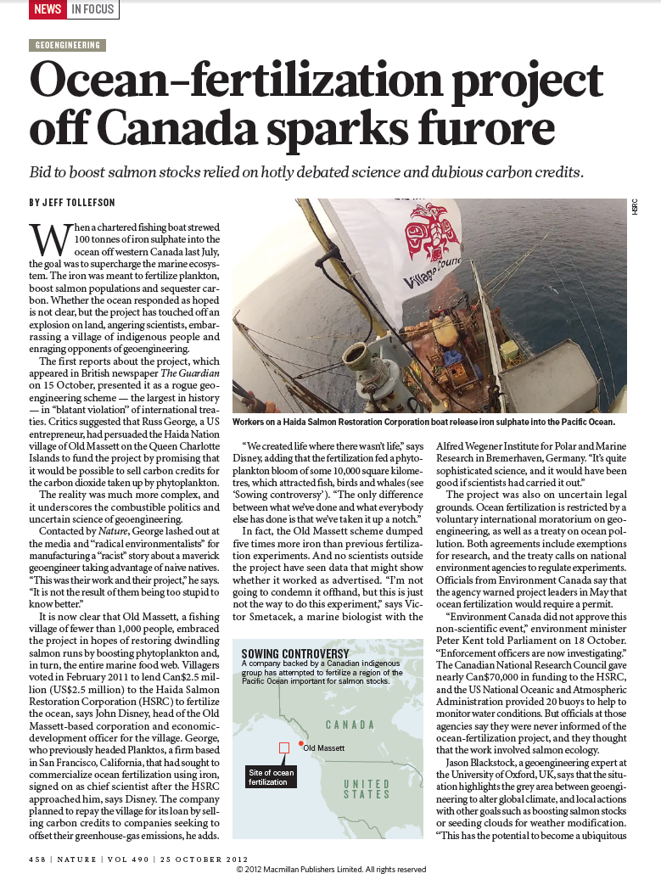
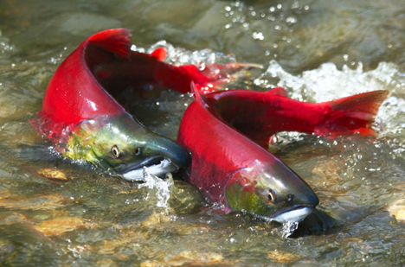

Slide 25
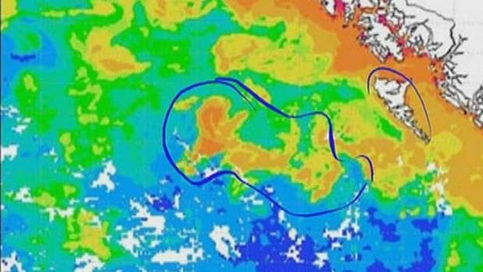
http://www.cbc.ca/news/canada/british-columbia/iron-fertilization-project-stirs-west-coast-controversy-1.1172422

Slide 26
A Tale of Two Pumps

Slide 27
Name one minor nutrients we talked about….

