Slide 1
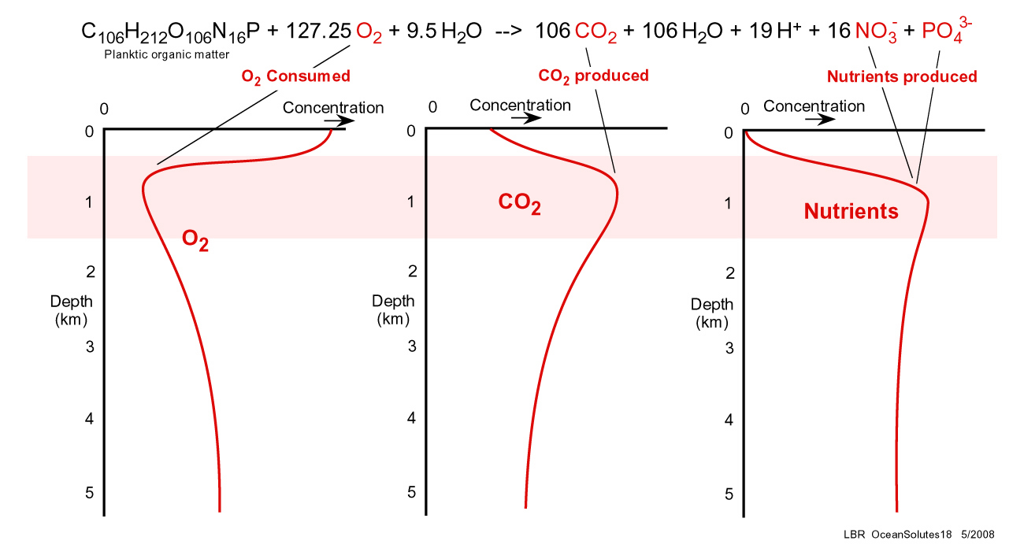
Aerobic Decomposition
Notes:
http://www.gly.uga.edu/railsback/Fundamentals/OceanSolutes18IV.jpg

Slide 2
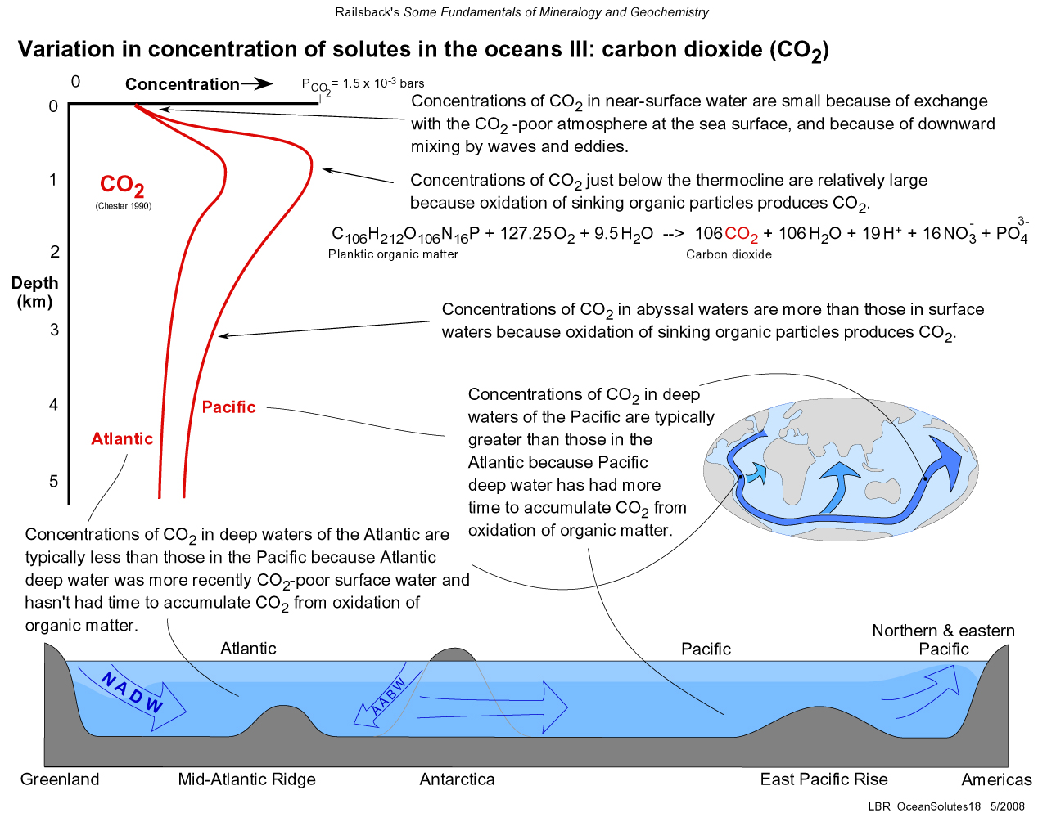
Variations in CO₂ by Depth
Notes:
http://www.gly.uga.edu/railsback/Fundamentals/OceanSolutes18III.jpg

Slide 3
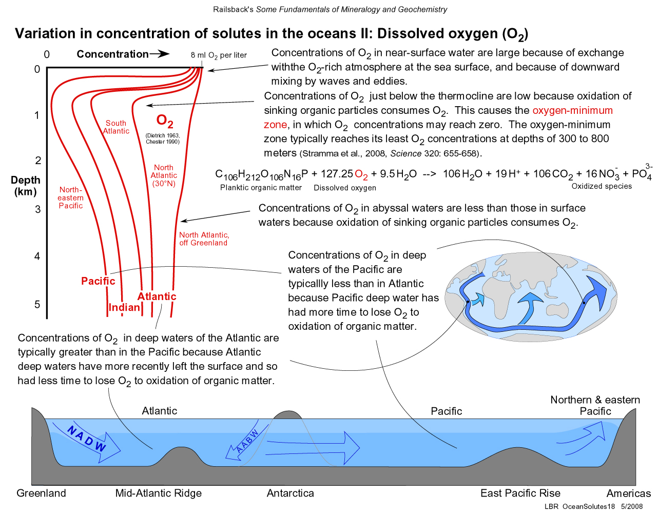
Variations in O₂ by Depth
Notes:
http://www.gly.uga.edu/railsback/Fundamentals/OceanSolutes18II.jpg

Slide 4
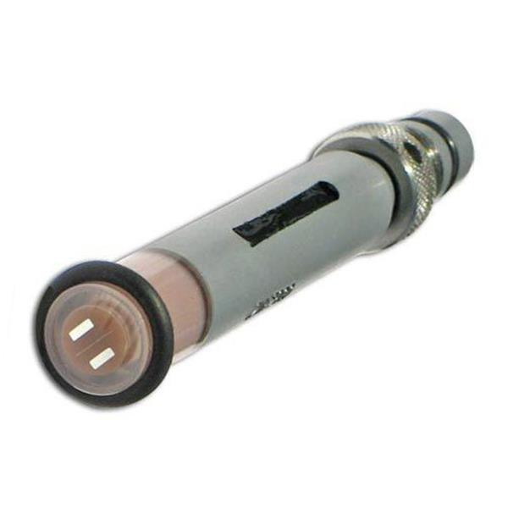
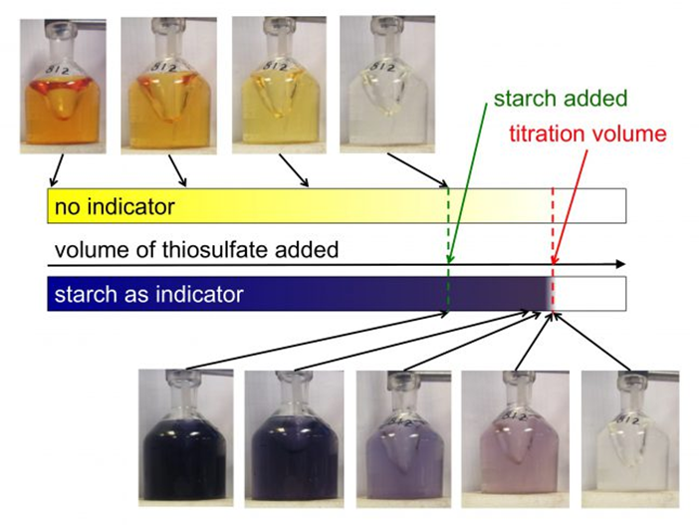
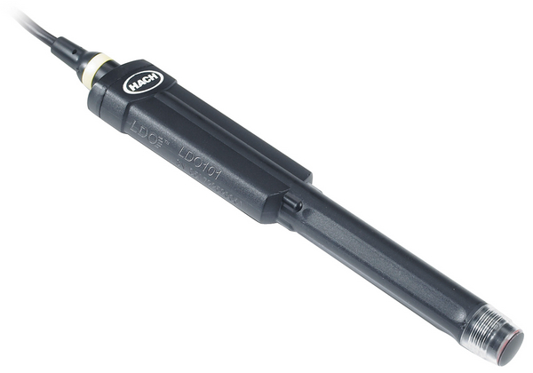
How do we measure dissolved oxygen?
Electrochemical
Chemical Method
Probe methods
Clark-type sensor w/a membrane
Optical
Winkler Titration
Luminescent detection

Slide 5
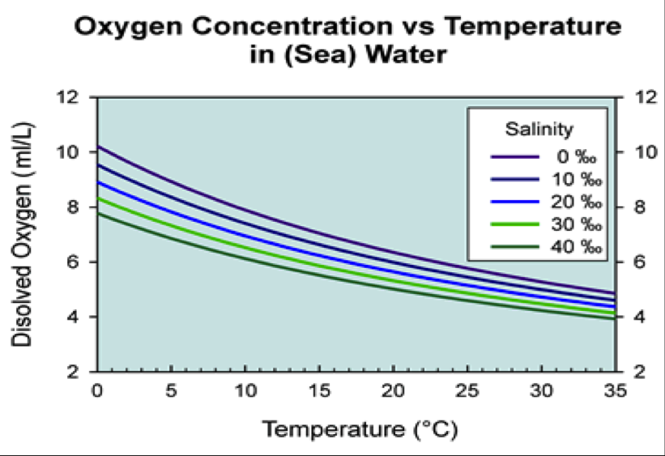
AOU – Apparent Oxygen Utilization
AOU = O_{2sat} – O_{2observed}
Higher AOU → greater amount of O₂ removed since water mass was at the surface
Lower AOU → lower amount of O₂ removed since water mass was at surface
“Know” what O₂ concentrations should be at given temperature and salinity (i.e., at equilibrium)

Slide 6
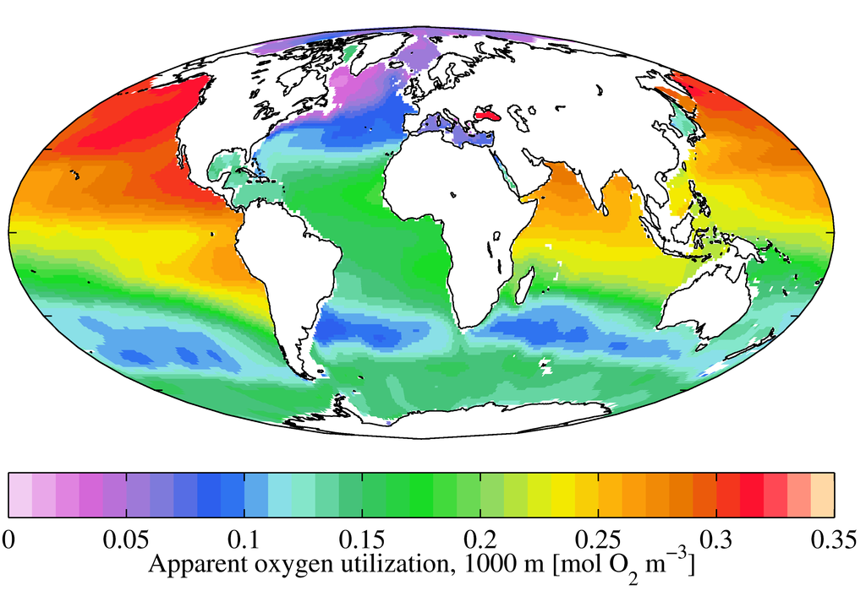
AOU – Apparent Oxygen Utilization

Slide 7
AOU can help us estimate amount of OM Respired
Respiration of 1 mole of POM:
Oxidation of carbon: 106 CH₂O + 106 O₂ → 106 CO₂ + 106 H₂O
Oxidation of nitrogen: 16 NH₃ + 32 O₂ → 16 NO₃⁻ + 16 H₂O
P is not oxidized during respiration of organic matter
What’s the ratio then of organic carbon consumed to oxygen respired?
106 C: 138O₂

Slide 8
Example:
AOU from North Pacific @ 4000 m = 190 μmol O₂ kg⁻¹ SW
190 * 106:138 = 146 μmol of C kg⁻¹ SW → 146 micromoles of C has been remineralized
How much N and P?
190 * 16:138 = 22 μmol of N kg⁻¹ SW → 22 micromoles of N has been remineralized
190 * 1:138 = 1.4 μmol of P kg⁻¹ SW → 1.4 micromoles of P has been remineralized
Notes:
To convert from L to Kg of SW – multiply by 44.6

Slide 9
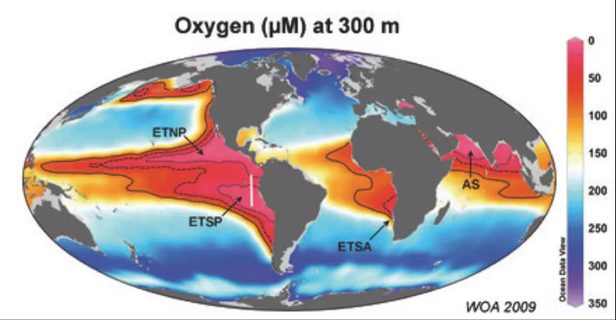
What happens when the rate of oxygen use exceeds the rate of supply?
These areas are characterized by having high water column production and slow deep water formation
Notes:
Oxygen levels at 300m, with extremely low oxygen oceanic ‘dead zones’ marked in red. World Ocean Atlas/Max Planck Institute for Marine Microbiology, Author provided

Slide 10
Oxygen decline in the open ocean and coastal waters over last fifty years
From Breitburg et al. 2018

Slide 11
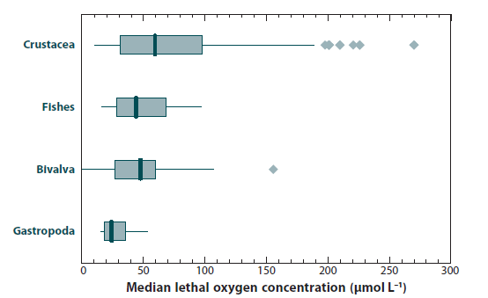
Impact of Low Oxygen on marine organisms
Working definition of hypoxia (DO < 62.5 μM L⁻¹)
From Keeling et al. 2010

Slide 12
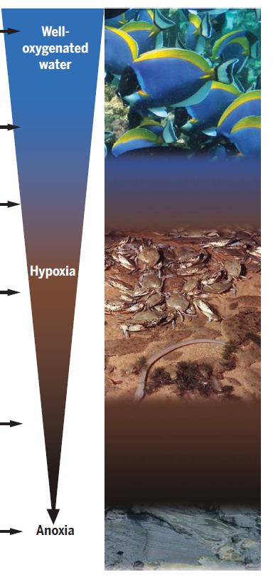
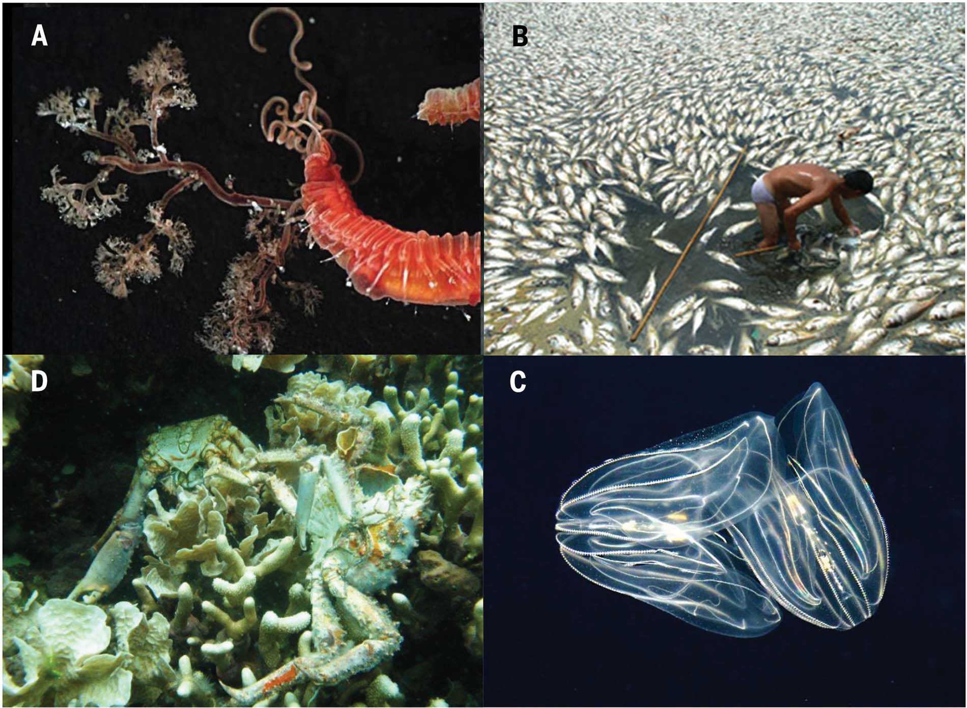
From Breitburg et al. 2018
Notes:
(A) Animals using low-oxygen habitats exhibit
a range of physiological, morphological, and behavioral adaptations. For example, teribellid
worms (Neoamphitrite sp., Annelida) with large branchaea and high hemoglobin levels can
survive in the extremely low oxygen levels found at 400 m depth in the Costa Rica Canyon.
(B) Fish kills in aquaculture pens in Bolinao, Philippines, had major economic and health
consequences for the local population. (C) The ctenophore Mnemiopsis leidyi is more
tolerant of low oxygen than trophically equivalent fishes in its native habitat in the Chesapeake
Bay and can use hypoxic areas from which fish are excluded. (D) A low-oxygen event
caused extensive mortality of corals and associated organisms in Bocas del Toro, Panama.
These events may be a more important source of mortality in coral reefs than previously
assumed.

Slide 13
Quick aside…
Why don’t we worry about hypoxia on land?
Air contains about 40 times more oxygen per unit volume than
water does during the summer.
Water is ~ 800 times denser than air and much harder to mix.

Slide 14
Quick aside…
When is hypoxia worse? Winter or summer?
O₂ saturation values for temperate estuary:
Summer
22°C
Winter
2°C
Salinity 15 p.s.u.
7.9 12.3
Salinity 30 p.s.u.
7.2 11.0
O₂ values from Pilson (1998)

