Slide 1
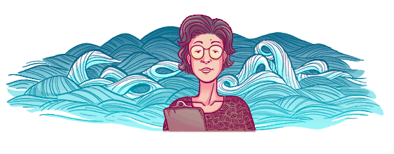
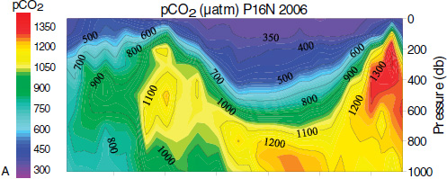
"“There are many women who have the ability to become great scientists," she said. "I would like to see the day when women can contribute to science & technology on an equal footing with men.” - Katsuko Saruhashi
Notes:
Google honors her today – 3/22/2018 – what would have been her 98th birthday
She was a Japanese geochemist – who made some of the first measurements of CO2 in seawater.
And she showed that radioactive fallout (from nuclear bomb testing in the Pacific) went into the atm and ocean – and while it took time – was distributed throughout the ocean…. Thus – the impact of these tests were global.
She also studied acid rain, was the first woman PhD in Chemistry from the University of Tokyo (1957), and
Established the Saruhashi Prize for Japanese female scientists who serve as a role model for younger women scientists.
Data figure from (Fabry et al., 2008b)
Drawing from google

Slide 2
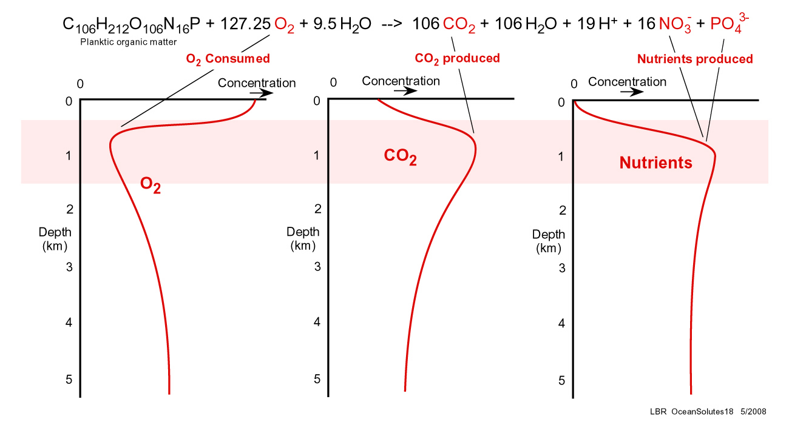
Aerobic Decomposition
Notes:
http://www.gly.uga.edu/railsback/Fundamentals/OceanSolutes18IV.jpg

Slide 3
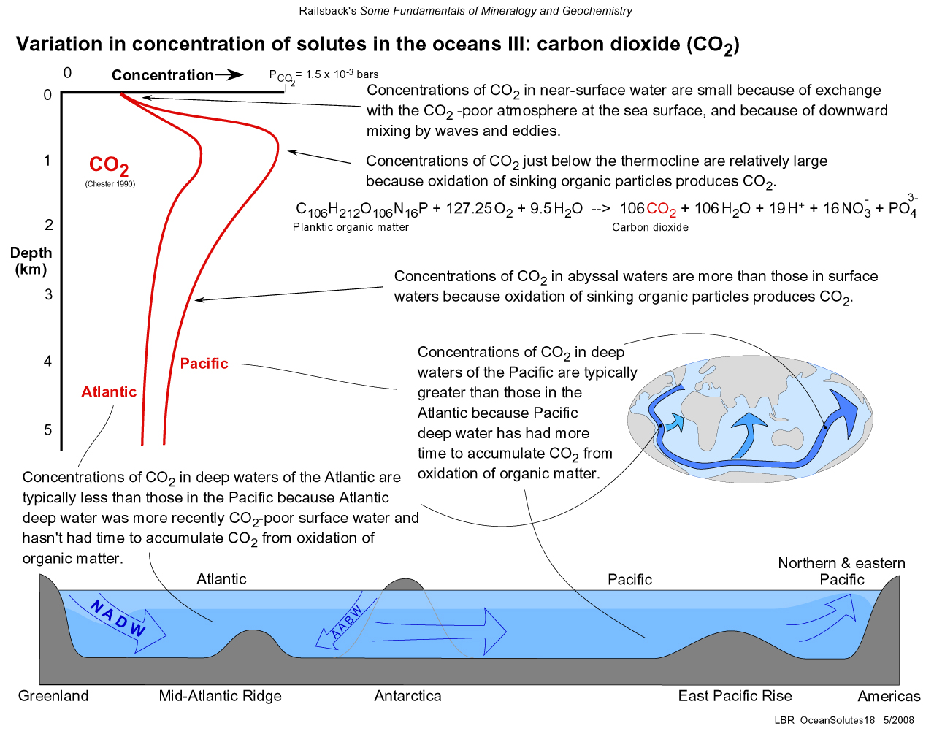
Variations in CO₂ by Depth
Notes:
http://www.gly.uga.edu/railsback/Fundamentals/OceanSolutes18III.jpg

Slide 4
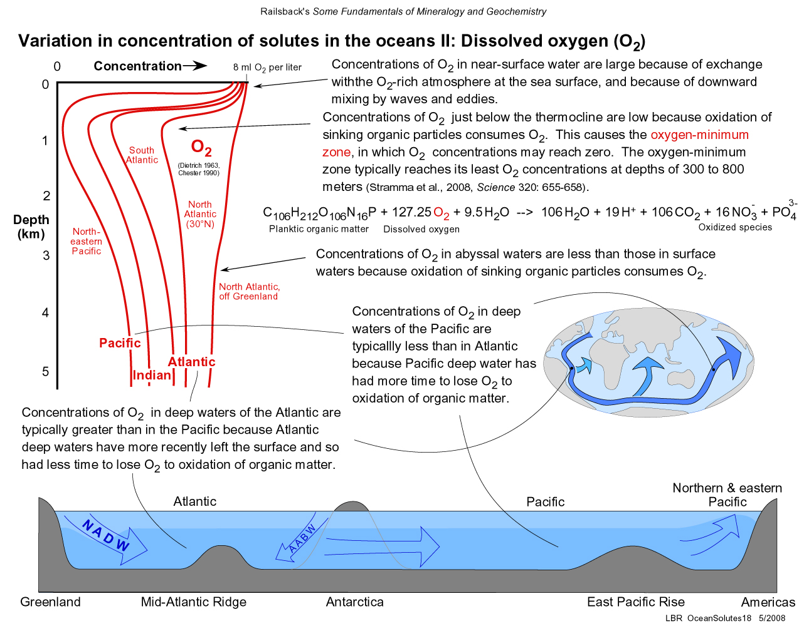
Variations in O₂ by Depth
Notes:
http://www.gly.uga.edu/railsback/Fundamentals/OceanSolutes18II.jpg

Slide 5
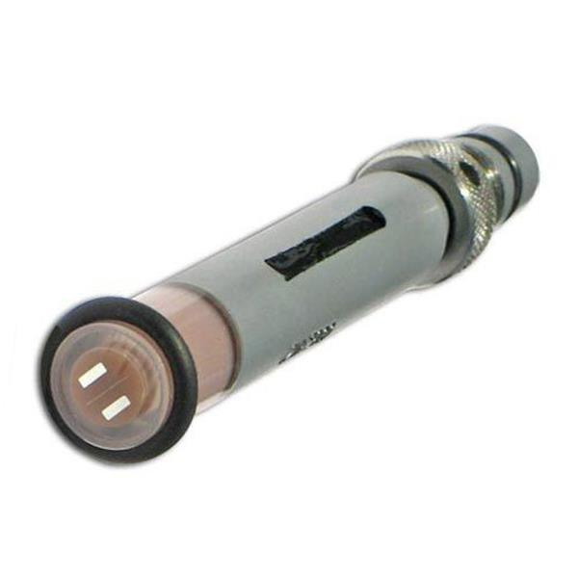
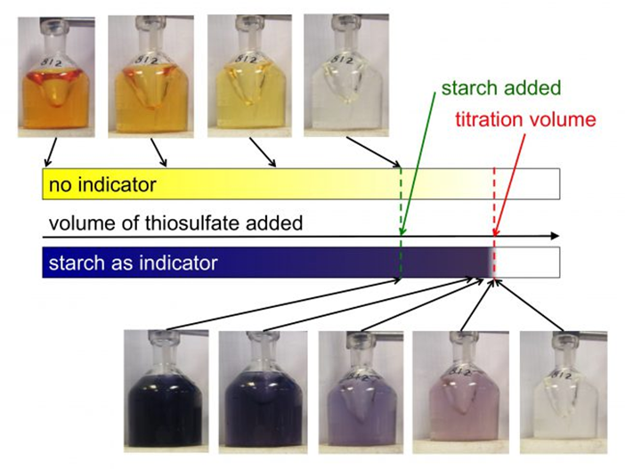
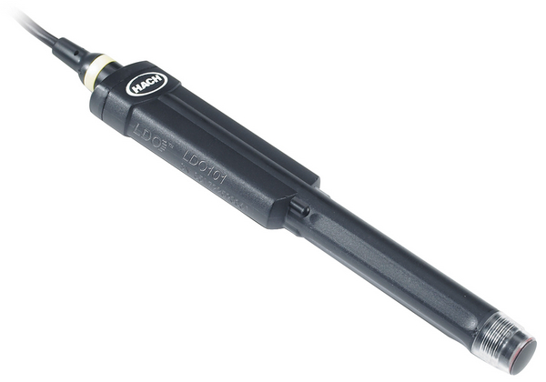
How do we measure dissolved oxygen?
Electrochemical
Chemical Method
Probe methods
Clark-type sensor w/a membrane
Optical
Winkler Titration
Luminescent detection

Slide 6
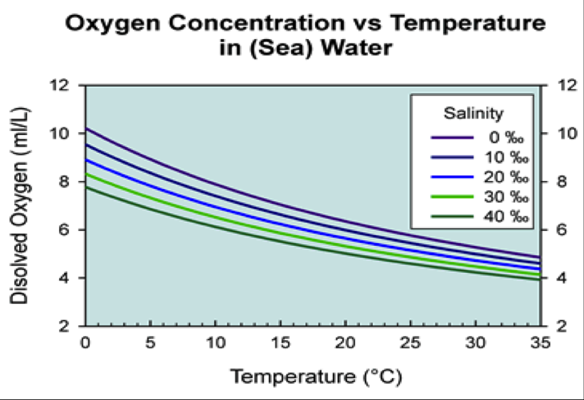
AOU – Apparent Oxygen Utilization
AOU = O_{2sat} – O_{2observed}
Higher AOU → greater amount of O₂ removed since water mass was at the surface
Lower AOU → lower amount of O₂ removed since water mass was at surface
“Know” what O₂ concentrations should be at given temperature and salinity (i.e., at equilibrium)

Slide 7
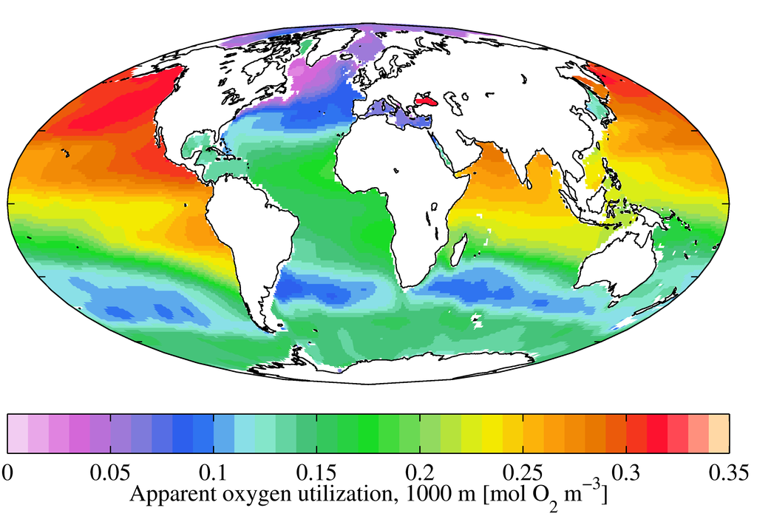
AOU – Apparent Oxygen Utilization

Slide 8
AOU can help us estimate amount of OM Respired
Respiration of 1 mole of POM:
Oxidation of carbon: 106 CH₂O + 106 O₂ → 106 CO₂ + 106 H₂O
Oxidation of nitrogen: 16 NH₃ + 32 O₂ → 16 NO₃⁻ + 16 H₂O
P is not oxidized during respiration of organic matter
What’s the ratio then of organic carbon consumed to oxygen respired?
106 C: 138O₂

Slide 9
Example:
AOU from North Pacific @ 4000 m = 190 μmol O₂ kg⁻¹ SW
190 * 106:138 = 146 μmol of C kg⁻¹ SW → 146 micromoles of C has been remineralized
How much N and P?
190 * 16:138 = 22 μmol of N kg⁻¹ SW → 22 micromoles of N has been remineralized
190 * 1:138 = 1.4 μmol of P kg⁻¹ SW → 1.4 micromoles of P has been remineralized
Notes:
To convert from L to Kg of SW – multiply by 44.6

Slide 10
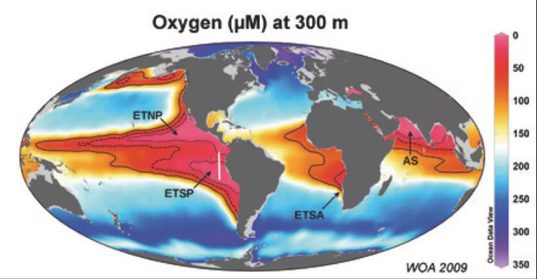
What happens when the rate of oxygen use exceeds the rate of supply?
These areas are characterized by having high water column production and slow deep water formation
Notes:
Oxygen levels at 300m, with extremely low oxygen oceanic ‘dead zones’ marked in red. World Ocean Atlas/Max Planck Institute for Marine Microbiology, Author provided

Slide 11
Oxygen decline in the open ocean and coastal waters over last fifty years
From Breitburg et al. 2018

Slide 12
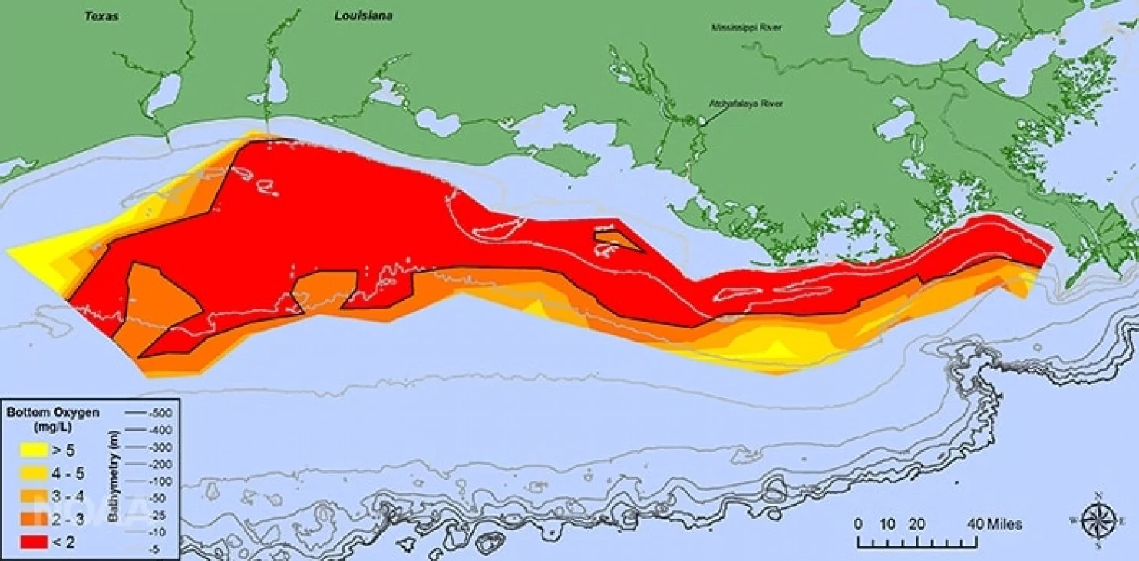
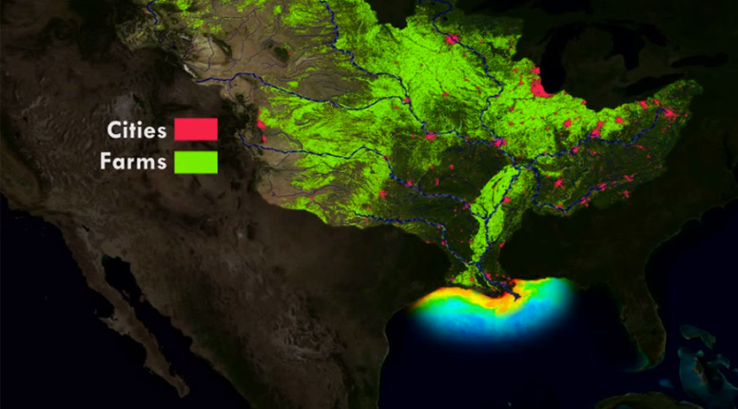
2017 Gulf of Mexico Dead Zone
Notes:
At 8,776 square miles, this year’s dead zone in the Gulf of Mexico is the largest ever measured. (Courtesy of N. Rabalais, LSU/LUMCON)
Map highlighting watershed from TNC
Massachusetts is 10,565 sq miles so in 2017 GOM dead zone was ~80% of the size of Massachusetts or 7X the size of RI

Slide 13
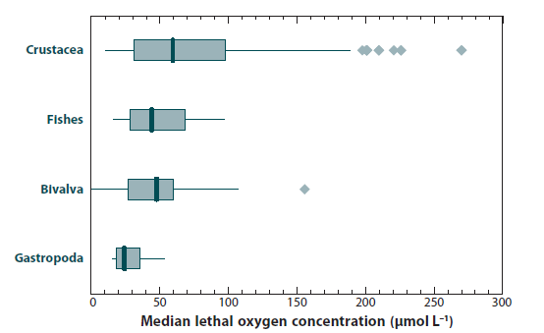
Impact of Low Oxygen on marine organisms
Working definition of hypoxia (DO < 62.5 μM L⁻¹)
From Keeling et al. 2010

Slide 14
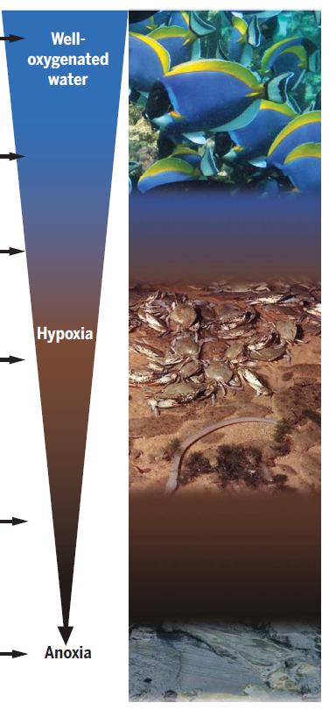
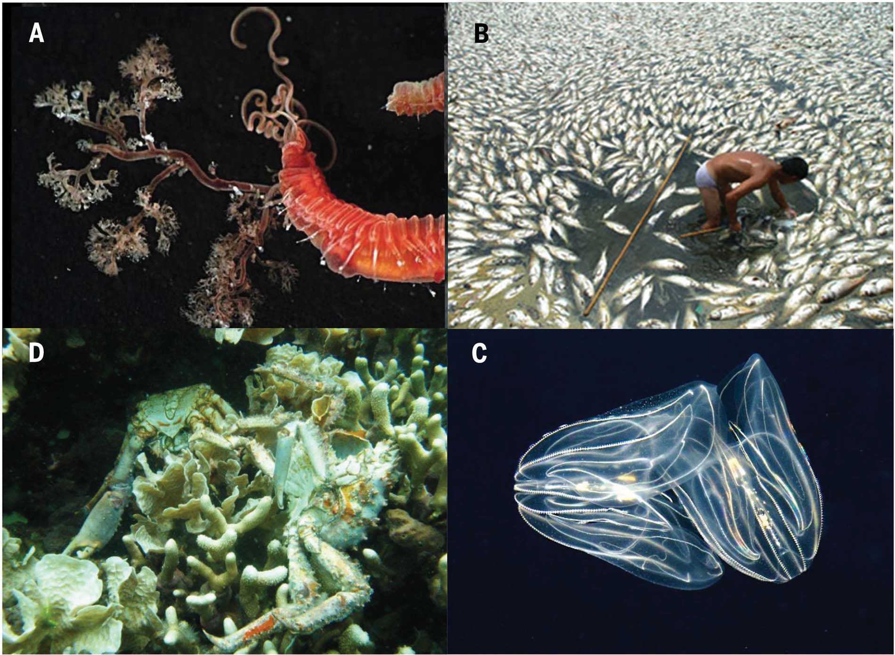
From Breitburg et al. 2018
Notes:
(A) Animals using low-oxygen habitats exhibit
a range of physiological, morphological, and behavioral adaptations. For example, teribellid
worms (Neoamphitrite sp., Annelida) with large branchaea and high hemoglobin levels can
survive in the extremely low oxygen levels found at 400 m depth in the Costa Rica Canyon.
(B) Fish kills in aquaculture pens in Bolinao, Philippines, had major economic and health
consequences for the local population. (C) The ctenophore Mnemiopsis leidyi is more
tolerant of low oxygen than trophically equivalent fishes in its native habitat in the Chesapeake
Bay and can use hypoxic areas from which fish are excluded. (D) A low-oxygen event
caused extensive mortality of corals and associated organisms in Bocas del Toro, Panama.
These events may be a more important source of mortality in coral reefs than previously
assumed.

Slide 15
Quick aside…
Why don’t we worry about hypoxia on land?
Air contains about 40 times more oxygen per unit volume than
water does during the summer.
Water is ~ 800 times denser than air and much harder to mix.

Slide 16
Quick aside…
When is hypoxia worse? Winter or summer?
O₂ saturation values for temperate estuary:
Summer
22°C
Winter
2°C
Salinity 15 p.s.u.
7.9 12.3
Salinity 30 p.s.u.
7.2 11.0
O₂ values from Pilson (1998)

