Slide 1
ES 144: Introduction to Oceanography

Slide 2
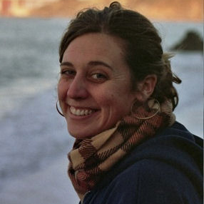
ES 144: Introduction to Oceanography
Me:
Wally Fulweiler, Ph.D.
Associate Professor
Department of Earth and Enviroment
Department of Biology
Director of the BU Marine Program
Lab website: www.fulweilerlab.com
Twitter: @Fulweilerlab
Teaching Fellow:
Sarah Foster
Soon to be (months away) Ph.D.
Graduate Student
Department of Earth and Environment
Email: sqfoster@bu.edu

Slide 3
Course Basics: When
ES 144 A1 – Lecture Only (MWF 2:30-3:20 pm)
Here – in CAS 522
Two Discussion Groups for Marine Science Majors Only (or if you are seriously considering being a major)
ES 144 MP – Lecture, Discussion Group (M 10:10-11 am, STO 453, 1st mtg 9/10)
ES 144 MR – Lecture, Discussion Group (T 3:35-4:25, STO 453, 1st mtg. 9/11)

Slide 4
Course Basics: Grades
Three Exams: 20% each
Participation: 10%
Final Exam: 30%
*note – if you are in a marine discussion group your grade will be determined in a slightly different manner (more details in discussion next week).

Slide 5
Grades:
A | 100-96
A- | 95-90
B+ | 89-86
B | 85-83
B- | 82-80
C+ | 79-76
C | 75-73
C- | 72-70
D+ | 69-66
D | 65-63
D- | 62-60
F | 59-0

Slide 6
Who are you?

Slide 7
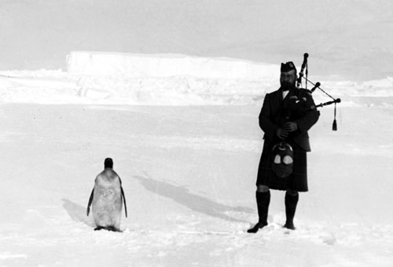
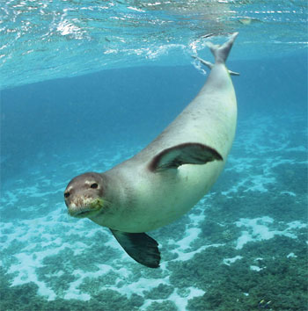
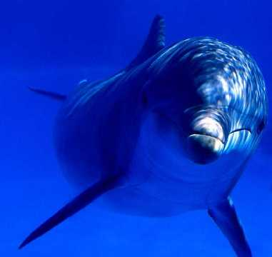

Slide 8
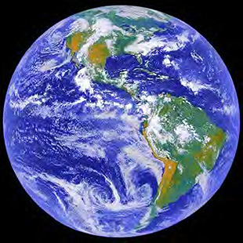
Geology
Astronomy
Geography
Physics
Biology
Chemistry

Slide 9
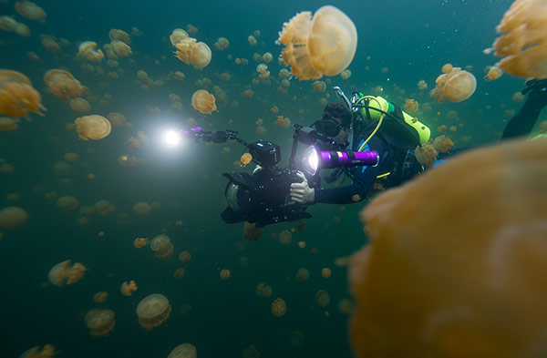
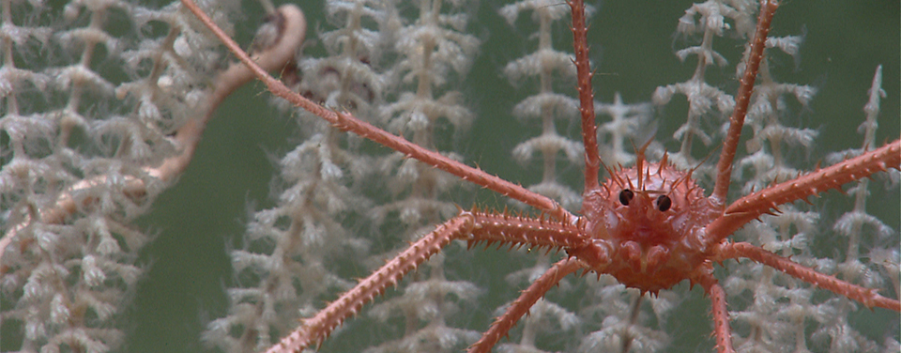
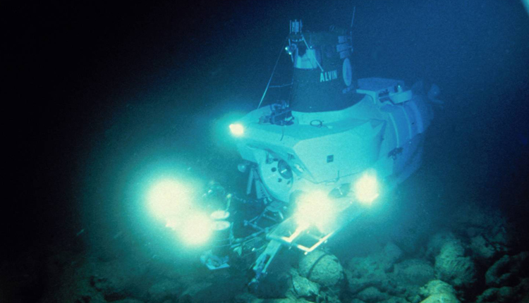
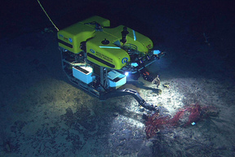

Slide 10
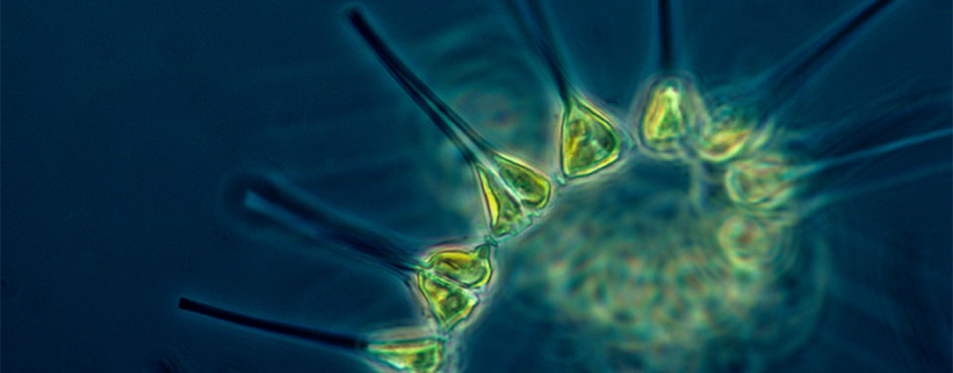
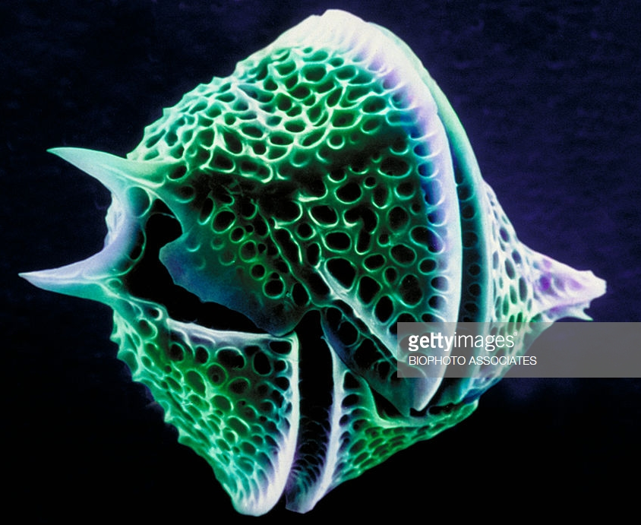
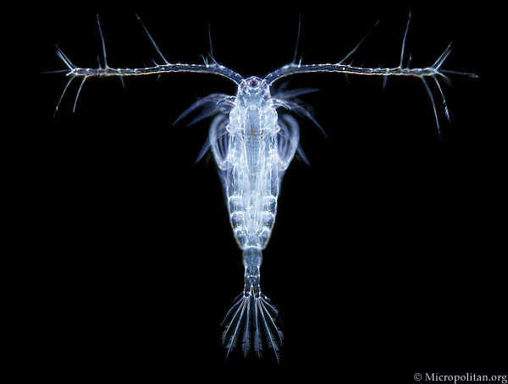
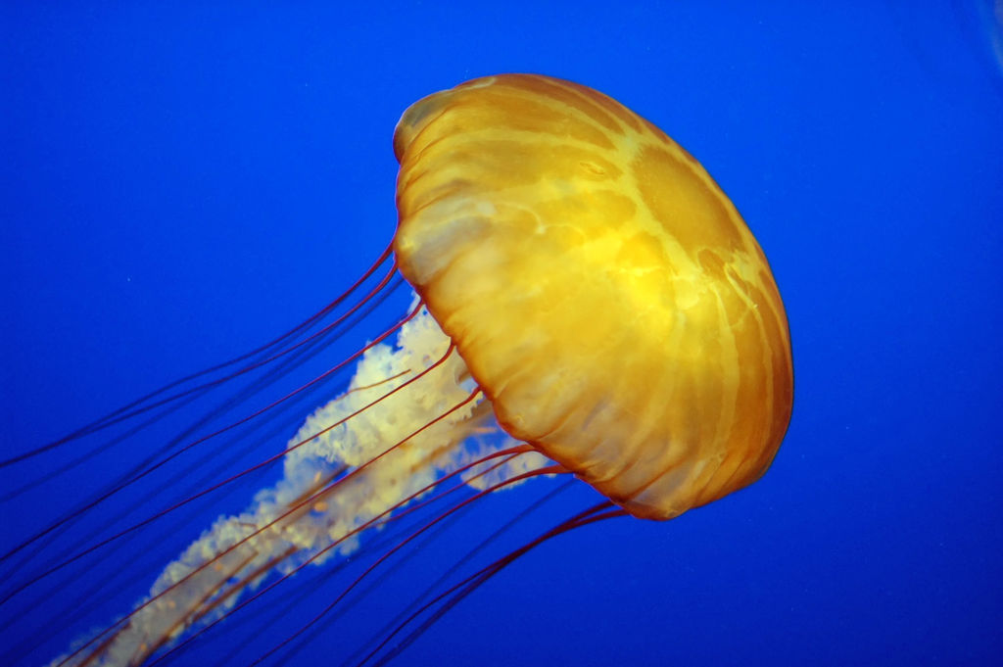
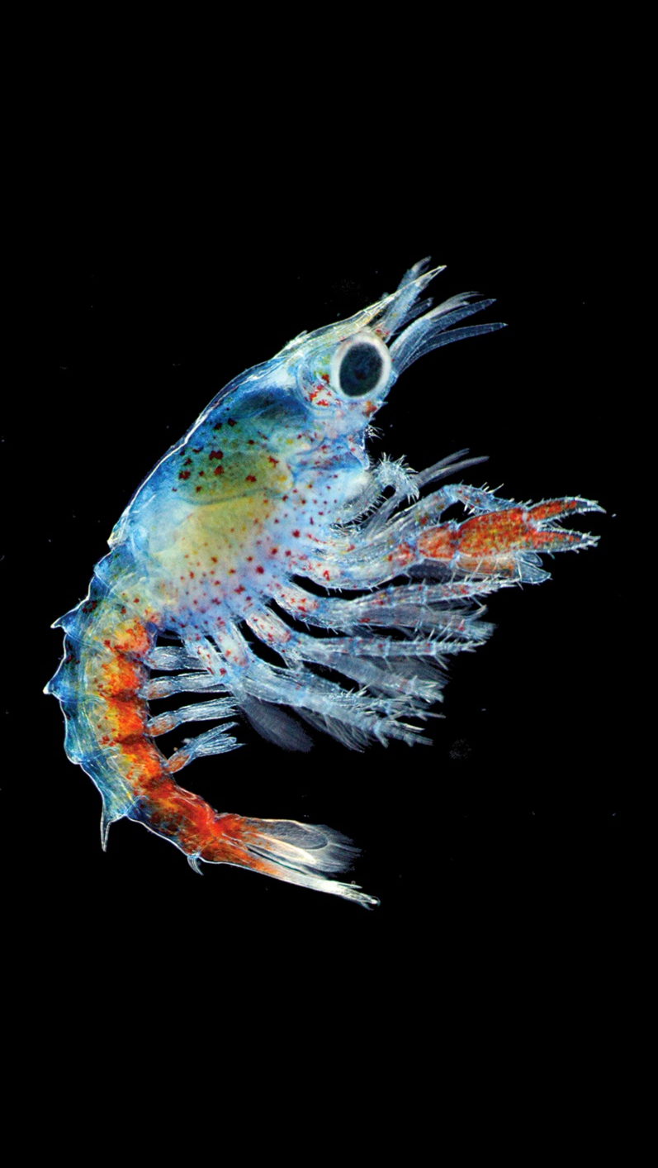
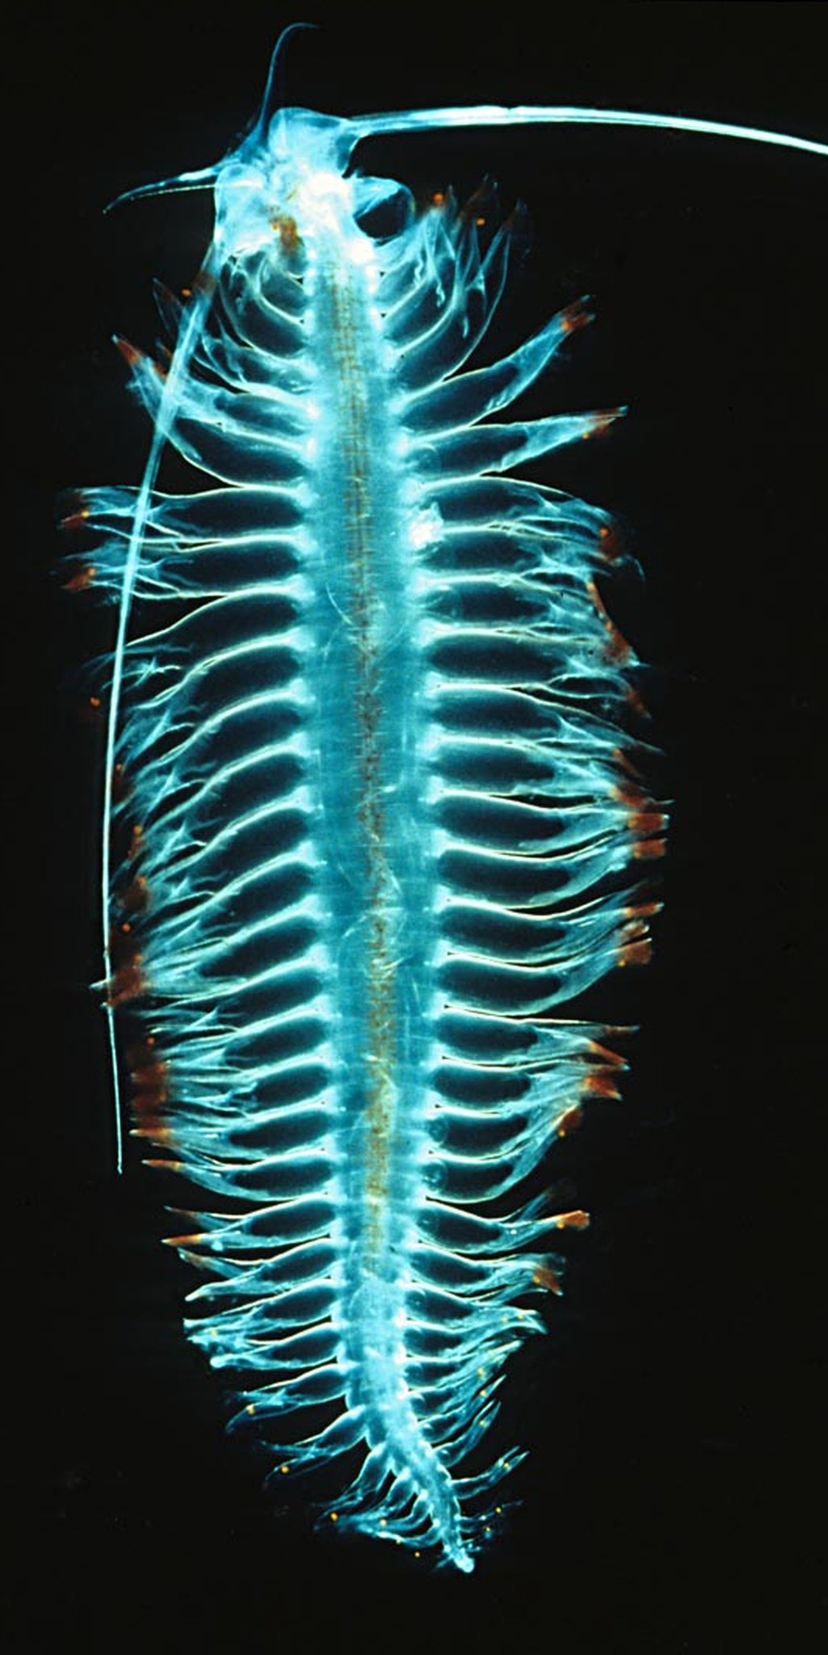

Slide 11
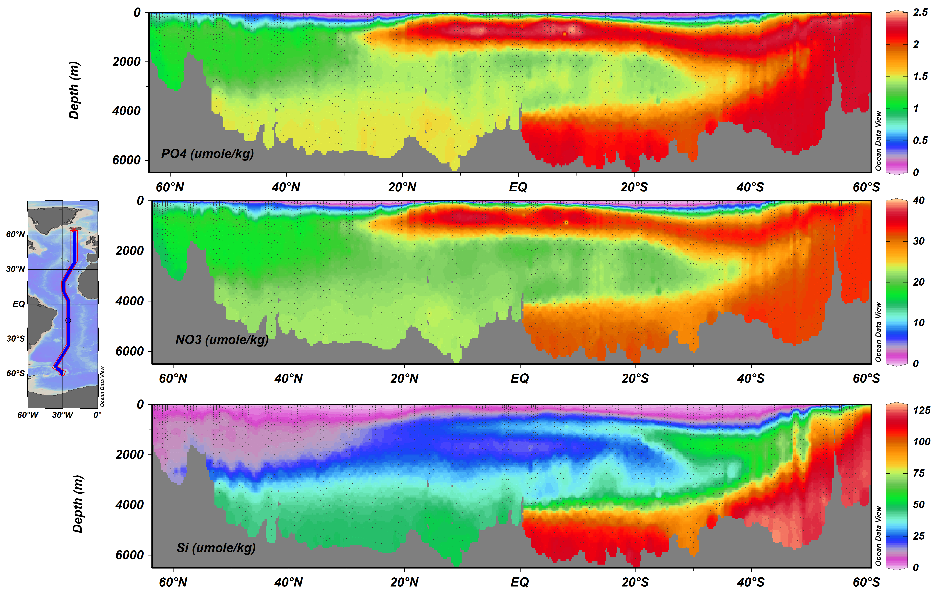

Slide 12
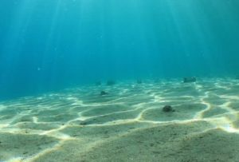
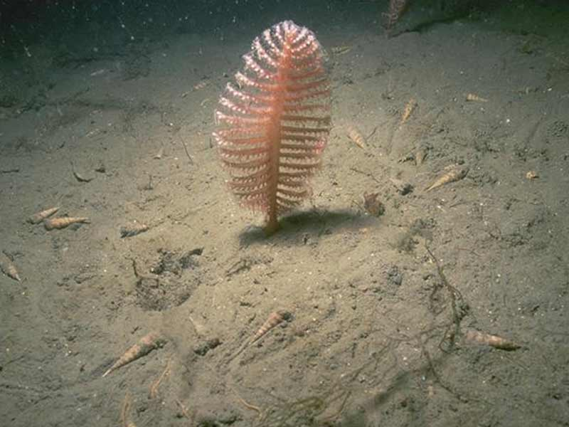
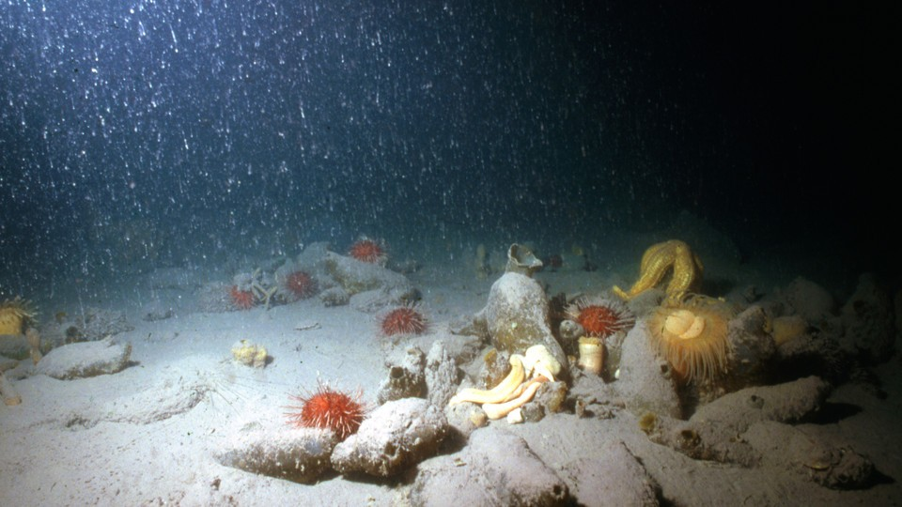
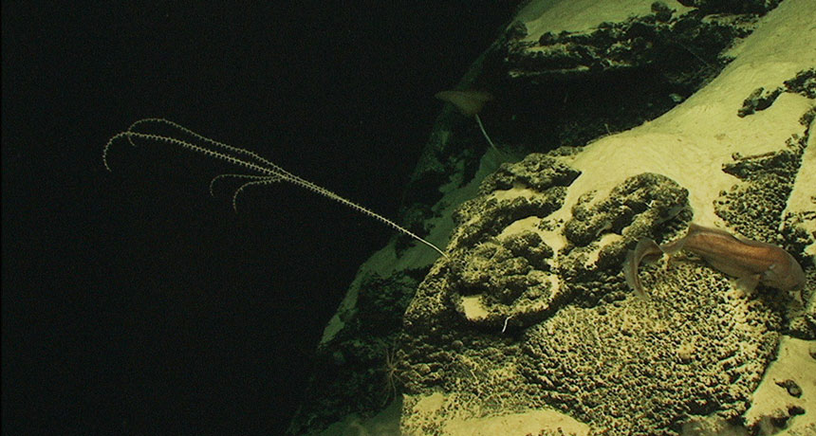

Slide 14
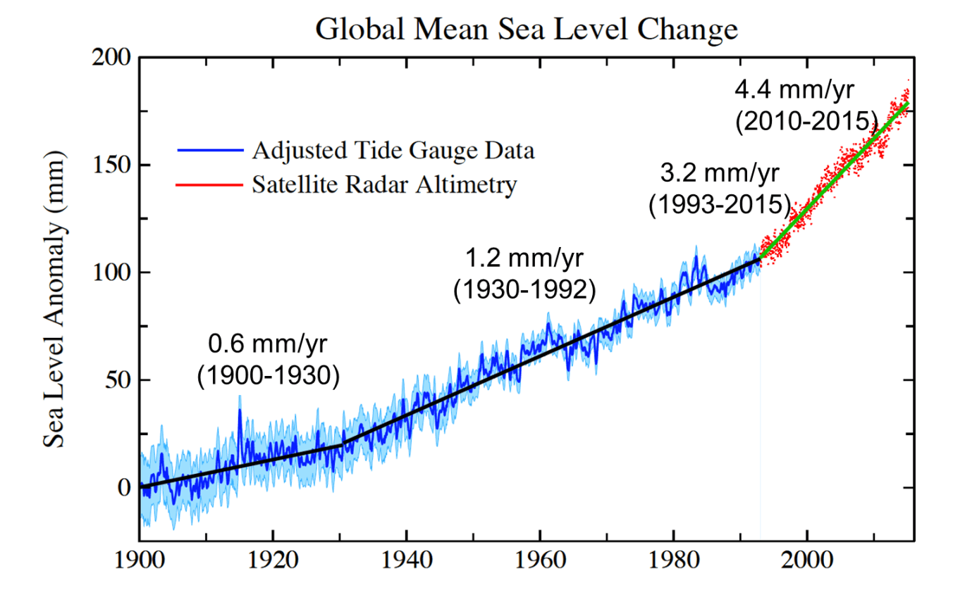
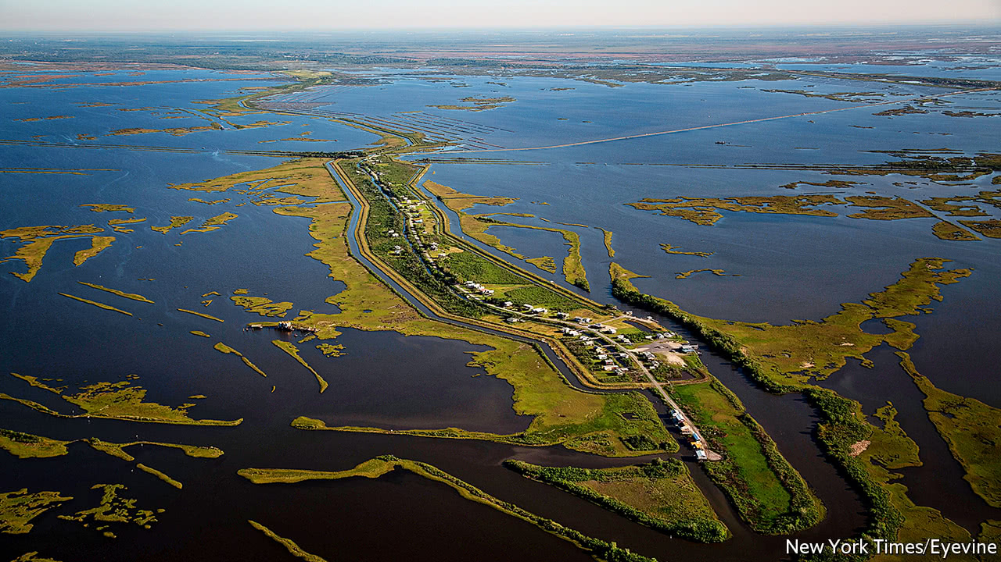
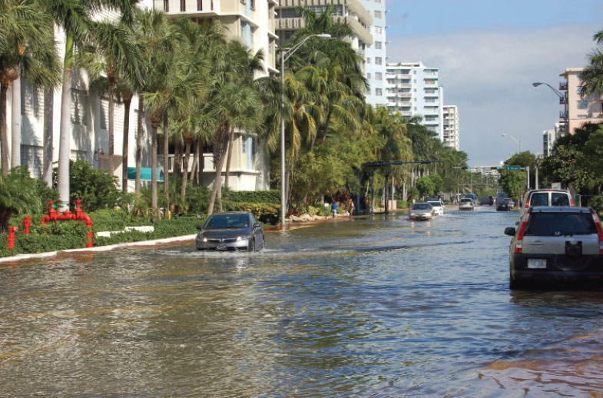
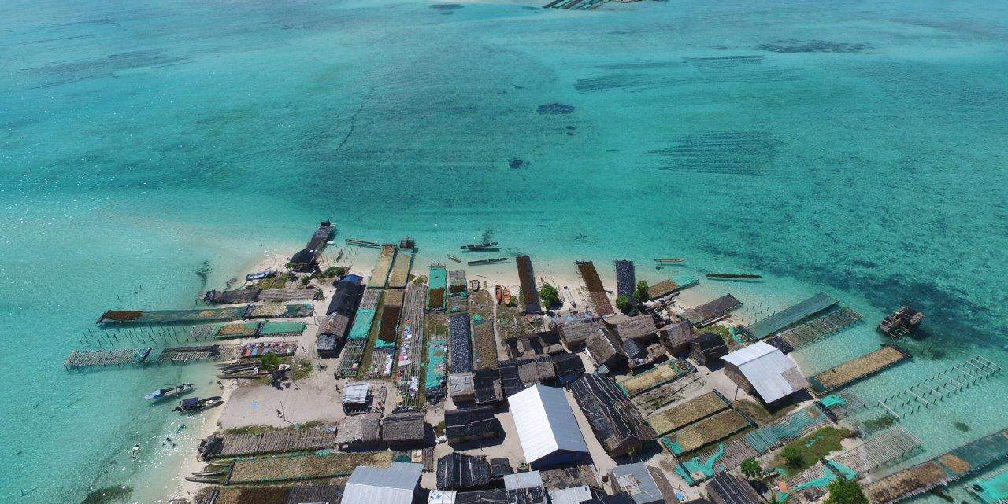
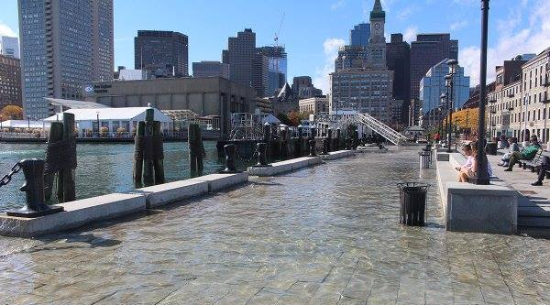
Notes:
2 billion refuges by 2100

Slide 15
