Slide 1
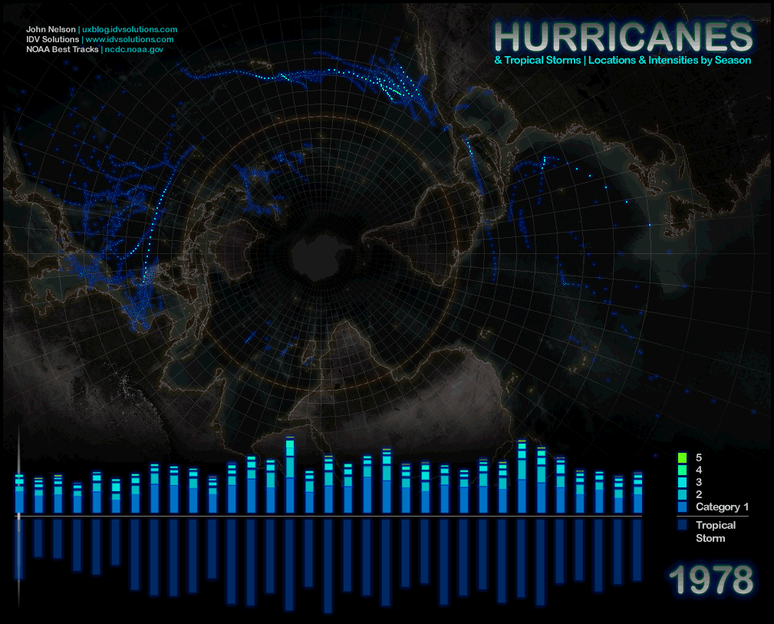

Slide 2
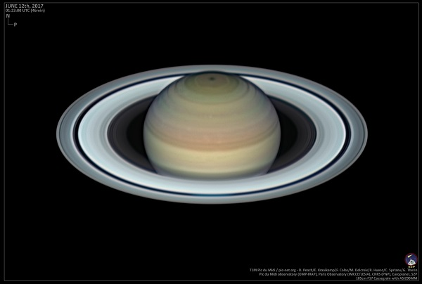
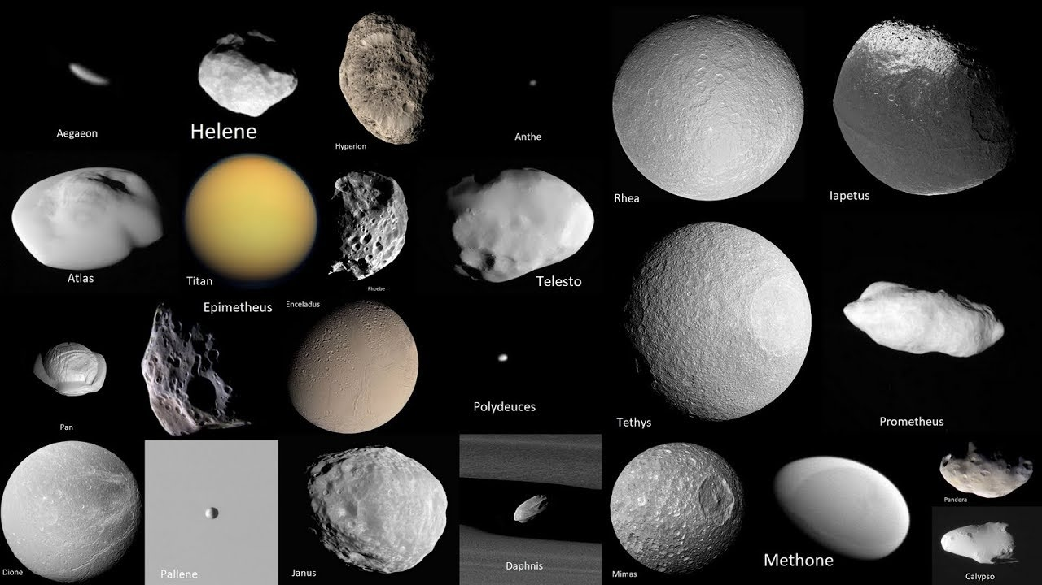
Question from last class: Are all moons like our moon?

Slide 3
Have you been in a hurricane before?
Yes
No

Slide 4
Many different names for the same storm:
Tropical Cyclone – the scientific name for these storms
Hurricanes – comes from the Huracan – the Caribbean Taino people’s god of wind
Typhoons – from the Chinese word for “great wind”: Tai-fung
Tropical Cyclones – Indian Ocean
Willi-willis - Australia
Hurricane Florence

Slide 5
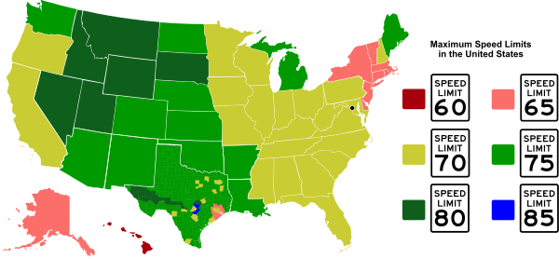
When’s a hurricane a hurricane? – all about wind speed
Winds of at least 119 km per hour (74 mph)
Tropical Depression
Winds less than 61 km/hour (38 miles/hour)
Tropical Storm
Winds 61–120 km/hour (38–74 miles/hour)
Notes:
Hurricane force winds are higher than the speed limit of many states in the U.S.

Slide 6
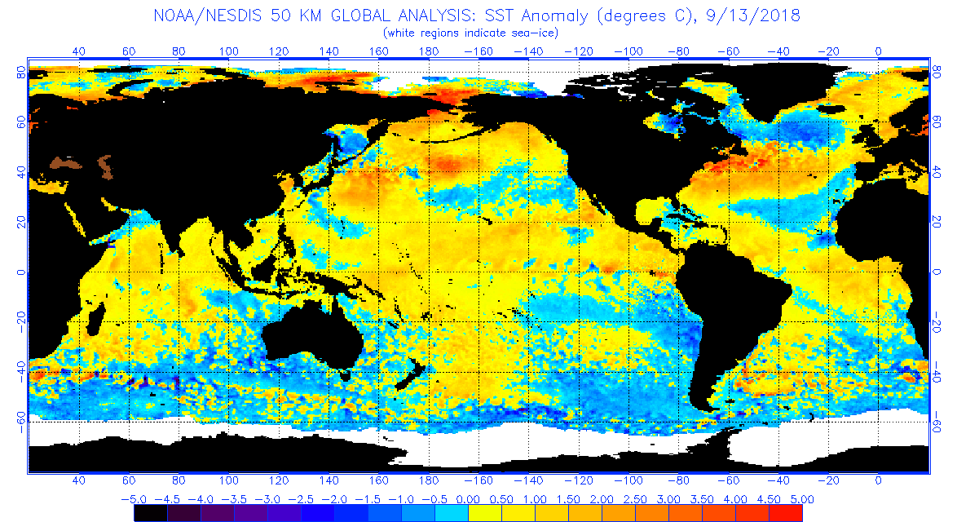
What drives a hurricane? – Ocean temperature
Notes:
Ocean temperatures must be in excess of 26C (79 F).

Slide 7
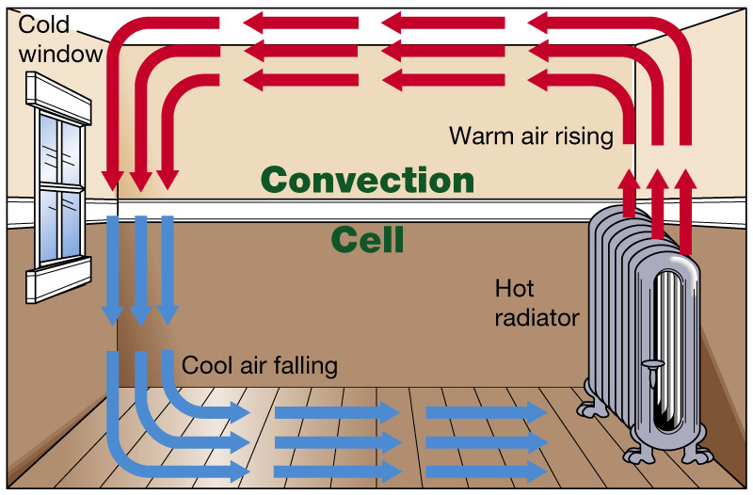
Basics of Atmospheric Circulation
Warm air – more water vapor
Cold air – less water vapor
Density variation in the atmosphere:
Heat Rises! – so warm air rises….
Cold air – dense → sinks!

Slide 8
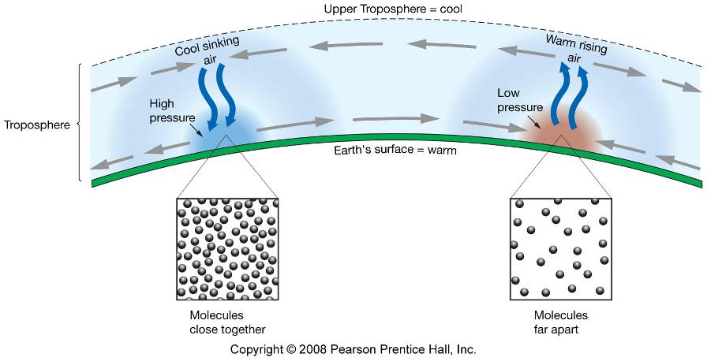
Pressure
A column of cool, dense air causes high pressure at the surface, which will lead to sinking air
A column of warm, less dense air causes low pressure at the surface, which will lead to rising air
Notes:
Wind!

Slide 9
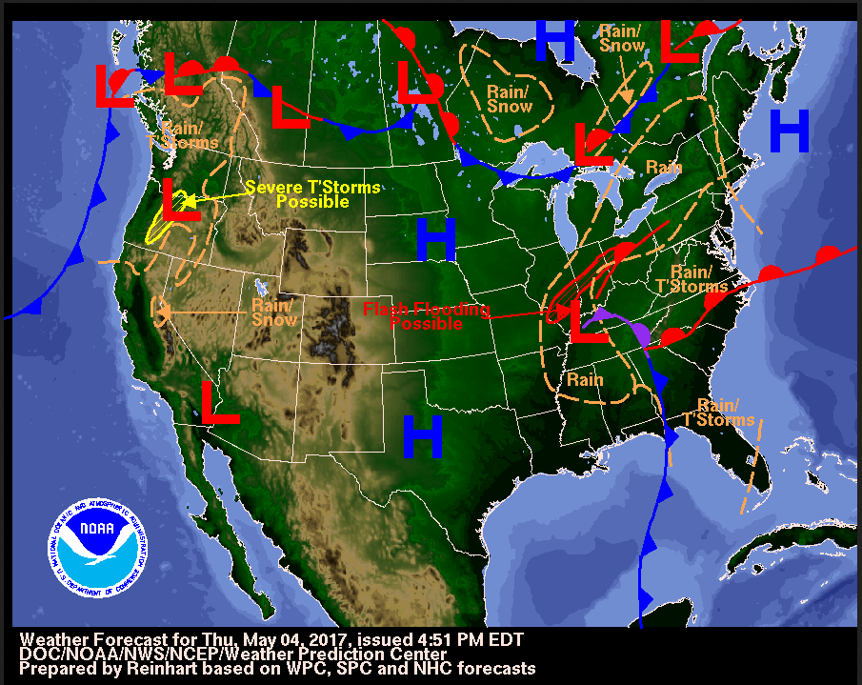
Weather and High and Low Pressure Systems
High pressure – typically
associated w/ dry, sunny weather
Low pressure – typically associated with rain or snow

Slide 10
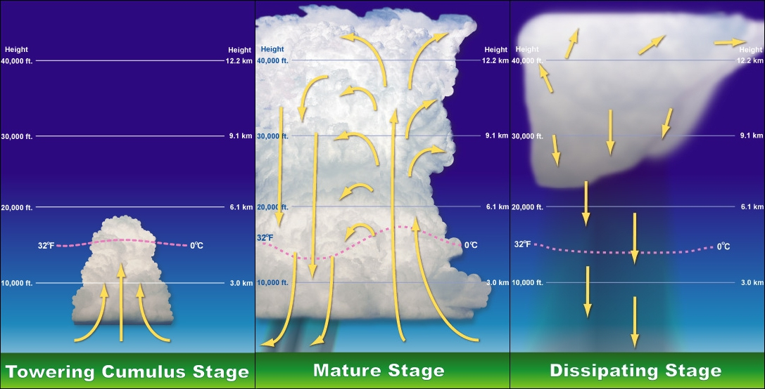
Low pressure cell
Winds feed water vapor
Air rises, low pressure deepens
Storm develops
Low wind speed above, so storms aren’t broken apart

Slide 11
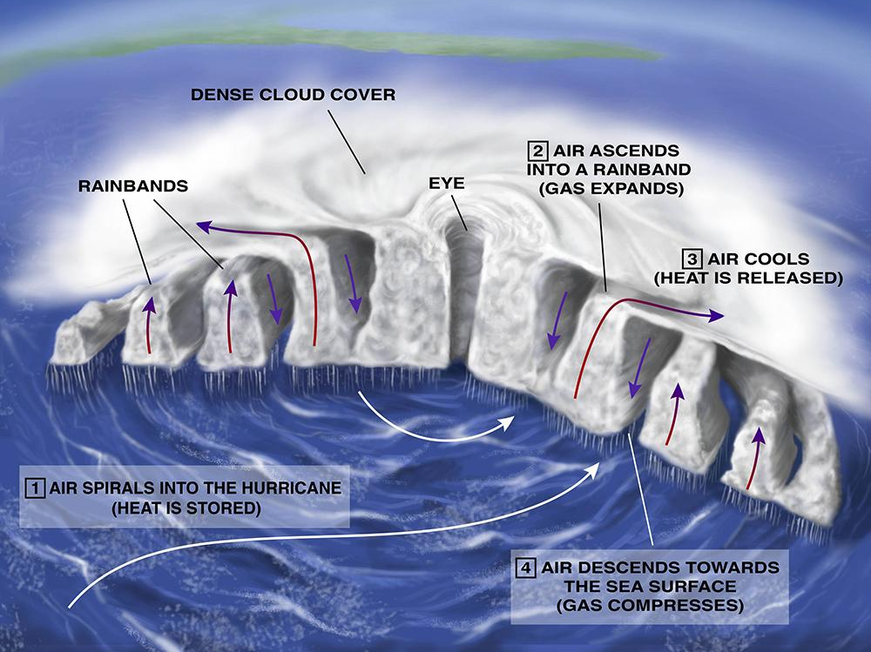
Hurricane Anatomy
Diameter typically less than 200 km (124 miles)
Larger hurricanes can be 800 km (500 miles)
Eye of the hurricane
Low pressure center
Spiral rain bands with intense rainfall and thunderstorms
Notes:
https://ocean.si.edu/planet-ocean/waves-storms-tsunamis/what-fuels-hurricane

Slide 12
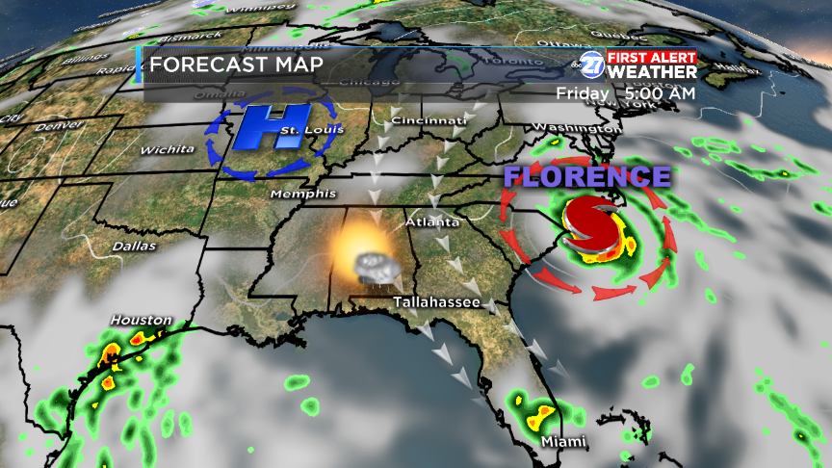

Slide 13
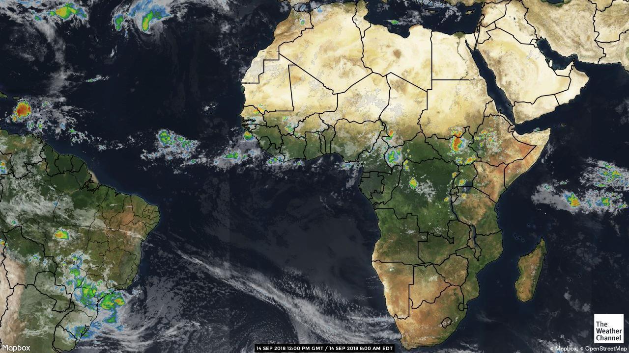
Notes:
Hurricanes for the North Atlantic start as thunderstorms off of Africa…..

Slide 14
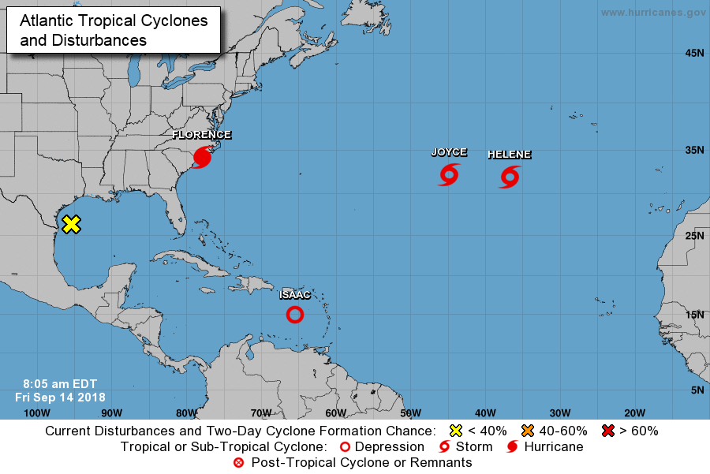
Notes:
https://www.nhc.noaa.gov/
The path to a hurricane then – is thunderstorm, tropical depression, tropical storm, then hurricane

Slide 15
Hurricane formation overview:

Slide 17
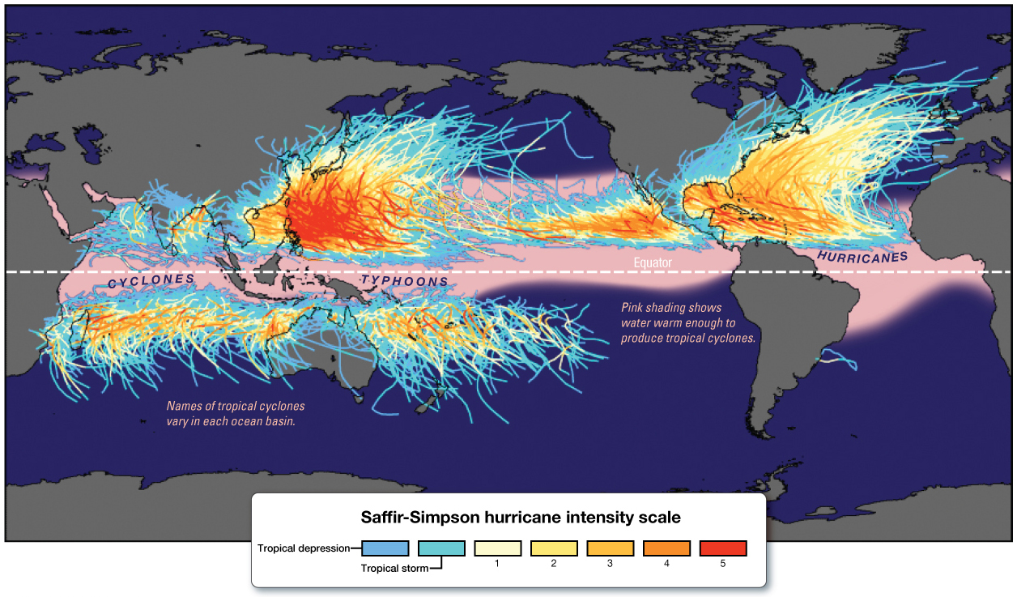

Slide 18
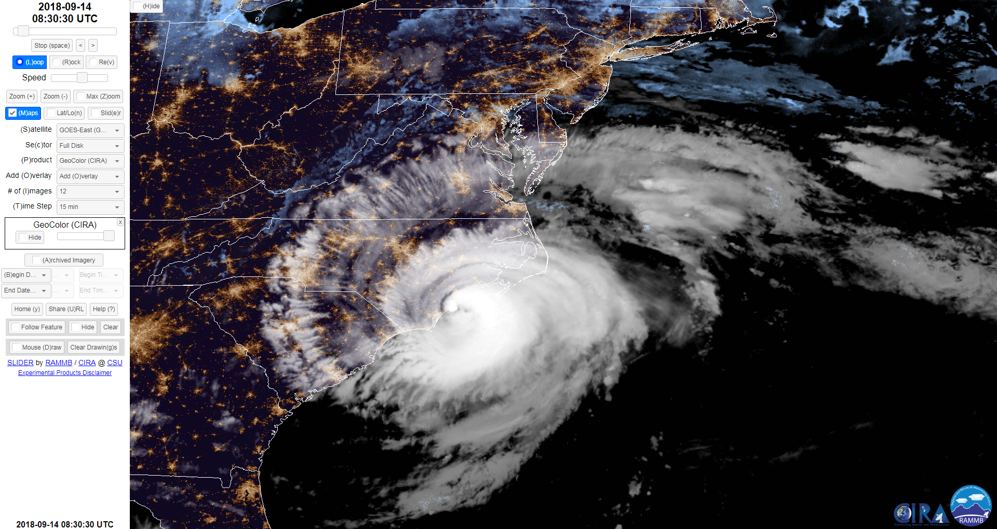
https://col.st/e3Ayk

Slide 19
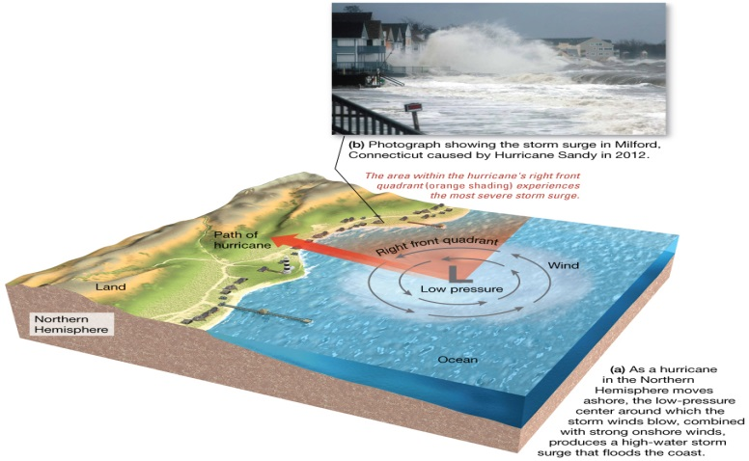
Hurricane Destruction
High winds
Intense rainfall
Storm surge

Slide 20
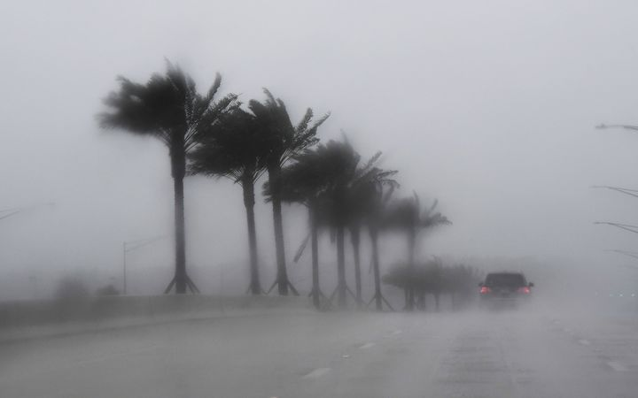
Rainfall can exceed 2.5 cm (1 in) an hour
This rain, as well as spray from waves helps to remove friction between the atmosphere and the sea – allowing the storm to move easier, faster
Notes:
, in 1 day 20 billion metric tons of water can fall
Storm can move 5 to 40 km per hour (3-25 mph)

Slide 21
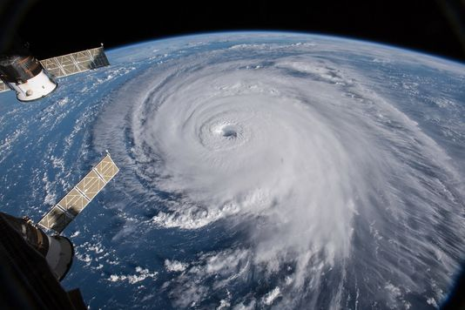
Storm surge
Under this low pressure, a dome of water can be formed up to 1 m (3.3 ft) in the open sea….

Slide 22
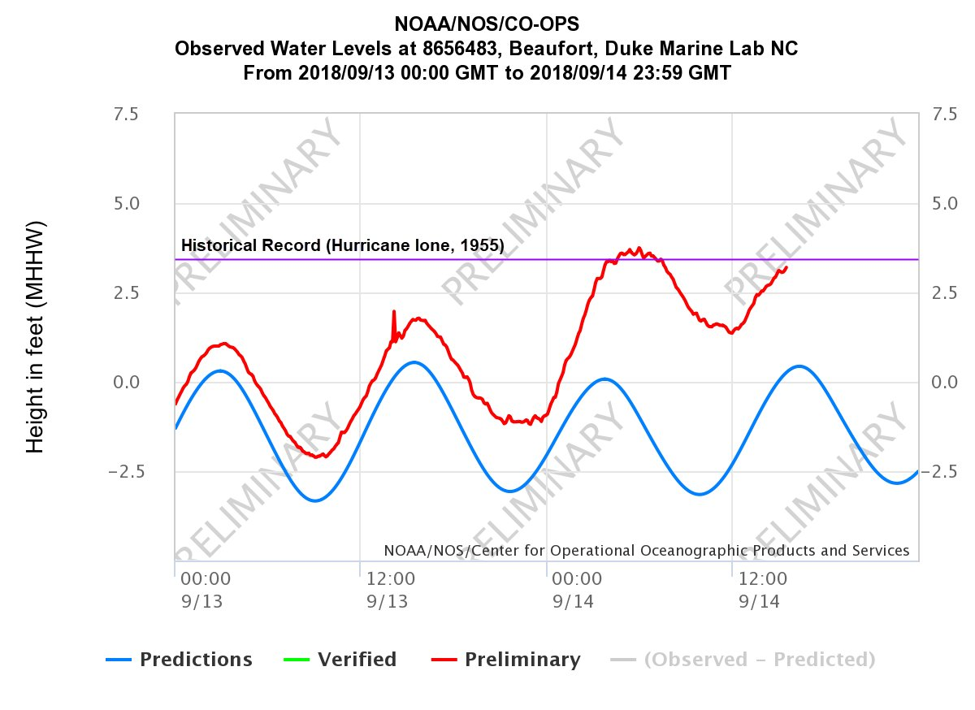

Slide 23
The most damaging part of a hurricane is its:
Storm surge
Wind
Rain
Bad reporting
Sharks on land

Slide 24
Storm Surge – location matters because of shoreline geography

Slide 25
Storm Surges
Bangladesh in 1970 – 12 m (40 ft)
Hurricane Katrina and Rita – 8 m (25 ft)

Slide 26
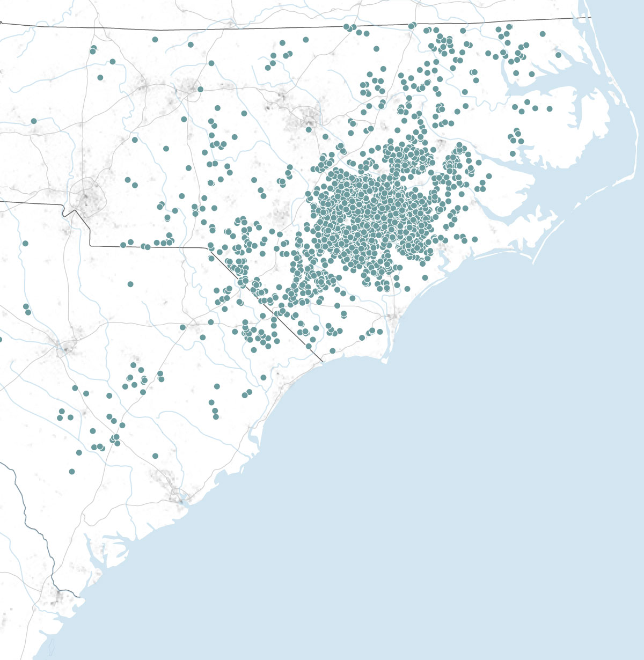
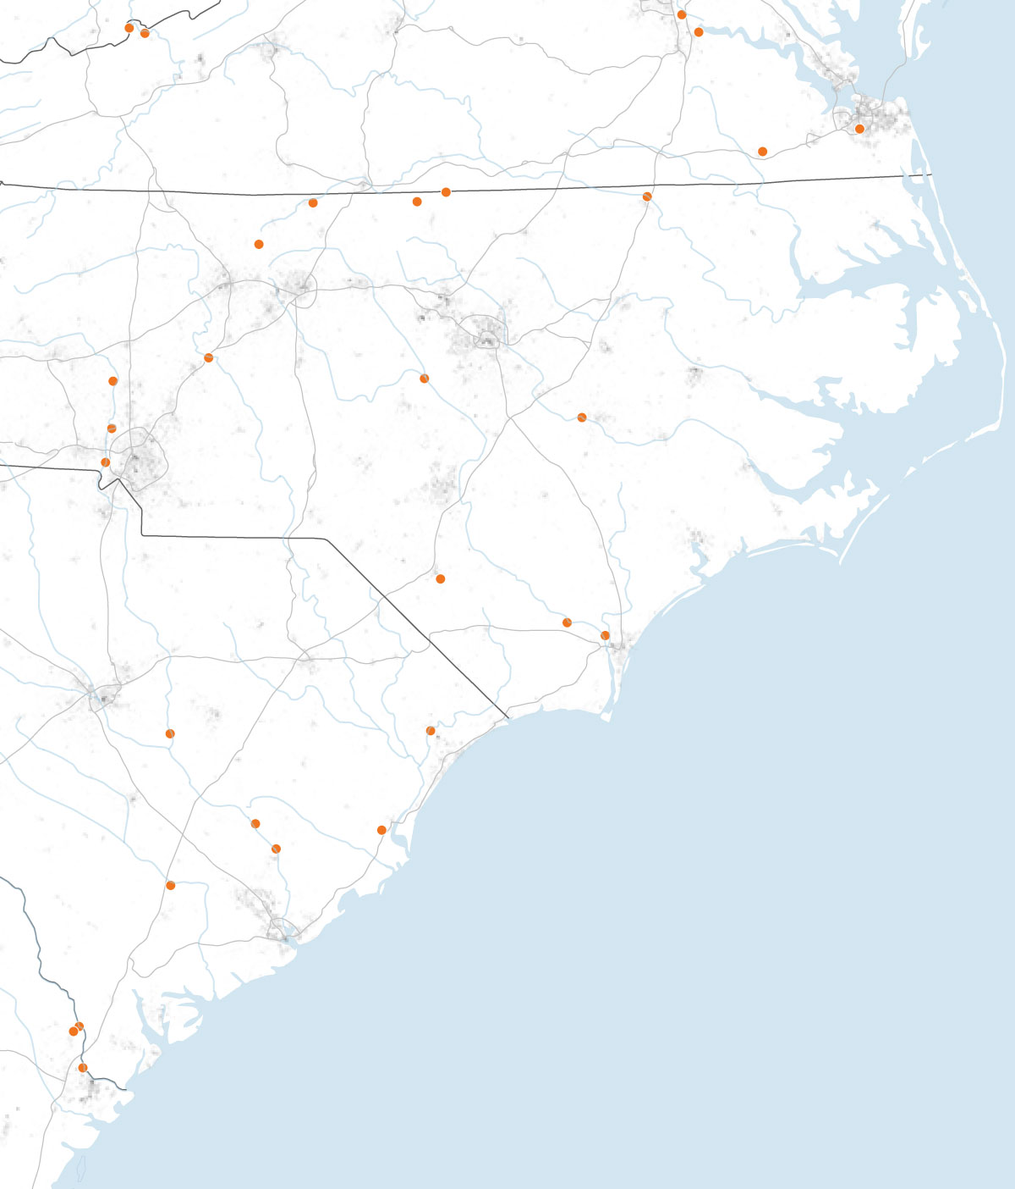
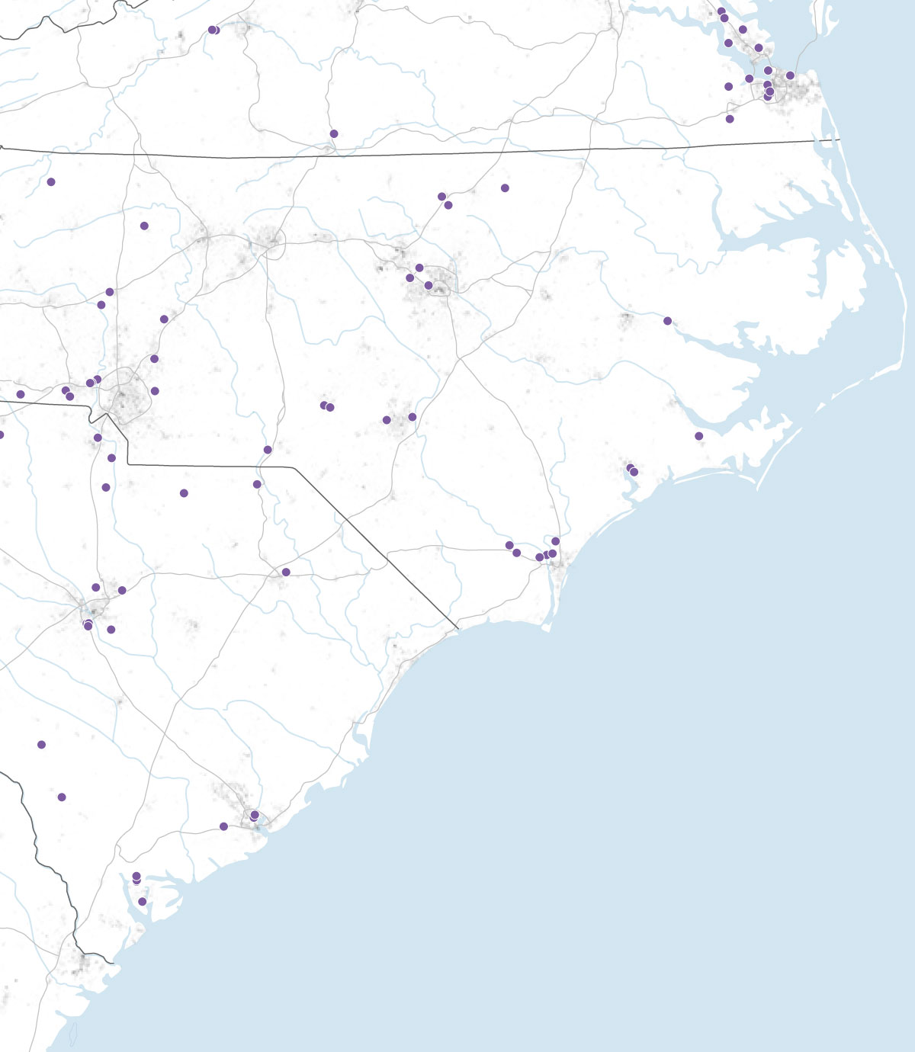
Other dangers
Pig Farms
Coal Ash Ponds
Superfund sites
Notes:
Sources: North Carolina Department of Environmental Quality; South Carolina Department of Health and Environmental Control
Coal ash ponds: “ contains heavy metals like arsenic, lead, mercury and selenium, which are linked to respiratory illnesses and cancer.”

Slide 27
video.nationalgeographic.com/video/101-videos/hurricanes-101

