Slide 1
“You and I are flesh and blood, but we are also stardust.”
-Bio AP text book

Slide 2
Six elements are the major constituents of living tissue…..
And they account for 95% of the biosphere……
Zone of Life on Earth
Global Sum of all ecosystems
C, H, O, N, P, S
Biotic/Abiotic (i.e. – the living/non living)
components of a system….

Slide 3
Chemistry 101
Atomic Number: number of protons
Hydrogen has 1 proton; Carbon has 6 protons
Atomic Weight: average mass of atoms of
an element, calculated using the relative abundance of isotopes in a naturally occurring element.
Carbon = 12.001; Nitrogen = 14.007

Slide 4
Isotope: Atoms with the same number of protons but different number of neutrons.
Carbon-12 = 6 protons + 6 neutrons
Carbon-14 = 6 protons + 8 neutrons

Slide 6
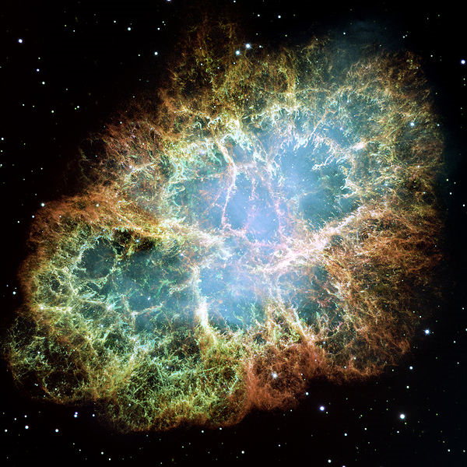
NASA's Hubble Space Telescope of the Crab Nebula

Slide 7
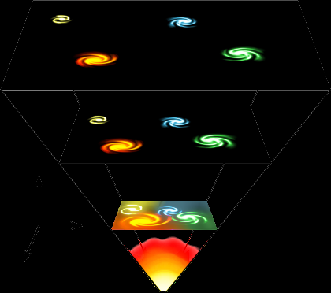
~ 13.7 billion years ago (bya)
Just seconds old
…began to form
H and He
Big Bang Nucleosynthesis…. 100-300 seconds…..

Slide 8
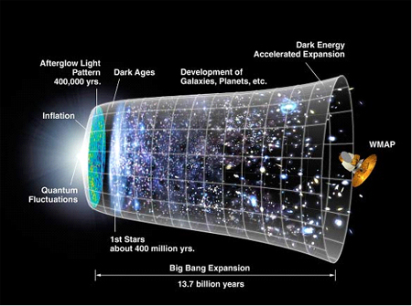
It’s speeding up….

Slide 9
One BILLION years later……..
Stars Formed…. And with them – other,
heavier elements……..
This is called Stellar Nucleosynthesis……

Slide 10
Temperature and Pressure
⁴He + ⁴He → ⁸Be
→ ⁸Be + ⁴He →
¹²C
¹²C + ⁴He → ¹⁶O

Slide 11
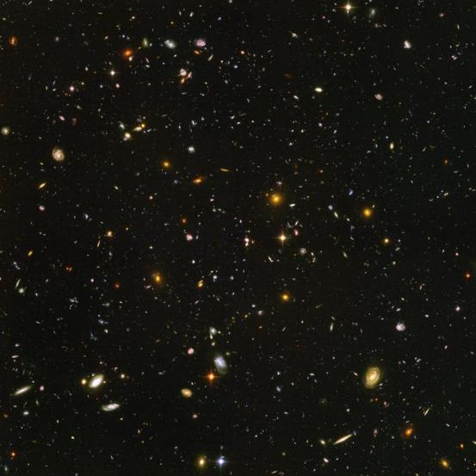
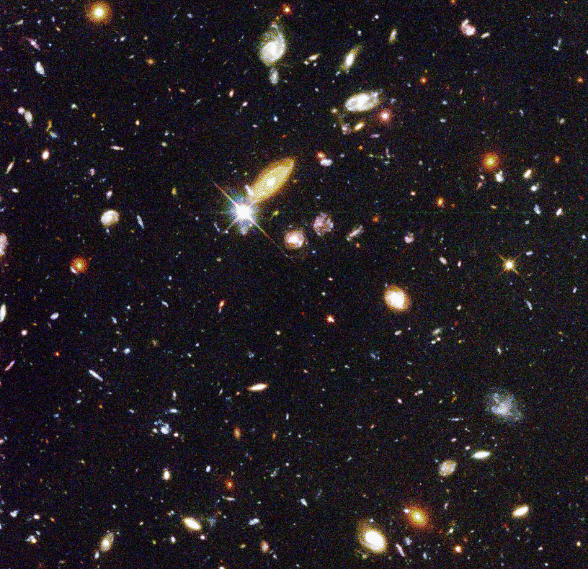
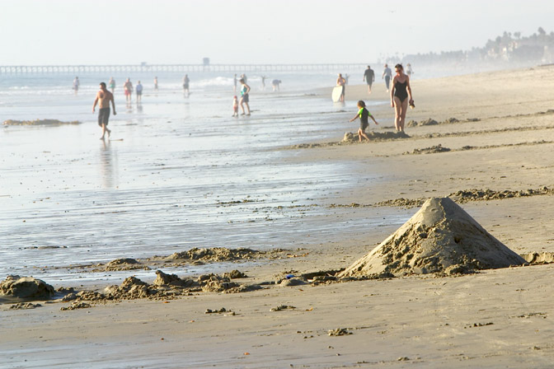
So how many stars are there….
Milky Way… we think – 200-400 billion…..
But there might be 3000 galaxies (in just a pin hole view of space)
Notes:
Viewed from southern sky – taken over a 16 month period (2003 and 2004)…Hubble – Ultra deep field….1/10th of he diameter of the moon…10,000 galaxies! Each with 200-400 billion stars.
So how many stars – the idea is that there are about 4 x 10^22 stars in the Universe. Or 1000 to 10,000 more than all the grains of sands on all the world’s beaches….

Slide 12
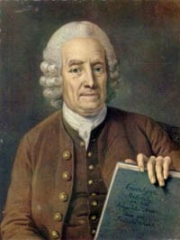
The Nebular Hypothesis
1734
Today
Emanuel Swedenborg
Solar Nebular Disk Model (SNDM) or Solar Nebular Model

Slide 13
Formation of a Solar System

Slide 14
Heavier Elements Drawn
to Center by Gravity

Slide 15
Formation of Protoplanets

Slide 16
Our Solar System

Slide 17
Planets in the outer ring of the solar system are made primarily of:
Metals
Rocks and metals
Gases and dust
Chicken bones

Slide 19
The densest planet in our solar system:
Pluto
Jupiter
Earth
Mercury

Slide 20
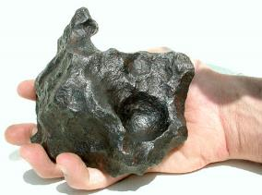
The Age of the Earth
Earth is ~ 4,570,000,000 years old
Meteorites give us access to debris left over from the formation of the solar system
We can date meteorites using radioactive isotopes and their decay products

Slide 21
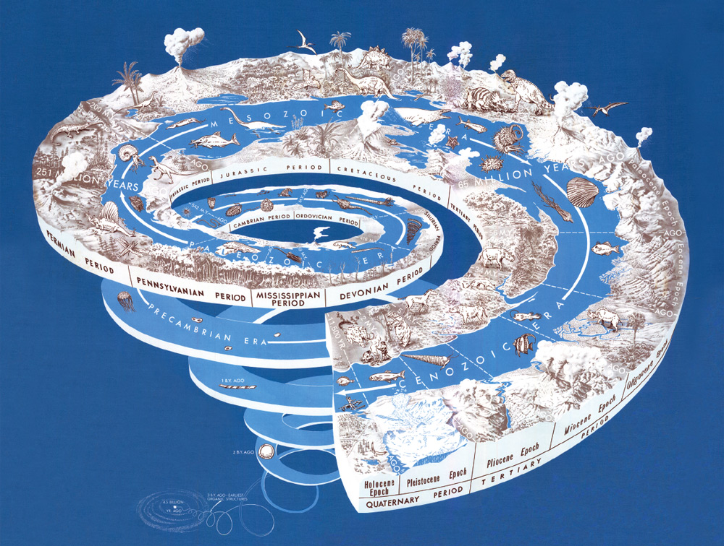
Geologic Time
Notes:
http://pubs.usgs.gov/gip/2008/58/

Slide 22
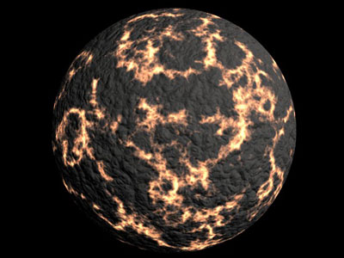
The Early Earth Heats Up
3 major factors that caused heating and melting in the early Earth’s interior:
1. Collisions (Transfer of kinetic energy into heat)
2. Compression
3. Radioactivity of elements (e.g. uranium, potassium, or thorium)

Slide 23
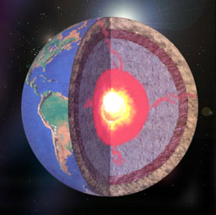
The Core
About 100 million years after initial accretion, temperatures at depths of 400 to 800 km below the Earth’s surface reach the melting point of iron
During this time….the heavier elements, including the melted iron, began to sink down into the core of the Earth, while the lighter elements such as oxygen and silica floated up towards the surface

Slide 24
Density stratification
Crust forms
What is density ?

Slide 25
Mass per unit volume
g/cm³

Slide 26
Water: 1.00 g cm⁻³
Glass: 2.50
lead: 11.34
mercury: 13.54
gold: 19.30

Slide 27
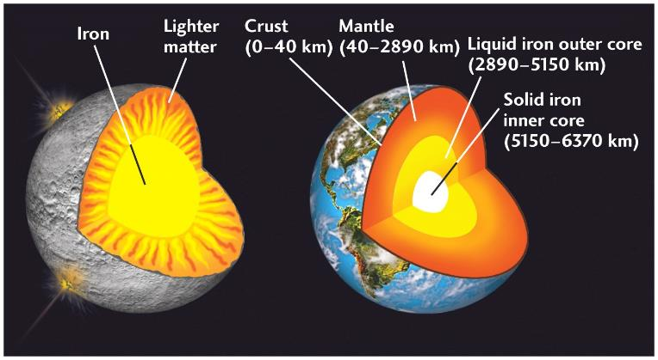
Global Chemical Differentiation
Chemical seperation was completed by about 4.3 billion years ago, and the Earth had developed a inner and outer core, a mantle and crust

Slide 28
Chemical Composition of Earth
Each of the major layers has a distinctive chemical composition, with the crust being quite different from the Earth as a whole
Whole Earth:
Fe+O+Si+Mg = 93%
Crust:
Si+O+Al = 82%

Slide 29
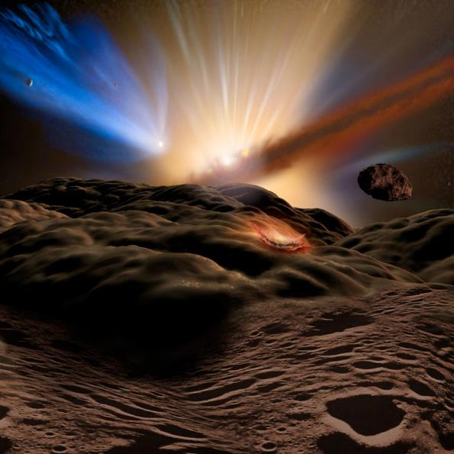
From Scientific America (2/25/2008), by Lawrence M. Krauss and Robert J. Scherrer
PROTO-EARTH: 4.5 billion years agoThe sky above a still-forming proto-Earth is filled with the dust, rocks and gas that are shaping our solar system. A rising proto-sun illuminates the dust and rocks that gravity brings hurtling toward this new planet. The first comets, scattered by the gravity of the giant outer planets, appear in our sky.
Notes:
PROTO-EARTH: 4.5 billion years agoThe sky above a still-forming proto-Earth is filled with the dust, rocks and gas that are shaping our solar system. A rising proto-sun illuminates the dust and rocks that gravity brings hurtling toward this new planet. The first comets, scattered by the gravity of the giant outer planets, appear in our sky.

Slide 30
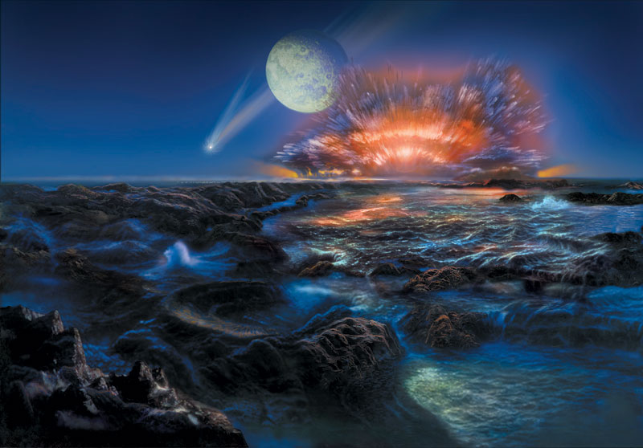
EARLY EARTH: 4 to 4.5 billion years ago - Our recently formed moon rises in the night sky. Not in its final orbit yet, the moon is seen much larger in the sky than than today's moon. Magma flow from mare volcanism can be seen on its surface. Three comets, or water-rich asteroids, begin their descent into Earth, delivering with them a supply of frozen water.
From Scientific America (2/25/2008), by Lawrence M. Krauss and Robert J. Scherrer

Slide 31
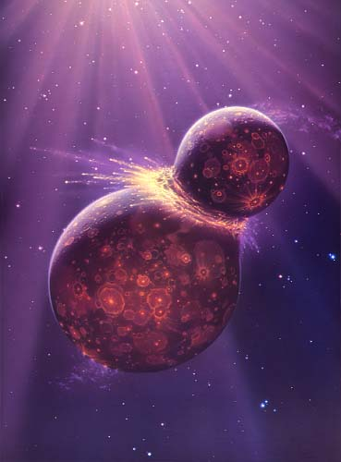
Formation of the Moon
The Giant Impact Hypothesis –
~ 50 million years after the initial creation of Earth, a planet about the size of Mars collided with Earth
This idea was first proposed about 30 years ago, but it took calculations by modern high-speed computers to prove the feasibility

Slide 32
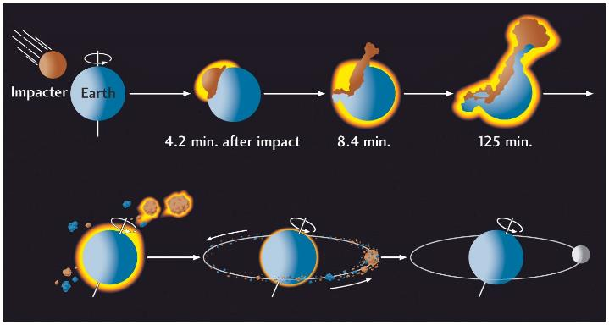
Formation of the Moon
Evidence
1. moon rock is younger than other celestial bodies (~ 30-55 million years)
2. similar composition to earth
3. moon is less dense than earth and other planets…..
So no iron core.
23.5°

Slide 33
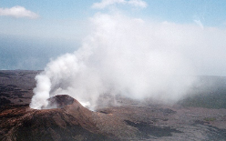
Origin of Earth’s atmosphere
Partial melting resulted in outgassing about 4 billion years ago
Similar to gases emitted from volcanoes
Mainly water vapor
Carbon dioxide, hydrogen
Other gases such as methane and ammonia

Slide 34
Where did the Ocean come from ?
two sources of water
Outgassing
Asteroids (maybe comets)

Slide 35
Origin of Earth’s oceans
Water vapor released by outgassing
Condensed as rain
Accumulated in ocean basins
About 4 billion years ago
Ice Comets were (maybe) also important to adding water to the Earth system

Slide 36
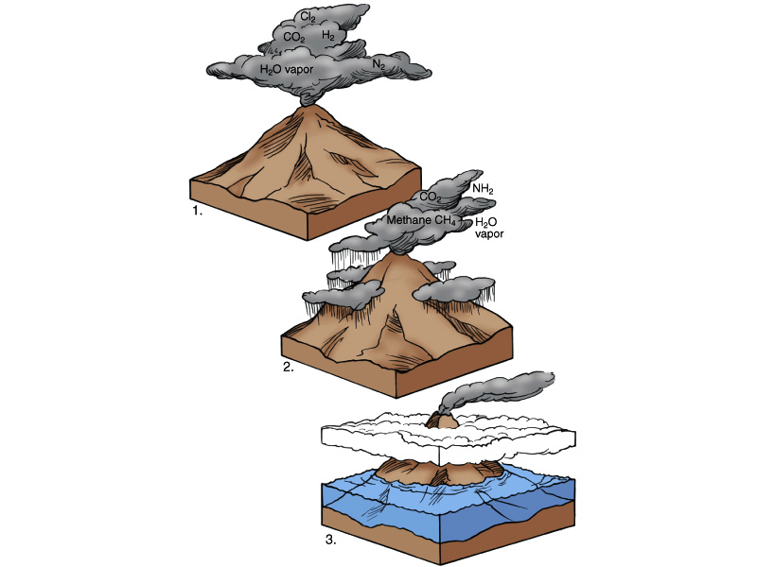
Formation of the Atmosphere and the Ocean
Early Solid Earth
Little or no
Atmosphere
And no Ocean
Outgassing
(Icy Comets)
Very Hot Surface
Condensing Water Vapor
Thick Clouds
Heavy Rain (~20 my)
As Earth cooled
Oceans formed
4 bya

Slide 37
Most of the water on earth is located?
Glaciers
Ocean
Lakes
Atmosphere

