Slide 1
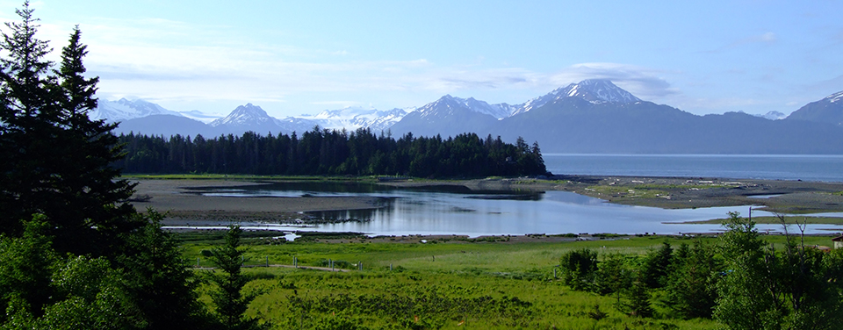
Today’s Class Outline
Mangroves
Salt marshes
Monday – bring your laptop – it’s evaluation day!

Slide 2
What’s on the final?
The final is cumulative.
~40-50% of the final is the new material we’ve covered since exam 3 (lectures 28-37)
~ 50-60% material from the previous exams.
Use the previous exams as a study guide for what topics to focus on.
If I did not ask about it on one of those previous exams, it will not be on the final (except for new material, see point 1 above).

Slide 3
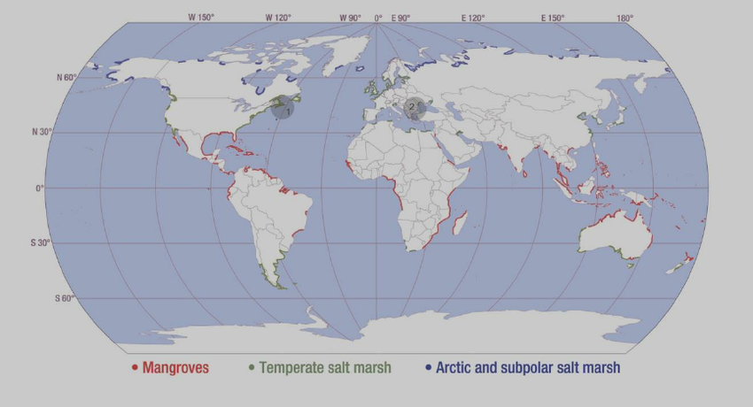
Coastal wetlands: mangroves and salt marshes
Mangroves are ‘forests’ – they contain the only trees that can exist in salt water.
Inter-tidal zone.
Mangroves in lower latitudes, salt marshes in higher latitudes
Salt marshes are ‘grasslands’

Slide 4
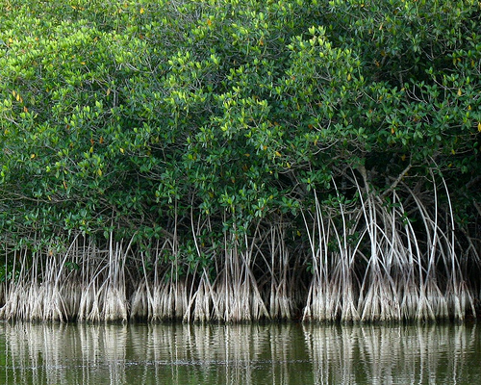
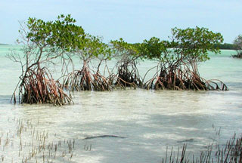
Red mangrove
Contain elaborate “prop” root system - stabilizes the trees.
Roots contain waxy substance that helps keep salt out
~25 m in height
Can handle (tolerant of) full saltine conditions

Slide 5
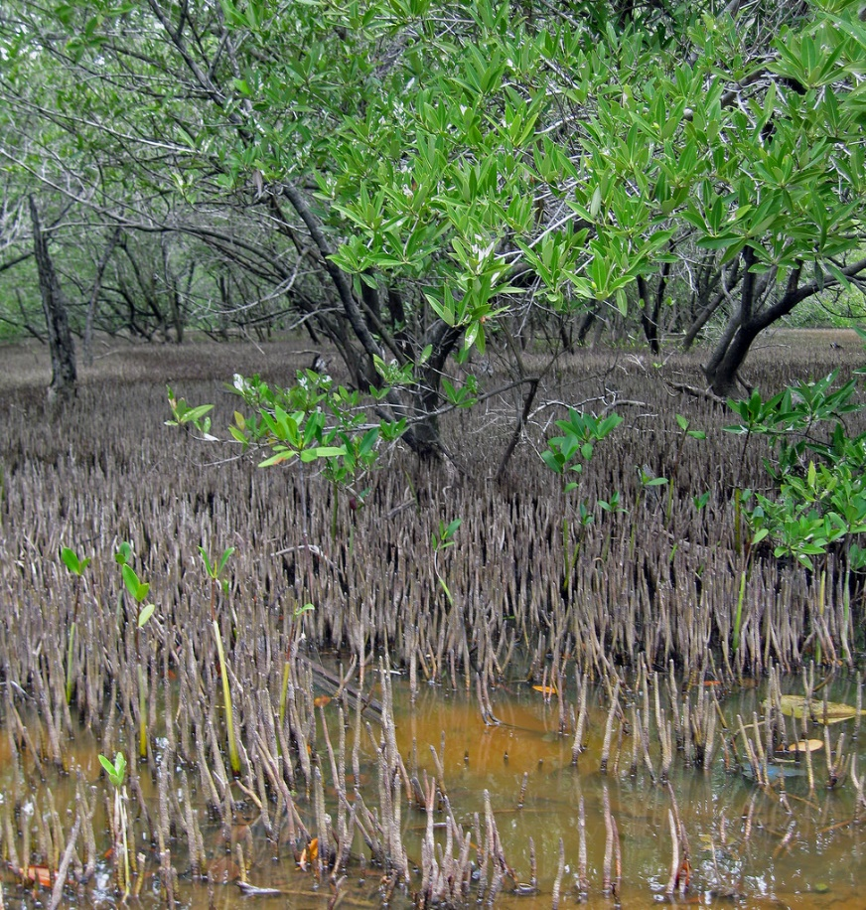
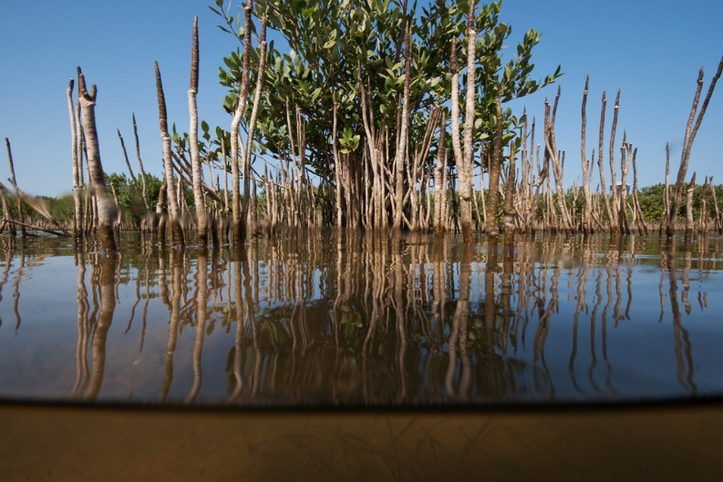
Black mangrove
Easily identified by roots (“pneumatophores”) - specialized to take in oxygen. - tubular bristles, stick out vertically and trap oxygen for its oxygen-starved root systems
Tolerant of high saline conditions
Trees grow in isolated groups –
individual trees large, 20-25 m high

Slide 6
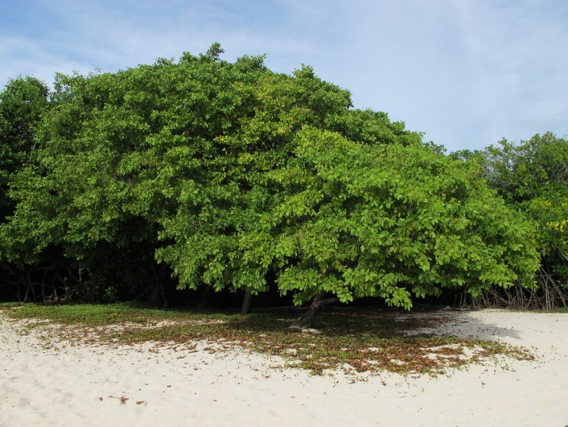
White mangrove
Shortest of the three, ~5 m tall
Doesn’t like complete inundation, so furthest back from shore.
No buttressed (prop) roots.
Unique openings (glands) to that release salt – so leaves are become coated with white salt crystals

Slide 7
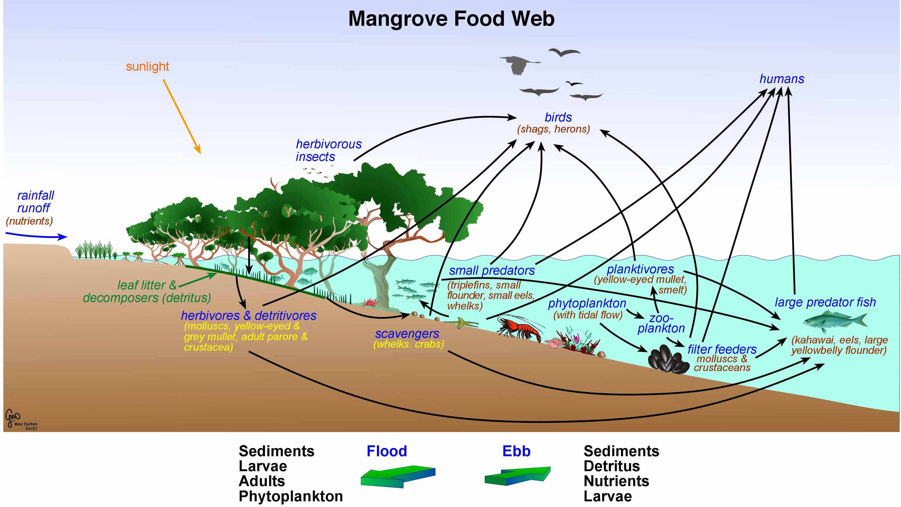

Slide 8
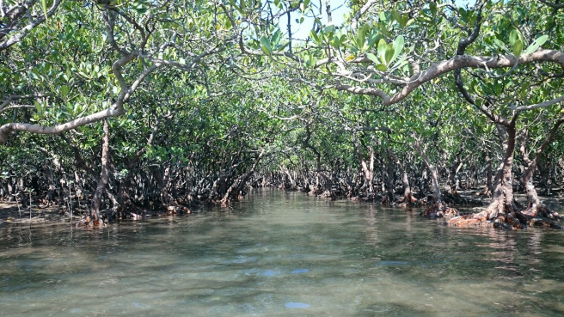
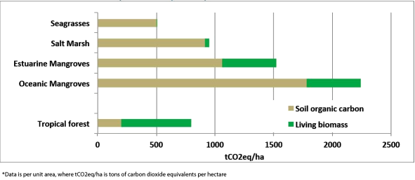
What’s the fuss about? Great habitat, but also important because of…..
CARBON

Slide 9
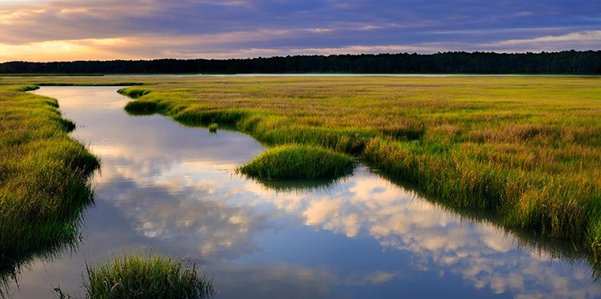
https://www.youtube.com/watch?v=dJ3TsANQBic

Slide 10
Dynamic salt marshes
Redfield 1965

Slide 11
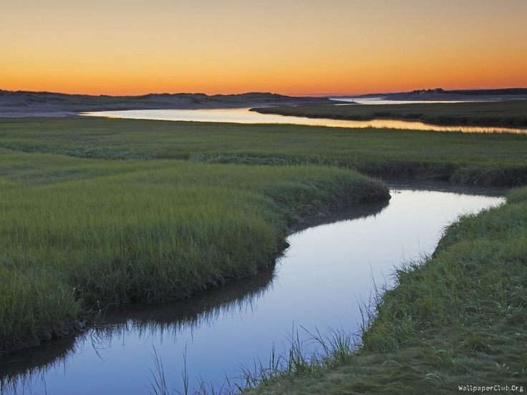
Salt marshes
Coastal wetlands at border of land and ocean
Exposed at low tide, submerged at high tide
Marsh platform (i.e., the surface) delicately situated at border of ocean and land
Plants and animals adapted for these environments

Slide 12
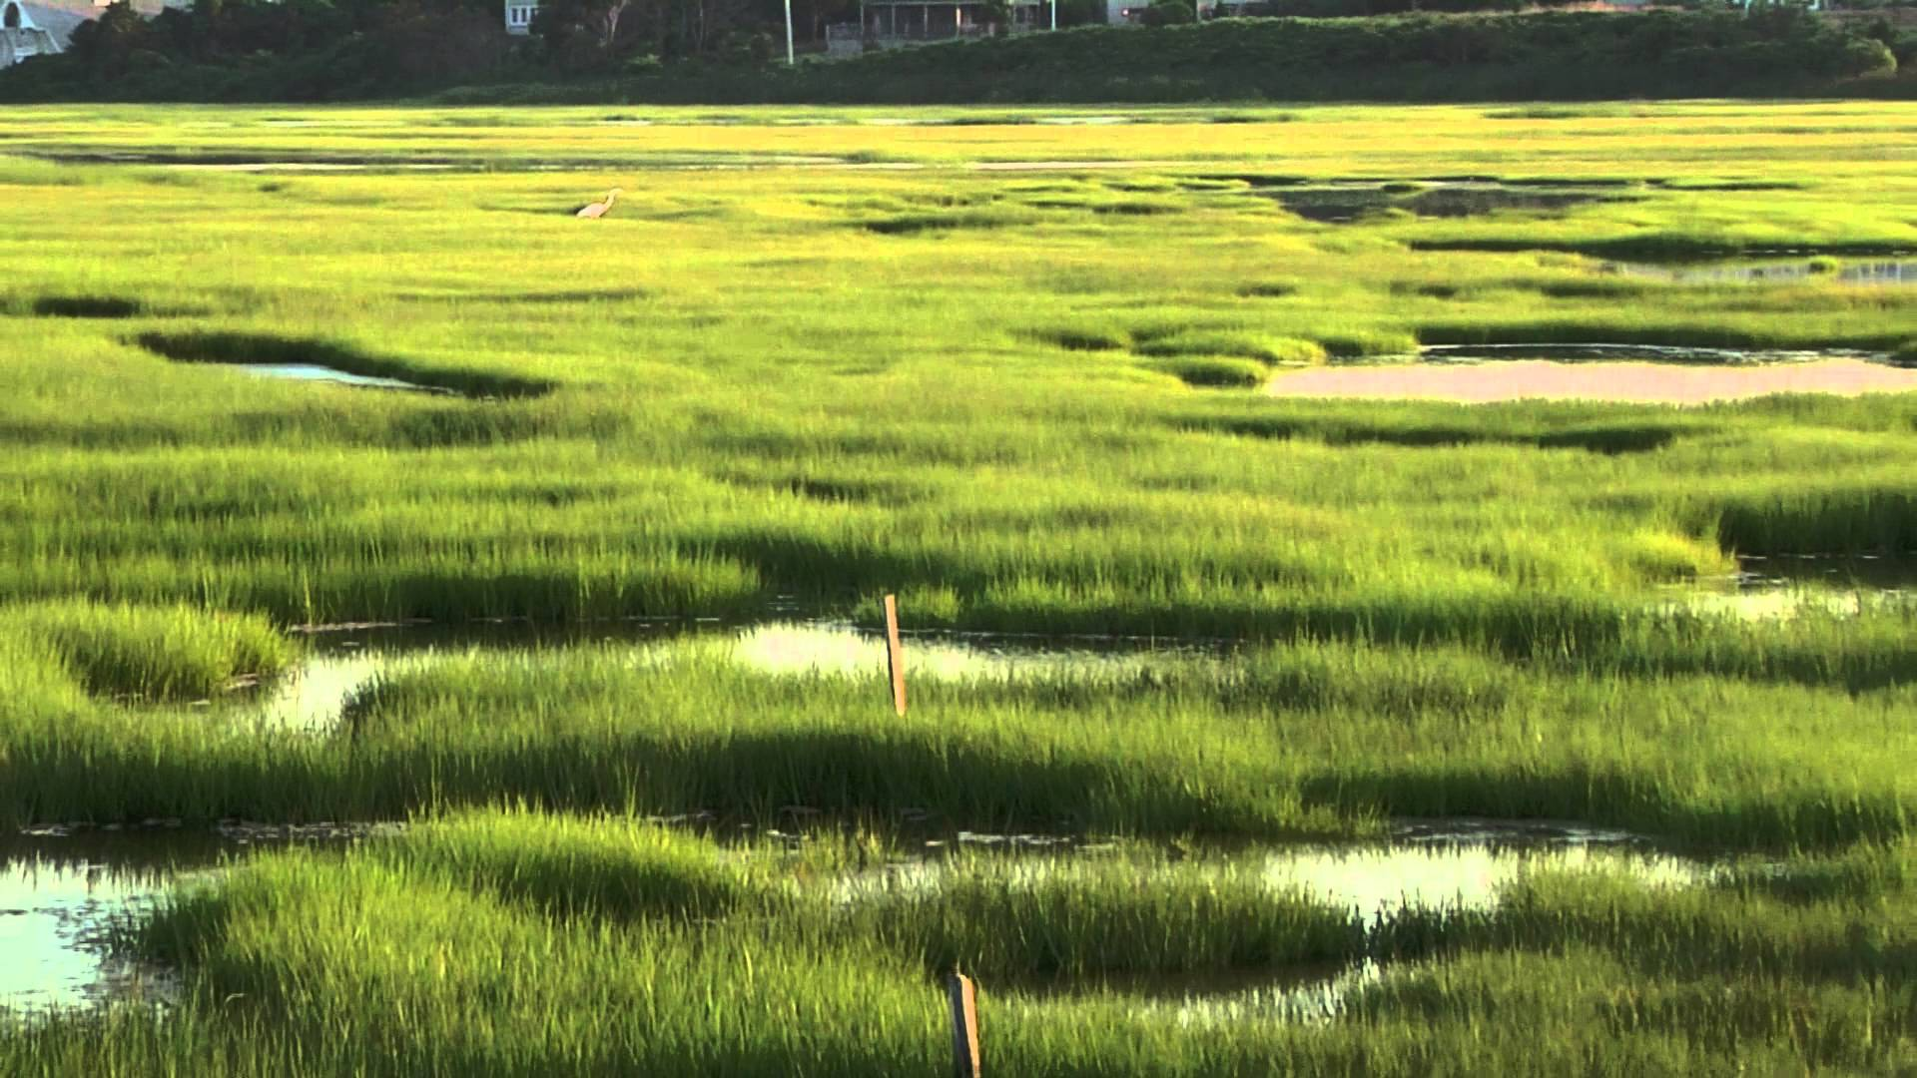
Salt marshes
Most productive ecosystems on Earth – store more C than forests per unit area
Places of rapid and dynamic biogeochemical transformations
Why?
Range of conditions (water availability, oxygen, salinity, nutrients).
Sediments host large variety of microbes that can break down material.

Slide 13
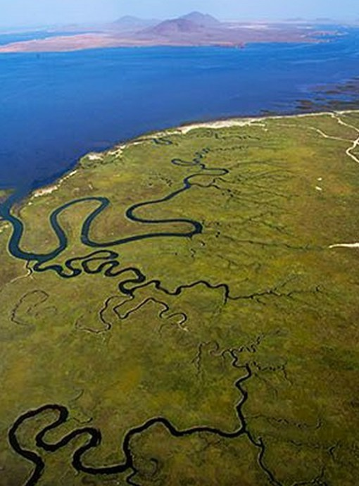
Quick 2 min activity: Turn to the person next to you and come up list of ecosystem services provided by marshes
Lots of carbon storage!
Important habitat: fish, birds, algae, crabs, etc
Flood protection: protect again storm surges, buffer from sea level rise
Nutrient filtration – natural cleaners of water
Recreation – kayaking, birding, hunting

Slide 14
How do marshes maintain their elevation right at the edge of the sea?
Sea level risen over the past 18,000 years by ~100 m
geology.uprm.edu

Slide 15
Mean sea level refers to the height of the sea in relation to a surface reference point. Sea level goes through periodic cycles of change throughout geologic time.
Eustatic – global (climate driven)
Isostatic - local
Global mean sea level rise since the 1990s - ~3.5 mm per year
Notes:
Local – glaciers make land sink, glaciers move away – land rises… for ex.

Slide 16
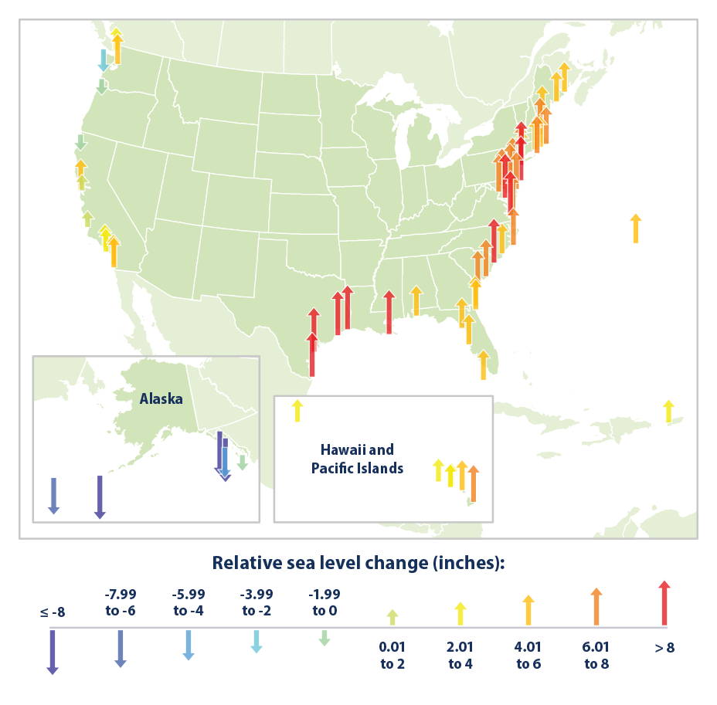
http://tidesandcurrents.noaa.gov/sltrends/sltrends.shtml
Notes:
https://www.epa.gov/climate-indicators/climate-change-indicators-sea-level

Slide 17
Why does sea level change?
Two dominant reasons….
1. Thermal Expansion
2. Melting of glaciers and ice caps
Notes:
Eustatic – global sea level rise

Slide 18
Melting Glaciers is the primary driver of sea level rise.
True
False

Slide 19
Marshes typically keep up with SLR (over last 4000 yrs)
RSLR = ‘relative sea level rise’
Most marshes in New England began developing about 4000 years ago, when rates of SLR slowed to a moderate 0.1 cm/yr
Orson et al. 1998

Slide 20
Accretion basics: driven by biotic and abiotic factors
Sediment Deposition
and
Primary Production
Erosion
and
Decomposition
Primary Production and Sediment inputs contribute positively to accretion – why?
Other Factors
Compaction, Subsidence
Which are abiotic and which are biotic?

Slide 21
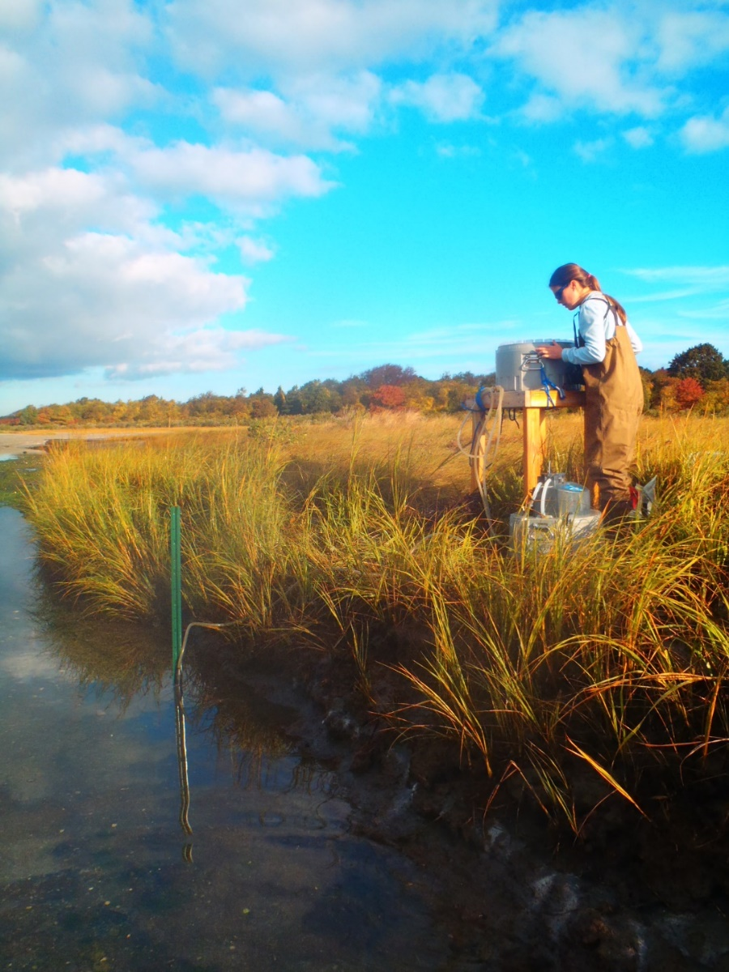
Major Controls on Primary Production in Salt Marsh
Nutrients
Necessary for primary production
Nitrogen limiting nutrient (mostly)
Oxygen Availability
Influenced by tidal inundation- so changes a lot over space and over time
More O₂ = plant happier

Slide 22
Primary Production doesn’t occur aboveground only! Importance of Belowground Organic Matter
Majority of organic matter in marsh belowground!
Image: Simon Mudd

Slide 23
HF = High Fertilization
LF = Low Fertilization
C = control
U= urea (another fertilizer type)
Rhizomes and roots are below ground
Notice percentage of biomass aboveground vs. rhizomes!
Importance of nutrients
Majority of organic matter in marsh belowground
Valiela et al. 1974

Slide 24
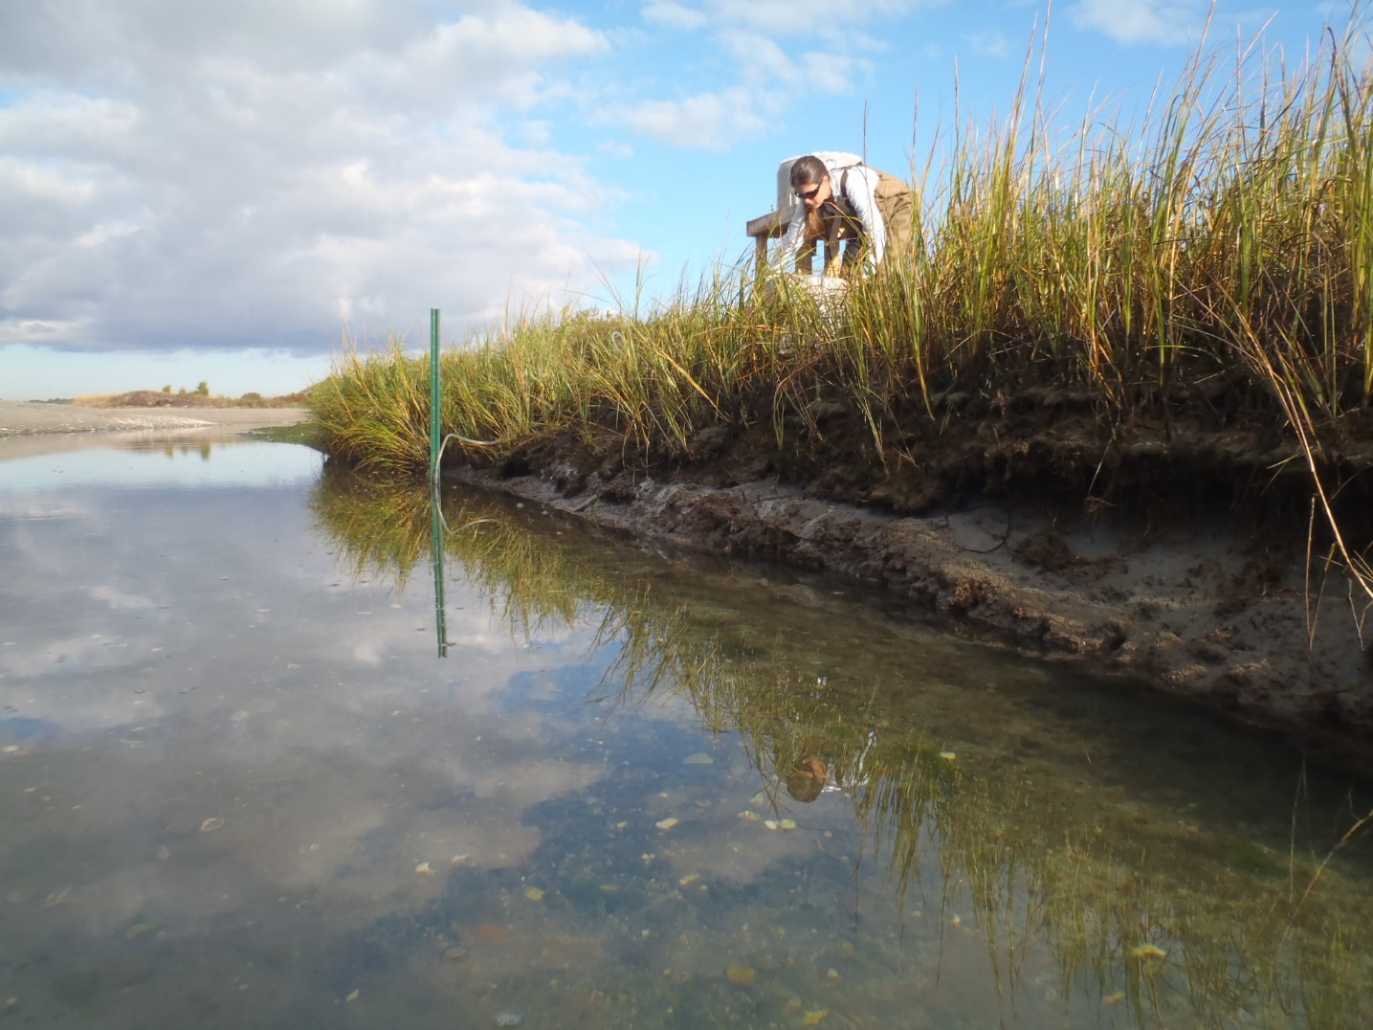
Mud!
You cannot have a marsh without sediment
Sediment brought into marsh via tides and rivers
Marsh grasses trap sediment
More sediment available allows for marsh stability at higher rates of SLR

Slide 25
Accretion basics: driven by biotic and abiotic factors
Sediment Deposition
and
Primary Production
Erosion
and
Decomposition
Other Factors
Compaction, Subsidence
Decomposition of organic matter and erosion contribute to negatively to accretion – why?

Slide 26
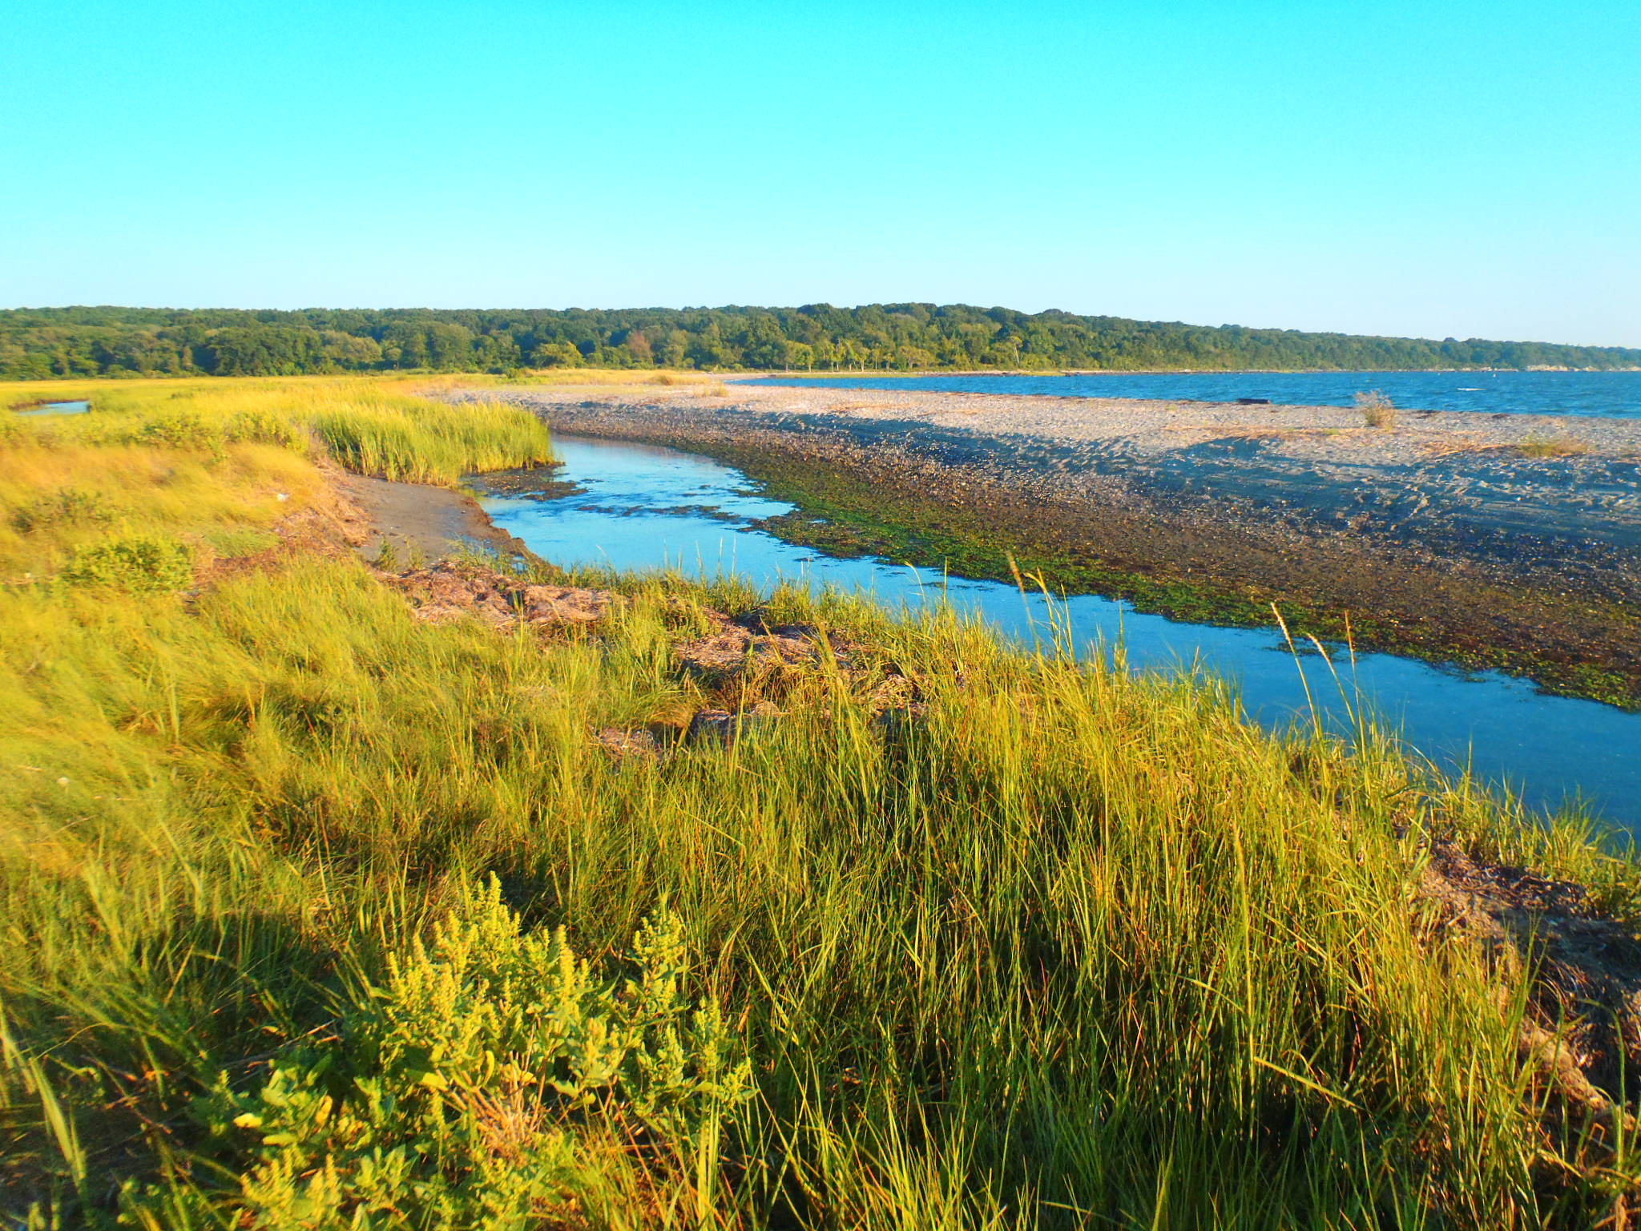
Controls on Decomposition Rates?
Oxygen availability (positive relationship, function of inundation)
Temperature (positive relationship)
Controls on Erosion Rates
Plant presence and condition
Wave action, storms, proximity to disturbances

