Slide 1
Hydrothermal Vents
November 7, 2018
Any slide that says Oxford University courtesy of my colleague Anni Djurhuus

Slide 2
All life on earth is ultimately dependent on sunlight.
True
False

Slide 3
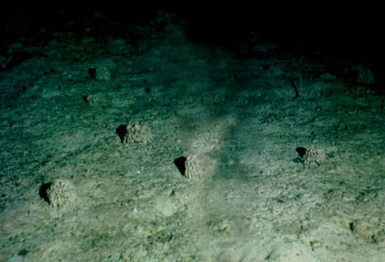
Deep Ocean - cold (0-3 °C) & Dark
No photosynthesis …
so where does the food come from?

Slide 4
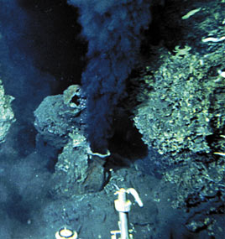
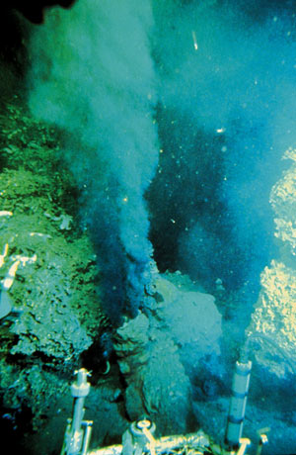
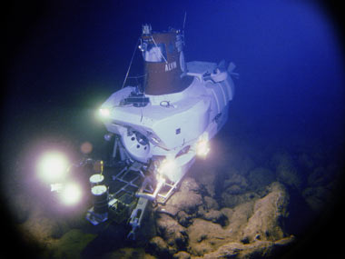
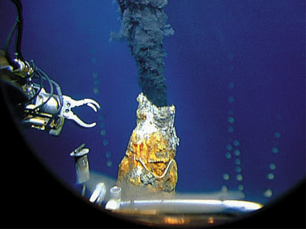
Hydrothermal Vents
1977: The Galapagos Rift
Black smokers and 350 ºC water found.
The first black-smoker chimney—
whoi.edu

Slide 5
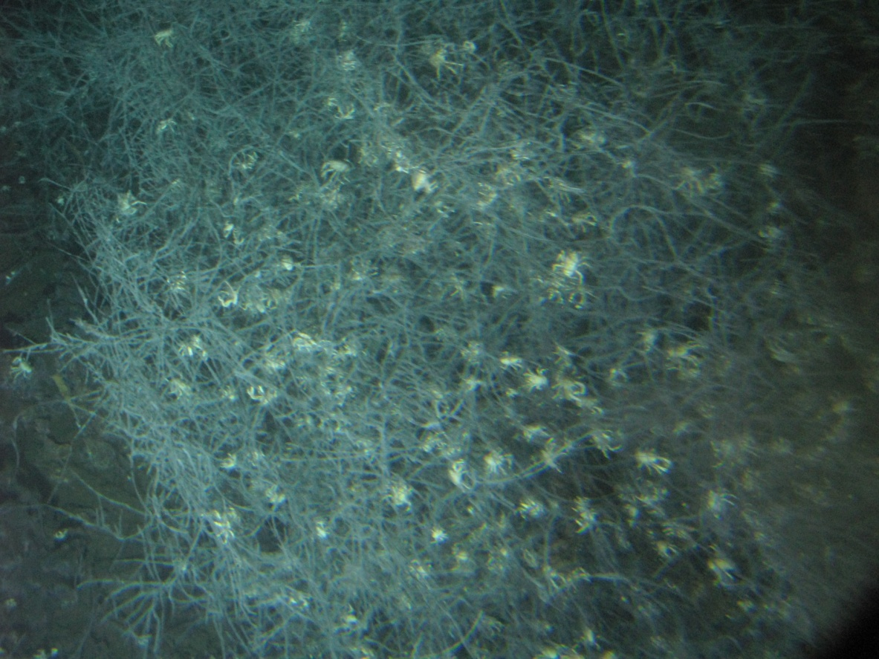
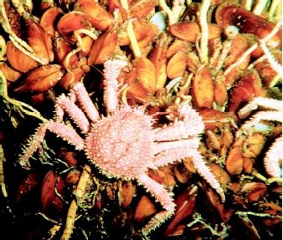
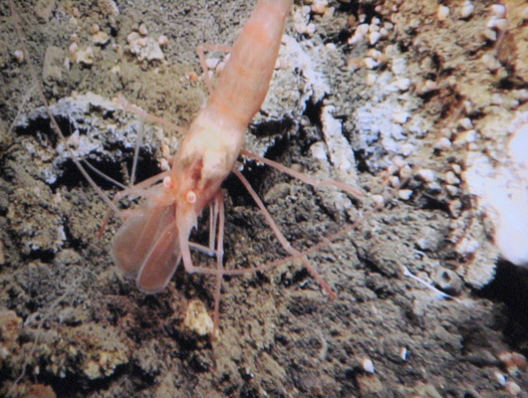
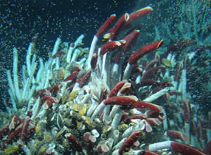

Slide 6
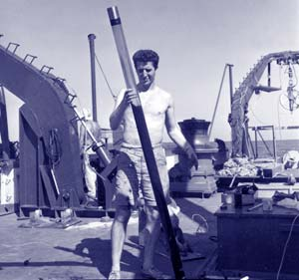
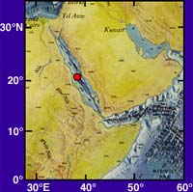
Early Clues - 1
Red Sea “Hot Brines”
1880s, Russian ship Vitaz,
Sampled 600m deep
found water to be hotter than expected.
1964, British Discovery
deep Red Sea waters 44°C (111°F)
1965 the R/V Atlantis II
Water temps of 56°C (133°F).
Dr. David A. Ross of Woods Hole Oceanographic Institution examines a sediment core collected in the Red Sea during a 1965 expedition on board R/V Chain. (Photo courtesy of WHOI Archives)
http://www.divediscover.whoi.edu/vents/index.html

Slide 7
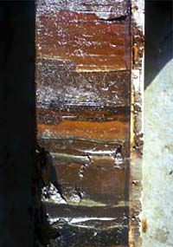
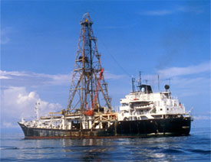
Early Clues - 2
Metal-Rich Sediments
1968 – 1983, Deep Sea Drilling Project, Golmar Challenger
Cores contained metal-rich sediments on top of volcanic ocean crust
Not just the Red Sea!
Atlantic, Pacific, Indian … wherever seafloor was spreading!
http://www.divediscover.whoi.edu/vents/index.html

Slide 8
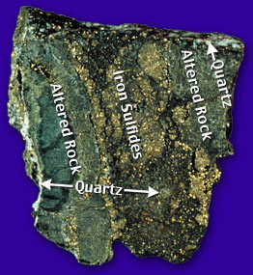
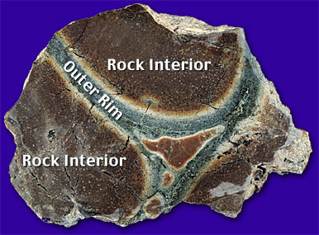
Early Clues - 3
Unusual Rocks
Most ocean-ridge rocks are black, white, pale green
Found mid-ocean ridge rocks of brown, orange, and dark green
Could only come from chemical reactions
involving hot water!
http://www.divediscover.whoi.edu/vents/index.html

Slide 9
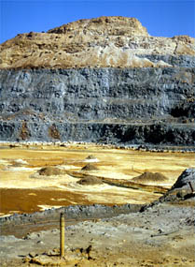
Early Clues - 4
Ophiolites
Ocean crust on land
Brought up onto continents during tectonic movement
Copper mine in Cyprus
http://www.divediscover.whoi.edu/vents/index.html

Slide 10
Early Clues - 5
“Missing Heat”

Slide 11
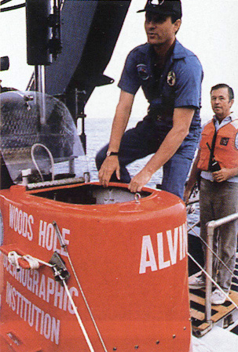
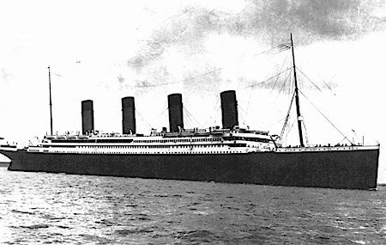
Discovery Cruises
In 1977 → a group of geologists
→ found one of the most exciting biological phenomena

Slide 12
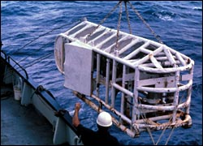
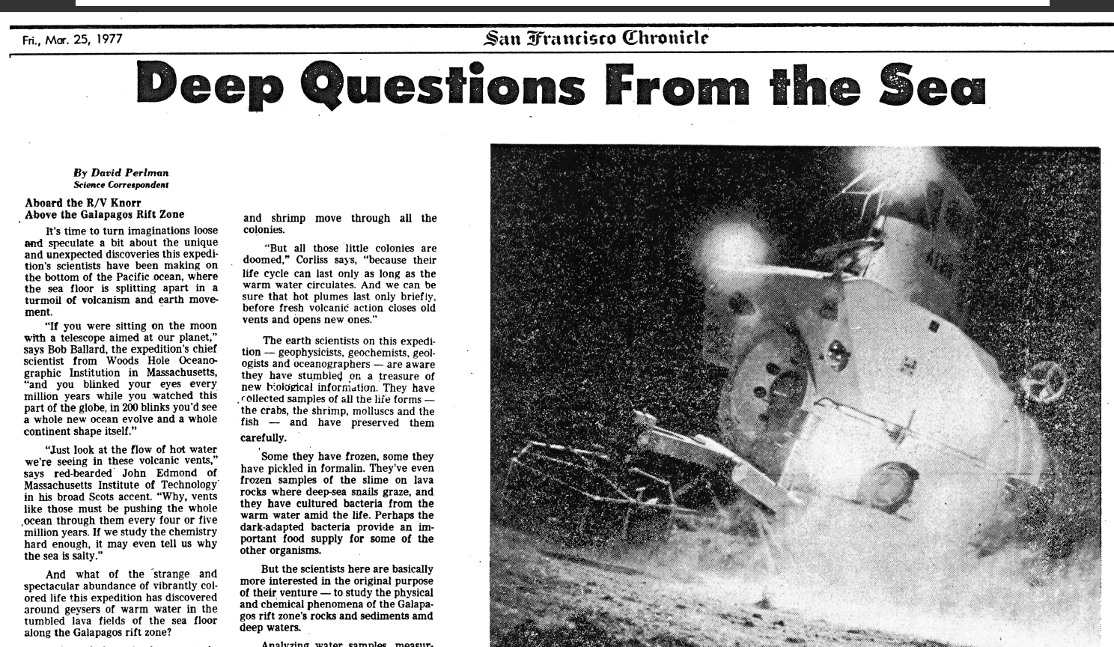
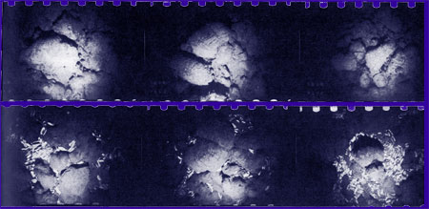
Discovery Cruises
ANGUS

Slide 13
Alvin diving on vents:

Slide 14
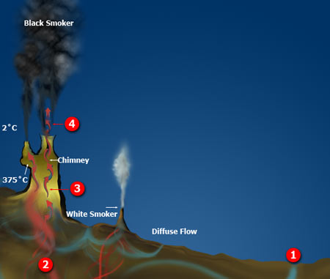
How do Hydrothermal Vents Work?
1. Cold seawater (2°C) seep into ocean floor cracks
2. 350 - 400°C, water reacts with crust
- oxygen removed
- becomes acidic
- picks up dissolved metals (Fe, Cu, Zn)
- Picks up hydrogen sulfide (H₂S)
3. Hot liquid rises carrying metals and H₂S
4. Exits, mix with cold, oxygen-rich water
- Black smoker: Metals and Sulfides mix
to form black minerals
- White smoker: Not as hot, silica and
anhydrite (white) precipitate

Slide 15
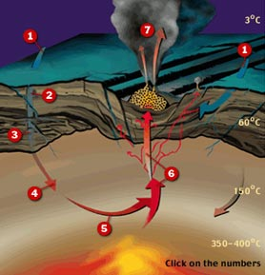
Vent Chemistry Affect Entire Ocean
7. Cold, oxygen precipitate
metals and sulfur
1. Cold seawater sinks into crust
2. Oxygen and
Potassium removed
3. Calcium, Sulfate,
Magnesium removed
6. Hot fluids carrying
dissolved metals
4. Sodium, Calcium, Potassium
from crust enter fluid
5. Copper, Zinc, Iron, Sulfur
from crust enter fluid
http://www.divediscover.whoi.edu/vents/index.html

Slide 16
Black Smokers vs. White Smokers
There are two main types of hydrothermal vents.
"Black smokers" are another name for the most common type. They are named for the black colored water that comes out of them, like the picture on the left. The black "smoke" is caused the presence of iron and sulfur, which combine to become iron monosulfide, which has a black color. When the iron monosulfide solidifies, it created the black chimneys. "White smokers" are the cooler cousins of black smokers. These vents release cooler water then "black smokers". These vents contain more barium, calcium and sillicon. These elements also have a white color, causing the white "smoke", as seen on the right. White smokers also create white chimneys, which are usually smaller.
Notes:
http://hydrothermalventszcrenshaw.weebly.com/black--white-smokers.html

Slide 17
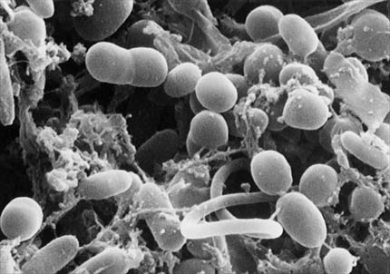
Life Without Sunlight
Chemosynthesis: Uses chemical energy instead of solar energy
Microscopic Archaea (bacteria-like organisms)
H₂O + CO₂ + H₂S + O₂ → CH₂O + H₂SO₄
Water Carbon dioxide Hydrogen sulfide Oxygen Carbohydrates Sulfuric acid
Chemosynthetic bacteria
whoi.edu

Slide 18
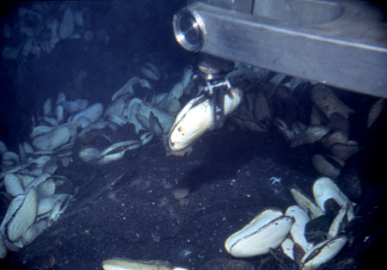
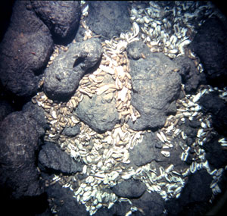
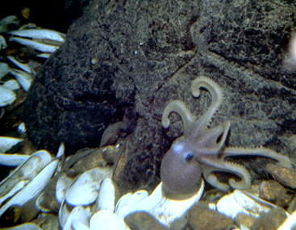
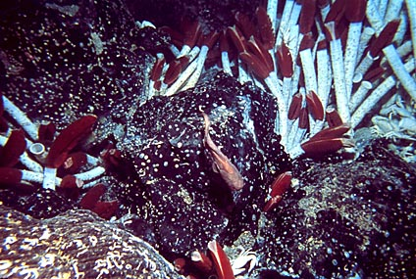
Life Without Lights
1977, The Galapagos Rift, thriving biological community
whoi.edu

Slide 19
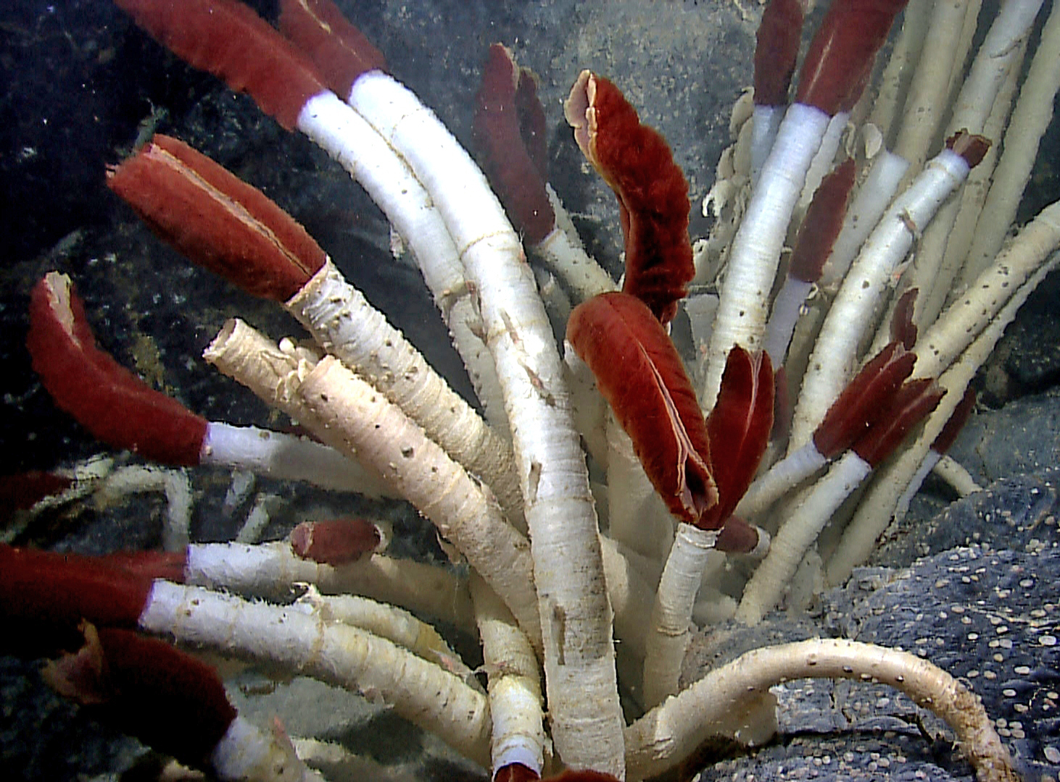
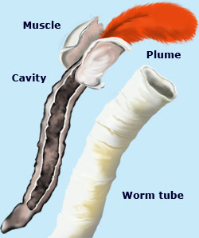
Life Without Lights
Tube Worms
Plume filters oxygen, hydrogen sulfide and CO₂ from seawater.
Plume contains hemoglobin (that’s why it’s red).
Blood transports chemicals to bacteria in the cavity.
Bacteria produces sugar and tube worms use some of it (symbiosis).
Worm tubes made of chitin

Slide 20
One of my favorite stories of scientific discovery:
https://video.tpt.org/video/how-giant-tube-worms-survive-at-hydrothermal-vents-cpms1j/

