Slide 1
Sediments, organic matter, decomposition, remineralization….ahhhhhh!! (Sediments are the best!)

Slide 2
Why Sediments?
Vertical distance = 4-6 km
Horizontal distance = 1000’s km
Large area of contact between seawater and sediment
Sediments are reservoirs for nutrients, carbon, microbes!
Hot spots of biogeochemical cycling!
In relation to water column – understudied…. So much to learn!

Slide 3
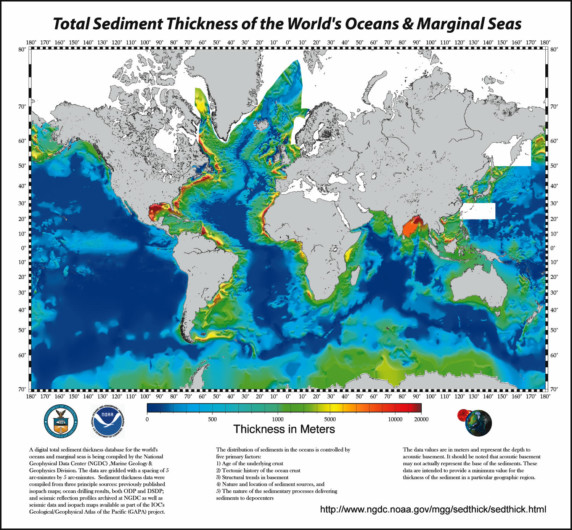

Slide 4
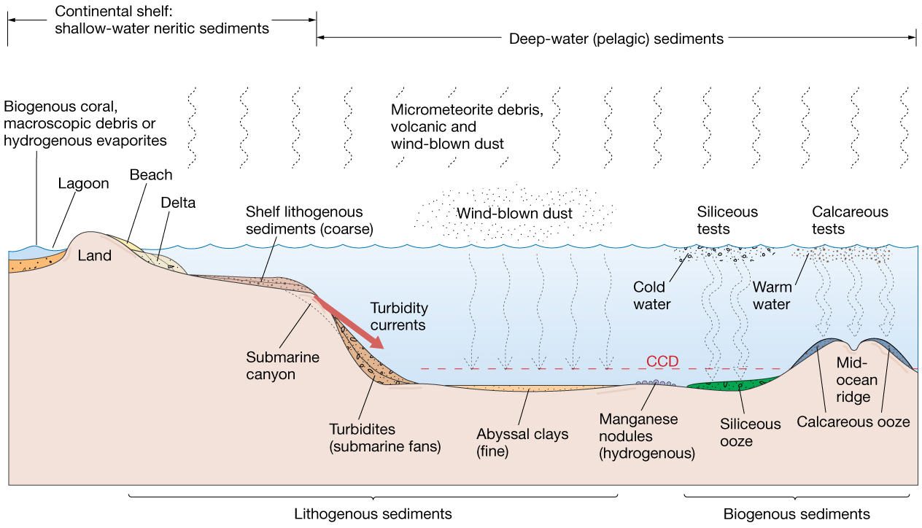
Marine Sediment Mixtures
Usually mixture of different sediment types
Typically one sediment type dominates in different areas of the sea floor.

Slide 5
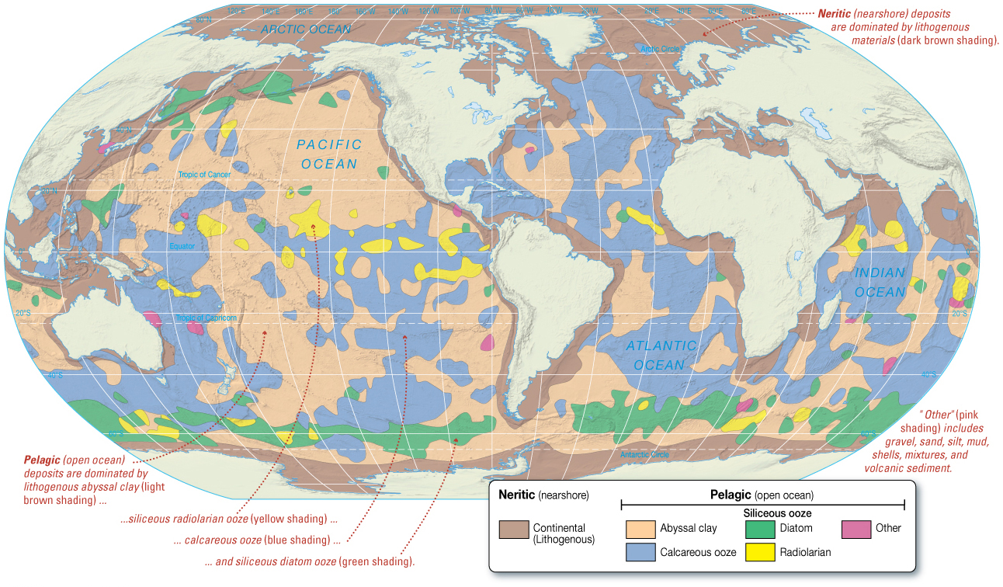
Pelagic and Neritic Sediment Distribution
Neritic sediments cover about ¼ of the sea floor.
Pelagic sediments cover about ¾ of the sea floor.

Slide 6
Neritic Deposits
Dominated by lithogenous sediment, may contain biogenous sediment
Carbonate Deposits
Carbonate minerals containing CO₃
Marine carbonates primarily limestone
CaCO₃
Most limestones contain fossil shells
Suggests biogenous origin
Ancient marine carbonates constitute 25% of all sedimentary rocks on Earth.

Slide 7
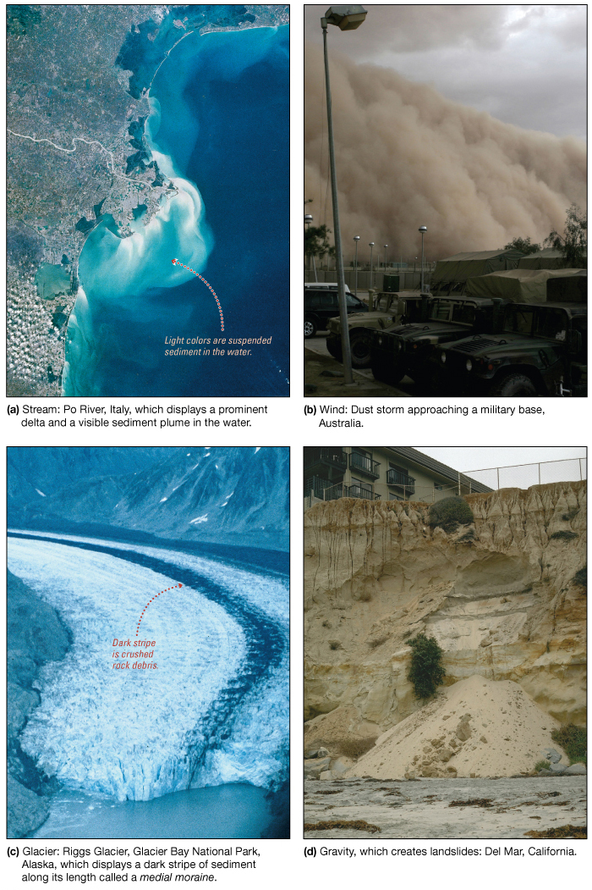
Lithogenous Sediments
Small particles eroded and transported
Carried to ocean
Streams
Wind
Glaciers
Gravity
Greatest quantity around continental margins

Slide 8
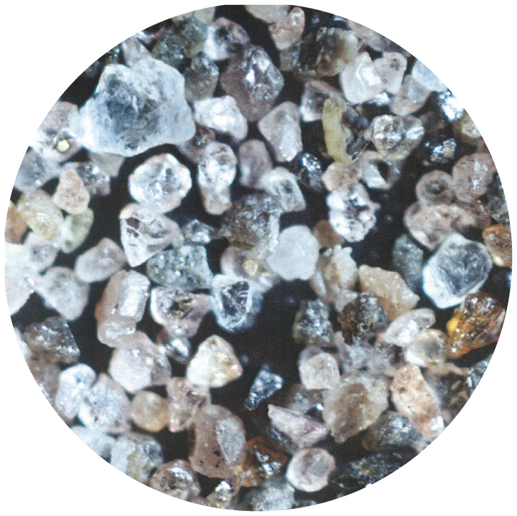
Lithogenous Sediments
Reflect composition of rock from which derived
Coarser sediments closer to shore
Finer sediments farther from shore
Mainly mineral quartz (SiO₂)

Slide 9
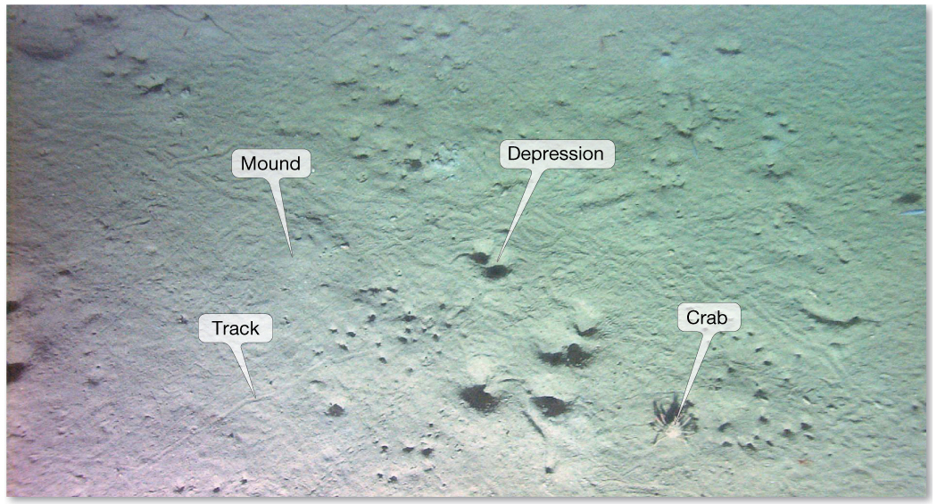
Pelagic Sediments
Eroded particles
Fragments of dust, dirt, other debris
Suspension settling – sediments settle out of water and accumulate on ocean floor.

Slide 10
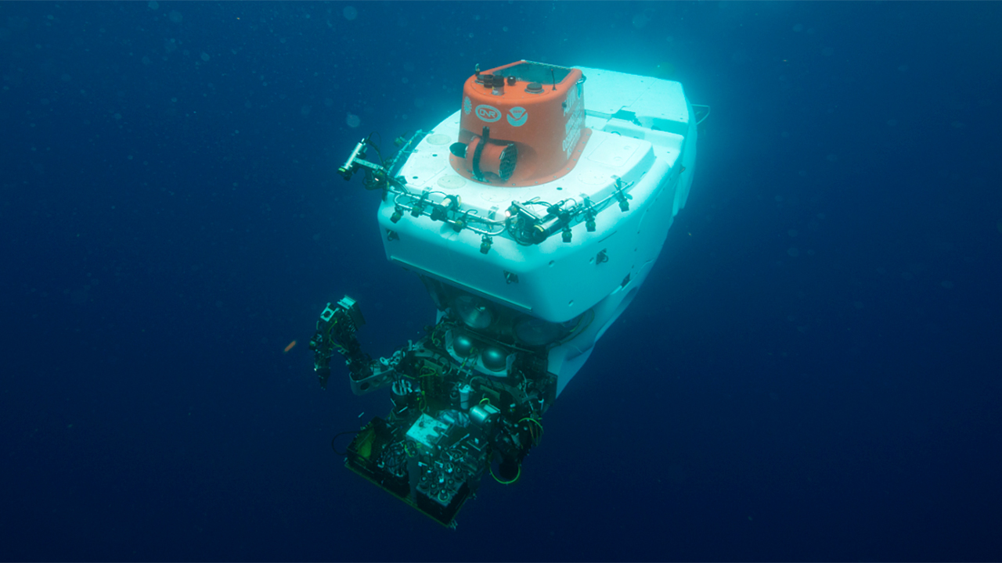
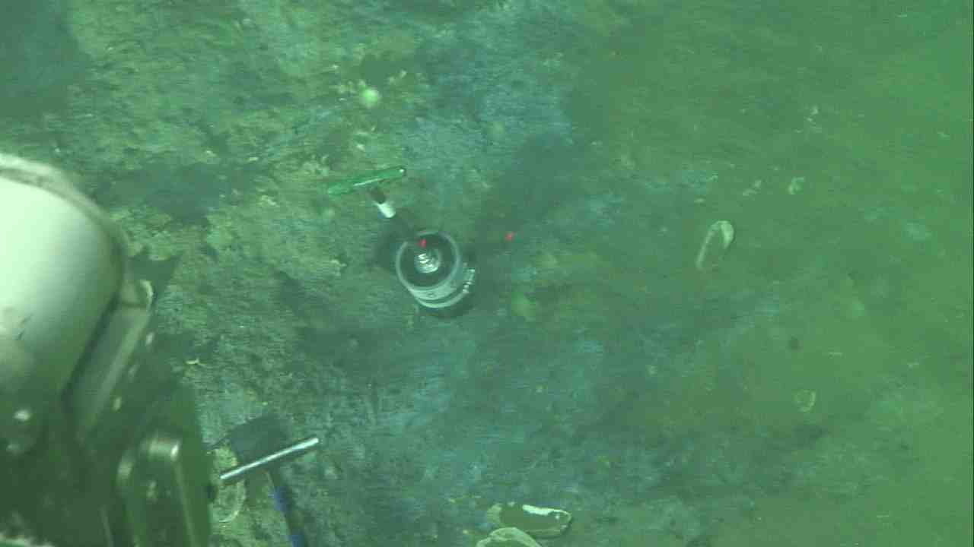
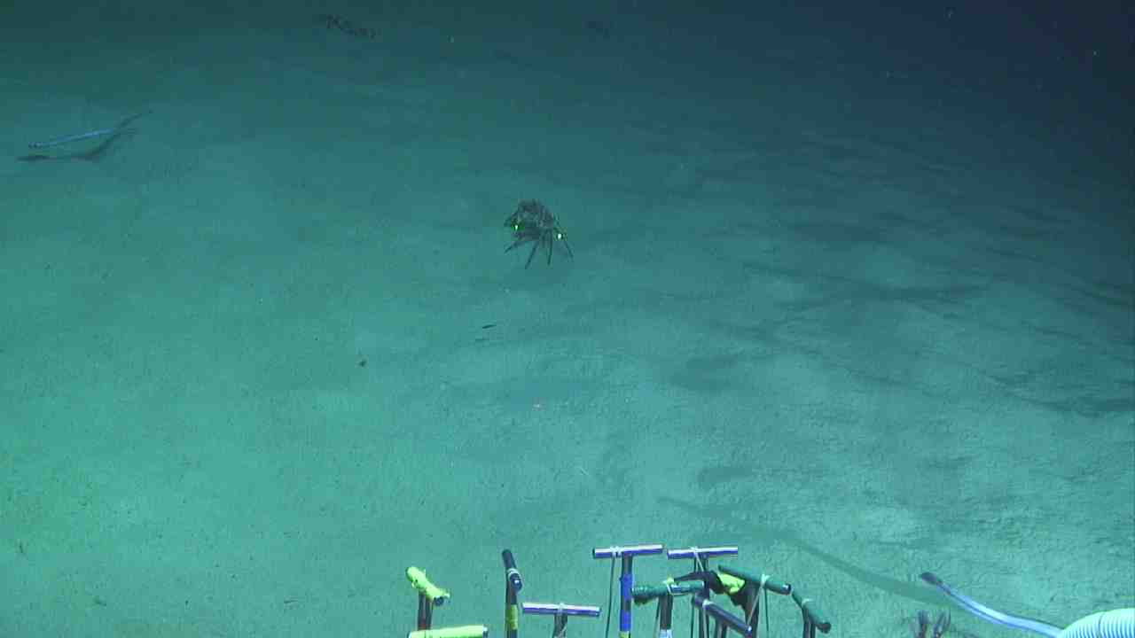
http://4dgeo.whoi.edu/alvin

Slide 11
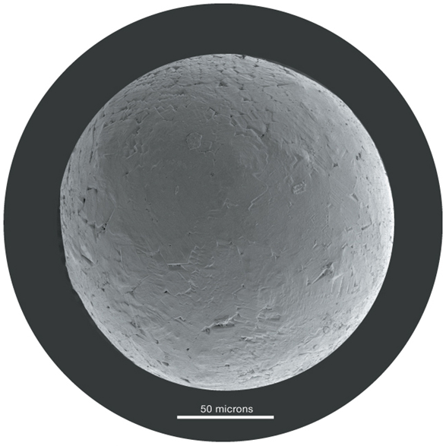
Cosmogenous marine sediments
Macroscopic meteor debris
Overall, insignificant proportion of marine sediments
Space dust!

Slide 12
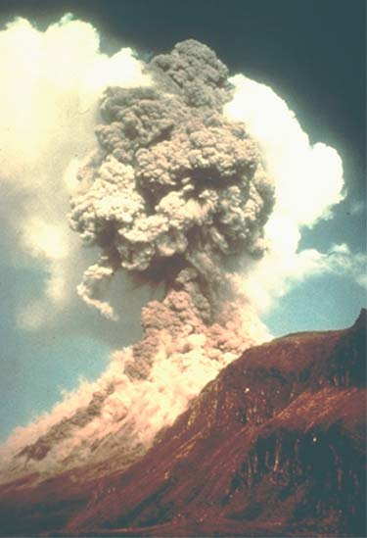
Volcanogenous marine sediments
Comes from volcanoes…ash
distributed in the marine realm by wind, streams, submarine gravity flows, ocean currents, and sea ice.

Slide 13
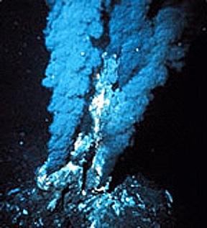
Hydrogenous (derived from water)
Also known as Authigenic
Near hydrothermal vents, lots of metal ions are released into the water, and these ions oxidize or combine with silica and precipitate out as dark, metal-rich sediment.
Minerals precipitate directly from seawater
Manganese nodules
Phosphates
Carbonates
Metal sulfides
Small proportion of marine sediments
Distributed in diverse environments
→ less common than lithogenous or biogenous sediments. They are almost never the dominant sediment type.

Slide 14
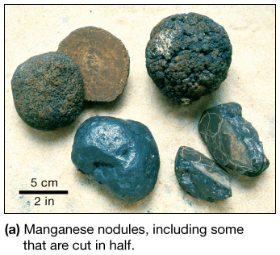
Manganese Nodules
Fist-sized lumps of manganese, iron, and other metals
Very slow accumulation rates
Many commercial uses
Unsure why they are not buried by seafloor sediments

Slide 15
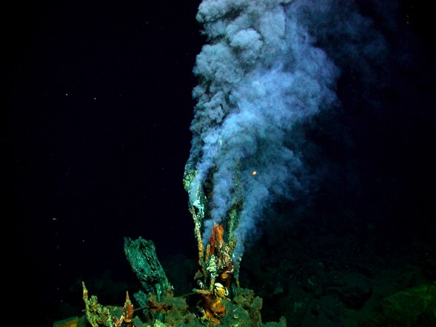
Metal Sulfides
Metal sulfides
Contain:
Iron
Nickel
Copper
Zinc
Silver
Other metals
Associated with hydrothermal vents

Slide 16
Biogenous marine sediments
Hard remains of once-living organisms
Shells, bones, teeth
- Macroscopic (large remains)
- Microscopic (small remains)
Tiny shells or tests settle through water column
Commonly either calcium carbonate (CaCO₃); Calcite or silica (SiO₂ or SiO₂·nH₂O)
Usually planktonic (free-floating)

Slide 17
POM Supply to Benthos
From Casciotti

Slide 18
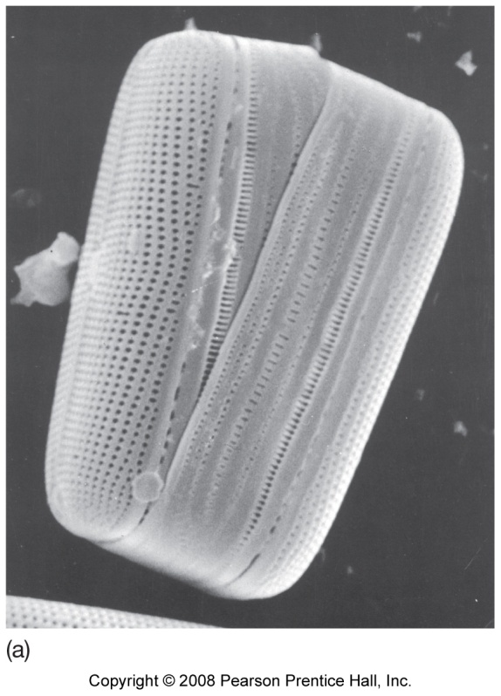
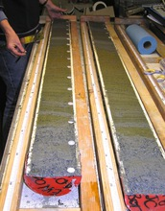
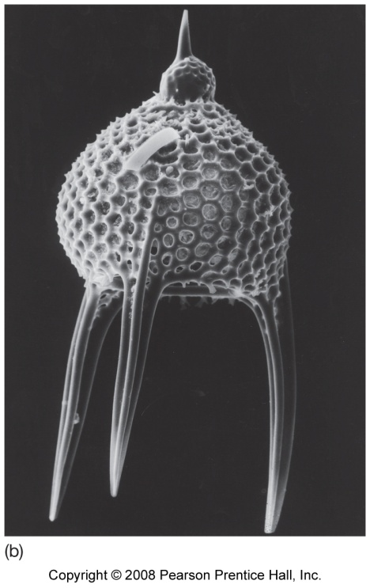
Silica in biogenic sediments
Diatoms (algae)
Photosynthetic
Diatomaceous earth
Radiolarians (protozoans)
Siliceous ooze
If 30% or more of sediment is made up of biogenic material –we call it ooze!

Slide 19
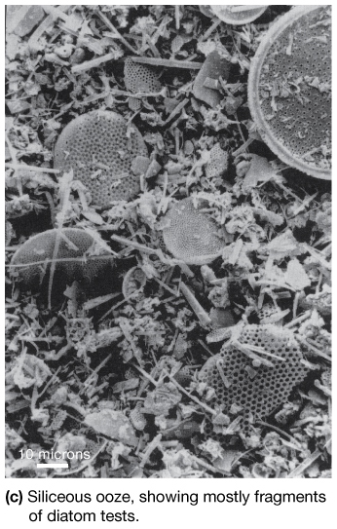
Silica in Biogenous Sediments
Tests – shells of microscopic organisms
Tests from diatoms and radiolarians generate siliceous ooze.

Slide 20
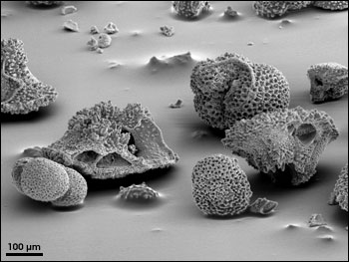
Calcium carbonate in biogenous sediments
Foraminifera (protozoans)
Calcareous ooze

Slide 21
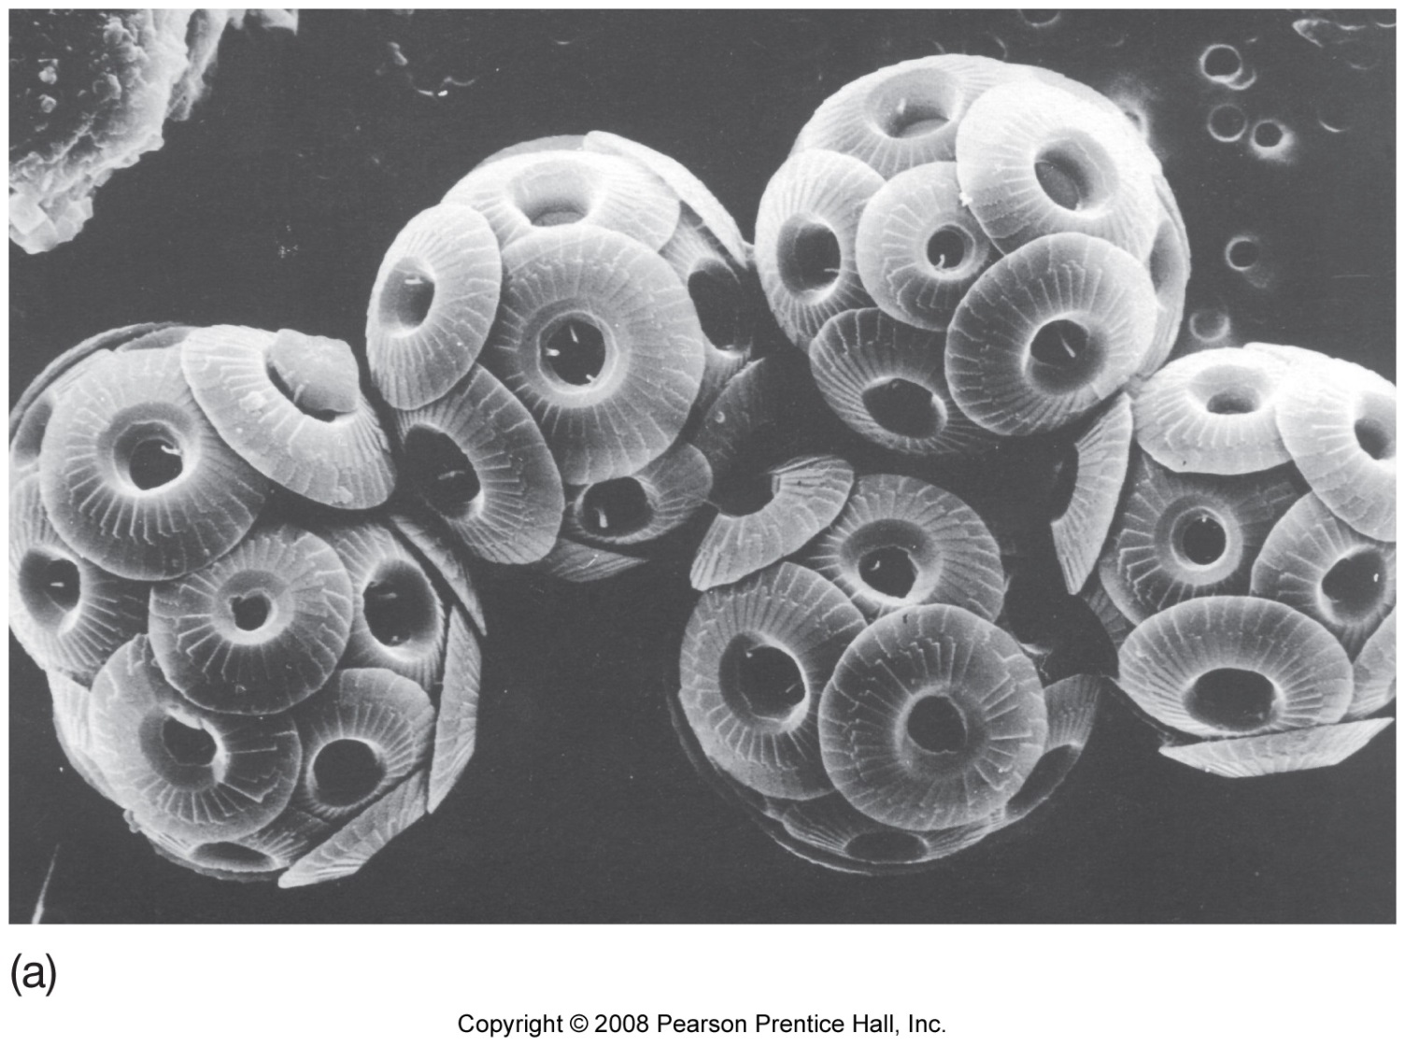
Calcium carbonate in biogenous sediments
Coccolithophores (algae)
Photosynthetic
Coccoliths (nano-plankton)
Rock chalk

Slide 22
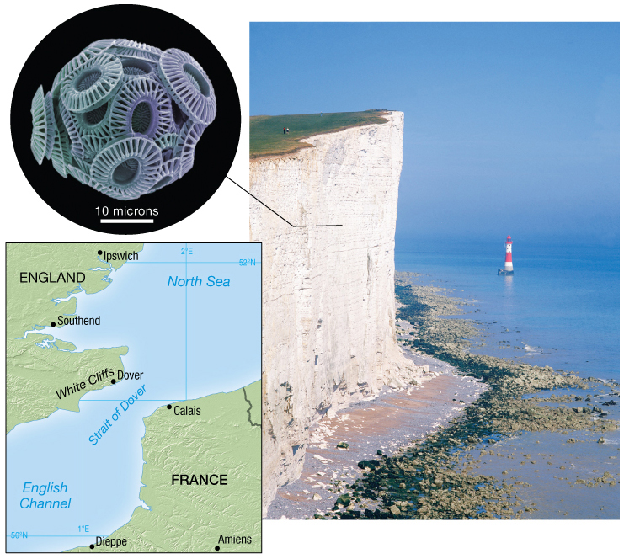
White Cliffs of Dover
Notes:
Highest height 350 ft or 110 m

Slide 23
Factors controlling distribution biogenous sediments
Productivity
Number of organisms in surface water above ocean floor
Destruction
Skeletal remains (tests) dissolve in seawater at depth
Dilution
Deposition of other sediments decreases percentage of biogenous sediments

Slide 24
Pelagic Deposits
Siliceous ooze
Accumulates in areas of high productivity
Silica tests no longer dissolved by seawater when buried by other tests

Slide 25
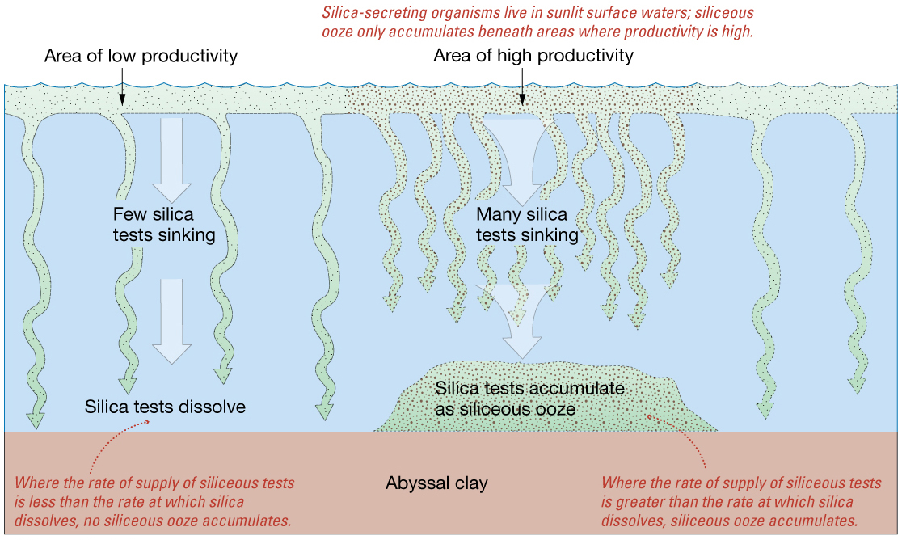
Pelagic Deposits

Slide 26
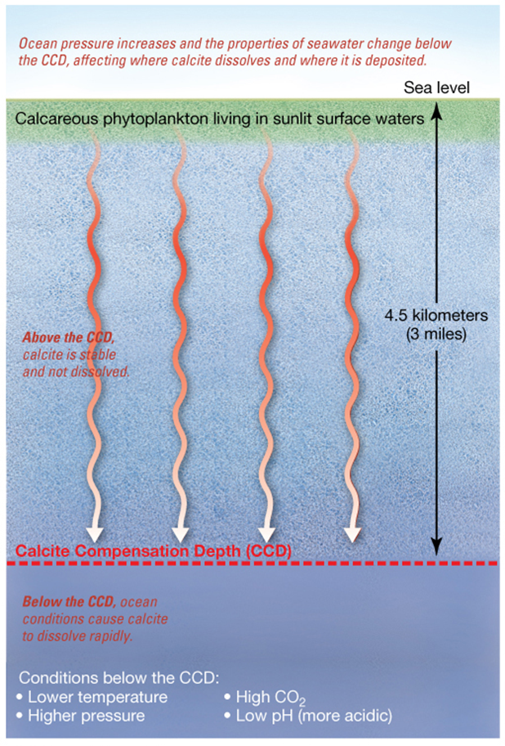
Calcareous Ooze
CCD – Calcite compensation depth
Depth where CaCO₃ readily dissolves
Rate of supply = rate at which the shells dissolve
Warm, shallow ocean saturated with calcium carbonate
Scarce calcareous ooze below 5000 meters (16,400 feet) in modern ocean
Ancient calcareous oozes at greater depths if moved by sea floor spreading

Slide 28
Diagenesis -
Greek - dia → “passing through”
- genesis → “origin, birth”
Diagenesis is the “sum of all processes that change a sediment or sedimentary rock subsequent to its deposition from water, but excluding metamorphism and weathering” (Berner, 1980)
(Or reactions in modern sediments!)
Notes:
Other geochemical transformations of sediments: • Metamorphism: burial reactions that take place at high pressure and temperatures >150oC • Weathering: reactions resulting from the effect of atmospheric contact on sediments (after uplift)

Slide 29
Diagenesis is Important for many reasons…..
1) Biogeochemical cycling
2) Geochemical balance depends on balance between burial and remobilization
3) Surface sediments are home to many organisms! (important food webs)
4) Production of oil, etc.
We are going to focus on reactions in top 100 m of sediment.
Processes happening at low temperature….
Examples: chemical reactions, microbial activity, compaction, dewatering, etc.

Slide 30
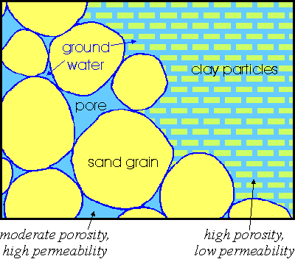
Porosity and Permeability
φ = porosity of sediment (cm_{water}³ /cm_{sed}³) = vol of space/total vol
Permeability – ability of a sediments to pass
water through pores and cracks
Diffusion dominates in muddy sediments
Advection dominates in sandy sediments
Notes:
Porosity Figure from: http://www.maine.gov/dacf/mgs/explore/water/facts/aquifer.htm
Flow figure from: https://www.mpi-bremen.de/en/Research-Projects-27.html

Slide 31
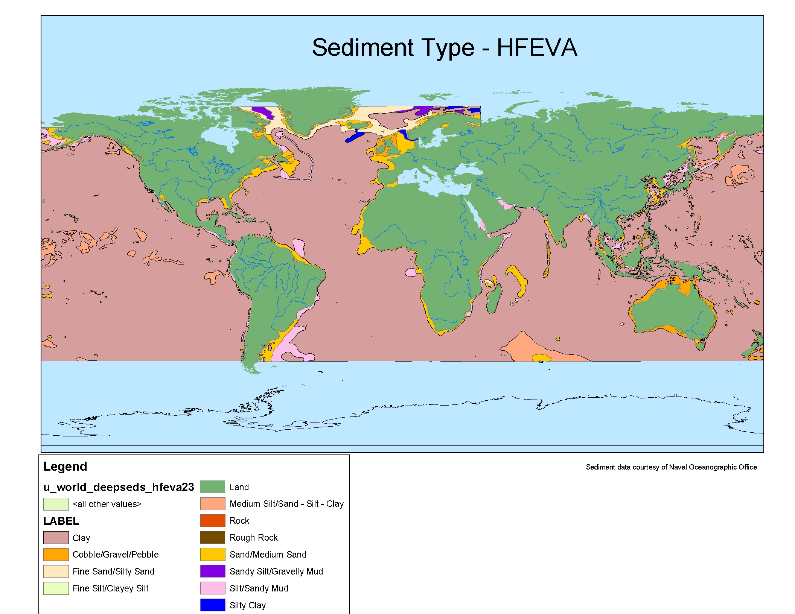
Sediment Type – Grain Size (HFEVA)
Notes:
HFEVA: High Frequency Environmental Acoustics

Slide 32
Compaction and Porosity
φ = porosity of sediment (cm_{water}³ /cm_{sed}³) = vol of space/total vol
Idealized porosity estimation as an exponential function of an initial porosity at the surface
φ = φ ₀e^{-cz}
c is average compressibility
z is depth

Slide 33
Real porosity differs from the exponential function
Each sediment layer has its own composition & compressibility
Orsini et al. (2003) – Ross Sea Antarctica

Slide 34
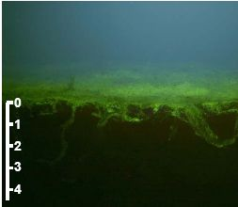
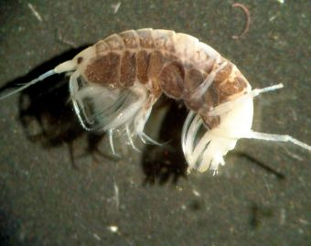
Bioturbation
Leptocheirus
L = depth range of bioturbation
Notes:
Crustecean - http://www.genustraithandbook.org.uk/genus/leptocheirus/
Leptocheirus and neris

Slide 37
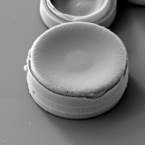
Commonly Observed Porewater Concentration Profiles
low
high
concentration
Non reactive (e.g., Chloride)
Surface Removal (e.g., O₂)
Subsurface consumption
e.g., Fe²⁺ _{(aq)} precipitating with
S²⁻ _{(aq)} to form FeS_{2(s)} (pyrite)
Reactive layer
Depth below sediment surface
Chemical released into pore waters from a subsurface layer and
then removed at another depth.
Chemical released at surface
Chemical released into
porewater from subsurface layer
Reactive layer 1
e.g., reduction of FeOOH_{(s)} to Fe²⁺ _{(aq)} (reactive layer 1)
and then Fe²⁺ _{(aq)} precipitating FeS_{2(s)} (pyrite; reactive layer 2)
e.g., Silica via dissolution
Reactive layer 2
Reactive layer
e.g., Mn²⁺ _{(aq)} release by reduction of MnO_{2(s)}
Notes:
MnO2 – manganese dioxide

Slide 40
Deep Sea Sediment

Slide 41
Nearshore Sediment

