Slide 1
Coral Reefs
“oases in the desert of the ocean”
Laura DiRoberts
Notes:
Photo: http://www.sciencemag.org/news/2016/09/some-relief-great-barrier-reef

Slide 2
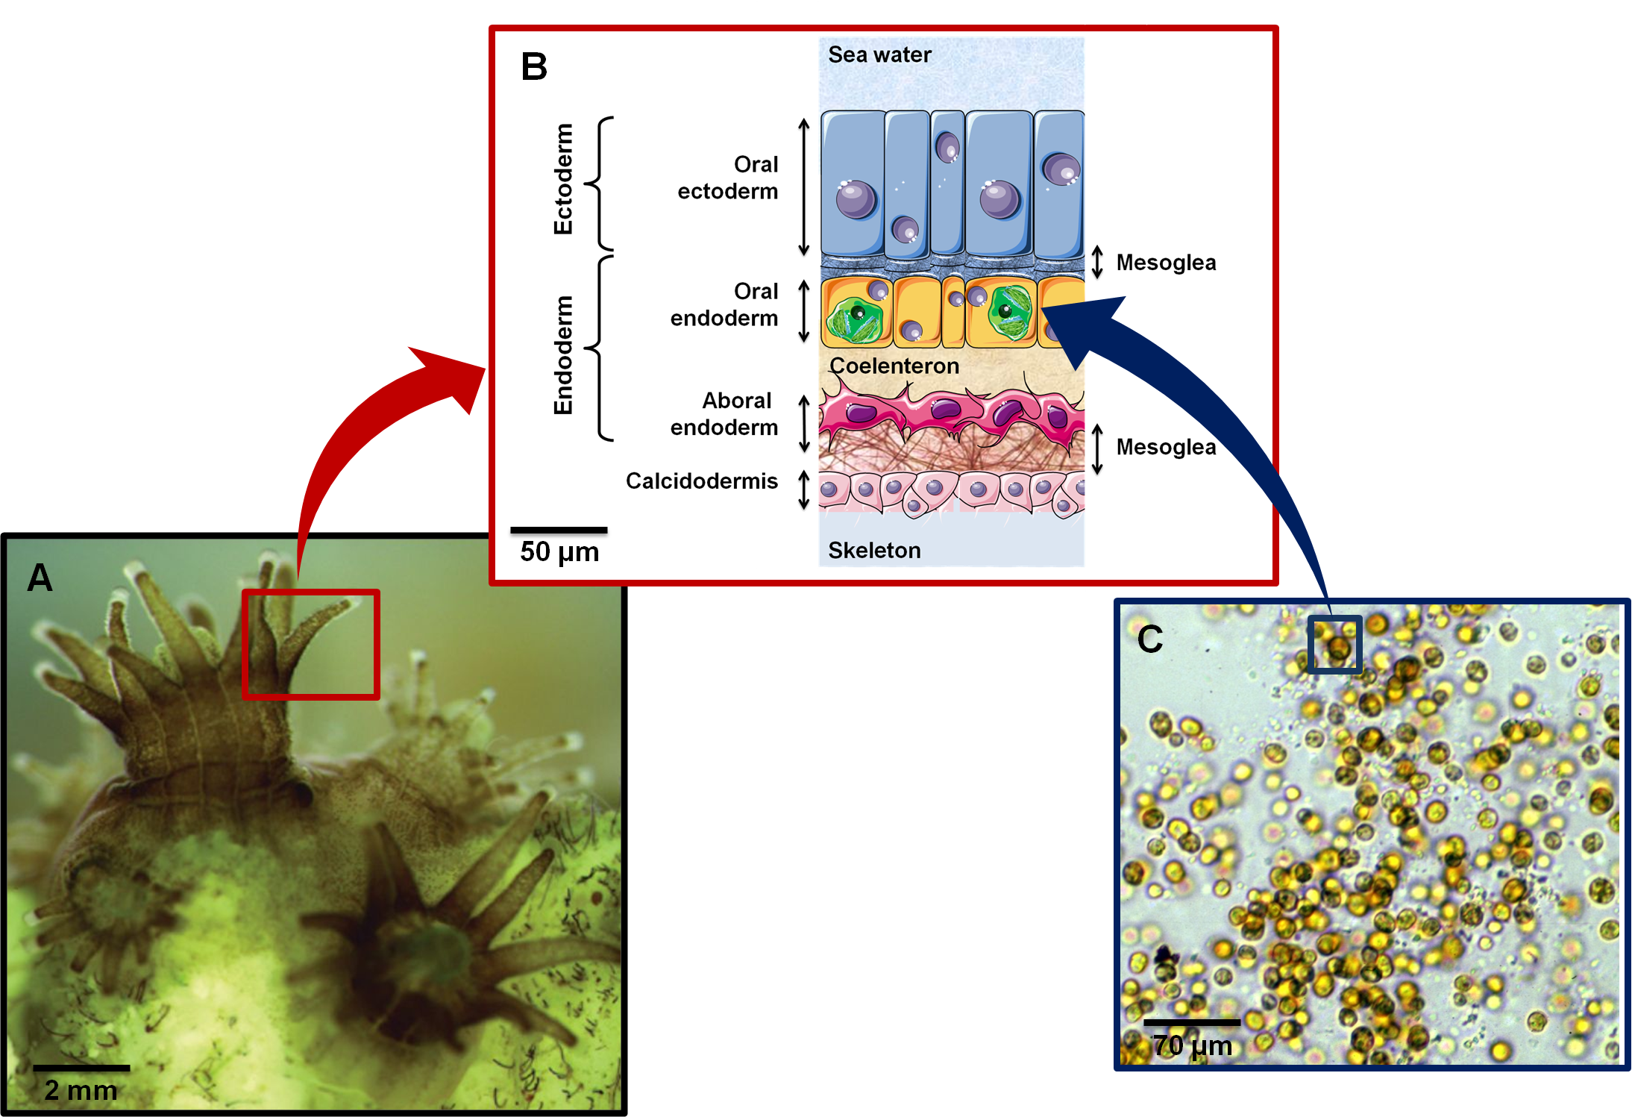
Coral Tissue
Notes:
Photo: http://biologie.ens-lyon.fr/ressources/bibliographies/m1-12-13-biosci-reviews-fournier-a-1c-m.xml

Slide 3
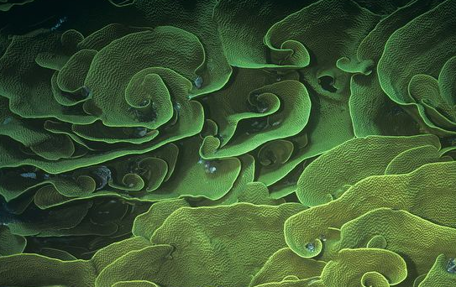
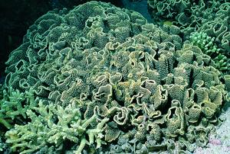
Morphological Plasticity
Turbinaria mesenterina
Morphology changes along environmental gradient
Notes:
Environmental gradient: different morphologies
Center of a gradient:
high plasticity, allows for similar energy acquisition amongst morphs
Edges of gradient:
less plasticity, optimized for photosynthetic energy acquisition in a specific environment
Reference:
Hoogenboom et al 2008
Photos:
https://coral.aims.gov.au/info/images/4_3.jpg
https://53744bf91d44b81762e0-fbbc959d4e21c00b07dbe9c75f9c0b63.ssl.cf3.rackcdn.com/media/64/64526599-8F3B-41F7-A5C0-7E6B3E369434/Presentation.Large/Turbinaria-mesenterina-coral.jpg

Slide 4
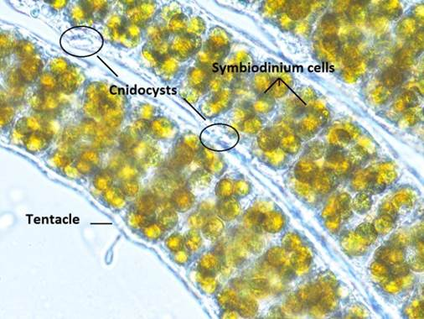
Symbiodinium
Endosymbiotic Photosynthetic Dinoflagellates
Notes:
Photosynthetic dinoflagellates
Live within coral tissue
Photosynthesize, share photosynthetically fixed carbon with host, gives host energy
Protected by host tissue
Benefit from host metabolic waste (DIN)
Share nutrients with each other
Reference:
Rädecker et al 2015
Photo: https://people.cornellcollege.edu/ctepper/Symbiodinium.jpg

Slide 5
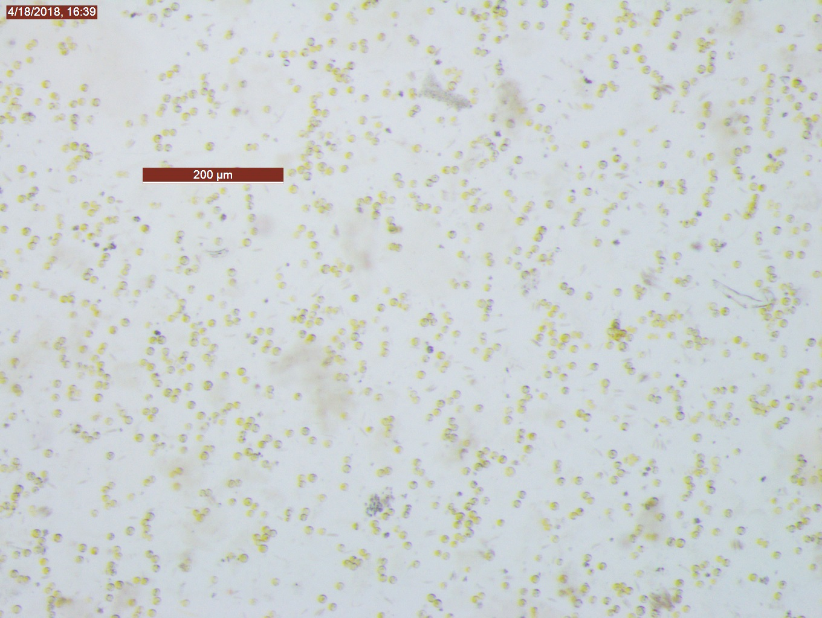
Symbiodinium
(Symbiodinium psygmophilium)
Symbiodinium retention is costly
Host must maintain high nutrient levels
Coral exerts control over symbiodinium growth
Notes:
Retention of symbiodinium by coral has high energy cost, must have high benefits for it to occur
Requires host to obtain high levels of nitrogen and other nutrients
Seasonal and diel variations in nutrient availability drive internal cycling
Coral control over symbiodinium:
host release factors (amino acids that trigger release of photosynthates),
degradation/digestion (keeps populations in check),
nutrient limitation (keeps symbionts from growing too fast)
Reference:
Rädecker et al 2015
Photo: Laura DiRoberts, Randi Rotjan

Slide 6
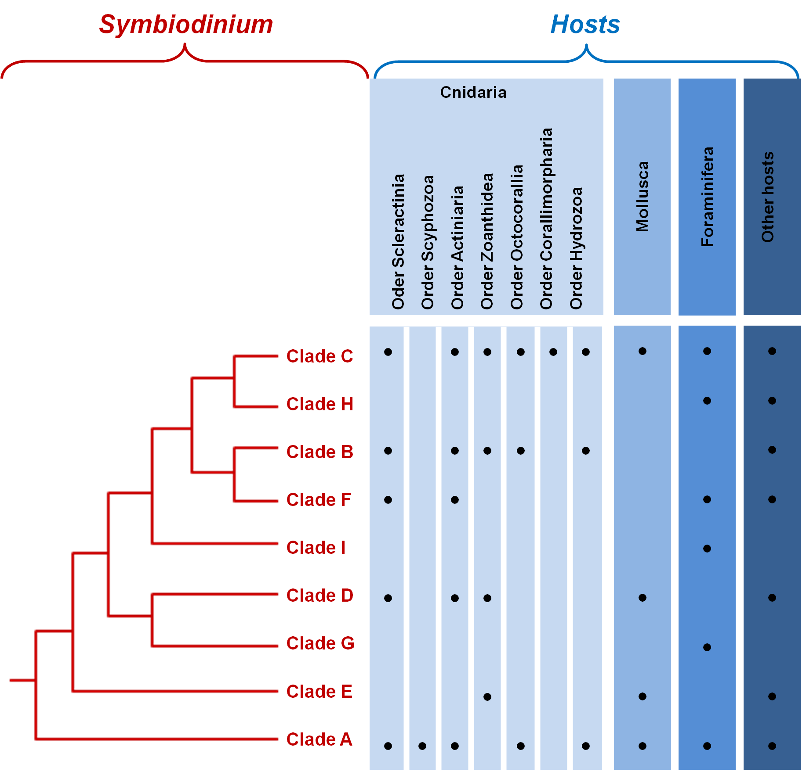
Symbiodinium Clades
Clade C: most common, most carbon fixation potential
Clade D: most heat tolerant
Clade A: most costly, least reciprocal
Notes:
Microbial metabolism and community composition are unique to coral species
Different corals are associated with particular clades of symbionts
A → I
Some clades are more beneficial than others
Clade C: most common, most carbon fixation potential
Clade D: most heat tolerant
Clade A: most costly, least reciprocal
Scleractinia: stony corals
Octocorallia: soft corals and gorgonian corals
Scyphozoa: Jellies
Actiniaria: anemones
Zoanthidea: zoanthids
Corallimorpharia: false corals
Hydrozoa: hydrozoans
References:
Sogin et al 2017
Potchon, Gates 2010
Stat et al 2008
Cunning, Baker 2014
Matthews et al 2017
Photo: http://biologie.ens-lyon.fr/ressources/bibliographies/m1-12-13-biosci-reviews-fournier-a-1c-m.xml

Slide 7
Autotrophy and Heterotrophy
Favia favus
Shallow (3m)
Favia favus
Deep (60m)
Stylophora pistillata
Shallow (3m)
Stylophora pistillata
Deep (60m)
Notes:
Shallow water tropical corals
Highly autotrophic
Excess carbon stored as lipid
Used by symbiodinium
Less autotrophy in deeper corals, more heterotrophy
Less lipid storage in deep coral
Lipids in animal decreased more than lipids in algae
Reference:
Alamaru et al 2009

Slide 8
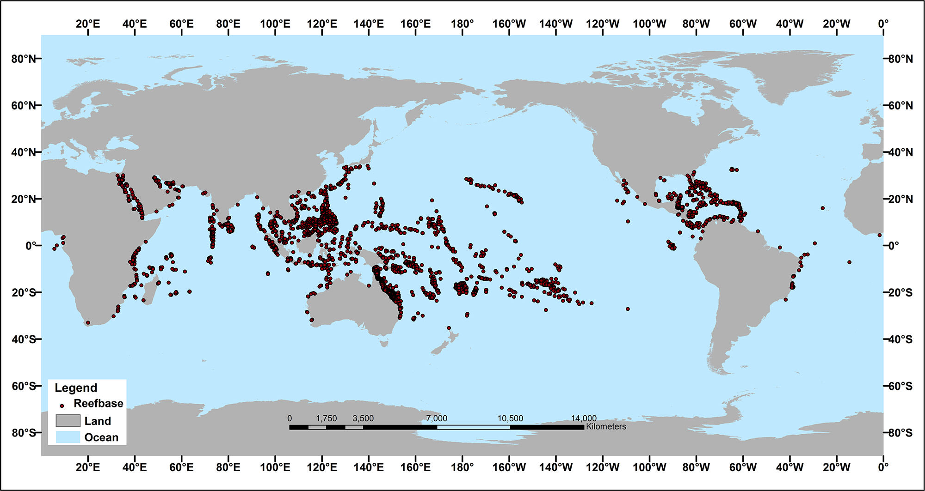
Abundance &
Distribution
Net gain of CaCO₃ necessary for coral growth
Coral Productivity: 8g-40g C m⁻² day⁻¹
Coral reefs: ∼0.2% of the ocean
Corals support about 35% of all ocean species
Notes:
Net gain of CaCO3 necessary for coral growth
Coral reefs: 0.2% of the ocean, support about 35% of all ocean species
Coral Productivity: 8g-40g C m⁻² day⁻¹
Nutrient loading has a positive effect on calcification
Reference:
Courtney et al 2017
Photo: https://aamboceanservice.blob.core.windows.net/oceanservice-prod/education/kits/corals/media/coralreefmap.jpg

Slide 9
Mucus
Undissolved mucus flocs float at surface, trap larger particles
Protects coral from desiccation, fouling, and sedimentation
Flocs sink, resediment particles, supply food to benthic community
Bacteria feed on mucus
Up to 50% of photosynthates transferred to coral can go towards making mucus
Rich in proteins, triglycerides, and wax esters
Notes:
Up to 50% of photosynthates transferred to coral can go towards making mucus
Rich in proteins, triglycerides, wax esters
Protects coral from desiccation, fouling, and sedimentation
Bacteria feed on mucus
Pelagic food source
Mucus can dissolve into water, distribute nutrients
Undissolved mucus can form flocs
Float at surface, trap larger particles
Get heavy with particles, sink, resediment particles, supply food to benthic community
Reference and photo:
Wild et al 2004

Slide 10
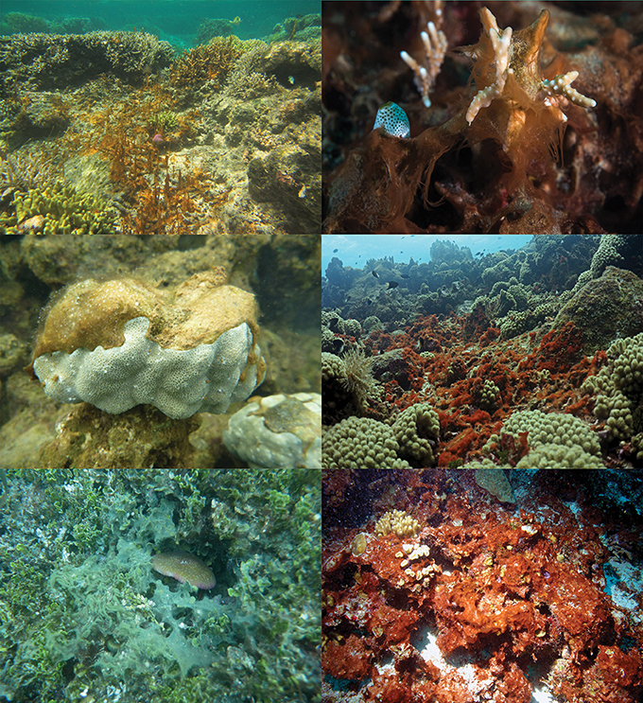
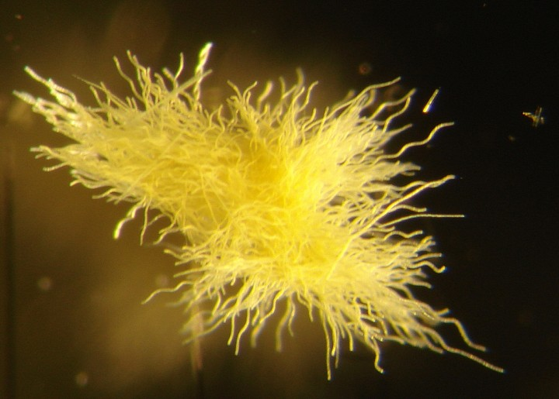
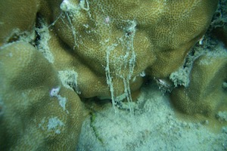
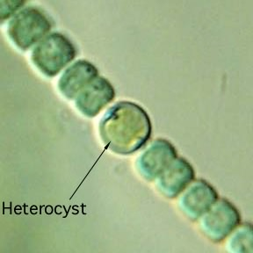
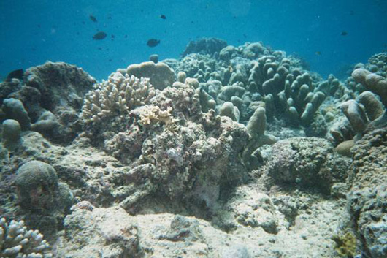
Diazotroph Diversity
Mucus
Cyanobacteria
Benthic Macroalgae
Bacteria & Archaea
Microbial Mats!
Skeleton & Rubble
Notes:
Diazotrophs: Bacteria and archaea that fix atmospheric nitrogen (N₂) into biologically usable dissolved inorganic nitrogen (DIN)
NH₄^{+→} NO₂^{-→} NO₃⁻
Heterocyst: cell containing anaerobic chamber that carries out N fixation
Heterocyst contains nitrogenase
Oxygen sensitive, deactivated
Diel cycle, N fixation at night when oxygen levels are lower
Diazotrophs function independent of irradiance, unlike photosynthesis and calcification
Diazotrophs found in water column, coral mucus, coral skeleton, coral tissue, reef sediment, rock, benthic macroalgaes, and microbial mats.
References:
Lesser et al 2018
Ford et al 2018
Photos: http://cmore.soest.hawaii.edu/microscopy/album/diazotrophs/slides/KM0715_Awhite_PreservedColonies%20003.jpg
https://ryotanakajima.com/wp-content/uploads/2017/03/Muchou_sheet_clean.jpg
http://www2.clarku.edu/departments/biology/biol201/2008/JaMitchell/Bermuda/Pictures/coral/coral%20sed.jpg
http://fnie-educationalmedia.pbworks.com/w/page/4271710/Cyanobacteria

Slide 11
Diazotrophs and Nitrogen Fixation
Nitrogenase
  N₂ → NH₄⁺
Corals and symbionts assimilate DIN and DON
  Corals: Ammonium
  Symbionts: Ammonium and Nitrate
DIN is highest in reefs with cyanobacterial mats and seagrass meadows
Human interference
  Disruptive
  Negatively affects diazotroph populations
Notes:
Both Corals and symbionts assimilate DIN and DON
DIN in the form of NH4+
Symbionts may also assimilate NO3-
DON: amino acids, urea
DIN is highest in reefs with cyanobacterial mats and seagrass meadows
Benthic fixation greater than pelagic fixation
Coral skeletons (endolithic bacteria), silicate sands, microbial mats
Microbial mats: cyanobacteria, sulfur bacteria, other microorganisms, highest rate of N fixation amongst benthic fixers
Pelagic DIN also contributes
Cyanobacteria (Trichodesmium)
Human interference can change availability of benthic substrate that is favorable to microorganisms
Affects diazotroph populations, reduces nitrogen fixation
Reference:
Cardini et al 2014
Photo: BU Marine Program Media Library, Tropical Marine Inverts 2017, Turneffe Lagoon Patch Reef

Slide 12
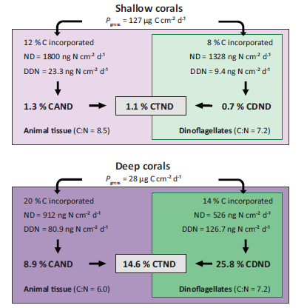
Diazotrophs and Metabolism
Shallow, highly autotrophic corals:
Less DDN assimilation
  Host is primary assimilator
Host releases more nitrogen as mucus
Deep, heterotrophic corals:
More DDN assimilation
  Algae is primary assimilator
More total nitrogen assimilation
  heterotrophic acquisition
Notes:
Diazotroph derived nitrogen (DDN)
Nitrogen demand (ND)
Shallow, highly autotrophic corals
Very little DDN assimilation
Host is primary assimilator, gives nitrogen to symbionts
Host release more nitrogen as mucus
Deeper, heterotrophic corals
More total nitrogen assimilation than shallow coral
Comes from heterotrophic feeding
Algae is primary assimilator
FIG 3 Overview of the percent contribution of DDN assimilation to the N demand (ND) of the animal
host (CAND), the dinoflagellates (CDND), and the total symbiotic association (CTND) from shallow and
deep S. pistillata corals. The ND was calculated from gross photosynthesis (Pgross) measurements (45),
from values of C incorporation into the animal host and the dinoflagellates (48), and from C/N ratios (70)
of S. pistillata corals at 5- and 50-m water depths in the Red Sea.
Reference and photo:
Bednarz et al 2017

Slide 13
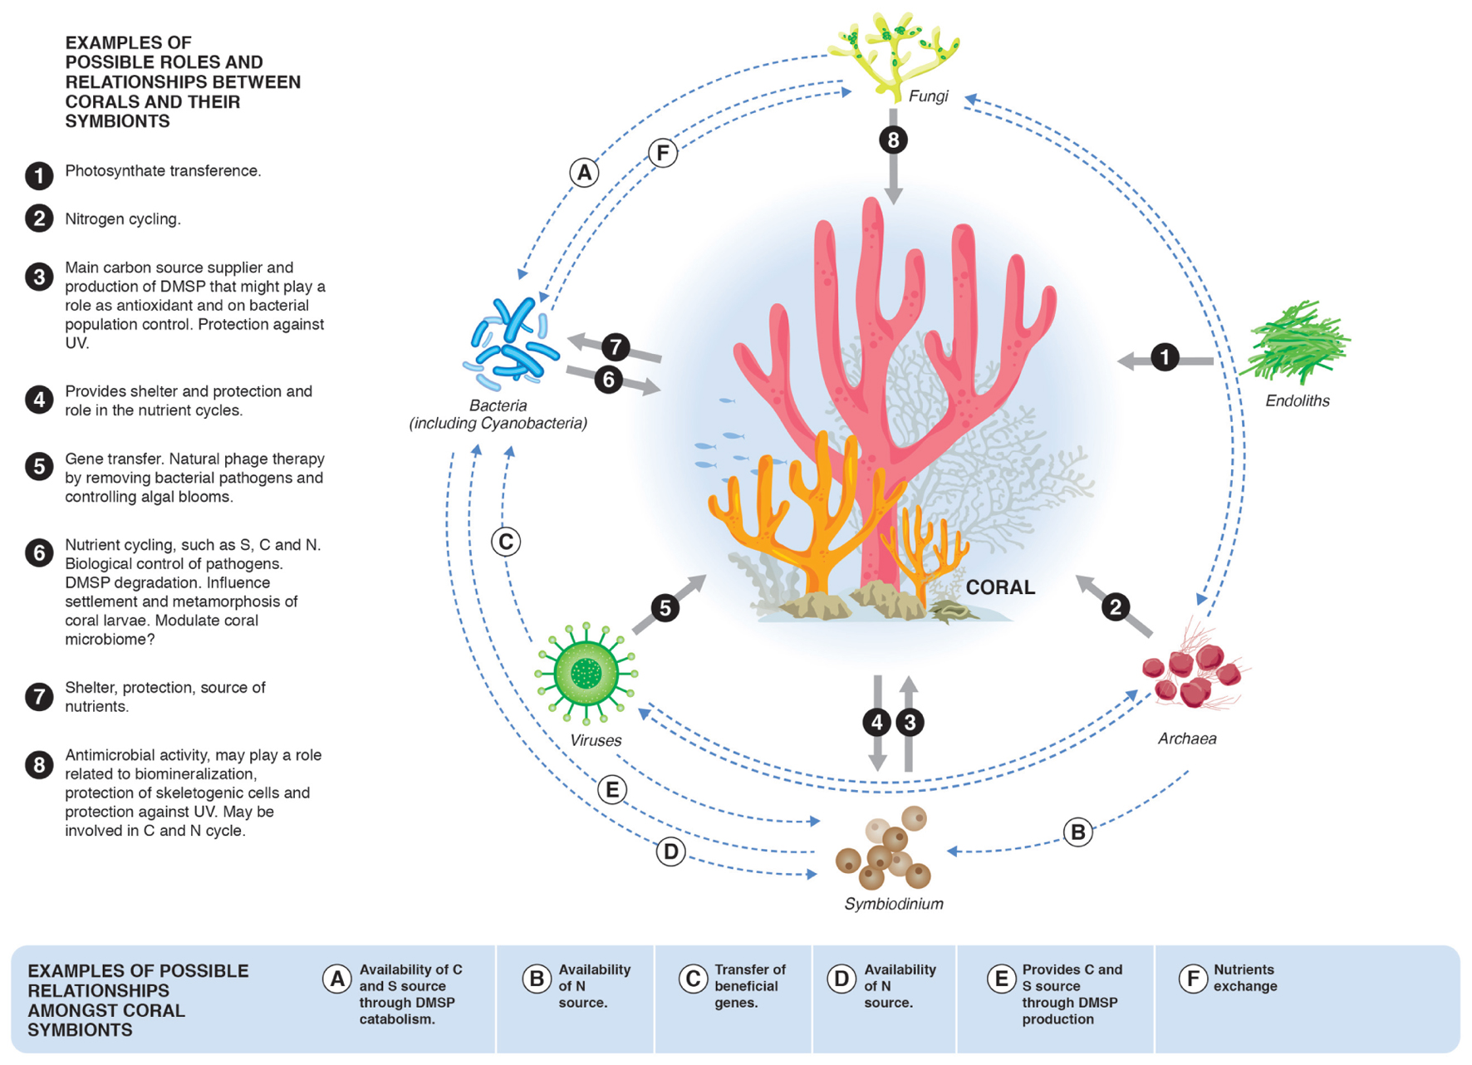
Holobionts: “Complex meta-organism”
Mutualistic associations and shared processes
Notes:
“Complex meta-organism”
consisting of coral, symbiodinium, ectosymbionts (protozoa, fungi, bacteria, and archaea) that live on and around the coral
Mutualistic associations:
Shared nutrients, regulation of coral/symbiont interactions (homeostasis), disease prevention (pathogen control)
Shared processes:
carbon fixation, nitrogen metabolism, sulfur cycling, antimicrobial defense
References:
Rädecker et al 2015
Peixoto et al 2017
Photo:
Peixoto et al 2017

Slide 14
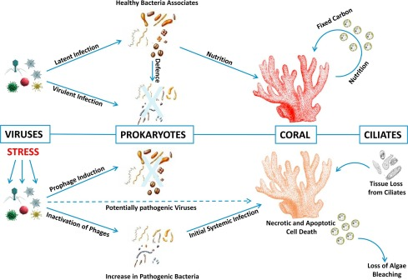
Viruses
Healthy and stressed corals
Mucous layer
Coupled with stress and bleaching
Highly abundant
Notes:
Viruses associated with both healthy and stressed corals
stress lowers disease resistance
Stressors:
heat, UV, pH, nutrient imbalance
Viruses are much more abundant in coral mucous layer than in in surrounding tissue (order of magnitude)
Virus abundance may increase likelihood of bleaching
Coupled with environmental stress overwhelms coral
Symbiodinium associated with viruses may show different gene expression under stress
Viruses less abundant than bacteria, but more abundant than archaea
Bacteriophages and archaeal phages are part of a healthy coral microbiome
References:
Bruwer et al 2017
Sweet, Bythell 2017
Photo:
Sweet, Bythell 2017

Slide 15
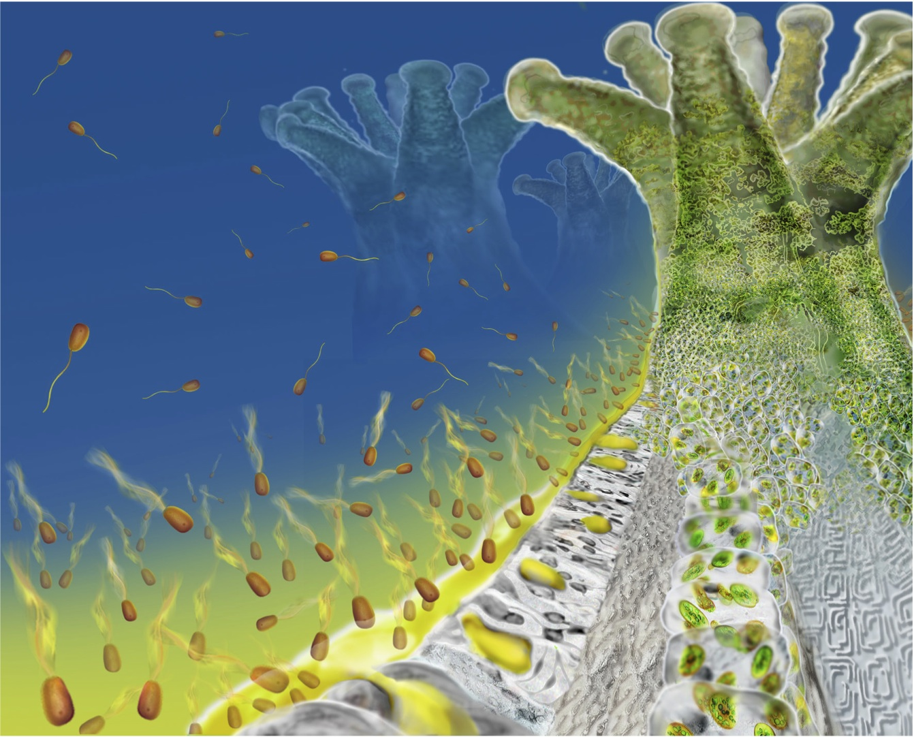
Bacteria and Archaea
Unique microbial communities
Micro-niches
Steady community assemblages
Symbiodinium ∼2-3 species of
Bacteria ∼30+ species
Notes:
Corals have microbial communities that differ from surrounding waters
Communities further divided into micro-niches
Coral/bacteria species associations don’t readily change
Corals have on average 2-3 species of symbiodinium associated with them, and 30 or more species of bacteria
Reference:
Rohwer et al 2002
Photo: https://reefs.com/2015/01/13/network-coral-health-communication/

Slide 16
Green Sulfur Bacteria
Autotrophic and mixotrophic
Carbon, Nitrogen, and Sulfur fixation
Benefits host and bacteria
Notes:
Autotrophic and mixotrophic
May play a role in anoxic photosynthesis, carbon fixation, nitrogen fixation, and sulfur fixation
Benefits to host:
provides nutrients, detoxifies sulfide
Benefits to bacteria:
anaerobic environment inside host, hydrogen sulfide electron donors for photosynthesis, acetate from host
Most commonly found in skeleton and basal tissue layer
Reference and photo:
Cai et al 2017

Slide 17
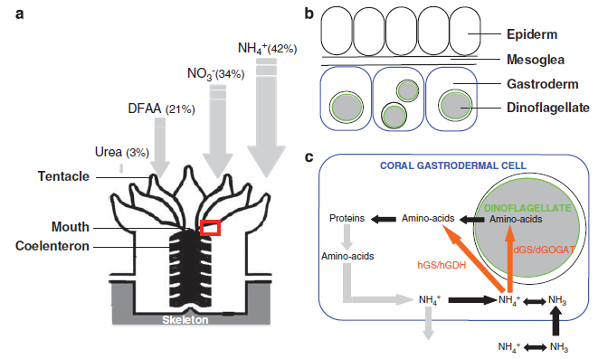
Nitrogen Cycling
Coral and symbiodinium
Seasonal variation
Primary production
Nitrogen assimilation
Notes:
Both coral and symbiodinium absorb DIN,
use it to make amino acids and proteins
DIN used by coral vary by season
Higher in the summer, lower in the winter
DDN only accounts for some of the DIN used by corals for primary production
DIN also absorbed from recycled metabolic waste
Coral and symbionts assimilate DON in the form of amino acids and urea
Coral and symbionts have enzymes that assimilate ammonium from seawater, symbionts also incorporate nitrate
Reference:
Benavides et al 2017
Photo: Pernice et al 2012

Slide 18
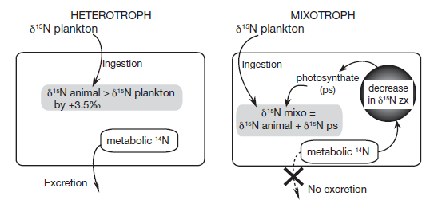
Nitrogen Conservation Theory
Heterotrophic Corals
Autotrophic/Mixotrophic Corals
Notes:
Internal Nitrogen cycling between coral and symbionts
Nitrogen conservation theory: heterotrophically obtained nitrogen is retained, autotrophically obtained nitrogen is respired out
Heterotrophic corals:
Less photosynthetic activity (less light, fewer symbionts)
Coral get “heavy nitrogen” from eating, excretes “light nitrogen”
More nitrogen is excreted by host than is needed by symbionts
Excess excreted out of animal
Autotrophic/mixotrophic corals:
More photosynthesis (more light, more symbionts)
Metabolic waste is used up by symbionts,
Not excreted out of animal
Fig. 4. Nitrogen pathway schematic for autotrophic and heterotrophic organisms (mean ± SE). mixo = mixotroph; zx =
Zooxanthellae
Reference and photo:
Reynaud et al 2009

Slide 19
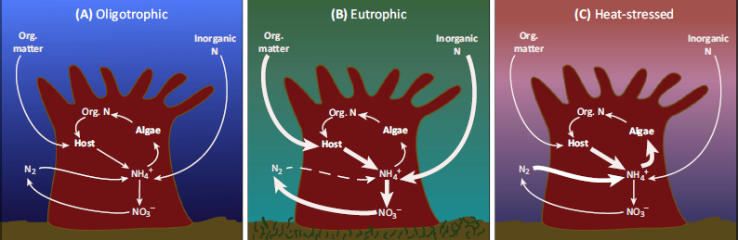
Symbiodinium and Nitrogen
Eutrophication leads to increased respiration
Heat stress leads to increases symbiont primary productivity
  Loss of general holobiont primary productivity
Combo leads to non-reciprocal relationship
Notes:
Excess nutrients and high temperatures promote symbiont growth
Strips nutrients from coral without reciprocating
Nutrient and temperature imbalance leads to increased coral respiration, decreased net holobiontic primary productivity increased symbiodinium productivity
Symbiont growth promotes carbon retention by symbionts
Mutualistic relationship can turn parasitic
Steals key nutrients from other parts of the system
Clades A and D more likely to parasitize host under heat induced stress conditions
Reference:
Baker et al 2018
Photo:
Rädecker et al 2015

Slide 20
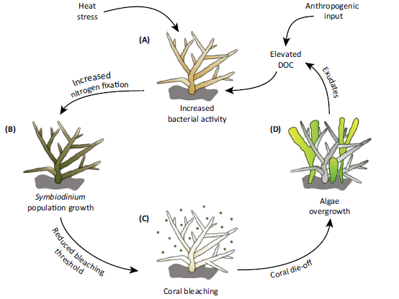
Nutrient Loading and Bleaching
Mutualism, interrupted
  Carbon/Nitrogen exchange breaks down
Selfish symbionts
N limited → P limited
Notes:
Nutrient loading may interrupt mutualism
Changes cost/benefit of species interaction
Endosymbionts benefit from excess nutrients, grow/multiply
Keep more photosynthates for themselves for growth
Less benefit to partner
Throws off balance of C/N trade
Excess nitrogen can contribute to bleaching by disrupting symbiont/coral balance
“Selfish Symbionts”: symbionts will us excess nitrogen if it is available
May shift system from being N limited to being P limited
P starved symbionts may start using their own phospholipids from their chloroplasts
Reduces autotrophy, leads to bleaching
References:
Shantz et al 2016
Pogoreutz et al 2016
Photo:
Rädecker et al 2015

Slide 21
Ocean Warming and Microbes
Different microbiomes, different tolerances
Symbiont repopulation
Increase in temperature → increase photosynthetic ability
Short term: + pCO₂ absorption
Long term: bleaching
Notes:
Different species have different tolerance ranges
Due to differences in both endo and ectosymbionts
More heat tolerant symbionts may repopulate after a bleaching event
Opportunistic repopulation
Never quite as efficient because of immune response
Likely to revert to native species over time if no more bleaching event occur
Carbon and Photosynthesis
Increased Temperature and pCO2 leads to algal growth, increased chl-a, cell density, and photosynthesis, decrease in calcification
Coral microbiome may make coral more resilient to climate change
Increase in temperature may increase photosynthetic ability in shallow corals
May offset rising pCO2 in the short term
In the long term, rising temps and atmospheric carbon emissions may cause bleaching events when tolerance limits are exceeded
References:
Grottoli et al 2018
Matthews et al 2017
Reynaud et al 2003
Photo:
Grottoli et al 2018

Slide 22
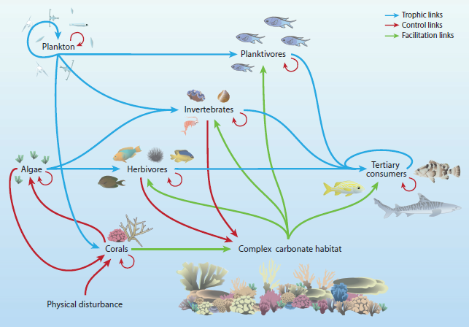
Stress and Ecosystem Function
Services: fisheries, raw materials, coastal defense,
Stressors: overfishing, ocean warming, declining water quality
Decreased pathway:
  Coral → invertebrates → heterotrophs
Increased pathway
  Algae → herbivores
Notes:
Ecosystem services: fisheries, raw materials, coastal defense,
Coral reef stressors: overfishing, ocean warming, declining water quality
Corals experienced negative functioning for all three stressors
Plankton suffered in warm water, benefited from reduced water quality
Algae benefited from warm water
Consumers suffered from all three stressors
Habitat provisioning decreased with warm water
Warm water helped plants grow until they reached their thermal limits, and then they suffered
Stressors in general shifted ecosystem away from corals/inverts/higher level consumers towards algae/herbivores
Reference and photo:
Harbone et al 2016

Slide 23
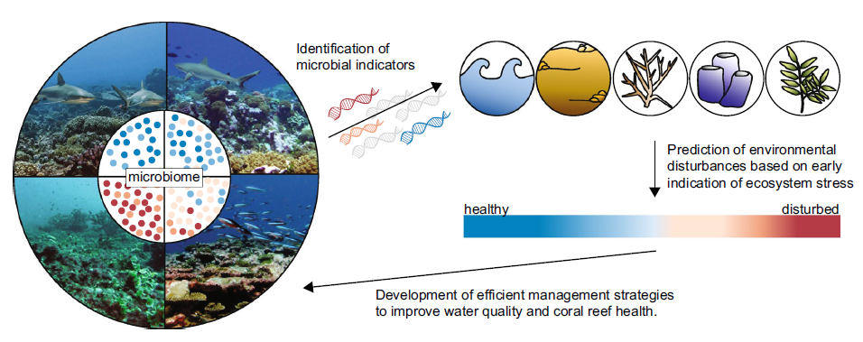
Microbial Indicators of Climate Change
Changes in microbial populations indicate environmental stress
Early warning indicators, policy adaptations
Notes:
Reef environment affected by anthropogenic increases in atmospheric CO2 and temperatures, ocean acidification, reduced water quality, increased UV radiation, sea level rise, eutrophication, pollution, disease, overfishing, invasive species, shoreline development
Environmental disturbances may alter microbial populations
Stress response
Monitoring changes in coral reef microbial populations may act as an early warning indicator of environmental disruption
Reference and photo:
Glasl et al 2017

Slide 24
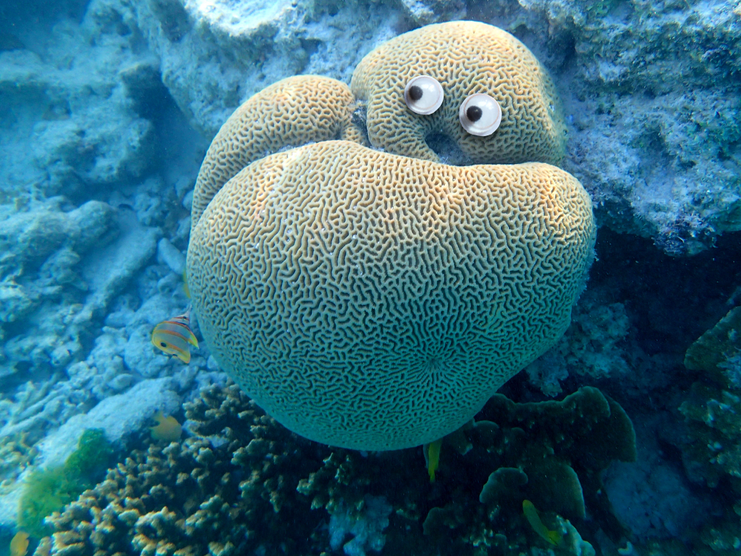
Questions?

