Slide 1

“Climate change adaptations of wild populations from corals to fish: the power of deep genomics”
April 19, 6:00 PM
BU Law Auditorium, 765 Commonwealth Ave.

Slide 2
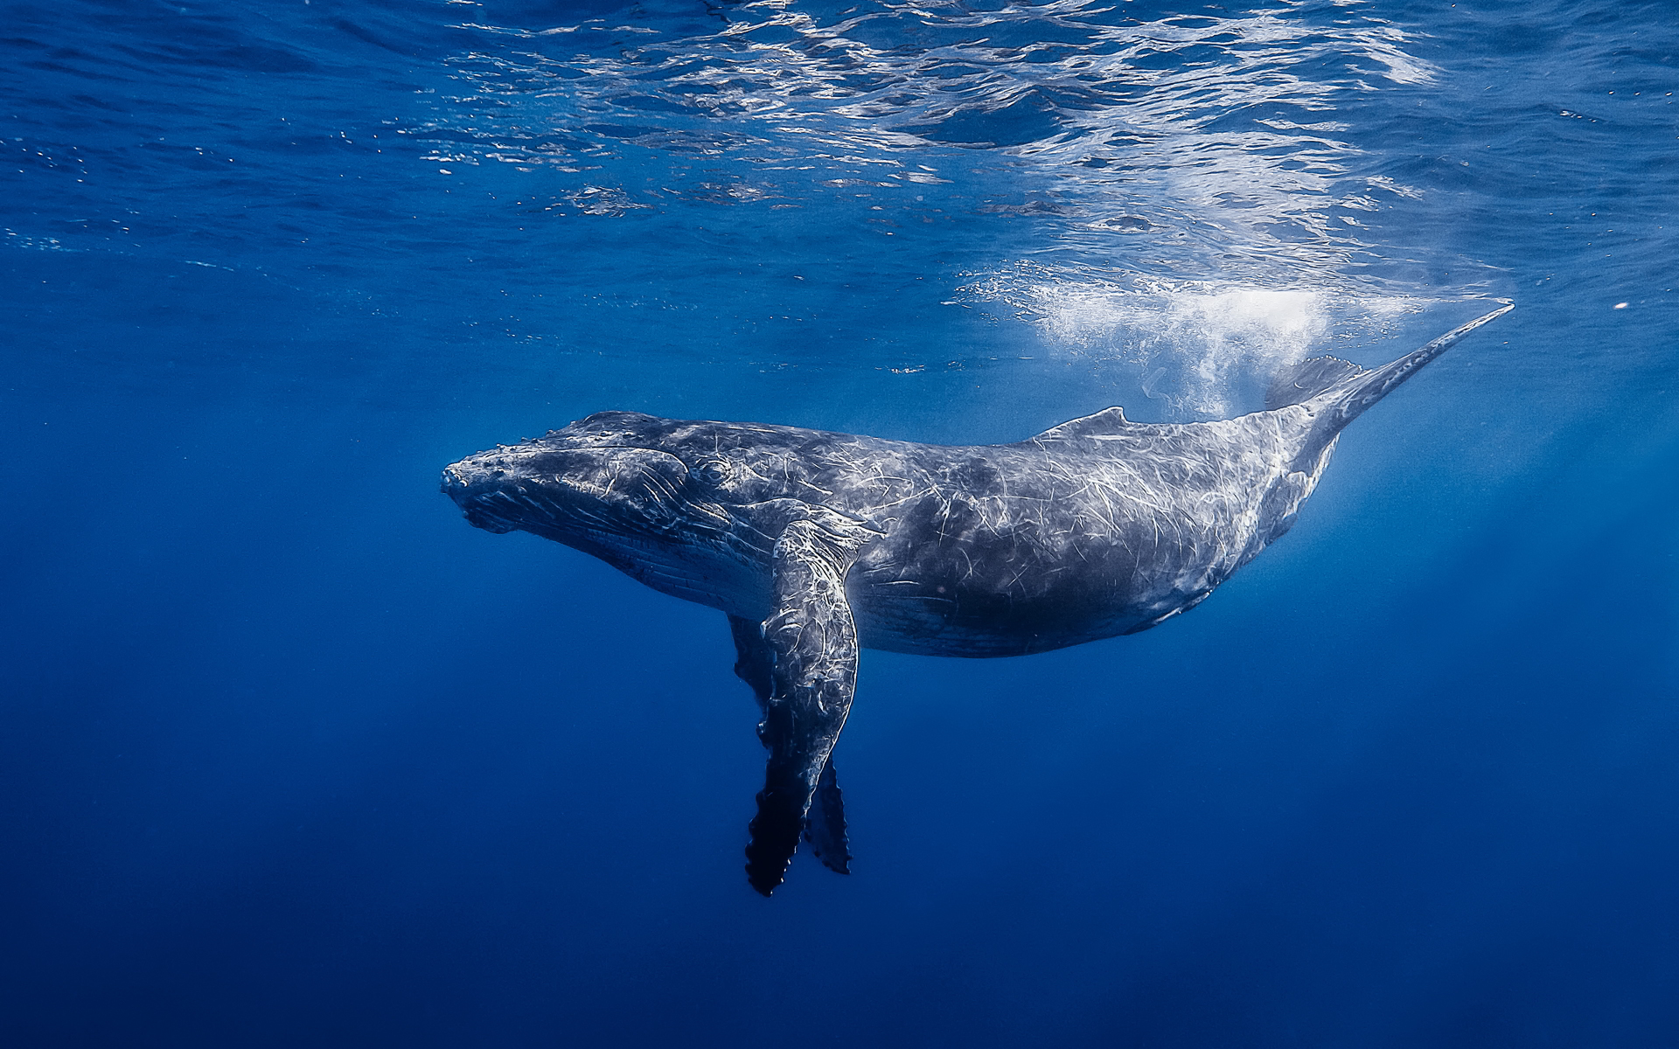
The Immortal Life of Nitrogen
Part 1: N cycle pathways
Part 2: Human impacts on N Cycle
“...the atoms of nitrogen are bound on the wheel of change, and ceaselessly pass through living and non-living phases.”
Johnstone (1908, p. 274)

Slide 3
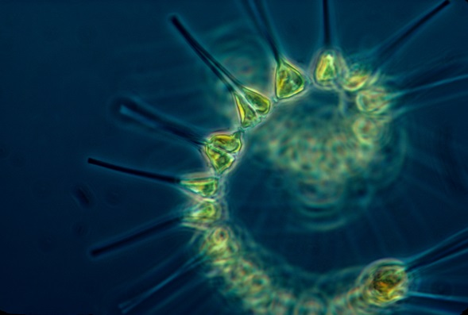
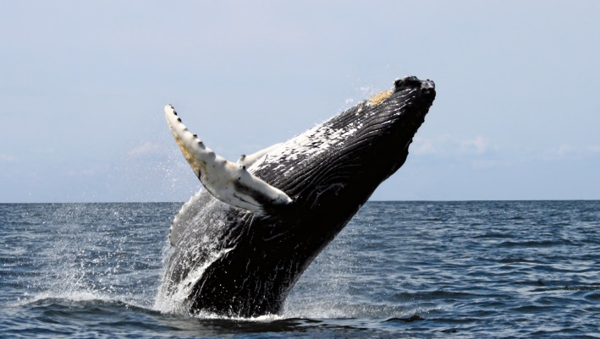
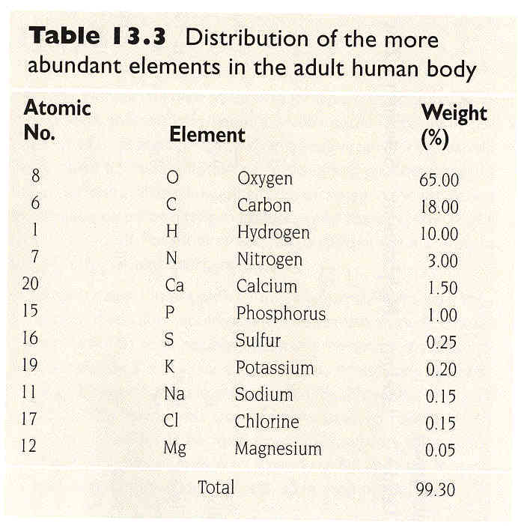
Nitrogen is essential for Life
Phytoplankton growth…..
Animal growth….
en.wikipedia.org
Our growth…..
% of body
weight

Slide 4
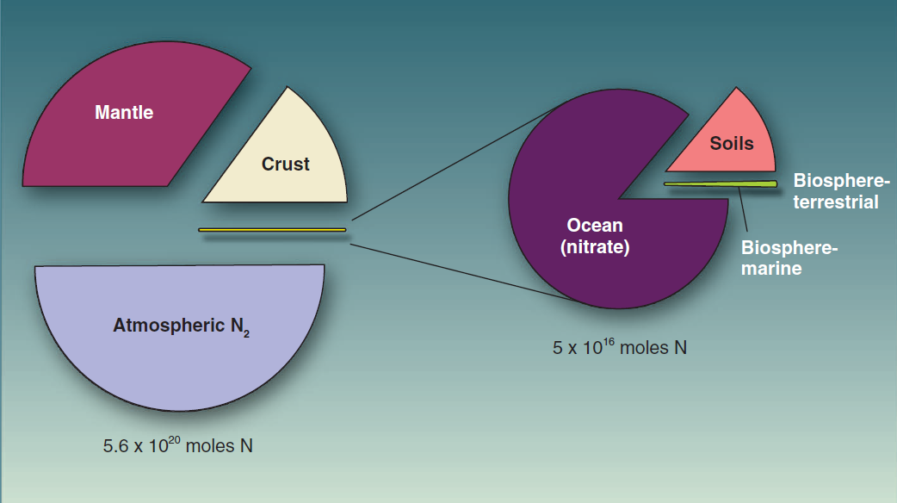
Pools of Nitrogen on Earth
Canfield et al. Nature 2010
**pool sizes are inversely related to their biological importance

Slide 5
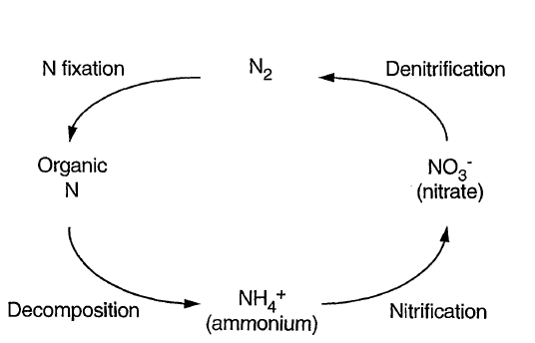
Joye and Hollibaugh 1995

Slide 6
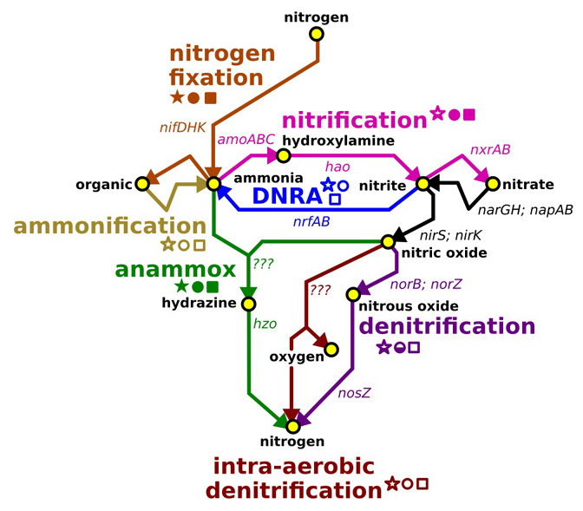
Nitrogen Network
http://journalofcosmology.com/ClimateChange113.html, Hanke and Strous (2010)

Slide 7
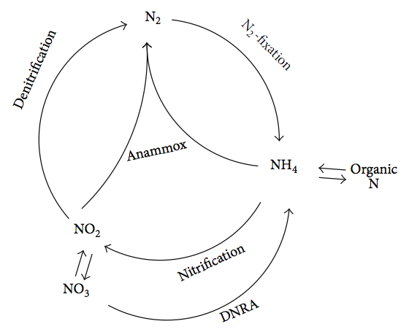
Figure from: Shou-Qing Ni and Jian Zhang (2013)

Slide 8
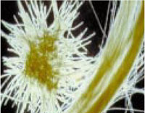
N₂ fixation
N₂
N₂
Slide modified from Debbie Bronk
Notes:
Thanks to the work of Team Capone, information on the spatial extend and magnitude has increased dramatically.
One of the big questions now is…who is doing it?
Jon Zehr et al. (2001) and Joe Montoya et al. (2004) have both recently published evidence for significant N2 fixation by single celled N fixers.
Regardless of whose doing it - we still are relatively in the dark with regard to where the N goes?

Slide 9
Nitrogen fixation
N₂ + 8H⁺ + 8e- + 16 ATP → 2 NH₃ + H₂ + 16 ADP + 16P_{i}
Nitrogenase
Energetically very expensive – N₂ has triple bond
Nitrogenase is irreversibly inactivated by oxygen
Most autotrophic N₂ fixers form heterocysts
Requires P, Fe, and trace metals (Mo, Co, V)
Slide modified from Debbie Bronk
Notes:
N fixation is the reduction of N₂ to NH₃ (amino form in proteins) involves breaking triple bond, which requires a high activation energy
Also requires P, Fe, and trace metals (Mo, Co, and V).
Reaction is catalyzed by nitrogenase
Nase is irreversibly inactivated by oxygen. So.... N fixation is an anaerobic process, even when it is performed by normally aerobic bacteria
Mechanism of damage: from oxygen radicals, superoxide, etc., destroys ability of Nase enzyme to transfer electrons
Enzyme must be physically or metabolically protected
In heterocystous forms and anaerobic bacteria, protection is less an issue than in non-heterocystous or unicellular aerobes.
Heterocysts are differentiated cells with thickened cell walls, act as selective gaseous diffusion barriers--oxygen and N cannot diffuse in.
Heterocysts contain only PSI (no PS II, which produces O₂ during photosynthesis).
Energy and reducing power comes from aerobic respiration - simultaneously consumes oxygen, to protect Nase, rather than
directly from photosynthesis
Generally, N fixation is enhanced by low light levels, due to increased respiratory substrate supply, but inhibited at high light levels due to
high resulting oxygen levels during high photosynthesis
Mystery - how do cyanobacteria, oxygenic photosynthesizers, manage

Slide 10
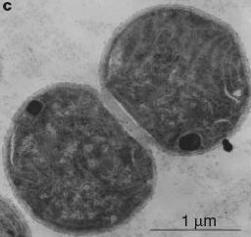
N₂ fixation
N₂
N₂
Zehr et al. 2001 Nature
Unicellular cyanobacteria that expressed nitrogenase at HOT
Montoya et al. 2004 Nature
Rates of N fixation by the single cell forms can equal or
exceed rates by Trichodemsium
Slide modified from Debbie Bronk
Notes:
Thanks to the work of Team Capone, information on the spatial extend and magnitude has increased dramatically.
One of the big questions now is…who is doing it?
Jon Zehr et al. (2001) and Joe Montoya et al. (2004) have both recently published evidence for significant N2 fixation by single celled N fixers.
Regardless of whose doing it - we still are relatively in the dark with regard to where the N goes?

Slide 11
Trichodesmium mystery
Non-heterocystous
Photosynthesis
CO₂ → O₂
N₂ fixation
N₂ → NH₄⁺
nitrogenase
Temporal or spatial segregation?
Notes:
Theory is that certain diazocytes along a trichome contain nitrogenase and are the only sites of N fixation.

Slide 12
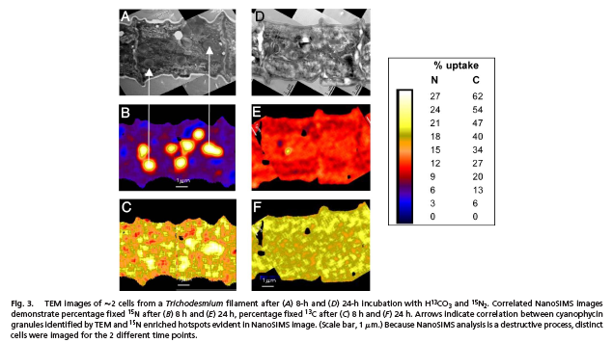
cyanophycin
granules
High resolution-secondary ion mass spectrometry (Nano SIMS)
Supports temporal segregation!
Finzi-Hart et al. 2009 PNAS
Notes:
Finzi-Hart et al. found that cyanophycin granules (N storage vacuole comprised of asparagine and aspartate polymer) were in similar density in all the cells so….the theory seems wrong.
Found that C13 incorporation was higher early in the day and that N15 incorporation was higher later in the day – temporal segregation.

Slide 13
Figure from: Shou-Qing Ni and Jian Zhang (2013)

Slide 14
N₂
Ammonification
N₂
*
DON
NH₄⁺
Phytoplankton
* Glibert & Bronk 1994
Slide modified from Debbie Bronk
Notes:
Now we have a deep ocean filled with NO3, which can diffuse into the surface waters.
Because there is so little labile N in the surface, as soon as it enters surface waters it gets taken up.

Slide 15
Ammonification -
the conversion of DON or PON to NH₄⁺
Two types:
Bacterial -
a. Traditional view of bacterial decomposition
b. Was considered primary source of NH₄⁺
(Now primary source if believed to be grazers)
Photochemical (abiotic!)
a. More recently recognized source
b. Importance of process is still debated
Slide modified from Debbie Bronk

Slide 16
Figure from: Shou-Qing Ni and Jian Zhang (2013)

Slide 17
Nitrification
Aerobic process (i.e., needs oxygen)
Autotrophic
dead cells/detritus
ammonification
NO₃⁻
NO₂⁻
NH₄⁺
PN or DON
Slide modified from Debbie Bronk
Notes:
There have been a number of studies that have come along that have really thrown how we think about the deep ocean out of wack.

Slide 18
Nitrification
NH₄⁺ -----------------> NO₂⁻ -----------------> NO₃
Ammonium oxidizers: Nitrite oxidizers:
very slow growing faster growing
sensitive to light more sensitive to light
Nitrifiers are chemolithoautotrophs.
Maximum water column rates occur near the base of the euphotic zone.
Slide modified from Debbie Bronk
Notes:
Deeper in the water column there is

Slide 19
Nitrification
dead cells/detritus
ammonification
NO₃⁻
NO₂⁻
NH₄⁺
PN or DON
Nitrifying bacteria - or is it??
Slide modified from Debbie Bronk
Notes:
There have been a number of studies that have come along that have really thrown how we think about the deep ocean out of wack.

Slide 20
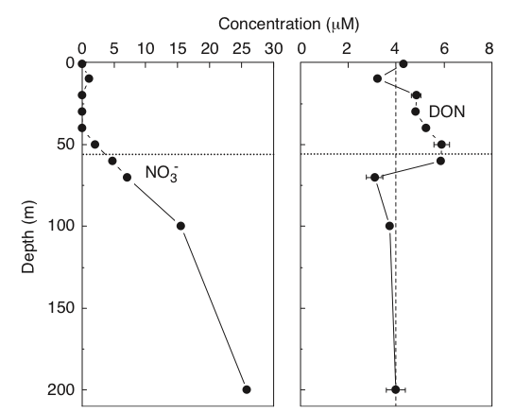
Nitracline
Slide modified from Debbie Bronk
Notes:
In the vertical in the ocean, you generally see these classic profiles.
The zone of increasing N concentration is termed the nitracline.
Organic N tends to accumulate in the surface water then falling off to a low background level in the deep ocean.

Slide 21
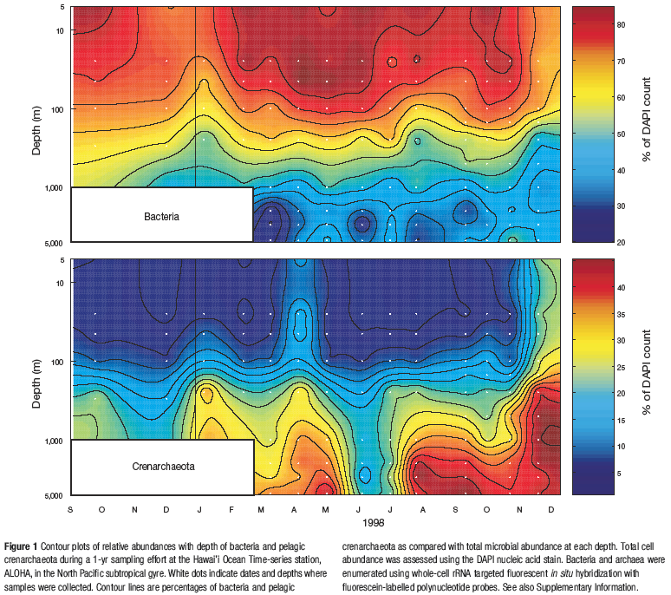
Karner et al. 2001 Nature
39% of the picoplankton in the mesopelagic at HOT are archaea.
Slide modified from Debbie Bronk
Notes:
A study near here at the HOT site found that 39%....
Now archaea were believed to live only in really extreme environments like hydrothermal vents.
Two other papers provide evidence that archaea are nitrifiers in the ocean.

Slide 22
Figure from: Shou-Qing Ni and Jian Zhang (2013)

Slide 23
Denitrification
N₂
Anerobic process (i.e., No oxygen)
Heterotrophic
NO₃⁻
NO₂⁻
NH₄⁺
PN or DON
NO₂⁻
NO
N₂O
N₂
Canonical denitrification
Slide modified from Debbie Bronk
Notes:
This is the ultimate sink for N, along with sediment burial.

Slide 24
Lost to
system
Denitrification
NO₃⁻
NO₂⁻
NO
N₂O
N₂
nitrate reductase nitrite reductase nitric ox. reductase nitrous oxide reductase
N is used as an electron acceptor, not as a N source
Lots of organisms can reduce NO₃⁻
Fewer can reduce NO₂⁻
All the enzymes are induced by anoxia
NO is very labile and does not accumulate

Slide 25
Figure from: Shou-Qing Ni and Jian Zhang (2013)

Slide 26
ANNAMOX
N₂
N₂
Anerobic process (i.e., No oxygen)
Autotrophic
N₂
NO₃⁻
NO₂⁻
NH₄⁺
PN
NO₂⁻
NO
N₂O
N₂
Slide modified from Debbie Bronk

Slide 27
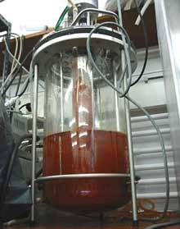
ANAMMOX
ANaerobic AMMonium OXidation
NO₂⁻
+
NH₄⁺
N₂
First described in a wastewater treatment plant in the
Netherlands in 1995.
Oxygen inhibition is reversible.
Slide modified from Debbie Bronk
Notes:
In 1995 the anammox reaction was discovered in a fluidized bed reactor.
Thamdrup and Dalsgaard (2002) published the first marine data on anammox in a study using isotope pairing in sediments.
Anammox bacteria are hearty - able to withstand exposure to oxygen
Since its discover, anammox has been found in many marine sediments where its been investigated and it can account for 0-80% of the measured N2 production.
In the oxygen minimum zones of the three oceans…if denitrifiers are undertaking the heterotrophic remineralization of OM and anammox bacteria are responsible for the remineralized ammonium - anammox could be responsible for an estimated 29% of N2 production (and this is conservative).

Slide 28
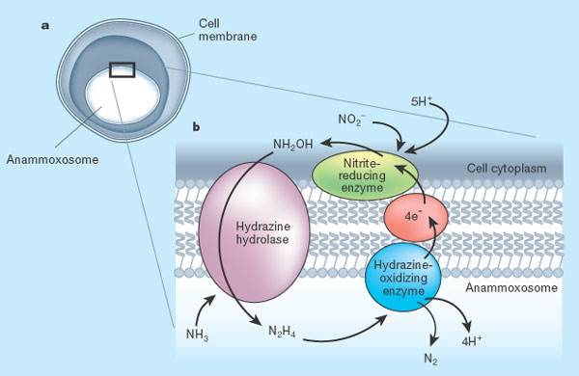
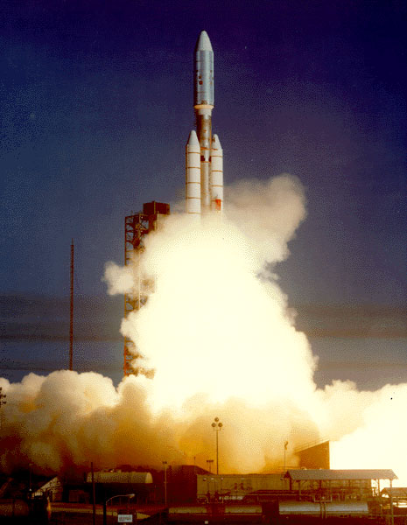
DeLong Nature 2002
Notes:
Ladderpane lipid membranes, hold rocket fuel!
Slow growing 7-22 days
Only known organism to make rocket fuel!

Slide 29
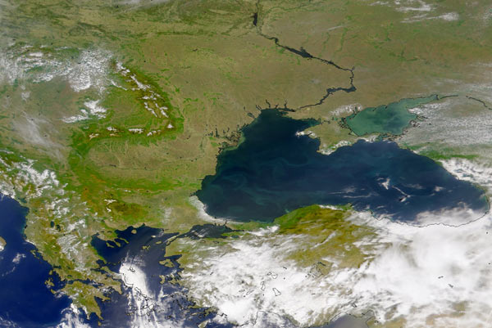
Anaerobic ammonium oxidation by anammox bacteria
in the Black Sea
Kuypers et al. Nature 2003.

Slide 30
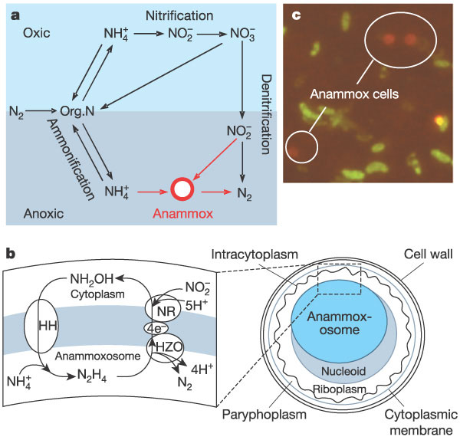
Kuypers et al. Nature 2003.

Slide 31
Canonical denitrification? OR Anammox??
NO₂⁻
+
NH₄⁺
N₂
obligate anaerobic autotrophs
NO₃⁻
NO₂⁻
NO
N₂O
N₂
facultative anaerobic heterotrophs
Slide modified from Debbie Bronk
Notes:
Does it really matter which process is occurring?
Yes! Because denitrification involves the production of greenhouse gas and anammox does not!
Canonical = standard or typical

Slide 32
Figure from: Shou-Qing Ni and Jian Zhang (2013)

Slide 33
DNRA
Dissimilatory Nitrate Reduction to Ammonium
NO₃⁻
NO₂⁻
NH₄⁺

Slide 34
Water column
Aerobic sediment
Suboxic sediment
Anoxic sediment

Slide 35
Part 2….. How humans have altered the global N cycle….

Slide 36
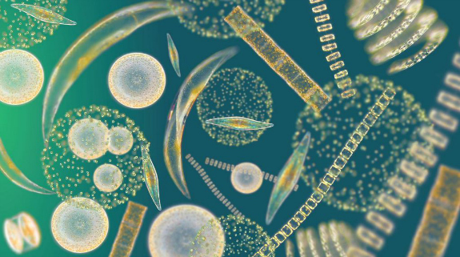
Denitrification? or DNRA?
N₂
NH₄⁺
Notes:
Does it really matter which process is occurring?

Slide 37
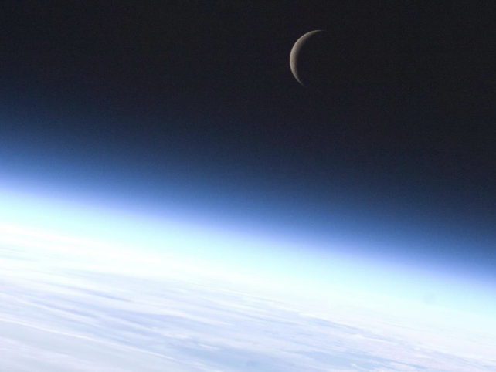



Two Broad Categories of Nitrogen
Biologically Usable
AKA:
Reactive Nitrogen (Nr)
2. **Biologically Un-usable
AKA:
Unreactive Nitrogen
NH₄⁺ = ammonium
NO₂⁻ = nitrite
NO₃⁻ = nitrate
  N₂ = Di-nitrogen gas

Slide 38
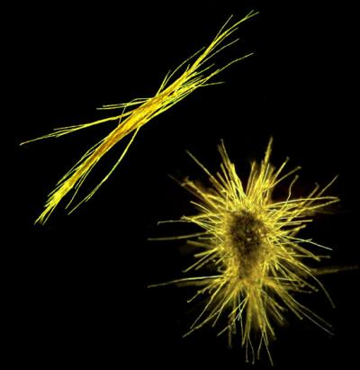
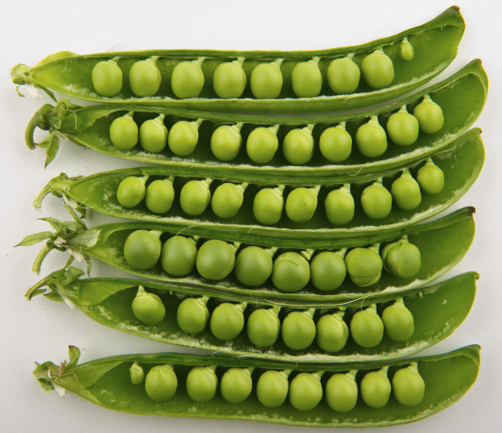
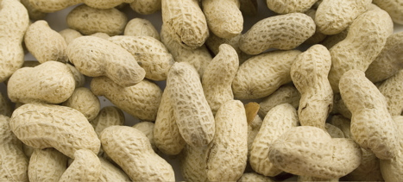
**Some organisms can use N₂!
Nitrogen Fixation
N₂ → NH₄⁺

Slide 39
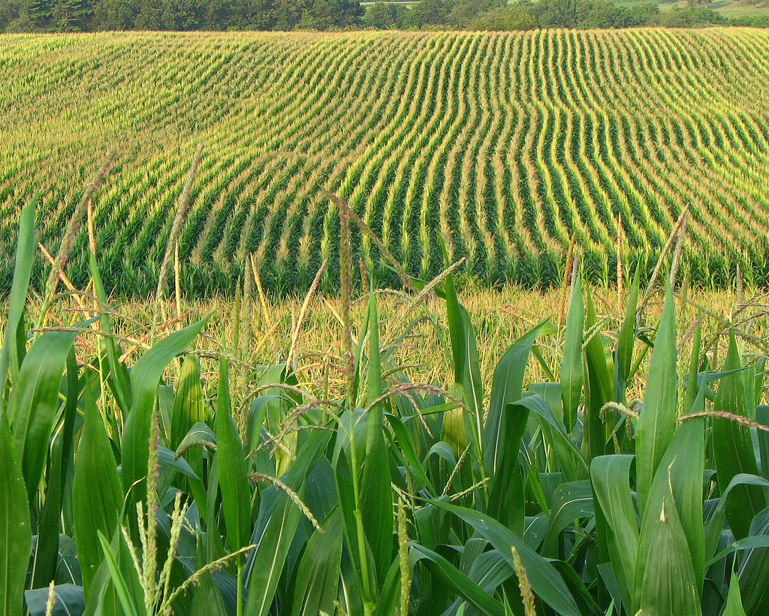

Slide 40
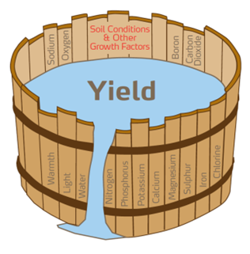
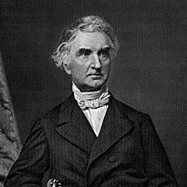
Justus von Liebig
“Father of Fertilizer Industry”
1855: Liebig’s Law of the Minimum
A limiting factor to biological activity is that material available in an amount most closely approaching the critical minimum required to sustain that activity (Odum 1971).

Slide 41
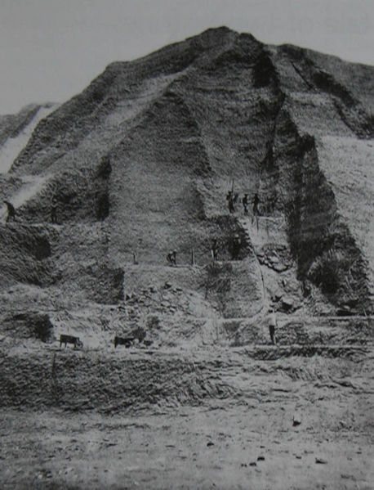
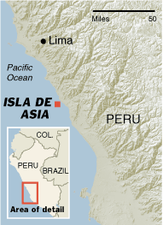
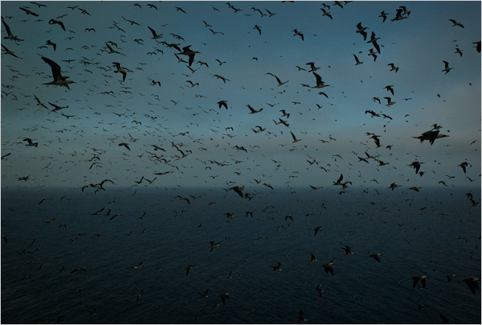
"Guano, though no saint, works many miracles.” Peruvian proverb

Slide 42

-1824 two caskets to The American
Farmer in Baltimore
1840 first shipment from Lima to
England
**Peak export from 1840 to 1870
Up to 600,000 tons
http://www.nuevayork-exhibition.org/galleries/2/port

Slide 43
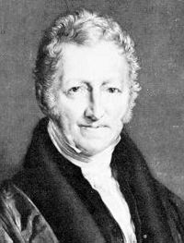
An Essay on the Principle of Population
or the "Malthusian catastrophe"
1798 - 1826 - six editions

Slide 44
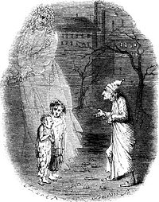

A Christmas Carol - 1843 - Charles Dickens
Ebenezer Scrooge states:
"If they would rather die they had better do it, and decrease the
surplus population…

Slide 45
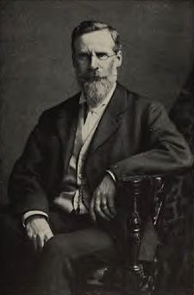
“The Wheat Problem”
“We are drawing on the earth’s capital and our drafts will not be perpetually honored.”
-Crookes, 1898
Sir William Crookes

Slide 46
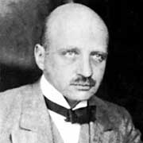


July 2, 1909 – discovered how to fix N
Fritz Haber
Nobel prize - 1918
Haber-Bosch process:
Under high temperatures and very high
pressures, with an iron catalyst,
hydrogen and nitrogen are combined to
produce ammonia.
Carl Bosch
Nobel prize - 1931

Slide 47
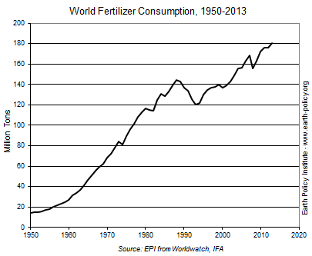

Slide 48
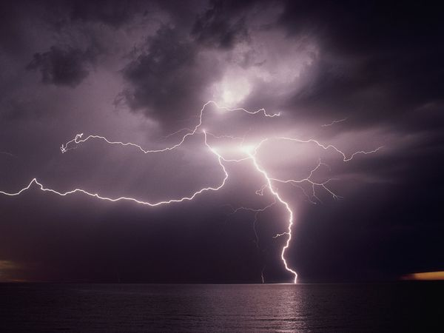
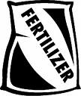
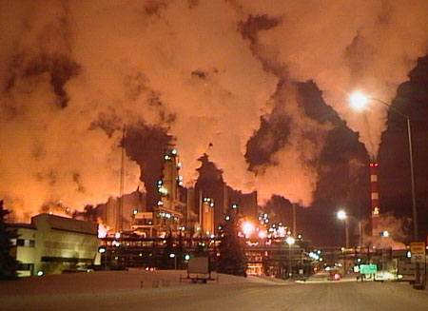
Human contribution:
1860
2000
Tg N y⁻¹
Tg N y⁻¹
Cultivation
15
33
Fossil Fuels
<1
25
Haber-Bosch
0
> 100
Total 1860: ~ 15 Tg N y⁻¹
Total 2000: ~ 165 Tg N y⁻¹
Galloway et al. 2003 - The N Cascade
Notes:
22-26 million (if it’s 140)

Slide 49

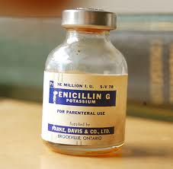


Greatest Invention of the last 150 or so years?

Slide 50
The Haber-Bosch process is often considered the most influential invention Of the 20th century because it
"detonated the population explosion...”
V. Smil, Nature, July 29 1999, p 415.
Notes:
Guesses on the % of the population that is alive today because of this process?

Slide 51
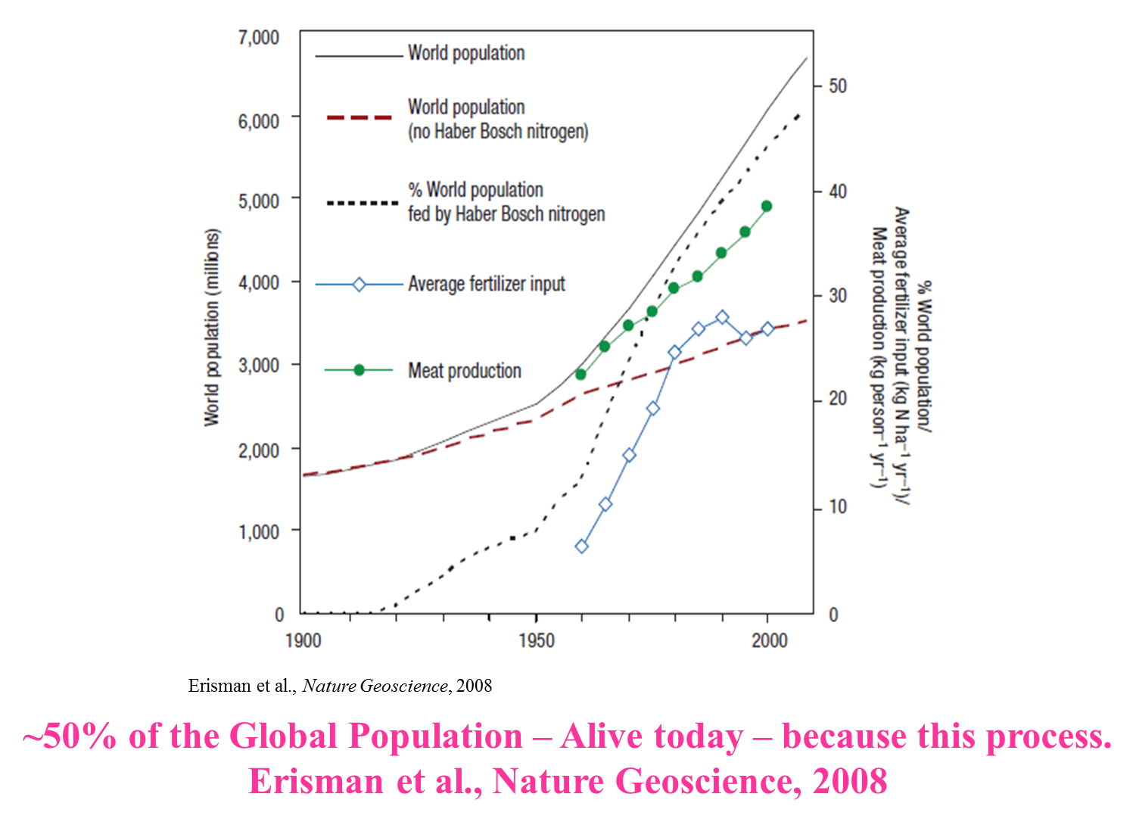

Slide 52
However….too much N - causes many
negative consequences…and, N gets
around…… that is - it doesn’t “stay put.”
“Cascades” through the
Environment….(from Galloway 2003)
Notes:
One nitrogen element can impact the ozone layer, land, freshwater, and marine waters….. It keeps going….

Slide 53
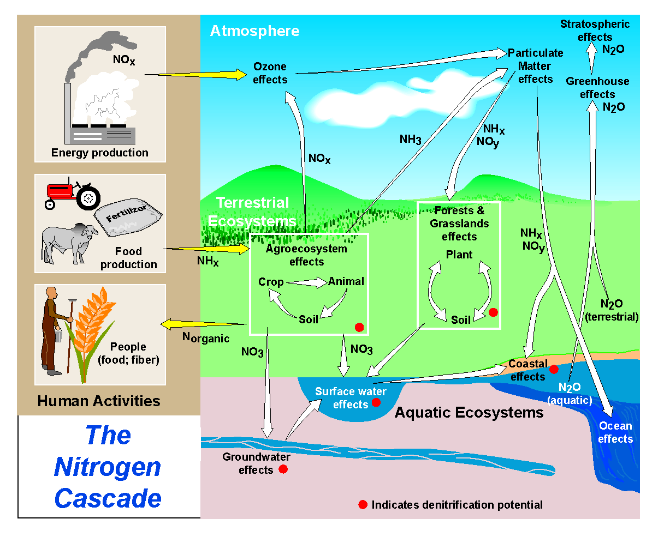
Nitrogen as a Shapeshifter
http://www.initrogen.net/94.0.html

Slide 54
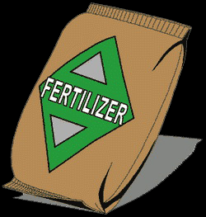
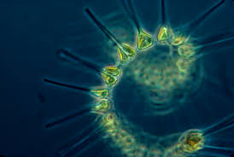
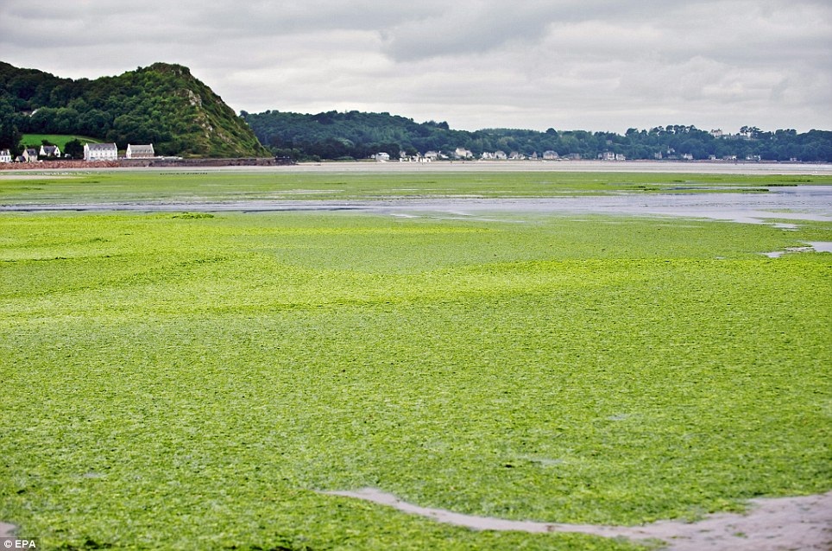
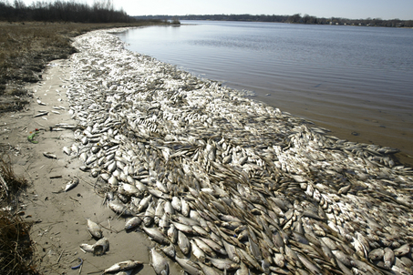

Too much of a good thing…
N
N

Slide 55
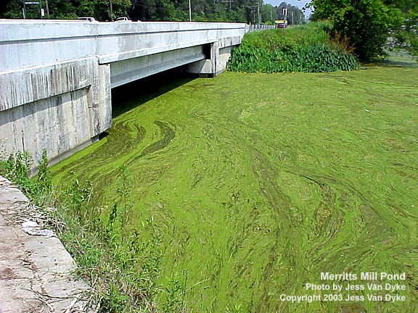
Eutrophication - an increase in the supply
of organic matter to a system. (Nixon 1995)

Slide 56

*
*
*
*
*
*
*
*
*
*
*
*
O₂
*
*
*
*
*
*
*
O₂
O₂
*
*
*
*
*
*
Septic tank
*
*
DIN_{r}
O₂
O₂
O₂
ANOXIA
Slide modified from S.Q. Foster

Slide 57
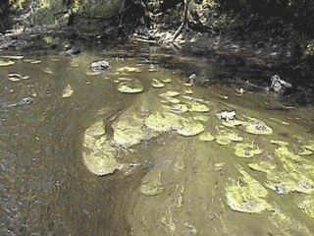
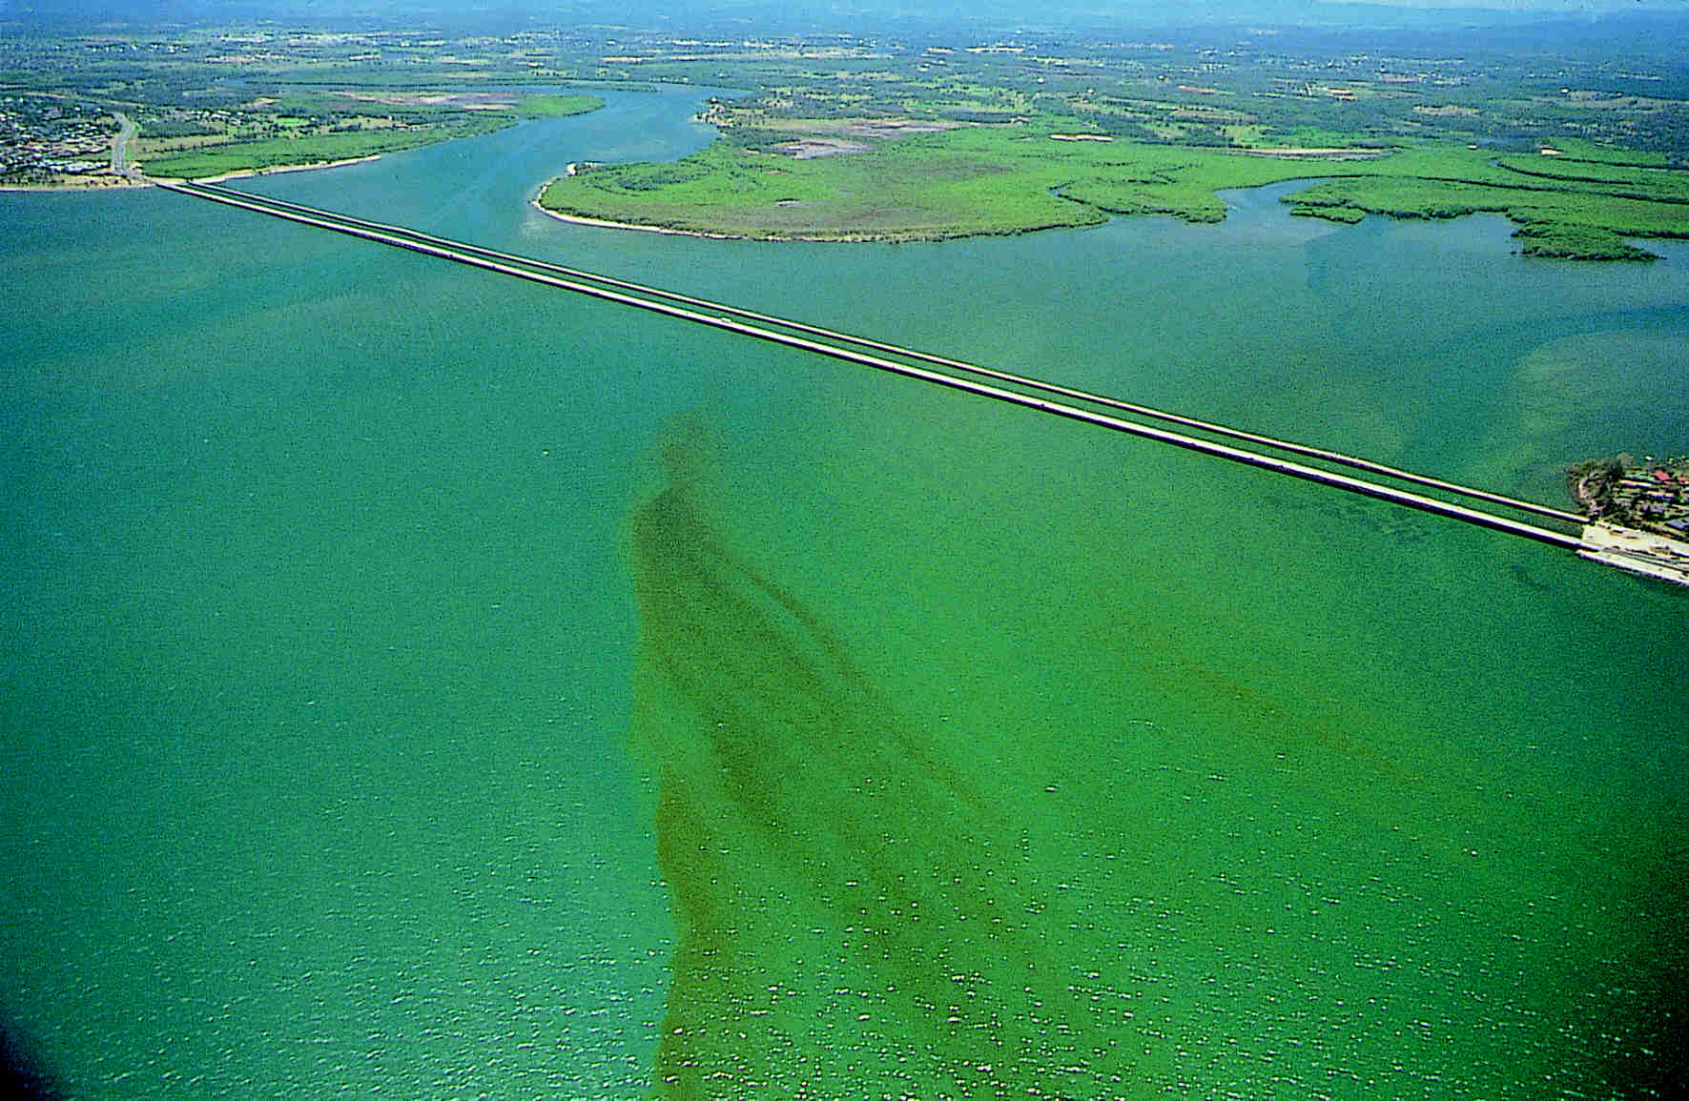
N Loading and Aquatic ecosystem response
• Increased algal productivity
• Harmful algal blooms
• Formation of nuisance algal mats
Low Oxygen Conditions
Fish kills - fin and shell
Loss of biodiversity
Loss of submerged aquatic vegetation
Sybil Seitzinger, 2003

Slide 58
Global Distribution of Low Oxygen Zones
Diaz and Rosenberg (2008) Science
Notes:
Dead zones in the coastal oceans have spread exponentially since the 1960s and have serious
consequences for ecosystem functioning. The formation of dead zones has been exacerbated by the
increase in primary production and consequent worldwide coastal eutrophication fueled by riverine
runoff of fertilizers and the burning of fossil fuels. Enhanced primary production results in an
accumulation of particulate organic matter, which encourages microbial activity and the consumption of
dissolved oxygen in bottom waters. Dead zones have now been reported from more than 400 systems,
affecting a total area of more than 245,000 square kilometers, and are probably a key stressor
on marine ecosystems.

Slide 59
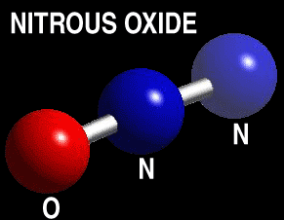
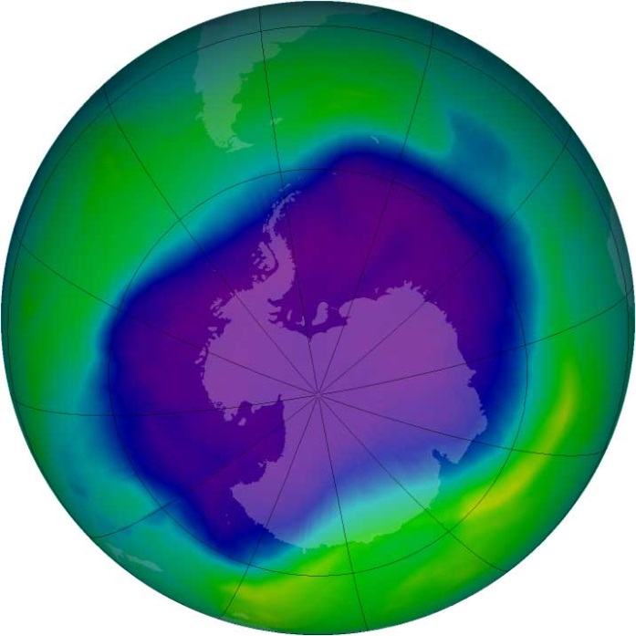
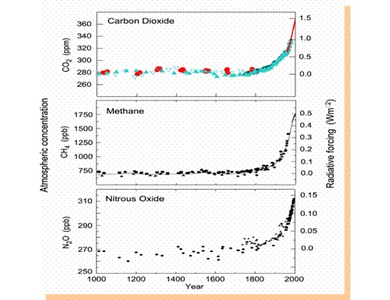

Slide 60


The Million Dollar Question:
How do we feed an ever growing population and protect our environment from excess N?
Increase fertilizer use efficiency
Increase plant nitrogen use efficiency
Augment the natural process of denitrification
Increase WWTP N removal

Slide 61

But What about us?
Don’t be a Bigfoot
#1 Way to lower you N footprint

Slide 62


We only require ~ 2 kg per year
Notes:
Galloway and Cowling – humans require 2 kg N y-1 – but we create about ~ 20 kg per person per year.

Slide 63
Eat Less Meat
Humans apply about 170 million metric tons of N to cropland
each year…. That’s roughly equivalent to more than 1.5 million blue whales worth of N…
12% of it enters our mouths (Galloway et al. 2003)
Think of it this way:
It takes 220 lbs of N in corn to produce 11 lbs of N in beef.

Slide 64


Slide 65


Reduce Fossil Fuel Use
Notes:
Releases NOx (NO and NO2 → comes down other places)

Slide 66

How do you stack up?
Want to find out?
http://www.n-print.org/N-Calculator
Notes:
Questions – what adds the most N? your diet? Your transport? …let’s look at mine.

Slide 67
Atmosphere
(km)
N₂
N₂O
N₂
Photosynthesis
Water
Column
(m)
Organic
matter
Bacterial
degradation
NH₄⁺
Nitrification
NO₂⁻
NO₃⁻
Aerobic conditions
N₂O
Bacterial
degradation
Detrital
Organic
matter
NH₄⁺
Sediment
(cm)
Denitrification
N₂O
N₂
Anaerobic conditions

