Slide 1
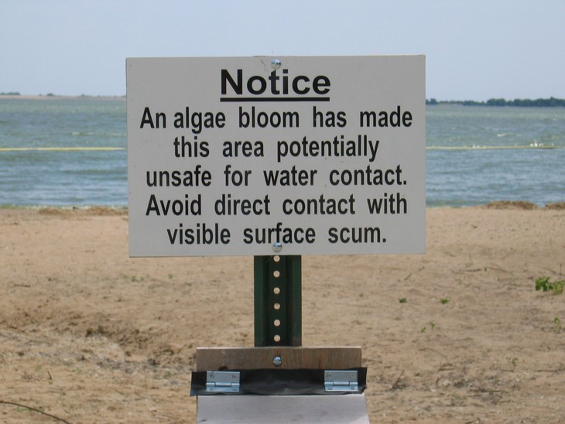
Harmful Algal Blooms - HABS
11/11/16

Slide 2
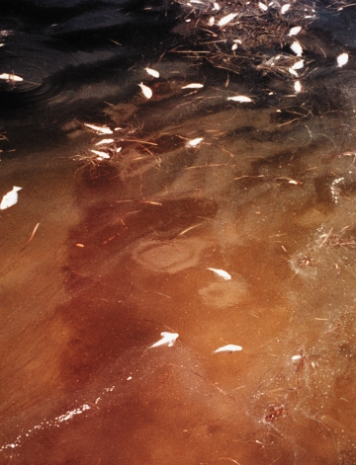
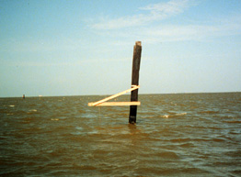
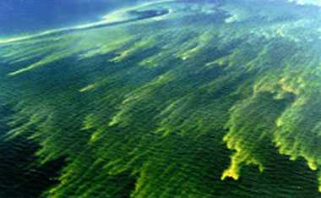
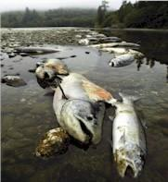
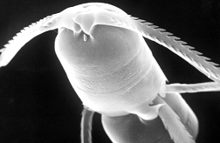
Harmful Algal Blooms - HABS
Cyanobacterial blooms in the late 1990's in
the Baltic Sea
Texas Brown Tide Bloom of Aureoumbra
Florida Red Tide Bloom of Karenia brevis
When they are very abundant …
1. Shading (blocking the sunlight)
2. Oxygen depletion
(excessive respiration or decomposition)
3. Mechanical irritation (damaging fish gills)

Slide 3
Dinoflagellates
Single-celled
2 flagellae
Bioluminuscent
Harmful algal blooms
6 – 8 million / L

Slide 4
Red tides
Toxic
Can cause
fish kills

Slide 5
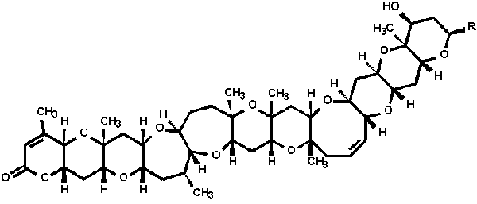
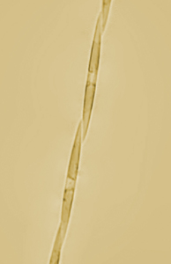
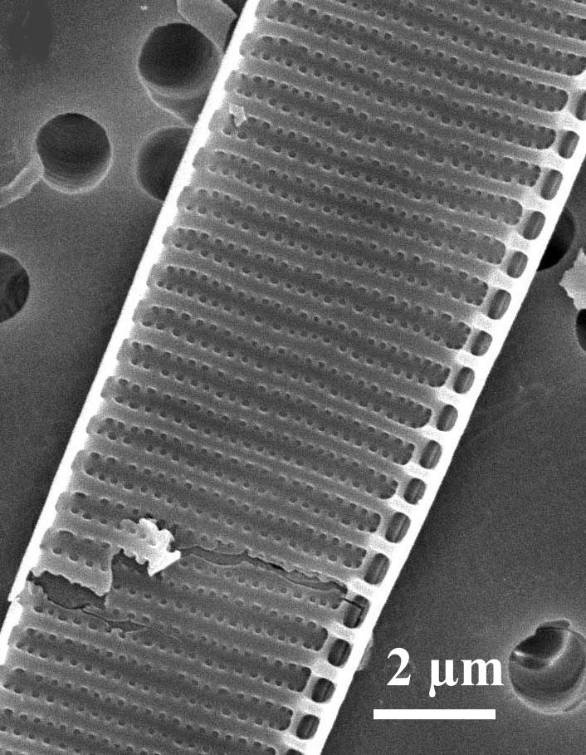
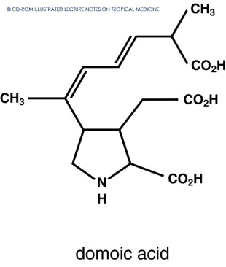
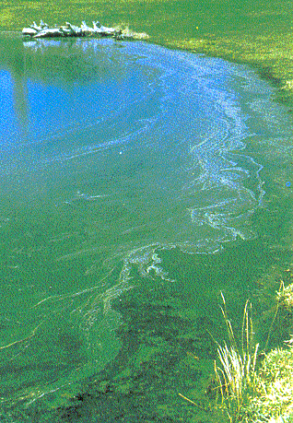
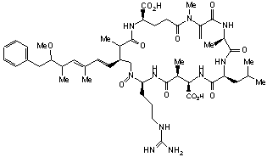
Neurotoxic Shellfish Poisoning (NSP)
Causative organism: Karenia brevis
Toxins produced: Brevetoxins
BREVETOXIN
DOMOIC ACID
Amnesic Shellfish Poisoning (ASP)
Causative organisms: Pseudo-nitzschia sp.
Toxin produced: Domoic Acid
Cyanobacterial Toxins
Causative organisms: Microcystis, Nodularia , Anabaena, Lyngbia…
Toxin produced: Microcystins and nodularins, cylindrospermopsin, and saxitoxin

Slide 6
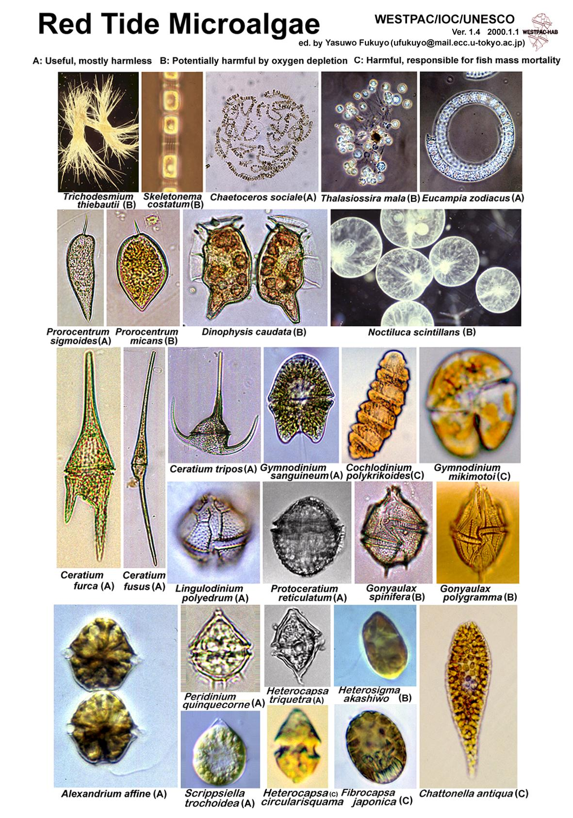
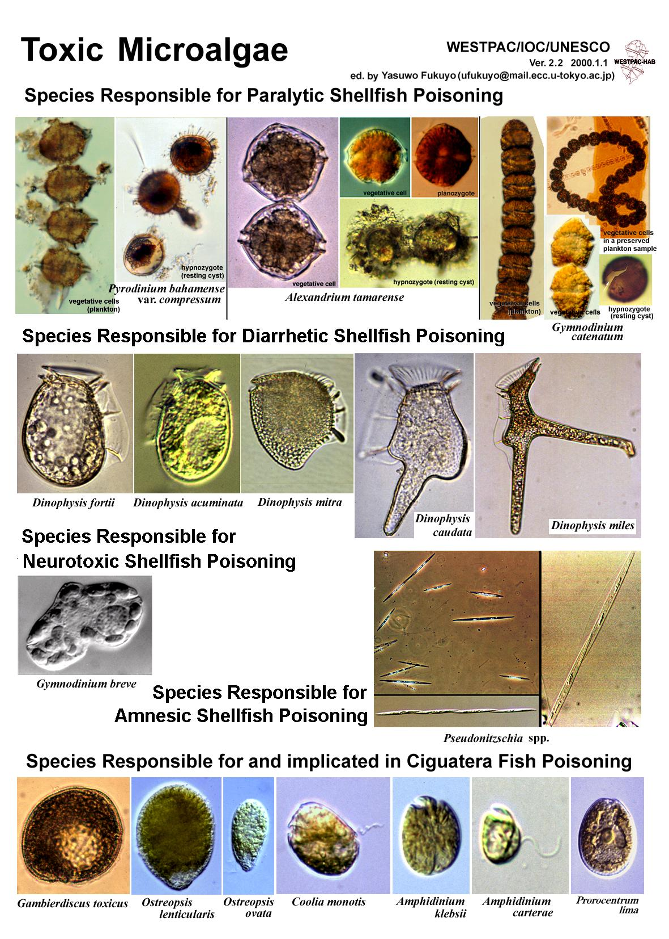
Harmful Algal Species
and the Syndromes

Slide 7
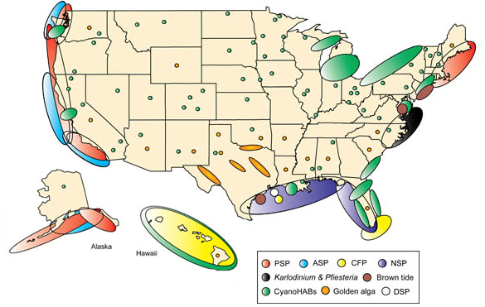
HABS in the US

Slide 8
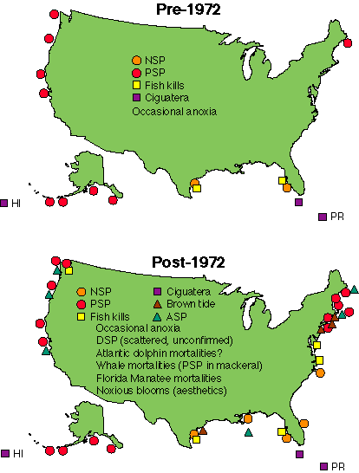
WHY???

Slide 9
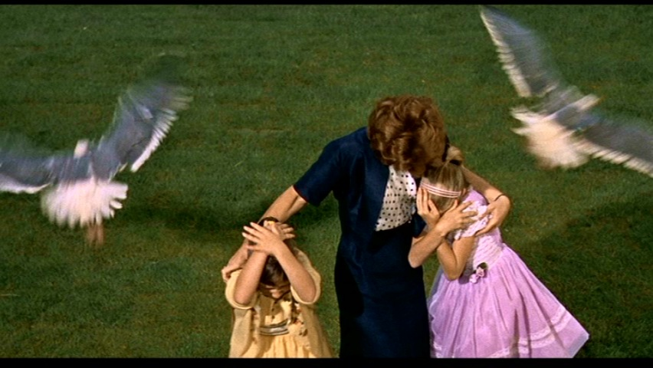
(the true story behind the birds) The Birds…………………………

Slide 10
“On 18 August 1961, a Californian newspaper reported that thousands of “crazed seabirds pelted the shores of North Monterey Bay, California” regurgitating anchovies.” – Bargu et al. 2011

Slide 11
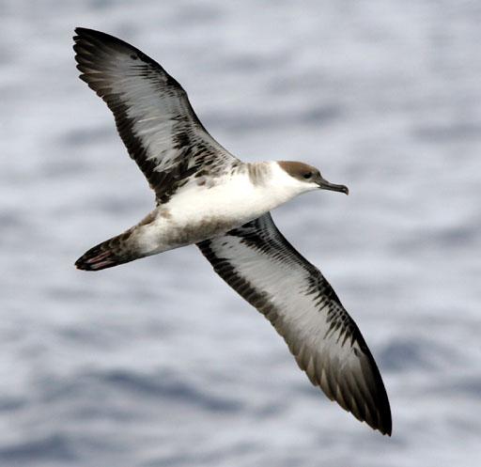
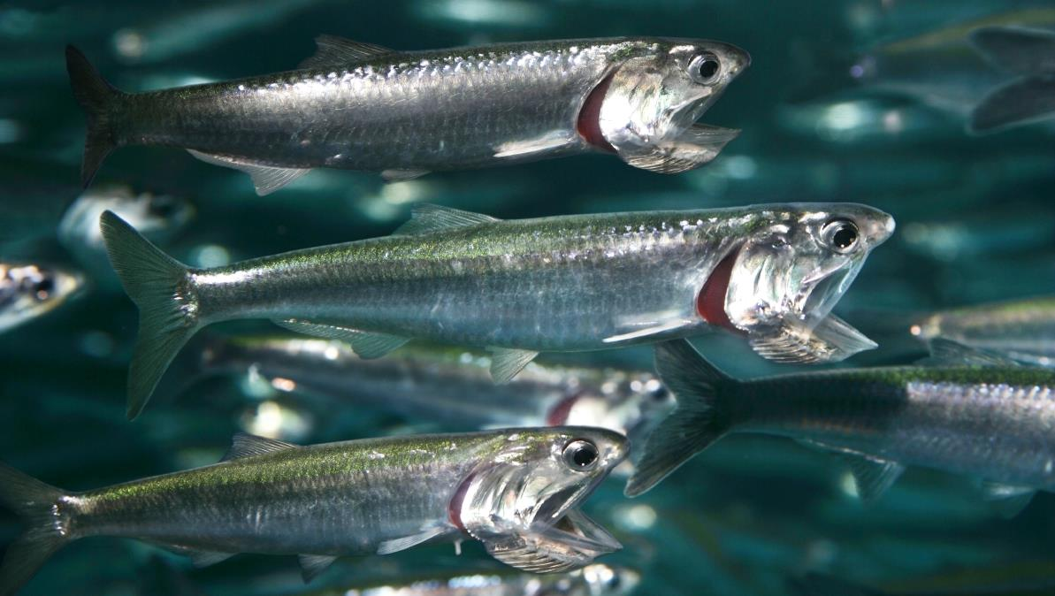
Sooty Shearwaters
Northern anchovies

Slide 12
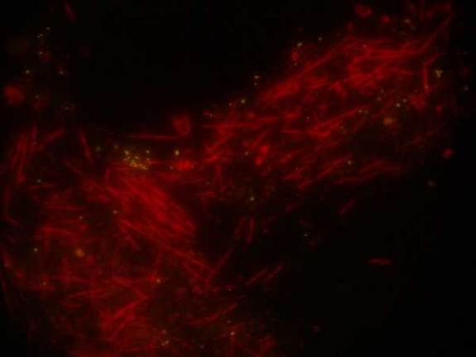
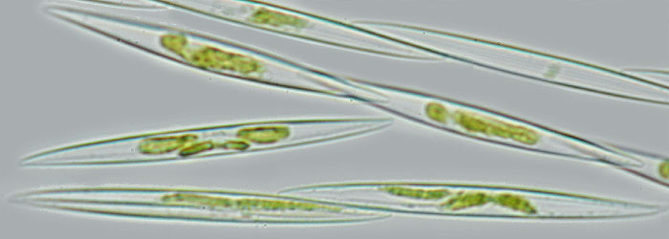
Pseudo-nitzschia

Slide 13
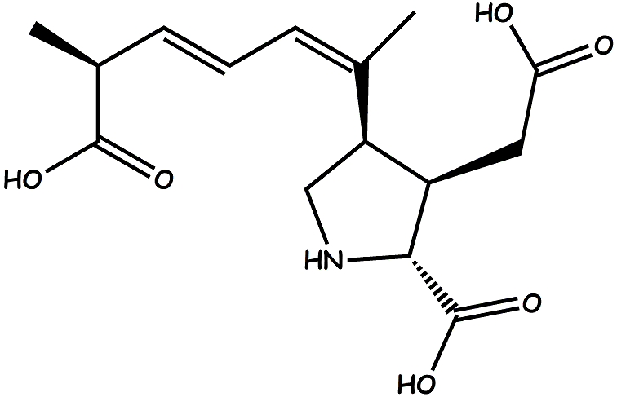
Domoic Acid Poisoning

Slide 14
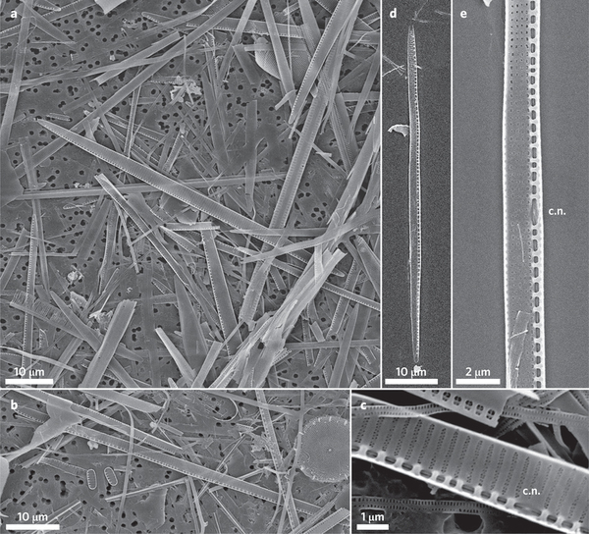
“domoic acid passes through the blood–brain barrier and binds to these receptors in birds and mammals, it causes symptoms such as confusion, disorientation, scratching, seizures, coma and even death” – Bargu et al. 2011

Slide 15
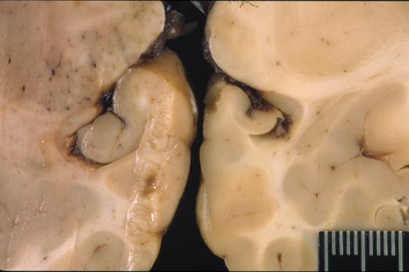
Shrunken hippocampus in sea lion brain….

Slide 16
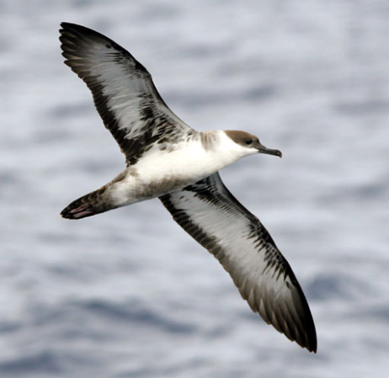
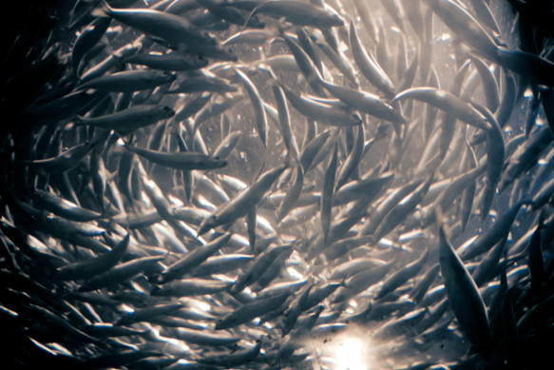
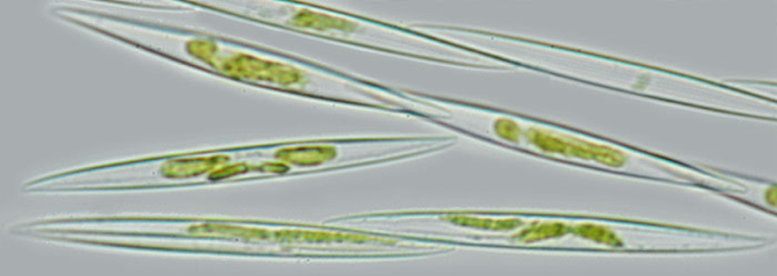

Slide 17
Energy flow in marine ecosystems
Ecosystem includes living organisms (biotic community) and environment
Solar energy converted to chemical energy by producers (mainly photosynthesis)
Consumers eat other organisms
Herbivores
Carnivores
Omnivores
Bacteriovores
Decomposers breaking down dead organisms or waste products

Slide 18
Algae-supported biotic community
Energy does not cycle…. It has a unidirectional flow

Slide 19
Nutrients cycle!
Nutrients cycled from one chemical form to another
Biogeochemical cycling
Example, nutrients fixed by producers
Passed onto consumers
Some nutrients released to seawater through decomposers
Nutrients can be recycled through upwelling

Slide 20
Biogeo-chemical cycling

Slide 21
Trophic levels
Chemical energy is transferred from producers to consumers
Feeding stage is trophic level
About 10% of energy transferred to next trophic level

Slide 22
So – what does this mean?
Transfer of energy is very inefficient

Slide 23
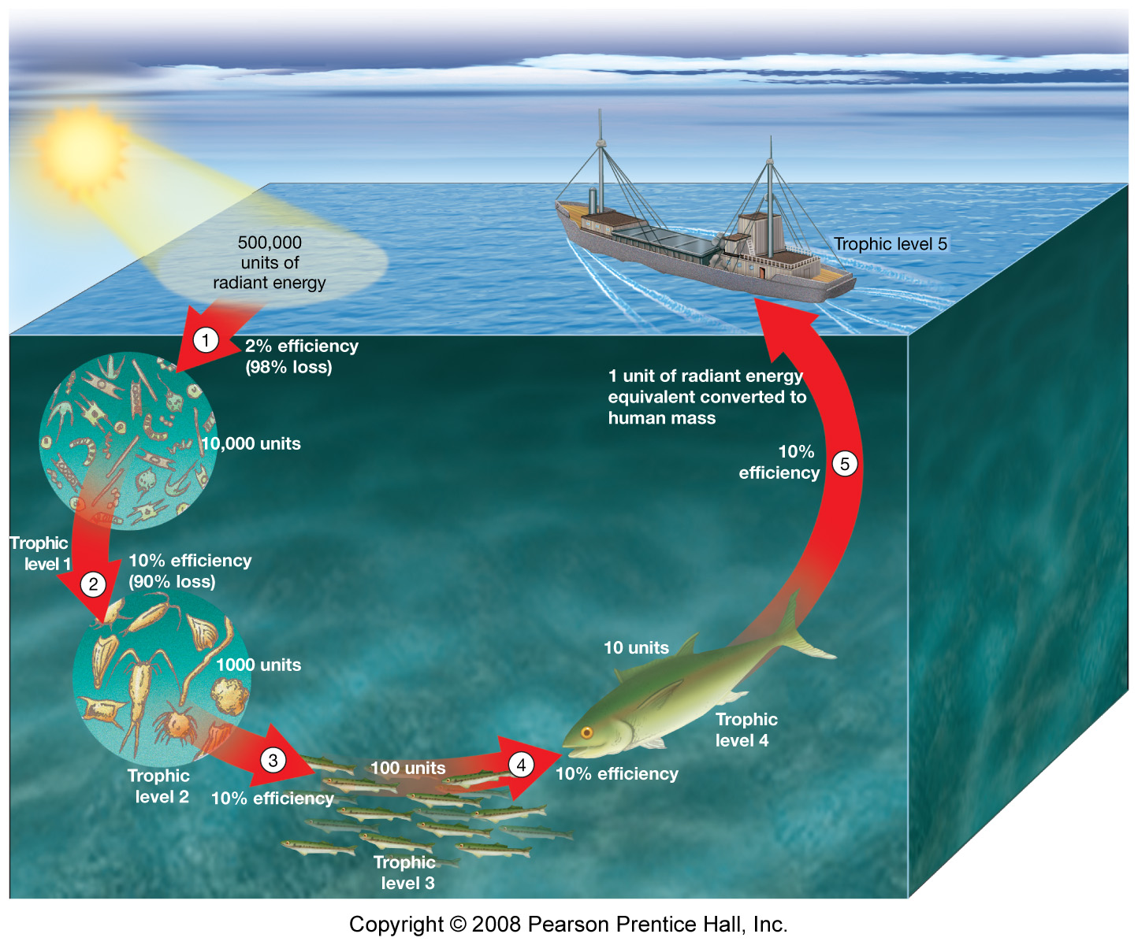

Slide 24
Food chain Food web
Primary producer
Herbivore
One or more carnivores
Branching network of many consumers
Consumers more likely to survive with alternative food sources

Slide 25
Biomass pyramid
Number of individuals and total biomass decrease at successive trophic levels
Organisms increase in size
Fig. 13.21

Slide 26
Quiz –
How much energy is transferred from one trophic level to the next?

Slide 27
How might we measure photosynthesis in the ocean?

Slide 28
Measurements of photosynthesis
Monitoring O₂ change in a dark bottle and a light bottle.
(dissolved oxygen is easy to measure)
Light bottle: Photosynthesis – Respiration.
Dark bottle: Respiration only.
Gross photosynthesis: Light bottle + Dark bottle.
Photosynthesis
&
Respiration
Respiration
Light bottle Dark bottle

Slide 29
Measurements of photosynthesis
Monitoring ¹⁴C uptake
Add dissolved ¹⁴C spike.
After time duration, filter particles (organic matter produced).
Measure ¹⁴C incorporated into particles.
FYI
Radioactivity of ¹⁴C is easy to measure when the concentration is VERY high (¹⁴C spike).
Measurement of natural level is harder (one ¹⁴C out of a trillion ¹²C in nature).

Slide 30
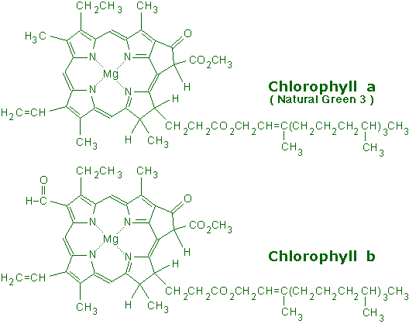
Measurements
Chlorophyll (Biomass measurement):
Pigments that absorb sun light (blue and red ends of the visible spectrum).
Can be monitored by fluorescence (in-situ instrument) and ocean color (satellites)
www.succulent-plant.com

Slide 31
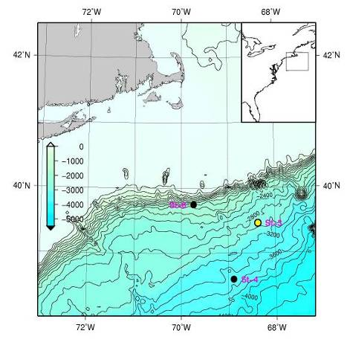
Chlorophyll
Depth (m)
Stn A, 2000m
Stn B, 3000m
Subsurface Chl.
max.
Stn C, 3500m

Slide 32
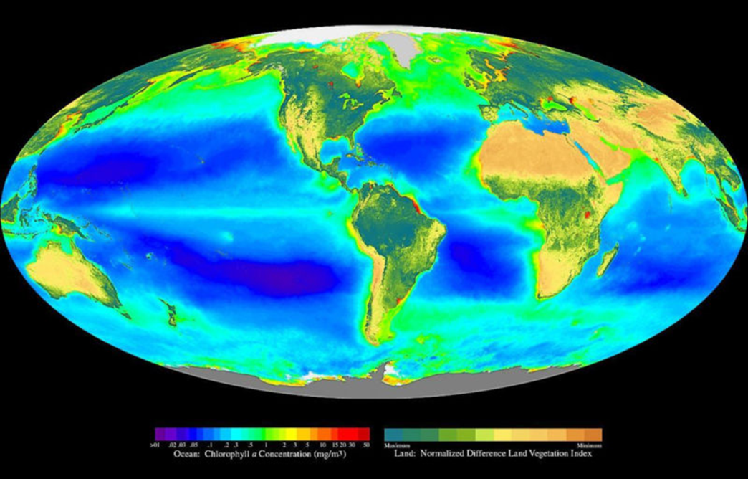
Chlorophyll
Productive along the continents.
Productive in the upwelling regions.
Deserts in centers of gyres (due to downwelling).

