Slide 1
“You can't stop the waves, but you can learn to surf.” - Jon Kabat-Zinn
Waves…..

Slide 2
Waves are moving energy!
Most waves wind-driven
Moving energy along ocean/air interface:
Wind main disturbing force
Boundary between and within fluids with different densities

Slide 3
Air/ocean interface → ex. - ocean waves

Slide 4
Air/air interface → ex. - atmospheric waves

Slide 5
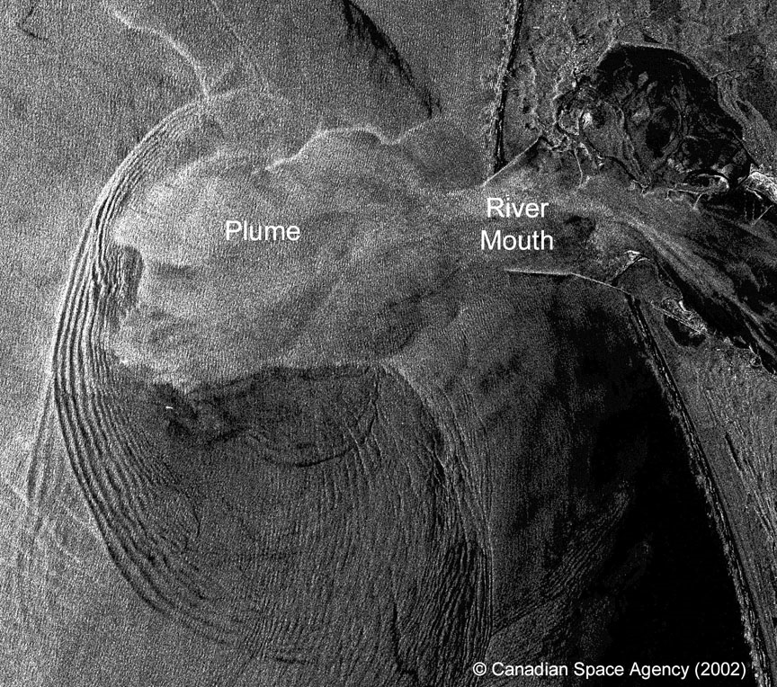
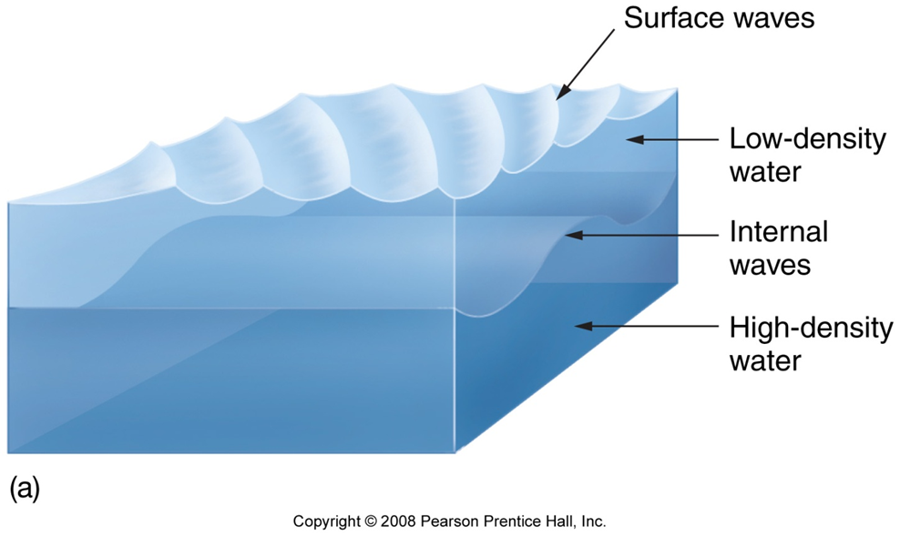
Water/water interface
→ ex. - internal waves

Slide 6
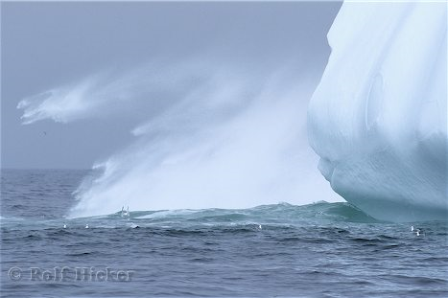
Other types of waves
Splash wave
Coastal landslides, calving icebergs

Slide 7
Seismic sea wave or tsunami
Sea floor movement
Notes:
Caused by uplift or downdropping of large areas of the seafloor. Transfers energy to the whole water column – not just the surface….examples include underwater volcanic eruptions, seafloor slippage, underwater avalanche (turbidity currents)

Slide 8
Wake
→ ex. Ships

Slide 9
Tides
Gravitational attraction among Moon, Sun, and Earth

Slide 10
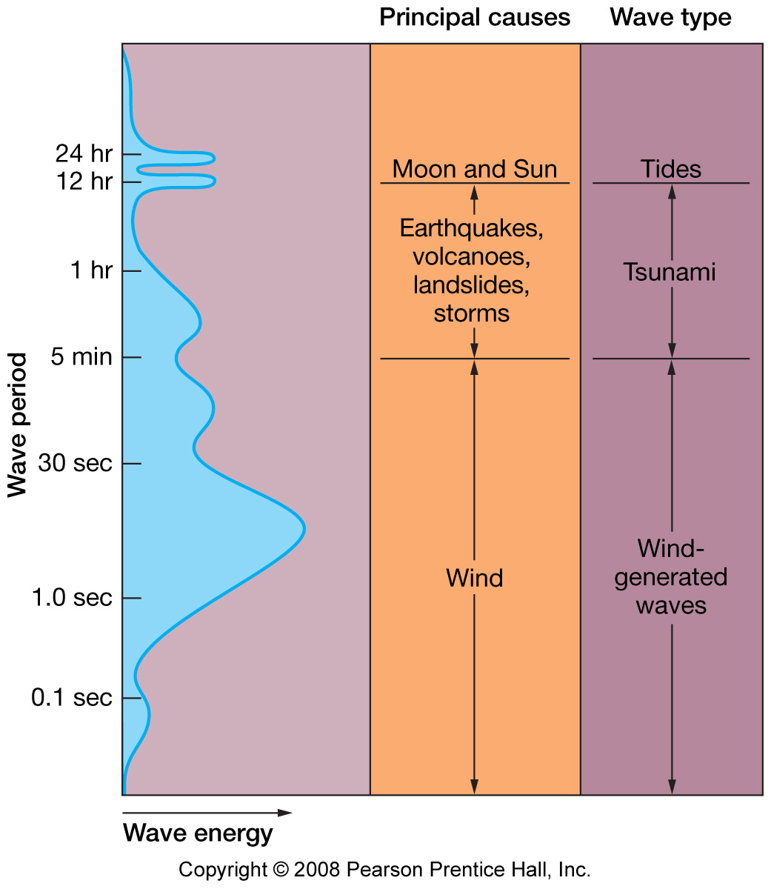
Types of ocean waves
Fig. 8.2

Slide 11
Let’s Dissect a Wave
Wave Length (L or λ)
Crest
Still water
Level
Trough
Wave Height (H)

Slide 12
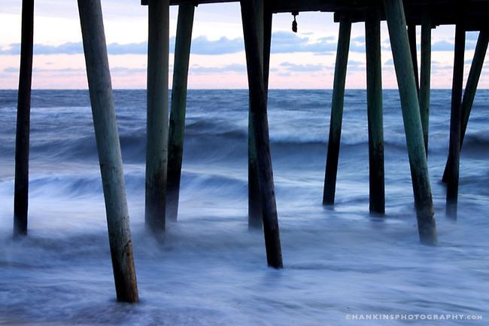
Wave Period = T
The time it takes for a full wave – or wavelength to pass a
fixed position
Typically ranges between 6 and 16 seconds

Slide 13
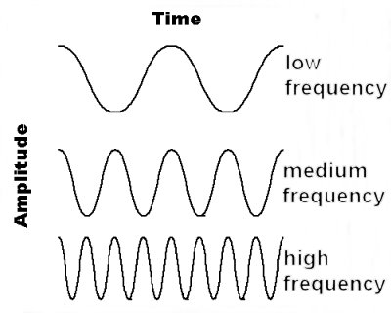
Wave Frequency = f
f= 1/T
Number of waves passing a fixed location per unit
time. It is the inverse of wave period.

Slide 14
Water doesn’t move –
only the waveform

Slide 15
Wave motion
Waves transmit energy
Cyclic motion of particles in ocean
Particles may move
Up and down
Back and forth
Around and around
Particles in ocean waves move in orbital paths

Slide 16
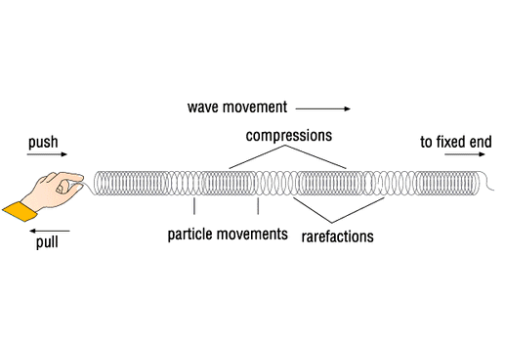
Longitudinal Waves (push-pull waves):
Particles move back and forth in direction of energy transmission.
Energy transmitted by compression and decompression.
Energy transmitted through solid, liquid, gas.
(www.allrefer.com)
Notes:
Example – sound…. As we clap for example - - a percussion is initiated – it compresses and decompresses the air - as sound moves through the air

Slide 17
Transverse Waves (side-to-side waves):
Particles move at right angles to direction of energy transmission.
Energy transmitted by vibration.
Generally transmits energy through solids

Slide 18
Body Waves – bc they transfer energy
through a body of matter
Surface Waves – bc they travel btw
Two different fluids (air & water); have
Characteristics of both longitudinal and transverse

Slide 19
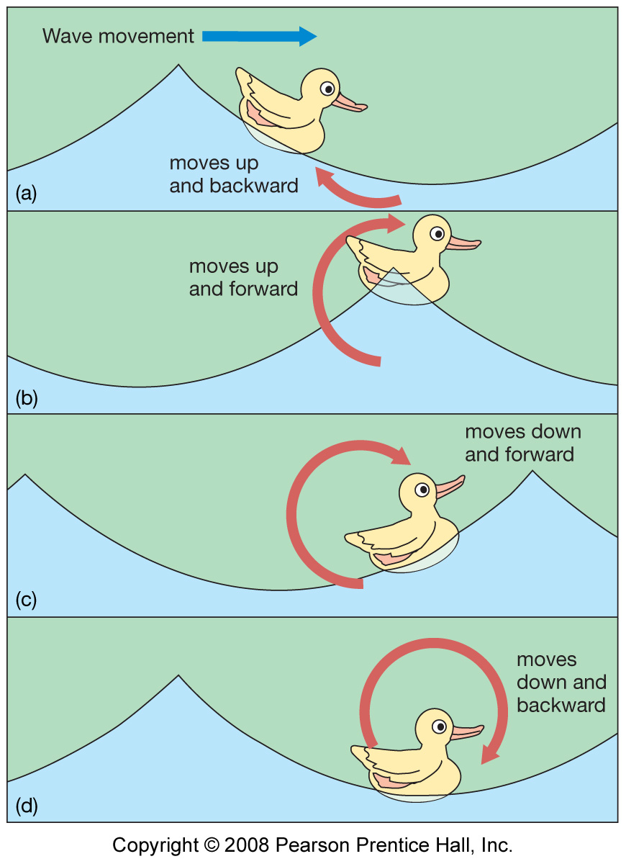
Particles move in orbital path
(both longitudinal and transverse).
Energy transmitted along
interface between two fluids
of different density.
Circular orbits of an object floating at the surface have a diameter equal to the wave height.
Circular Orbital Motion

Slide 20
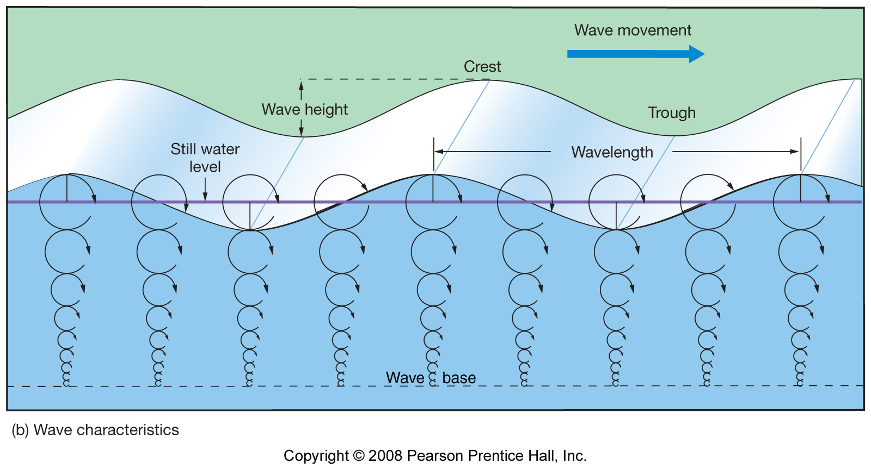
Only wavelength controls the depth of the wave base…..so the longer the wave the deeper the wave base!
Wave Base:
equal to one half of the wavelength (at SWL) or L/2

Slide 21
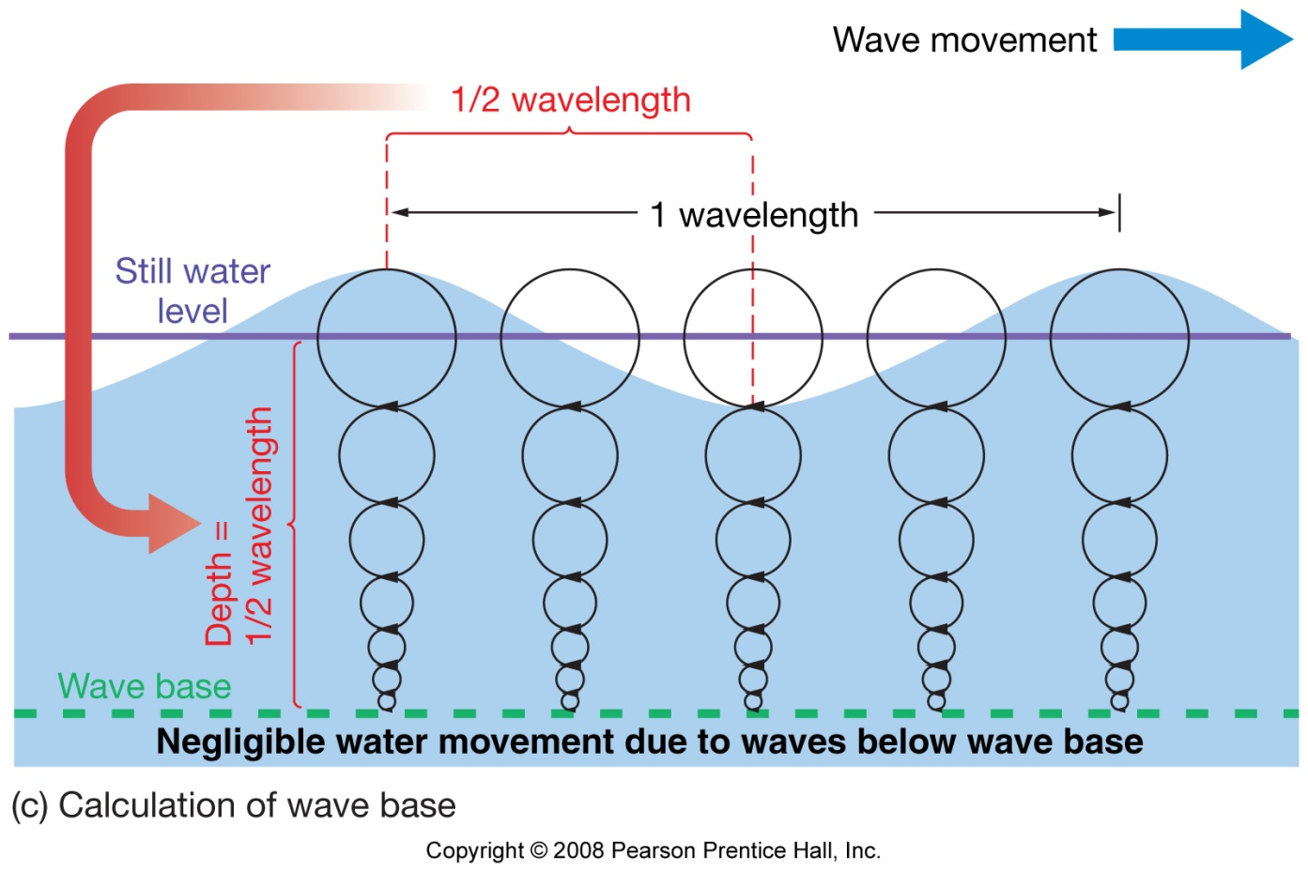
Orbital motion
Diameter of orbital motion decreases with depth of water
Wave base = ½ L (or L/2)
Hardly any motion below wave base due to wave activity

Slide 22
We describe waves in relation to the depth of the water and their wavelength….
Deep-water Waves
Shallow –water Waves
Transitional Wave

Slide 23
Wave Base – defined as ½ the wave length
Or
L/2
Wave Length (L or λ)

Slide 24
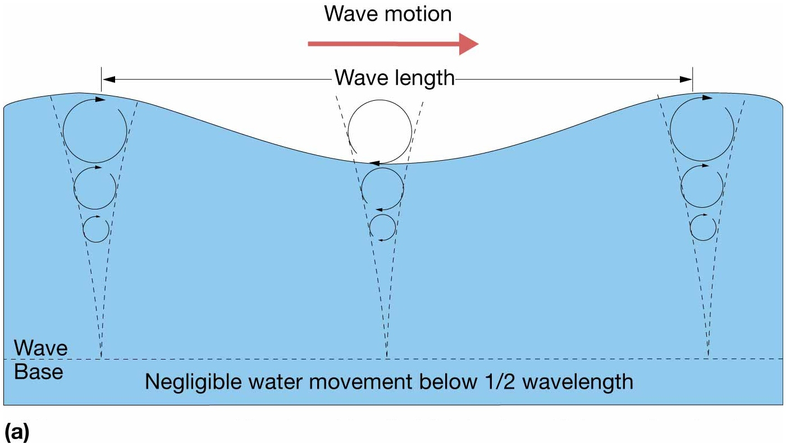
Deep-water waves
Water depth is greater than wave base (>1/2L)
Ex. – includes all wind generated waves in the open ocean

Slide 25
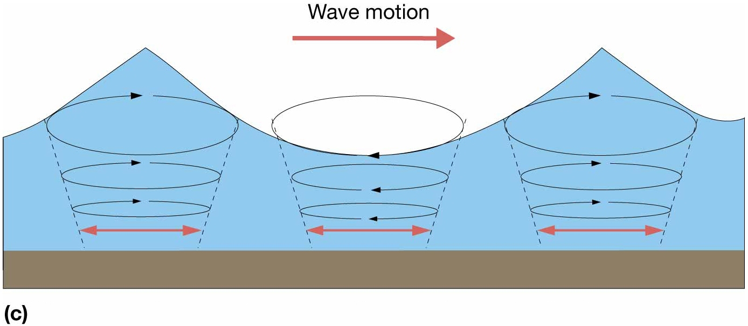
Shallow-water wave (long wave)
Water depth is < 1/20L
Fig. 8.7c

Slide 26
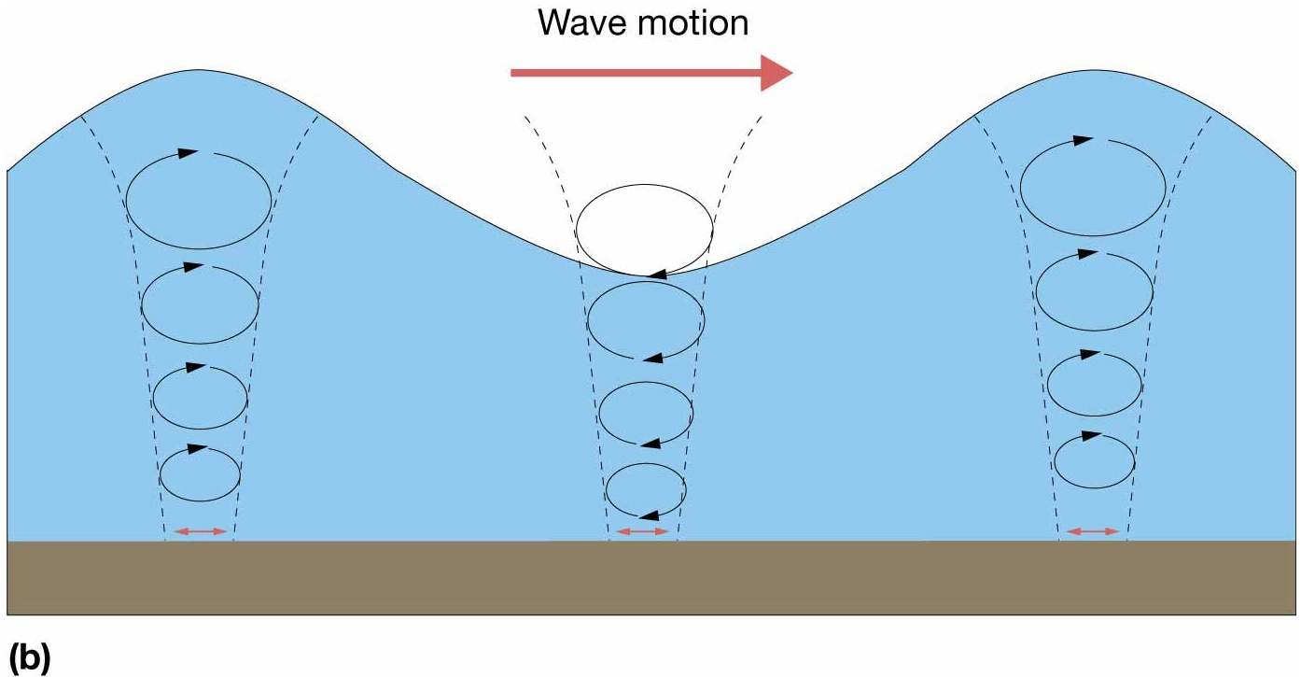
Transitional waves
Characteristics of both deep and shallow-water waves
Depth is greater than 1/20 wavelength but less than ½ wavelength
Fig. 8.7b

Slide 27
Wave Speed
S= wavelength (L)/ period (T)
More correctly known as CELERITY –
Used only in relation to waves where no mass is in motion, just the wave form.

Slide 28
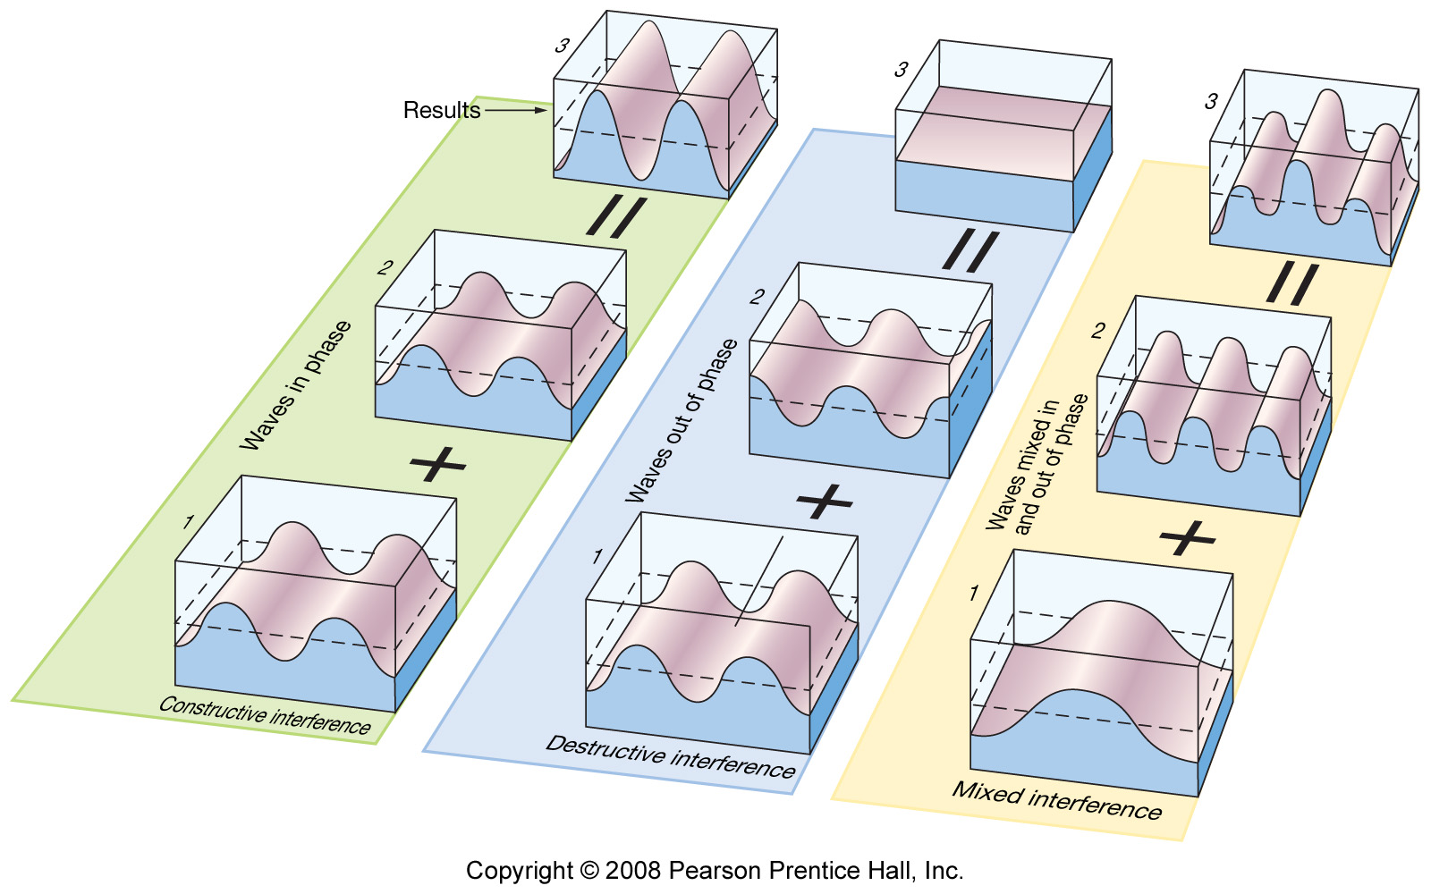
When waves meet
Two waves with the same wavelength.
In phase: Constructive interference.
Out of phase: Destructive interference.

Slide 29
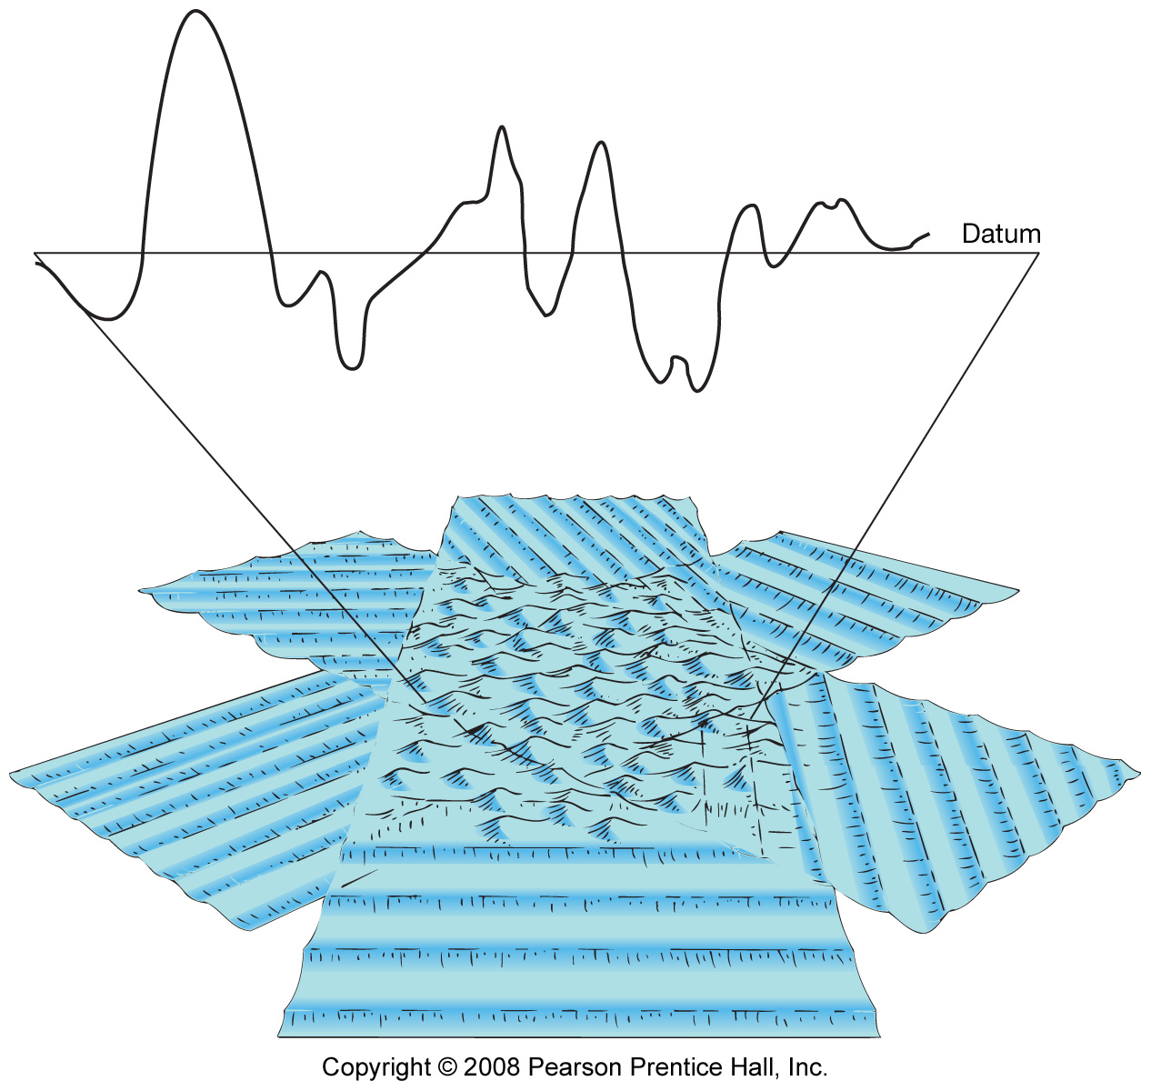
Mixed interference

Slide 30
How do you build a big wave?

Slide 31
Three Factors affecting wave height:
Wind speed
Duration – how long wind blows
in one direction.
3. Fetch – distance it blows in one
direction.

Slide 32
Wave Development
Wave breaks when steepness (Wave height H / wavelength L) > 1/7.
Swells: uniform, symmetrical waves.

Slide 33
Wave Steepness
= Wave height / Wavelength
Or
=H/L
Or
= H/λ

Slide 34
Wave Steepness
= H/L
1/7 Rule…..
If the ratio of wave height to wavelength exceeds 1/7 – the wave breaks!
Ratio also tells us about maximum wave height….
For example – if a wave is 7 m long…. It can only be 1 m high - Otherwise it would break….

Slide 35
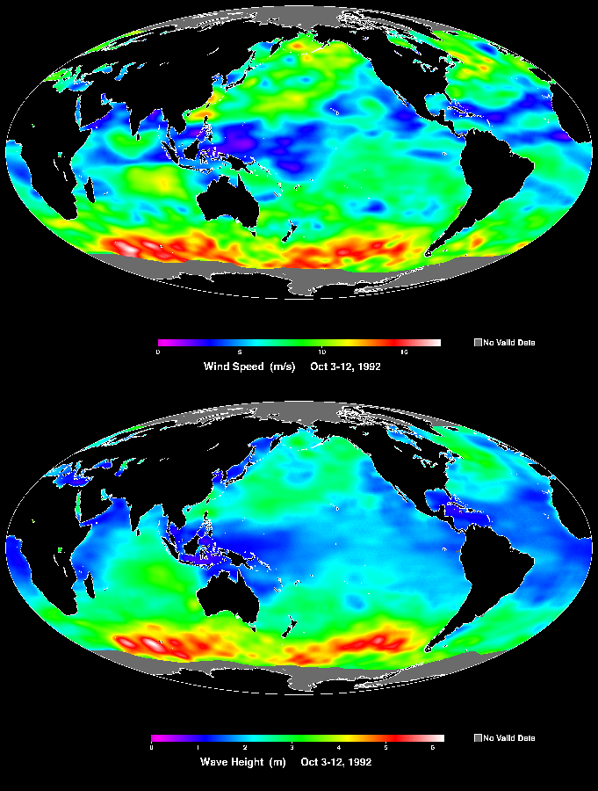
http://topex-www.jpl.nasa.gov/newsroom/press-releases/images/wind_wave.gif

Slide 38
Quiz
Complete this sentence:
Waves are moving _________________.

