Slide 1
Atmosphere and Ocean Circulation II
Today!! – at 4:00 pm, CAS 132
Is Climate Change Impacting the Deep Sea
Pete Girguis, Harvard University

Slide 2
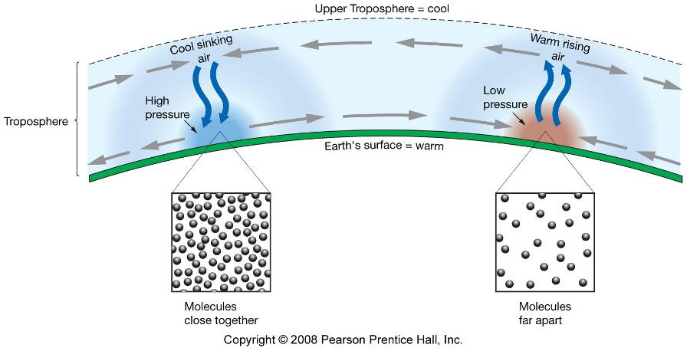
Air always flows from high to low pressure.
Wind – moving air

Slide 3
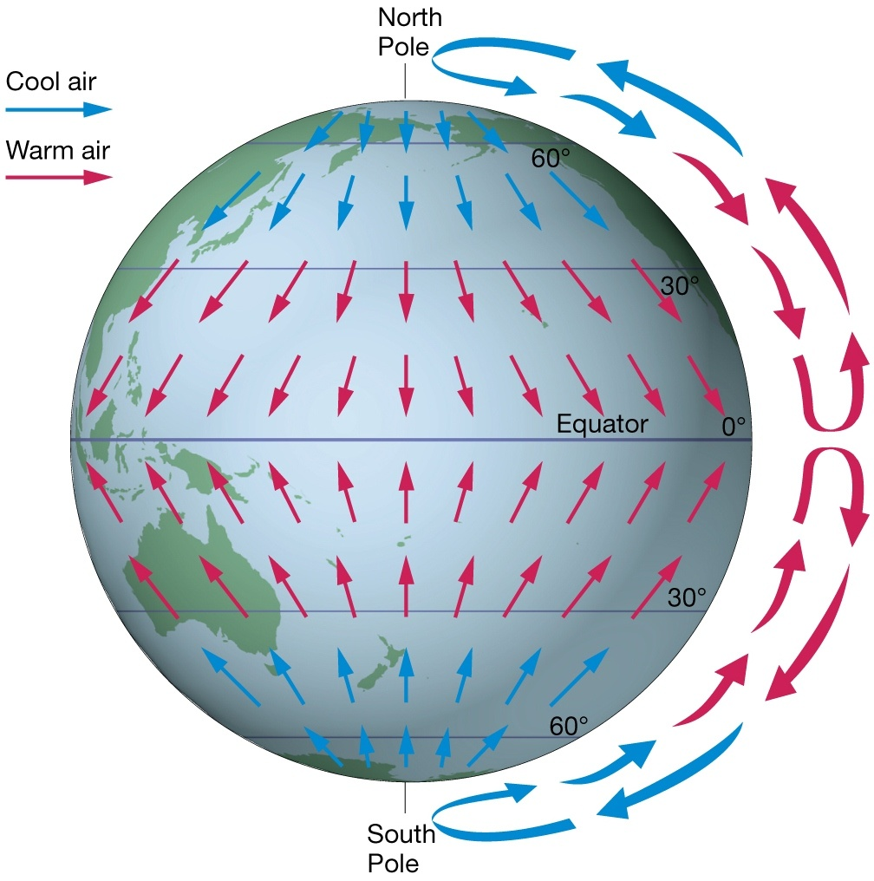
Non-rotating earth….
Fictional nonspinning Earth
Air rises at equator (low pressure)
Air sinks at poles (high pressure)
Air flows from high to low pressure

Slide 4
Idealized Three-Cell Model
More complex in reality due to
Tilt of Earth’s axis and seasons
Lower heat capacity of continental rock vs. seawater
Uneven distribution of land and ocean

Slide 5
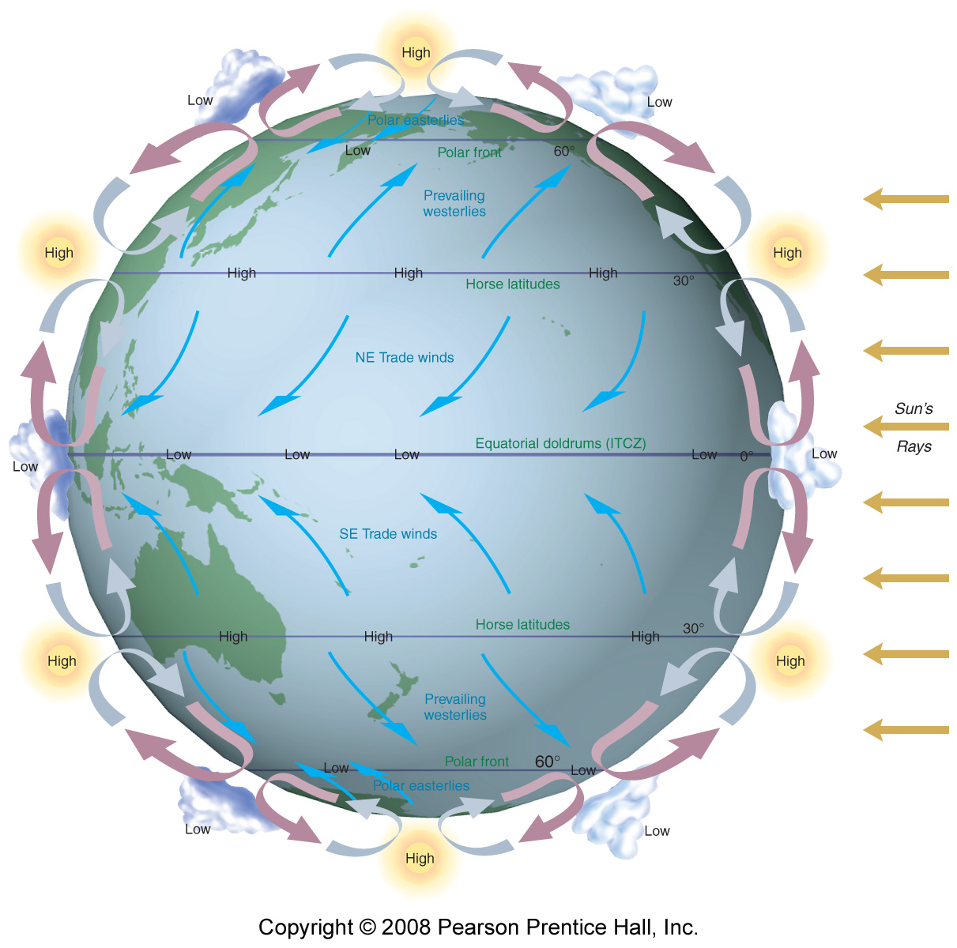
Convection Cells
Ferrel Cell
(30-60°)
Polar Cell
(60-90°)
Low
High
Hadley Cell
(0-30°)
Low
High
Low
Notes:
Polar – ferrel – haddley

Slide 6
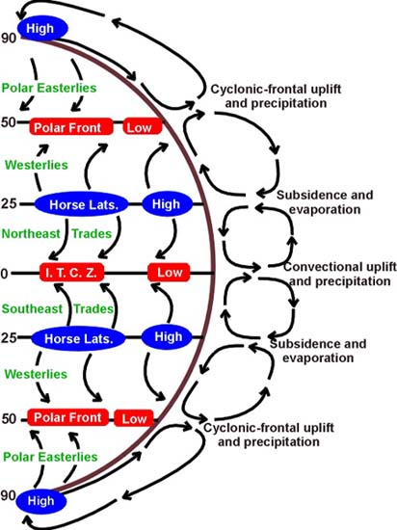
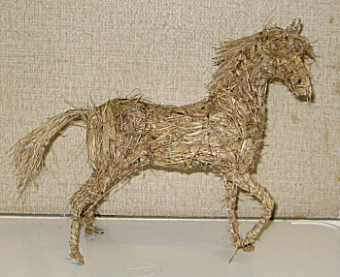
90º
High pressure, dry climate
60º
Low pressure, wet climate, overcast skies
High pressure, dry climate, clear sky
30º
ITCZ intertropical convergence zone= doldrums
Low pressure, wet climate
0º
30º
60º
90º

Slide 7
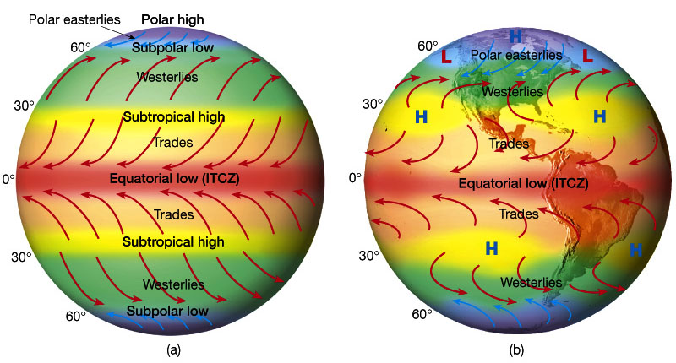
Actual wind patterns owing to land mass distribution..
Idealized winds generated by pressure gradient and Coriolis Force.
Horse Latitudes Around 30°N we see a region of subsiding (sinking) air. Sinking air is typically dry and free of substantial precipitation. Many of the major desert regions of the northern hemisphere are found near 30° latitude. E.g., Sahara, Middle East, SW United States.
Doldrums Located near the equator, the doldrums are where the trade winds meet and where the pressure gradient decreases creating very little winds. That's why sailors find it difficult to cross the equator and why weather systems in the one hemisphere rarely cross into the other hemisphere. The doldrums are also called the intertropical convergence zone (ITCZ).
Notes:
Horse Latitudes Around 30°N we see a region of subsiding (sinking) air. Sinking air is typically dry and free of substantial precipitation. Many of the major desert regions of the northern hemisphere are found near 30° latitude. E.g., Sahara, Middle East, SW United States.
Doldrums Located near the equator, the doldrums are where the trade winds meet and where the pressure gradient decreases creating very little winds. That's why sailors find it difficult to cross the equator and why weather systems in the one hemisphere rarely cross into the other hemisphere. The doldrums are also called the intertropical convergence zone (ITCZ).

Slide 8
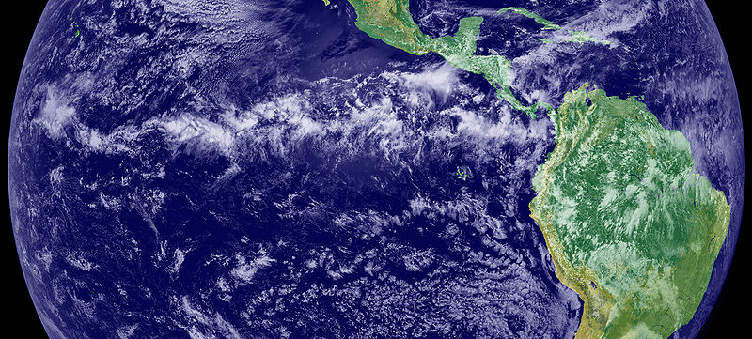
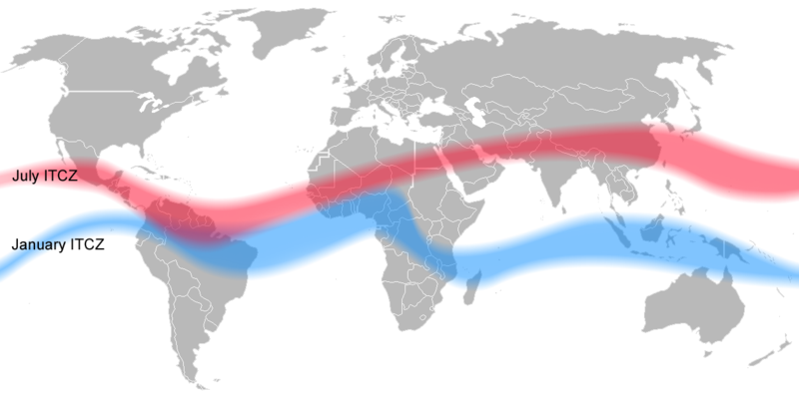
Intertropical Convergence Zone - ITCZ
Doldrums, horse latitudes,
Trade winds, westerlies,
Shift north in the summer
Big differences over land
Doldrums, horse latitudes,
Trade winds, westerlies,
Shift south in the winter

Slide 9
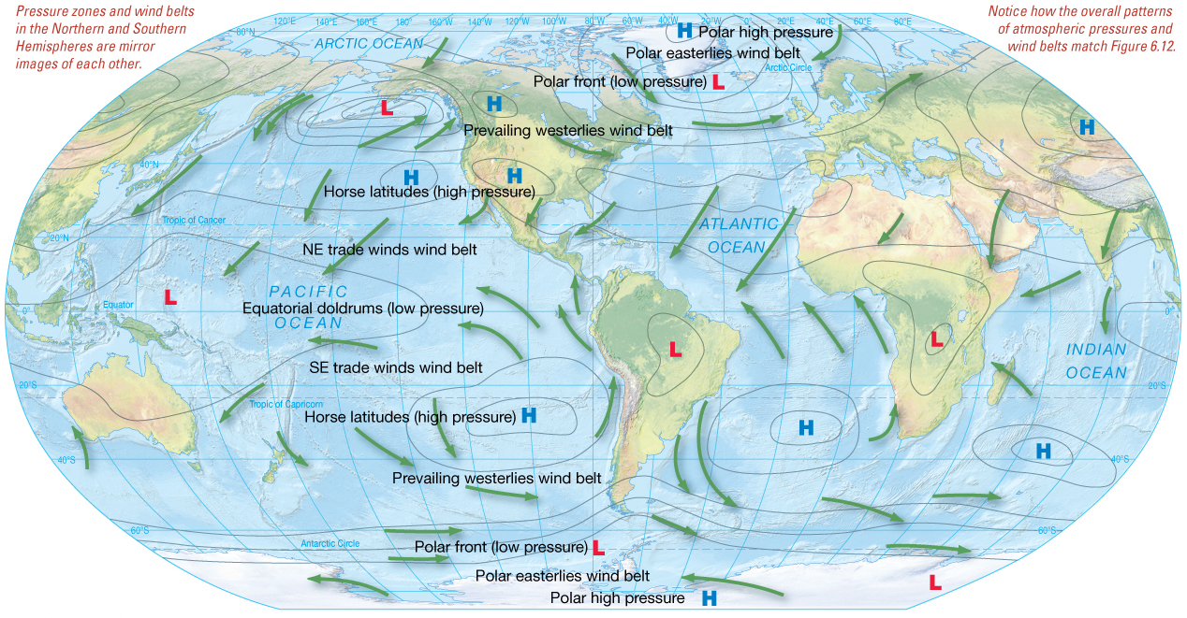
January Atmospheric Pressures and Winds

Slide 10
Doldrums = intertropical convergence zone (ITCZ).
Samuel Taylor Coleridge's The Rime of the Ancient Mariner:
All in a hot and copper sky,
The bloody Sun, at noon,
'Right up above the mast did stand,
No bigger than the Moon.
Day after day, day after day,
We stuck, no breath no motion;
As idle as a painted ship
Upon a painted ocean.

Slide 11
What’s the difference between
weather and climate?
Weather is the day-to-day state of the atmosphere, and its short-term (minutes to weeks) variation.
Climate is defined as statistical weather information that describes the variation of weather at a given place for a specified interval. (usually - locality averaged over some period (usually 30 years) plus statistics of weather extremes.

Slide 12
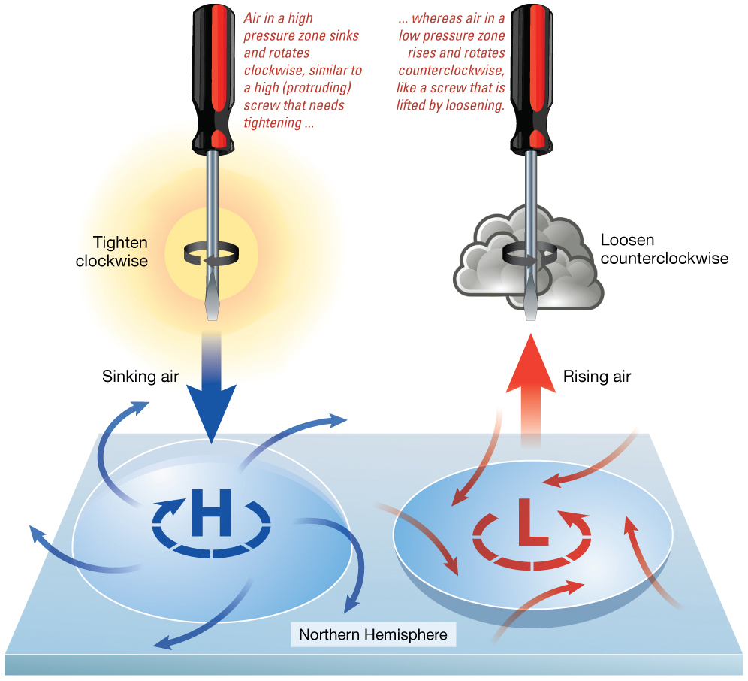
Cyclonic flow
Counterclockwise around a low in Northern Hemisphere
Clockwise around a low in Southern Hemisphere
Anticyclonic flow
Clockwise around a high in Northern Hemisphere
Counterclockwise around a low in Southern Hemisphere

Slide 13
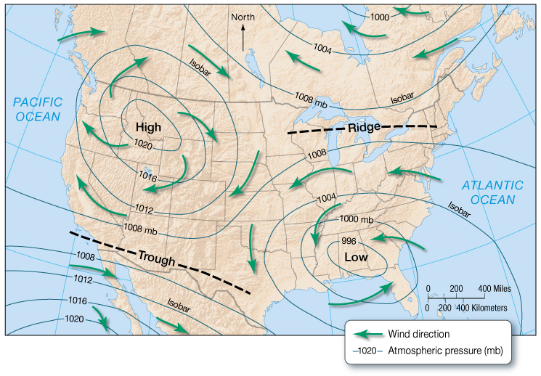
Winds
Weather maps show pattern of wind flow relative to high and low pressure regions.

Slide 14
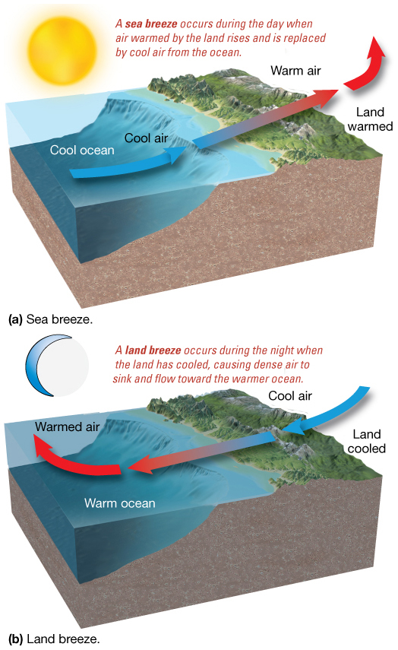
Sea and Land Breezes
Differential solar heating is due to different heat capacities of land and water.
Sea breeze
From ocean to land
Land breeze
From land to ocean

Slide 15
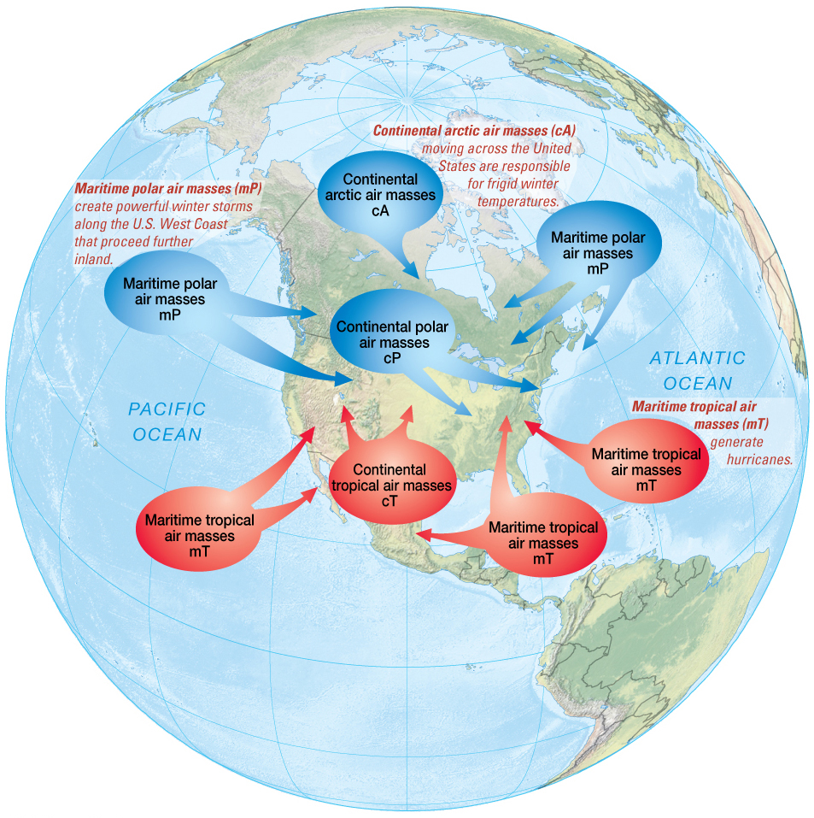
Storms and Air Masses
Storms – disturbances with strong winds and precipitation
Air masses – large volumes of air with distinct properties
Land air masses dry
Marine air masses moist

Slide 16
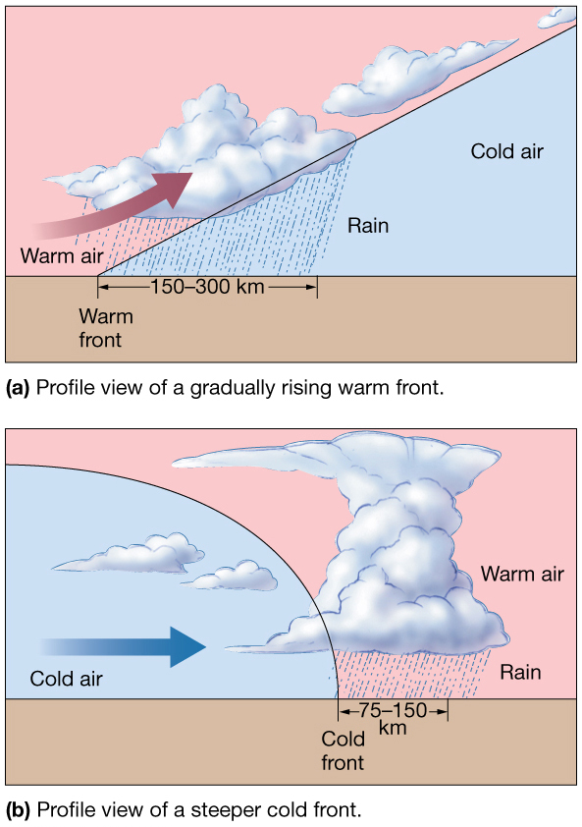
Fronts
Fronts – boundaries between air masses
Warm front
Contact where warm air mass moves to colder area
Cold front
Contact where cold air mass moves to warmer area

Slide 17
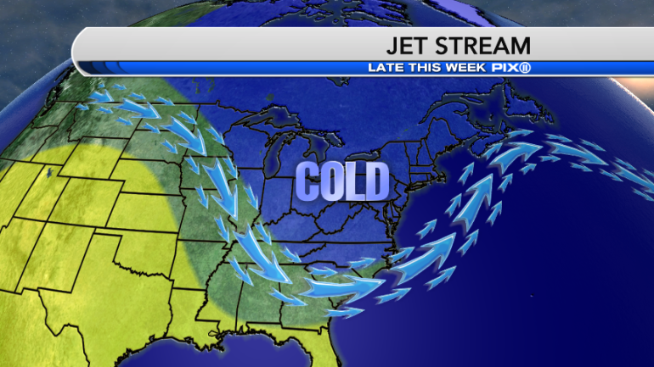
Fronts
Storms typically develop at fronts.
Jet Stream – narrow, fast-moving, easterly air flow
At middle latitudes just below top of troposphere
May cause unusual weather by steering air masses

Slide 18
Tropical Cyclones (Hurricanes)
Large rotating masses of low pressure
Strong winds, torrential rain
Classified by maximum sustained wind speed
Typhoons – alternate name in North Pacific
Cyclones – name in Indian Ocean

Slide 19
Hurricane Origins
Low pressure cell
Winds feed water vapor
Air rises, low pressure deepens
Storm develops
Tropical Depression
Winds less than 61 km/hour (38 miles/hour)
Tropical Storm
Winds 61–120 km/hour (38–74 miles/hour)
Hurricane or tropical cyclone
Winds above 120 km/hour (74 miles/hour)

Slide 20
Saffir-Simpson Scale of Hurricane Intensity

Slide 21
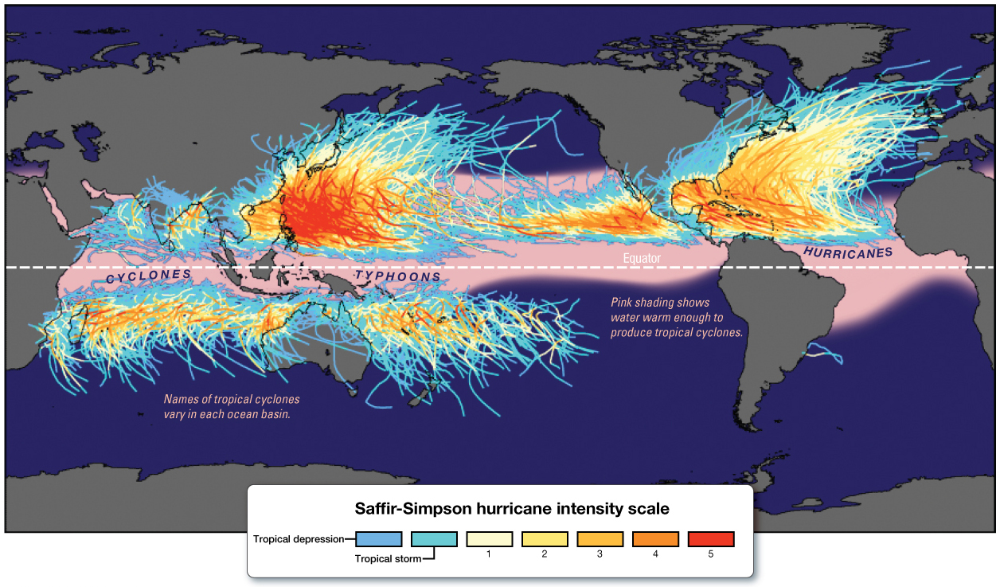
Hurricanes
About 100 worldwide per year
Require
Ocean water warmer than 25°C (77°F)
Warm, moist air
The Coriolis effect
Hurricane season is June 1–November 30

Slide 22
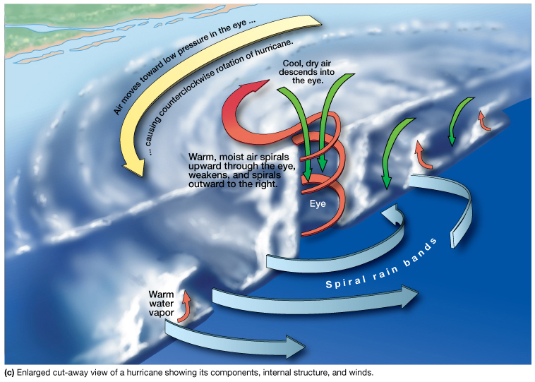
Hurricane Anatomy
Diameter typically less than 200 km (124 miles)
Larger hurricanes can be 800 km (500 miles)
Eye of the hurricane
Low pressure center
Spiral rain bands with intense rainfall and thunderstorms

Slide 23
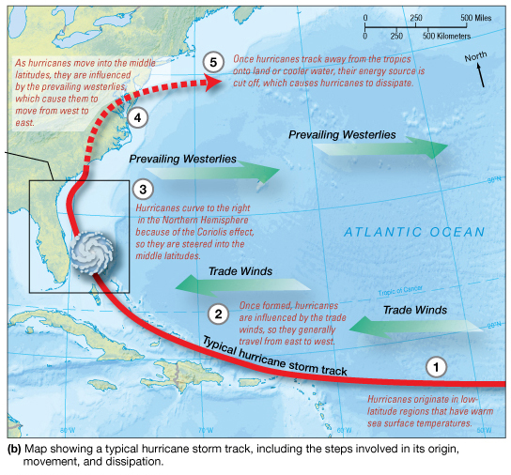
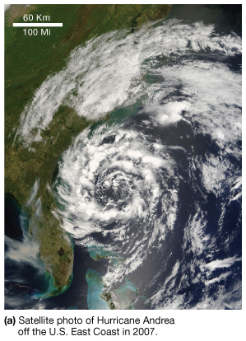
Hurricane Movement

Slide 24
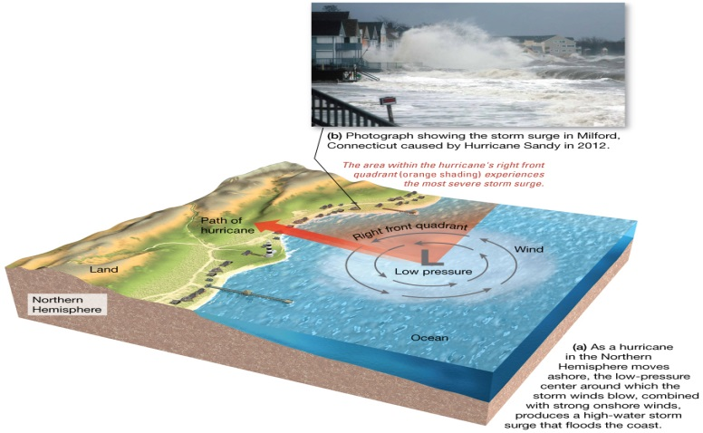
Hurricane Destruction
High winds
Intense rainfall
Storm surge – increase in shoreline sea level

Slide 25
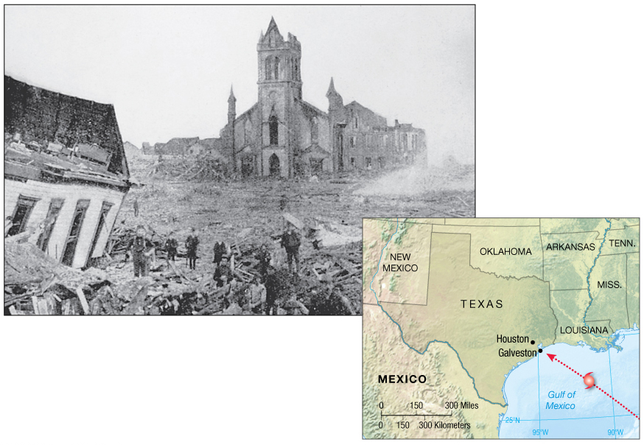
Storm Destruction
Historically destructive storms
Galveston, TX, 1900
Andrew, 1992
Mitch, 1998
Katrina, 2005
Ike, 2008
Irene, 2011
Sandy, 2012

Slide 26
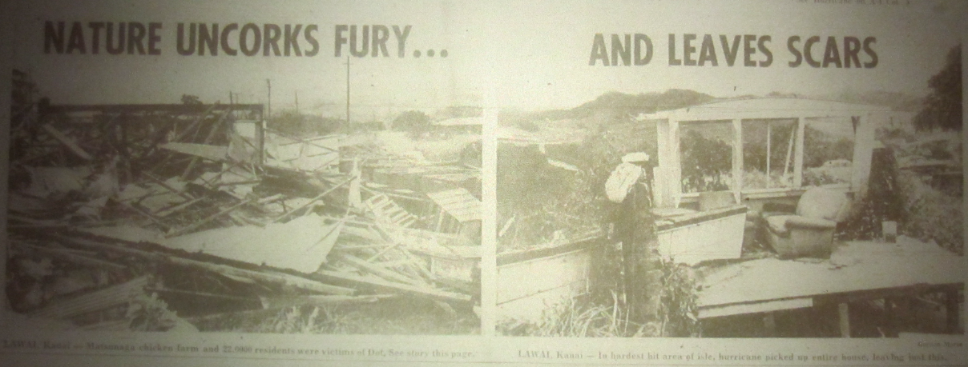
Historic Hurricane Destructions
Most hurricanes in North Pacific
Bangladesh regularly experiences hurricanes
1970 – massive destruction from storm
Southeast Asia affected often
Hawaii
Dot in 1959
Iwa in 1982

Slide 27
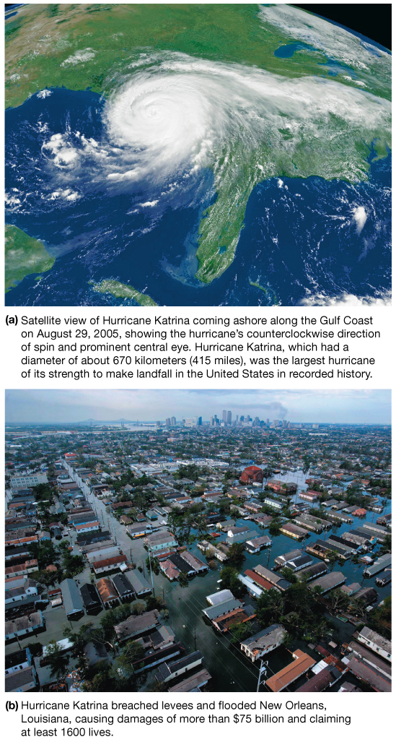
Hurricane Katrina
Costliest and deadliest U.S. hurricane
Category 3 at landfall in Louisiana
Largest hurricane of its strength to make landfall in U.S. history
Flooded New Orleans

Slide 28
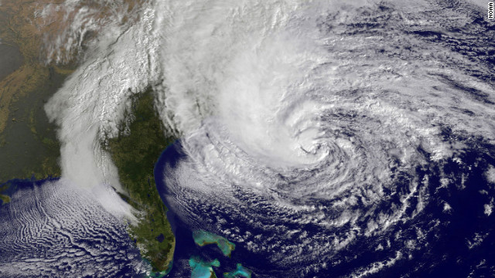
Hurricane Sandy, 2012
Category 1
Largest Atlantic hurricane on record
Storm surge coincided with peak high tides in heavily populated New York and New Jersey.
Severe coastal erosion
Extreme flooding
233 deaths, more than $68 billion in damages.
Second costliest hurricane after Katrina

Slide 29
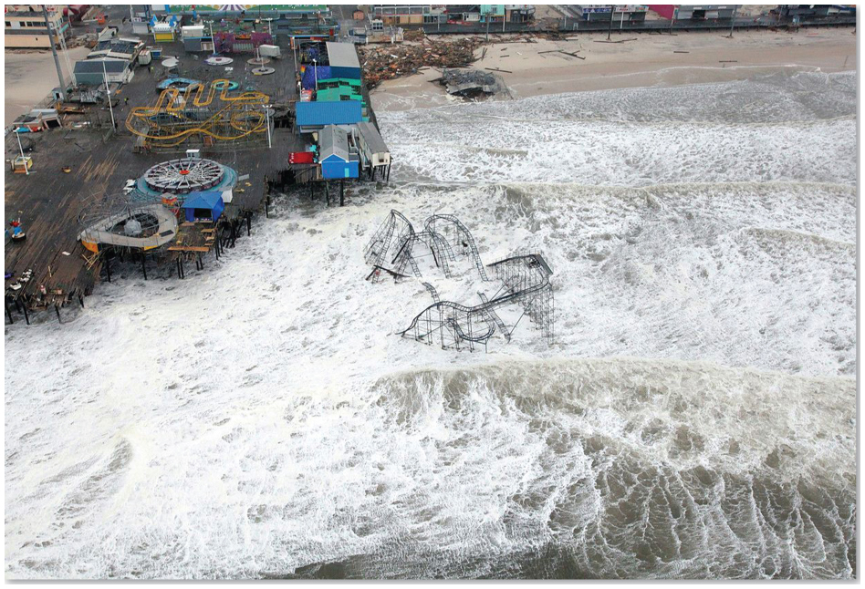
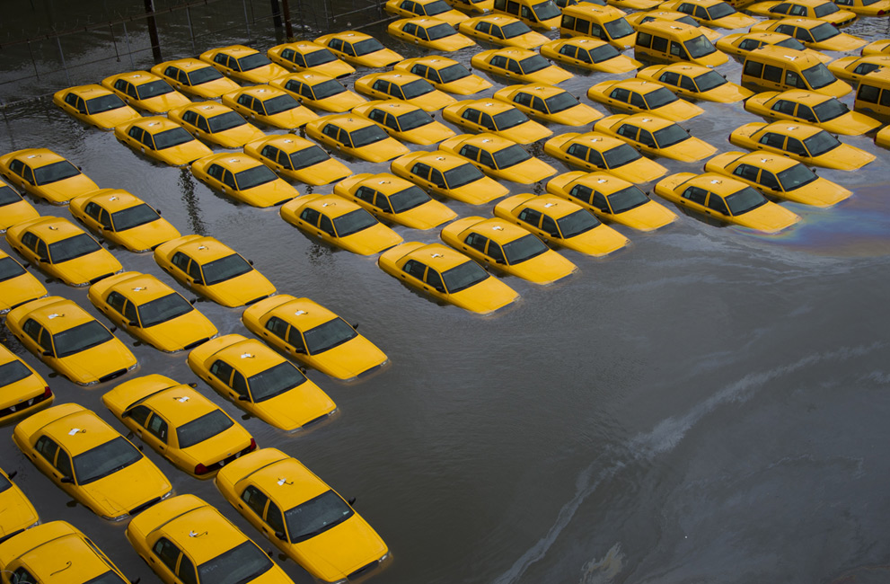
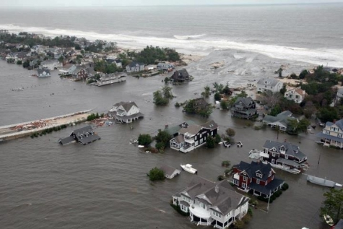
Damage in New Jersey from Hurricane Sandy, 2012

Slide 30
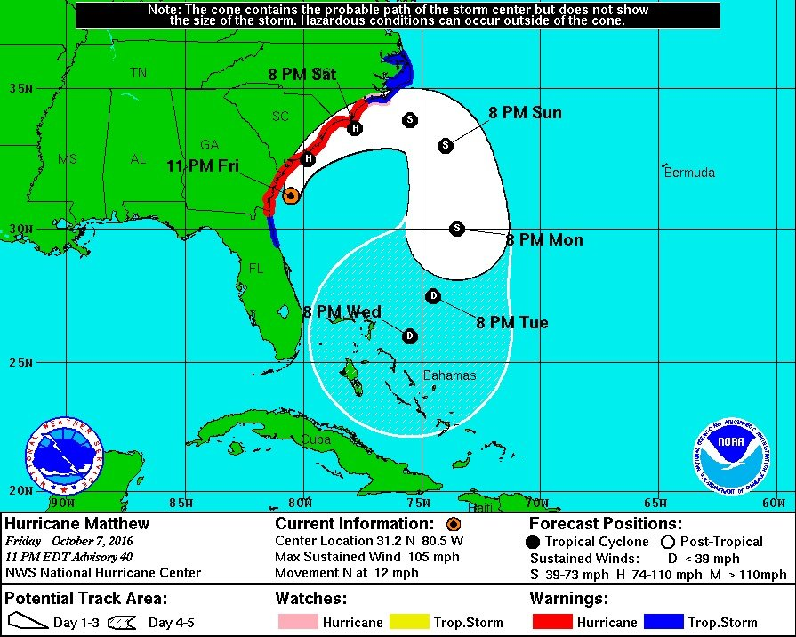
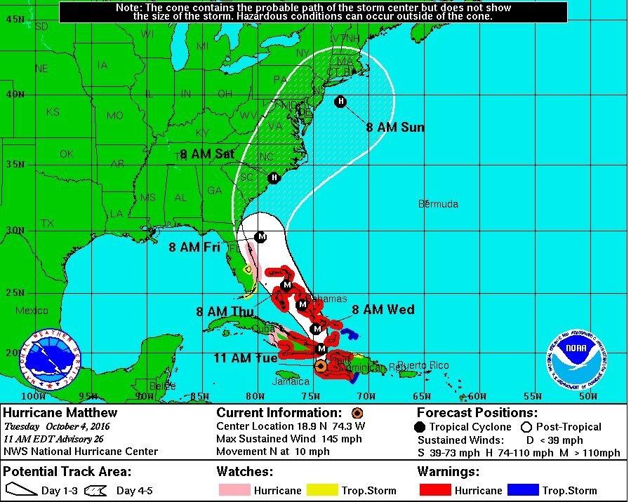
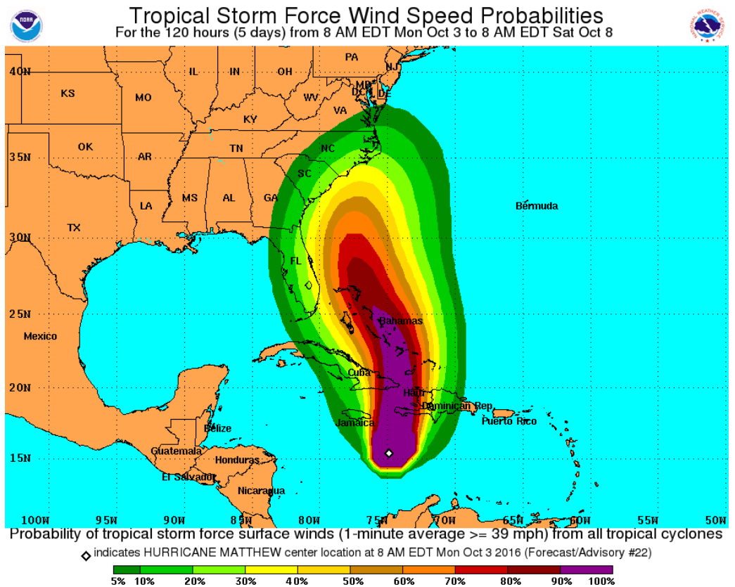
Hurricane Matthew

Slide 31
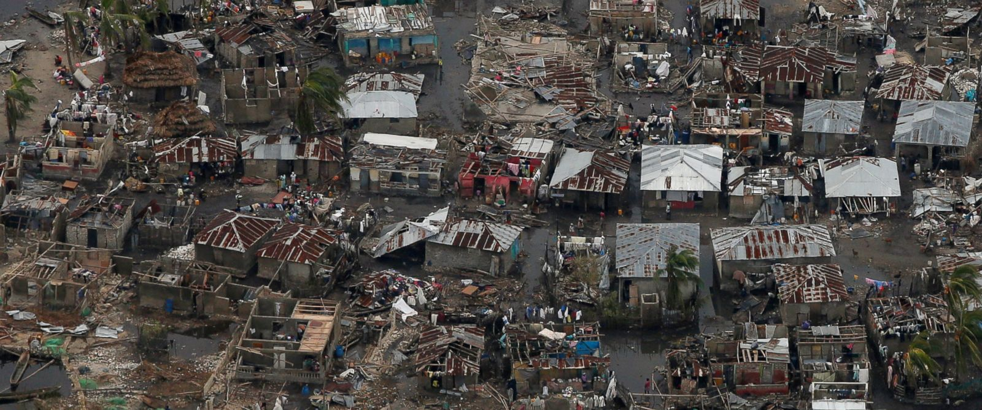
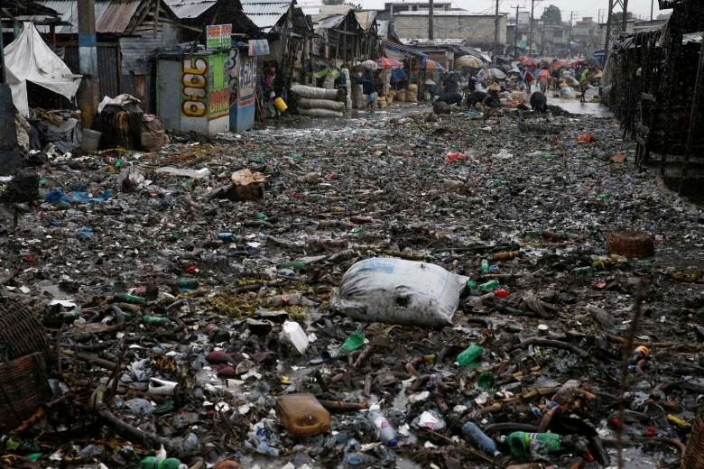
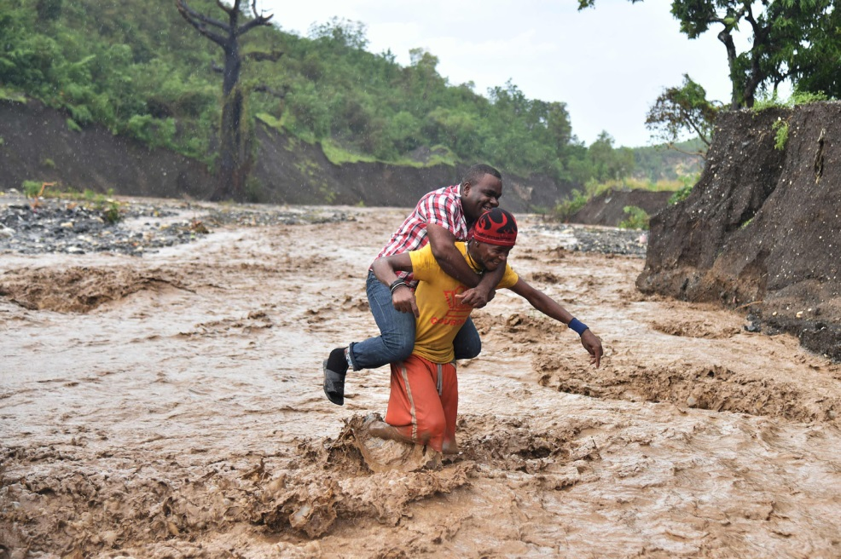
Damage in Haiti

Slide 32
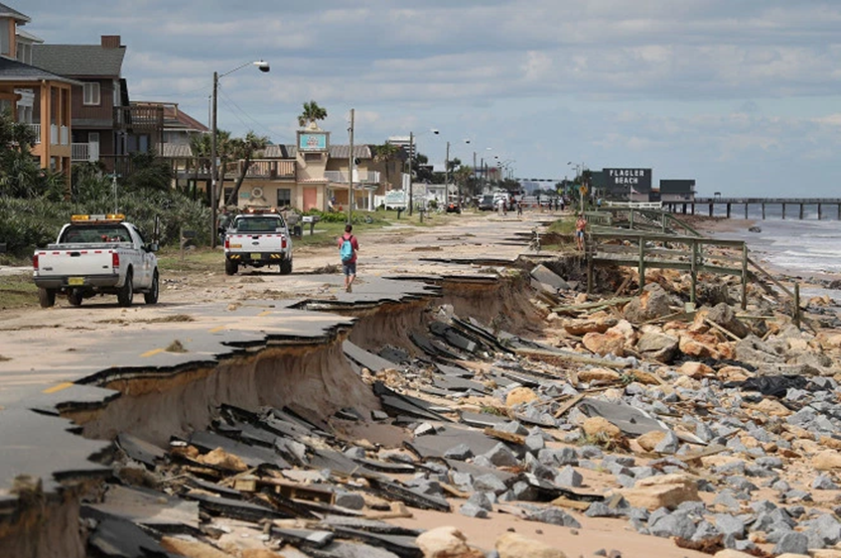
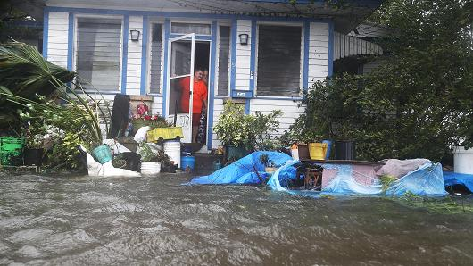
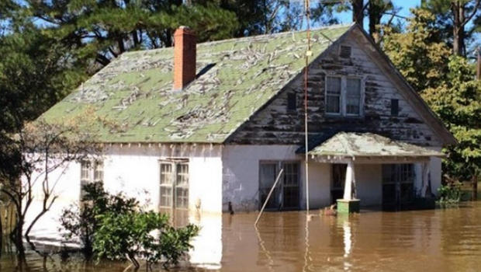
Damage in Florida and North Carolina

Slide 33
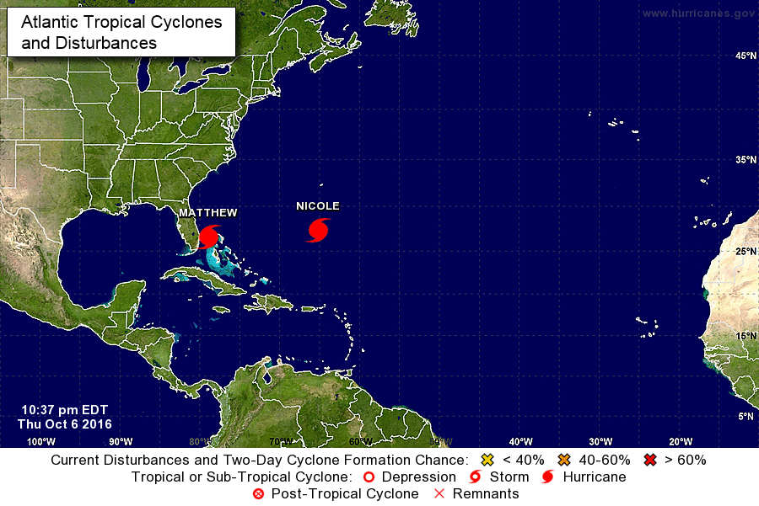

Slide 34
Quiz
True/False: Hurricanes are rotating masses of low pressure.

