Slide 1
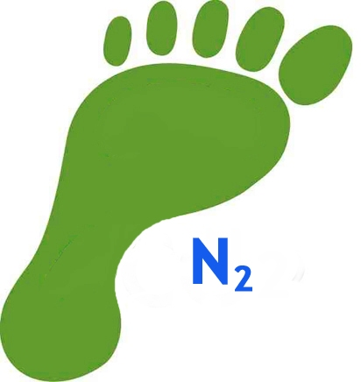
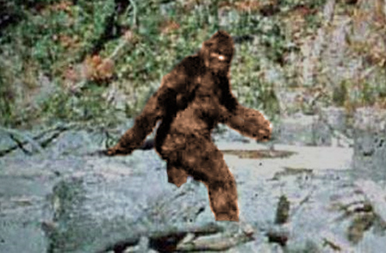
Bigfoot:
Nitrogen, the Ocean, and You
Robinson W. Fulweiler • Boston University • Department of Earth and Environment • Department of Biology

Slide 2
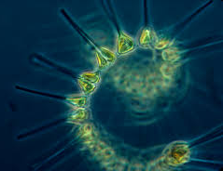
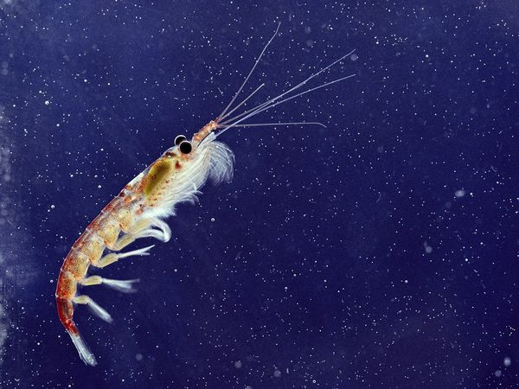
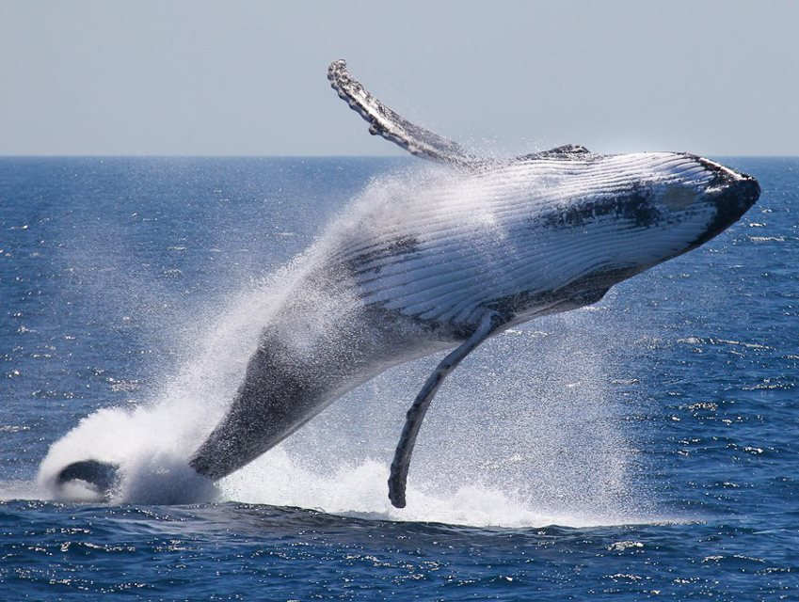

Nitrogen is essential for Life

Slide 3
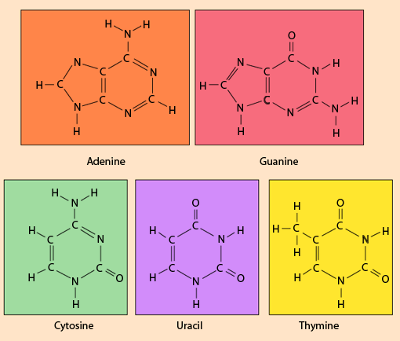
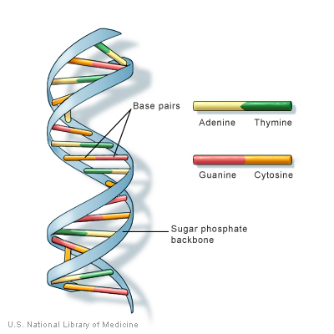
http://hyperphysics.phy-astr.gsu.edu/hbase/organic/base.html
http://ghr.nlm.nih.gov/handbook/basics/dna

Slide 4
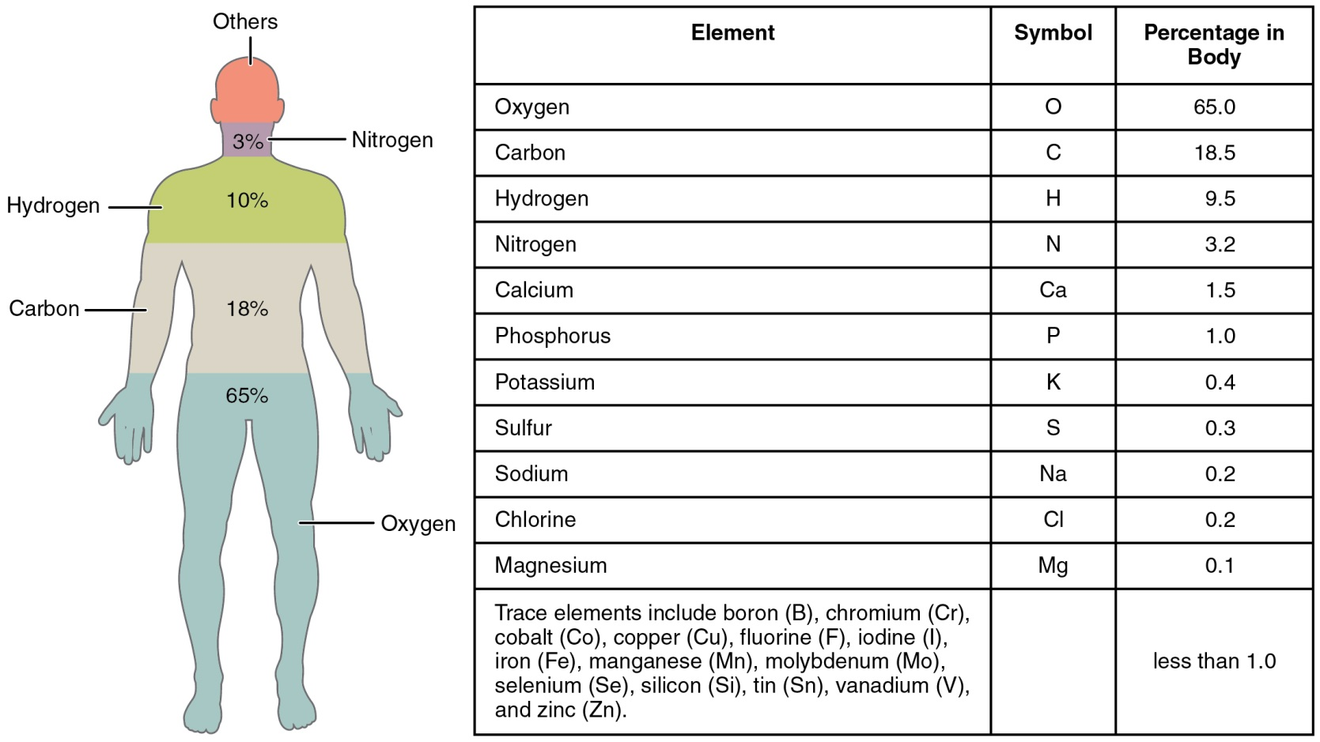
"201 Elements of the Human Body-01" by OpenStax College - Anatomy & Physiology, Connexions Web site. http://cnx.org/content/col11496/1.6/

Slide 5
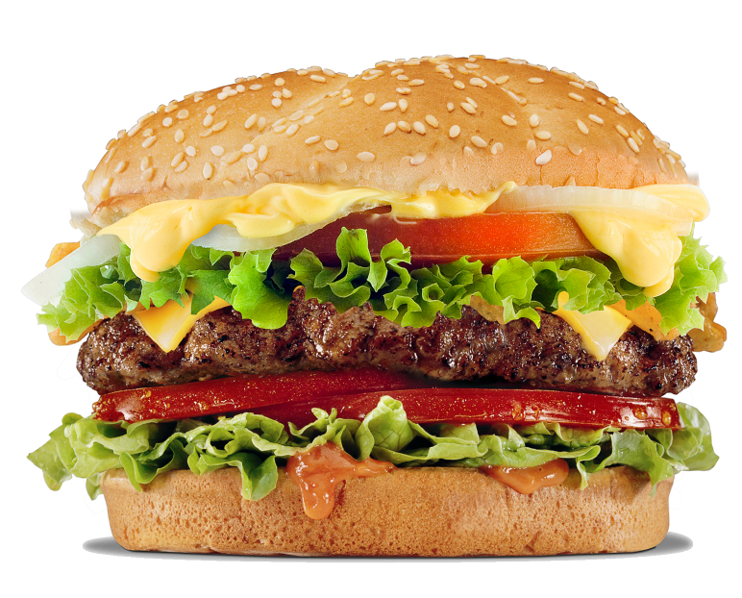
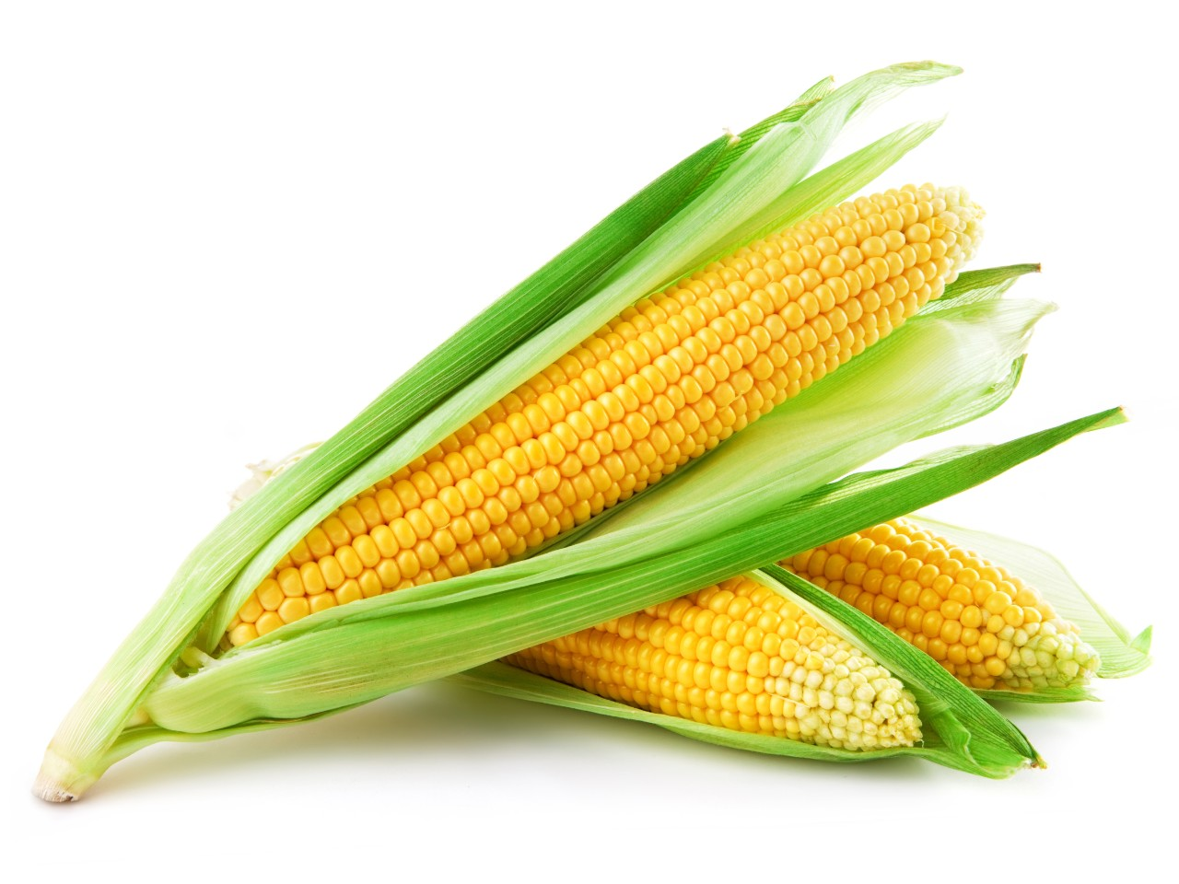

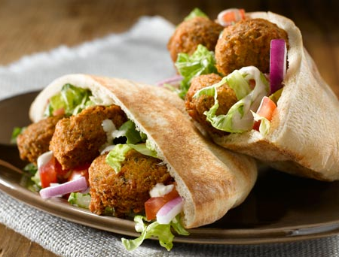

Slide 6
The Nitrogen Conundrum

Slide 7
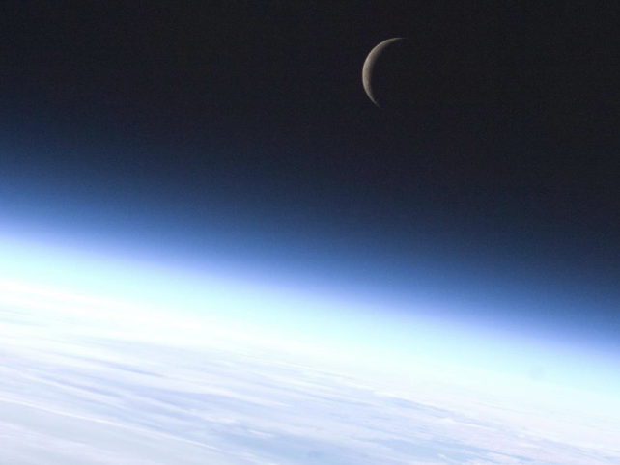

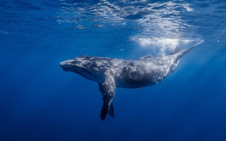
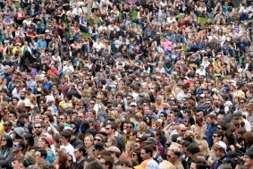
Two Broad Categories of Nitrogen
Biologically Usable
AKA:
Reactive Nitrogen (Nr)
2. **Biologically Un-usable
AKA:
Unreactive Nitrogen
NH₄⁺ = ammonium
NO₂⁻ = nitrite
NO₃⁻ = nitrate
  N₂ = Di-nitrogen gas

Slide 8
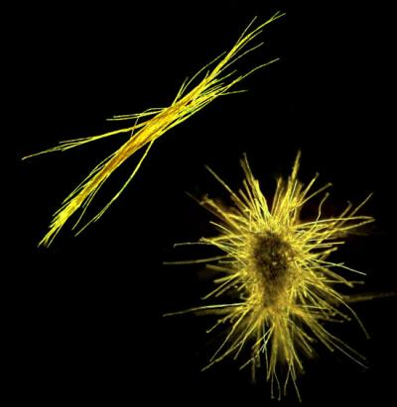
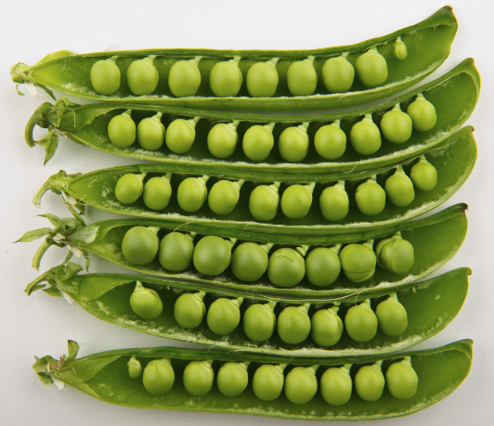
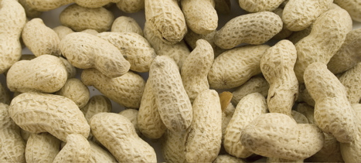
**Some organisms can use N₂!
Nitrogen Fixation
N₂ → NH₄⁺

Slide 9
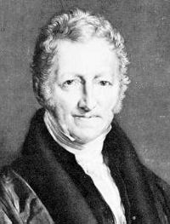
An Essay on the Principle of Population
or the "Malthusian catastrophe"
1798 - 1826 - six editions

Slide 10
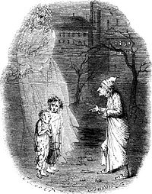
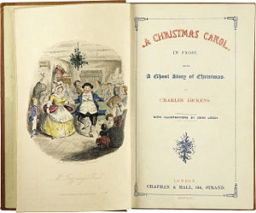
A Christmas Carol - 1843 - Charles Dickens
Ebenezer Scrooge states:
"If they would rather die they had better do it, and decrease the
surplus population…

Slide 11
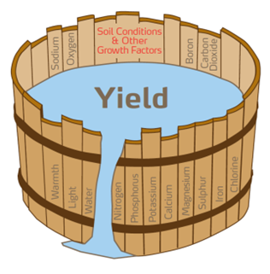
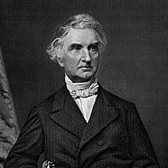
Justus von Liebig
“Father of Fertilizer Industry”
1855: Liebig’s Law of the Minimum
A limiting factor to biological activity is that material available in an amount most closely approaching the critical minimum required to sustain that activity (Odum 1971).

Slide 12
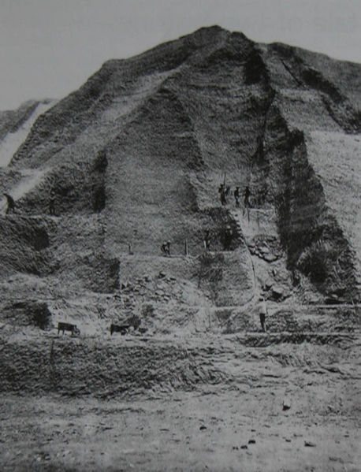
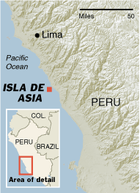
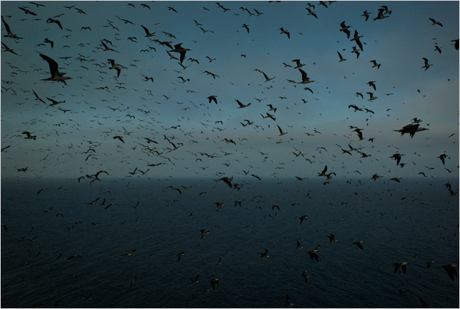
"Guano, though no saint, works many miracles.” Peruvian proverb

Slide 13

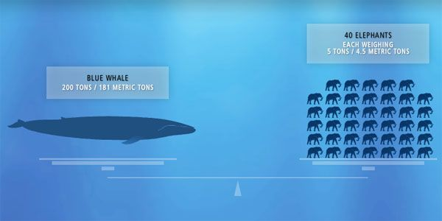
-1824 two caskets to The American
Farmer in Baltimore
1840 first shipment from Lima to
England
**Peak export from 1840 to 1870
Up to 600,000 tons
http://www.nuevayork-exhibition.org/galleries/2/port

Slide 14
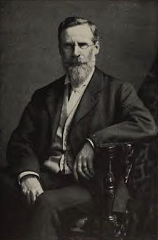
“The Wheat Problem”
“We are drawing on the earth’s capital and our drafts will not be perpetually honored.”
-Crookes, 1898
Sir William Crookes

Slide 15
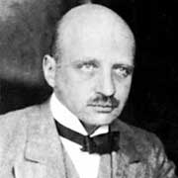

Haber-Bosch process:
Under high temperatures and very high
pressures, with an iron catalyst,
hydrogen and nitrogen are combined to
produce ammonia.
Fritz Haber
Nobel prize - 1918
Carl Bosch
Nobel prize - 1913
Applied for patent: October 13, 1908!!!

Slide 16
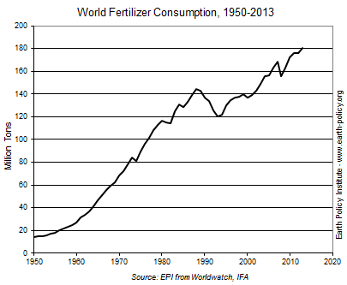

Slide 17

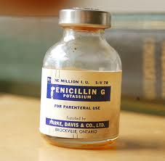


Greatest Invention of the last 150 or so years?

Slide 18
The Haber-Bosch process is often considered the most influential invention Of the 20th century because it "detonated the population explosion," driving the world's population from 1.6 billion in 1900 to 6 billion in 2000.”
V. Smil, Nature, July 29 1999, p 415.
Notes:
Guesses on the % of the population that is alive today because of this process?

Slide 19
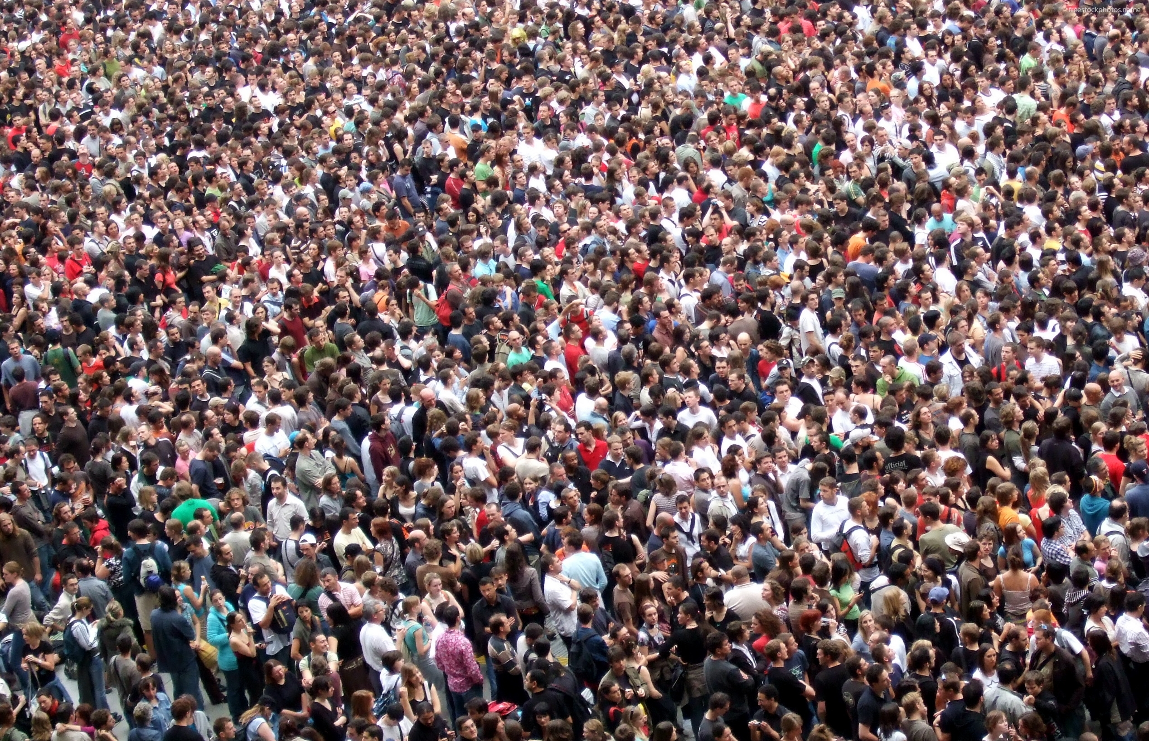
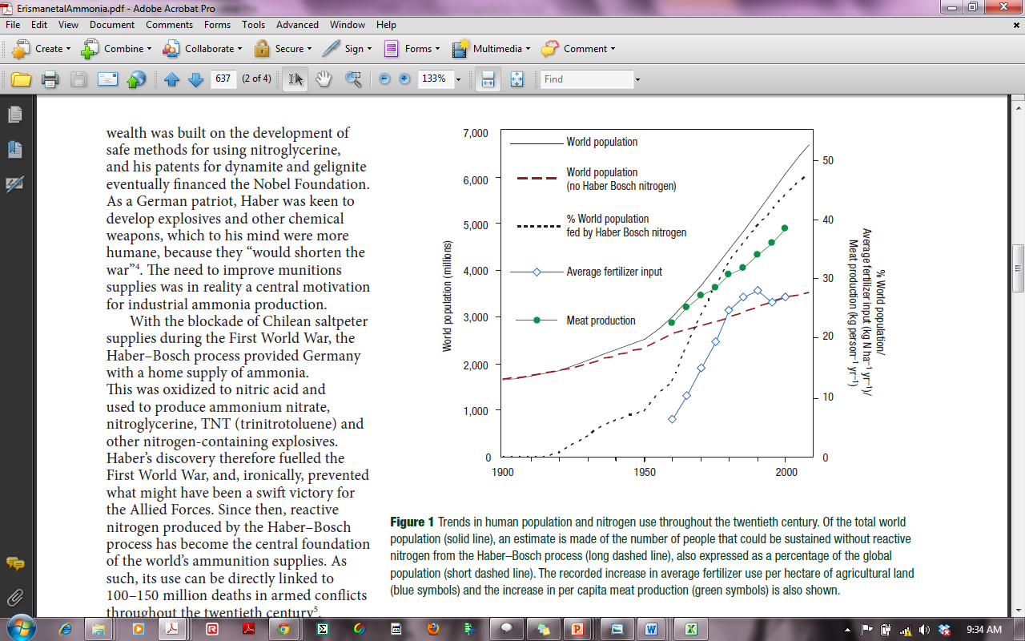
~50% of the Global Population is alive today because of the Haber-Bosch process
Erisman et al. (2008) Nature Geoscience

Slide 20
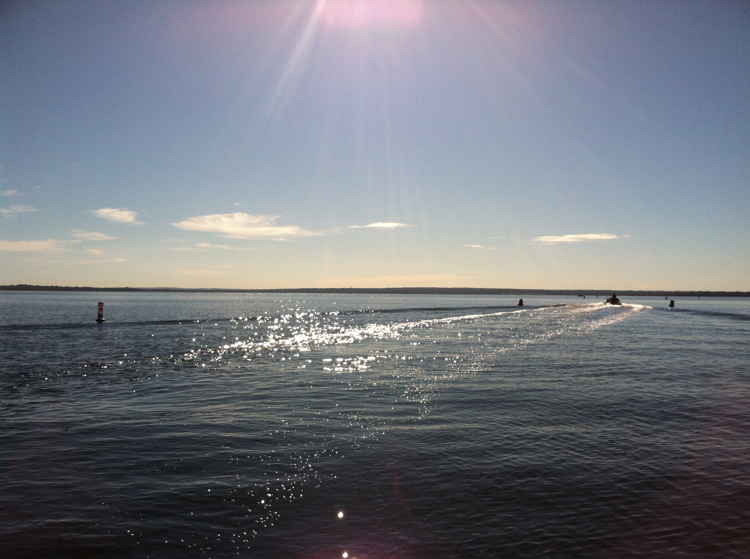
Human Driven Reactive Nitrogen Change
Human Reactive N contribution:
*1860
**2010
Tg N y⁻¹
Tg N y⁻¹
Cultivation
15
60
Fossil Fuels
<1
30
Haber-Bosch
0
> 120
Total 1860: ~ 15 Tg N y⁻¹
Total 2010: ~ 210 Tg N y⁻¹
(1300% increase)
*Galloway et al. (2003), **Fowler et al. (2013)

Slide 21
However….too much N - causes many
negative consequences…and, N gets
around…… that is - it doesn’t “stay put.”
“Cascades” through the
Environment….
Notes:
One nitrogen element can impact the ozone layer, land, freshwater, and marine waters….. It keeps going….

Slide 22
The Fate of Haber-Bosch Nitrogen
N Fertilizer
Produced
N Fertilizer
Consumed
N
in Crop
N
Harvested
N
in Food
N
Consumed
100
94
47
31
26
14
-6
-47
-16
-5
-12
~ 14% of the N produced in the Haber-Bosch process enters the
human mouth……….
if you are a vegetarian
Data from Galloway JN and Cowling EB. 2002; Slide modified from Galloway 2003
Notes:
Factory to Field….then Field to crop…….crop to harvest….harvest to food product and then product to mouth…. (12 is spoilage and waste)

Slide 23
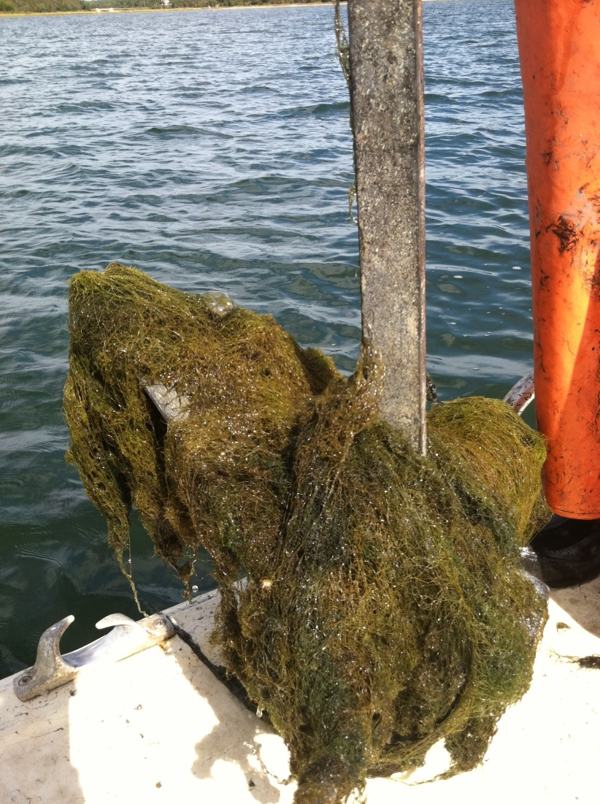
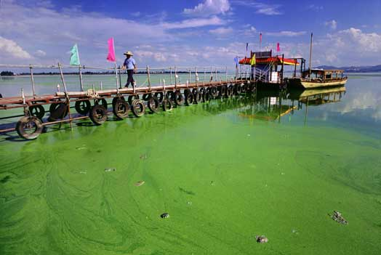
Eutrophication - an increase in the supply
of organic matter to a system. (Nixon 1995)

Slide 24

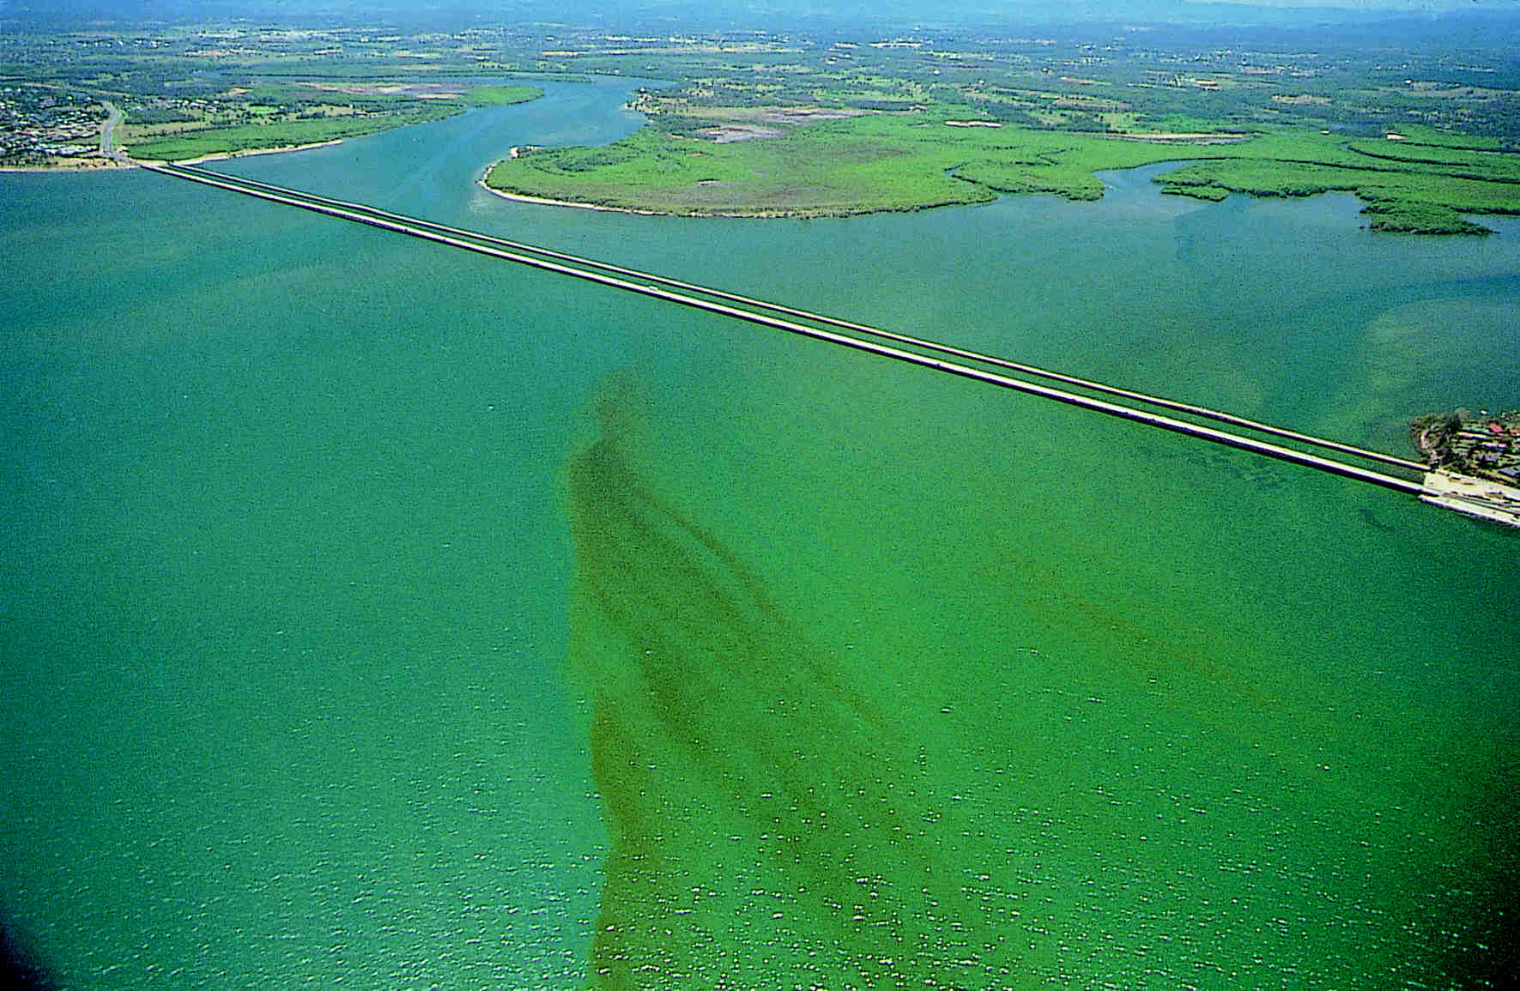
N loading and marine ecosystem response
Increased phytoplankton productivity
Harmful algal blooms
Formation of nuisance algal mats
Loss of submerged aquatic vegetation
Low Oxygen Conditions
Fish kills - fin and shell
Loss of biodiversity
Significant Economic cost in terms of losses and remediation efforts

Slide 25

*
*
*
*
*
*
*
*
*
*
*
*
O₂
*
*
*
*
*
*
*
O₂
O₂
*
*
*
*
*
*
Septic tank
*
*
DIN_{r}
O₂
O₂
O₂
ANOXIA
Slide courtesy of Sarah Foster
Slide modified from S.Q. Foster

Slide 26
Global Distribution of Low Oxygen Zones
Diaz and Rosenberg (2008) Science
Notes:
Dead zones in the coastal oceans have spread exponentially since the 1960s and have serious
consequences for ecosystem functioning. The formation of dead zones has been exacerbated by the
increase in primary production and consequent worldwide coastal eutrophication fueled by riverine
runoff of fertilizers and the burning of fossil fuels. Enhanced primary production results in an
accumulation of particulate organic matter, which encourages microbial activity and the consumption of
dissolved oxygen in bottom waters. Dead zones have now been reported from more than 400 systems,
affecting a total area of more than 245,000 square kilometers, and are probably a key stressor
on marine ecosystems.

Slide 27
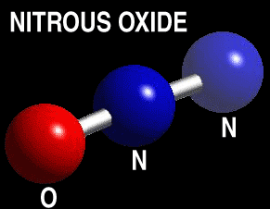
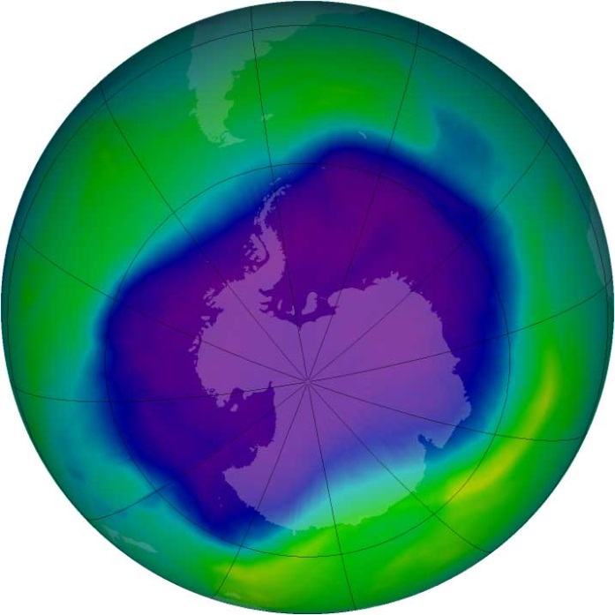
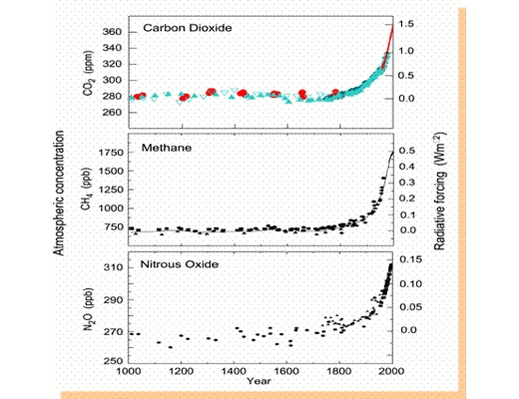

Slide 28
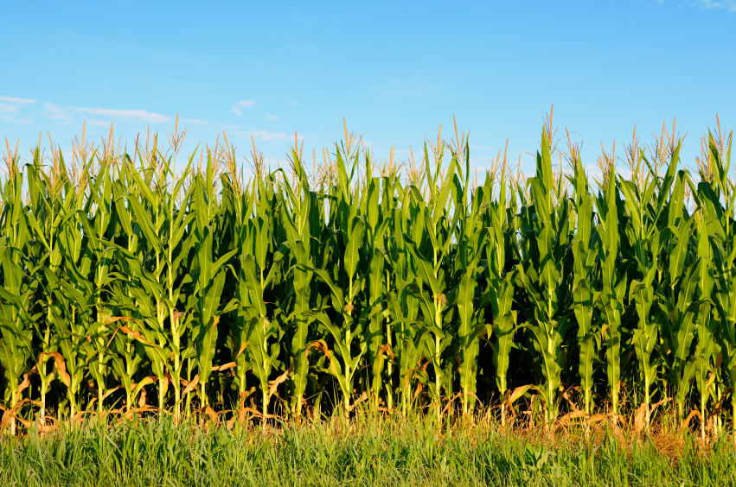
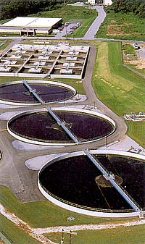
Our Grand Challenge:
How do we feed an ever growing population and protect our environment from excess N?
Increase fertilizer use efficiency
Increase plant nitrogen use efficiency
Augment the natural process of denitrification
Increase WWTP N removal

Slide 29
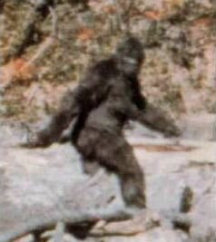
But What about us?
Don’t be a Bigfoot
#1 Way to lower you N footprint

Slide 30
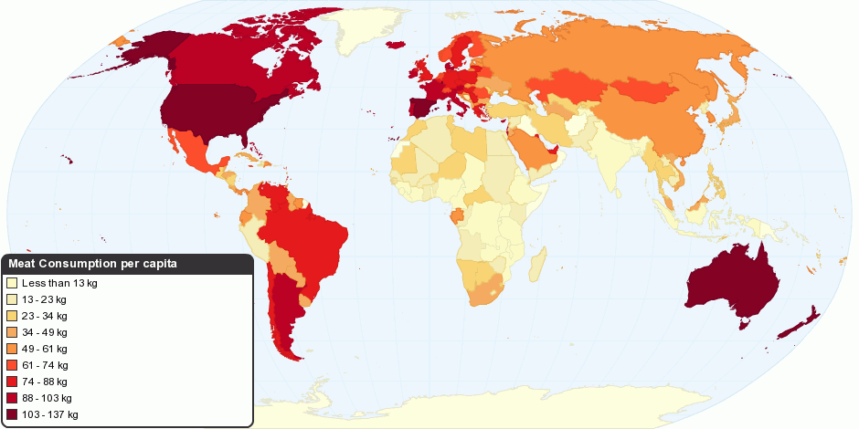
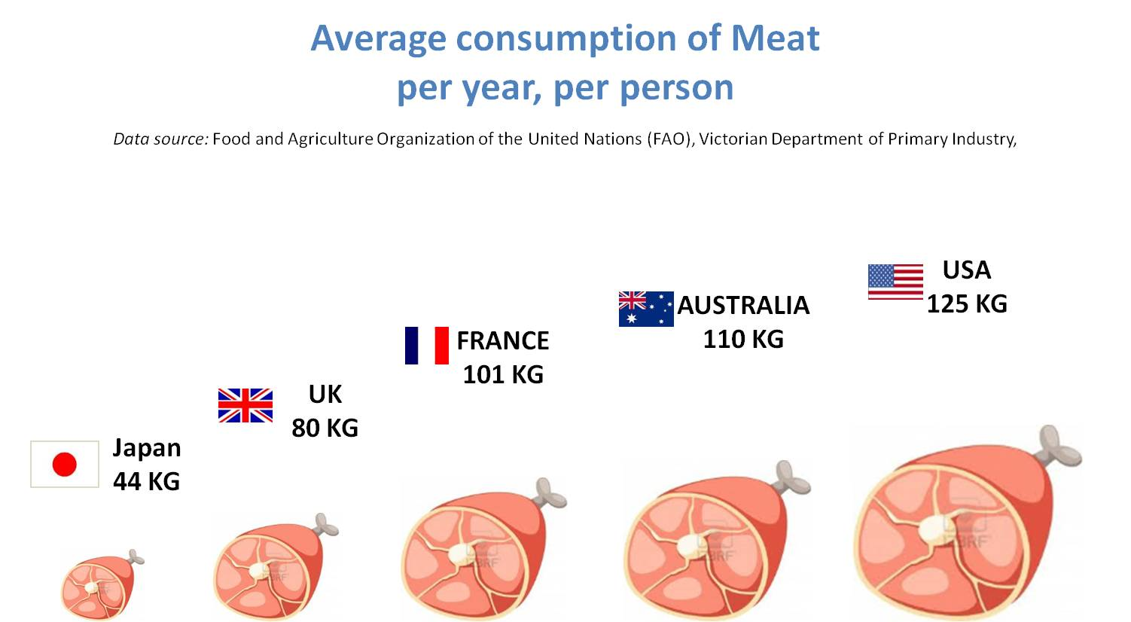
We only require ~ 2 kg per year
Notes:
Galloway and Cowling – humans require 2 kg N y-1 – but we create about ~ 20 kg per person per year.

Slide 31
Eat Less Meat
Humans apply about 170 million metric tons of N to cropland
each year…. That’s roughly equivalent to more than 1.5 million blue whales worth of N…
Think of it this way:
It takes 220 lbs of N in corn to produce 11 lbs of N in beef.

Slide 32
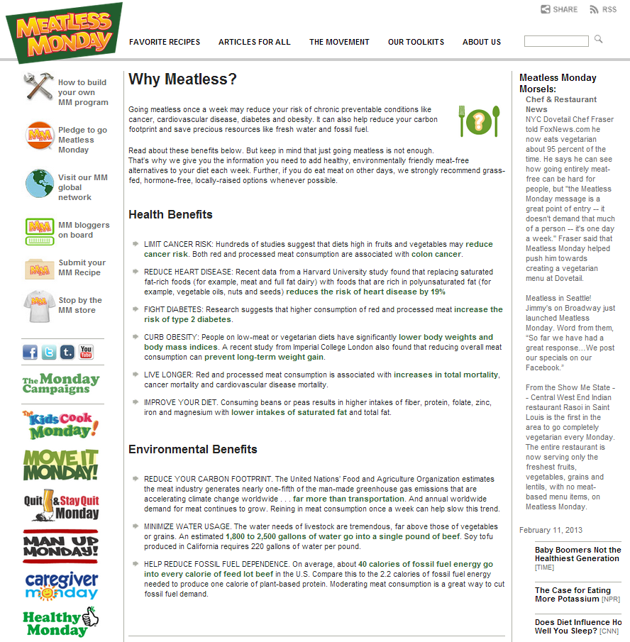

Slide 33
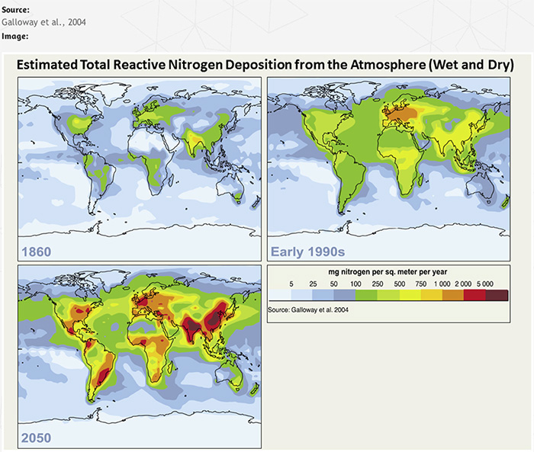
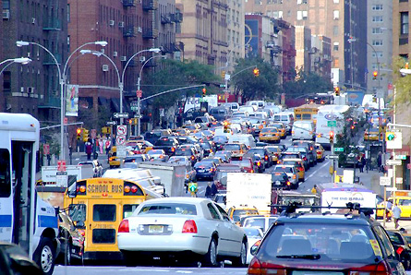
Reduce Fossil Fuel Use
Notes:
Releases NOx (NO and NO2 → comes down other places)

Slide 34
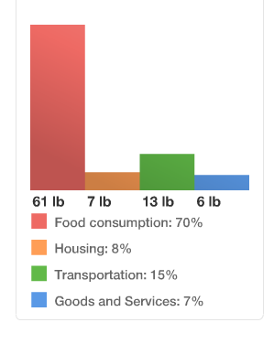
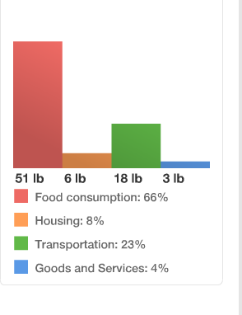
How do you stack up?
Want to find out?
http://www.n-print.org/N-Calculator
Notes:
Questions – what adds the most N? your diet? Your transport? …let’s look at mine.

Slide 35
What to know more?
More about N:
1. http://www.thenakedscientists.com/HTML/features/columnists/people/robinson-fulweiler/
2. http://vista.cira.colostate.edu/improve/Education/ReactiveN/NitrogenCycling.swf
3. http://n-print.org/
More about our research at BU or if you have questions?
Follow us on Twitter @FulweilerLab or Facebook – Fulweiler Lab
Or our website: www.fulweilerlab.com
Or email…. rwf@bu.edu

Slide 36
Name one way you can decrease your nitrogen footprint

