Slide 1
Integrating across scales: biogeochemical and metabolic models
Elena Forchielli
ES 623
4/26/18

Slide 2

What are models?
Models are abstractions of natural systems or processes
  Help us to understand concepts and define questions more clearly

Slide 3
Why do we use models?
Sung Nature Comm (2017)
Steinacher Biogeosciences Disc (2009)
IPCC 2007

Slide 4
How do we use models in MBGC?
Notes:
Common depiction marine microbial food web
- They are just illustrations/representations to show how substances move through air, water, soil, rock, and living organisms

Slide 5
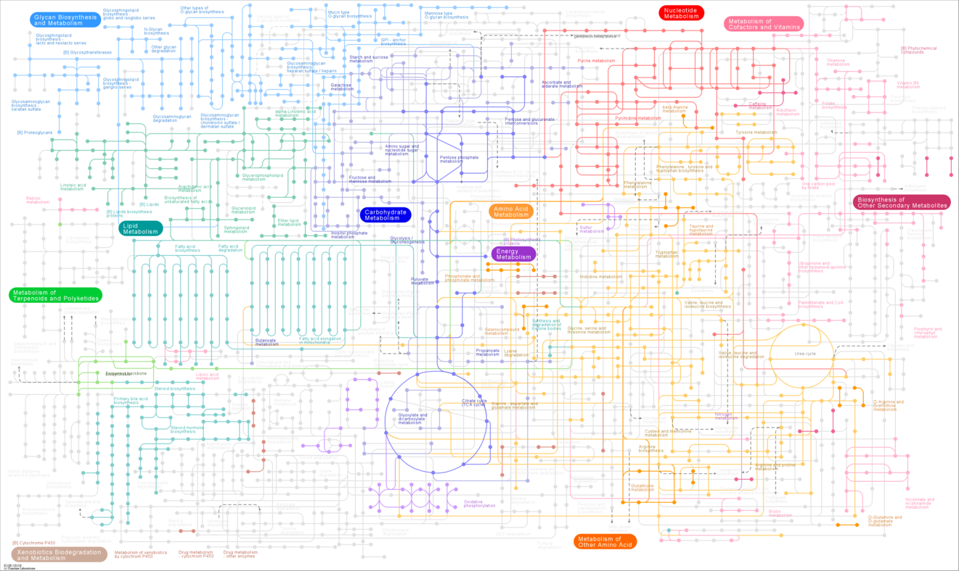
How do we use models in microbiology?
Kegg.jp

Slide 6
What are we doing when we say we’re “modeling”?
“Make” a model
”Use” a model
Fondi Marine Genomics (2017)
Notes:
From what is FBA?
Formulation of an FBA problem. (a) A metabolic network reconstruction consists of a
list of stoichiometrically balanced biochemical reactions. (b) This reconstruction is converted into a mathematical model by forming a matrix (labeled S), in which each row represents a metabolite and each column represents a reaction. Growth is incorporated into the reconstruction with a biomass reaction (yellow column), which simulates metabolites consumed during biomass production. Exchange reactions (green columns) are used to represent the flow of metabolites, such as glucose and oxygen,
in and out of the cell. (c) At steady state, the flux through each reaction is given by Sv = 0, which defines a system of linear equations. As large models contain more reactions than metabolites, there is more than one possible solution to these equations. (d) Solving the equations to predict the maximum growth rate requires defining an objective function Z = cTv (c is a vector of weights indicating how much each reaction (v) contributes to the objective). In practice, when only one reaction, such as biomass production, is desired for maximization or minimization, c is a vector of zeros with a value
of 1 at the position of the reaction of interest. In the growth example, the objective function is Z = vbiomass (that is, c has a value of 1 at the position of the biomass reaction). (e) Linear programming is used
to identify a flux distribution that maximizes or minimizes the objective function within the space
of allowable fluxes (blue region) defined by the constraints imposed by the mass balance equations and reaction bounds. The thick red arrow indicates the direction of increasing Z. As the optimal solution point lies as far in this direction as possible, the thin red arrows depict the process of linear programming, which identifies an optimal point at an edge or corner of the solution space.

Slide 7
What are we doing when we say we’re “modeling”?
Angermueller Mol Sys Bio (2016)
Notes:
From what is FBA?
Formulation of an FBA problem. (a) A metabolic network reconstruction consists of a
list of stoichiometrically balanced biochemical reactions. (b) This reconstruction is converted into a mathematical model by forming a matrix (labeled S), in which each row represents a metabolite and each column represents a reaction. Growth is incorporated into the reconstruction with a biomass reaction (yellow column), which simulates metabolites consumed during biomass production. Exchange reactions (green columns) are used to represent the flow of metabolites, such as glucose and oxygen,
in and out of the cell. (c) At steady state, the flux through each reaction is given by Sv = 0, which defines a system of linear equations. As large models contain more reactions than metabolites, there is more than one possible solution to these equations. (d) Solving the equations to predict the maximum growth rate requires defining an objective function Z = cTv (c is a vector of weights indicating how much each reaction (v) contributes to the objective). In practice, when only one reaction, such as biomass production, is desired for maximization or minimization, c is a vector of zeros with a value
of 1 at the position of the reaction of interest. In the growth example, the objective function is Z = vbiomass (that is, c has a value of 1 at the position of the biomass reaction). (e) Linear programming is used
to identify a flux distribution that maximizes or minimizes the objective function within the space
of allowable fluxes (blue region) defined by the constraints imposed by the mass balance equations and reaction bounds. The thick red arrow indicates the direction of increasing Z. As the optimal solution point lies as far in this direction as possible, the thin red arrows depict the process of linear programming, which identifies an optimal point at an edge or corner of the solution space.

Slide 8
How are they different?
Ecological Models
Microbial Models
https://www.geomar.de/en/research/fb2/fb2-bm/
Orth Nature Biotech (2010)

Slide 9
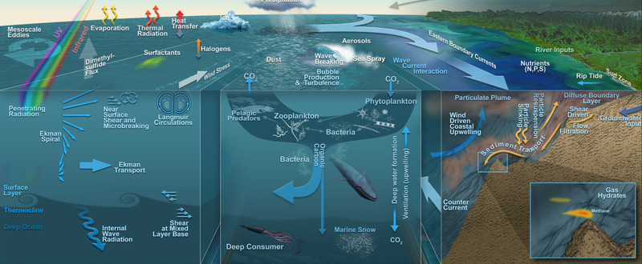
Why don’t they play nice together?
Worden Science (2015)
Follows Annual Rev Marine Sci (2011)

Slide 10
But why would we want them to play nice together?
Follows Annual Rev Marine Sci (2011)
Worden Science (2015)

Slide 11
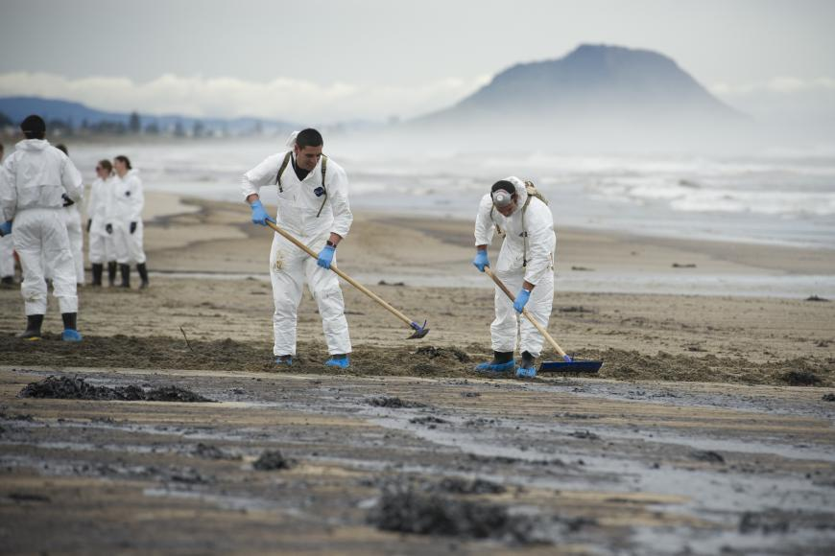
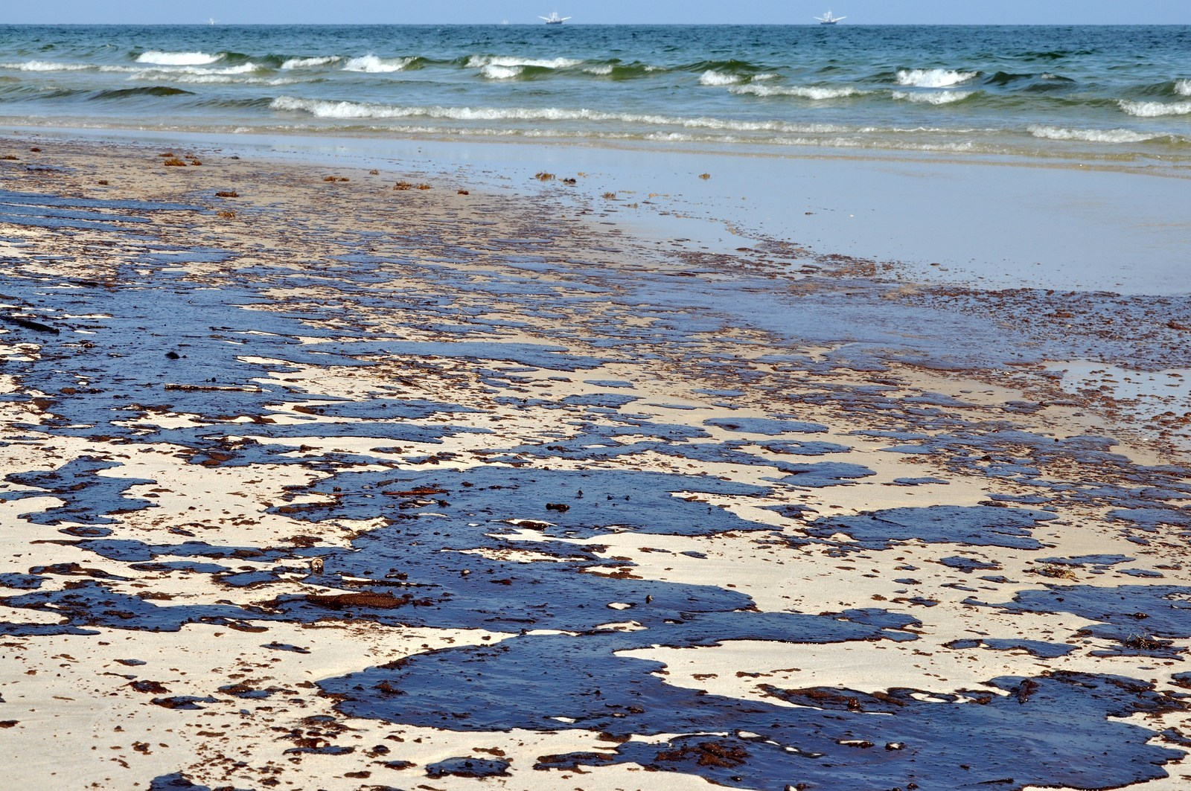
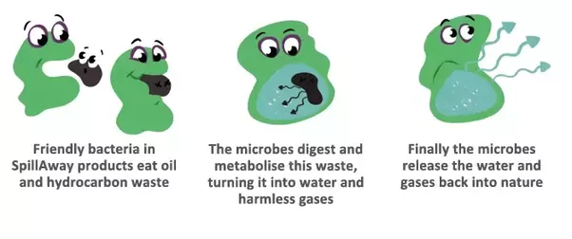
Bioremediation
http://thescienceexplorer.com/nature/bioremediation-nature-s-hazmat-crews
https://www.ecomena.org/bioremediation/
https://i.pinimg.com/originals/be/b0/11/beb0114dd5581ac9ef309fb8da1714dd.jpg
Notes:
http://thescienceexplorer.com/nature/bioremediation-nature-s-hazmat-crews
https://www.ecomena.org/bioremediation/
https://i.pinimg.com/originals/be/b0/11/beb0114dd5581ac9ef309fb8da1714dd.jpg

Slide 12
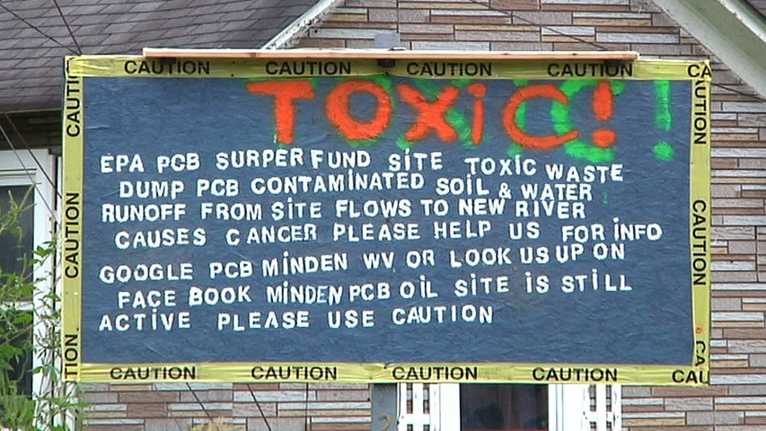
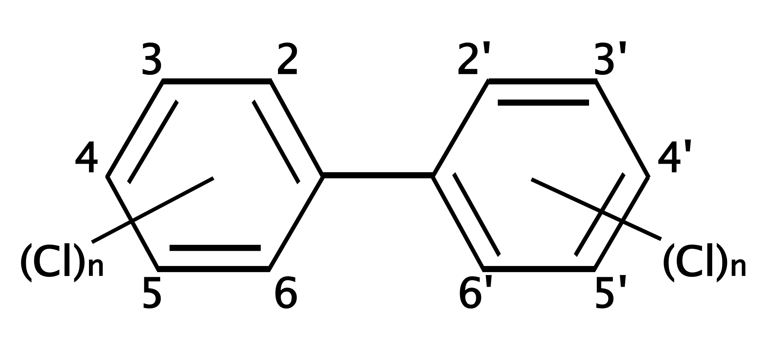
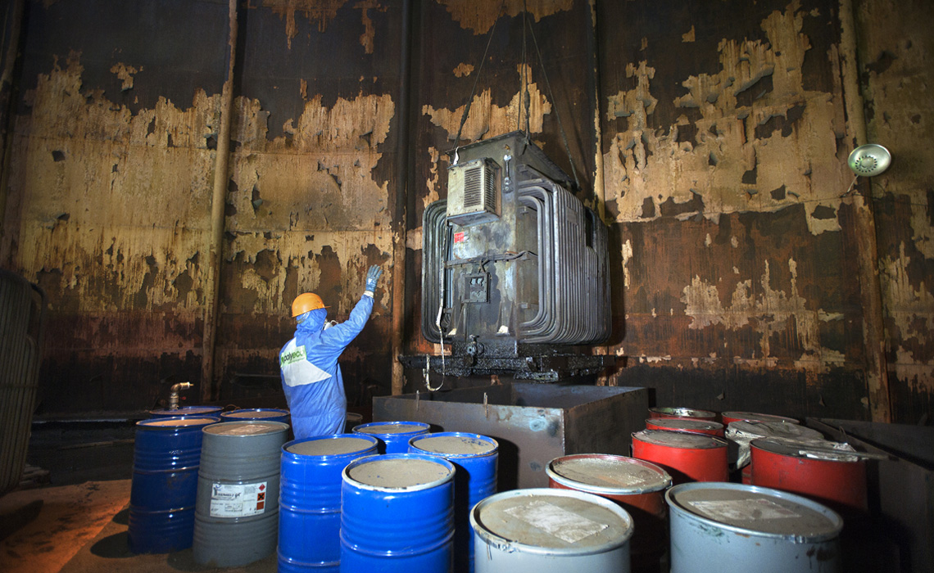
Polychlorinated Biphenyls
http://www.mdpi.com/2305-6304/6/1/1
https://www.eopugetsound.org/magazine/pcb-theory
http://www.polyecogroup.com/news/lebanon-pcb-equipment/
Notes:
https://www.eopugetsound.org/magazine/pcb-theory
http://www.polyecogroup.com/news/lebanon-pcb-equipment/
http://www.mdpi.com/2305-6304/6/1/1

Slide 13
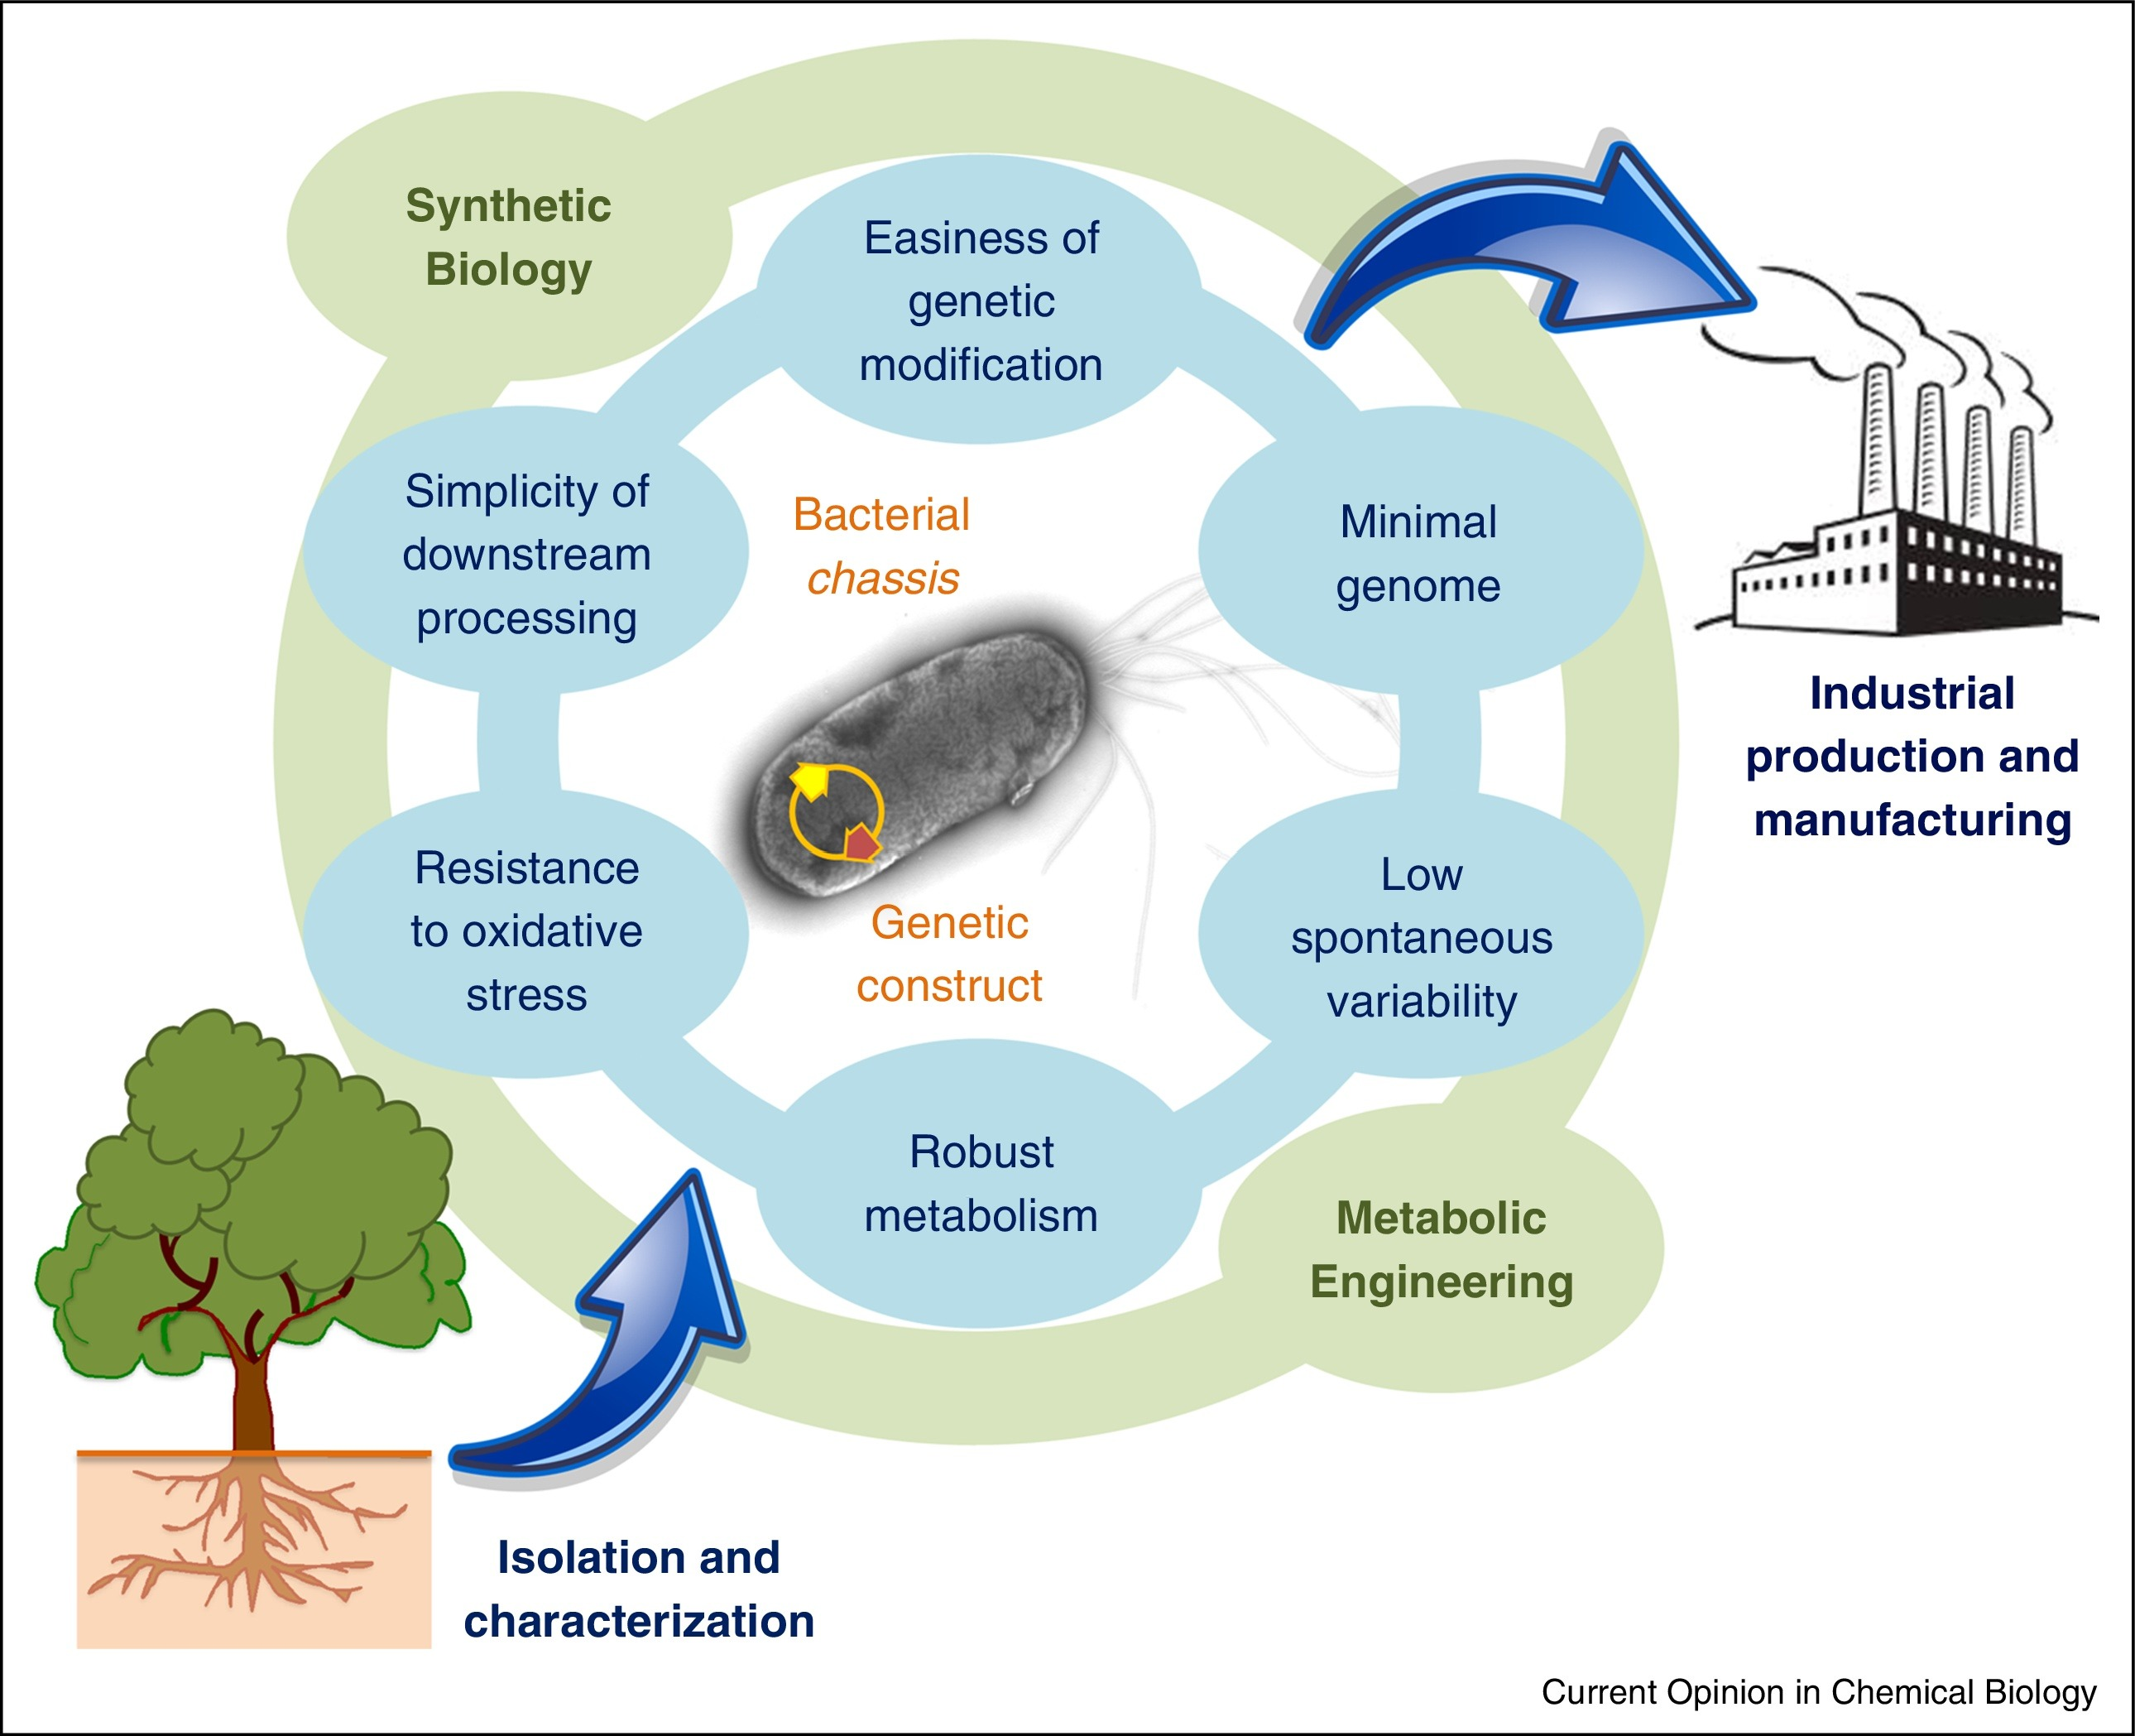
P. putida PCB degradation
Nikel Curr Opin Chemical Biology (2016)
Murugan Ecotoxicology and Environmental Safety (2018)
Notes:
Intracellular toxicity exerted by PCBs and role of VBNC bacterial strains in biodegradation
Karuvelan Murugan, Namasivayam Vasudevan⁎

Slide 14
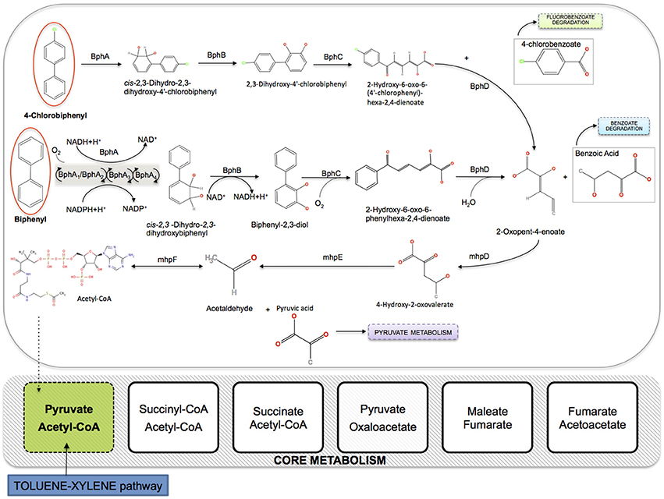
Big Picture
Taffi Frontiers in Genetics (2014)
Taffi Ecological Modelling (2015)
Notes:
Figure 2. Integration of the aerobic pathway of PCBs degradation in the core metabolism of P. putida KT2440 (iJN746). BphA, biphenyl 2,3-dioxygenase (multicomponent Rieske non-heme iron oxygenases); BphB, cis-2,3-dihydrobiphenyl-2,3-diol dehydrogenase; BphC, biphenyl-2,3-diol 1,2-dioxygenase; BphD, 2,6-dioxo-6-phenylhexa-3-enoate hydrolase; mhpD, 2-keto-4-pentenoate hydratase; mhpE, 4-hydroxy 2-oxovalerate aldolase; mhpF, acetaldehyde dehydrogenase.

Slide 15
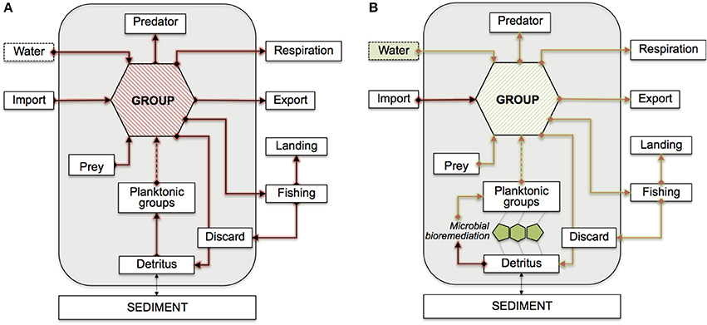
What they did
Taffi Frontiers in Genetics (2014)
Notes:
Figure 1. Conceptual model of the Adriatic PCBs bioaccumulation network. Flows are shown with respect to a generic functional group. Mass-balanced groups are enclosed in the gray boxes, externals are shown outside. The dashed arrow from planktonic groups indicate possible indirect connections. Feeding links from discard and detritus are omitted. (A) Red arrows indicate contaminant flows mediated by feeding connections. (B) Green arrows highlight the potential propagation of bioremediation effects. Possible bioremediation scenarios are assumed at the interface between detritus and planktonic groups (microbial loop), or in the water compartment.

Slide 16
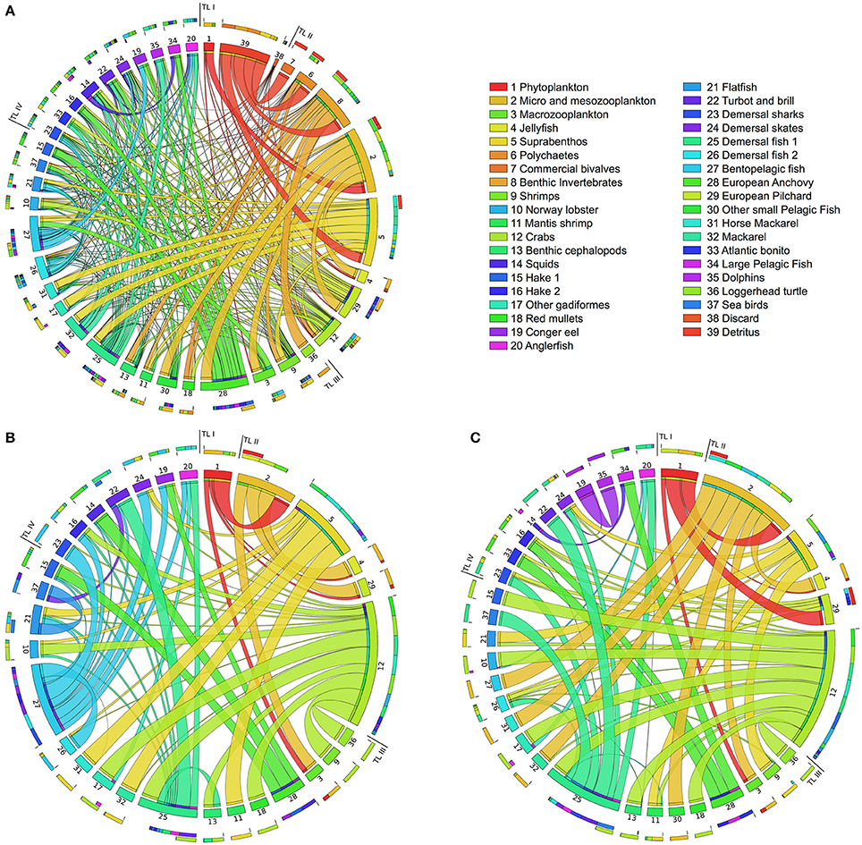
Were they successful?
Taffi Frontiers in Genetics (2014)

Slide 17
Marine microbe community structure
Worden Science (2015)
Sunagawa Science (2015)

Slide 18
Modeling Communities
Zomorrodi J Mol Biol (2016)
Amin Microbiology and Molecular Biology Reviews (2012)
Notes:
From Ali + Segre paper
Metabolic modeling of microbial communities provides an opportunity to infer, rather than assuming, inter-species interactions network from the intracellular metabolic networks of community members.
A conceptual representation of the division of labor in the consortium-based conversion of lignocellulosic feedstock to biofuels. One organism is proficient in the degradation of lignocellulosic feedstock into soluble sugars (e.g., Trichoderma reese and Clostridium cellulolyticum), one in metabolizing pentoses (e.g., Escherichia coli) and the other in metabolizing hexoses (e.g., Saccharomyces cerevisiae). See also Table 1.

Slide 19
Future Directions
Magnusdottir Nature Biotech (2017)

